Slide 1

UBT Straws
University of Liverpool
18/9/25
T. Bowcock

Slide 2
Short Message
Understand the problem
Apply the technology
Build & Test Prototype
Optimize….

Slide 3
What do SHiP want?
0 Material detector DIRECTLY after Muon Shield
Before He Volume
Before what was the SND (neutrino detector)
3x1m area (!)
Tracking/VETO
What physics benefit (cost)?

Slide 4
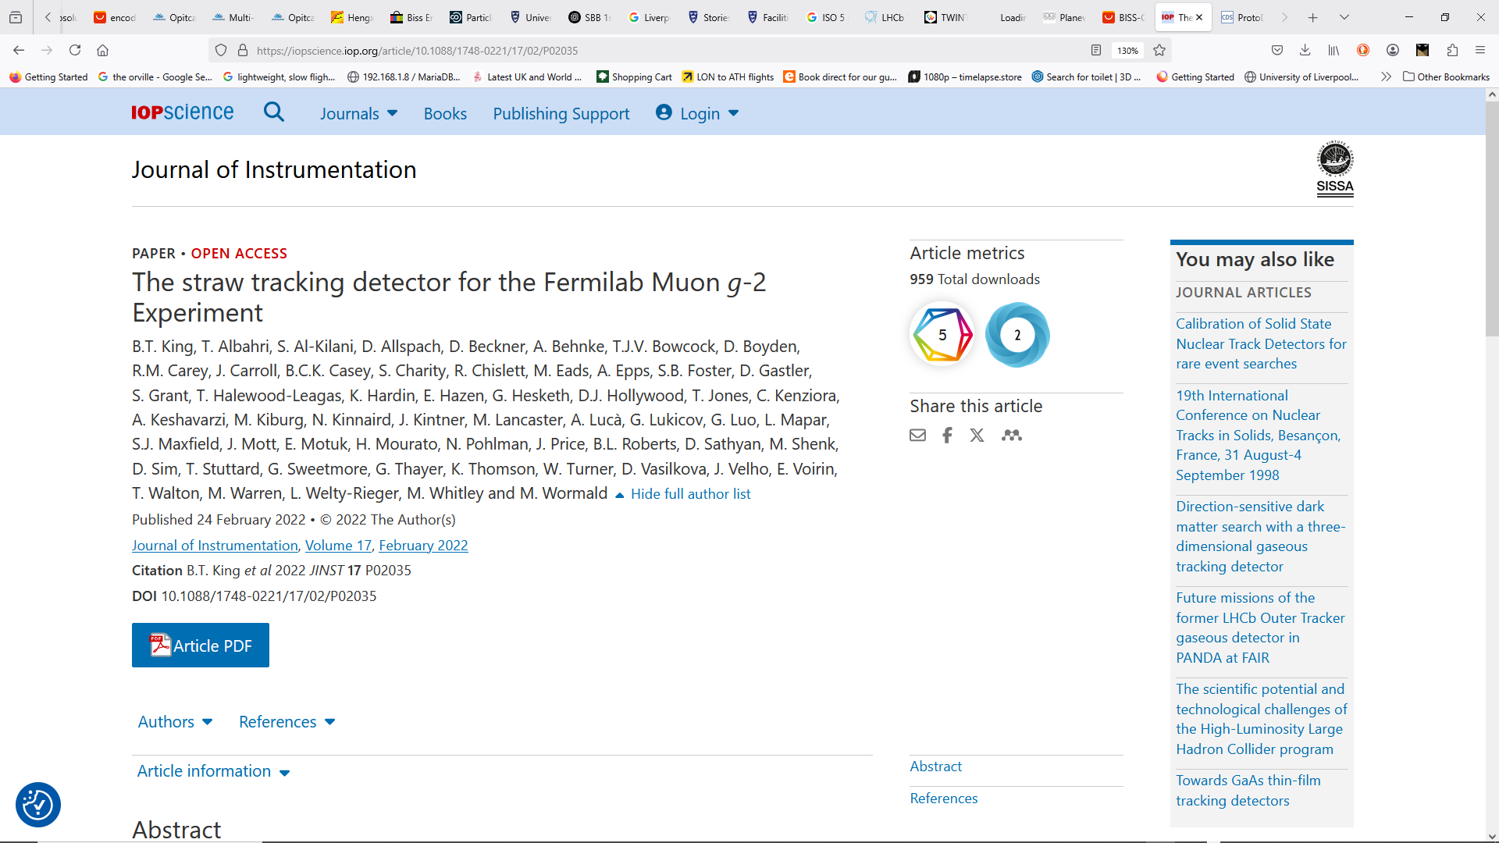
Straws
See talk in Zürich (May)
Updates
A quick recap of what we know
Cheap
Efficient
Capable of O(<50 μm track resolution)
Can be built “light” or “heavy”, “small or large” (more later)
Pretensioning can be an issue (more later)
QA/QC critical
Takes about 1 year to build a 3000 straw tracker
Design for SHiP would be faster

Slide 5
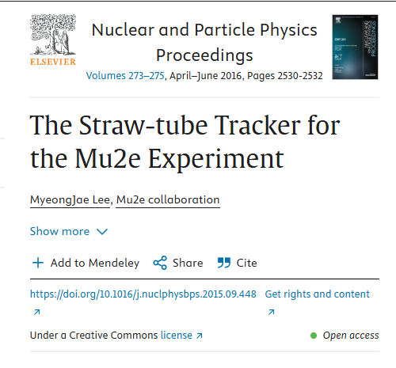
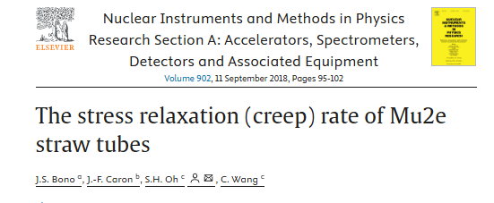
Pretensioning mu2e
Four different initial tension of 300, 400, 500 and 600 gram-meter (gm) were ap plied to 120 cm long straws
An extrapolation of measured tension data results that O(600) gm initial tensioning is required to get > 200 gm tension after life time operation of straw.
Test for 5 years

Slide 6
Why is this important?
Wires need to be tensioned
SEPARATELY
FRAME AND WIRE CAN MATCH EXPANSION (3ppm)
Straws Usually Tensioned
Differential Expansion (T)
Straw 20ppm
Humidity
Tensioning keeps straw geometry aligned with wire
Can you retain geometry (e.g. under pressure) and wire tension WITHOUT extreme tension??
1000*500g=0.5 Tonne
Stiff and strong frame!!
Secondary enclosure?
R&D?

Slide 7
Performance
Efficiency – ~97-98% over all straw (99% best)
Resolution O(100 μm/layer)
Voltage – 1650V
Lifetime – no degradation at all seen
Leakage – maintain better than 10⁻⁹ torr in region of detectors
Operated in 2T field

Slide 8
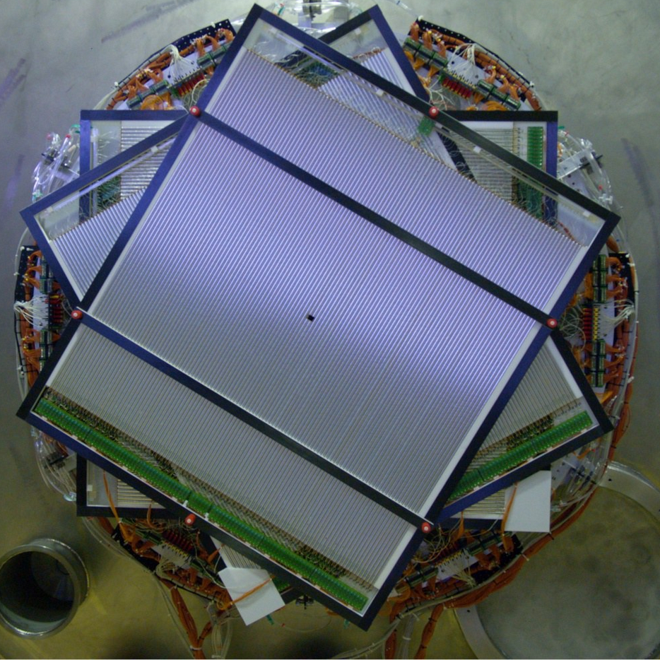
For SHiP
Build O(1.2 m) detector with 5mm straw.
Each plane a double one for efficiency (2 layers per plane)
Split into 3 submanifolds of 128 (64 in each layer?)
Arranged “vuw” (0, 60, 120,0,60, 120?)
Julich Configuration
O(2300) straws
Straw length about 1150mm
To be tuned for radiation profile
Wire Pretensioning problem
Engineers suspension bridge
Partially Solved by using composite frame
Tuned to Tungsten Rhenium +Epoxy

Slide 9
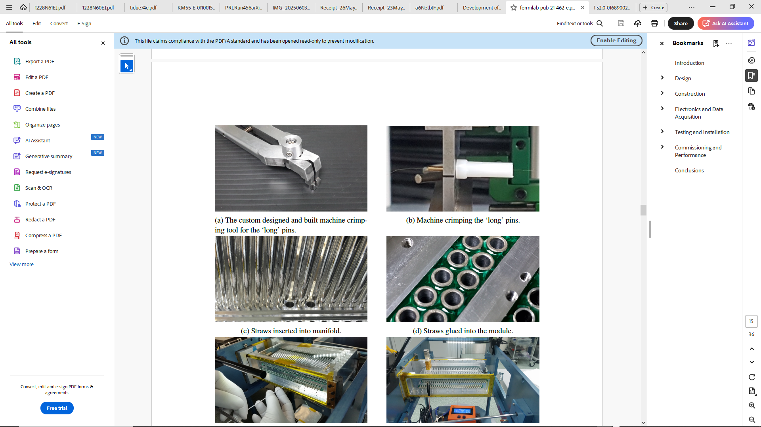
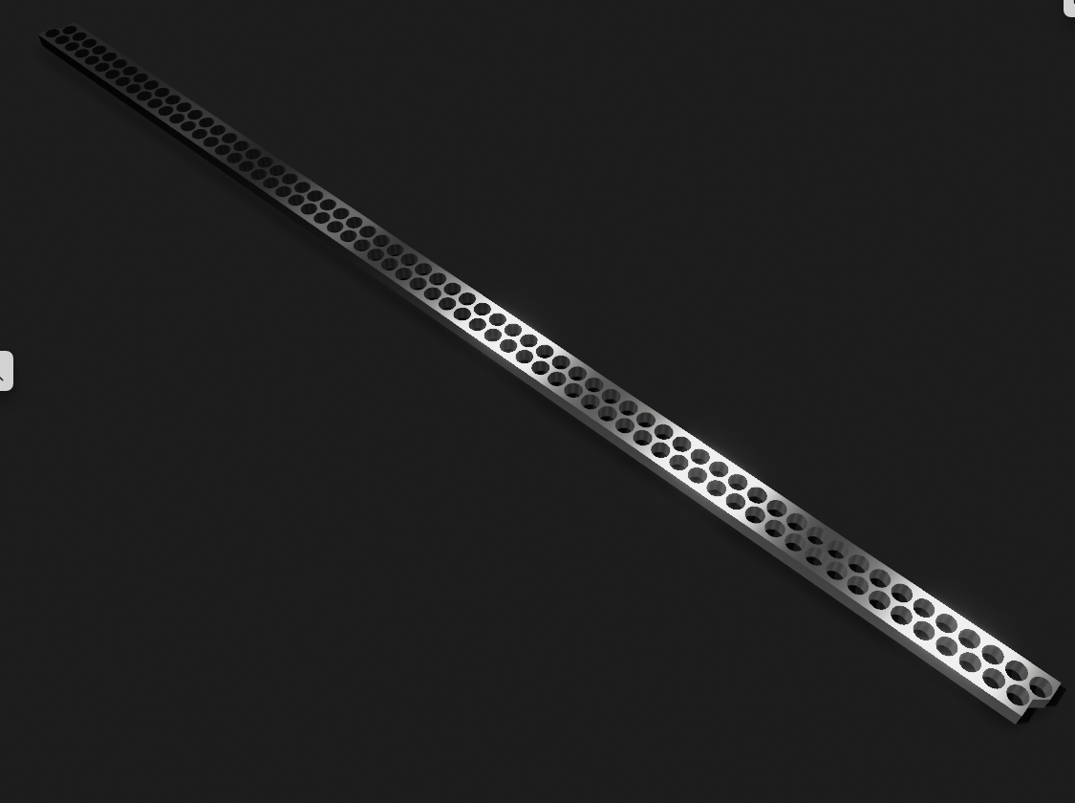
Propose (Sep)
6mm separation
64*6=384 mm
Each manifold 128 straws
Double layer

Slide 10
To understand/calculate
Max load on each CF frame >> tensioning
Match wire and frame CTE (“easy”)
Influence of straw creep
Environment (Radiation)
Physics Requirements
Precise Requirements on Detector Resolution etc.

Slide 11
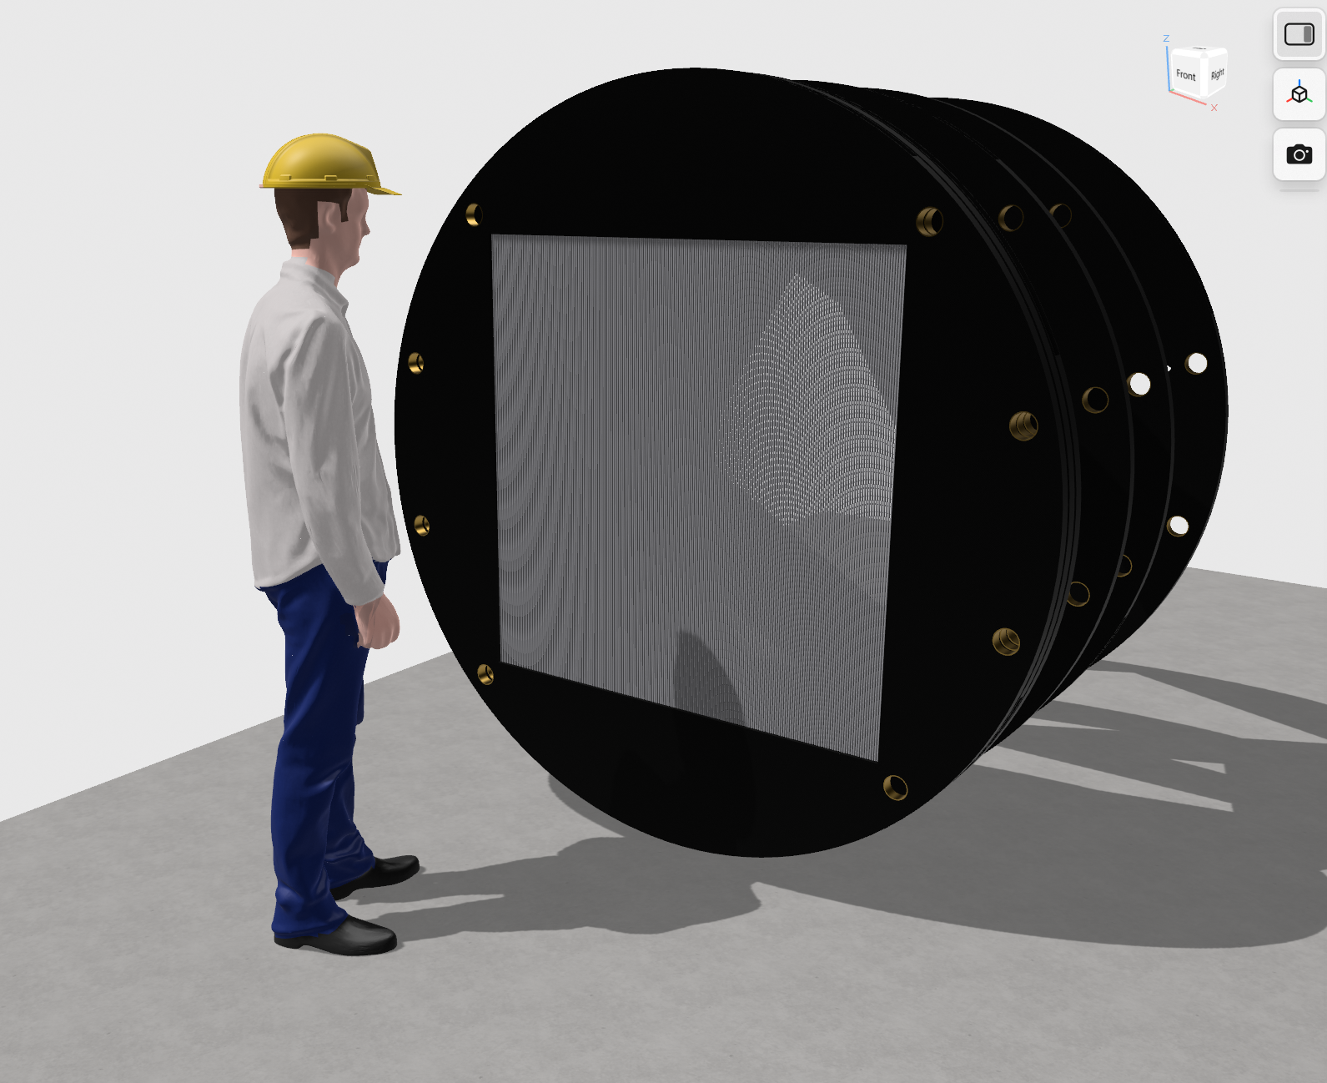
ZURICH MODEL

Slide 12
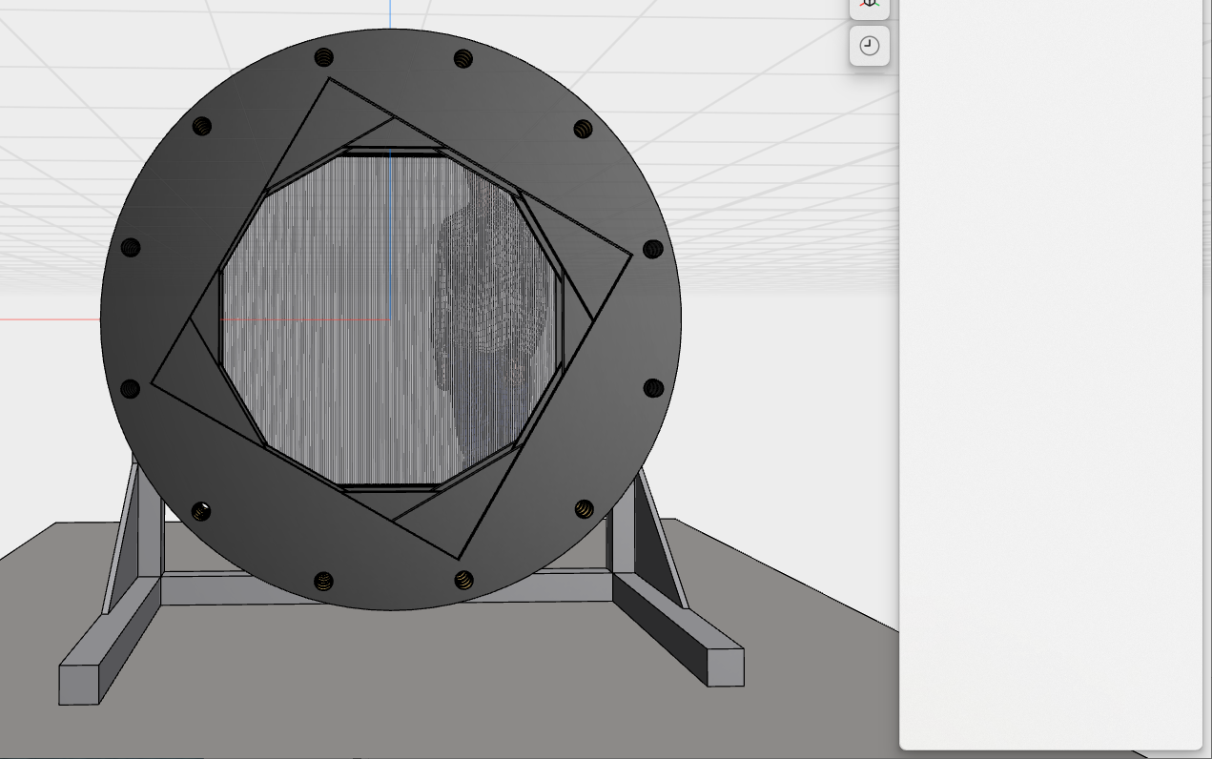
Improved (slightly). Support. Holes.
0 °
60 °
120 °

Slide 13
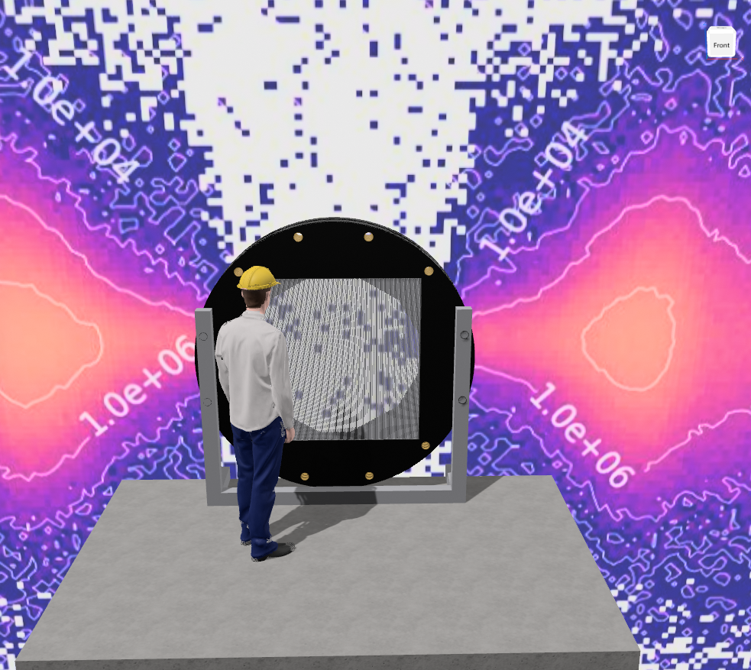
Cost O(0.5M)

Slide 14
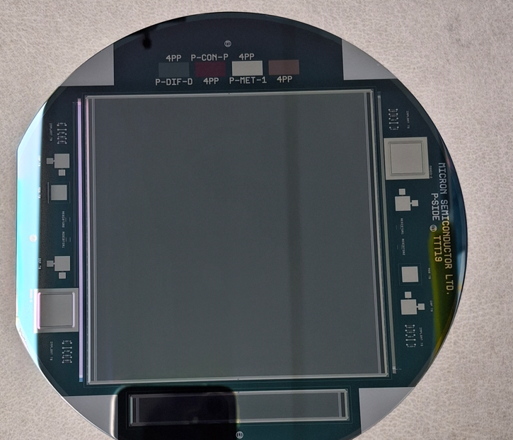
Large Area Silicon Tiles (FYI)
We have just had delivered (to be tested 2025) – 150kChf development
New design – 10cm x 10cm tile
From Micron Semiconductor
Can be rad hard (or not!!)
50 micron readout (with intermediate strip) 1990s technology
Designed for < 5 micron resolution
We could instrument with these
Once we have the ASIC!!!!
2025 Addon!!

Slide 15
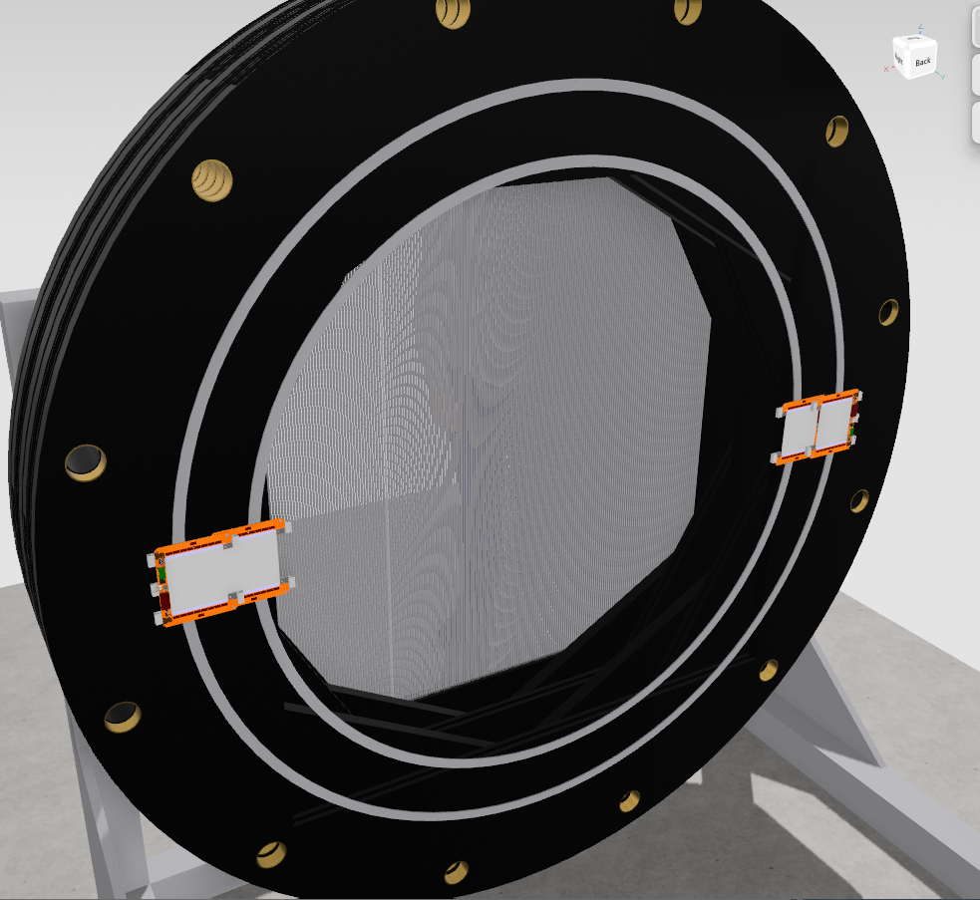
CMS 2S Modules

Slide 16
Summary(1)
Understanding environment
Looking at allocating effort for MC
With ASIC we think this can be built in 1 year (once we know our parameters)
We propose for cost/effort/tooling retaining 5mm straws.

Slide 17
But this not good enough!!
Basically
3x1 area is needed to be instrumented and clear (not just core)
No material in centre (manifolds, structure)
Building long vertical straws (a la ATLAS TRT is HARD)
FCCee
Can we save the 1.3x1.3module we could build now?

Slide 18
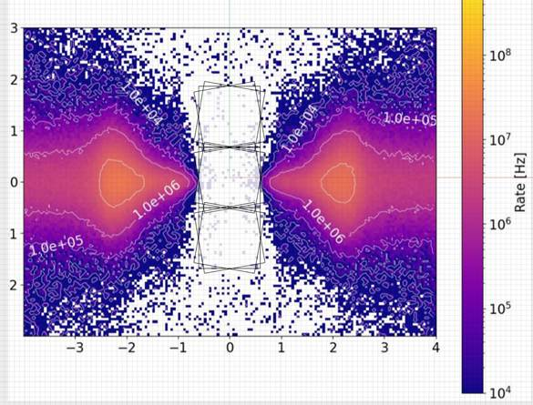
Strawman
Multiple 1m2 modules
Horizontal Straws
No manifolds in volume
But how do we keep the tension O(0.2-.5tonne) on straws without building giant frame
Assume we do NOT want to build big fram

Slide 19
Idea -
This in inscreases cost (0.1M)
Build identical modules similar to Zurich Design
Design so when installed (onto the Muon Shield?) the horizontal tension strut can be removed
Build/Transport
Install
Remove tension struts

Slide 20
Summary
Don’t reinvent the (SHiPs) wheel!
If we don’t worry about detector mass makes life easier
Probe tensioning options.
NOTE CF frames have real advantages
Spiral v Laminar – choose what is available
We are predisposed to spiral as its an “old friend” and robust.
PROTOTYPE
Establish QA/QC
If we need large area precision (£) Si – we are working on it!!
MuonE
We would propose to add a few planes to straws in high rate overlap region
WE NEED TO UNDERSTAND PHYSICS/BENEFIT

Slide 21
Backup

Slide 22
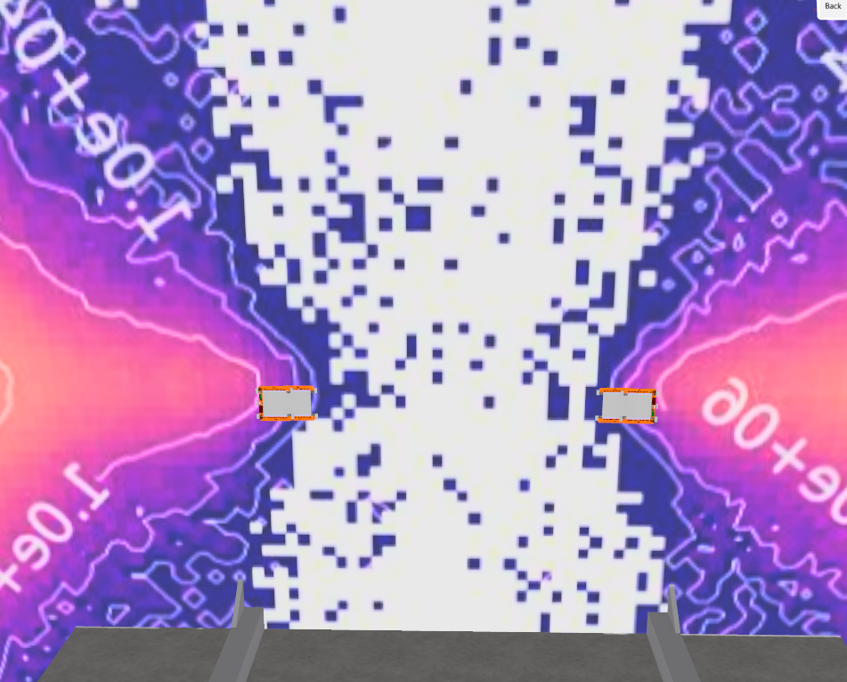

Slide 23
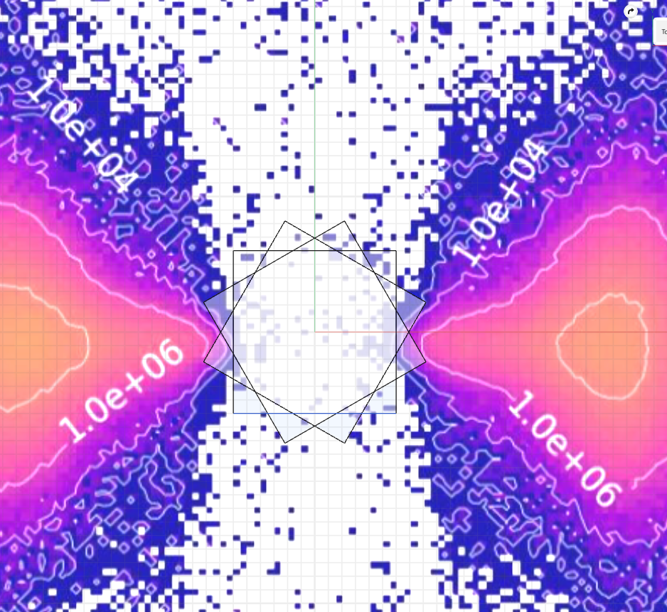
The Julich arrangement “tends” to avoid the high radiation/rate areas.

Slide 24
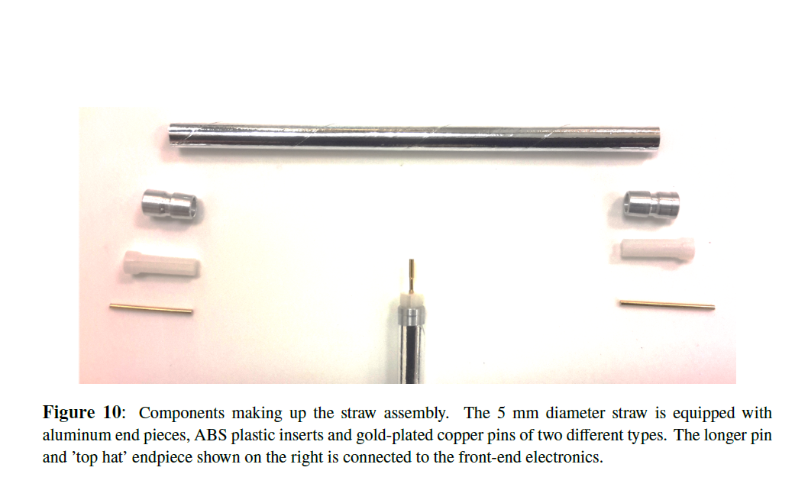
5mm straws
2 layers (6 microns, 3 microns of glue) – spiral wound
Wire 25μm Tungsten Rhenium
Ar:C₂H₆ 50:50; chosen for gain plateau & low leak rate through aluminized Mylar
Straws operated in vacuum and tested in 1.2 m lengths (0% leak/burst)
“Double helix” of ~6 µm Mylar with ~3 µm adhesive (≈15 µm total) inner surface 500 Å Al + 200 Å Au (cathode) outer surface 500 Å Al (shielding & reduced permeation)
Mylar (PET) (less soft than Kapton)
Young’s modulus: ~4–6 GPa
Tensile strength: ~150–200 MPa
Elongation at break: ~100–120%
At 1atm expansion O(10um)
Operate at <10% of elastic yield
Mu2e shows O(100um) creep over 10years . Double layer helps. Prestress.

Slide 25
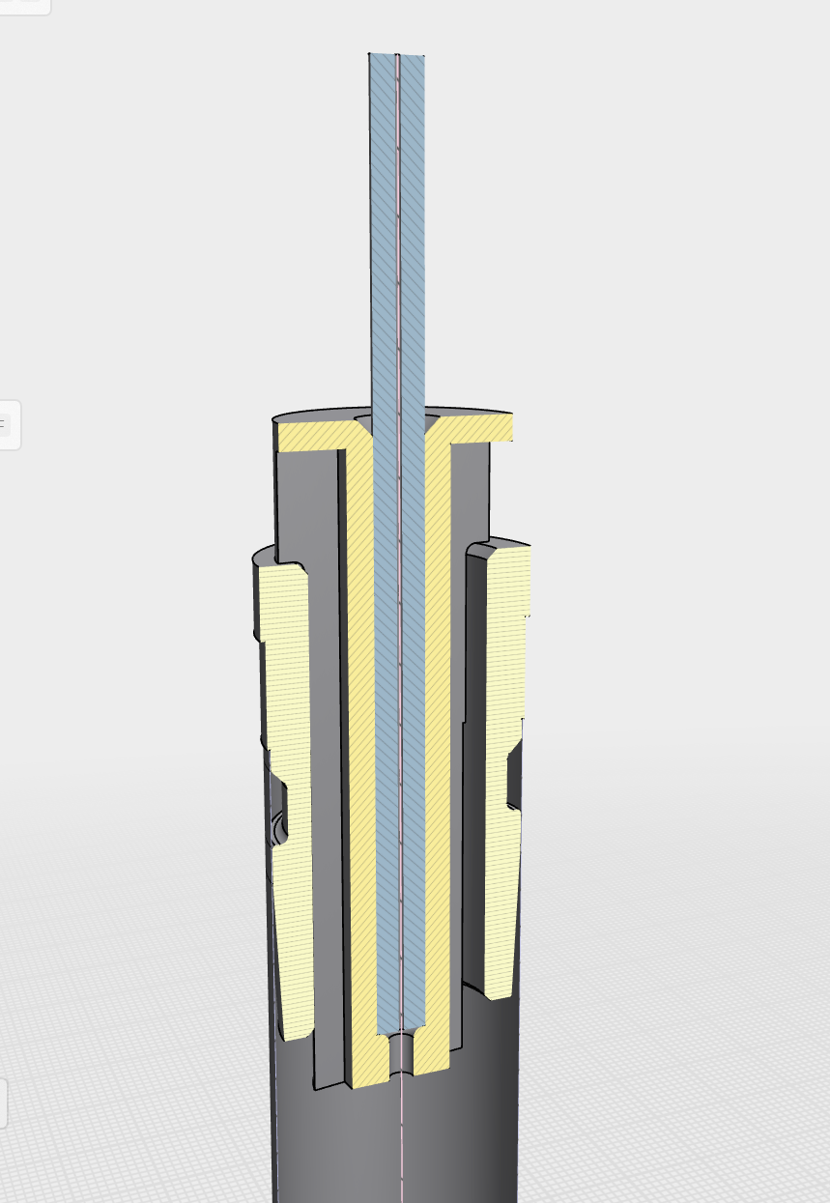
One end
Pin (annealed)
Toleranced to microns
Plastic insert
Al ( one end with lip)
Straw ends here (OD Al 30um larger than straw)
WE HAVE ESTABLISHED ALL TOOLING EXISTS BOTH AT LIVERPOOL AND IN COMPANIES THAT MAKE PARTS

Slide 26
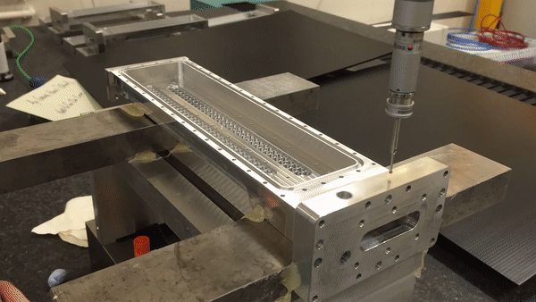
Tooling etc
Everything built to O(10um). Propose to retain this precision.

Slide 27
Commentary
Everything databased and qualified individually
Wires, pins, straws (precision parts used)
Aligned and metrologized to 10 microns
Precision manifolds and careful work
CLEAN ROOM => NO HV TRAINING EVER NEEDED
Clean procedures and training
To my knowledge not even 1 spark over 6-8 years of prototype/operation
This is good starting point
Need to establish operating conditions (MHz, composition…)
We can confidently cost materials (exc electronics ) 150K.

Slide 28
Spiral Tubes
No long straight seam → stresses are distributed helically, not concentrated.
Redundancy: even if one seam leaks slightly, the second offset layer helps maintain gas integrity.
Proven technology: used successfully in ATLAS TRT, Mu2e, g-2.
Manufacturing is scalable (Paramount Tube and similar vendors can mass-produce).
Survive 1atm differential easily
Helical seam leads to slight periodic non-uniformities in wall thickness and surface.
More material (≈15 μm total wall vs. thinner possible with welded), slightly worse radiation length.
Adhesive layers can age/outgas.
Field symmetry is not perfect (we found this negligible)

