Slide 1





Towards Radiation-hard Transverse Beam Imaging with Multimode Fiber and Machine Learning
Supervisors: H. Zhang, A. Hill, G. Trad, F. Roncarolo, C. P. Welsch
Qiyuan Xu
PhD Student
15, Oct 2025
qiyuan.xu@cockcroft.ac.uk

Slide 2
Outline
Background and Motivation
Evaluation Metrics
Experiment and Dataset
Model and Training
Results
Qiyuan Xu
October 15, 2025

Slide 3
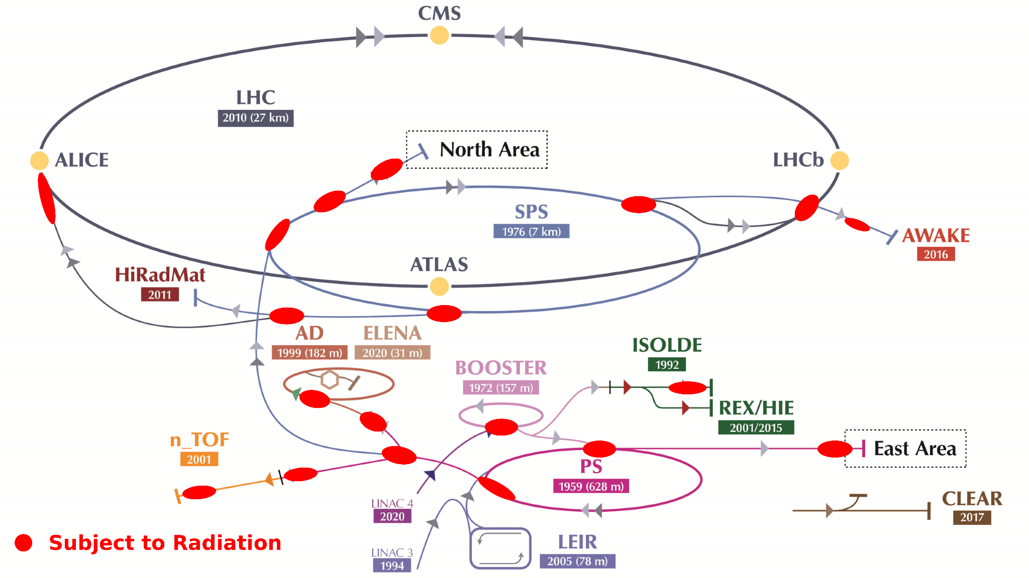
Transverse beam imaging at CERN
About 200 systems / from Linac to LHC and experimental areas.
Goal: Capture the light generated by screen interaction with particles. The resulting image is the footprint of the beam at this location.
Problem: areas such as beam dumps and fixed targets are exposed to high level of radiation.
Special thanks to Stephane Burger for the image
Qiyuan Xu
October 15, 2025

Slide 4
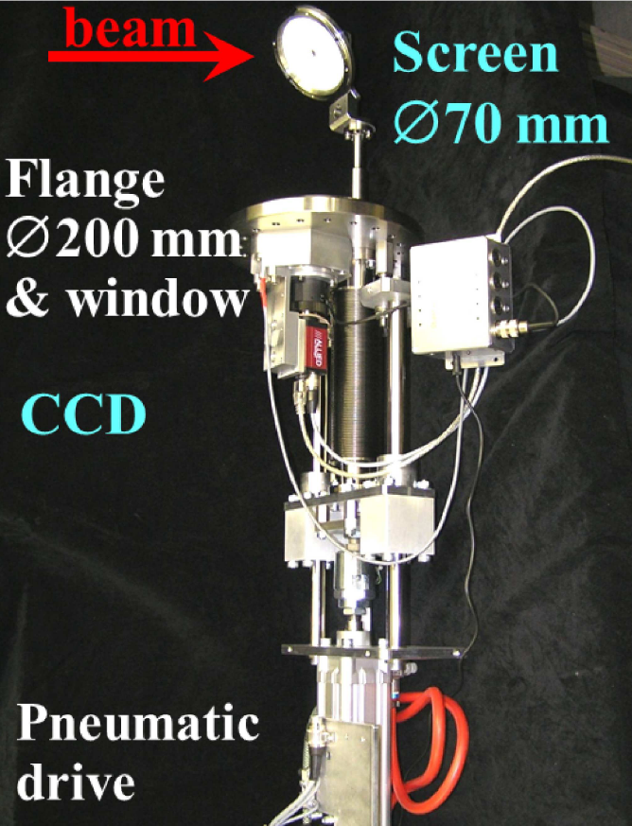
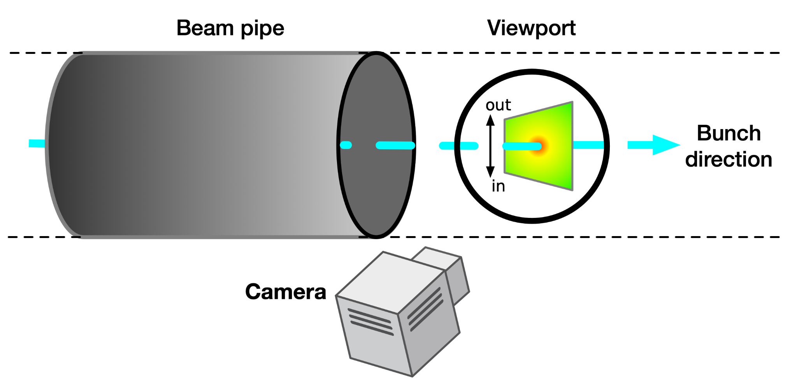

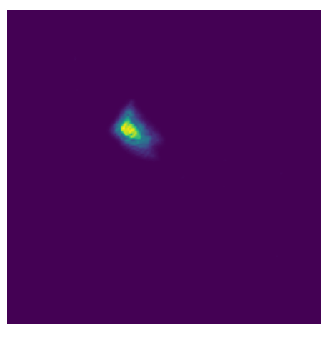
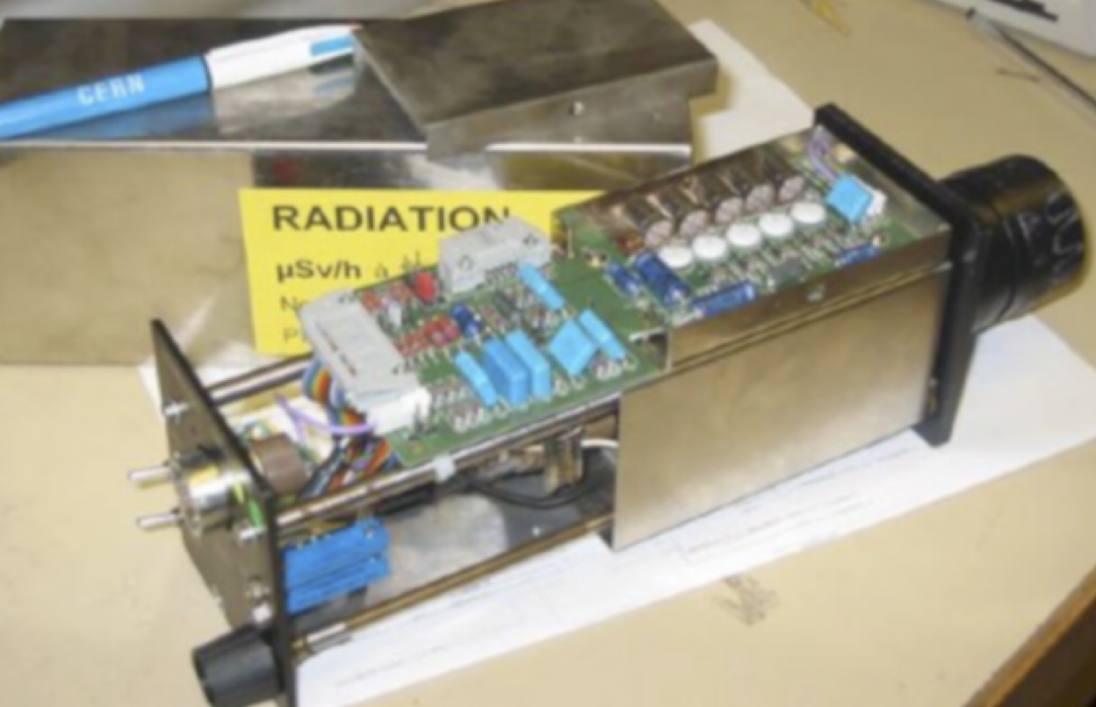
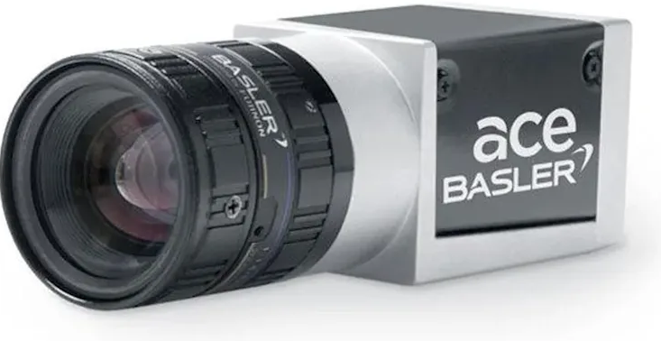
Beam imaging system - interceptive screen and camera
(Forck et al., 2011)
e.g.
?
Transverse beam distribution
Vidicon camera tube
CMOS camera
Qiyuan Xu
October 15, 2025

Slide 5
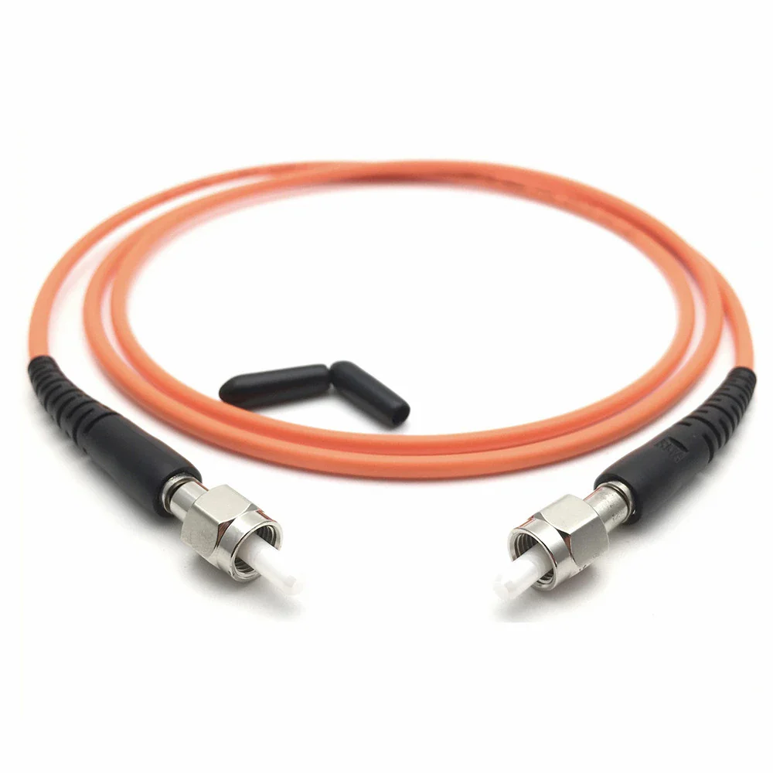
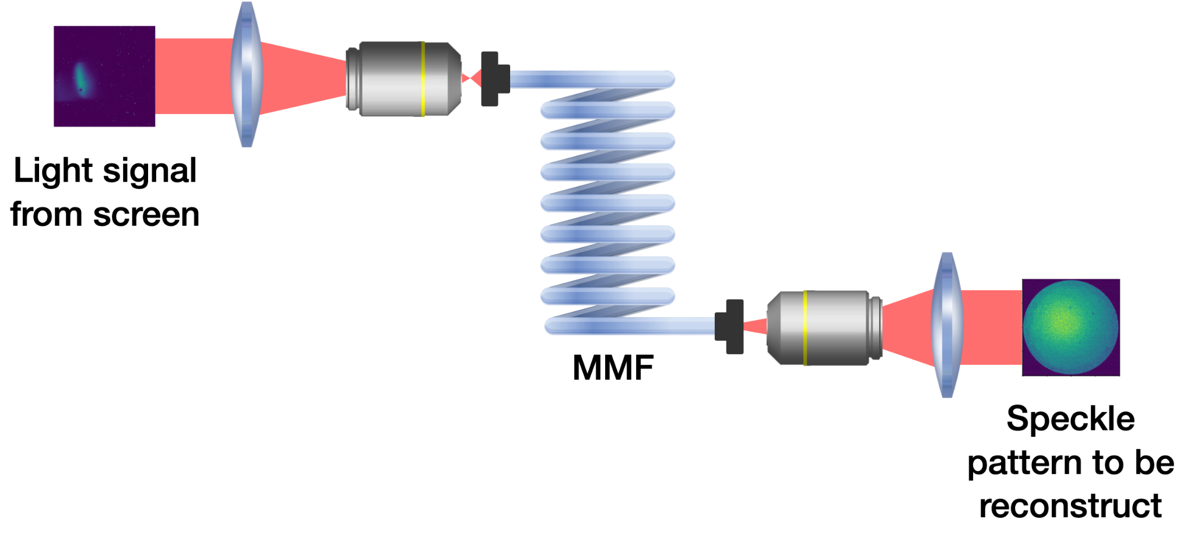
Beam imaging in high-radiation environments
Multimode fiber (MMF)
CMOS camera
Qiyuan Xu
October 15, 2025

Slide 6
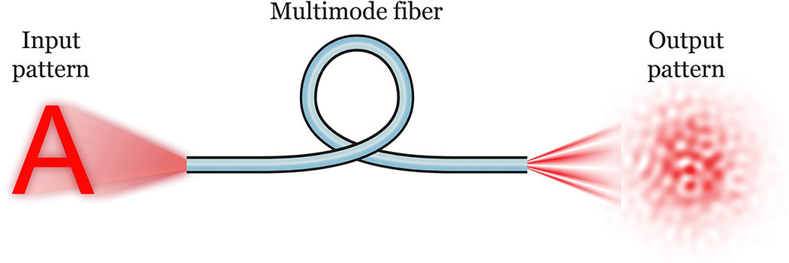
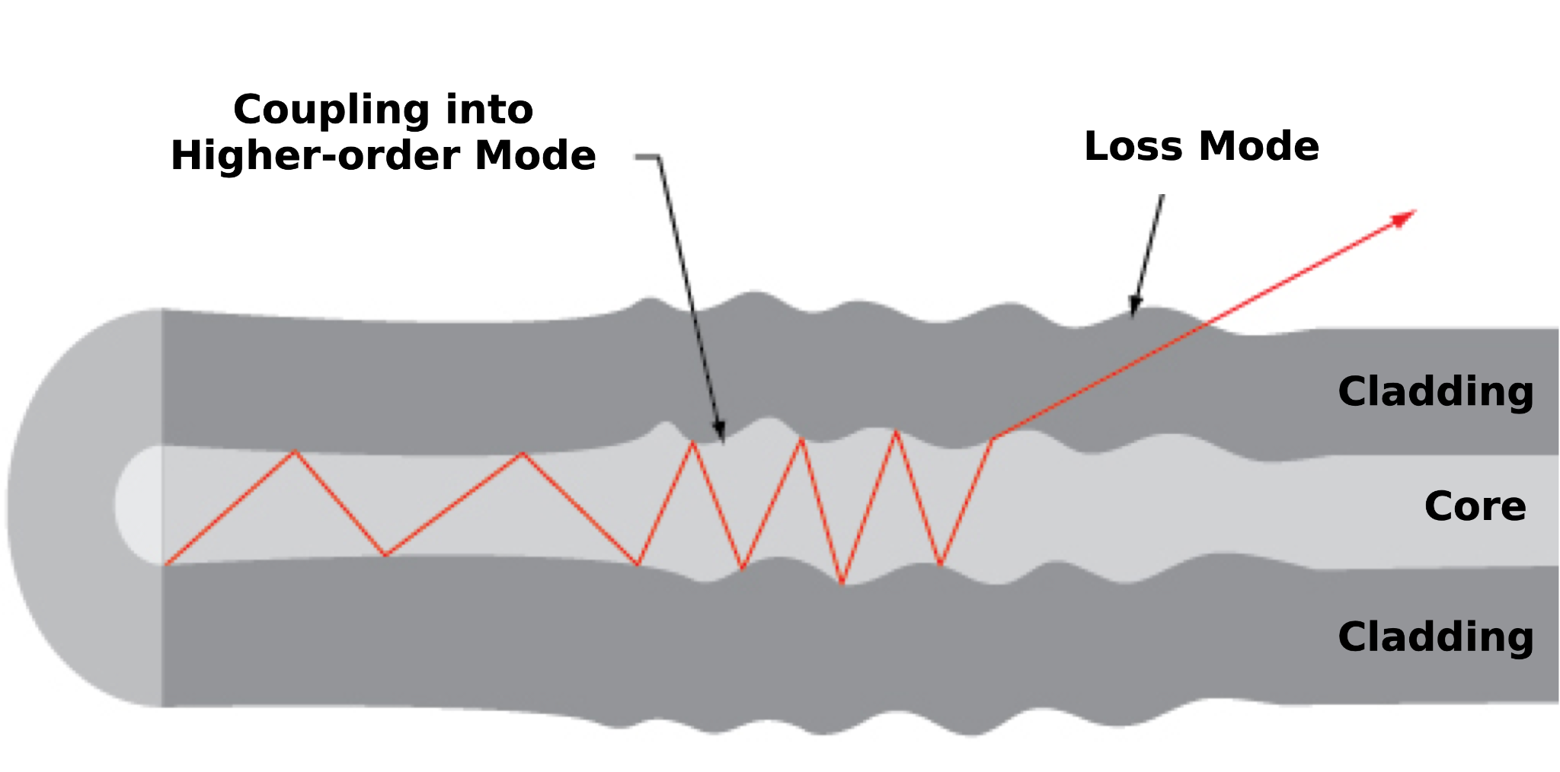
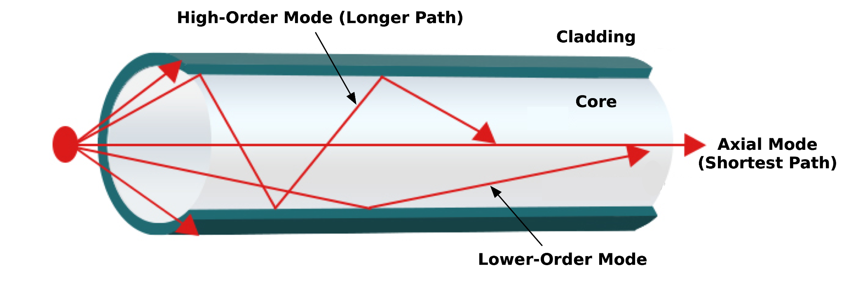
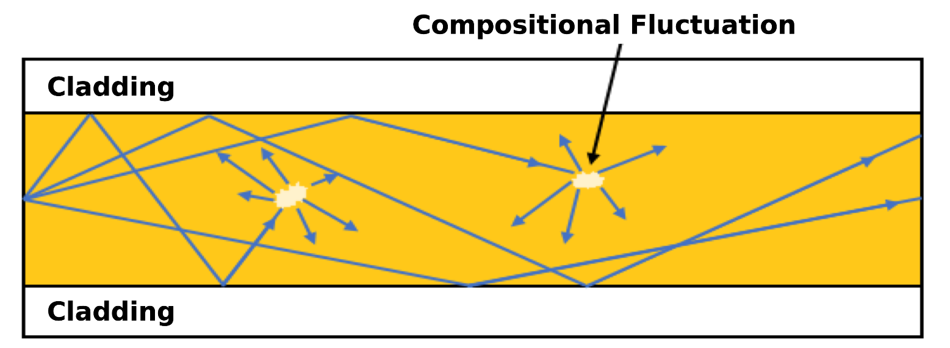
Multimode fiber imaging - challenges
(Psaltis and Moser, 2016)
Modal dispersion
Mode coupling
Scattering
Qiyuan Xu
October 15, 2025

Slide 7
Outline
Background and Motivation
Evaluation Metrics
Experiment and Dataset
Model and Training
Results
Qiyuan Xu
October 15, 2025

Slide 8
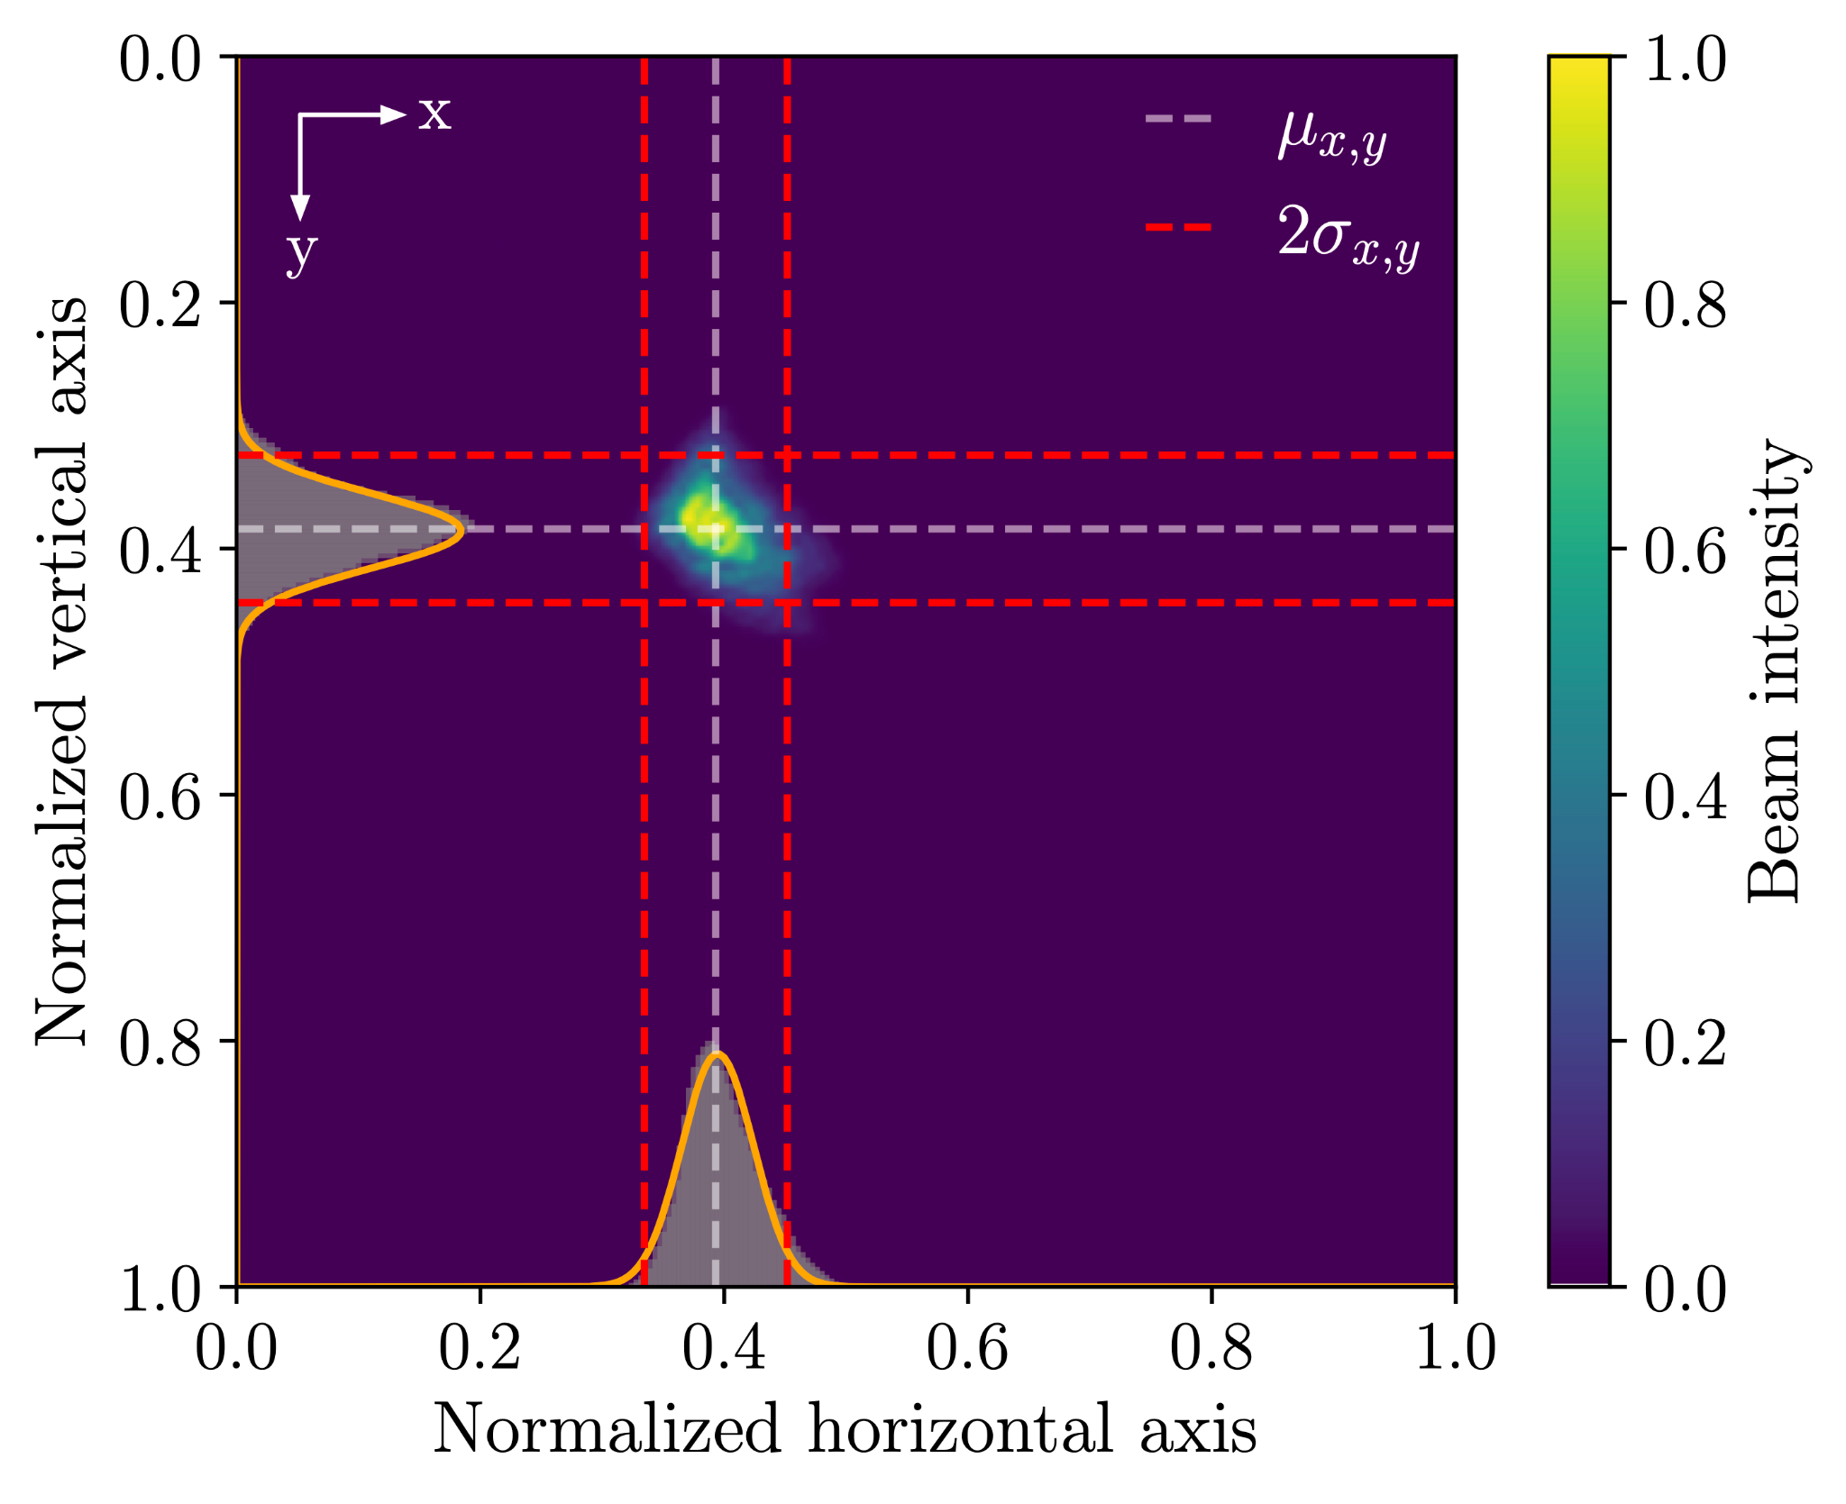
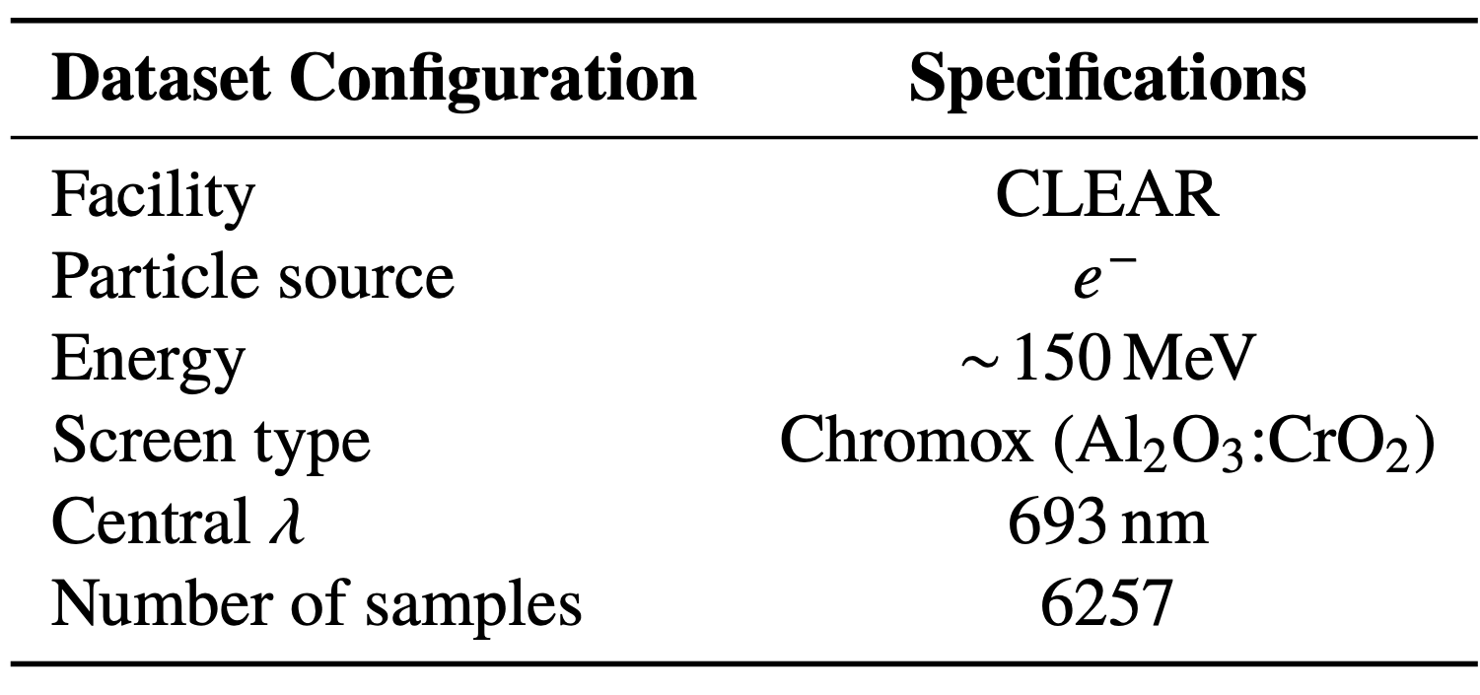
Evaluation metrics - defining the goal
Qiyuan Xu
October 15, 2025

Slide 9
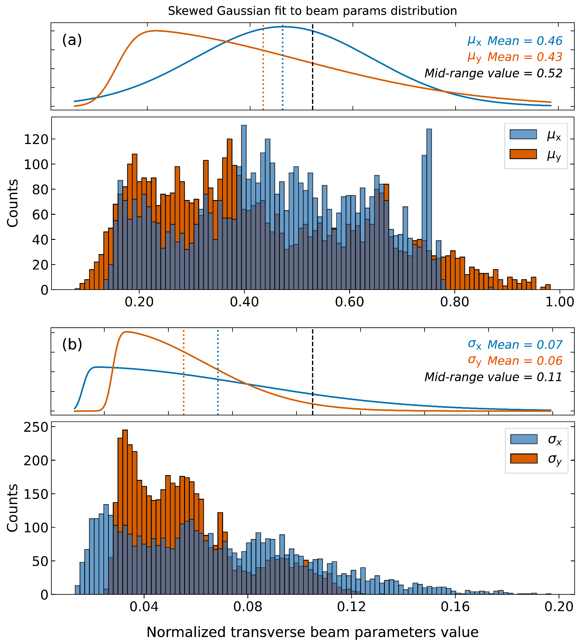
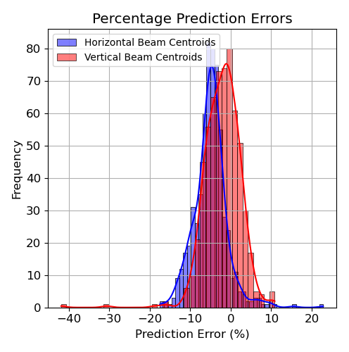
Training with Only Real Beam Data?
Skewed Gaussian fit to beam params distribution
Limited data availability: Restricted beam time and operational constraints.
Radiation exposure: Continuous imaging degrades ground truth cameras.
Biased distributions: Real data often covers a narrow and uneven subset of beam conditions.
Sparse parameter coverage: Full beam parameter space is hard to scan in practice.
Low variance: Insufficient diversity limits ML model generalization to unseen beam data.
Normalized beam centroids
Skewed Gaussian fit to beam params distribution
Normalized beam widths
Qiyuan Xu
October 15, 2025

Slide 10
Outline
Background and Motivation
Evaluation Metrics
Experiment and Dataset
Model and Training
Results
Qiyuan Xu
October 15, 2025

Slide 11
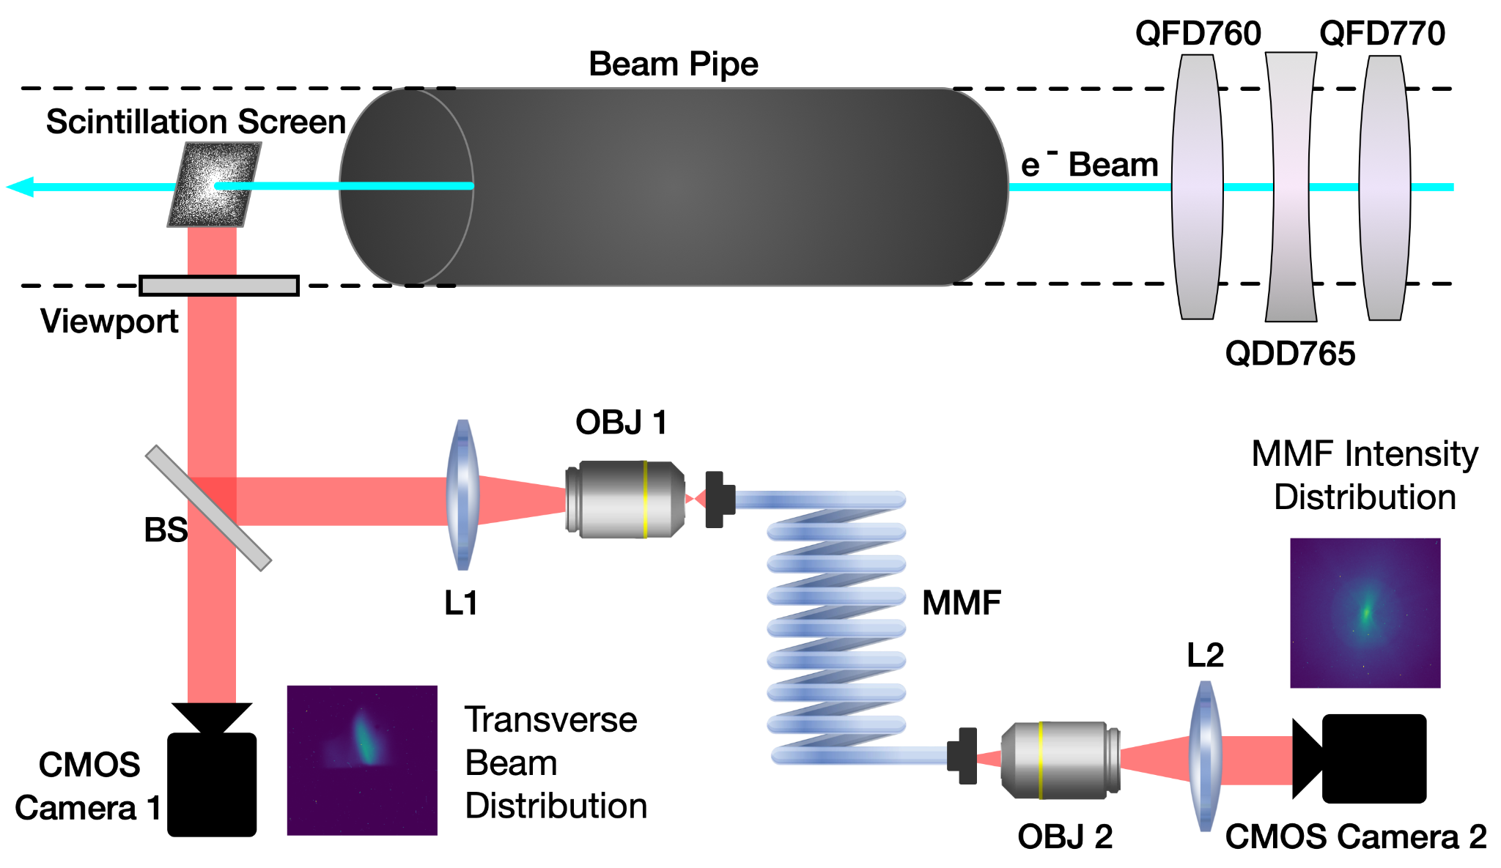
Exploring synthetic data
Qiyuan Xu
October 15, 2025

Slide 12
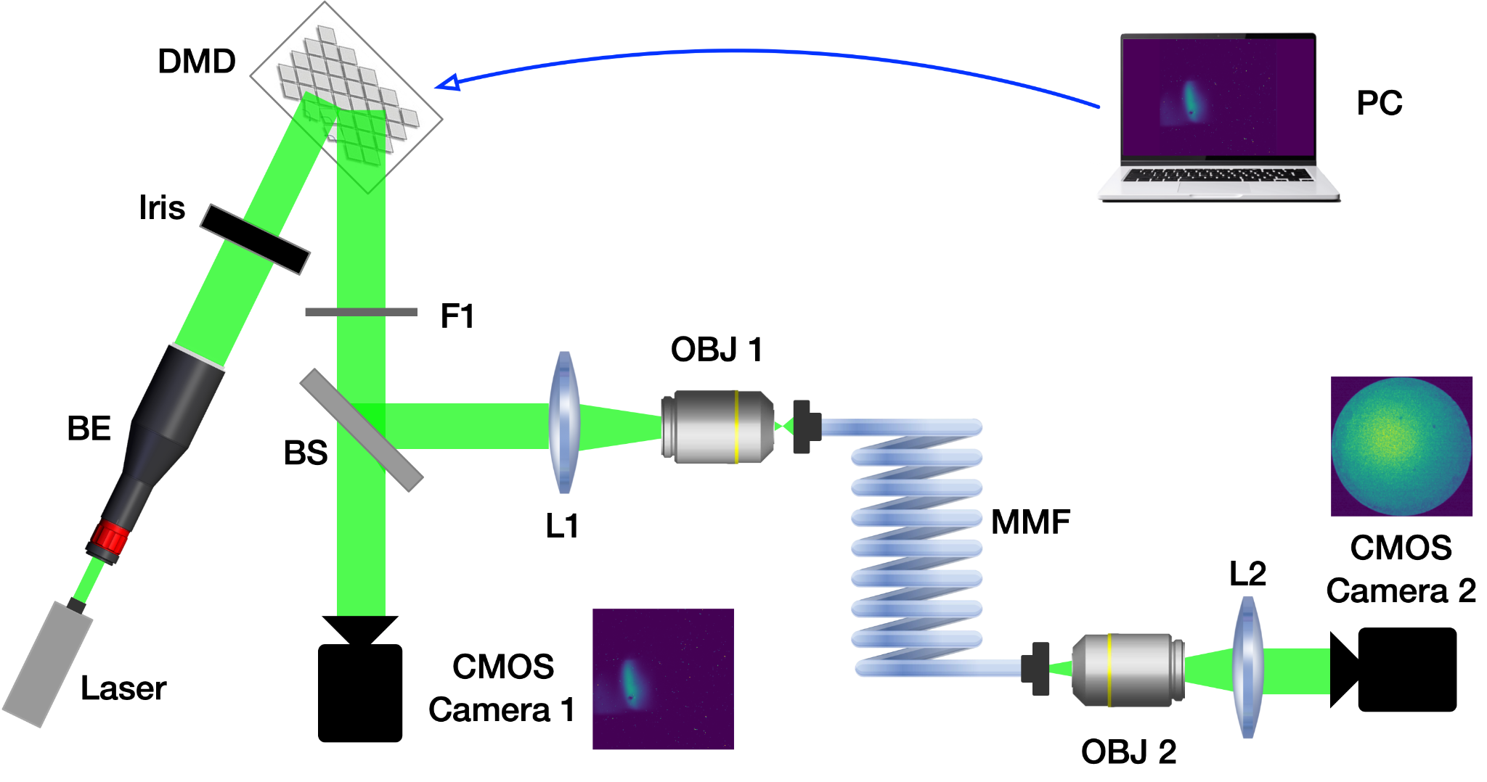
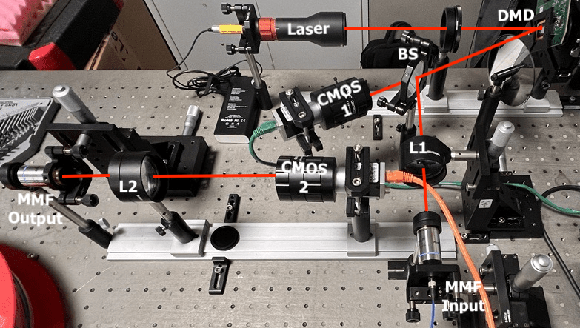
Exploring synthetic data
Use a laser-illuminated DMD (Digital micromirror device) to emulate emission from a scintillation screen.
Load synthetic data (e.g., from simulations) onto the DMD as the training set.
Load real beam images (e.g., from previous experiments) onto the DMD as evaluation (test) data.
Qiyuan Xu
October 15, 2025

Slide 13
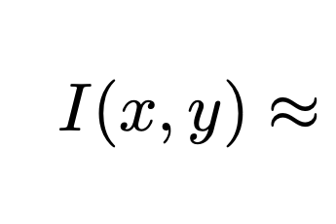
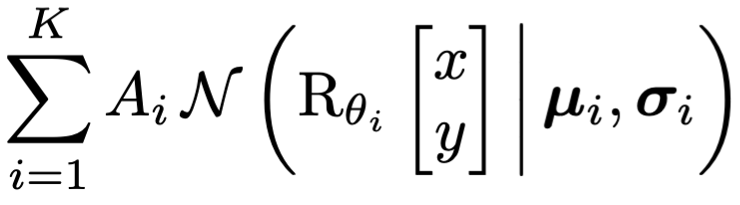
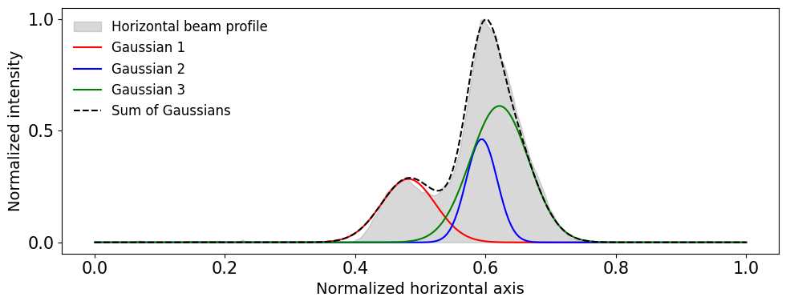
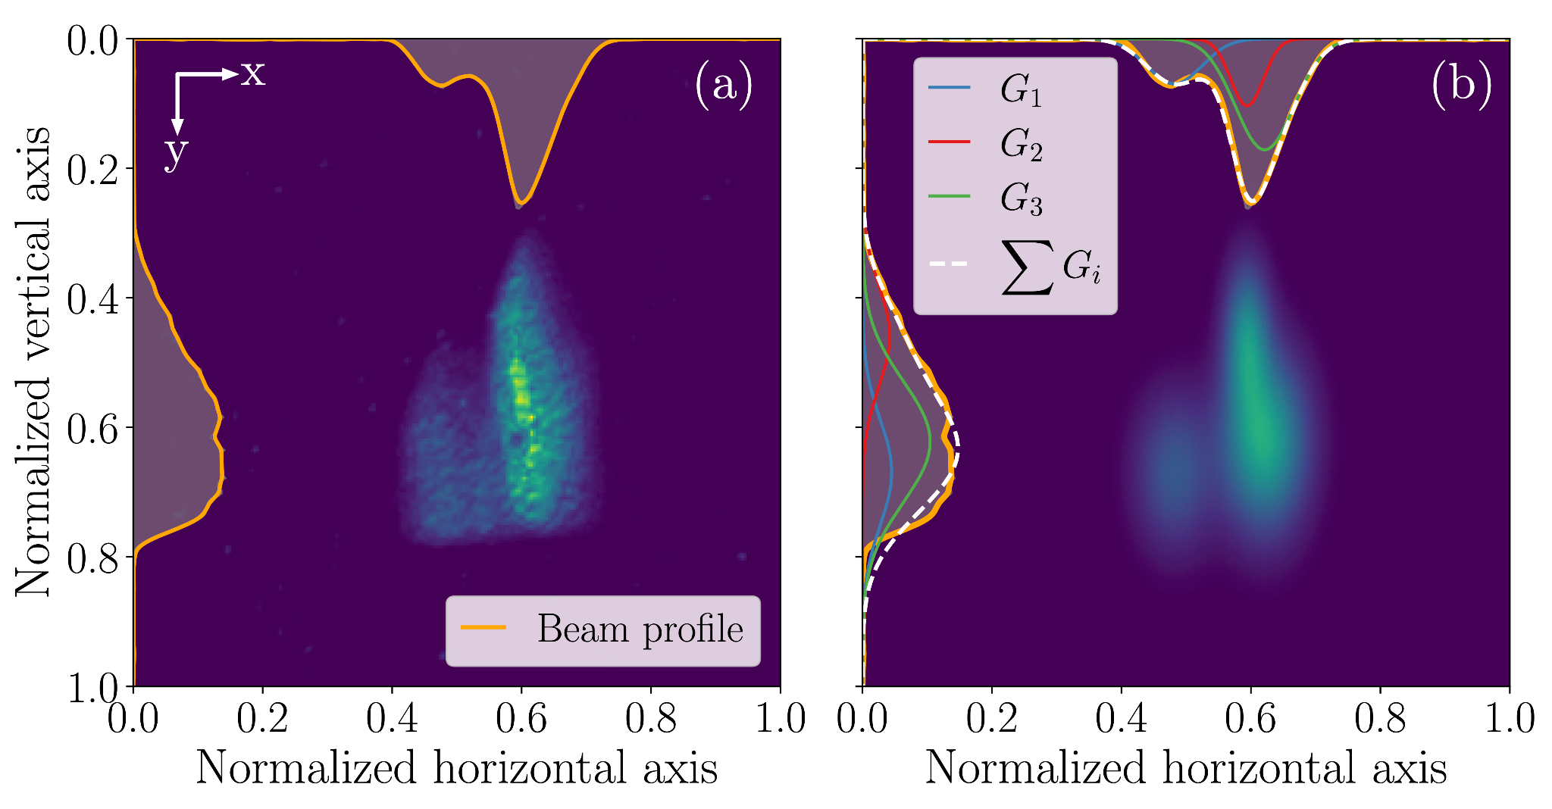
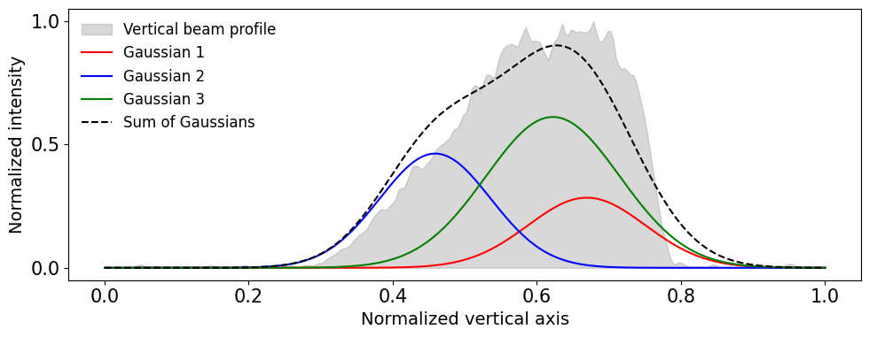
Synthetic data - Stochastic Gaussian Mixture
The image above illustrates that a complex transverse beam distribution can be effectively approximated using a Gaussian Mixture Model with as few as three components.
Qiyuan Xu
October 15, 2025

Slide 14
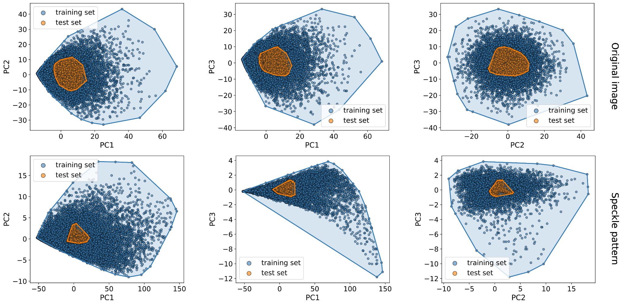
Synthetic vs. Real dataset Variance
PCA visualization of the training and test dataset images projected onto their three most significant principal components.
The training set (blue) covers a broader region in PCA space than the test set (yellow), indicating higher variance and better coverage.
Qiyuan Xu
October 15, 2025

Slide 15
Outline
Background and Motivation
Evaluation Metrics
Experiment and Dataset
Model and Training
Results
Qiyuan Xu
October 15, 2025

Slide 16
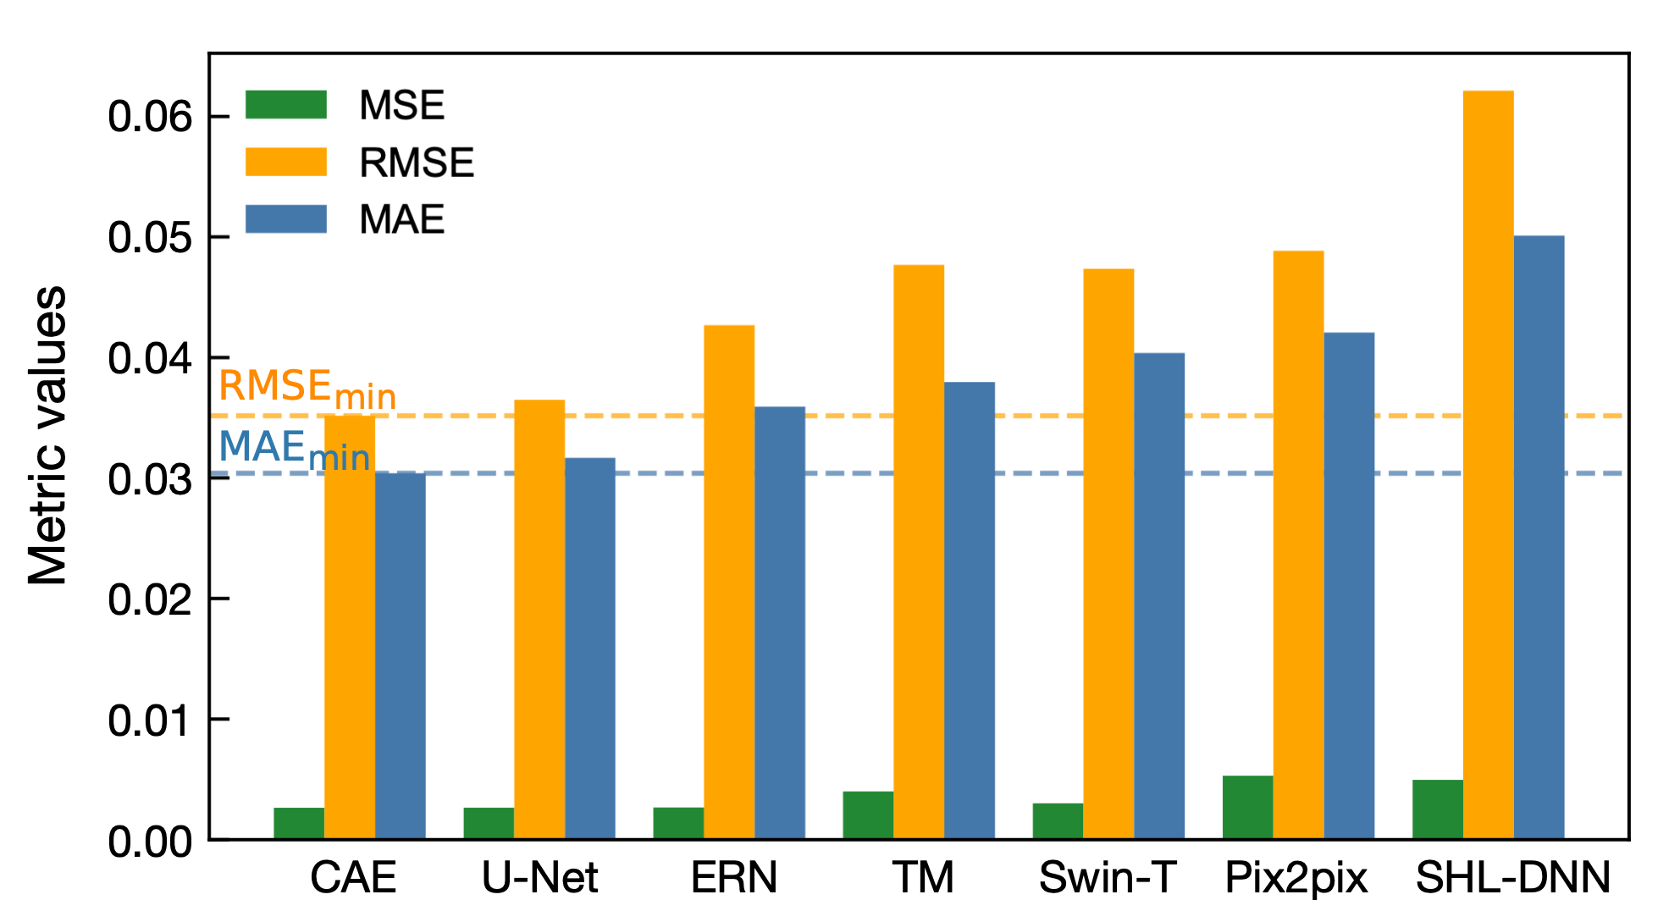
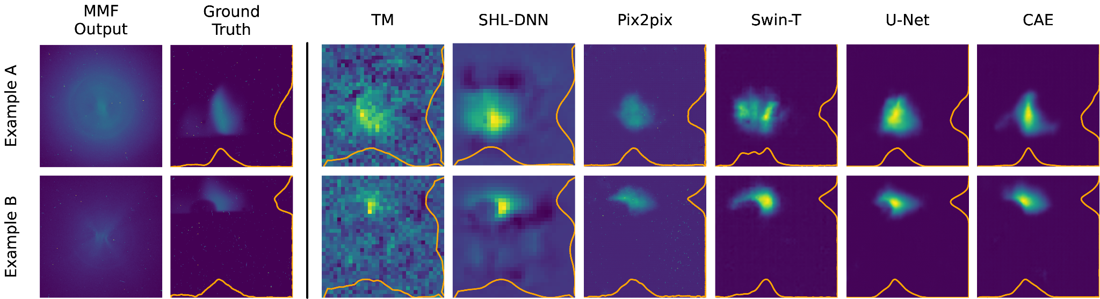
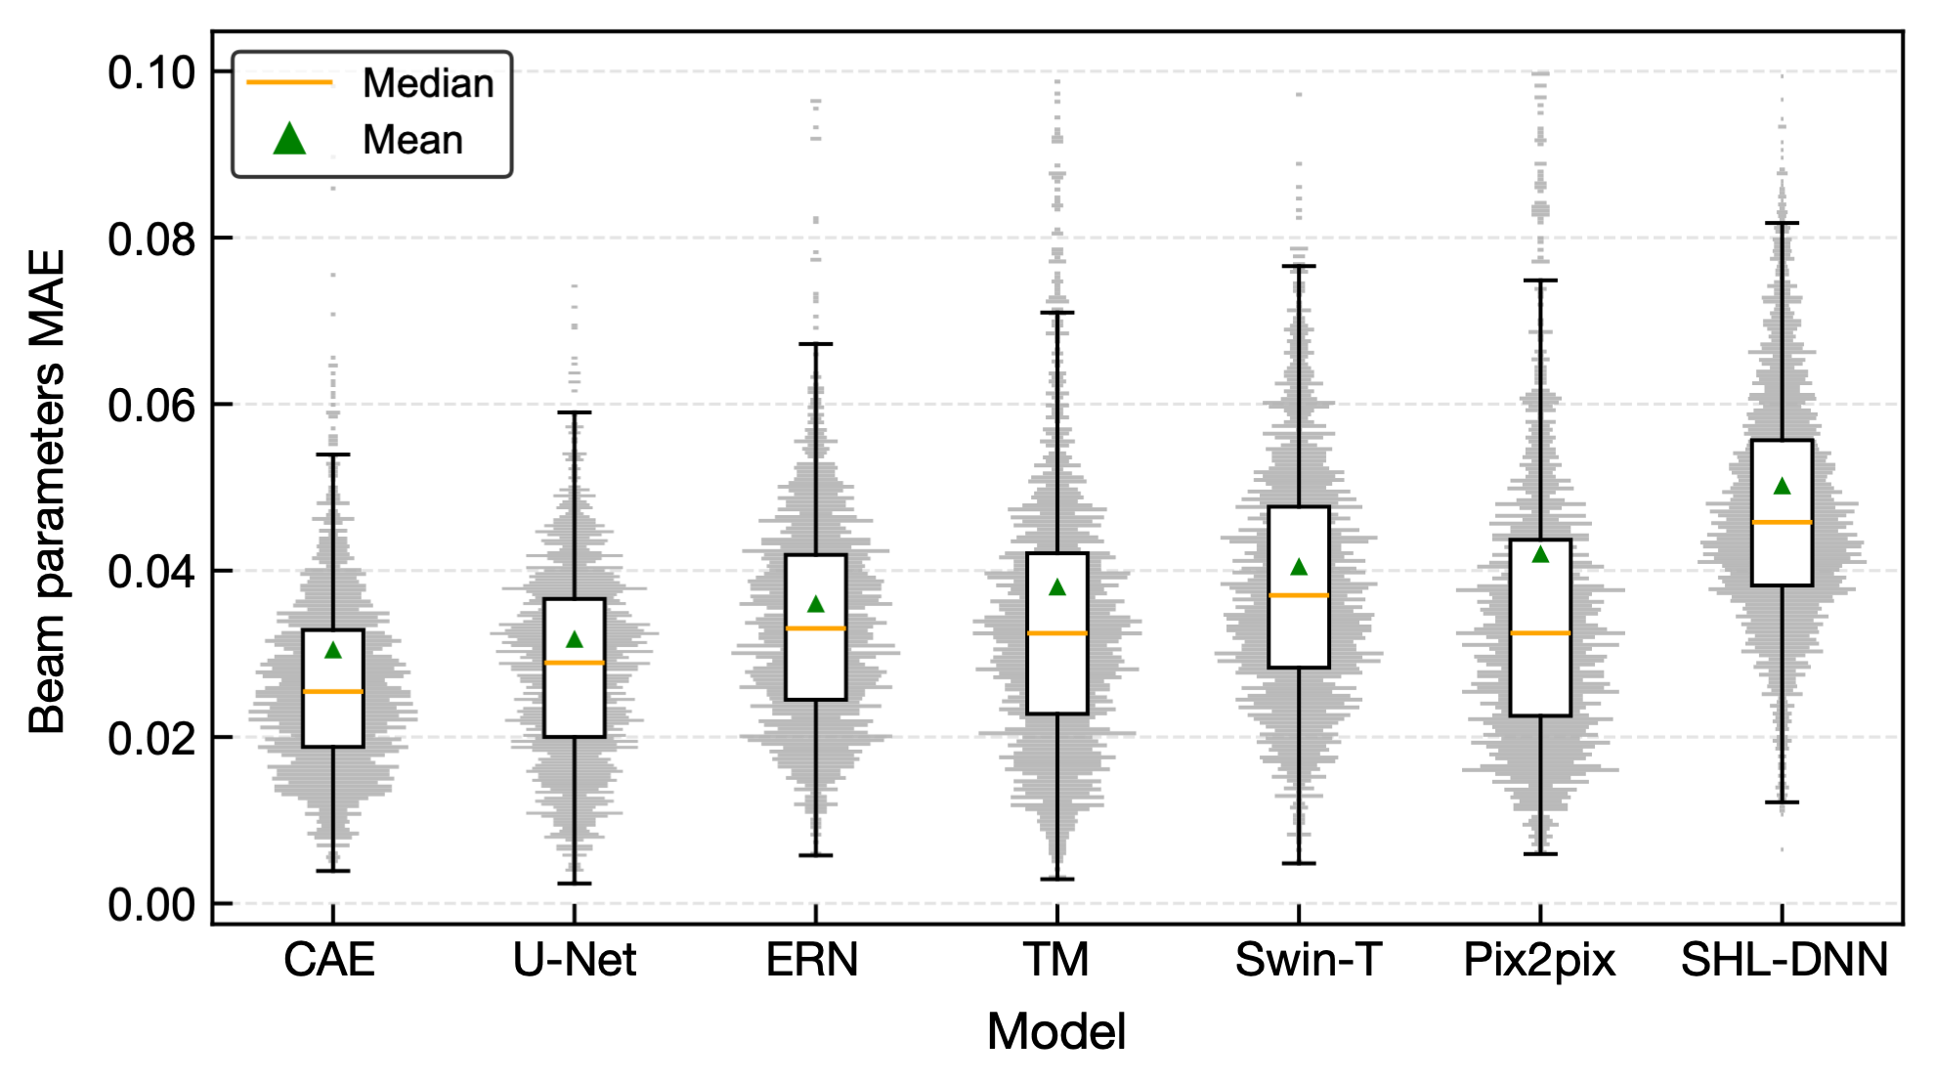
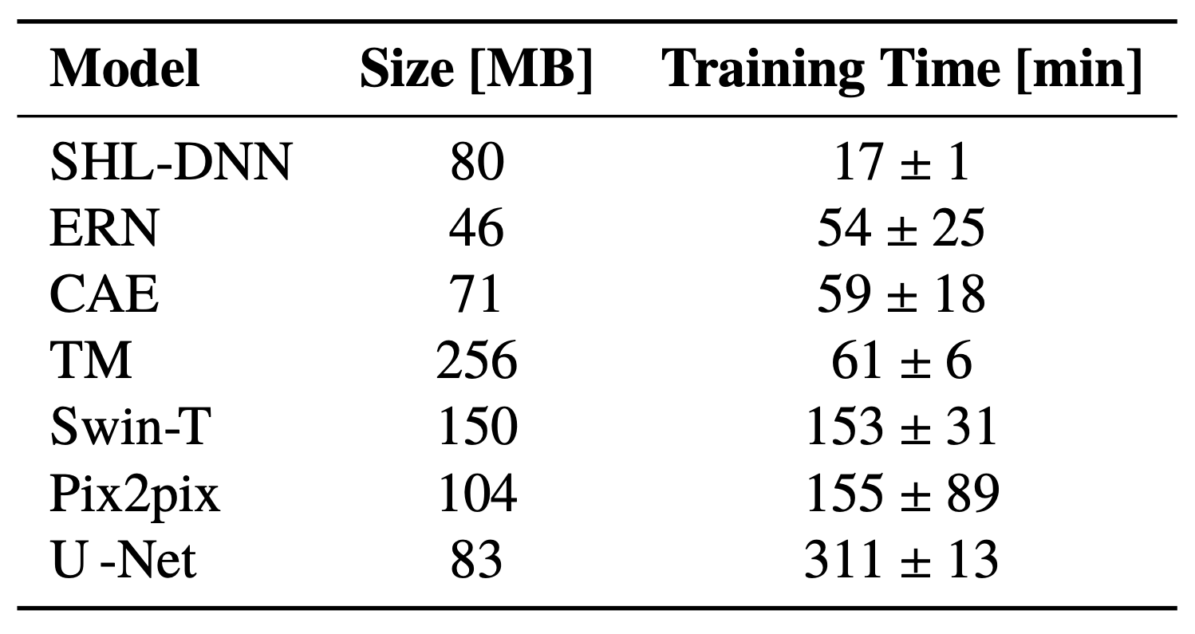
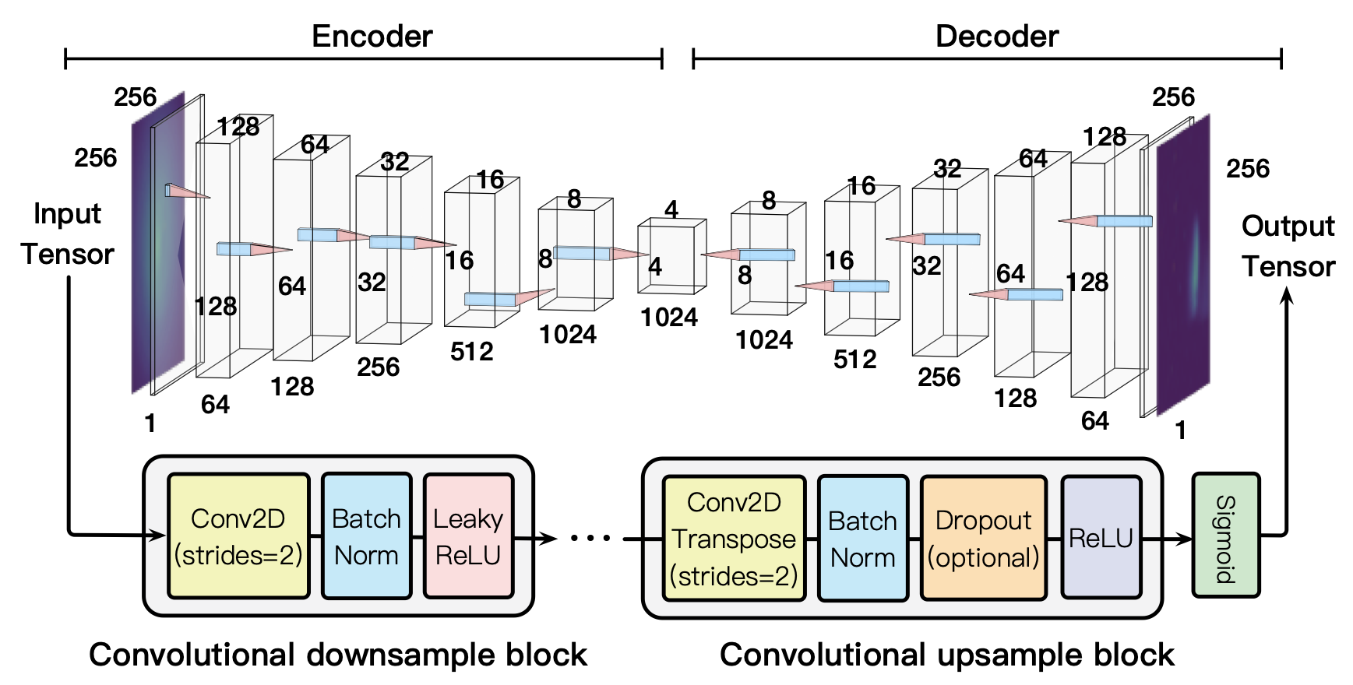
Model comparison
Qiyuan Xu
October 15, 2025

Slide 17
Outline
Background and Motivation
Evaluation Metrics
Experiment and Dataset
Model and Training
Results
Qiyuan Xu
October 15, 2025

Slide 18
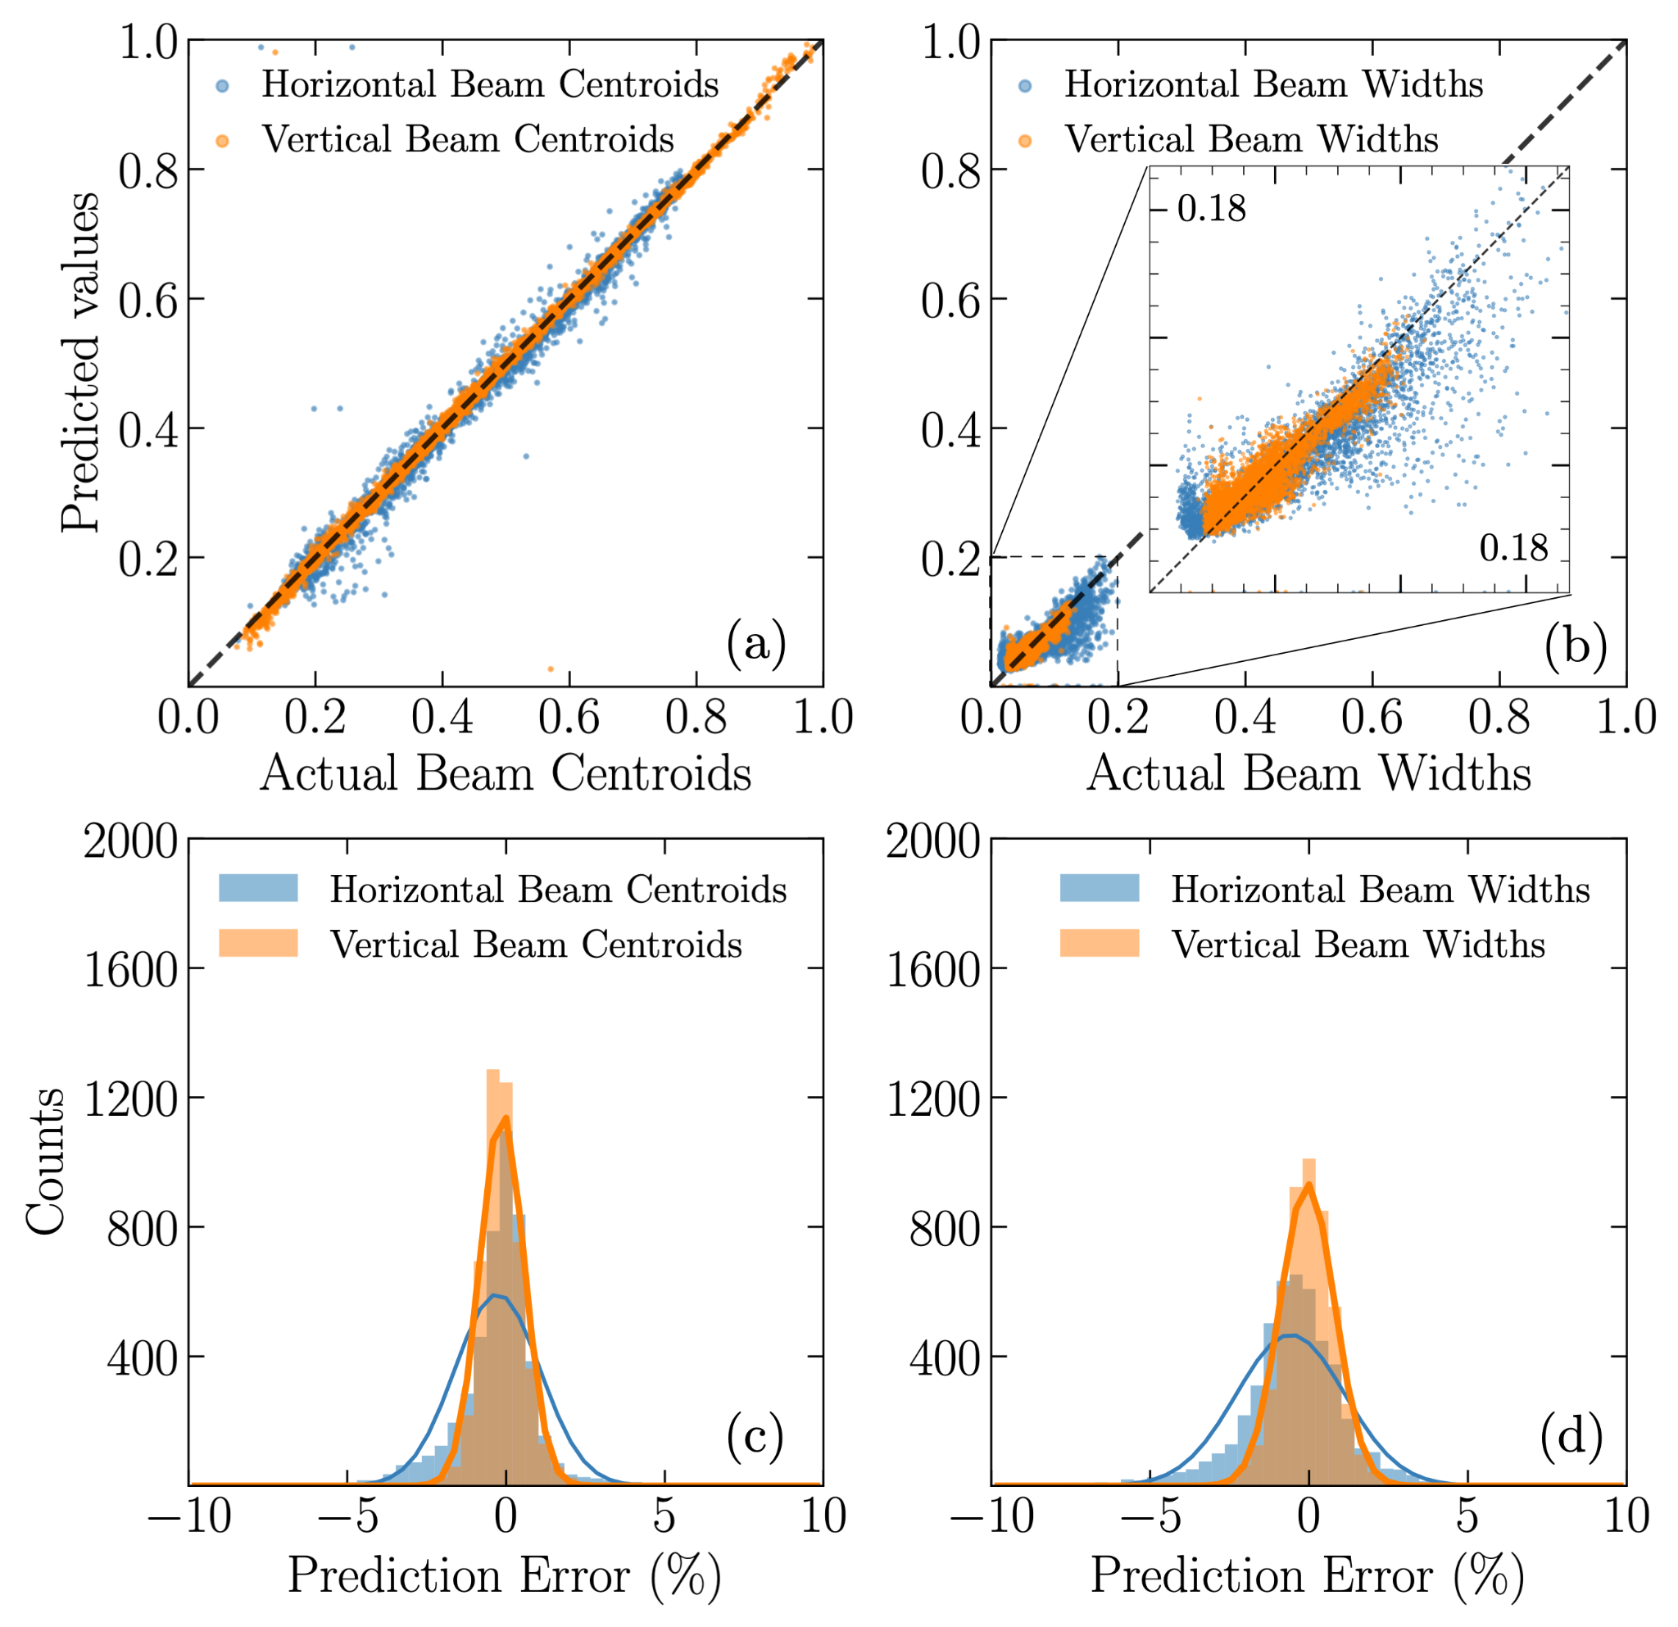
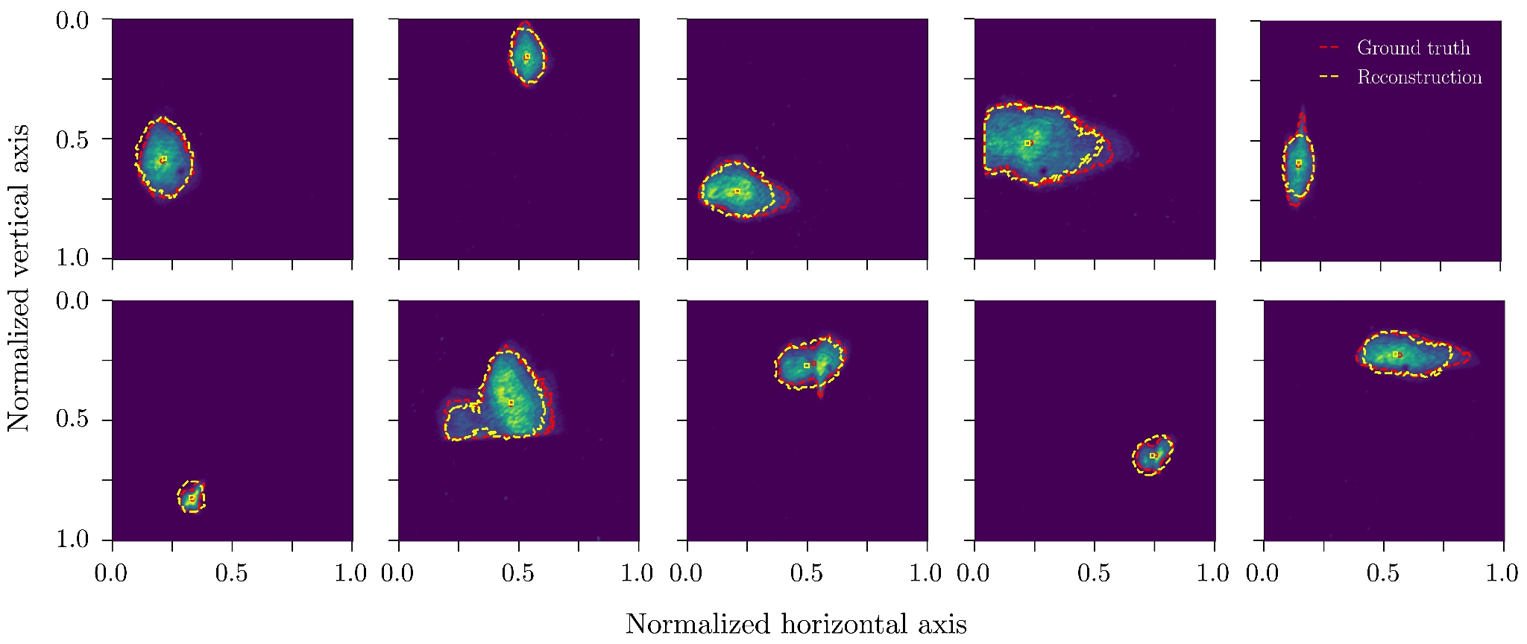
Testset reconstruction samples
The final model achieved an average reconstruction RMSE of 1.49% across four transverse beam parameters on the real beam test set on the DMD. 77% lower than the 6.59% baseline.
Qiyuan Xu
October 15, 2025

Slide 19
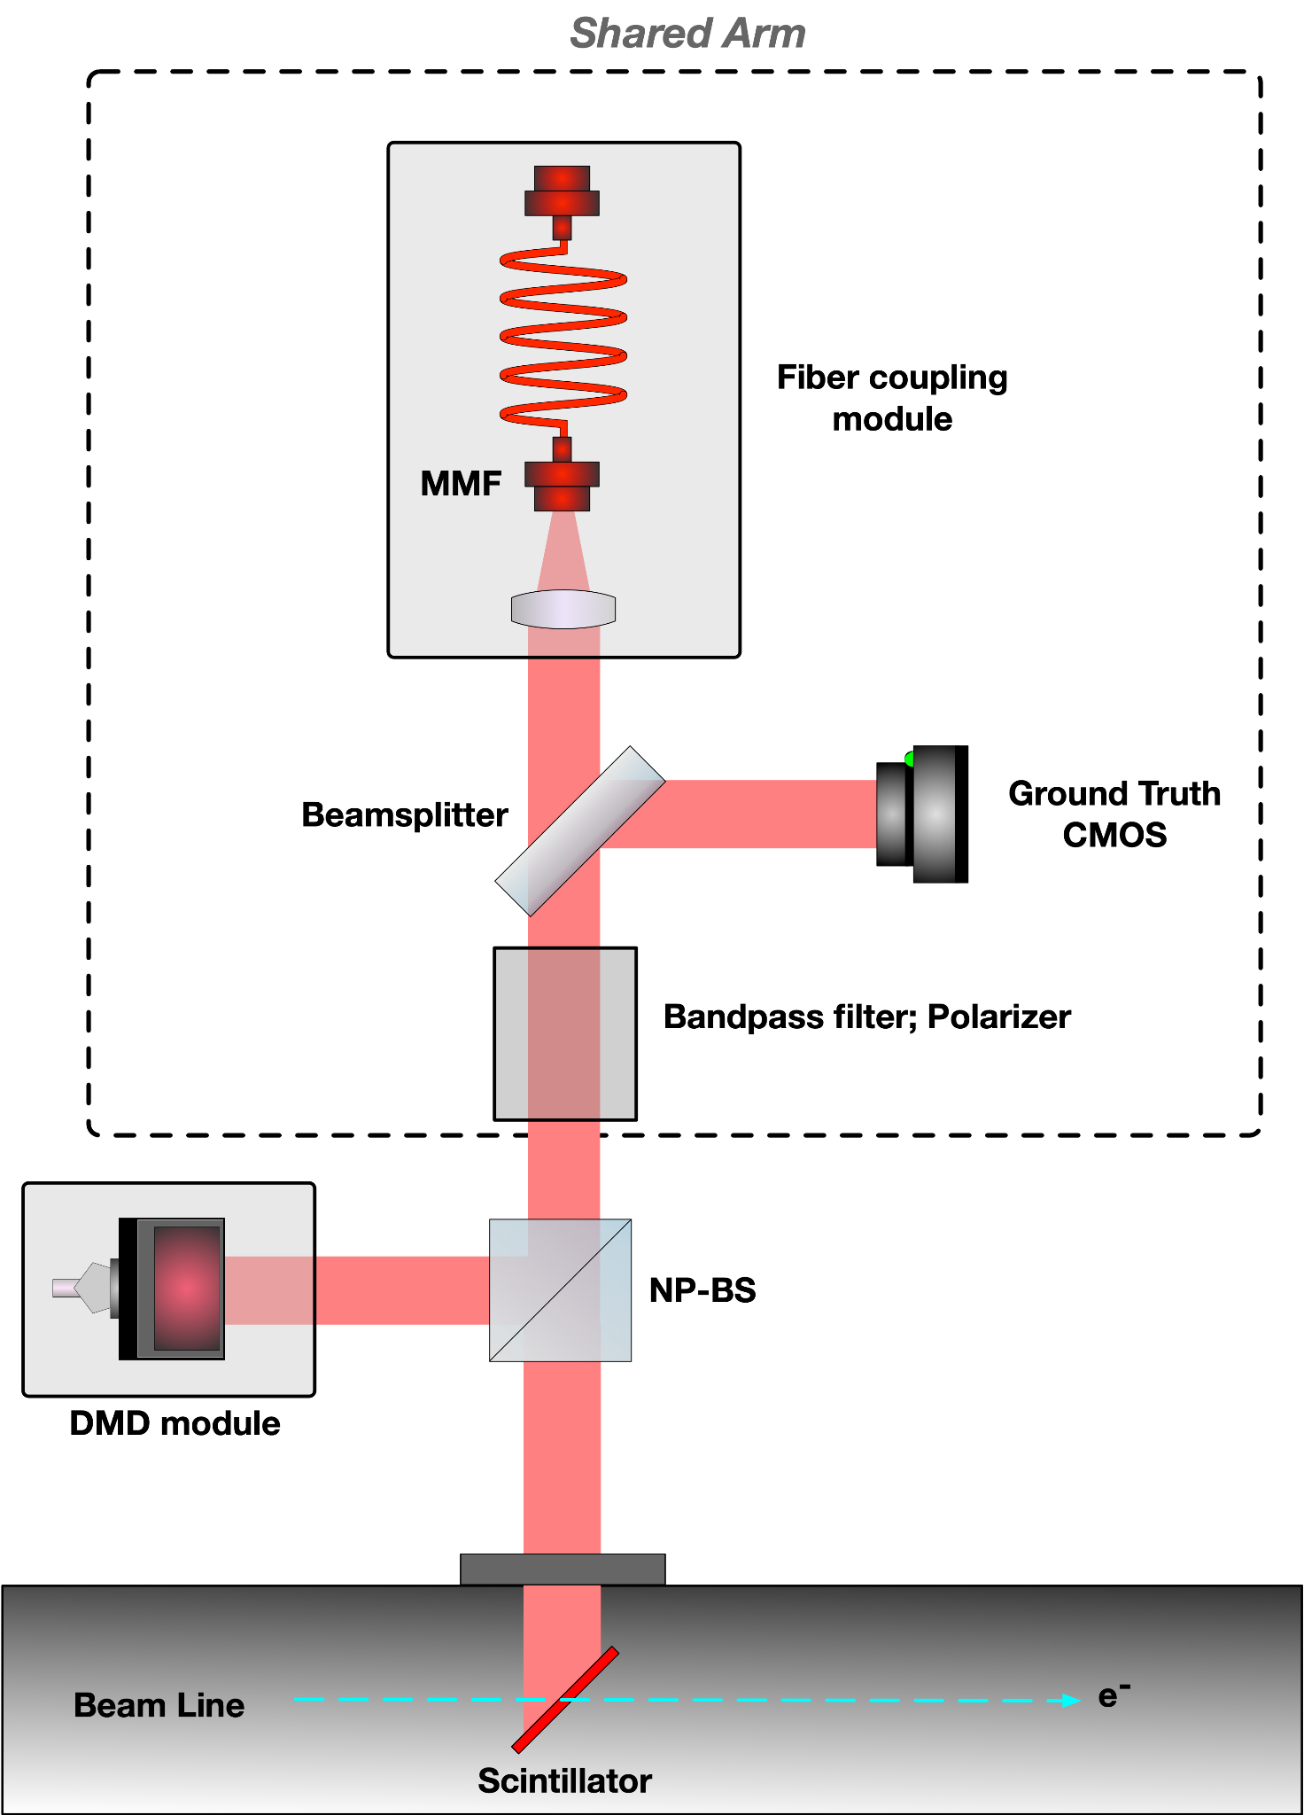
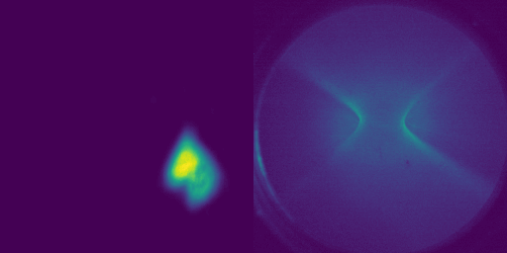
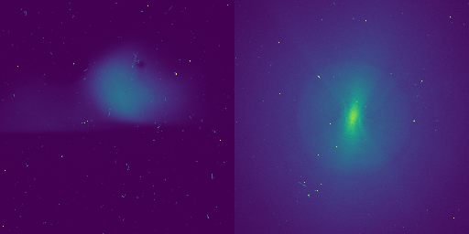
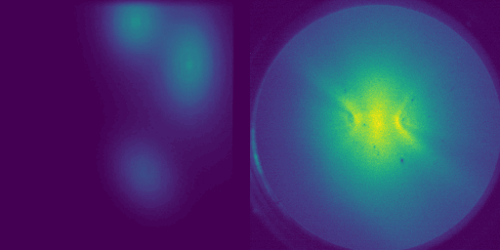
New design for beamline with optimized light source
Real beam distribution on DMD with incoherent, unpolarized, 694 nm wavelength centered light source
SGM synthetic data on DMD also using the optimized light source
Real sample on the scintillating screen
Qiyuan Xu
October 15, 2025

Slide 20
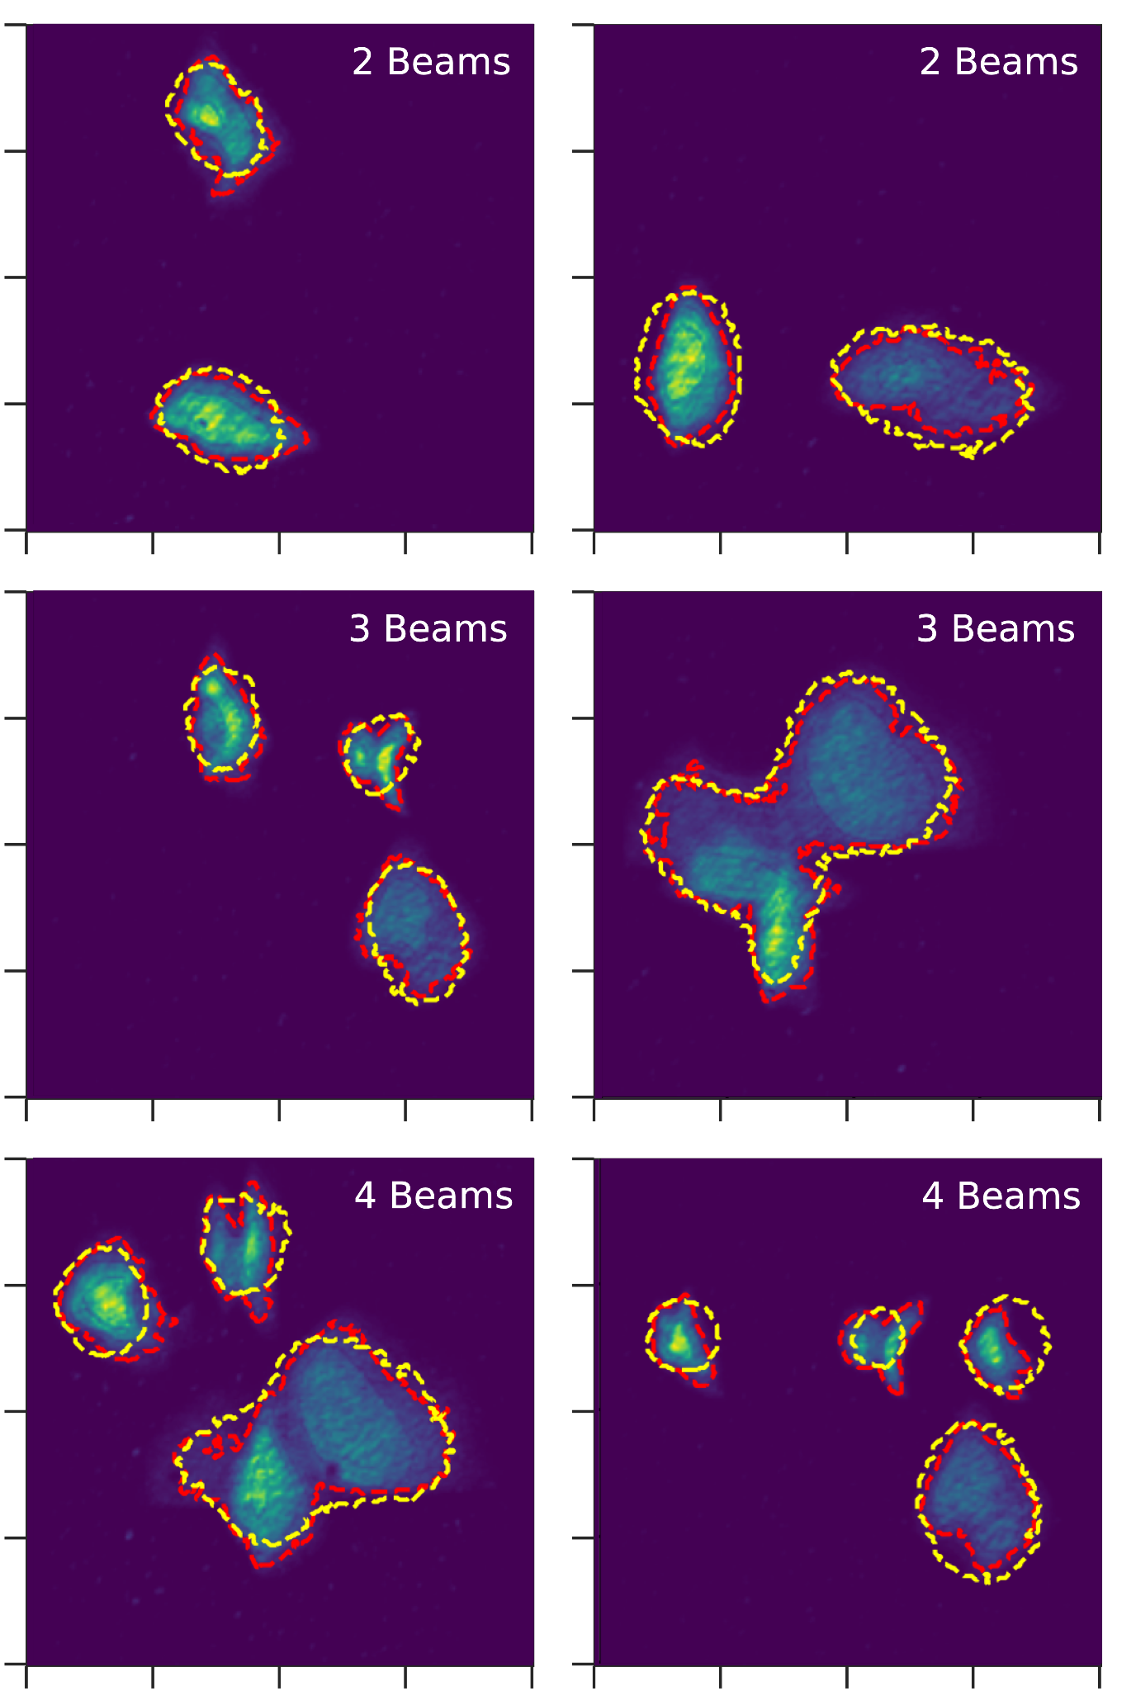
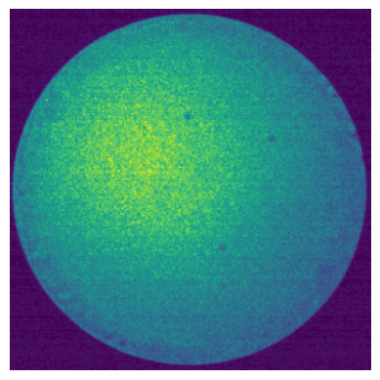
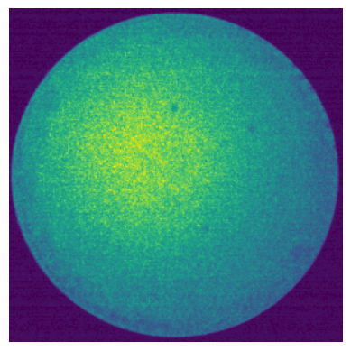
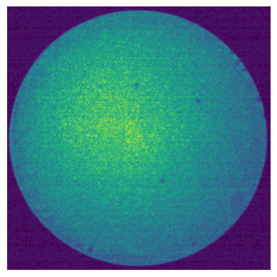
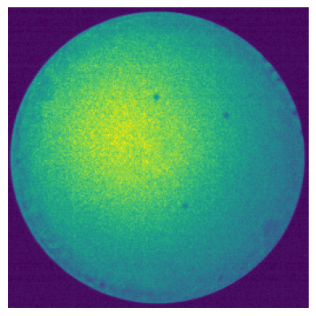
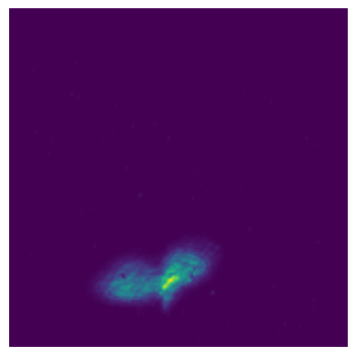
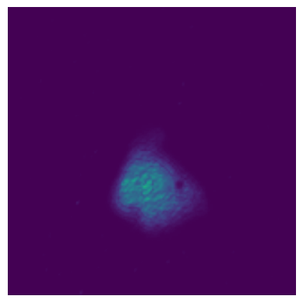
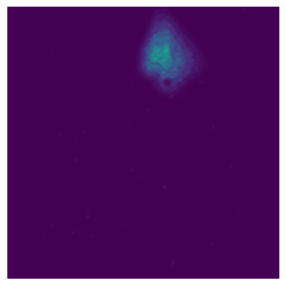
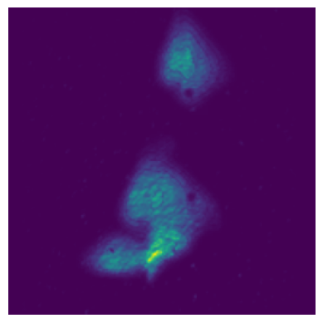
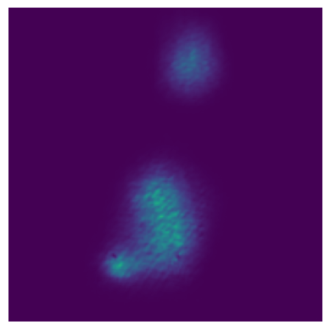
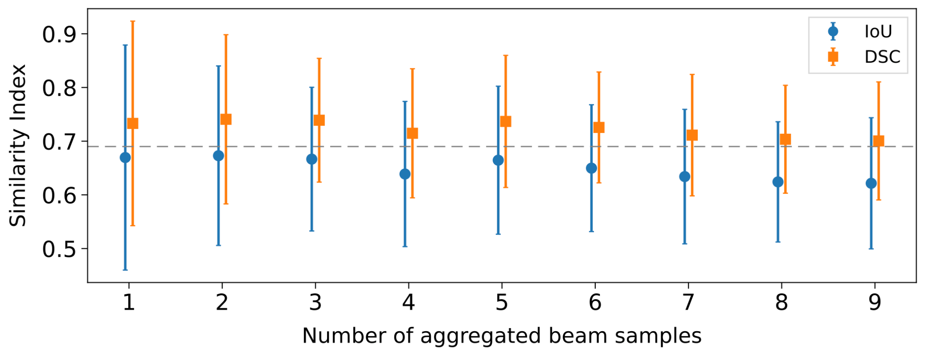
Superposition property of fiber system
Autoencoder
Direct pixel-wise stacking of multiple MMF speckle patterns.
Feed to our reconstruction model.
The reconstructed output matches the combined beam profile.
Indicating the potential for a more compact training set.
Qiyuan Xu
October 15, 2025

Slide 21
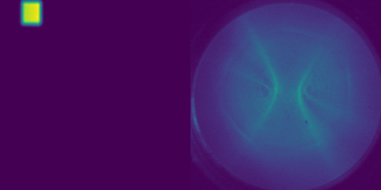
Orthogonal Basis Data Augmentation?
Use high-intensity inputs; then apply multiplicative (gain) scaling to the pixel values to cover the full dynamic intensity range with good SNR.
Use relatively small patterns and combine them linearly (superposition) to ensure resolution and cover distribution variability.
Potentially bring data collection time from 10 hs → 10 mins
Qiyuan Xu
October 15, 2025

Slide 22
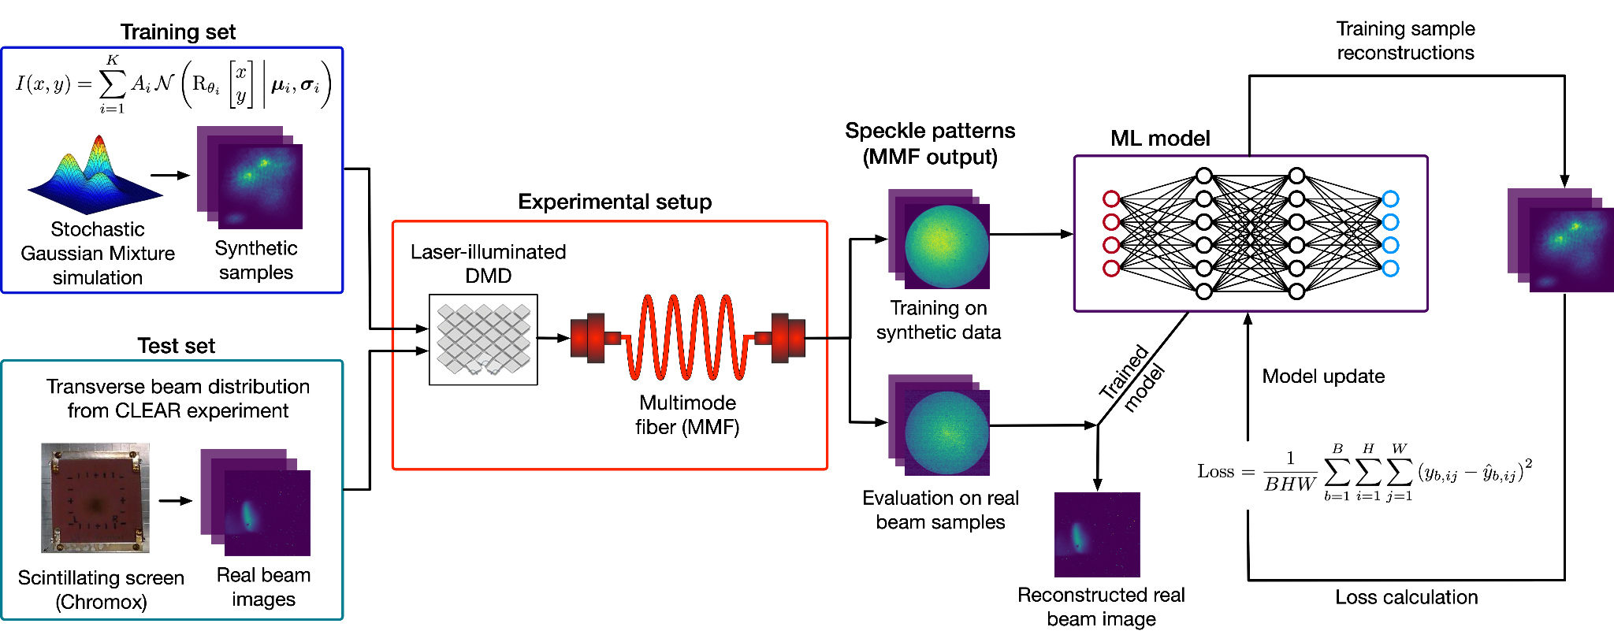
Conclusion
Qiyuan Xu
October 15, 2025

Slide 23
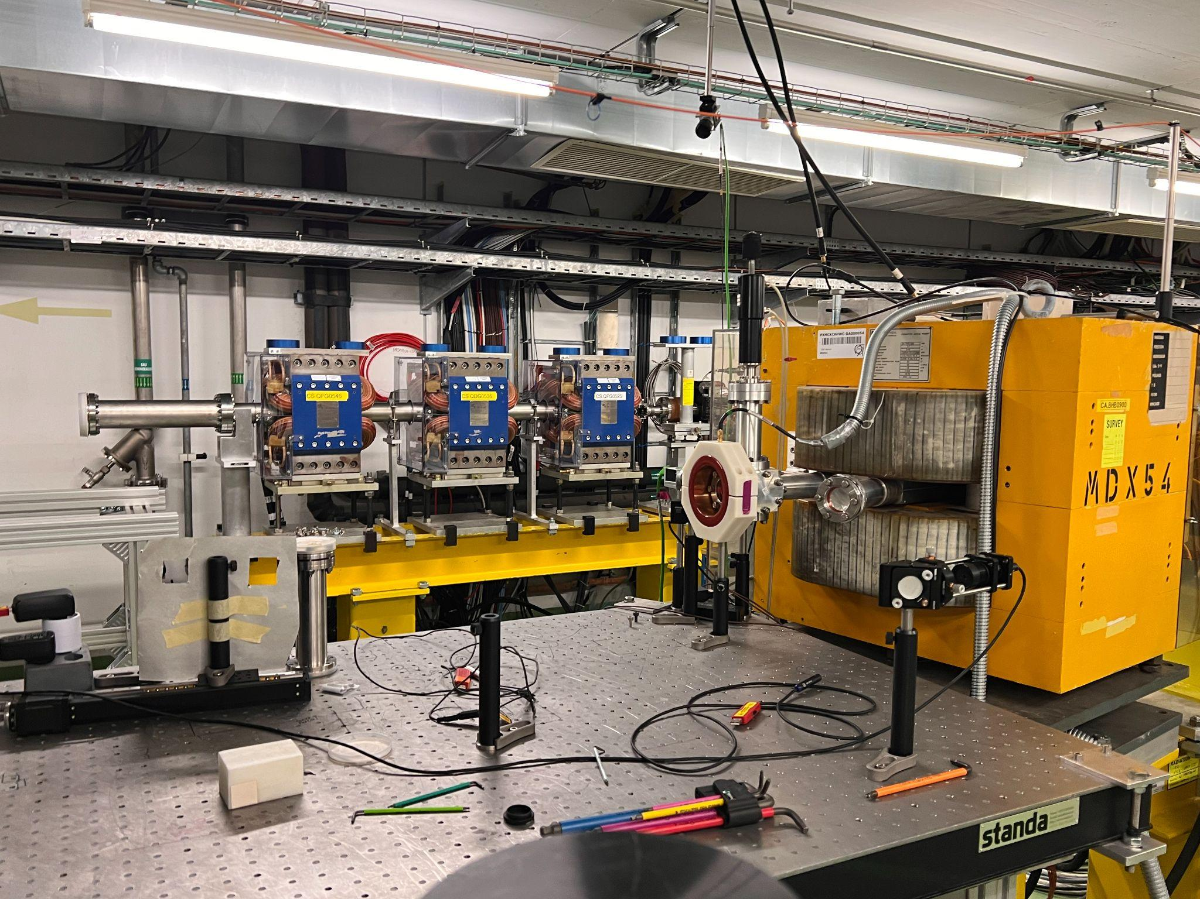
Future plans
Deployment at the CLEAR facility is planned for real-beam validation.
Ongoing work includes a systematic study of environmental perturbations (e.g., temperature variations, fiber geometry changes, and temporal stability) and radiation-induced effects on MMF performance.
Qiyuan Xu
October 15, 2025

Slide 24
References
[1]. P. Forck et al., "Lecture notes on beam instrumentation and diagnostics," Joint Universities Accelerator School (JUAS 2010), 2011.
[2]. B. Walasek-Hoehne, K. Hoehne, and R. Singh, "Video Cameras used in Beam Instrumentation--an Overview," arXiv preprint arXiv:2005.04977, 2020.
[3]. D. Psaltis and C. Moser, "Imaging with multimode fibers," Optics and Photonics News, vol. 27, no. 1, pp. 24-31, 2016.
[4]. E. Spitz and A. Werts, "Transmission des images à travers une fibre optique," Comptes Rendus Hebdomadaires Des Séances De L'Académie Des Sciences Série B, vol. 264, no. 14, pp. 1015–+, 1967.
[5]. P. Caramazza, O. Moran, R. Murray-Smith, and D. Faccio, "Transmission of natural scene images through a multimode fibre," Nature Communications, vol. 10, no. 1, p. 2029, 2019.
[6]. F. Roncarolo, S. Burger, G. Trad, F. Velotti, A. Topaloudis, T. Levens, A. Guerrero, and T. Lefevre, "JACoW: Review of CERN beam instrumentation for fixed target experiments," JACoW IPAC, vol. 2023, paper THPL080, 2023.
[7]. G. Trad and S. Burger, "Artificial Intelligence-Assisted Beam Distribution Imaging Using a Single Multimode Fiber at CERN," JACoW IPAC, vol. 2022, pp. 339-342, 2022.
[8]. Q. Xu, A. Hill, H. D. Zhang, C. P. Welsch, F. Roncarolo, and G. Trad, "Estimation of beam transverse parameters through a multimode fiber using deep learning," Proc. IBIC2024, pp. 170–173, JACoW Publishing, Geneva, Switzerland.
Qiyuan Xu
October 15, 2025

Slide 25


Thank you
Connect LinkedIn
Project Repository
Qiyuan Xu
October 15, 2025

Slide 26


Appendix
Qiyuan Xu
October 15, 2025

Slide 27

Fiber coupling
Spatial-based input coupling efficiency in an MMF. (a) Example input distribution at the fiber’s proximal end. (b)-(d) Heat maps showing the transmission efficiency for each input location, with brighter colors indicating higher coupling efficiency.
Qiyuan Xu
October 15, 2025

Slide 28


Result analysis
Beam centroid: errors concentrate near boundary regions, particularly along the vertical direction (higher variance), indicating lower accuracy for extreme cases.
Beam width: errors are relatively larger near two boundary regions, suggesting highly anisotropic or large beam size have reduced reconstruction accuracy.
Qiyuan Xu
October 15, 2025

Slide 29


Beam imaging in high-radiation environments
(Fujikura FIGR-10)
Single mode fiber bundle
Vidicon camera tube
CMOS camera
Qiyuan Xu
October 15, 2025

Slide 30
Theory: Every MMF Known Linear and Non-Linear effects
Linear (power‑independent)
Non-linear (power‑dependent)
Absorption & scattering
Dispersion
Mode coupling
Mode‑dependent noise
Kerr‑effect phenomena
Stimulated scattering
Spatiotemporal multimode dynamics
Perturbations
Kerr‑effect phenomena
Stimulated scattering
Spatiotemporal multimode dynamics
Perturbations
Given the input light energy is much less than 1mW, incoherent, unpolarized and wavelength in visible light with relatively narrow bandwidth. most nonlinear effects can be ignored. (nonlinearities are orders of magnitude below relevance)
Non‑linear effects generally are triggered by optical power (light intensity is high enough to alter the refractive index)
Qiyuan Xu
October 15, 2025

