Slide 1
Single-shot electron bunch profile monitor based on coherent transition radiation imaging
Ana Guisao-Betancur^{1,2}, Joseph Wolfenden^{1,2}, Erik Mansten³, Sara Thorin³, Johan Lundquist³, Oliver Grimm³, Carsten Welsch^{1,2}
A.M.Guisao-Betancur@liverpool.ac.uk
¹. Department of Physics, University of Liverpool, Liverpool L69 7ZX, UK
². Cockcroft Institute, Sci-Tech Daresbury, Daresbury WA4 4AD, UK
³. MAX IV Laboratory, Lund University, Lund 224 84, Sweden

Slide 2
Content overview
----------------------------------------------------------------------------------------------------------------------------------------------
Problem description
Transition radiation-based monitor
Designing for a short-pulse facility
Results and discussion
Next steps
References

Slide 3
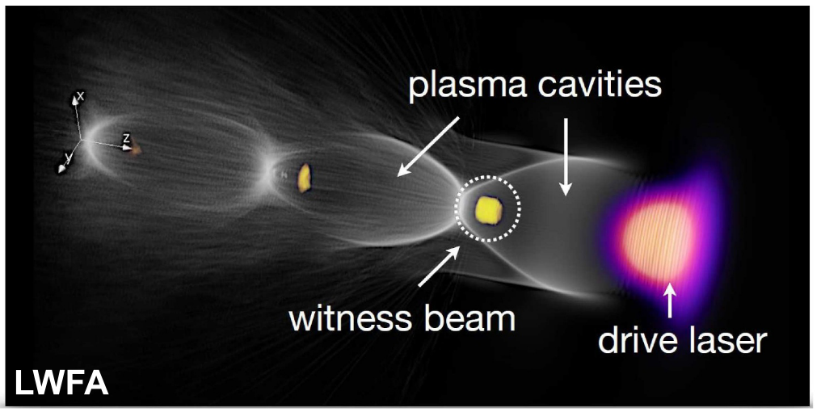
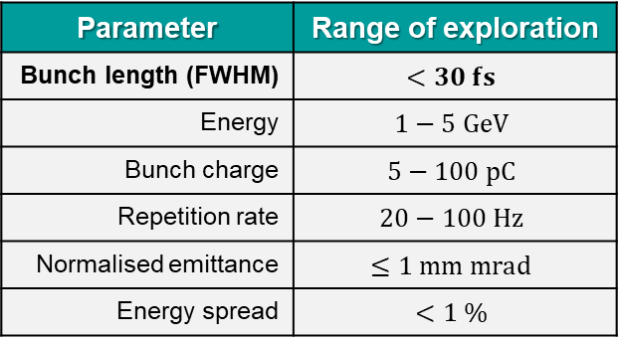
1. Problem description
Need for monitoring ultrashort electron bunches in the femtosecond range
Plasma-based accelerators can produce ultra-short electron bunches and impart energy gain of several GeV with accelerating distances of only few centimeters.
In the case of EuPRAXIA and other short-pulse accelerators, bunch lengths can be sub-fs to a few hundreds of fs long. This brings a challenge for the development of longitudinal diagnostics.
Figure 1. Wakefield generation and electron beam acceleration in a plasma accelerator showing the behavior in a laser-driven plasma (wakefield) accelerator (LWFA) .
Table 1. Summary of the electron beam properties for EuPRAXIA (at entrance of undulator for FEL).
Parameter | Range of exploration
Bunch length (FWHM) | $$<30 fs$$
Energy | $$1−5 GeV$$
Bunch charge | $$5−100 pC$$
Repetition rate | $$20−100 Hz$$
Normalised emittance | $$≤1 mm mrad$$
Energy spread | $$<1 \%$$
Assmann, R. W. et al. EuPRAXIA Conceptual Design Report. Eur. Phys. J. Spec. Top. 229, 3675–4284 (2020).

Slide 4
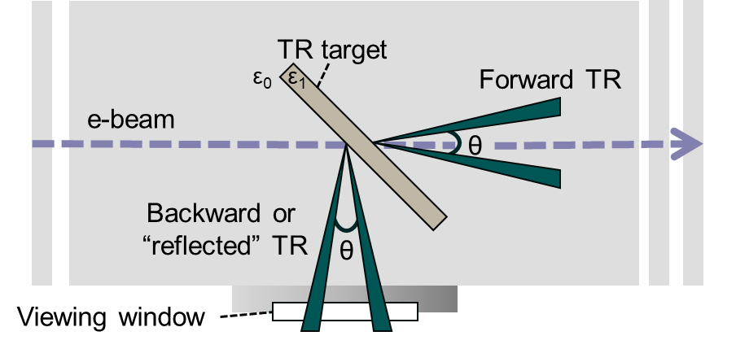
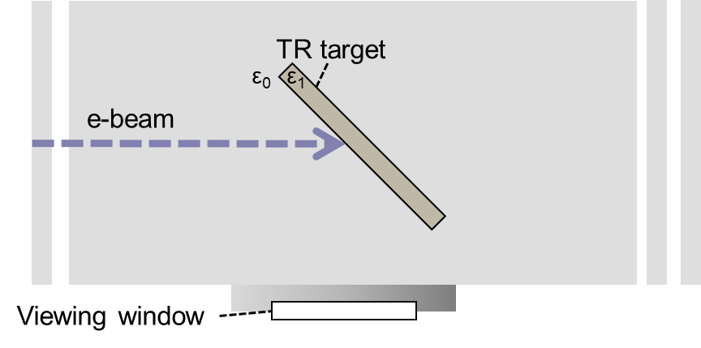
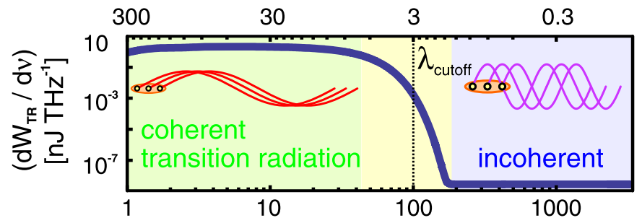
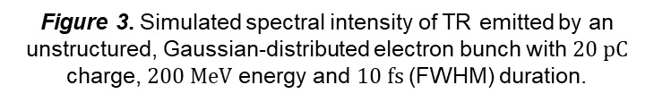
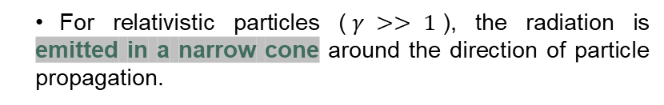
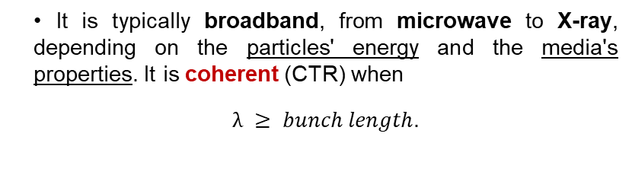


2. Transition radiation-based monitor
About generation of (coherent) transition radiation
Transition radiation (TR) is produced when charged particles pass a boundary between two media with different dielectric properties.
It is typically broadband, from microwave to X-ray, depending on the particles' energy and the media's properties. It is coherent (CTR) when
$λ ≥ bunch length$.
Figure 2. Transition radiation generation scheme.
Figure 3. Simulated spectral intensity of TR emitted by an unstructured, Gaussian-distributed electron bunch with $20 pC$ charge, $200 MeV$ energy and $10 fs$ (FWHM) duration.
$$λ [μm]$$
Detector position | Image plane
Image information | Point-to-point spatial distribution of the TR source
Commonly studied with
Spectrometer
Our approach
Imaging system
For relativistic particles ($γ >> 1$), the radiation is emitted in a narrow cone around the direction of particle propagation.
$$ν [THz]$$
Zarini, O. et al. Multioctave high-dynamic range optical spectrometer for single-pulse, longitudinal characterization of ultrashort electron bunches. Phys. Rev. Accel. Beams 25, 1–19 (2022).

Slide 5
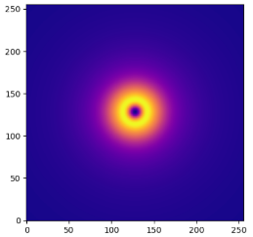
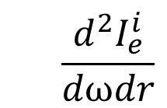





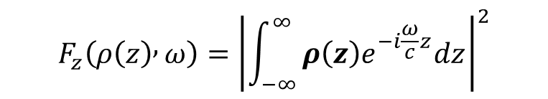
2. Transition radiation-based monitor
Working principle: CTR spatial distribution image and longitudinal bunch profile
CTR image (from a bunch)
Assuming transverse coherence condition on the beam size $σ_{r}≪γλ/2π$
$$\frac{dI_{bunch}^{i}}{dr}≈N_{e}^{2}\int_{Δω}{\frac{d^{2}I_{e}^{i}}{dωdr}F_{z}(ρ\left(z\right),ω)dω}$$
Where:
Sample of simulated CTR image
(spatial distribution)
Contains information about the particle distribution $ρ\left(z\right)$ or bunch longitudinal profile:
$$N_{e}^{2}$$
No. of e⁻
$$Δω$$
Bandwidth
Longitudinal form factor
$$F_{z}\left(ρ\left(z\right) , ω\right)={\left|\int_{−∞}^{∞}{ρ\left(z\right)e^{−i\frac{ω}{c}z}dz} \right|}^{2}$$
$$\frac{d^{2}I_{e}^{i}}{dωdr}$$
Single e⁻ spectral image
Wolfenden, J. et al. Coherent Transition Radiation Spatial Imaging As a Bunch Length Monitor. in 10th Int. Particle Accelerator Conf. 2713–2716 (2019).
Shkvarunets, A. G. & Fiorito, R. B. Vector electromagnetic theory of transition and diffraction radiation with application to the measurement of longitudinal bunch size. Phys. Rev. Spec. Top. - Accel. Beams 11, 012801 (2008).

Slide 6
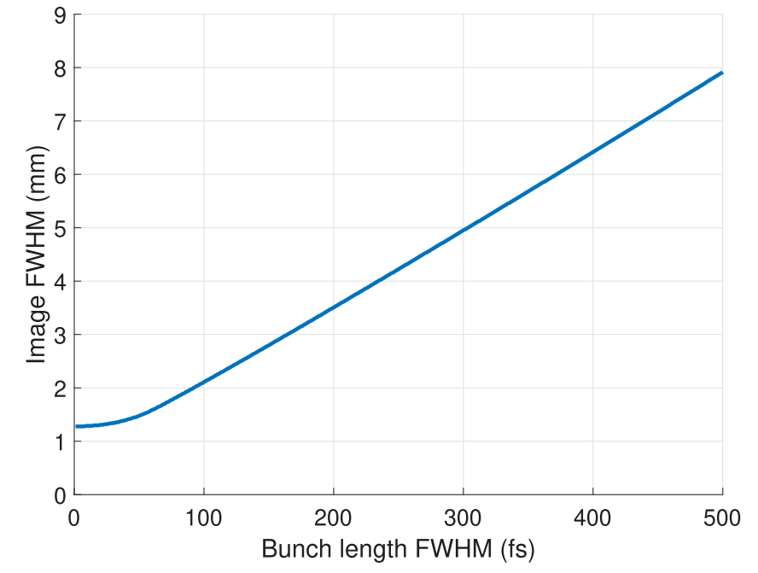
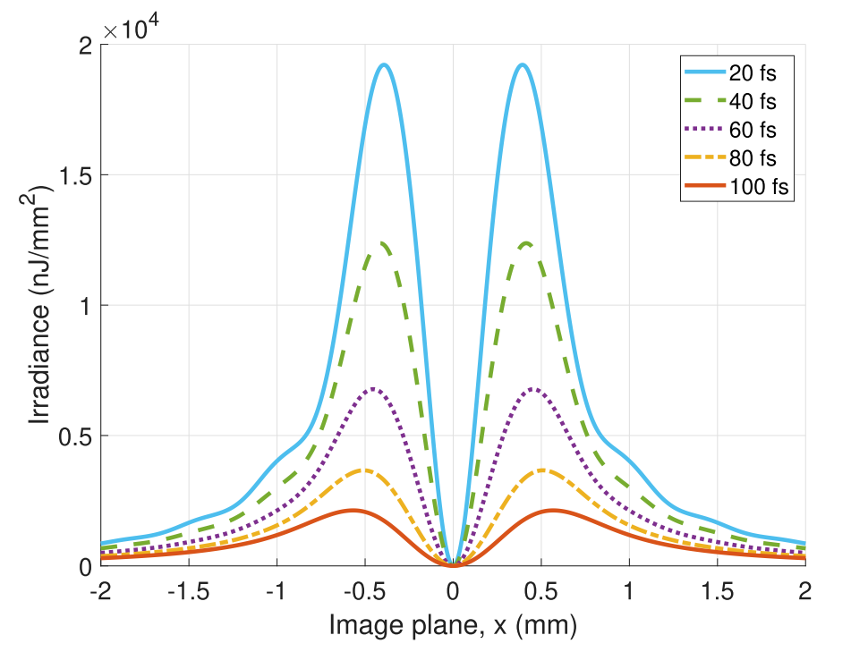
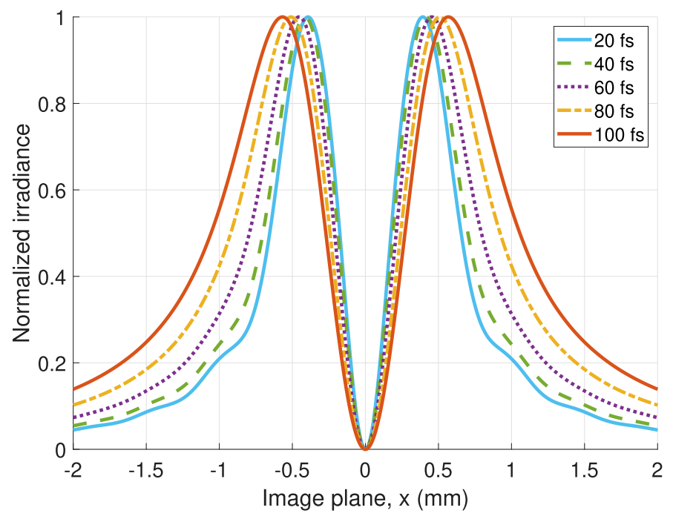
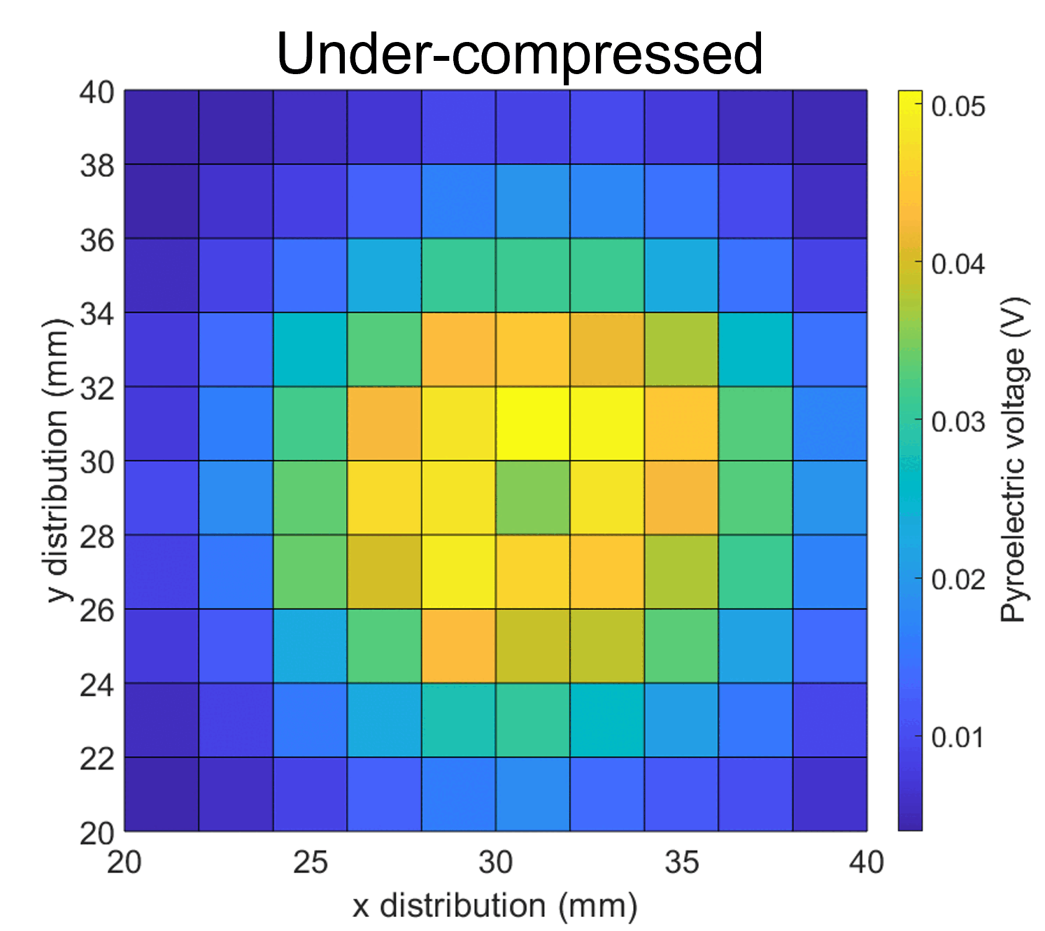
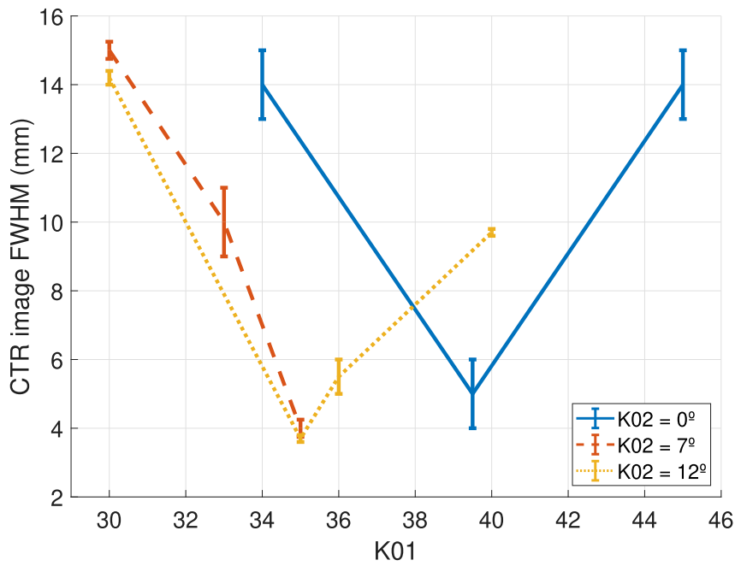
2. Transition radiation-based monitor
Working principle: previous work
Figure 5. Demonstration of FWHM distance variation with bunch length in CTR image distributions.
CTR image parameters such as the peak-to-peak distance or the image width (FWHM) show dependence on the bunch length.
Figure 4. Simulated 1D cross-sections of the absolute (a) and normalized (b) spatial distribution of a CTR image from a for a range of Gaussian longitudinal bunch profiles.
Figure 6. CTR image FWHM variation with K01 and K02 phase.
TPX lens 2f-2f imaging system
Sample of simulated CTR image
(spatial distribution)
Examples of measured images
Wolfenden, J. et al. First demonstration of coherent radiation imaging for bunch-by-bunch longitudinal compression monitoring. Submitted to Phys. Rev. Accel. Beams (2025).
@ MAX IV SPF

Slide 7
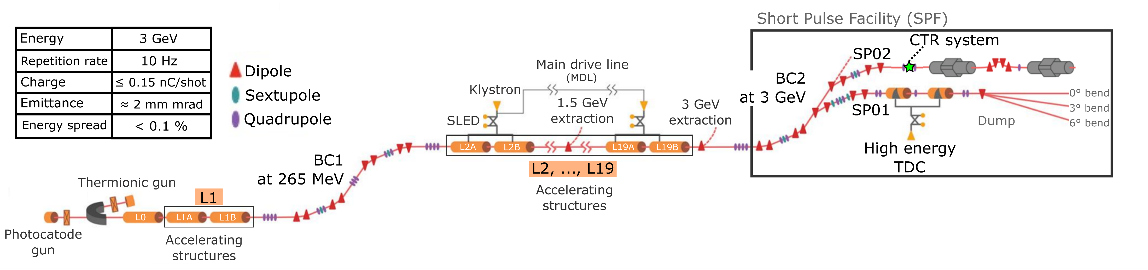
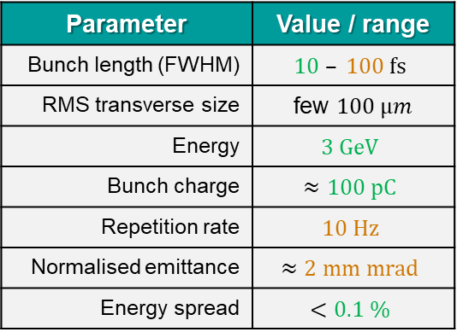



3. Designing for a short-pulse facility
Identifying the requirements for the MAX IV short pulse facility (SPF)
Figure 7. Targeted system location at the MAX IV SPF.
Parameter | Value / range
Bunch length (FWHM) | $$10 – 100 fs$$
RMS transverse size | few $100 μm$
Energy | $$3 GeV$$
Bunch charge | $$≈100 pC$$
Repetition rate | $$10 Hz$$
Normalised emittance | $$≈2 mm mrad$$
Energy spread | $$<0.1 \%$$
Requirement for an imaging system covering
$$λ≳3−30 μm$$
Table 2. Electron beam parameters at the SPF (and CTR location).
$σ_{r}≪γλ/2π$
Transverse coherence condition
$γλ/2π≈2800 μm$ at $3 μm$

Slide 8
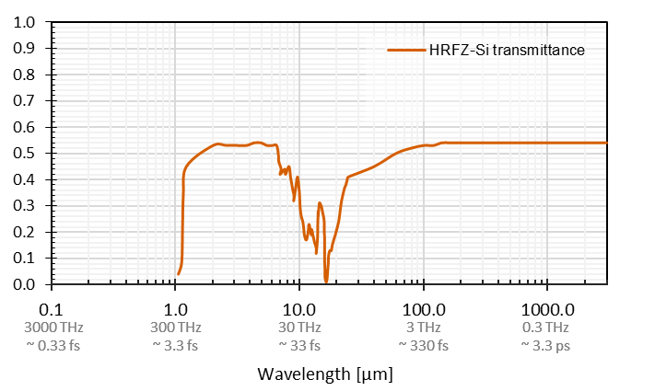
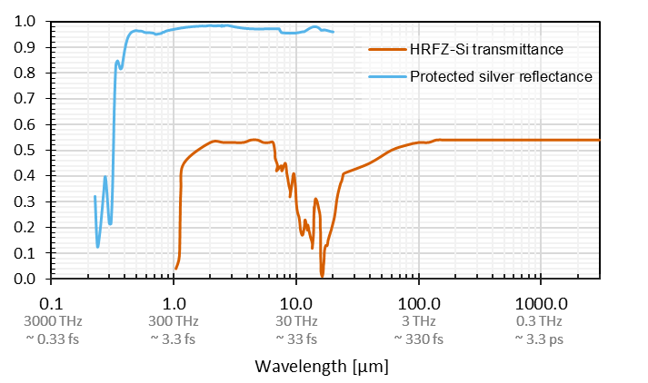
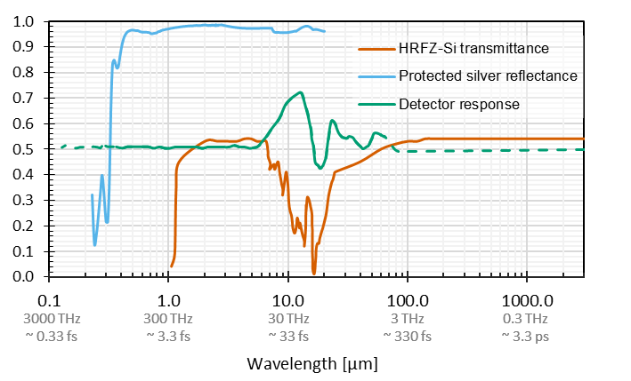
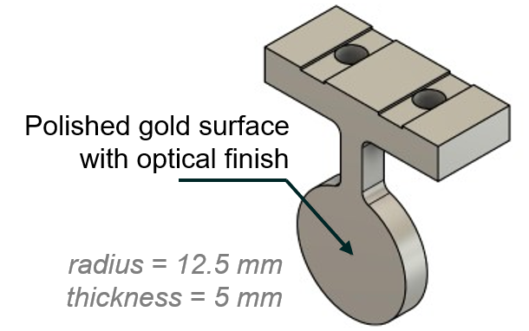
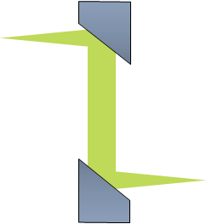
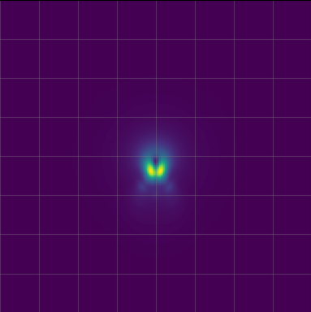

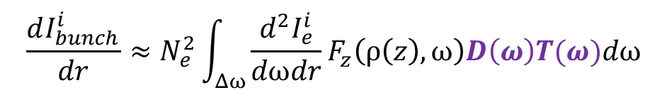
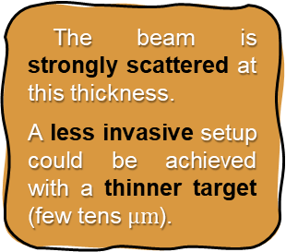
3. Designing for a short-pulse facility
Design of the acquisition system: description of the components
Figure 8. Schematic of the CTR imaging system.
Figure 9. Optical properties for the elements on the imaging system.
Vacuum viewport window
High resistivity float zone silicon (HRFZ-Si)
TR target
RFL=4”
Off-axis parabolic (OAP) mirrors
Protected silver coating
The beam is strongly scattered at this thickness.
A less invasive setup could be achieved with a thinner target (few tens $μm$).
CTR spatial image
e-beam
$$\sim 10 fs$$
RFL=8”
Pyrocam
2x magnification
These will modulate the resulting image.
Pyrocam™ IIIHR GigE 160x160 px
13 to 355 nm and 1.06 to 3000 μm
$$\frac{dI_{bunch}^{i}}{dr}≈N_{e}^{2}\int_{Δω}{\frac{d^{2}I_{e}^{i}}{dωdr}F_{z}\left(ρ\left(z\right),ω\right)D\left(ω\right)T(ω)dω}$$

Slide 9
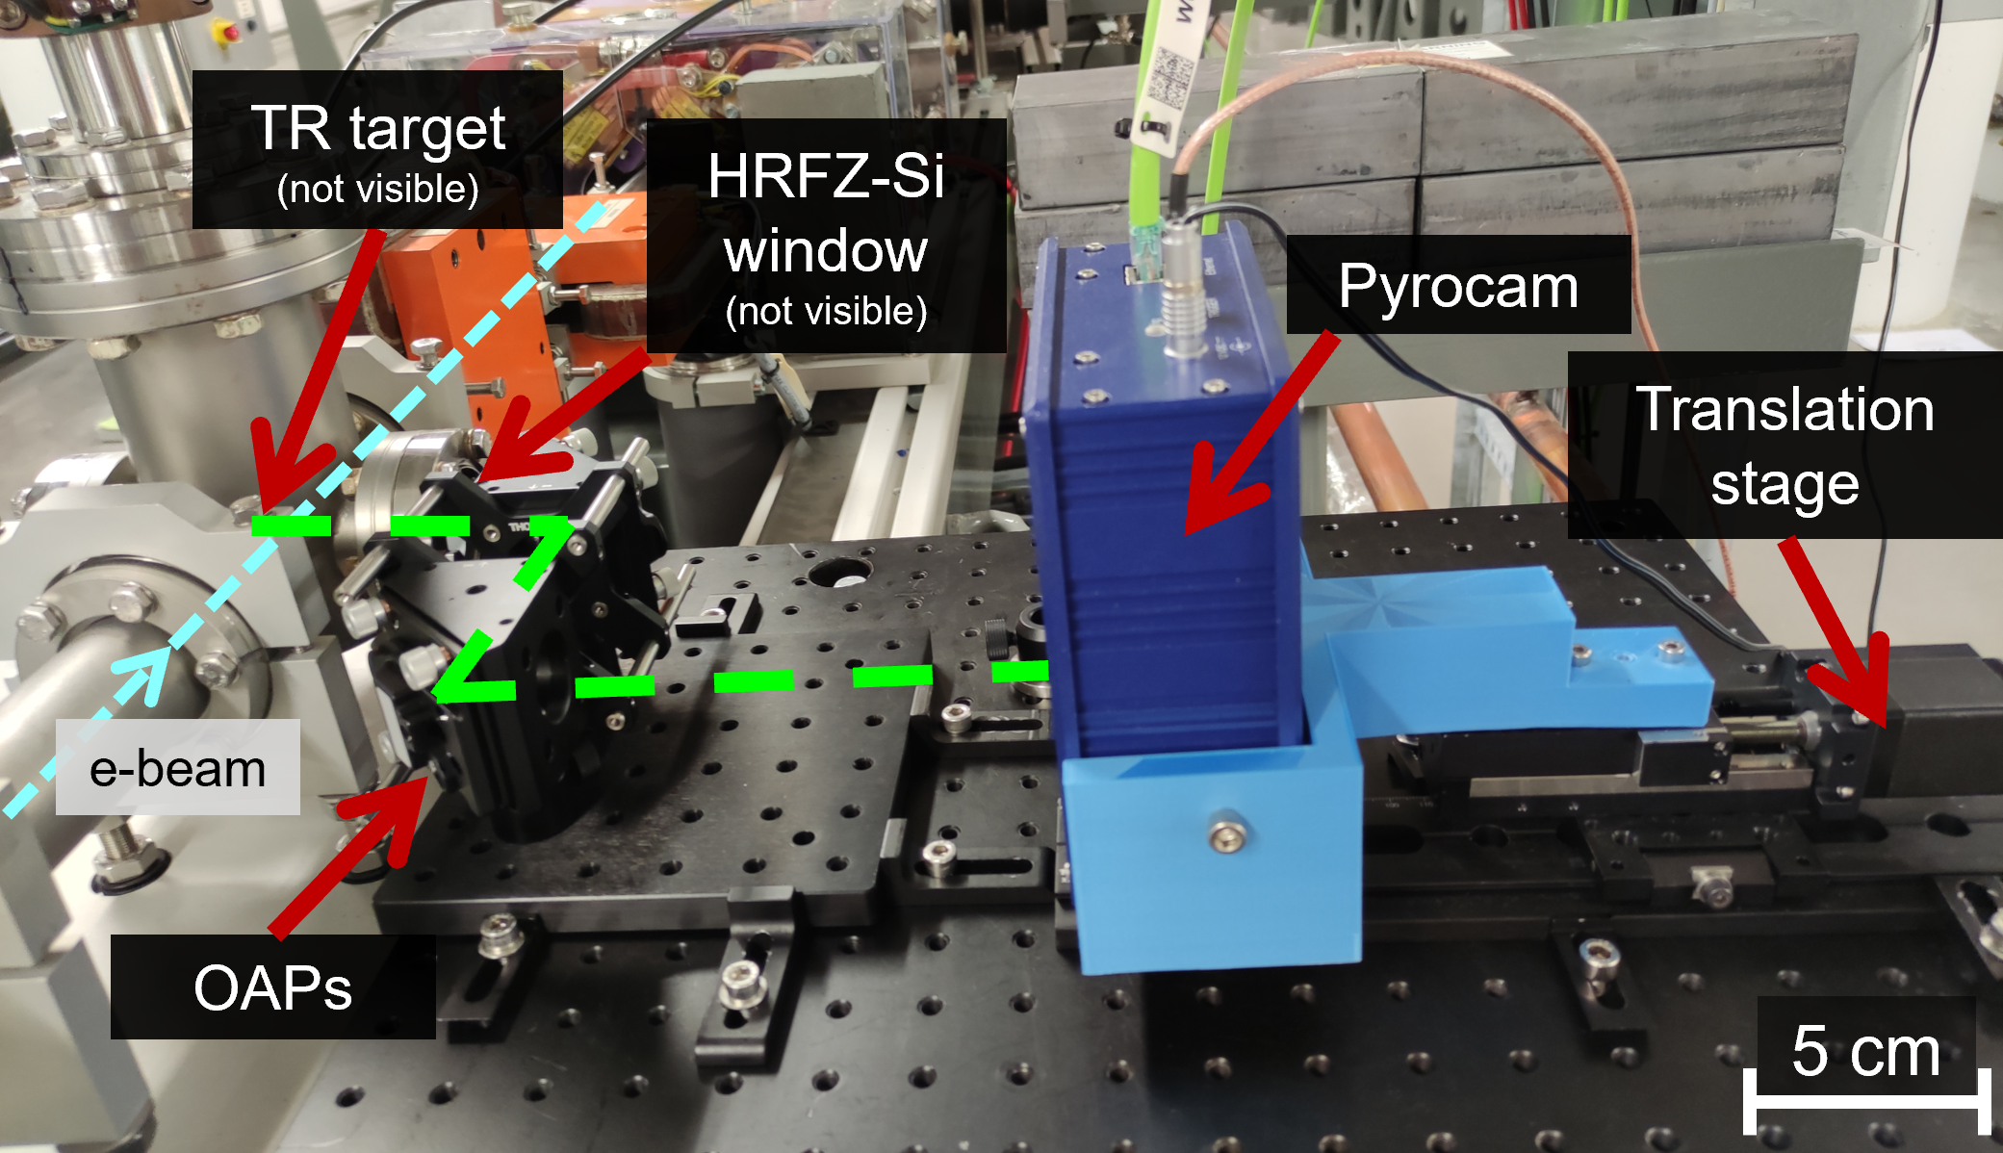
4. Results and discussion
Monitor location and installation
Figure 10. SPF data collection positions.
Figure 11. CTR imaging system at SP02.
CTR images’ location
Transverse deflecting cavity (TDC) for reference measurements
Compact system

Slide 10
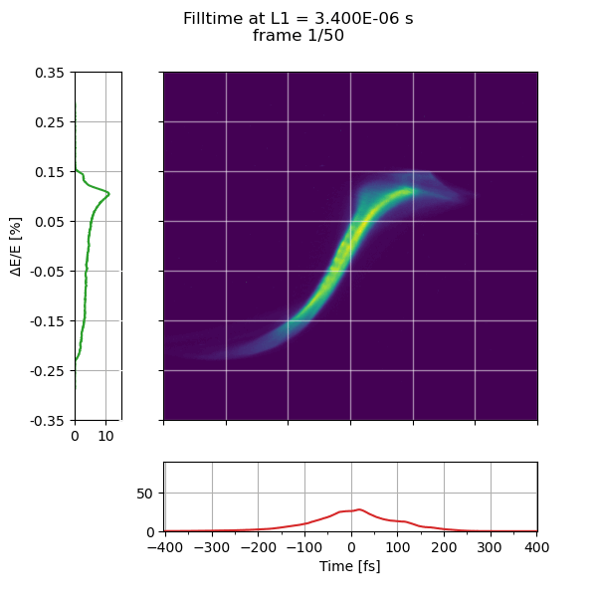
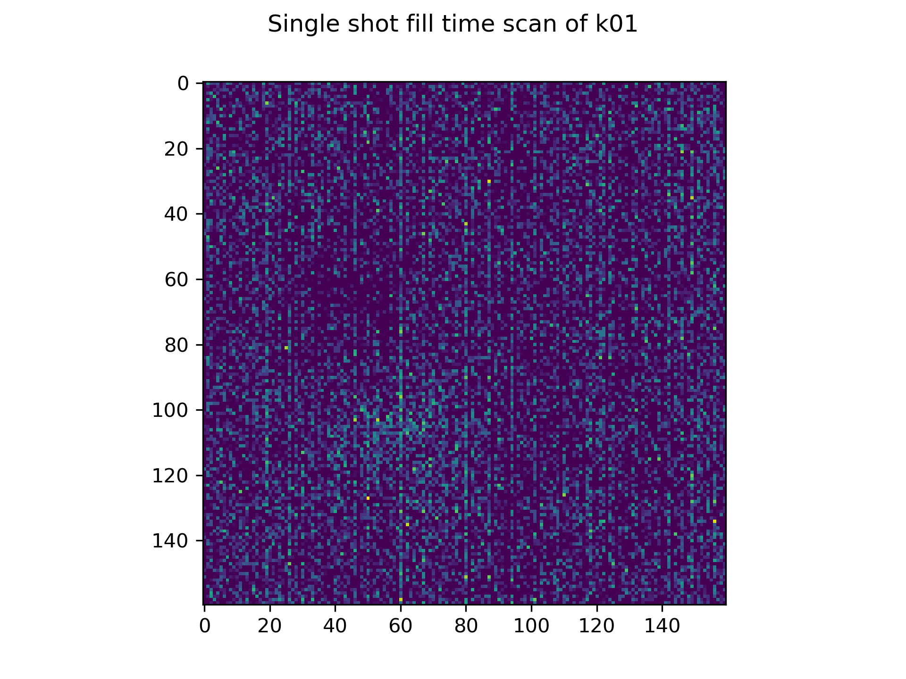
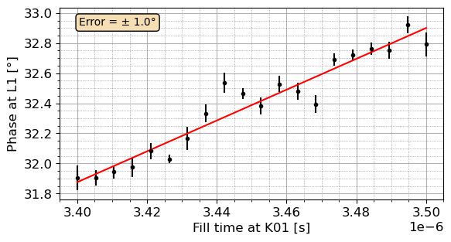
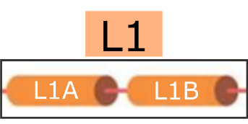
4. Results and discussion
Data collection: CTR image acquisition and reference bunch profile data
Figure 12. CTR sample phase scan at linac L1.
Figure 13. TDC reference phase scan at linac L1.
160x160 px

Slide 11
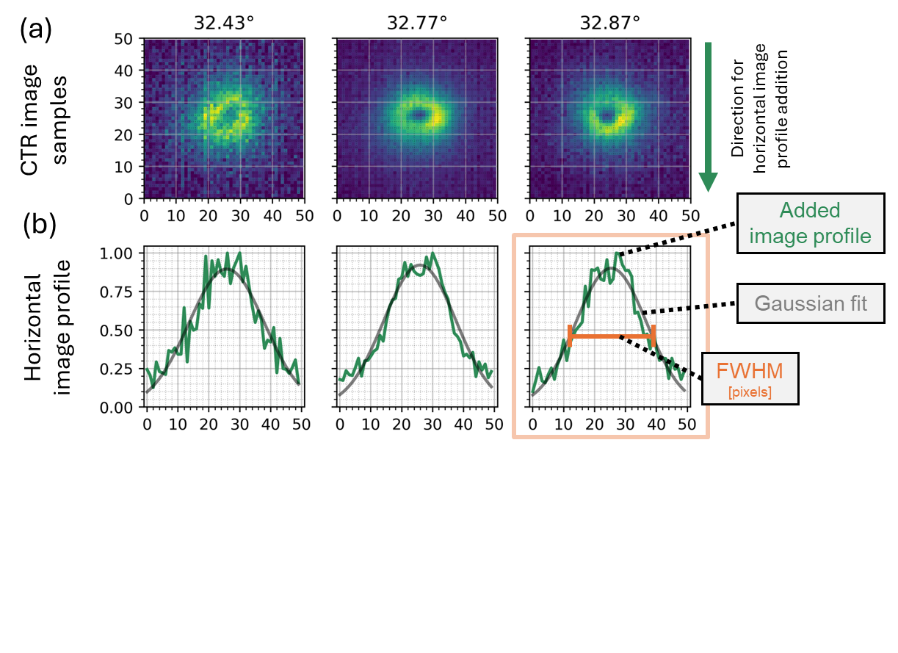
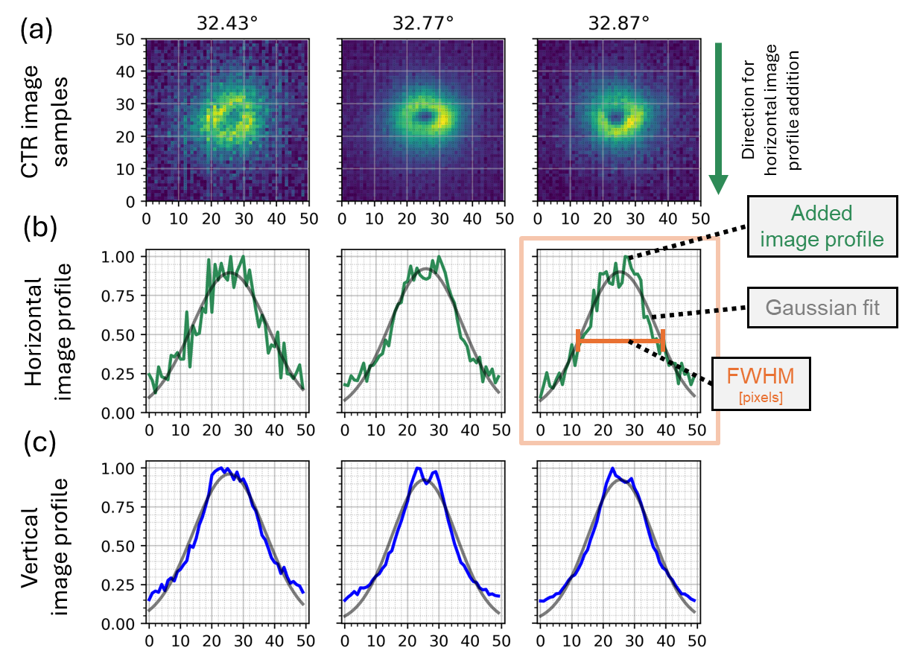
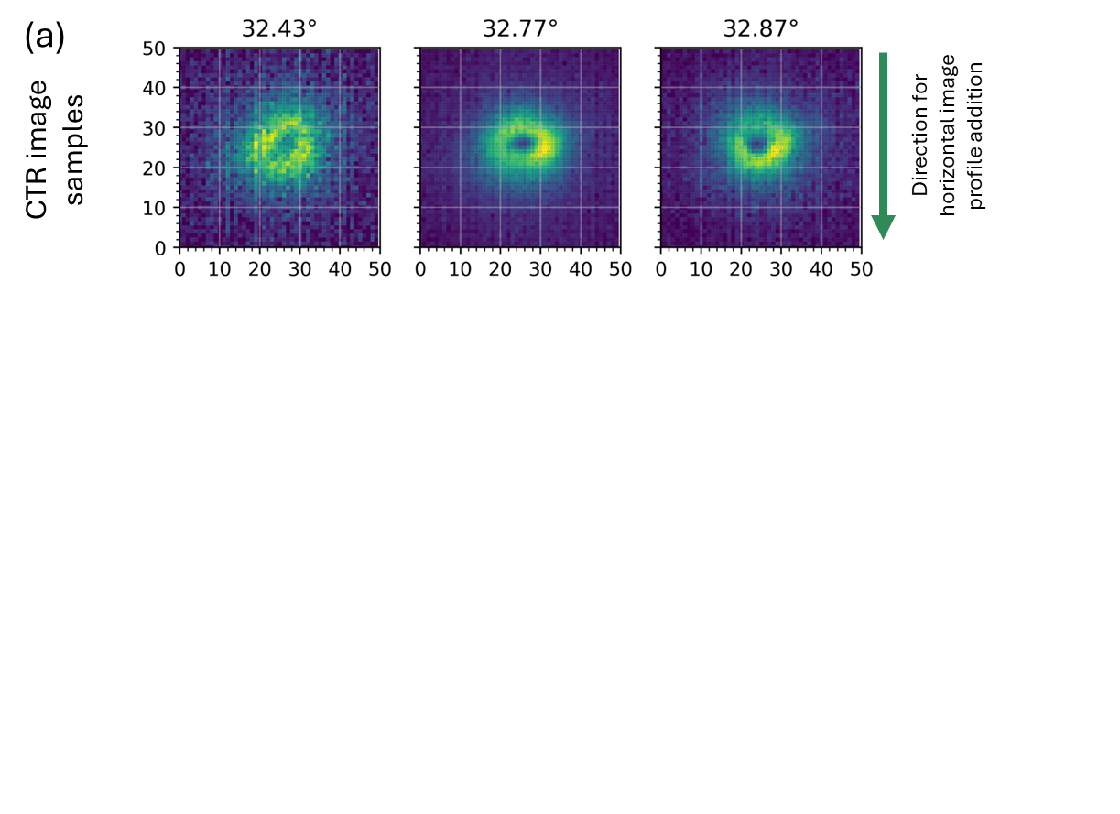
4. Results and discussion
First look at the CTR images: CTR image analysis & bunch length
Figure 14. Methodology for CTR image analysis.
Single-shot
Examples of CTR images to be analysed.
Horizontal image profiles obtained by summing pixel values vertically, fitted to Gaussians, and FWHM extracted (feature used for analysis).
Vertical image profiles.
2x magnification

Slide 12
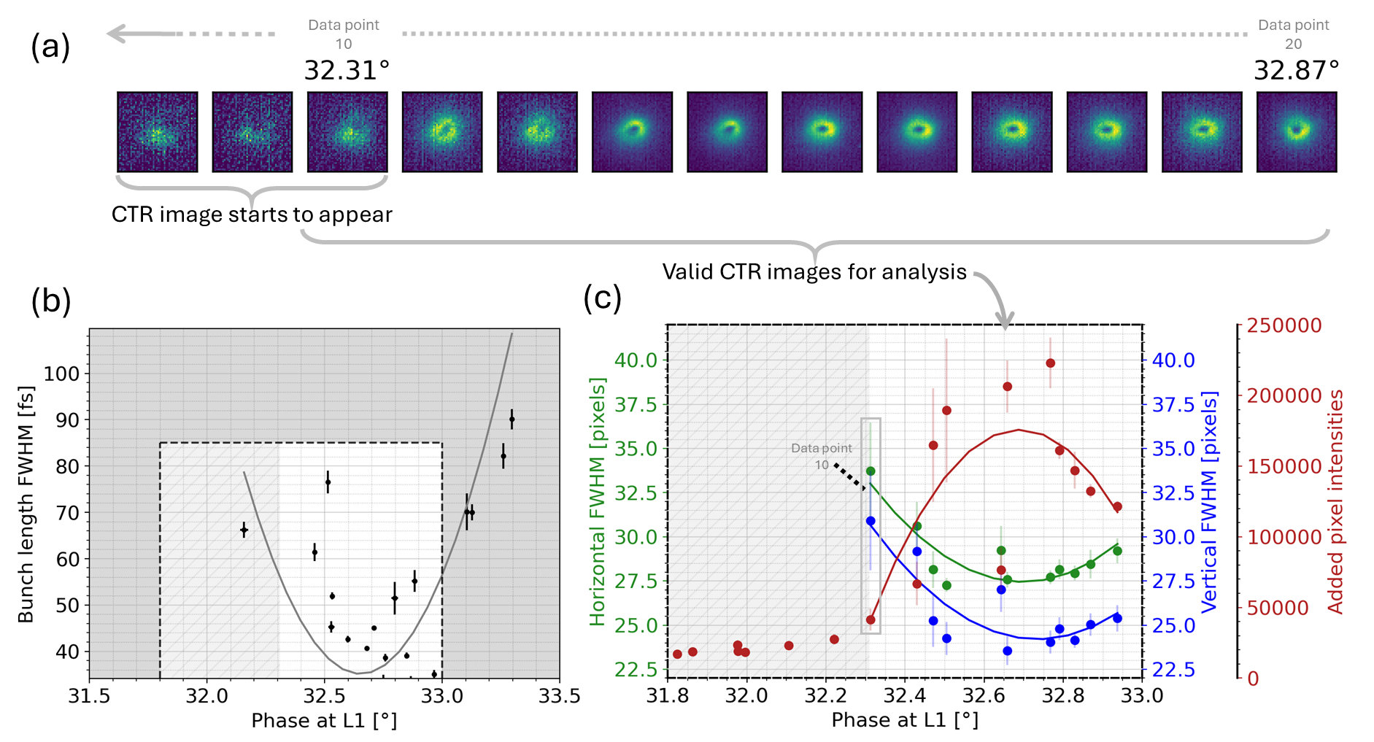
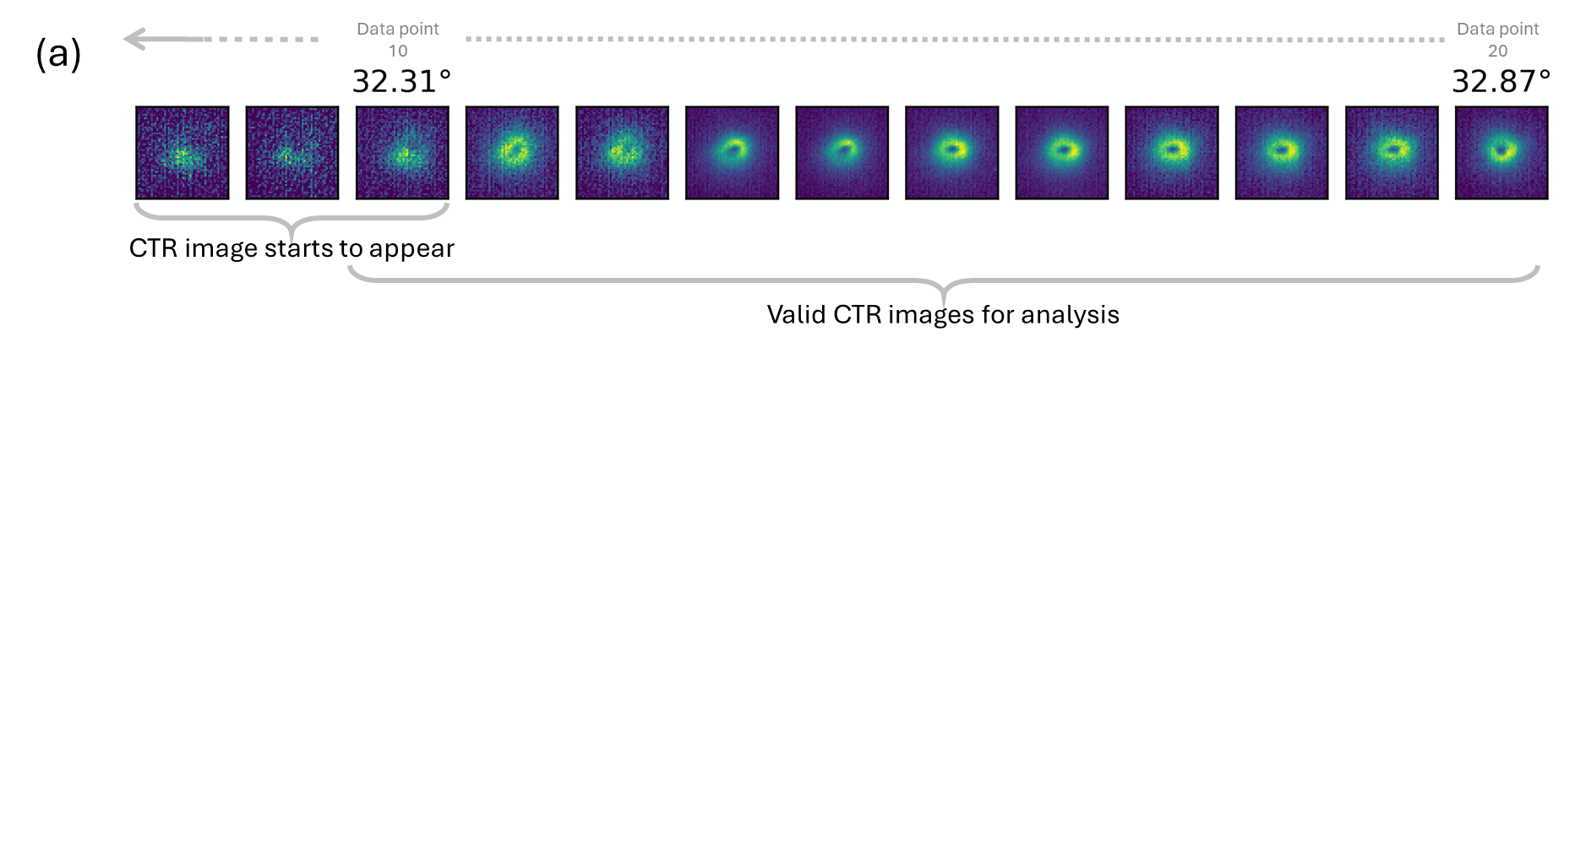
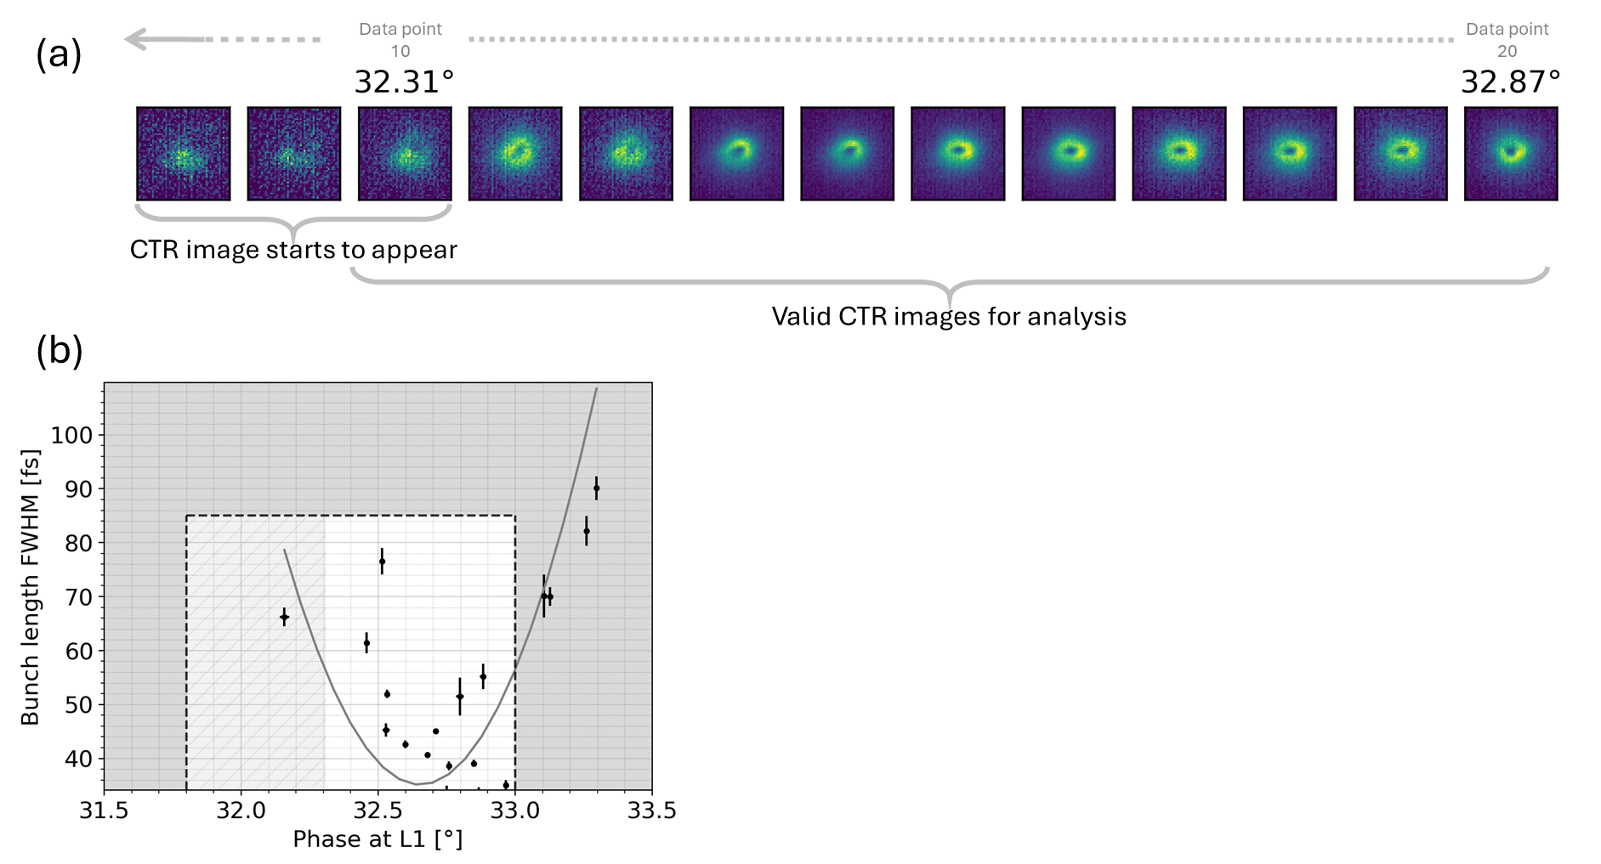
4. Results and discussion
Preliminary direct analysis of the spatial images
Figure 15. Analysis for a 1D phase scan at linac L1.
Visible CTR images within the scan range that are valid for performing the posterior analysis.
Reference bunch length variation through the phase scan from TDC measurements, reaching a point of maximum compression or waist.
Results from the CTR image analysis, which feature the FWHM changes for the image profiles in both horizontal (green) and vertical (blue) dimensions, as well as the total image intensity (red), all suggest an analogous behaviour of the bunch passing through a waist, as depicted in the reference data from (b).

Slide 13
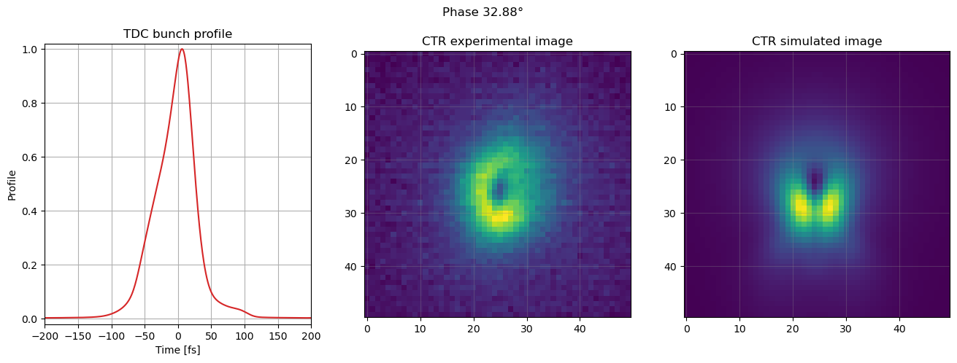
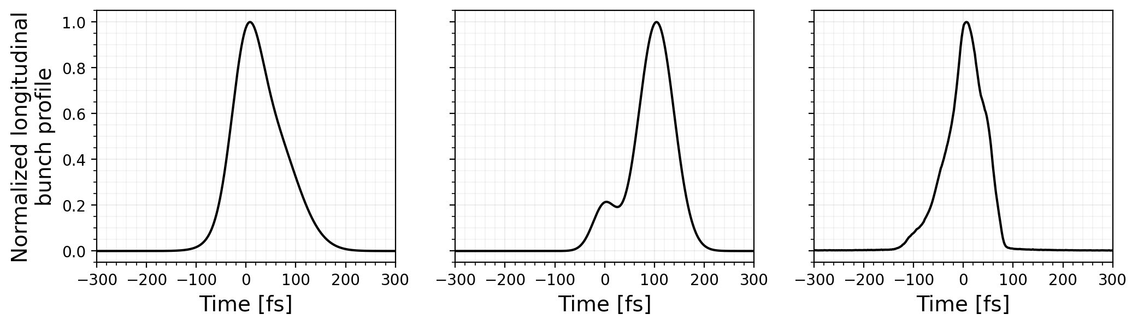
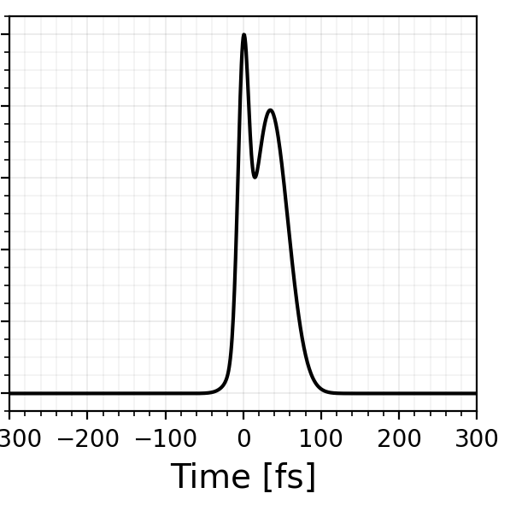
5. Next steps
Understanding further the CTR images
Next steps
Figure 16. Experimental and simulated data comparisons.
(A) Direct comparisons using simulated CTR images to get a rigorous characterization of the CTR image distributions and the corresponding bunch lengths.
How certain features of the bunch profile translate to the CTR image.
different bunch profile “shape”
different CTR images
same FWHM
+
=

Slide 14
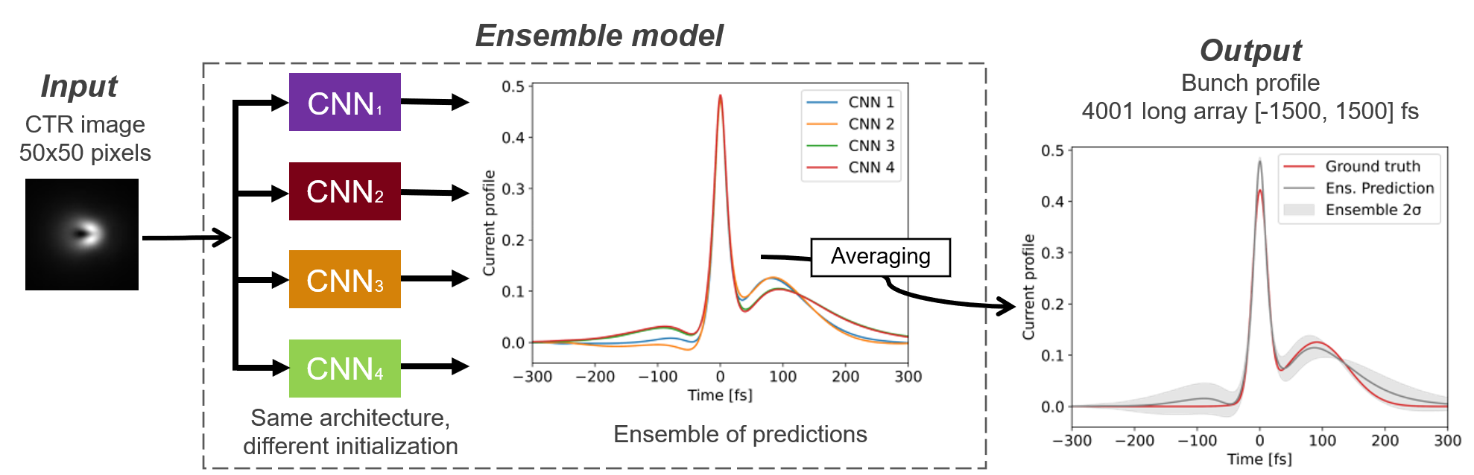
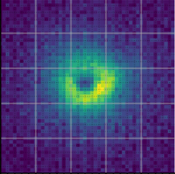
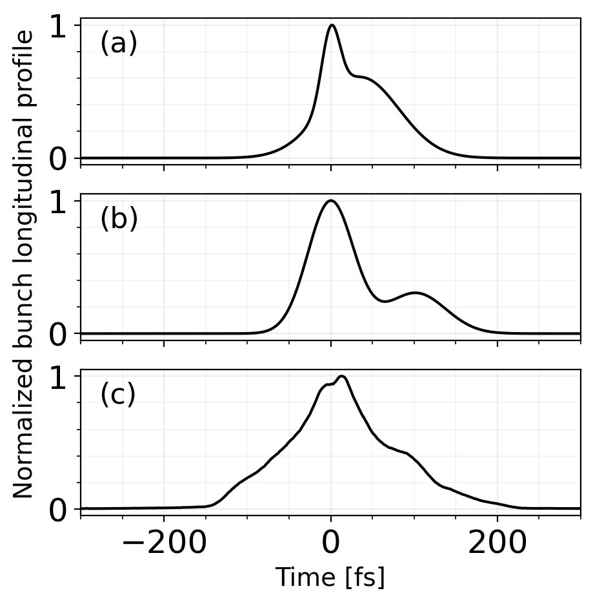
5. Next steps
Extension to bunch profile reconstruction
Figure 17. Bunch profile reconstruction deep learning workflow.
Next steps
Convolutional neural networks (CNNs)
(B) Extend to bunch profile reconstruction from the whole CTR image using deep learning.
Works for simulated CTR images for sums of Gaussian profiles.
Currently working with the experimental dataset.
experimental CTR images
reference bunch profiles from the TDC

Slide 15
References
----------------------------------------------------------------------------------------------------------------------------------------------
R. W. Assmann et al., “EuPRAXIA Conceptual Design Report,” Eur. Phys. J. Spec. Top., vol. 229, no. 24, pp. 3675–4284, Dec. 2020, doi: 10.1140/epjst/e2020-000127-8.
M. C. Downer, R. Zgadzaj, A. Debus, U. Schramm, and M. C. Kaluza, “Diagnostics for plasma-based electron accelerators,” Rev. Mod. Phys., vol. 90, no. 3, p. 35002, 2018, doi: 10.1103/RevModPhys.90.035002.
Curcio et al., “Non-invasive bunch length measurements exploiting Cherenkov diffraction radiation,” Phys. Rev. Accel. Beams, vol. 23, no. 2, p. 22802, 2020, doi: 10.1103/PhysRevAccelBeams.23.022802.
Davut et al., “Design and experimental verification of a bunch length monitor based on coherent Cherenkov diffraction radiation,” Phys. Rev. Res., vol. 7, no. 1, p. 13193, 2025, doi: 10.1103/PhysRevResearch.7.013193.
H. Yamada et al., “Study of Coherent Smith–Purcell Radiation in the Terahertz Region Using Ultra-Short Electron Bunches,” Particles, vol. 6, no. 3, pp. 693–702, 2023, doi: 10.3390/particles6030042.
B. Schmidt, N. M. Lockmann, P. Schmüser, and S. Wesch, “Benchmarking coherent radiation spectroscopy as a tool for high-resolution bunch shape reconstruction at free-electron lasers,” Phys. Rev. Accel. Beams, vol. 23, no. 6, p. 62801, 2020, doi: 10.1103/PhysRevAccelBeams.23.062801.
N. M. Lockmann, C. Gerth, B. Schmidt, and S. Wesch, “Non-invasive THz spectroscopy for bunch current profile reconstructions at MHz repetition rates,” Phys. Rev. Accel. Beams, vol. 23, no. 11, p. 112801, 2020, doi: 10.1103/PhysRevAccelBeams.23.112801.
S. Wesch, B. Schmidt, C. Behrens, H. Delsim-Hashemi, and P. Schmüser, “A multi-channel THz and infrared spectrometer for femtosecond electron bunch diagnostics by single-shot spectroscopy of coherent radiation,” Nucl. Instruments Methods Phys. Res. Sect. A Accel. Spectrometers, Detect. Assoc. Equip., vol. 665, pp. 40–47, 2011, doi: 10.1016/j.nima.2011.11.037.
M. Heigoldt et al., “Temporal evolution of longitudinal bunch profile in a laser wakefield accelerator,” Phys. Rev. Spec. Top. - Accel. Beams, vol. 18, no. 12, pp. 1–6, 2015, doi: 10.1103/PhysRevSTAB.18.121302.
S. I. Bajlekov et al., “Longitudinal electron bunch profile reconstruction by performing phase retrieval on coherent transition radiation spectra,” Phys. Rev. Spec. Top. - Accel. Beams, vol. 16, no. 4, pp. 1–14, 2013, doi: 10.1103/PhysRevSTAB.16.040701.
O. Zarini et al., “Multioctave high-dynamic range optical spectrometer for single-pulse, longitudinal characterization of ultrashort electron bunches,” Phys. Rev. Accel. Beams, vol. 25, no. 1, pp. 1–19, 2022, doi: 10.1103/PhysRevAccelBeams.25.012801.
F. G. Bisesto, M. Castellano, E. Chiadroni, and A. Cianchi, “Zemax simulations describing collective effects in transition and diffraction radiation,” Opt. Express, vol. 26, no. 4, p. 5075, 2018, doi: 10.1364/oe.26.005075.
J. Wolfenden, C. P. Welsch, T. H. Pacey, and A. Shkvarunets, “Coherent Transition Radiation Spatial Imaging As a Bunch Length Monitor,” pp. 2713–2716, 2019, doi: 10.18429/JACoW-IPAC2019-WEPGW095.
A. G. Shkvarunets and R. B. Fiorito, “Vector electromagnetic theory of transition and diffraction radiation with application to the measurement of longitudinal bunch size,” Phys. Rev. Spec. Top. - Accel. Beams, vol. 11, no. 1, p. 012801, Jan. 2008, doi: 10.1103/PhysRevSTAB.11.012801.
V. E. Rogalin, I. A. Kaplunov, and G. I. Kropotov, “Optical Materials for the THz Range,” Opt. Spectrosc., vol. 125, no. 6, pp. 1053–1064, 2018, doi: 10.1134/S0030400X18120172.
S. Sung et al., “THz optical design considerations and optimization for medical imaging applications,” Terahertz Emit. Receiv. Appl. V, vol. 9199, p. 91990S, 2014, doi: 10.1117/12.2062403.
C. Brückner, G. Notni, and A. Tünnermann, “Optimal arrangement of 90° off-axis parabolic mirrors in THz setups,” Optik (Stuttg)., vol. 121, no. 1, pp. 113–119, 2010, doi: 10.1016/j.ijleo.2008.05.024.
N. Chopra and J. Lloyd-Hughes, “Optimum Optical Designs for Diffraction-Limited Terahertz Spectroscopy and Imaging Systems Using Off-Axis Parabolic Mirrors,” J. Infrared, Millimeter, Terahertz Waves, vol. 44, no. 11–12, pp. 981–997, 2023, doi: 10.1007/s10762-023-00949-8.

Slide 16
Thank you!
Any questions?
Ana Guisao-Betancur^{1,2}, Joseph Wolfenden^{1,2}, Erik Mansten³, Sara Thorin³, Johan Lundquist³, Oliver Grimm³, Carsten Welsch^{1,2}
A.M.Guisao-Betancur@liverpool.ac.uk
¹. Department of Physics, University of Liverpool, Liverpool L69 7ZX, UK
². Cockcroft Institute, Sci-Tech Daresbury, Daresbury WA4 4AD, UK
³. MAX IV Laboratory, Lund University, Lund 224 84, Sweden

