Slide 1
SHIP
Carl Gwilliam
21st May 2026
HEP Annual Meeting

Slide 2
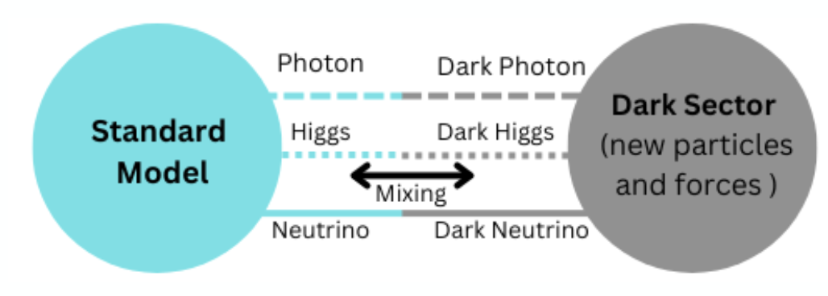
Motivation
We know SM can’t be complete e.g. dark matter (DM), dark energy, BAU, …
  But there are no significant signs of new physics (NP) at the energy frontier
On the other hand, many BSM theories predict new light, feebly interacting particles (FIPs)
  Hidden sector (HS): DM is part of a more complex NP sector, interacting with SM via mediator/portal
Such feeble coupling tends to lead to long lifetimes
  Giving rise to long-lived particles (LLPs) that may evade GPDs
Efficiently exploring the FIPs phase space needs dedicated experiments
  Transverse or forward of colliders, such as FASER at the LHC
  At proton beam dumps, such as the Search for Hidden Sector Particles (SHiP) at the SPS …
  Vector Portal e.g dark γ
  Scalar Portal e.g. dark H
  Pseudoscalars Portal e.g. ALPs
  Fermion Portal e.g HNLs

Slide 3
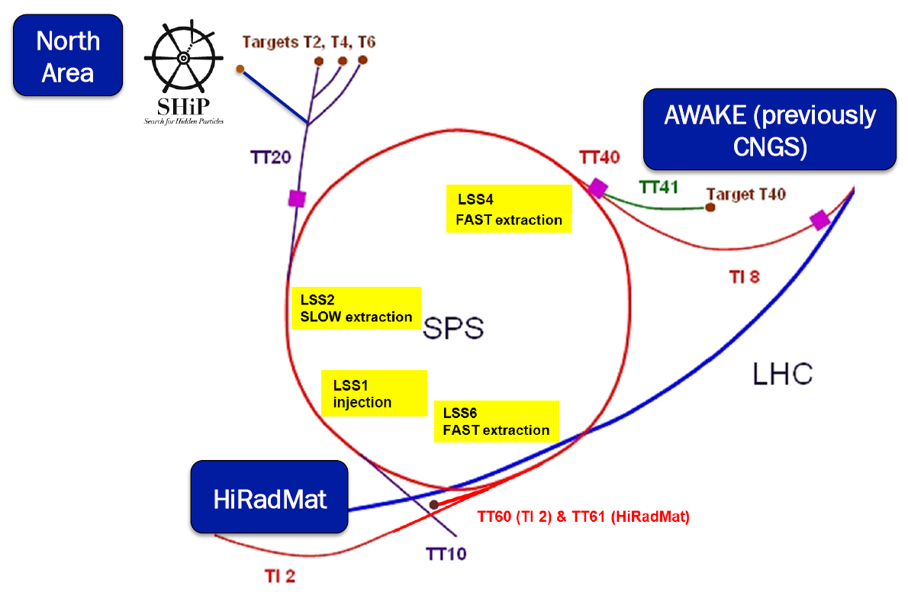
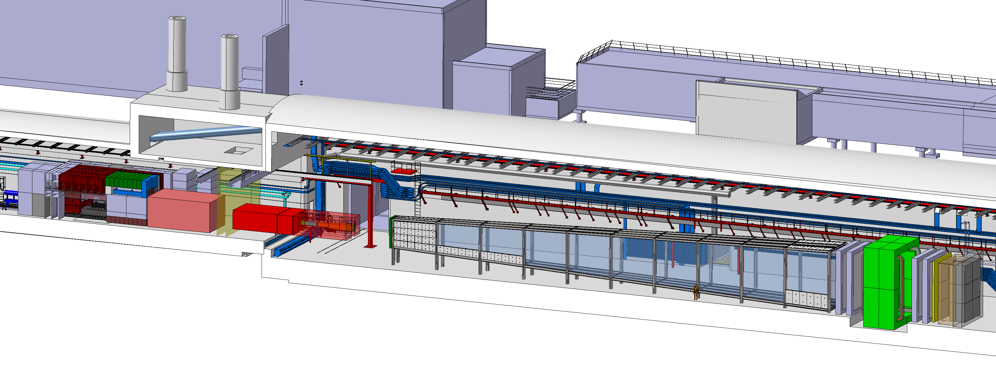
Experiment
SHIP is an approved experiment at the upgraded ECN3 facility in the SPS North Area
  Liverpool officially joined in July 2025 with small fractions of several people
    Carl (TL), Themis, Christos Joe, Saskia, Eduardo, Dave S, John C, Tim J
Spectrometer
(tracker, PID + calo)
Hadron
absorber
p
Target
Muon
shields
Neutrino
detector
Decay volume
Plan to start operation in last year of run 4 (2032) before upgrades over LS4 for run 5 (2036-41)
  Aiming to collect 6 x 10²⁰ protons on target at 400 GeV with near zero background.

Slide 4
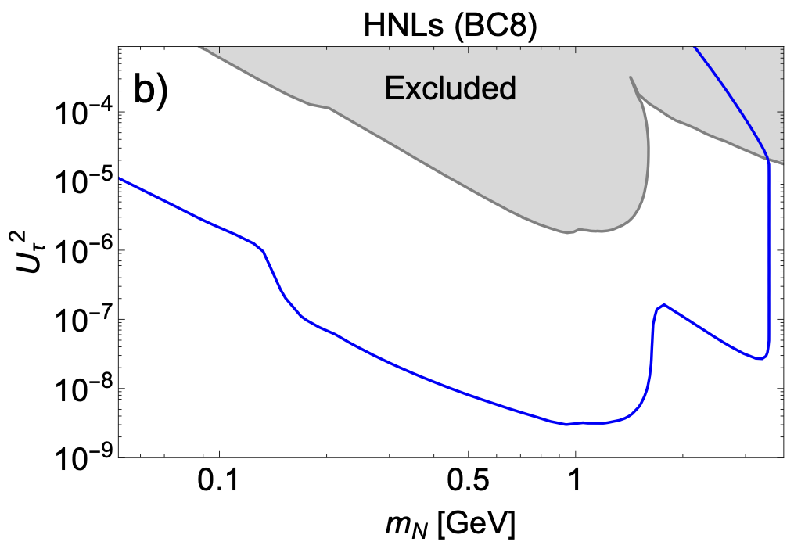
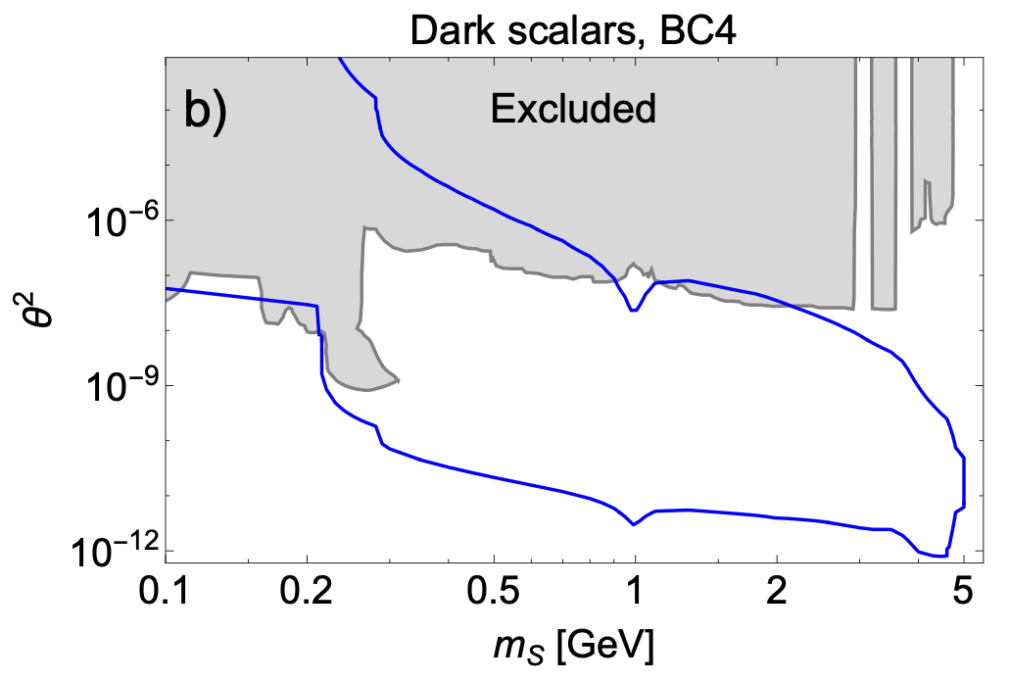
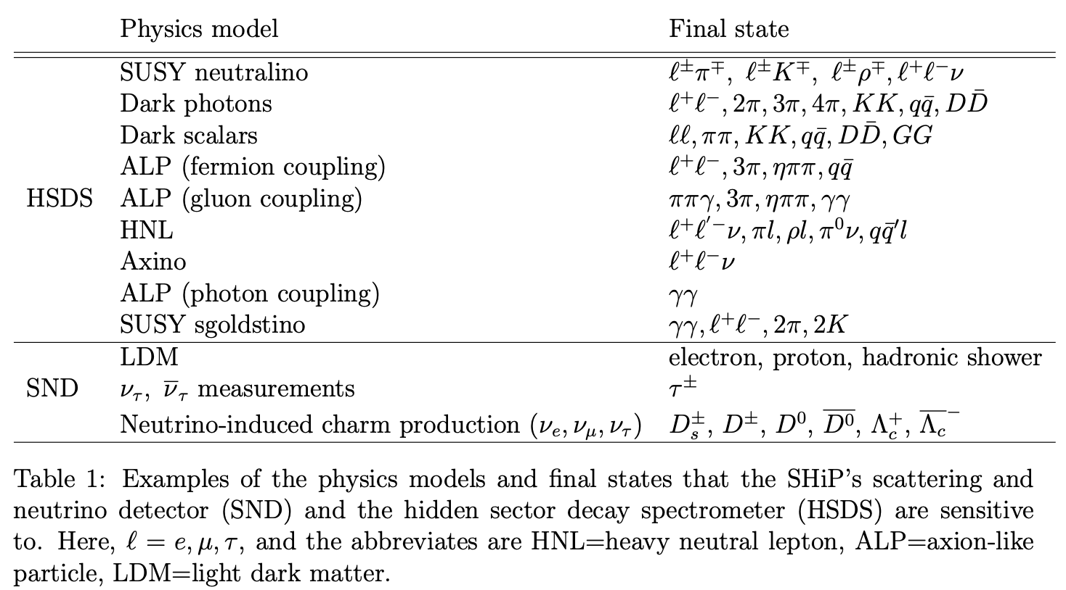
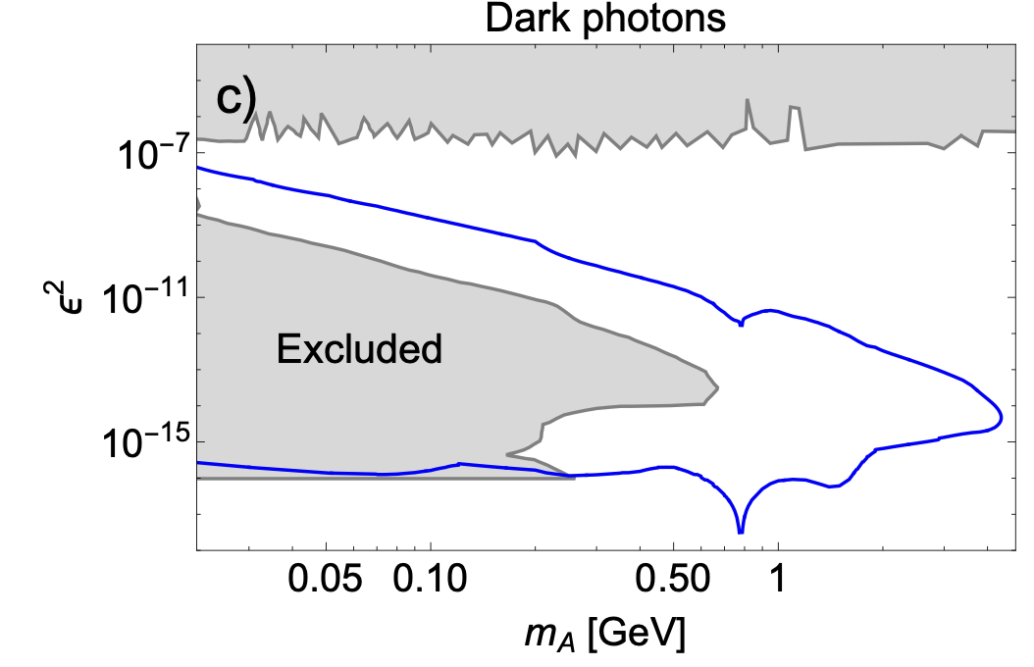
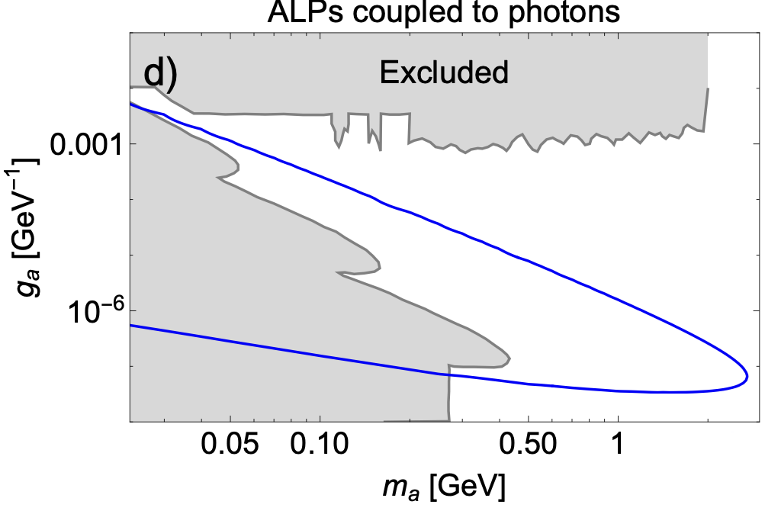
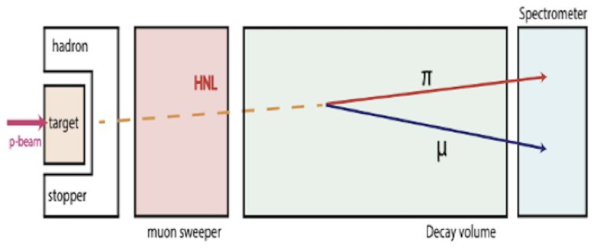
Physics: Decay Spectrometer
Slamming 400 GeV protons into target produces copious D/B mesons
  These could decay immediately into FIPs in narrow solid angle, which are reco’d via their decay back to SM particles
Significant new coverage in wide variety of HS models for m < 5 GeV (assuming can achieve 0 background)

Slide 5
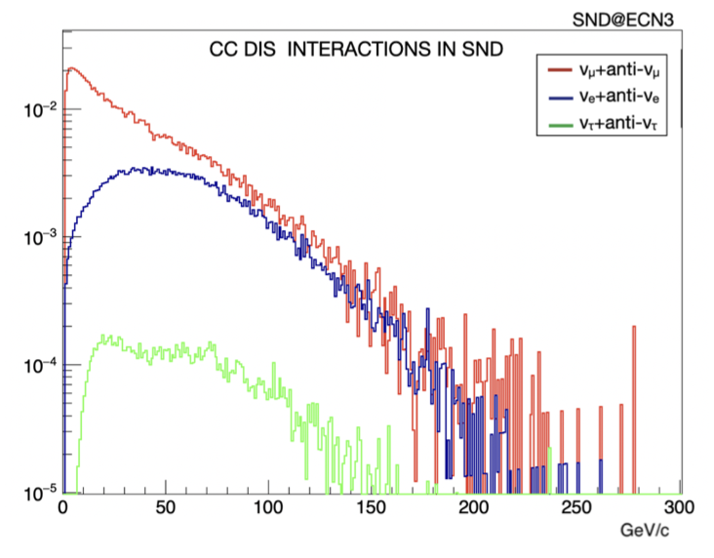
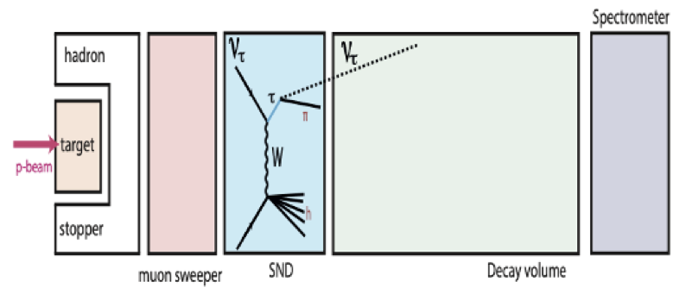
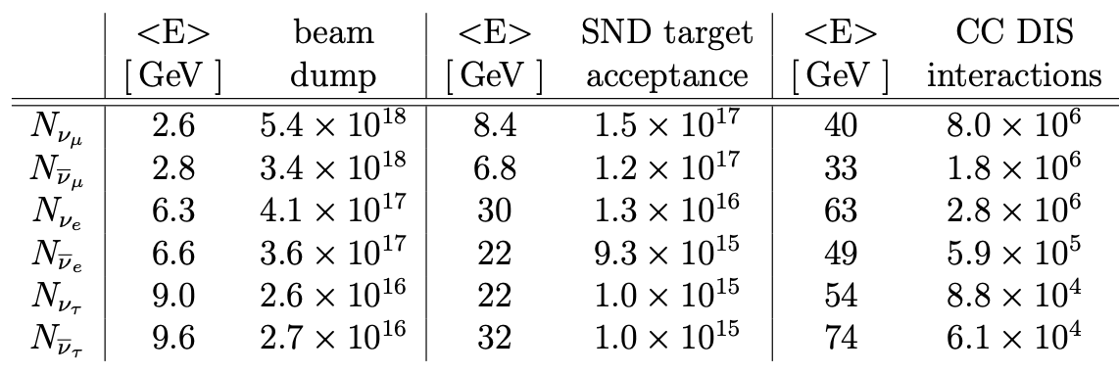
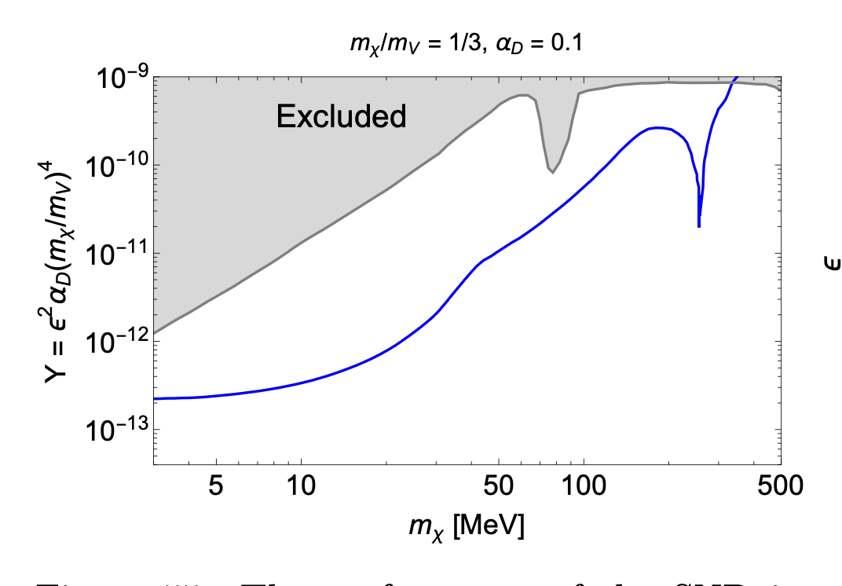
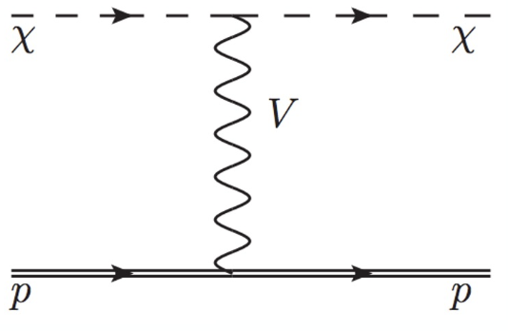

Physics Reach: Neutrino detector
Protons interactions in target also produce copious number of multi-GeV energy neutrinos
  Detected via dedicated scattering neutrino detector (SND) upstream of decay volume
  Allows in depth studies such as ν-induced charm production + detailed ν_{τ} measurements
Also acts as target for light (sub-GeV) DM searches
  Scatters of nucleon or electron via mediator
    E.g. DM scattering off electron via A’
Further details in updated SHiP proposal
  CERN-SPSC-2023-033
e
e

Slide 6
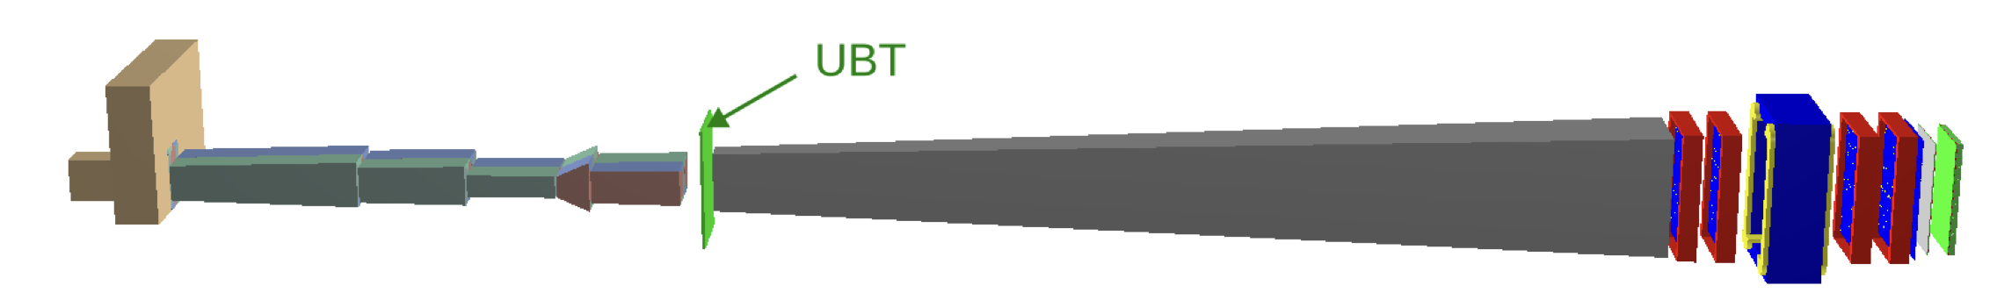
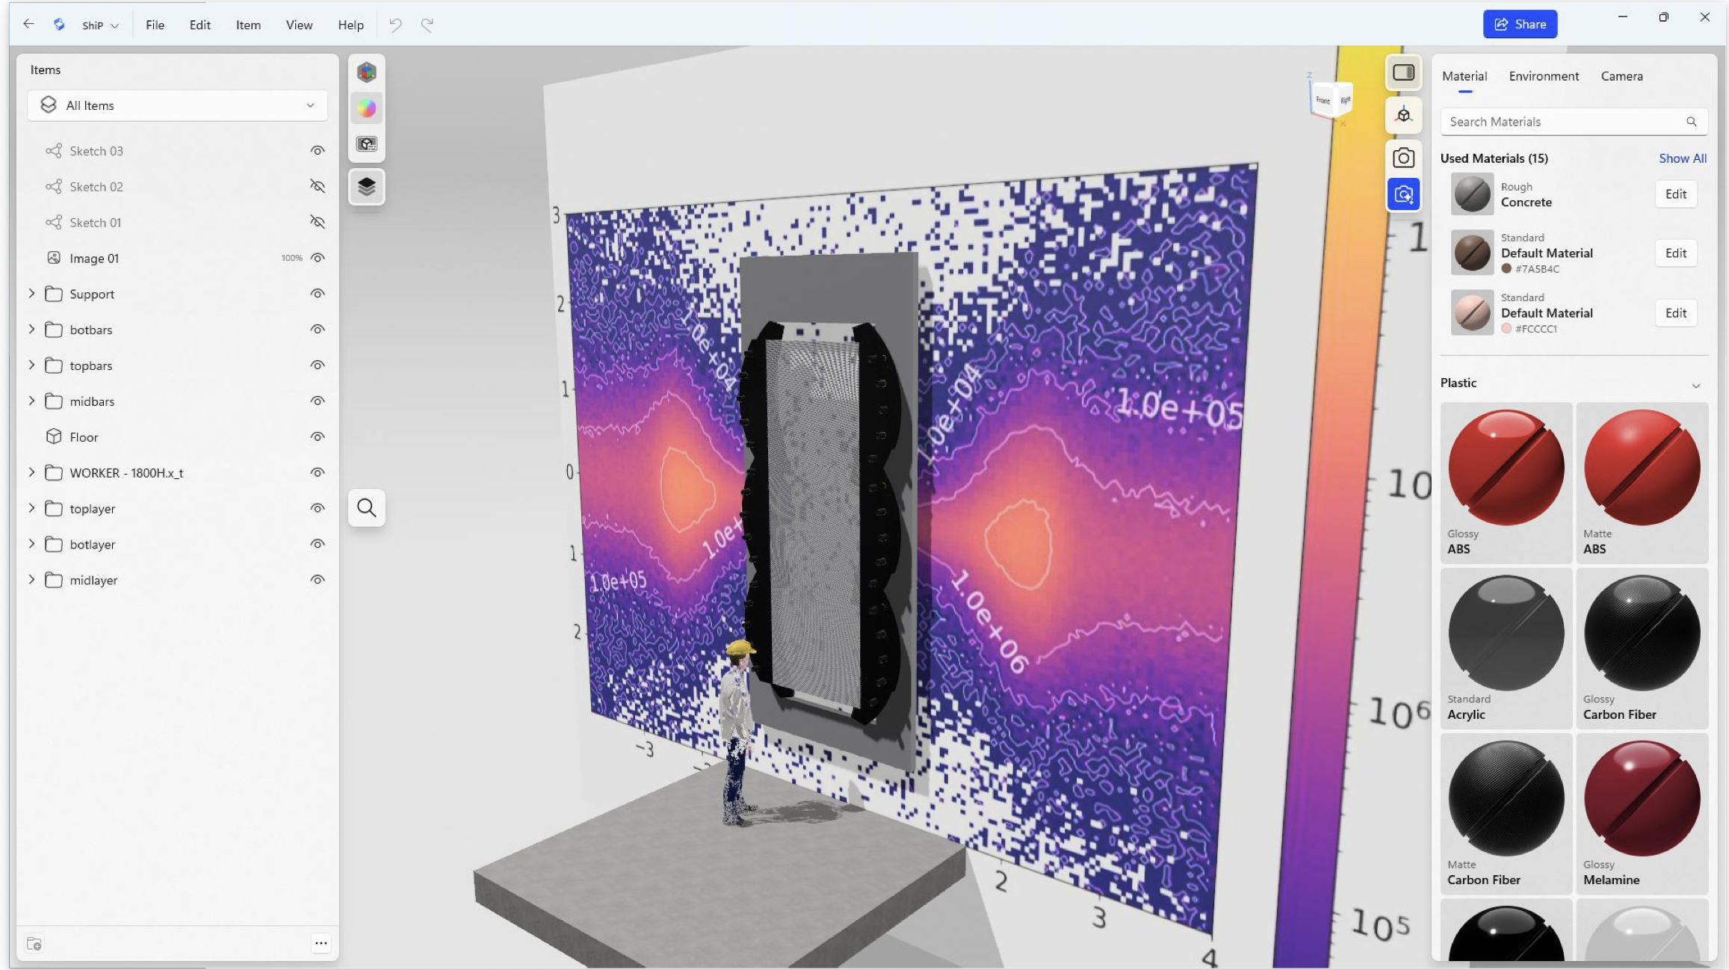
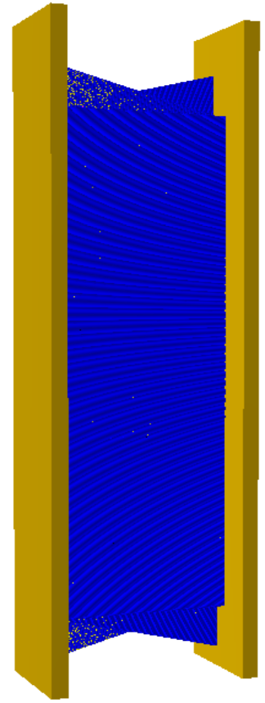
Liverpool Involvement
SHiP design being simplified to reduce complexity and save money
  He rather than vacuum in decay volume → harder to veto background
  Replace emulsion SND with electronic detector → more space upstream
Liverpool have proposed Upstream Background Tracker (UBT) as part of veto system
  Straw tracker utilising on our experience from g-2
Also contributing to offline software
  e.g. sim, track reco, B-field, infrastructure
Longer term interest mostly in FIPs searches
  But potentially also in neutrino measurements

Slide 7

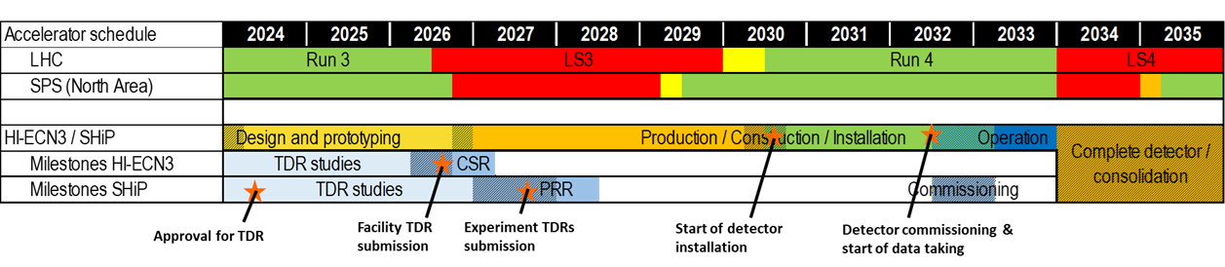
Summary
Liverpool joined SHiP experiment to search for FIPs
  And potentially measure neutrinos
Investigating potential upstream straw veto tracker
  Dependent on (non-STFC) funding
Timeline is tight, with TDRs needed by next year
  Aim to contribute here, utilising project students

