Slide 1
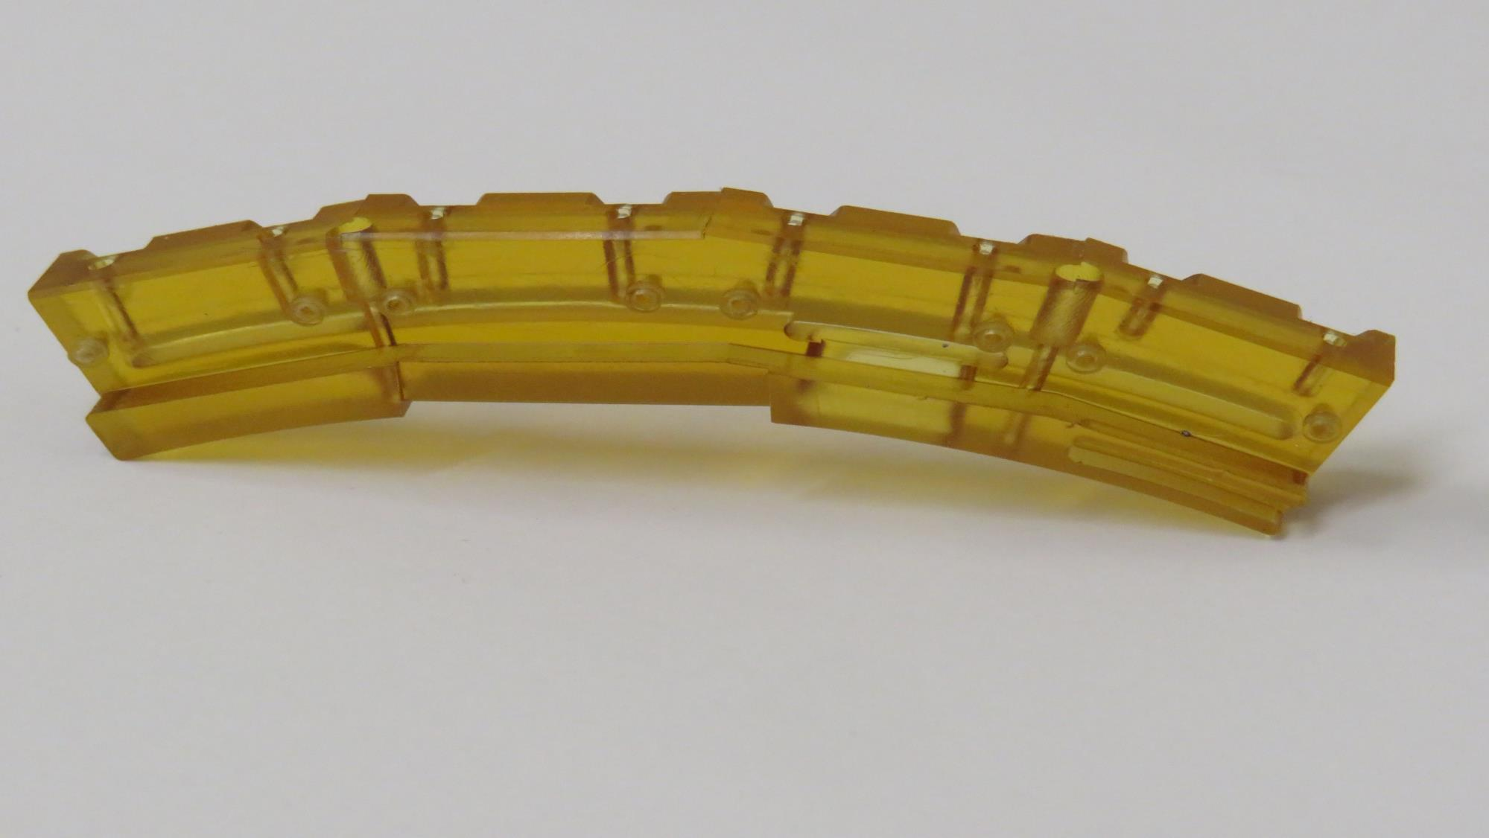

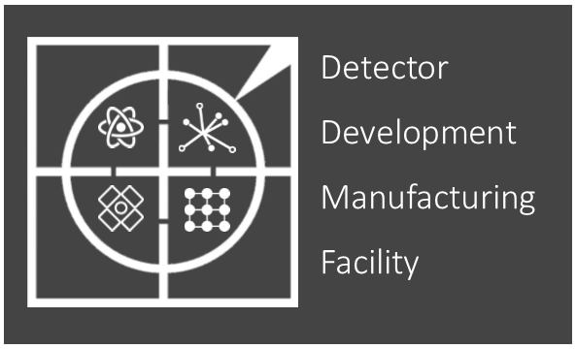
2025-26 Review
Mark Whitley

Slide 2
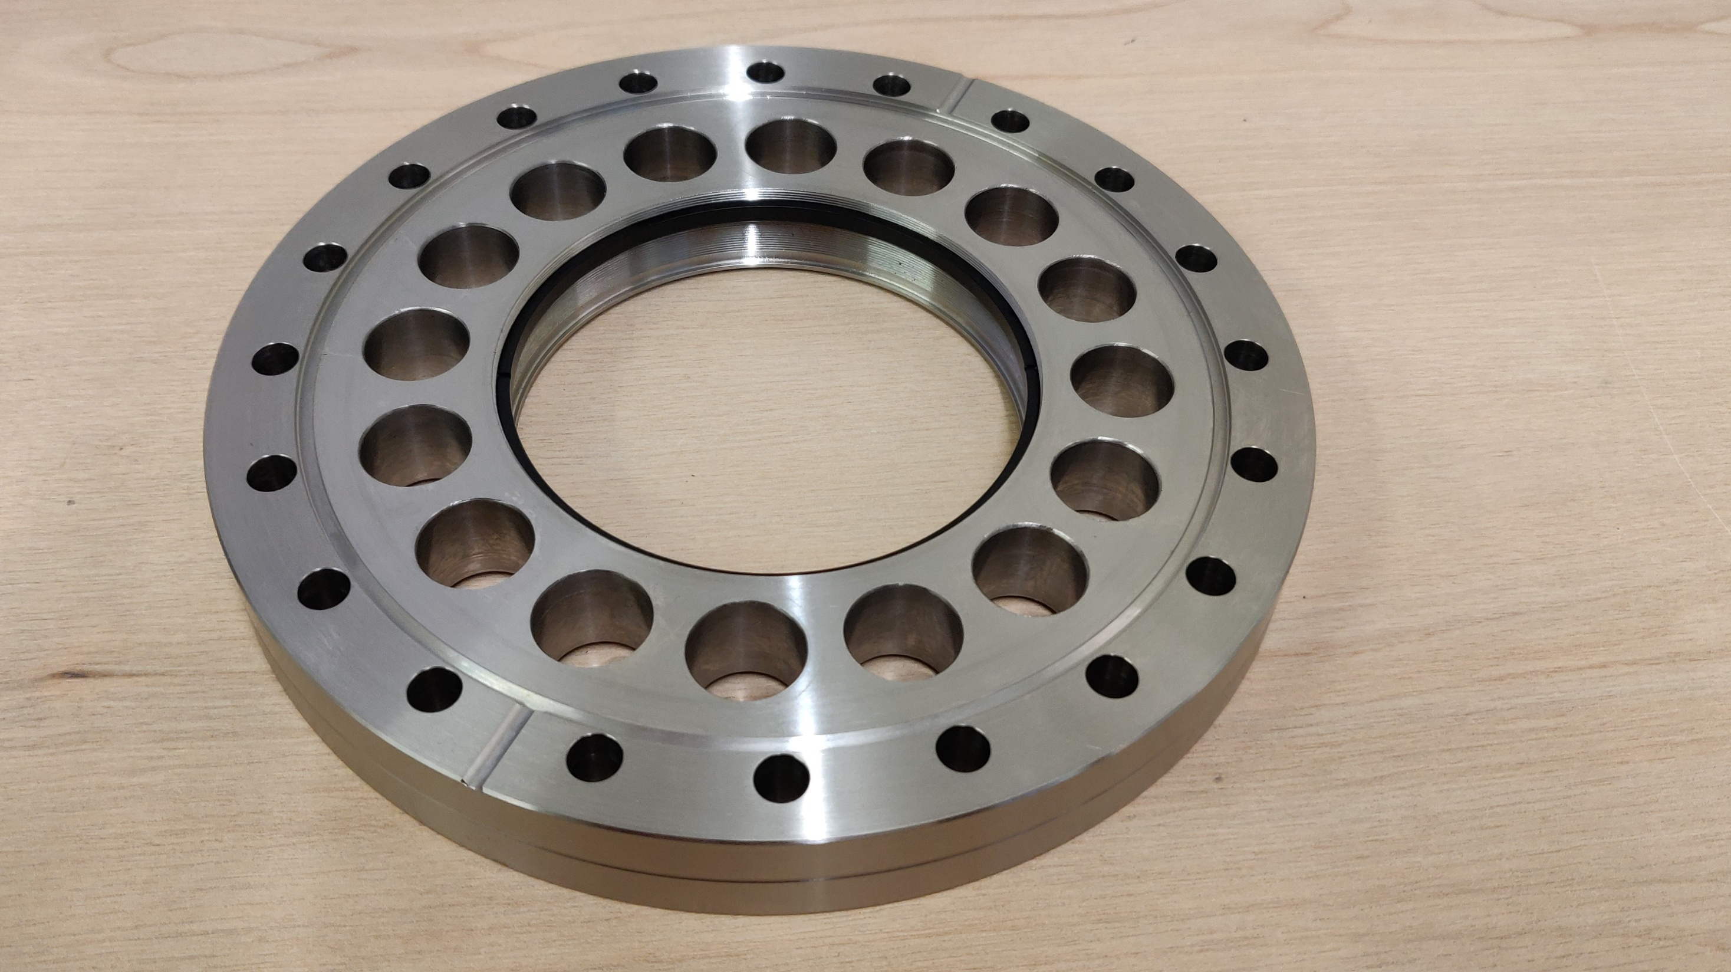
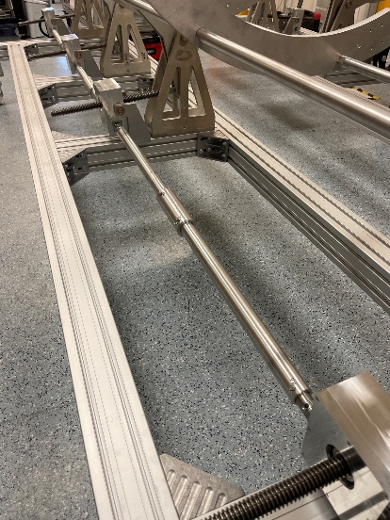
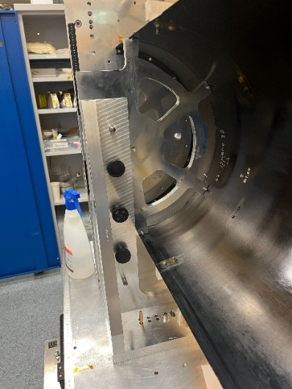
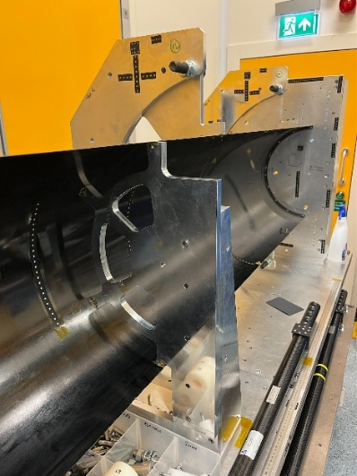
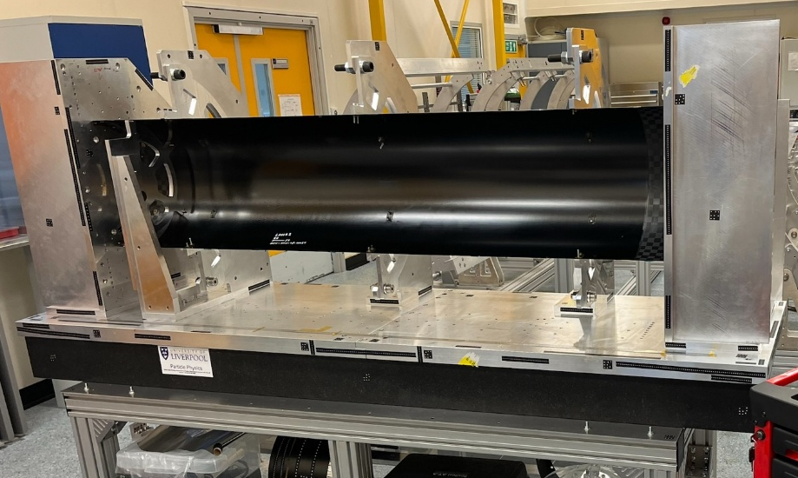
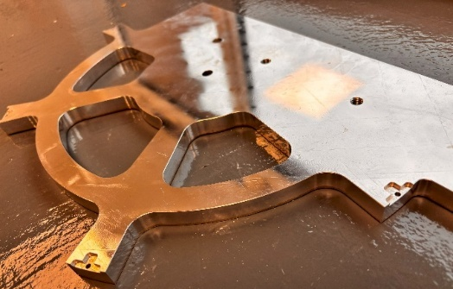
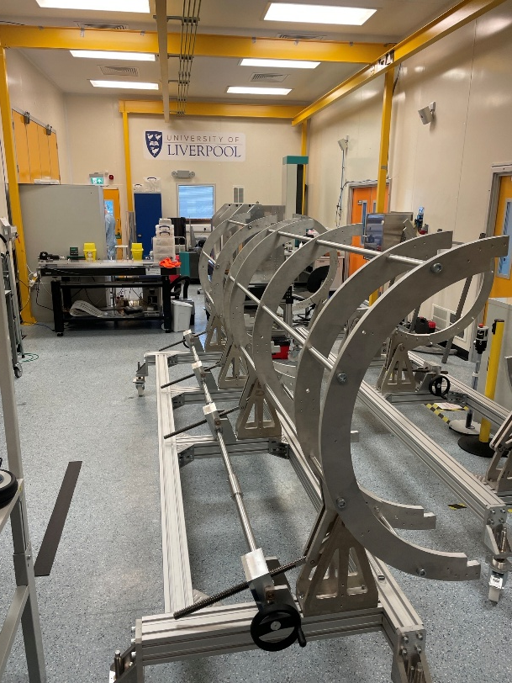
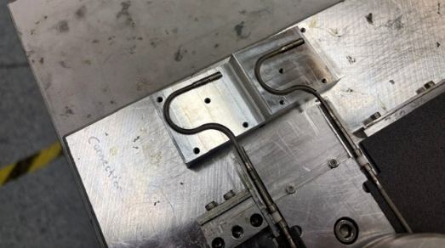
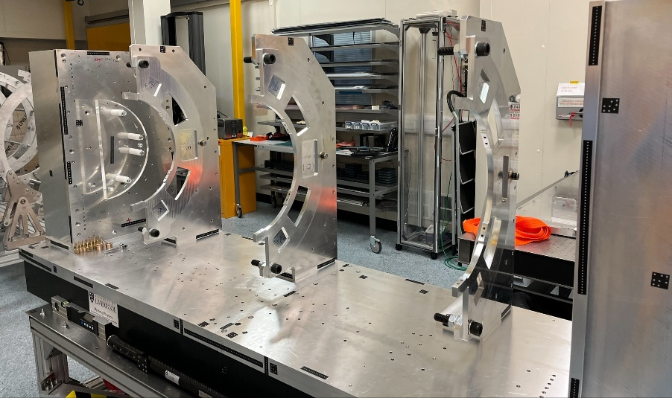
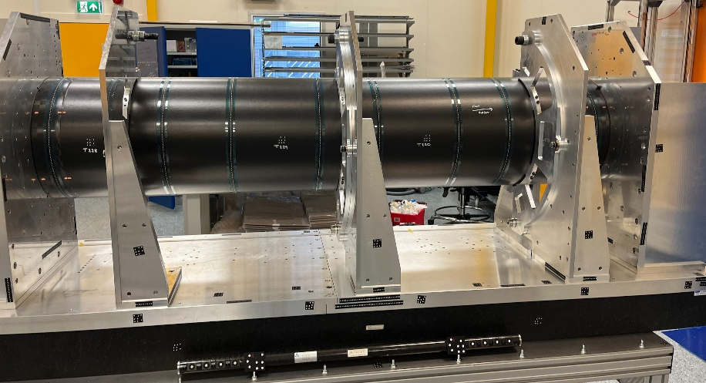
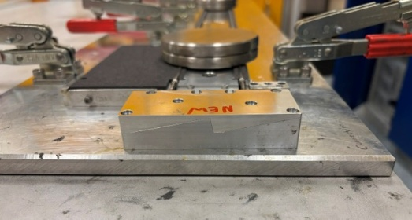
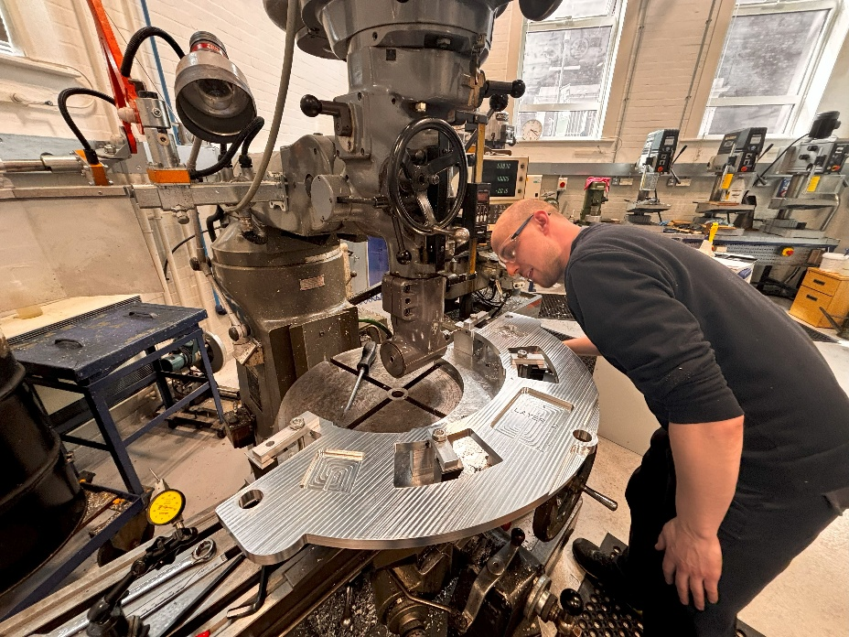
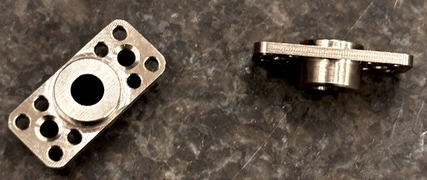
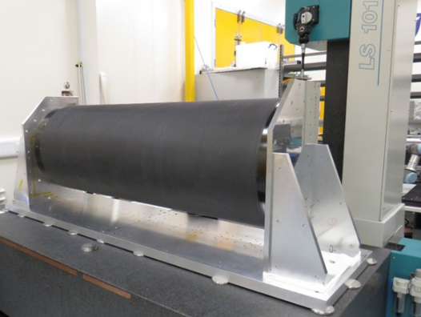
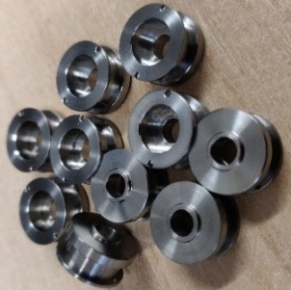
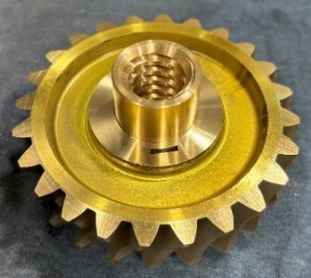
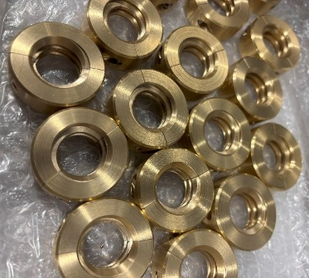
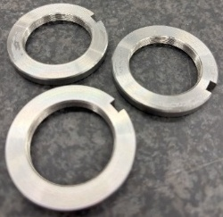
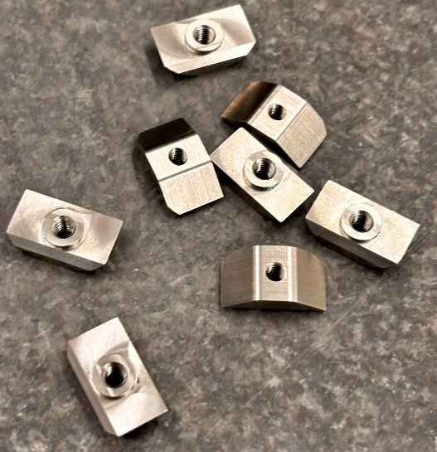
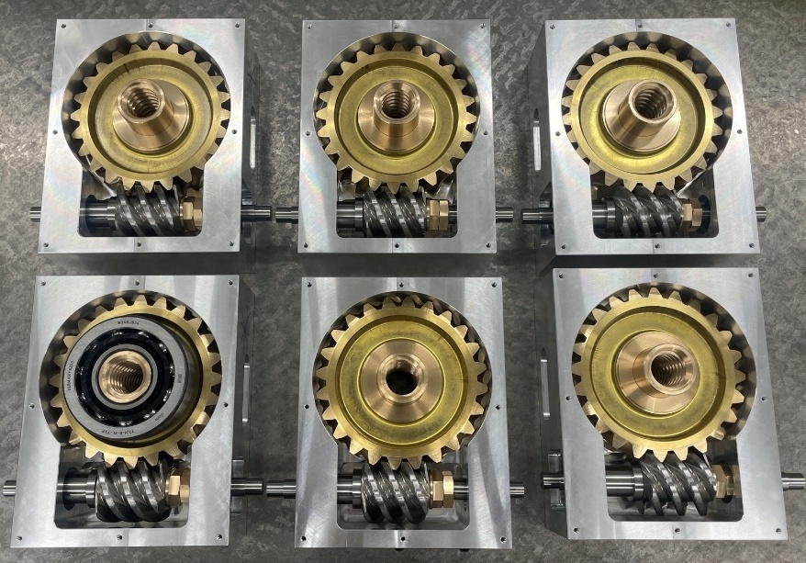
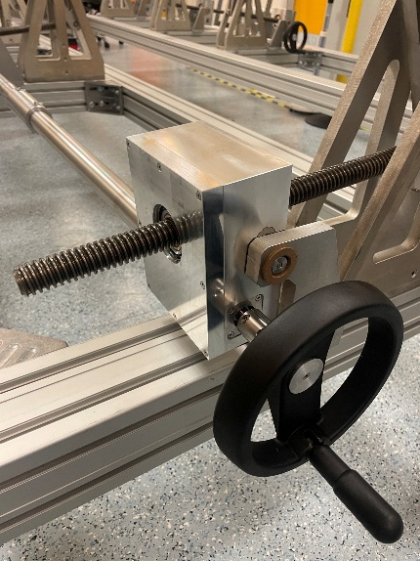
Showcase
A selection of Atlas components

Slide 3
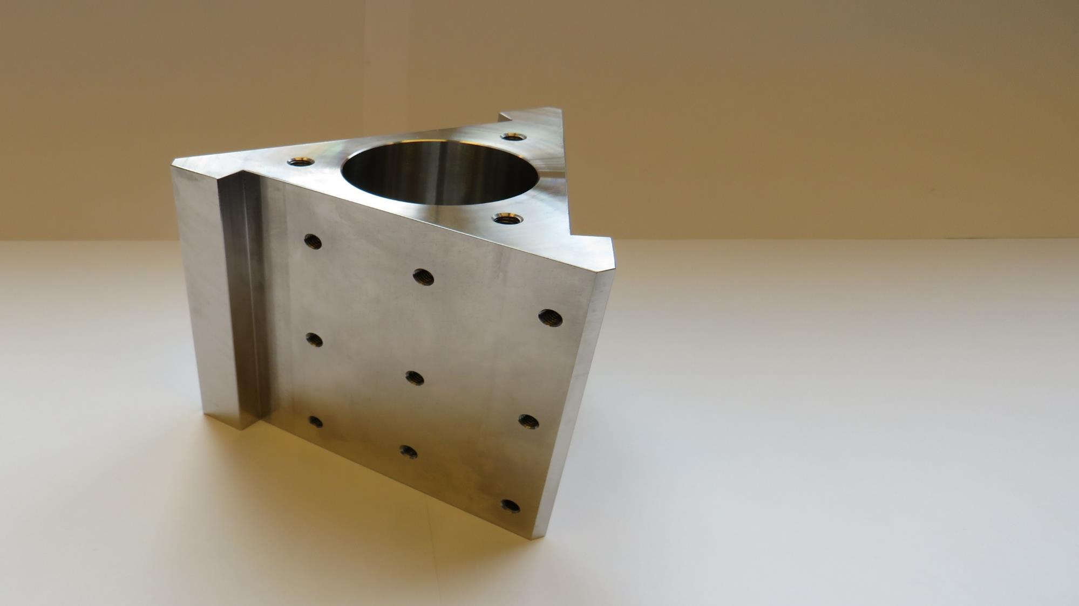
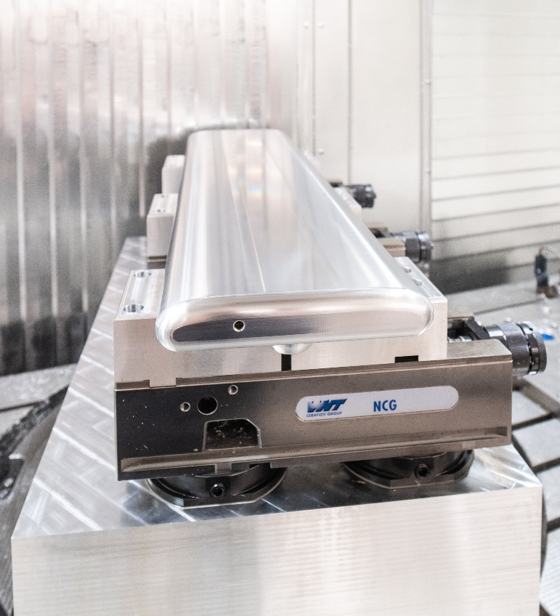
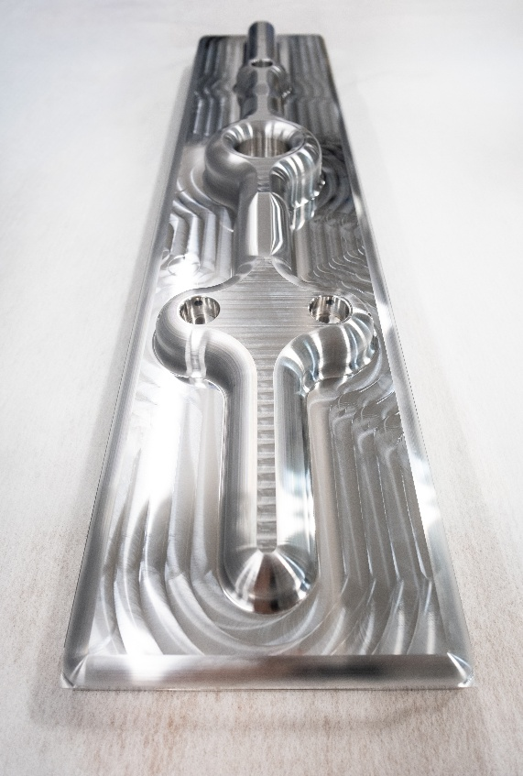
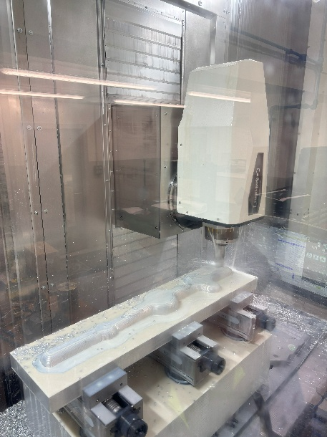
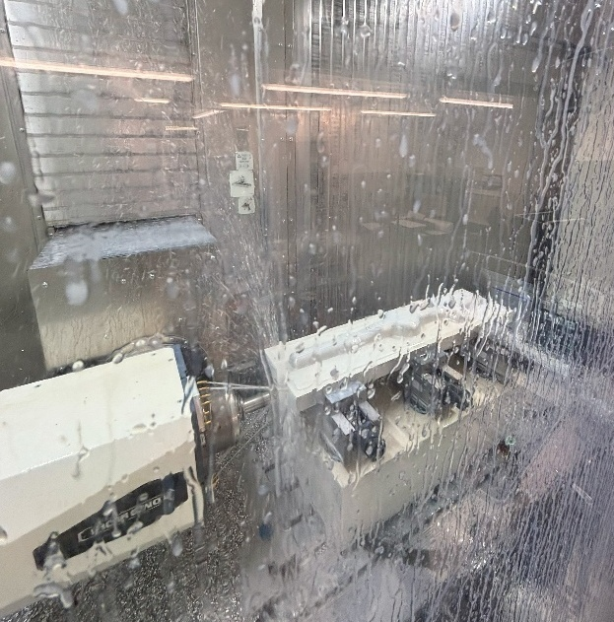
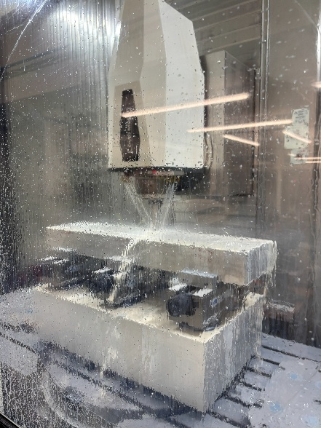
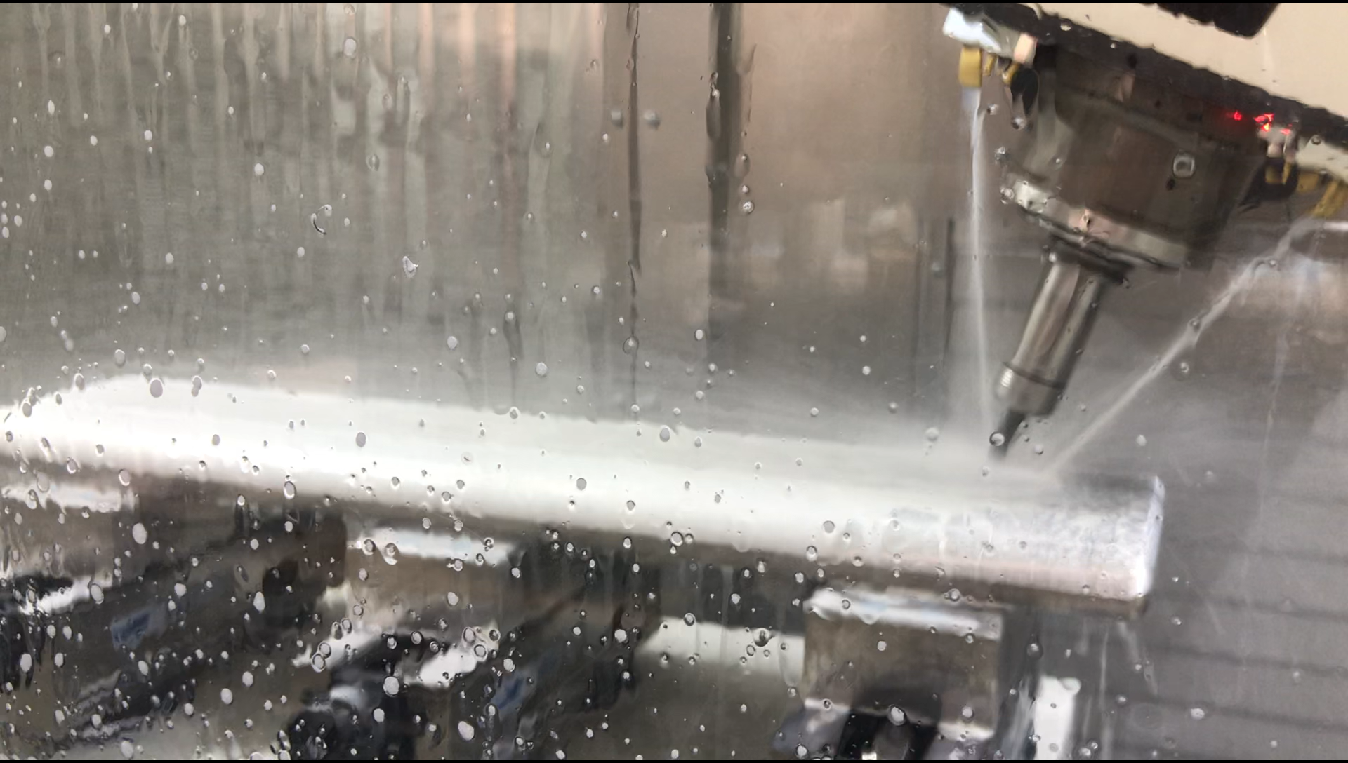
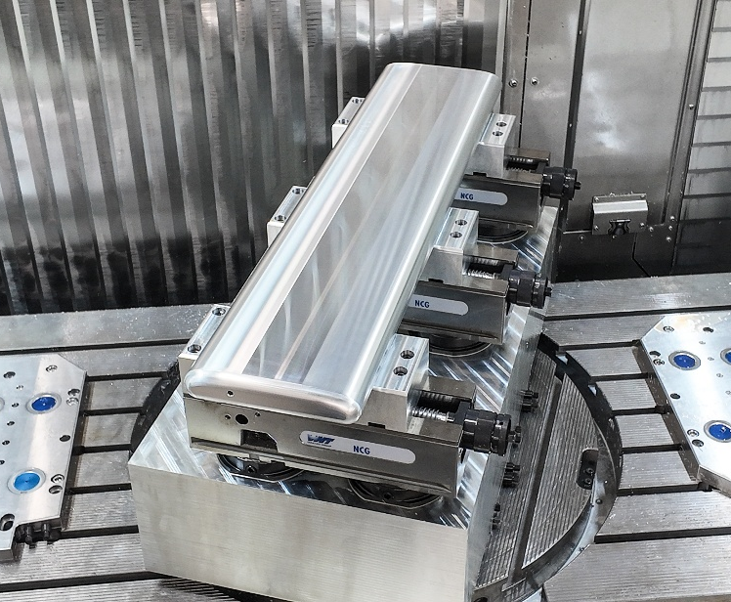
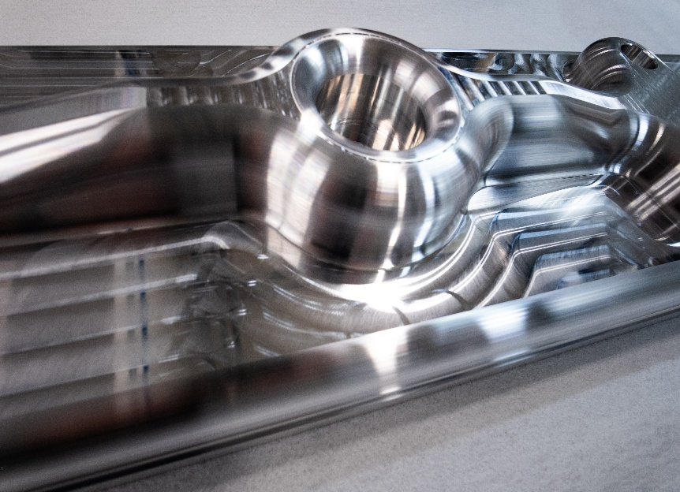
Showcase
Proton EDM components
Electrodes
Photo credit David Edwards
Photo credit David Edwards
Photo credit David Edwards
Photo credit David Edwards

Slide 4
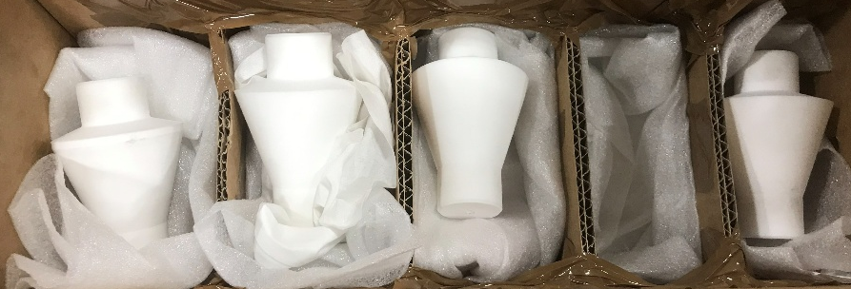
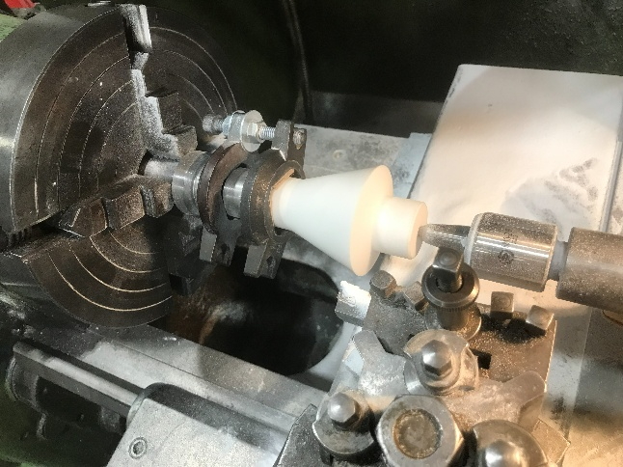
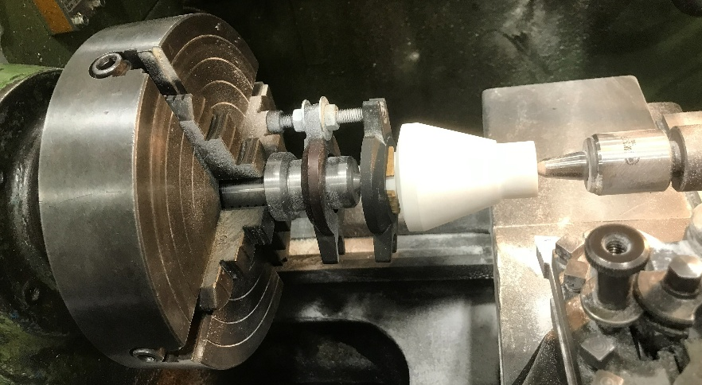
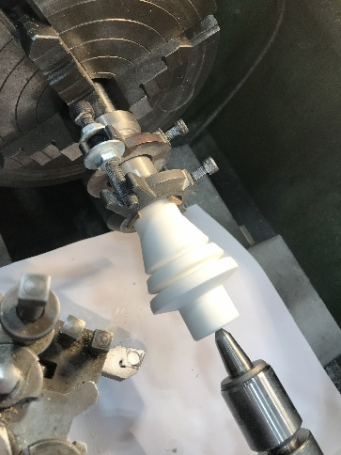
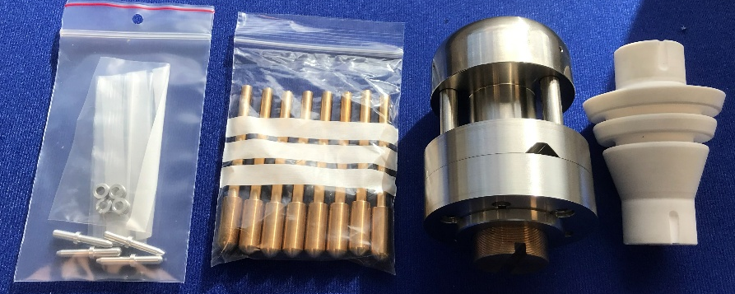
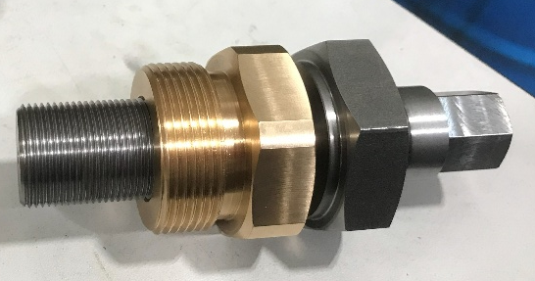
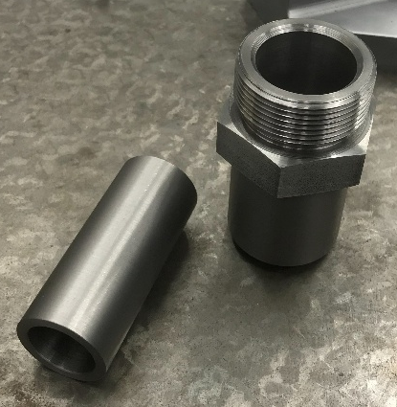
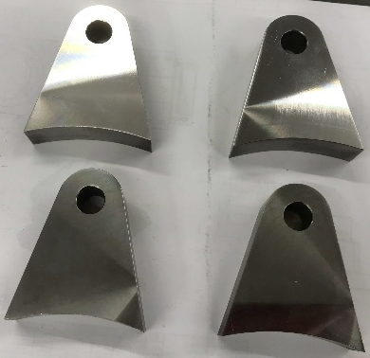
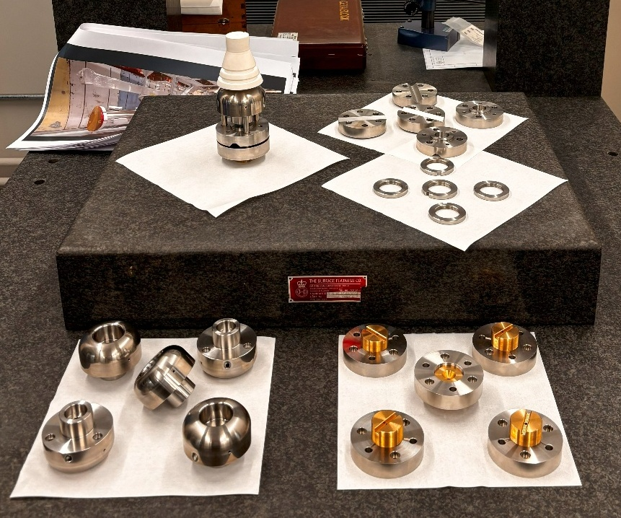
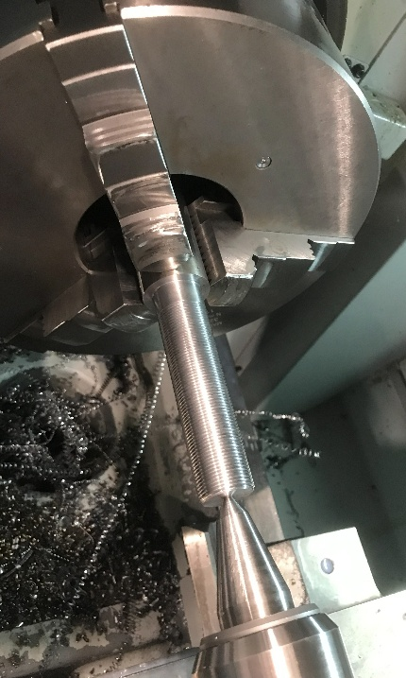
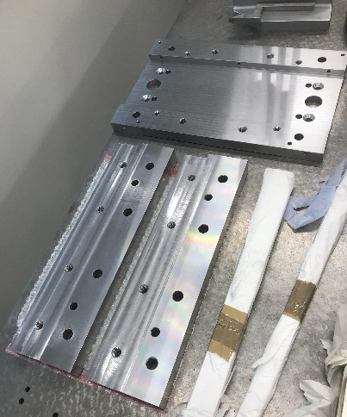
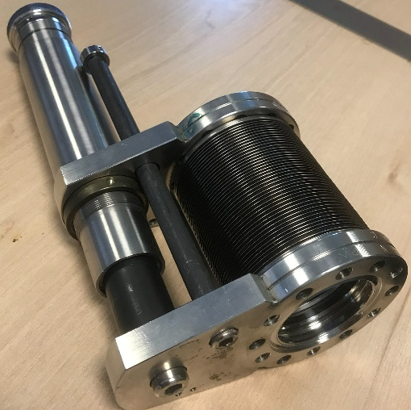
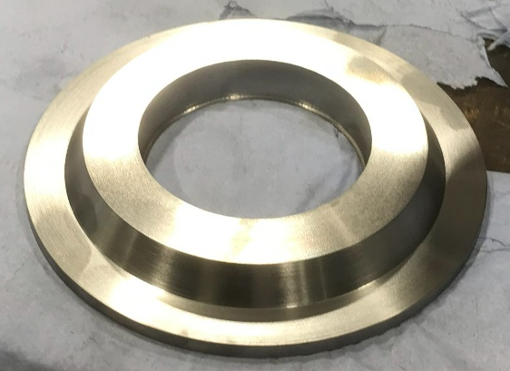
Showcase
Proton EDM components
Insulators
Kinematic mount
Buffer return
X-Drive assy
High voltage test actuator
Kinematic mount
Keeper plate

Slide 5
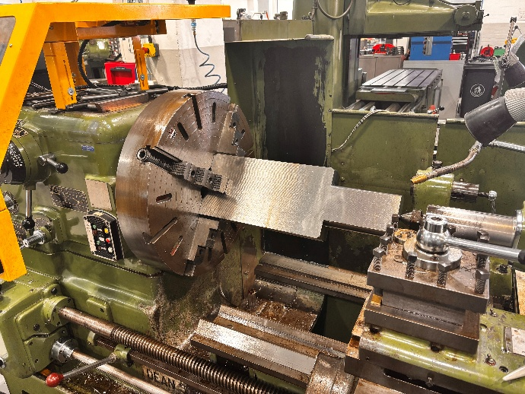
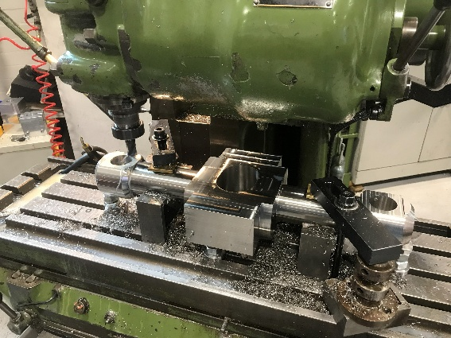
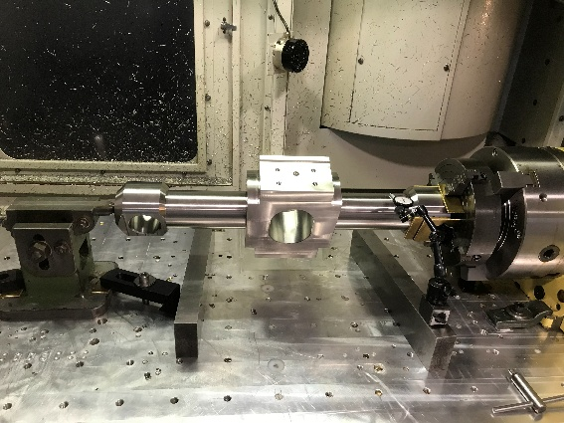
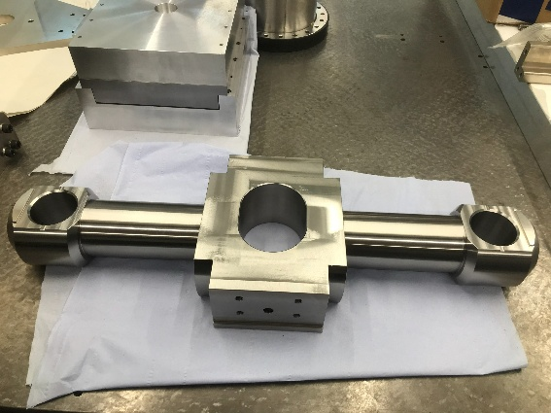
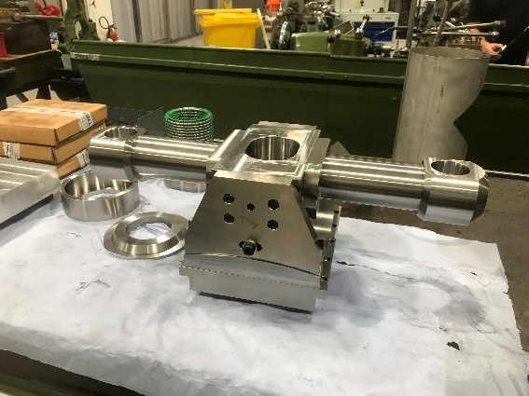















Showcase
Proton EDM components
Yoke
Carriage
Ram
Ram socket
X-stage
Bellows assembly

Slide 6



Showcase
Proton EDM components
Full upper assembly
Photo credit David Edwards

Slide 7















Showcase
Proton EDM components
Roll mechanism
Cradle

Slide 8


























Showcase
Proton EDM components

Slide 9














Showcase
Mixture of Mu3e parts

Slide 10




















Facilities
As previously mentioned, our basement experiences water ingress from the external wall following heavy rainfall. While this is a long-standing issue, it has become significantly more disruptive as water is now penetrating our new internal walls. PCS are actively investigating the situation; they have conducted several site visits and confirmed that all surrounding pipework is intact. We are anticipating a permanent solution shortly, which will likely involve installing a gully to divert water into our existing sump pump drainage system.
Property and Campus Support
Update on our refurbishments: While we expected to be finished by now, we have encountered a significant issue with the floor’s slip resistance. Despite initial assurances, the University Safety Office has confirmed the flooring is not suitable for our needs. We are currently in discussions with PCS to replace or treat the surface. This will unfortunately involve major disruption to our workspace. I will share a detailed timeline and plan as soon as they become available
We now have Paxton access control into our areas. This is for all of our safety. Anyone is welcome and can request a fob for access. If you just need to pop in and don’t have a fob you just need to ring the doorbell and one of the team will come but you may need to be patient.
We’re working to improve our workspace! To manage the glare and heat caused by our large windows, PCS is looking into installing solar-reflecting film. We are also investigating new ways to increase fresh air circulation to help offset the heat produced by our machinery.

Slide 11











Facilities
Maintenance and upgrades
We need to address the maintenance of our Bridgeport milling machines. We are currently evaluating two paths: investing in the repair of two existing units or, alternatively, replacing at least one machine with a modern equivalent to ensure operational continuity.
New digital readout for our Parkson milling machine
£1.5-2K
£40-50K
£20-30K
£10-20K
We should begin planning for the phased replacement of our aging small lathes. Modernizing this equipment will ensure long-term reliability and maintain the precision required for our ongoing projects.
£20-30K
Looking ahead, I suggest enhancing our CNC capabilities by investing in a Turn-Mill machine. These systems allow for six-sided machining, integrating both turning and milling applications into a single setup. This would significantly streamline our production process and improve part accuracy
https://www.youtube.com/watch?v=tzqGWH-Vifo
£350-450K
£30-40K
Costings rate for our Physics workshop
It costs £3659 per day for our facility to provide the service that we are giving you. Without your support in going out and finding new and exciting projects for us to work with you, we will struggle in the future.

Slide 12

















AML
AML Facilities
Radial Support Arm. Two CF sheets with honeycomb sandwiched in the middle, this is used to support the half cylinder.
Main section half cylinder assembly, with End Flanges and Radial Supports.
Co-curing of the Atlas half rings
Half Sandwich. Two of these come together to make a Half Ring. The foam is co-cured to the CF, meaning it uses the resin within the pre-preg to bond together.
End flange and mould tool.

Slide 13






AML
Composite and 3D printed parts for MUonE
Onyx (Nylon + chopped Carbon fibre) 3D printed parts

Slide 14


None of this would be possible without…
A Massive thank you to
Tom Gibbs, Tony Watling, Rob Malley, Warren Jones, Levi Cornah,
Luke Marshall, Kevin McCormick, Daniel Hollywood, Paul Sinclair and Paul Cook.
for their excellent effort, help and support through another busy year
Notes:
14

Slide 15

That’s all folks
thanks for listening
Notes:
15

