Slide 1


The Mu2e Experiment and Stopping Target Physics
By Sean Isaac
Supervisor: Joe Price

Slide 2
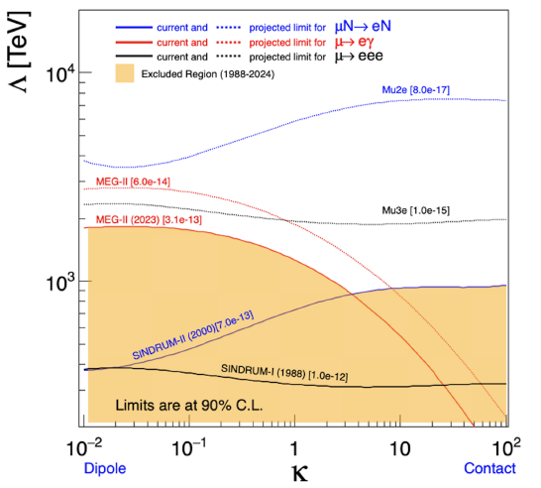








Motivation - CLFV and The Standard Model
Standard Model
Beyond Standard Model
$${SU(3)}_{C}⊗{SU(2)}_{L}⊗{U(1)}_{Y}$$
Neutrino Oscillations
PMNS
Matrix
BR(CLFV)=$𝒪({10}^{−54})$
Type I
BR($\frac{μN→eN}{μ→eγ}$)=$0.1 − 10$
Electroweak Unification
See-Saw
Extensions
Type II
BR($\frac{μN→eN}{μ→eγ}$)=$𝒪({10}^{−2})$
SSB
Type III
BR($\frac{μN→eN}{μ→eγ}$)=$𝒪({10}^{3})$
$$(M_{D})_{ij}=\frac{ν}{\sqrt{2}}λ_{ij}^{(e)}$$
SMEFT $(κ,Λ$) Space
Dirac Mass Matrix
Unitary Transformations
Mu2e has the highest new physics mass scale sensitivity across the space.
$$U_{L}^{⊺}M_{D}U_{R}=M_{D}^{diag}$$
Charged Lepton Flavour Violation

Slide 3
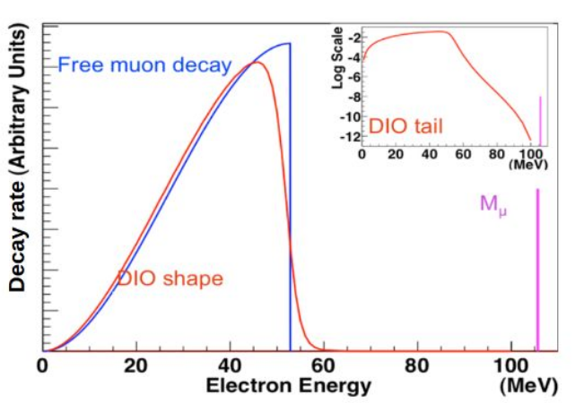
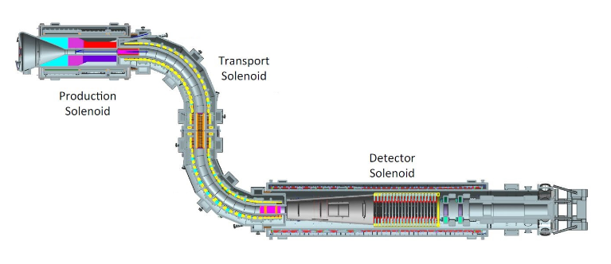
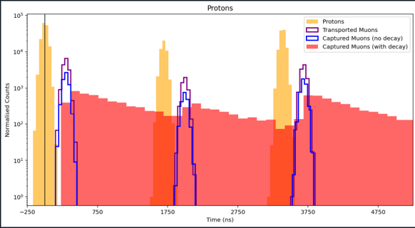
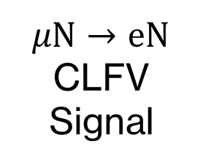
The Mu2e Experiment
$μN→eN$ CLFV Signal
Production Target
Pulsed Protons
4.6T
2.5T
Live
Measurement
Windows
Stopping Target Monitor
Momentum Selection
Stopping Target
(Aluminium)
Calorimeter
(20m)
2T
1T
Tracker
Mu2e Image credit: https://users.hep.manchester.ac.uk/u/markl/muons/mu2e/index.shtml

Slide 4
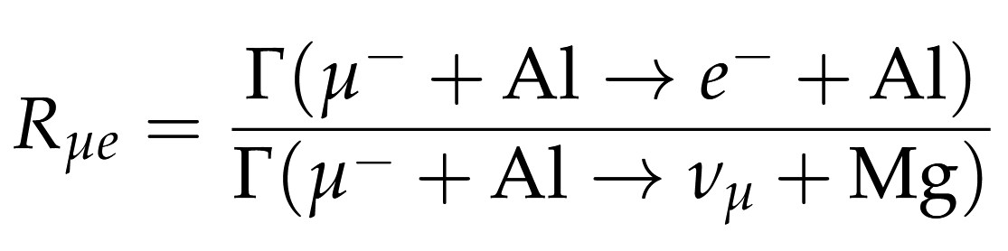
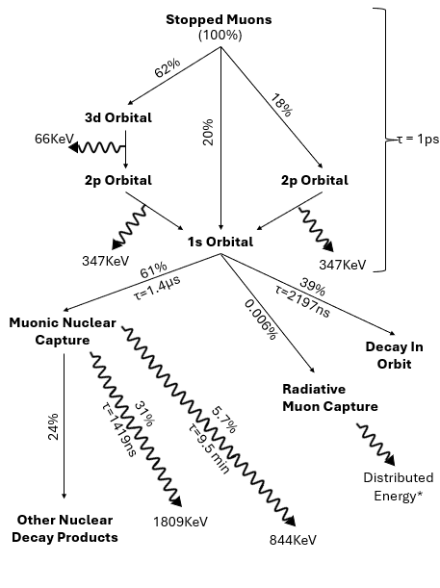
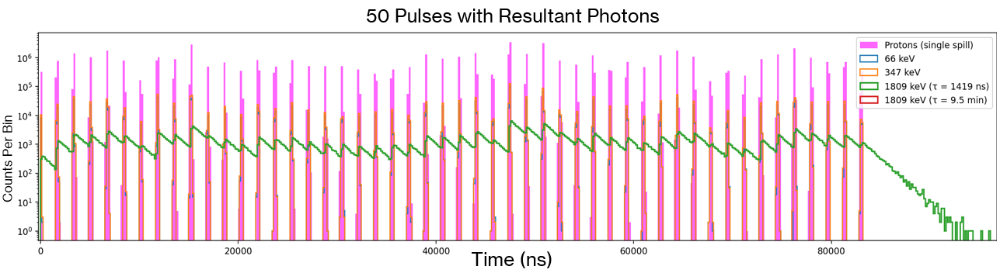
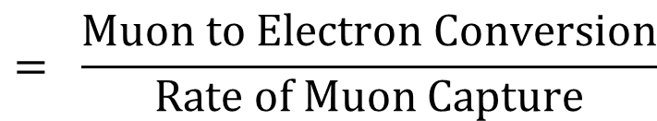
Why is the Stopping Target important?
$$= \frac{Muon to Electron Conversion}{Rate of Muon Capture}$$
Theoretical Predictions exceed uncertainty requirements

Slide 5
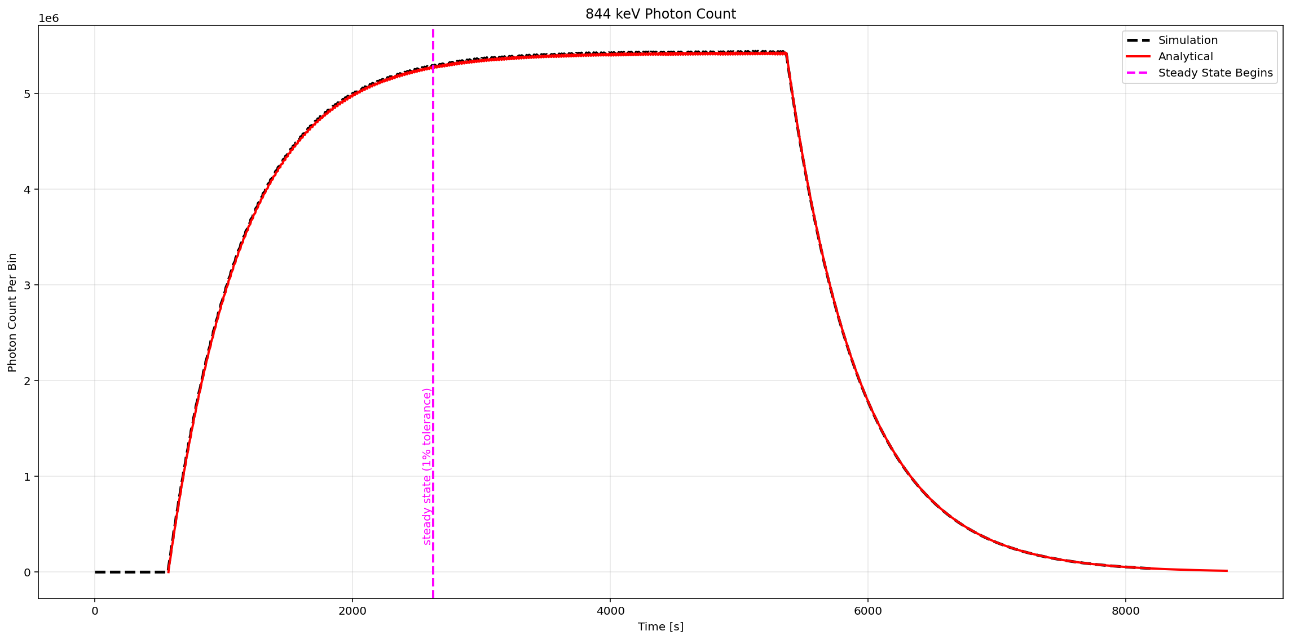

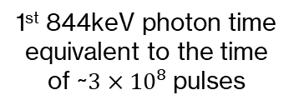

Effect of Lifetime on Measurement
Exact Physics:
$N_{k+1}=N_{k}e^{{−t_{gap}}/τ}+A$
Summation-Free Form:
$N_{k}=A\frac{1−e^{{−kt_{gap}}/τ}}{1−e^{{−t_{gap}}/τ}}$
Steady State:
$N_{ss}=\frac{A}{1−e^{{−t_{gap}}/τ}}$
Governing Equation:
$\frac{dN}{dt}=\frac{−N(t)}{τ}+R(t)$
$\sim$5τ (44min)
8000 pulses of 100000 muon stops
RMS error of 0.1808%
1st 844keV photon time equivalent to the time of ~$3×{10}^{8}$pulses

Slide 6
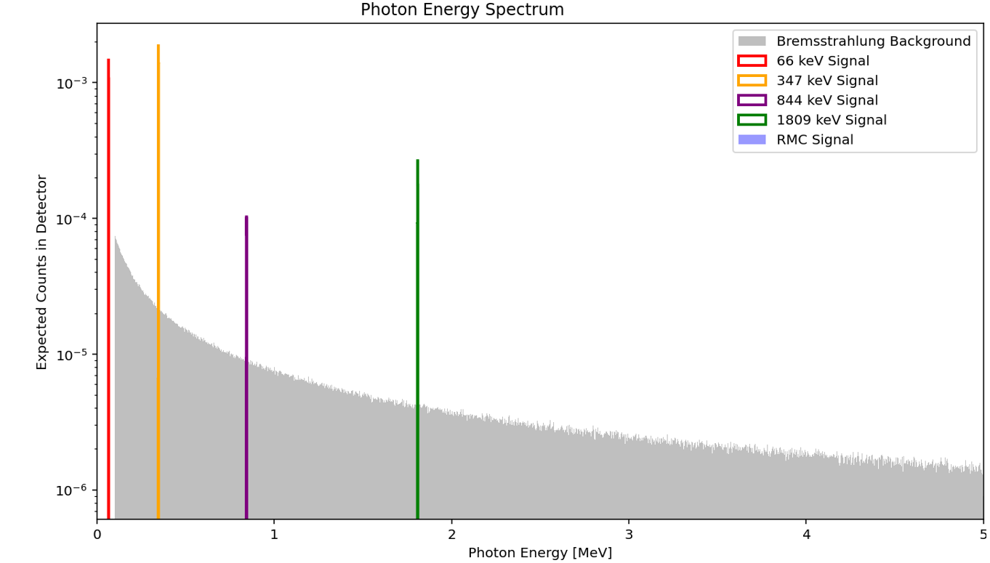
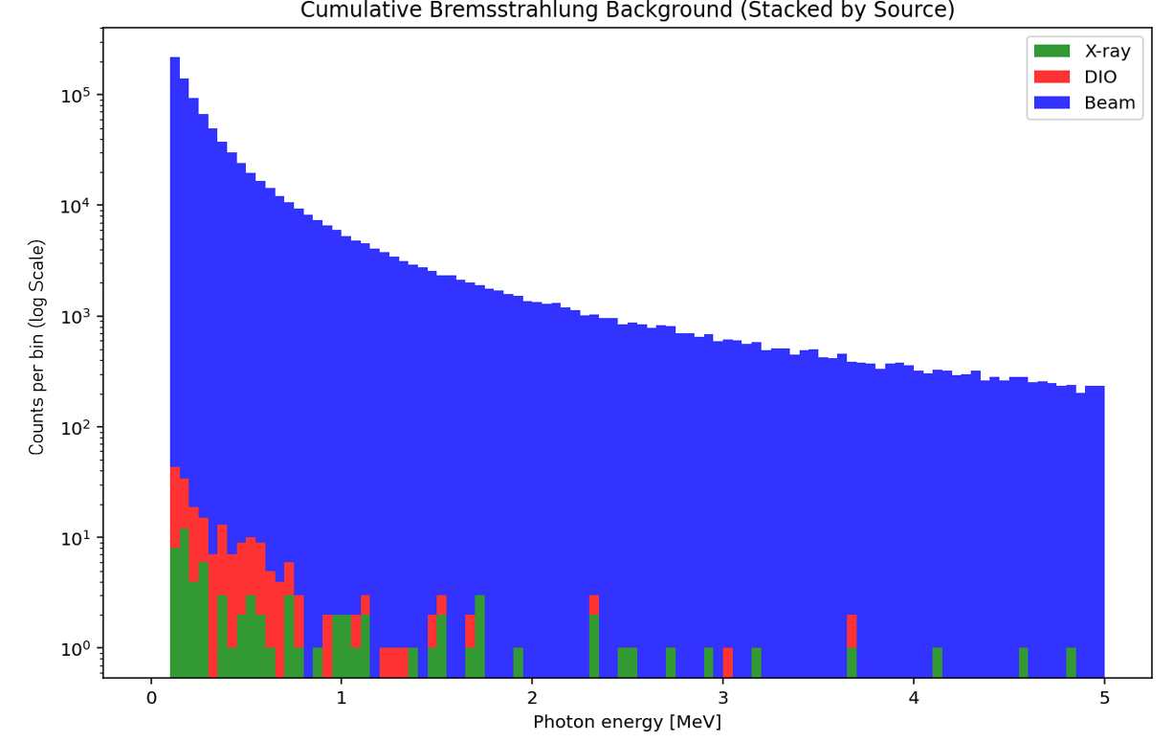
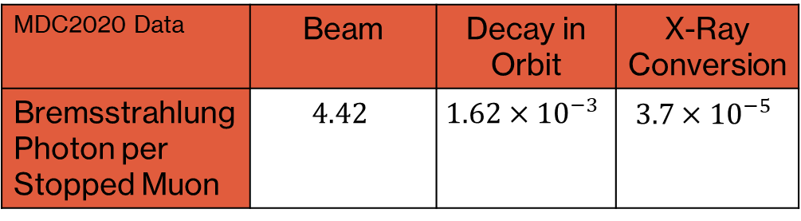
Wider Photon Environment
Beam
  Muon Decay in Flight -> Electrons (μ → e νν̄ ) -> Bremsstrahlung
  Pion Decay in Flight -> Electrons (π → e ν) -> Bremsstrahlung
  Electrons Formed at Production Target -> Bremsstrahlung
DIO
  Decay in Orbit -> Electrons (μ → e νν̄ ) -> Bremsstrahlung
Conversion Electron
  X-Ray Conversion Electrons -> Bremsstrahlung
RPC
Outside of keV Energy Range
  Radiative Pion Capture -> Photons
MDC2020 Data | Beam | Decay in Orbit | X-Ray Conversion
Bremsstrahlung Photon per Stopped Muon | $$4.42$$ | $$1.62×{10}^{−3}$$ | $$3.7×{10}^{−5}$$

Slide 7
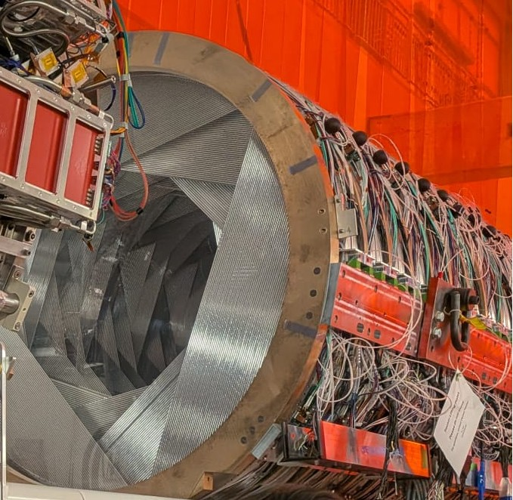
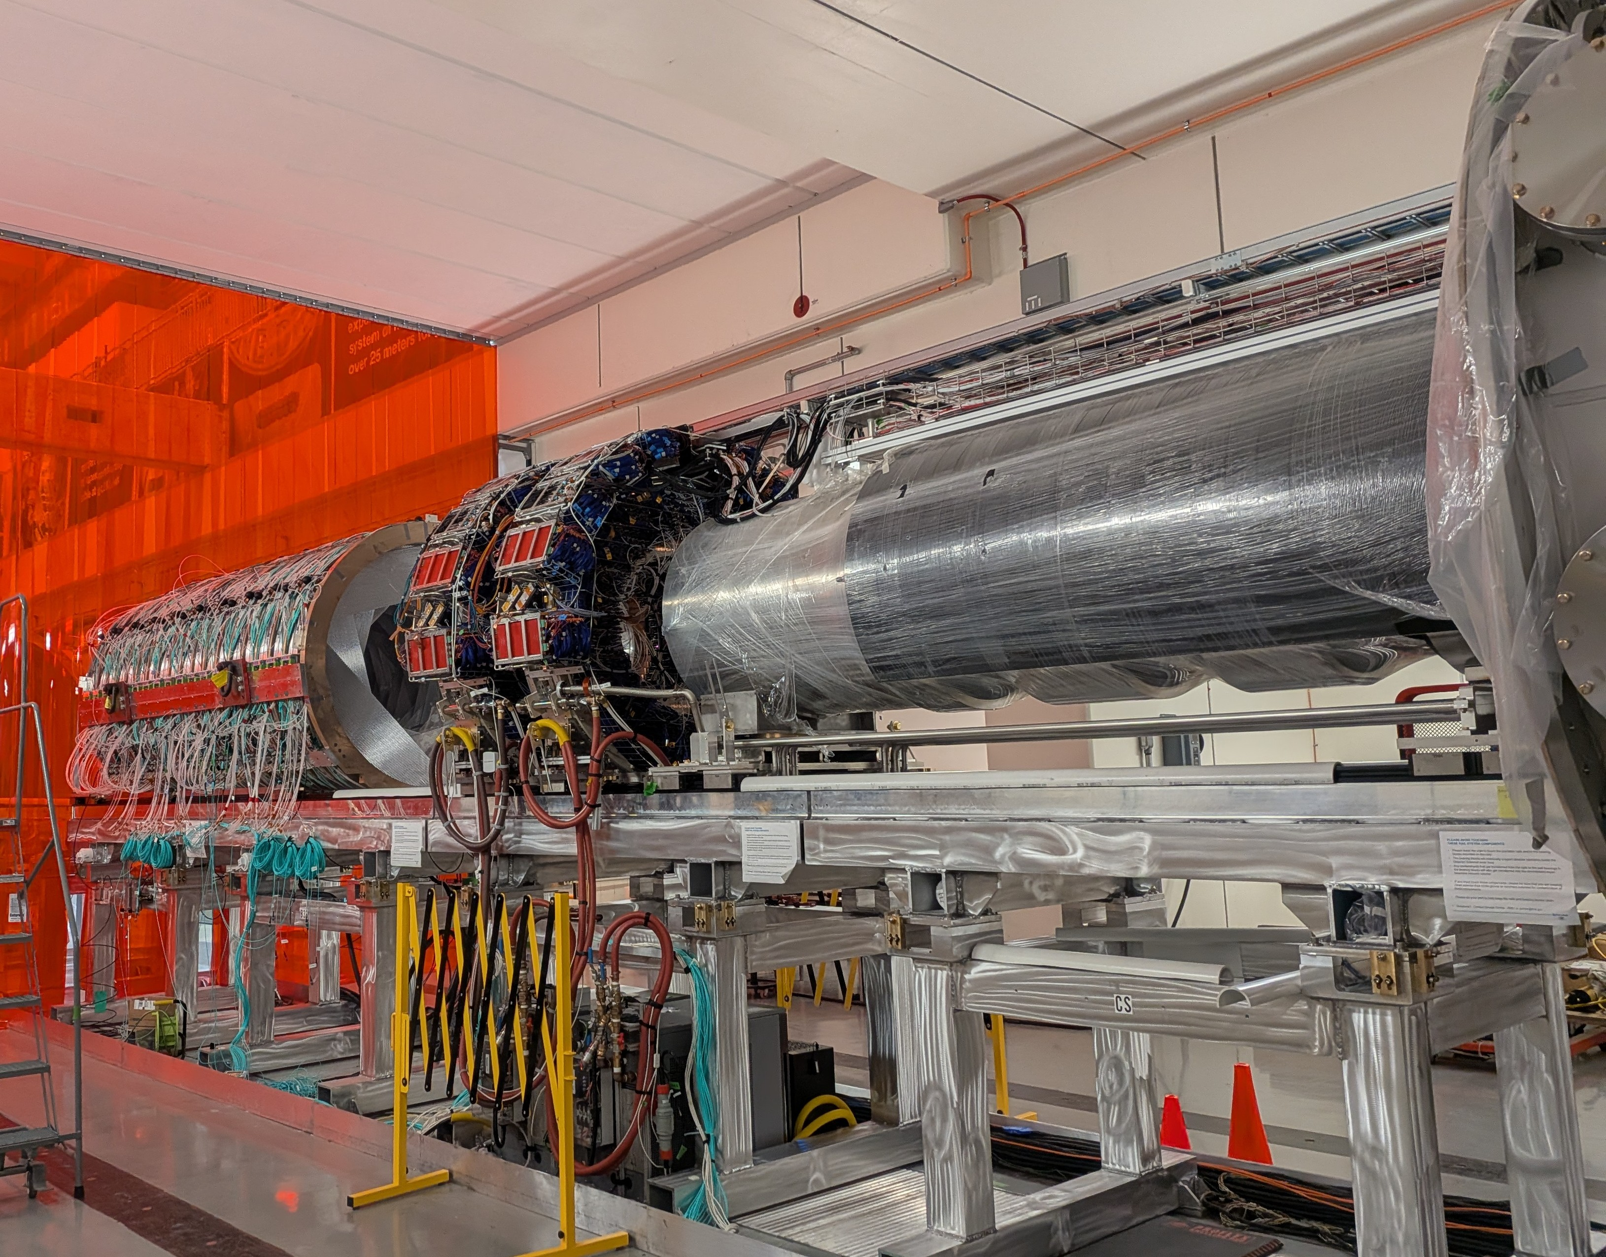
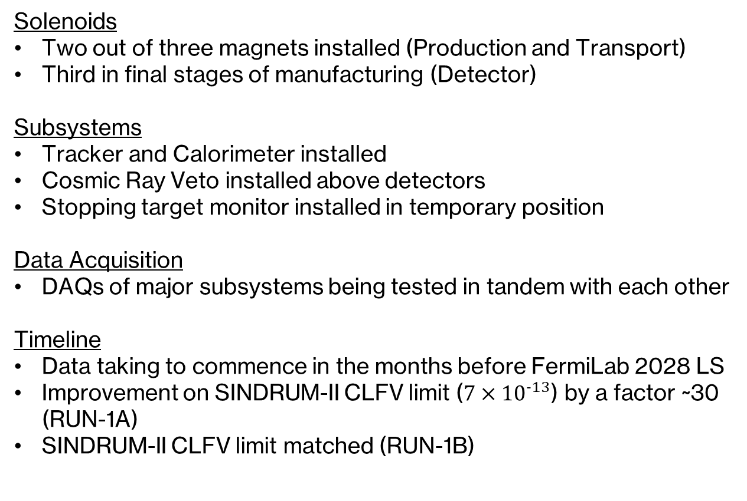
Current Status
Solenoids
Two out of three magnets installed (Production and Transport)
Third in final stages of manufacturing (Detector)
Subsystems
Tracker and Calorimeter installed
Cosmic Ray Veto installed above detectors
Stopping target monitor installed in temporary position
Data Acquisition
DAQs of major subsystems being tested in tandem with each other
Timeline
Data taking to commence in the months before FermiLab 2028 LS
Improvement on SINDRUM-II CLFV limit ($7×{10}^{−13}$) by a factor ~30 (RUN-1A)
SINDRUM-II CLFV limit matched (RUN-1B)

Slide 8
Conclusion
Progress
Established Mu2e’s viability as a CLFV searching experiment
Characteristic muon capture photons modelled under mu2e’s pulsed beam structure
Derived a closed-form analytical description of the long-lifetime photon population and validated against Monte Carlo to sub-percent agreement
Bremsstrahlung background studies
Mapped muon capture processes and how the data is processed through the DAQ (In Backup)
Detector smearing modelled (In Backup)
Key Takeaways
The 844 keV line requires ~44 minutes (~5τ) of continuous running before reaching 99% steady state.
The beam electron bremsstrahlung dominates the photon environment at the STM by a factor of ~120,000 over the next largest contribution
What’s Next
Feed my photon emission studies directly into the Mu2e GEANT4 simulation chain. Upgrading the current treatment of long-lifetime photon sources from a continuous approximation to a physically accurate pulsed description

Slide 9
Thank You.

Slide 10
Back-up Slides

Slide 11
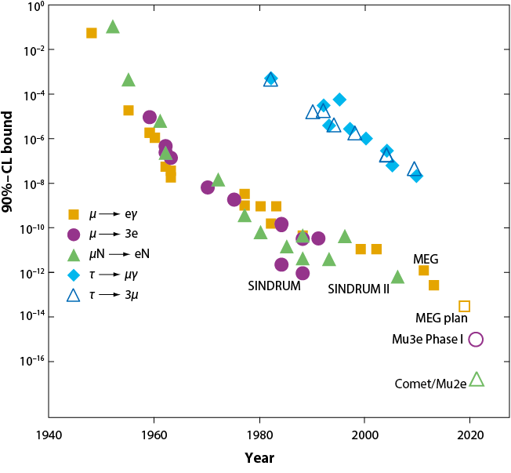
Mu2e Sensitivity Compared to Other CLFV Searches

Slide 12
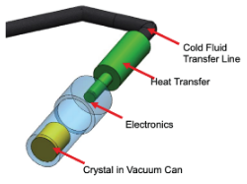
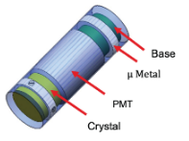
STM Detectors
Within the STM there are two detectors chosen on how they compliment each others weaknesses.
HPGe:
  Solid-state germanium crystal at a cryogenic temperature.
  High energy resolution (order of 1-2KeV) to distinguish the photon lines, allowing to detect which process they came from.
  Limited maximum count rate (struggles around the order 10^5 photons per second).
  Needs to be heavily shielded due to radiation damage.
LaBr3
  3 inch cylindrical scintillator crystal with hits recorded by a photomultiplier tube (PMT).
  Poorer energy resolution relative to HPGe detector.
  High maximum count rate (~8x that of HPGe)
Both are located 35m from the stopping target.
Both are heavily shielded and collimated for background reduction.
Image credit: The Mu2e Experiment — Searching for Charged Lepton Flavor Violation M. T. Hedgesa,∗, on behalf of the Mu2e Collaboration

Slide 13
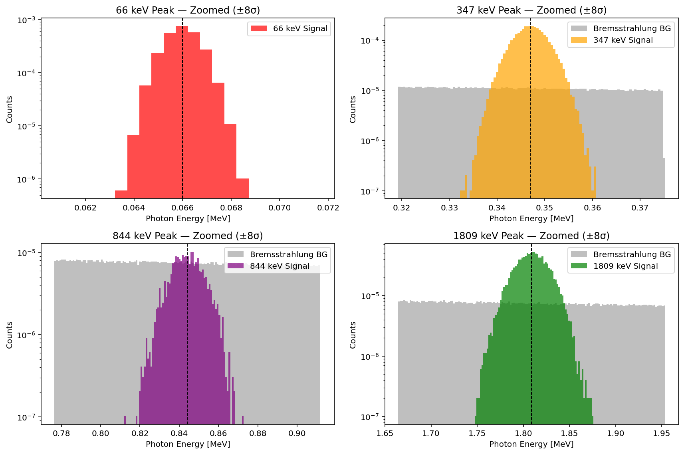
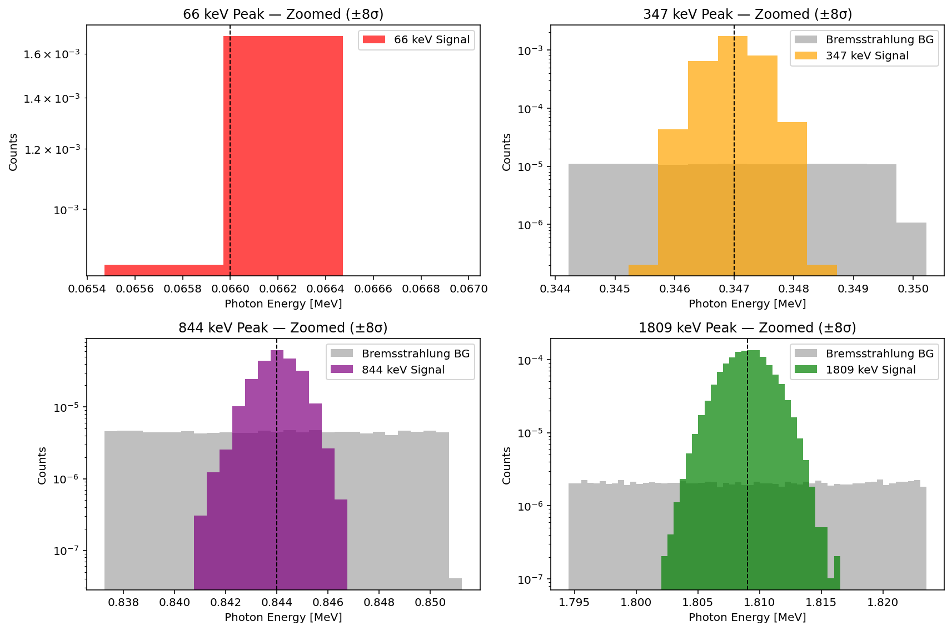
LaBr Smearing
HPGe Smearing
Key Takeaways:
This simulation naturally prefers the HPGe detector as rate/ timing are not modelled. Remember the HPGe detector favours energy resolution over count rate. It is the reverse for LaBr.
Hence, peaks are more visible in this simulation for the HPGe detector.
By design, the LaBr has much poorer background rejection too. Thus, the background appears larger than the HPGe detector.

Slide 14
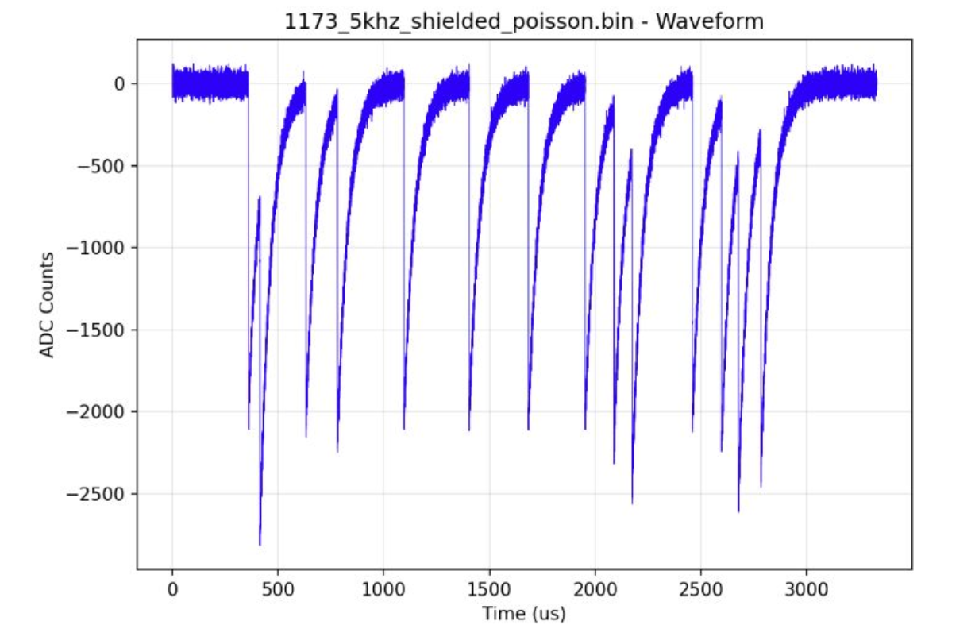
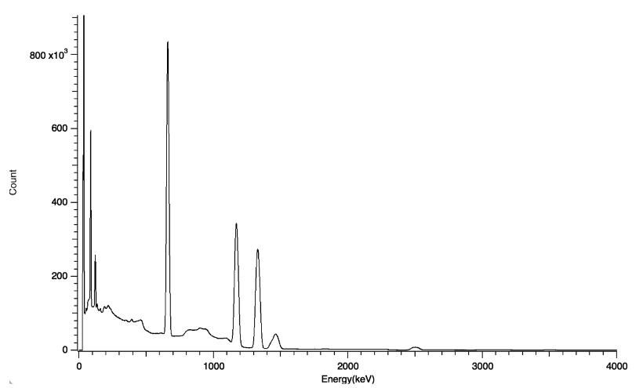
Detector Pulses
Credit to Leo Liu (left) and Yuze Lin (Right)
HPGe
LaBr

Slide 15
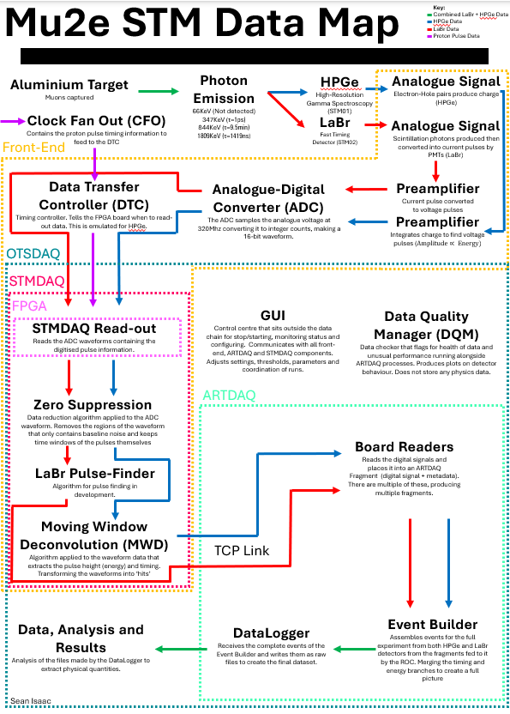
DAQ Data Map

Slide 16
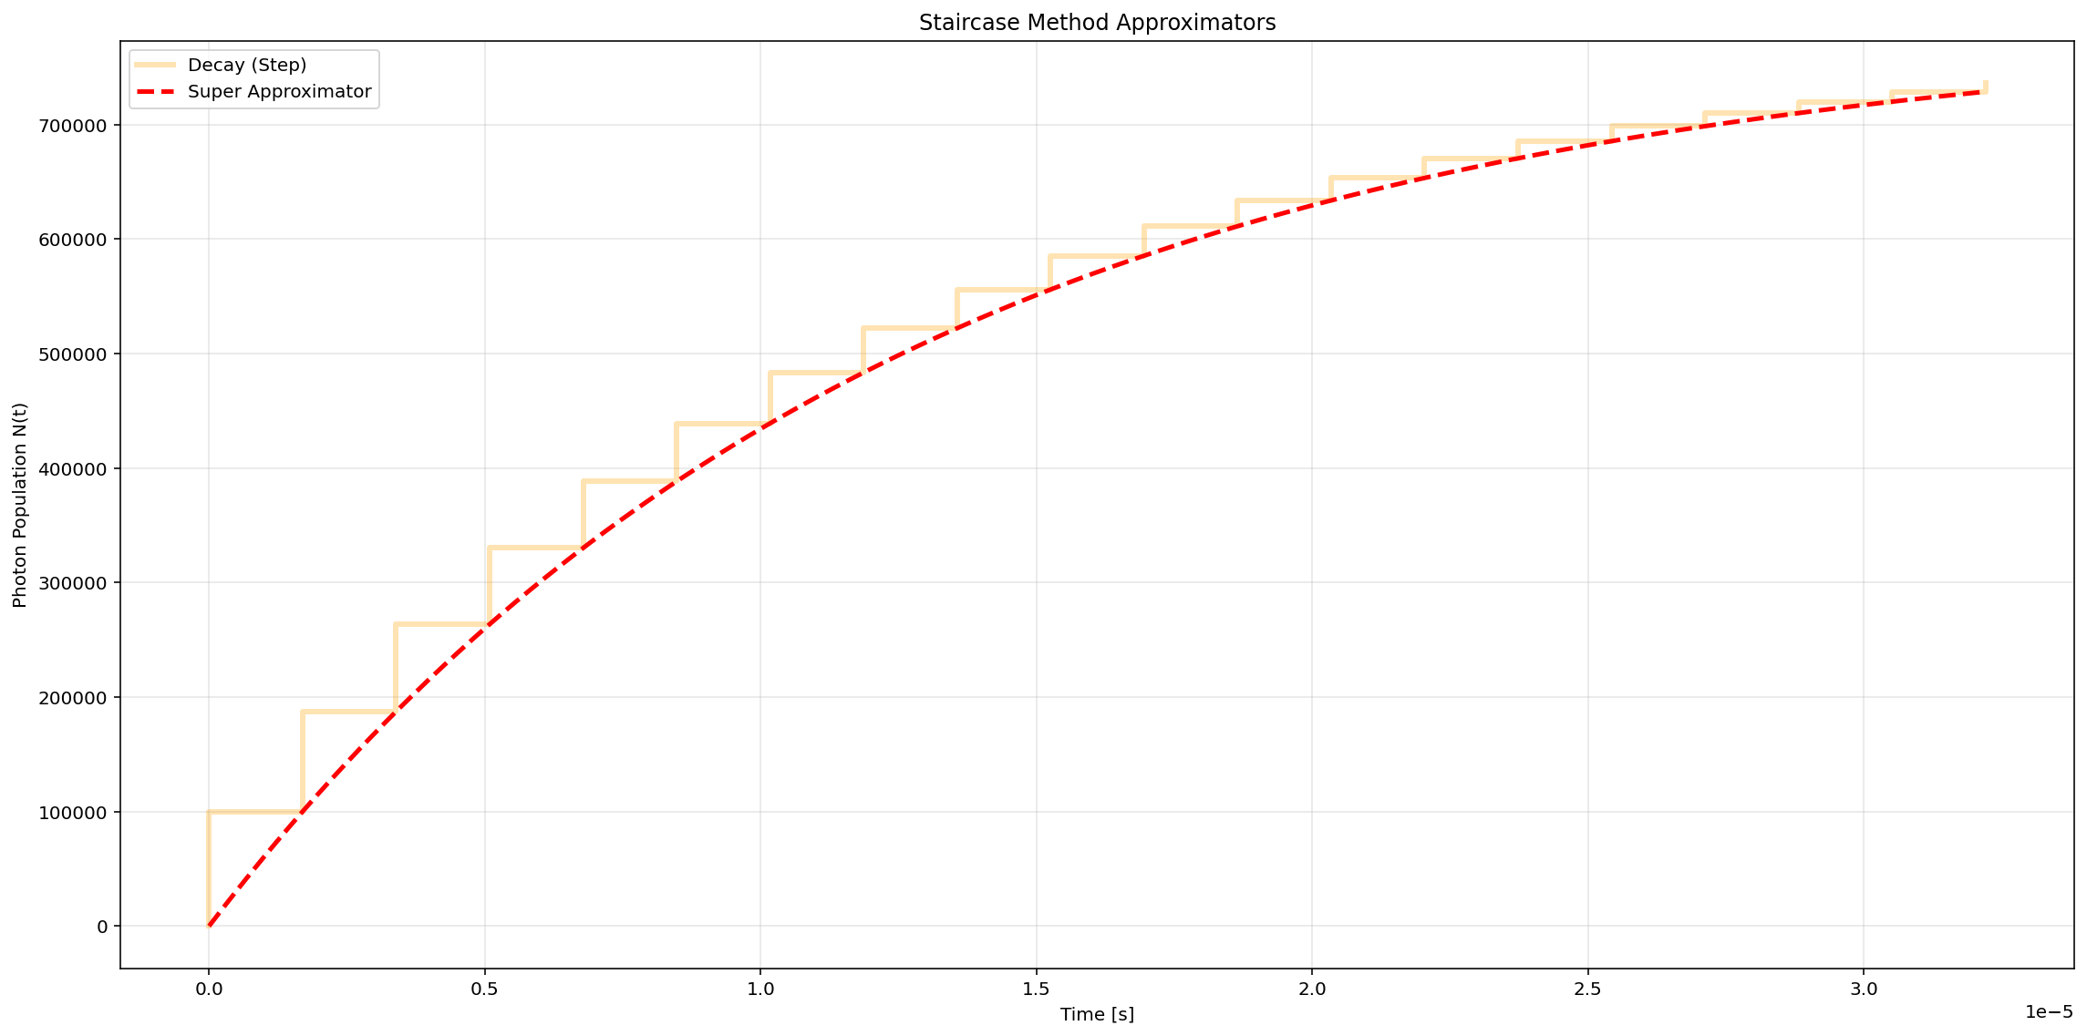
Recurrence Relation Visualised

Slide 17








Long Lifetime Photons Extra Description
Photon System
The Steady State
Population
Analytical Description
$$\frac{dN}{dt}=\frac{−N(t)}{τ}+R(t)$$
Recurrence Relation
Per Pulse Population
$$N_{n}=N_{n−1}e^{{−t_{gap}}/τ}+A$$
$$N_{pulse}=\int_{t_{i}}^{t_{i}+∆t}{\sum_{k=0}^{i}{N_{k}(t)}dt}$$
Pulses until Steady State
$$Production (Pulse In)$$
$$N\left(t\right)=\frac{A}{τ}(t−t_{p})e^{\frac{−(t−t_{p})}{τ}}$$
$$n \sim \frac{τ}{t_{gap}}ln\left(\frac{1}{ε}\right)$$
Population at Steady State
Decay (Pulse Gap)
$$N = (A∗SDF)\left(\frac{1}{1−e^{\frac{−t_{gap}}{τ}}}\right)$$
Time until Steady State
$$N(t)= N(t_{0})e^{\frac{−(t−t_{p})}{τ}}$$
$$t \sim τln\left(\frac{1}{ε}\right)$$
Population at a Given Time
$$N\left(t\right)=N\left(t_{0}\right)e^{\frac{−\left(t−t_{p}\right)}{τ}}H\left(t−t_{0}\right)+$$
$$\frac{A}{τ}\left(t−t_{p}\right)e^{\frac{−\left(t−t_{p}\right)}{τ}}\left[H\left(t−t_{p}\right)−H\left(t−t_{p}−∆\right)\right]$$
Approximator
$$N\left(t\right)=\frac{A_{pulse}}{1−e^{{{−t}_{gap}}/τ}}\left(1−e^{{−t}/τ}\right)$$

Slide 18
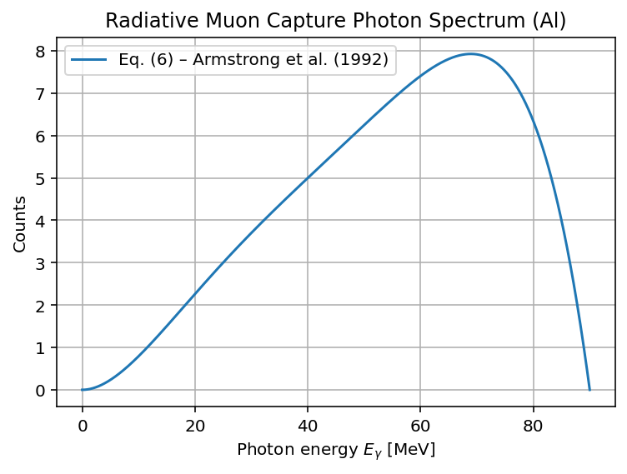
RMC Spectrum

