Slide 1

Summary of Previous µCF Experiments and Lessons Learned
2026/7/2
Akihisa TOYODA
KEK

Slide 2
Previous µCF Experiments
Patrick-san exp. (ddμ): Recycling muon detection
Toyoda exp. (ddμ): Solid ortho-/para-D₂ targets
Imao-san exp. (ddμ): Solid, liquid, and gaseous ortho-/para-D₂ targets
RIKEN-RAL exp. (dtμ): Solid and liquid DT targets

Slide 3
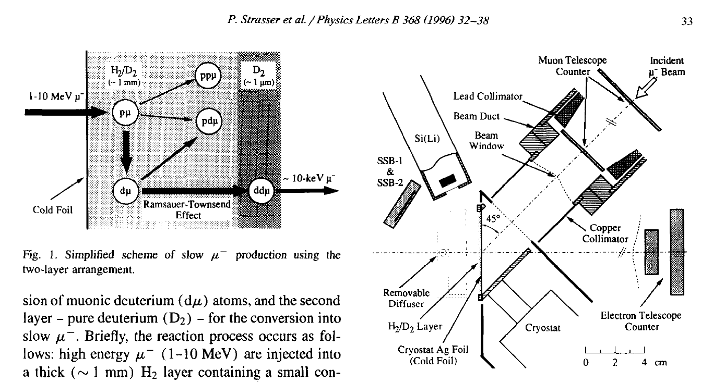
Patrick-san’s ddμ experiment
To measure and maximize ～10 keV recycling muons
Estimation of absolute dμ yield from H₂/D₂ layer (Ramsauer-Townsend effect)
→Tommorow session Patrick-san’s talk

Slide 4
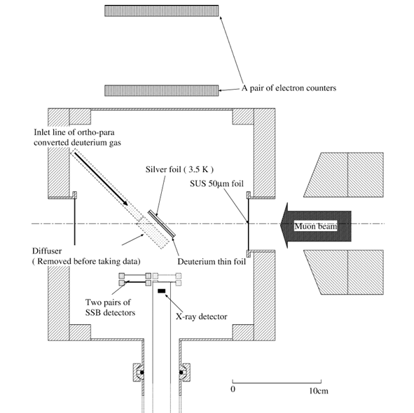
Toyoda’s ddμ experiment
Target: Solid D₂ 280 μm, ortho-para controlled
Plastic scintillators for mu-e decay electrons
Si(Li) for X-ray
SSBs for charged particles(dE,E) with particle identification to measure 3 MeV fusion protons

Slide 5
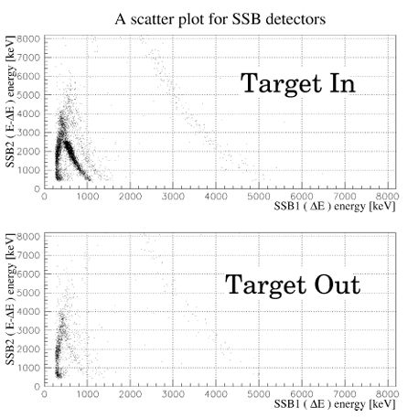
SSB E-dE PID
A. Toyoda et al., Physics Letters B 509 (2001) 30–36
He
d
Successfully measure 3 MeV fusion protons by using the E-dE technique.
→To detect fusion protons, E-dE technique is powerful to decrease backgrounds of nuclear muon capture and scattered muon beam.
fusion proton

Slide 6
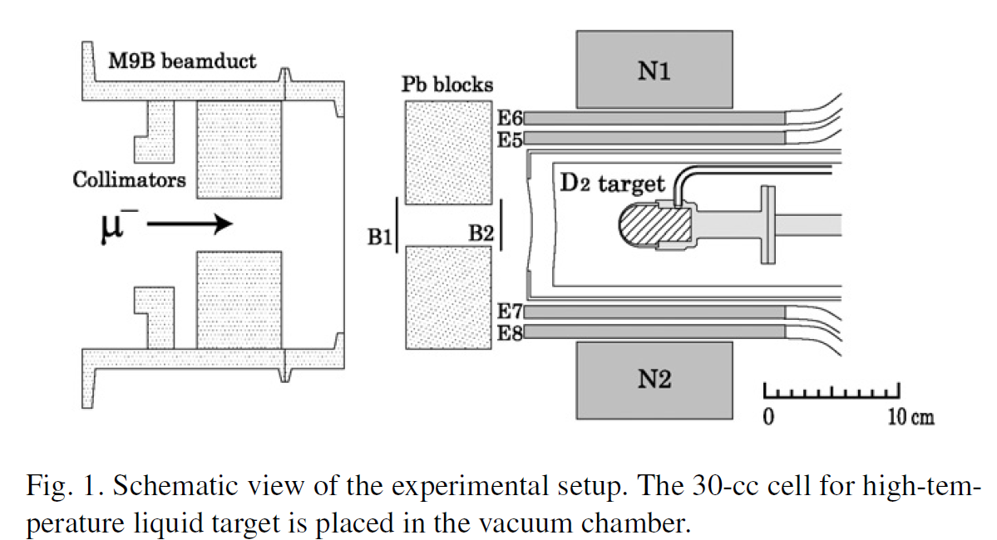
Imao-san’s ddμ experiment
H. Imao, Physics Letters B 658 (2008) 120–124
D₂ target (solid, liquid, gas) with ortho-para control
B,E: plastic scintillator
N: NE213 liquid organic scintillator to measure 2.5 MeV fusion neutrons

Slide 7
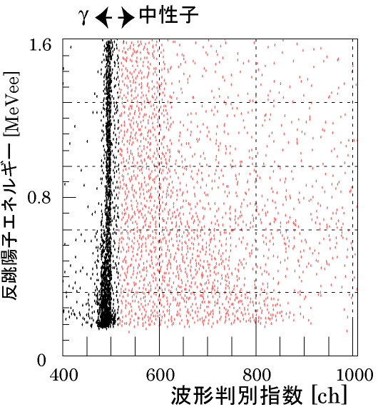
2.5 MeV fusion neutron detection
Imao’s Doctor thesis
neutron
Recoil proton energy
PSD index
DC beam is necessary ←

Slide 8
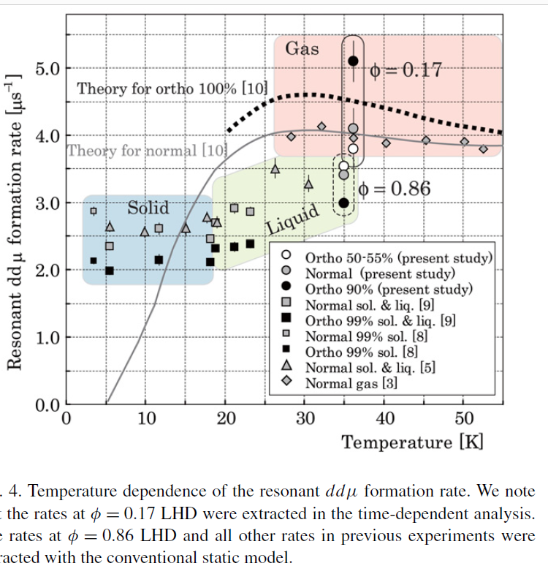
Observed ddμ OrthoPara effect
H. Imao, Physics Letters B 658 (2008) 120–124
density or phase dependence
Ortho-para controlled dt-μCF experiments were conducted at RIKEN-RAL
  This result was not published, but some ortho-para effect seemed to be observed.
Toyoda’s experiment

Slide 9
RIKEN-RAL dt-μCF experiment
Target: Solid or Liquid D₂/T₂
Plastic scintillators for mu-e decay electron
Si(Li) for X-ray
NE213 liquid organic scintillator to measure 14 MeV fusion neutrons
2.4 T Solenoid magnetic field to focus muon beam
→Today’s afternoon session Kawamura-san’s talk
K. Ishida et al., Hyperfine Interactions 138: 225–234, 2001.

Slide 10
RIKEN-RAL dt-μCF experiment
Tritium handling system
→Kawamura-san’s
talk
Three layers confinement
1. Container and piping
2. Glove box
3. Housing.
Performance:
Purification of the D-T target gas (Pd filter + Cryo-trap)
Adjustment of the D-T mixing ratio
Measurement of the hydrogen isotope components
Handling gas quantity:
D-T gas with the volume of 1.1 liter
The maximum gas pressure of 760 torr
(Handling the D-T gas with negative pressure.)
The maximum tritium gas inventory of 56 TBq (1500 Ci)
K. Ishida, Future muon sources,
Huddersfield,UK 13 Jan 2015

Slide 11
RIKEN-RAL dtμ experiment
Fusion neutron detection
→Kawamura-san’s talk
λ_{n}
Y_{n}
N. Kawamura et al., Nuclear Instruments and Methods in Physics Research A 465 (2001) 525–539

Slide 12
RIKEN-RAL dtμ experiment
3He accumulation effect in Solid
→Kawamura-san’s talk
Liquid
Solid
accumulates in solid D-T,
with anomaly around critical concentration CHe~120 ppm
muon transfer to 3He
K. Ishida, Future muon sources,
Huddersfield,UK 13 Jan 2015

Slide 13
RIKEN-RAL dtμ experiment
Solid target with tritium
→Kawamura-san’s talk
According to Kawamura-san, in solid tritium targets, heat generated by tritium decay can induce target migration toward colder regions, leading to shape changes over several hours. This phenomena could cause the detection efficiency change.
  If a thin solid tritium foil target is employed, reproducibility checks and visual monitoring of the target position/distribution are recommended.
He also noted that solid targets may appear either transparent or opaque, possibly due to differences between fcc and bcc crystal phases.
  This effect should be monitored visually and evaluated for reproducibility.

Slide 14
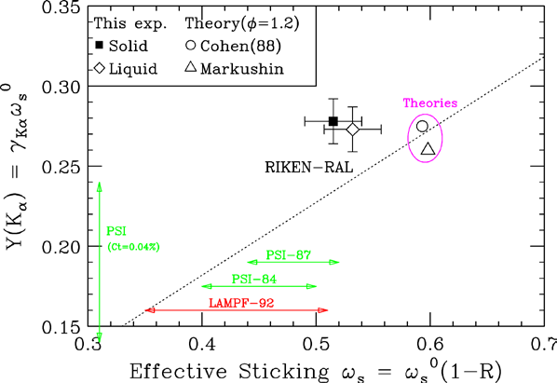
RIKEN-RAL dtμCF result
K. Ishida, Future muon sources,
Huddersfield,UK 13 Jan 2015

Slide 15
RIKEN-RAL’s dtμCF result
Normalized cycle rates
T. Yamashita et al., Sci. Rep.12 (2022) 6393
Jones, S. E. et al. Experimental investigation of muon-catalyzed d − t fusion. Phys. Rev. Lett. 51, 1757–1760 (1983).@ Los alamos
Breunlich, W. H., Kammel, P., Cohen, J. S. & Leon, M. Muon-catalyzed fusion. Annu. Rev. Nucl. Part. Sci. 39, 311–356 (1989). Review
Kawamura, N. et al. Anomalous temperature-dependent phenomena of muon catalyzed fusion in solid deuterium and tritium mixtures. Prog. Theor. Phys. Suppl. 154, 233–240 (2004).@ RIKEN-RAL
Bom, V. R. et al. Experimental investigation of muon-catalyzed dt fusion in wide ranges of D/T mixture conditions. J. Exp. Theor. Phys. 100, 663–687 (2005). @ JINR

Slide 16
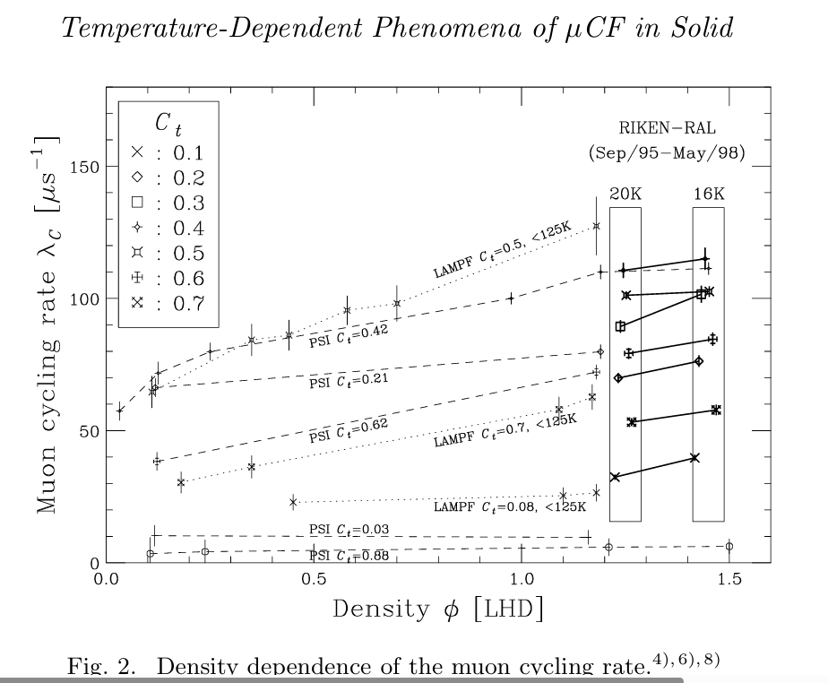
RIKEN-RAL’s dtμCF result
Kawamura, N. et al. Anomalous temperature-dependent phenomena of muon catalyzed fusion in solid deuterium and tritium
mixtures. Prog. Theor. Phys. Suppl. 154, 233–240 (2004).
Normalized cycle rates
？
We have a chance to improve the cycling rate by changing the target density

Slide 17
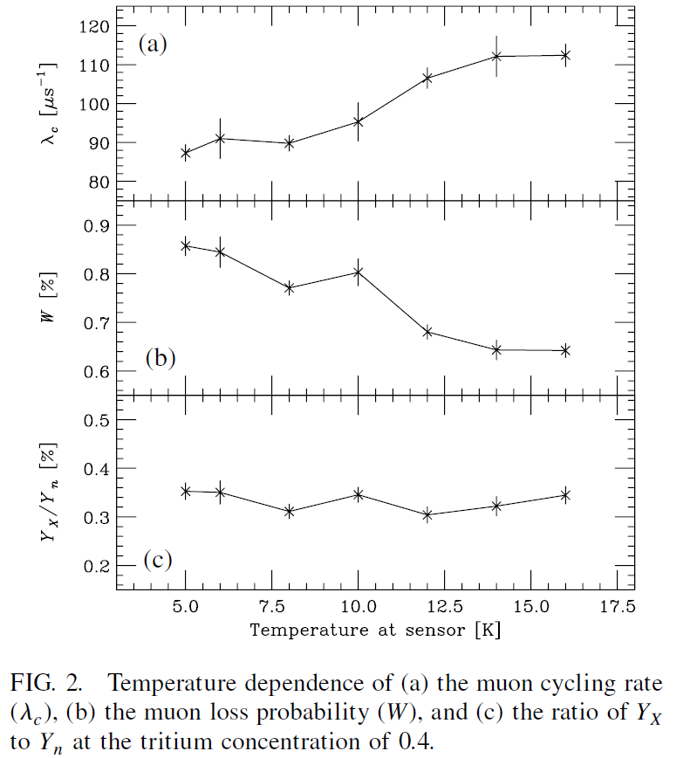
RIKEN-RAL’s dtμCF result
N. Kawamura DOI: 10.1103/PhysRevLett.90.043401
Normalized cycle rates
？
Sticking probability
It may be possible to decrease the sticking probability

Slide 18
Summary
Patrick-san’s ddμ experiment
  Utilized the Ramsauer–Townsend effect.
  Detected 3 MeV fusion protons.
Toyoda's ddμ experiment
  Employed an E–ΔE silicon surface-barrier detector (SSB) system for particle identification (PID).
  Detected 3 MeV fusion protons.
  Achieved the first observation of the ortho–para effect in solid D₂.
Imao-san's ddμ experiment
  Used a DC muon beam and NE213 detectors to measure 2.5 MeV fusion neutrons with decay-e coincidence technique.
  Observed the ortho–para effect in solid, liquid, and gaseous D₂ targets.
RIKEN-RAL dtμ experiment→ Kawamura-san’s talk
  Measured 14 MeV fusion neutrons with NE213 detectors and sticking X-rays with Si(Li) detectors in solid and liquid DT targets.
  The observed density dependence of the density-normalized cycling rate and the temperature dependence of the sticking probability provided valuable guidance for optimizing the F-factor in future μCF experiments.

