Slide 1


Future plan at PSI and J-PARC and international coordination
Satoshi MIHARA
KEK/J-PARC

Slide 2
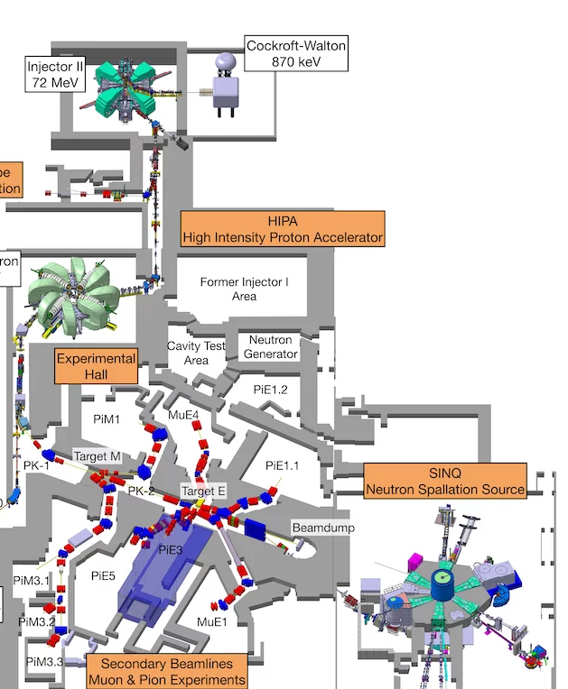
PSI secondary beamline and schedule 2026

Slide 3
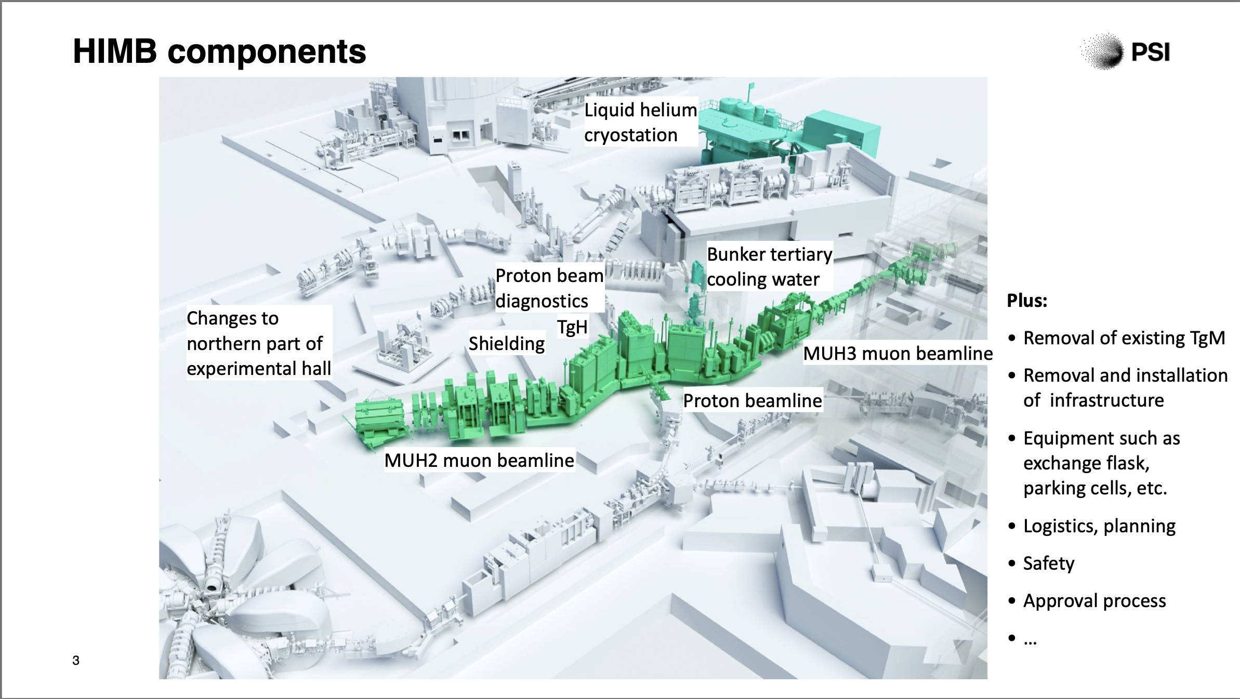
Users Meeting BVR57
A. Knecht

Slide 4
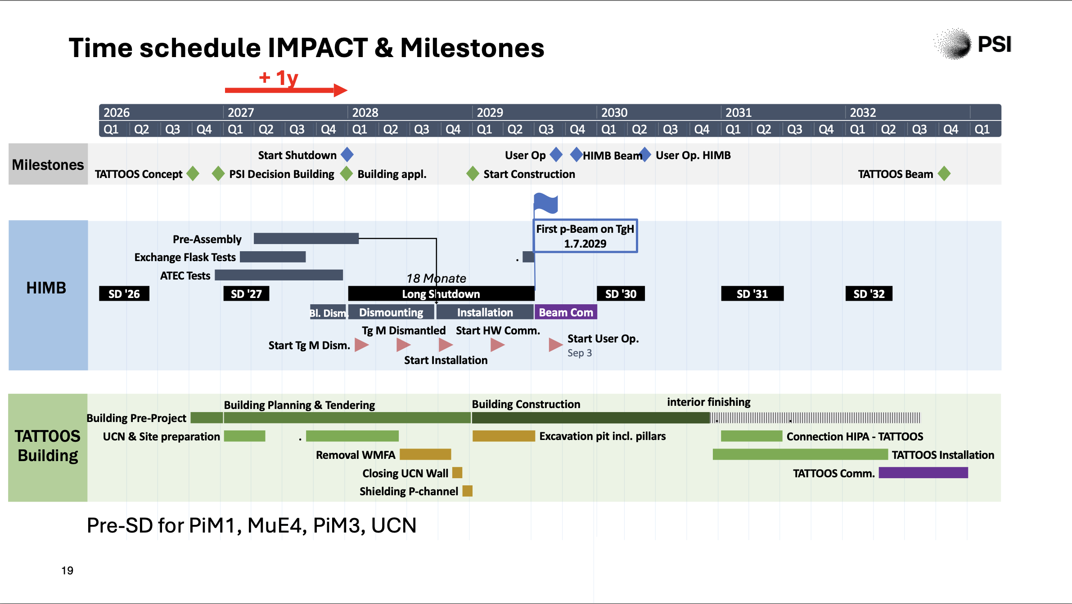
Users Meeting BVR57
A. Knecht

Slide 5
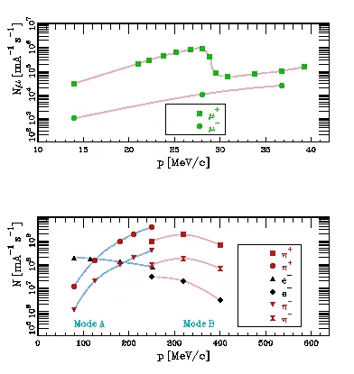
Availability of PSI muon beam (DC)
PiE1 & PiM1 beam
Particle physics program can use
  PiE1(second half), PiM1 & PiE5
Long shutdown starts in Oct. 2027 and continues for 21 months. User operation will start in Q3 2029
Possible periods to use PSI muon beam are Q2 & Q3 in 2027 or after Q3 in 2029.
Deadline of proposal submission is 15/Jan/2027
  Beamtime coordinator is Stefan RITT

Slide 6
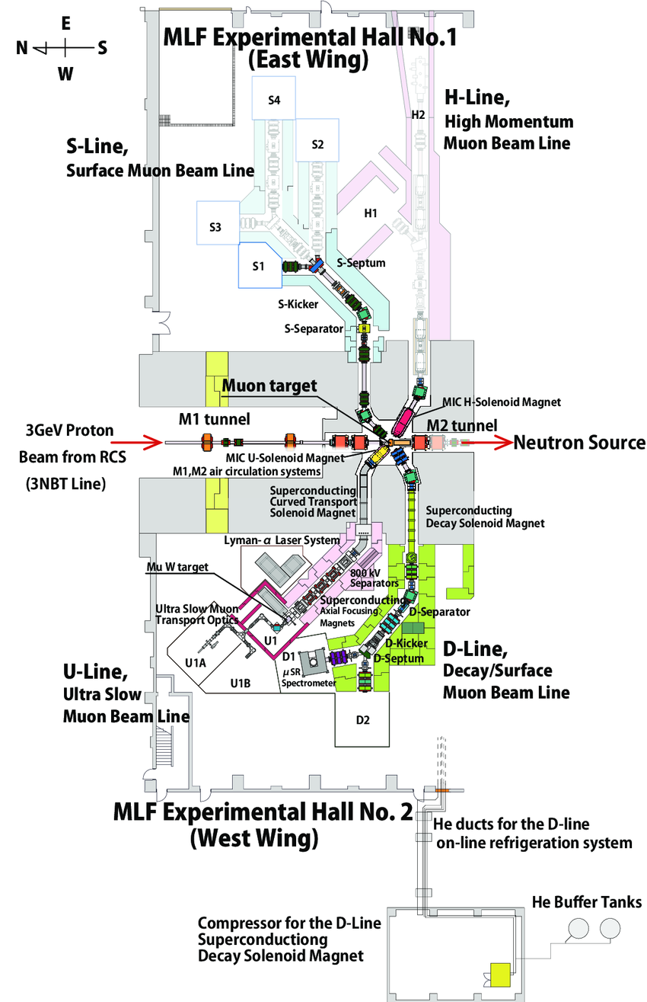
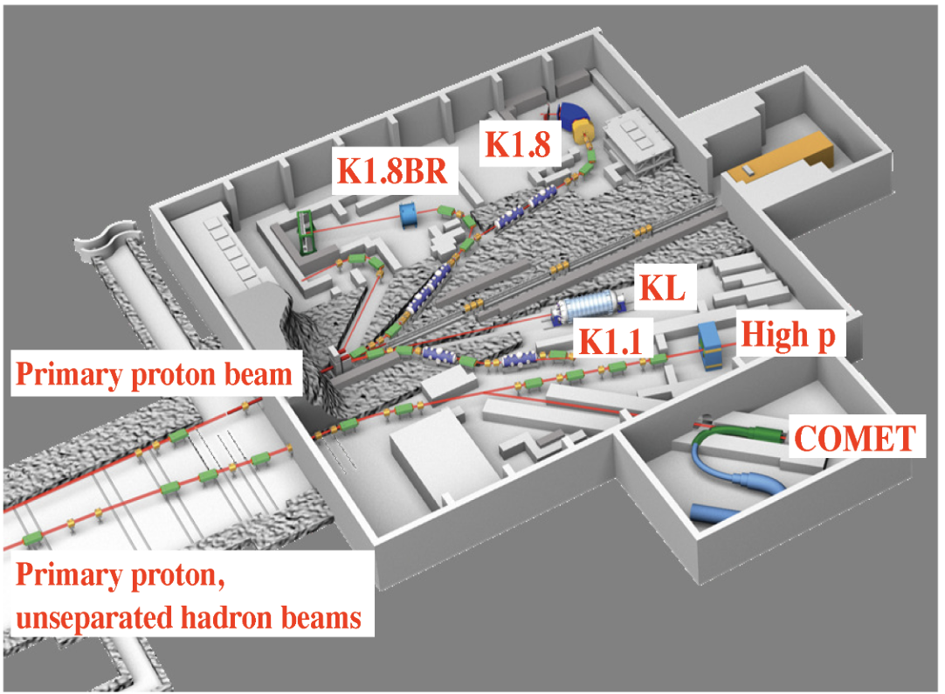
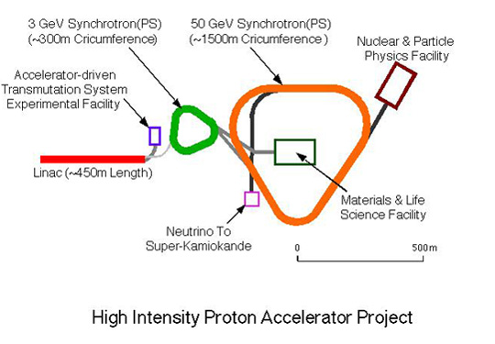
J-PARC available muon beamlines (pulsed)
COMET muon beamline
Muon production by 8GeV 0.86MHz proton beam
DC operation is also possible (though not tested)
Beam will be available in 2028
MUSE D-line
Muon production by 3GeV 25Hz proton beam

Slide 7
J-PARC muon beam
MLF muon beam D1&D2
  Decay muon 20~45MeV/c
  5 x 10⁶ muons/sec @ 500kW
  Beam size 30mm in diam.
  Clean environment and suitable for precise investigation of the muCF process
  The experiment area is not an enclosed space.
COMET muon beam
  Wide momentum range 40-100MeV/c
  10⁹ muons/sec @3.2kW
  Beam size 200 mm in diam.
  Neutron BG from the pion production target and beam dump.
  The experiment area is an enclosed space with a dedicated air ventilation system.
  Facility construction is close to the end. 1st beam will be in 2028. Beam intensity will increase step by step.

Slide 8
International coordination
Establish an international hub for experimental muon-catalyzed fusion research by integrating global expertise with domestic accelerator and detector technologies.
Muon Catalyzed Fusion
Research Infrastructure
Global partnership, J-PARC, PSI, RAL
Human Resource Development
Muon beam
Tritium handling & closed gas-loop system
Dedicated muCF experiment platform
Common simulation (& DAQ framework)
International Leadership
Student exchange
Joint PhD supervision
Young researcher mobility
Joint beam-time proposal
Shared detector development
Open data analysis framework
Global muCF collaboration
Steering committee
Shared roadmap

Slide 9
COMET Facility

Slide 10
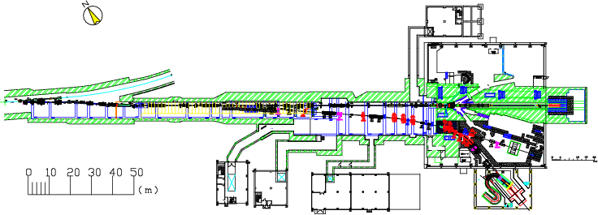
Proton transport Beamline Overview
Lambertson +
2 x Septum magnets
MR
A-line (existing)
B-line (high-p/COMET)
New B-line is constructed for high-p/COMET experiments
The branch is realized by a Lambertson magnet at Phase-I.
(for simultaneous operation of high-p experiment and A-line experiment)

Slide 11

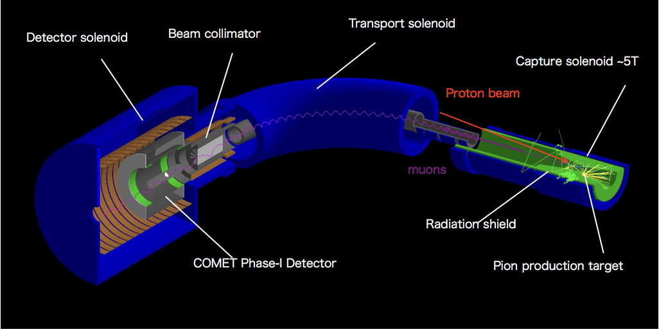
COMET Phase-I detector
Muon stopping target (17 Al disks) at the center of the detector solenoid magnet
Measure 105MeV signal electron momentum with the CDC
Triggering counter at both ends of the CDC

Slide 12
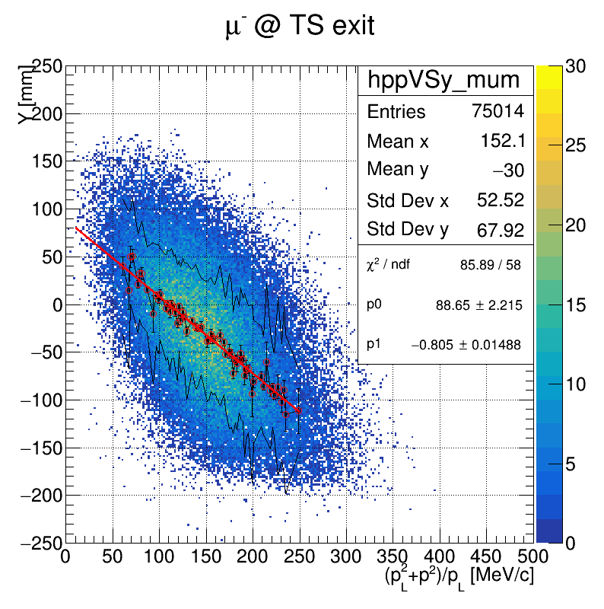
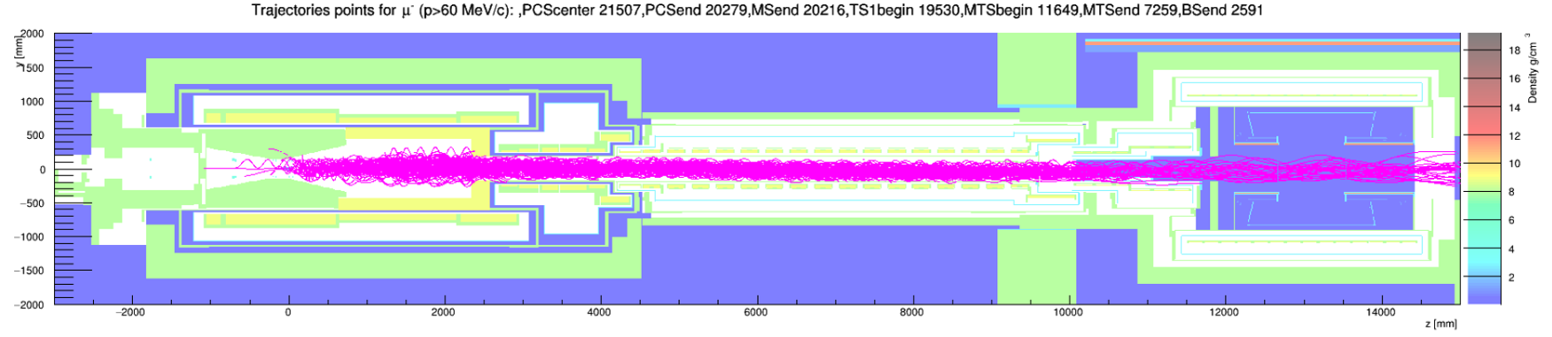
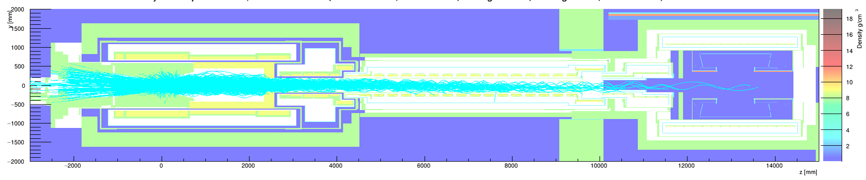
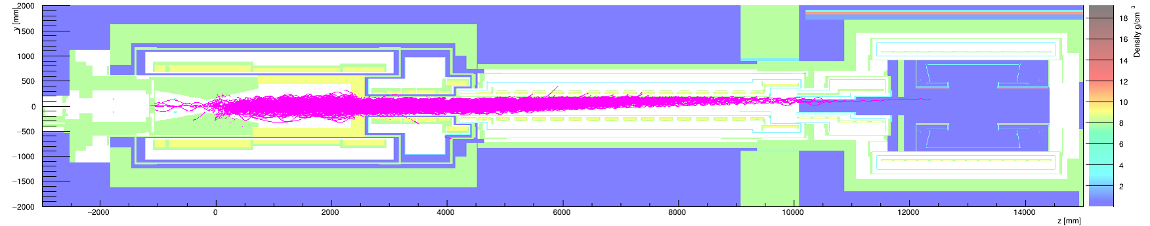

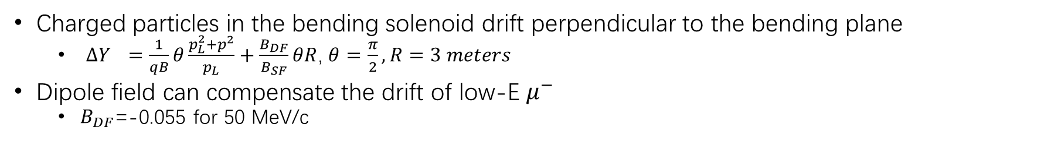


COMET Muon Beam - Bending Solenoid
Charged particles in the bending solenoid drift perpendicular to the bending plane
  ${ΔY}_{}=\frac{1}{qB}θ\frac{p_{L}^{2}+p^{2}}{p_{L}}+\frac{B_{DF}}{B_{SF}}θR$, $θ=\frac{π}{2},R=3 meters$
Dipole field can compensate the drift of low-E $μ^{−}$
  $B_{DF}$=-0.055 for 50 MeV/c
$$μ^{−}$$
TS exit
$$π^{−}$$
$$μ^{+}$$

Slide 13
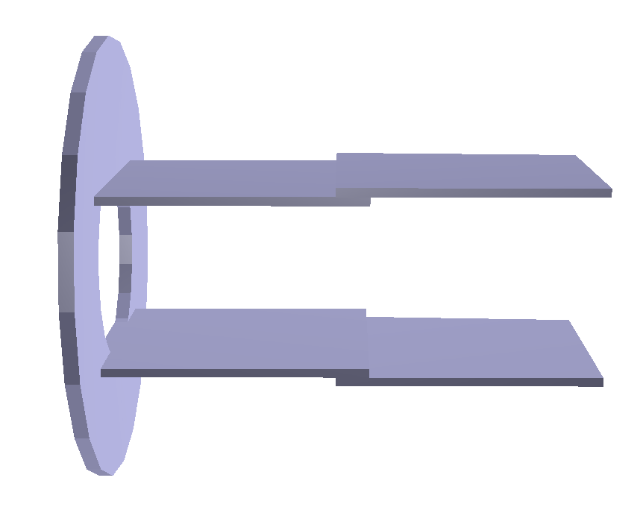
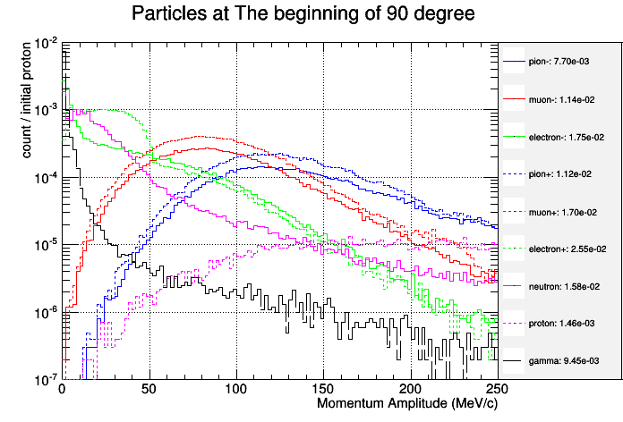
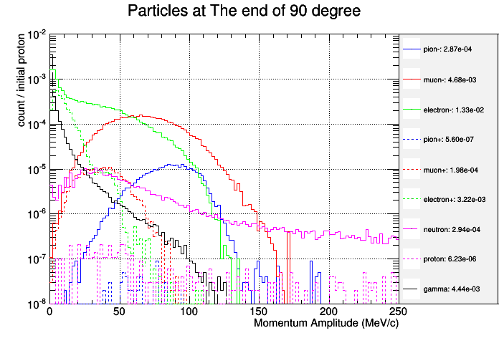


COMET Muon Beam - Collimator
Plate-shape collimator: placed at the end of MTS
  To reduce beam background and beam flash
$$μ^{−}$$
90 degree bending
Muon Transport Solenoid
Entrance of MTS
Exit of MTS
Suppressed
+Collimator
$μ^{−}$ yield not influenced

Slide 14
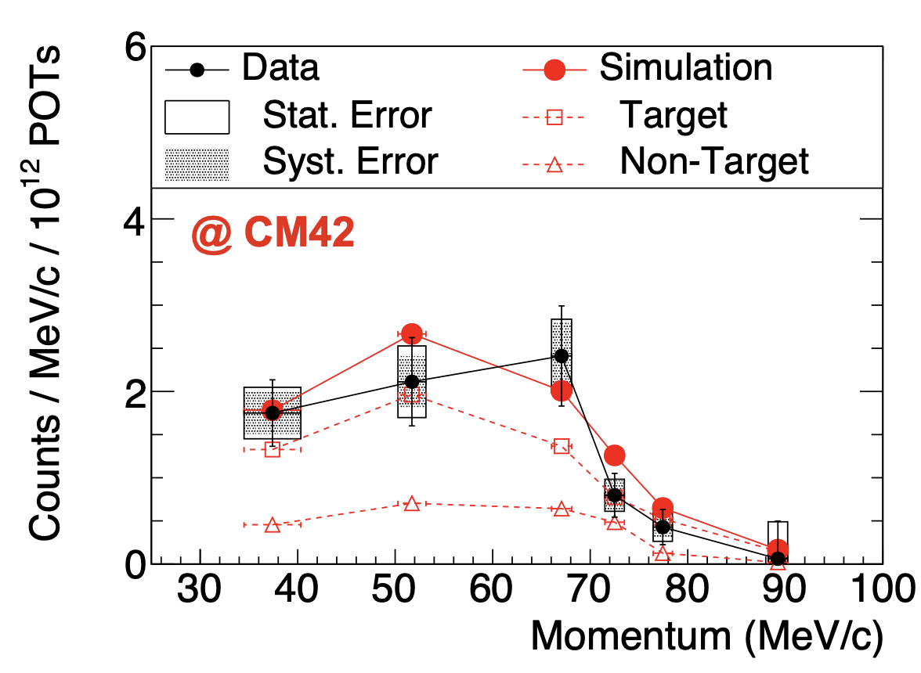
COMET Engineering Run in 2023
Preliminary
Physics beam starts in 2027-2028

