Slide 1

Detector Concepts and Key Measurements in Future µCF Experiments
2026/7/2
Akihisa TOYODA
KEK

Slide 2
Okada-san’s μCF diagram
Radiation chemistry effect: High muonic-molecule formation rates for D₃⁺
Fast Track:A high-speed reaction pathway via resonant states
In-flight reactions: Suppression of α–μ sticking (W) through fusion occurring in flight
3
１
2

Slide 3
Excited muonic molecule
Radiation Chemistry Effect
dtμ*
Fast Track
non-radiative
radiative
In-flight reactions
tμ
d
tμ
d
hot ～1 keV
cold
Hot dμ / tμ detection
X-ray detection by TES

Slide 4
Key measurements
Measure fusion products and sticking X-rays from targets subjected to radiation-chemical effects in order to evaluate the fusion yield, fusion rate, and sticking probability.
  Aim to maximize the muonic molecular formation rate.
Observe radiative decays from excited muonic molecules using TES.
  Investigate changes in the radiative decay yield in combination with radiation-chemical effects.
  Improve the understanding of the muon-catalyzed fusion (μCF) process by comparing the measured spectra with theoretical predictions.
  →In this session Toyama-san’s talk
Observe non-radiative decays from excited muonic molecules through the detection of hot muonic atoms.
  Investigate changes in the non-radiative decay yield in combination with radiation-chemical effects.
  Evaluate the non-radiative decay yield and its correlation with the sticking probability. Combined with the TES measurements, these studies will provide further insight into the μCF process.

Slide 5
Key measurement targets
Excited muonic
molecule X-ray ～2 keV
fusion proton
3 MeV
mu-e decay e
0～52.5 MeV
ddμCF
～50%
d
d
μ
p
t
μ
recycling muon
～10 keV
Hot dμ
～1 keV
n
³He
μ
～50%
fusion neutron
2.5 MeV
Sticking X-ray
6-10 keV
Excited muonic
molecule X-ray ～2 keV
fusion alpha
3.5 MeV
dtμCF
mu-e decay e
0～52.5 MeV
n
⁴He
recycling muon
～10 keV
t
d
μ
μ
Hot tμ
～1 keV
fusion neutron
14 MeV
Sticking X-ray
6-10 keV

Slide 6
Detector candidates
fusion products
  proton, alpha: SSBs → Cedric-san’s talk
  neutron: NE213, OGS, … → Ueno-san and Aramaki-san’s talk
mu-e decay electrons: plastic scintillator
X-rays: SDD or TES → Toyama-san’s talk
recycling muon: special setup is needed →Patrick-san’s talk
Hot dμ/tμ: special setup is needed→ in this talk

Slide 7
Observables and typical resolution
Yield, Energy, Timing, Pulse shape...
fusion products
  proton, alpha: Yield, Energy for PID (resolution～20 keV), Timing
  neutron: Yield, Pulse shape and Energy for PID, Timing
mu-e decay electrons: Timing(resolution～1 ns)
X-rays(He Sticking, excited muonic molecule): Energy(～150 eV for He Sticking), Timing

Slide 8
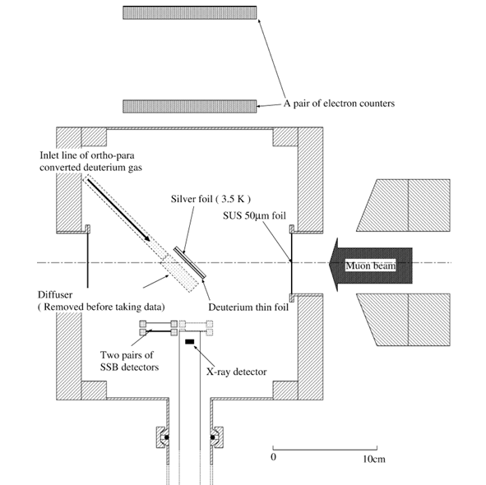
Setup of ddμCF in solid
Similar to past Toyoda’s ddμCF experiment
Diffuse deuterium gas onto the cold (4 K) silver foil and form the thin solid foil (～300 μm^{t})
Measure 3 MeV fusion protons to determine the fusion rate.
Both DC beams and pulse beams are fine.
Other detectors: plastic scintillators, the X-ray detector (incl. TES)
Apparatus for producing radiation-chemical effects such as an electron gun

Slide 9
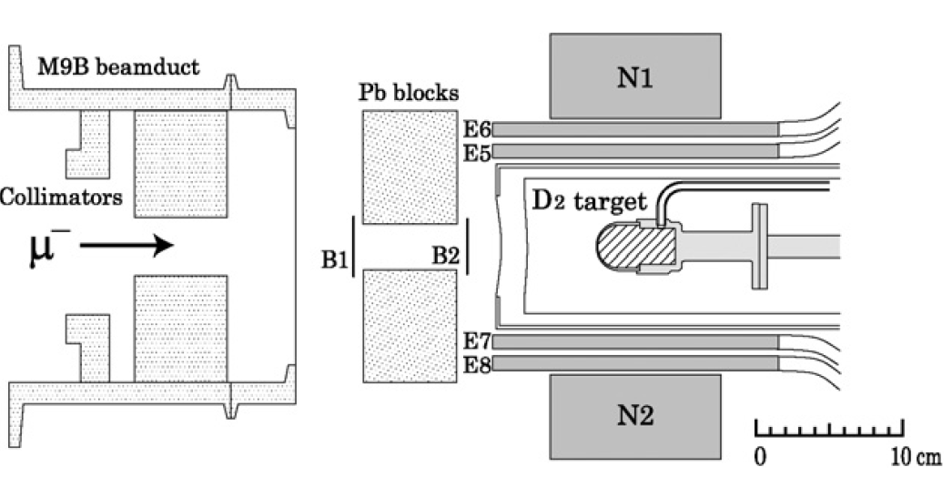
Alternative dd-μCF setup in liquid/solid
H. Imao, Physics Letters B 658 (2008) 120–124
Similar to past Imao-san’s ddmuCF experiment
Target cell temperature is controlled (about 4-35 K) to form solid or liquid deuterium target.
Measure 2.5 MeV fusion neutrons to determine the fusion rate.
DC beams are necessary to measure low energy neutrons.
Other detectors: plastic scintillators, the X-ray detector
Apparatus for producing radiation-chemical effects

Slide 10
dt-μCF in liquid/solid
K. Ishida et al., Hyperfine Interactions
138: 225–234, 2001.
Similar to past RIKEN-RAL dt-μCF experiment
Target cell temperature is controlled (about 5-20 K) to form solid or liquid D/T target.
Measure 14 MeV fusion neutrons to determine the fusion rate.
Both DC beams and pulse beams are fine.
Other detectors: plastic scintillators, the X-ray detector(incl. TES)
Apparatus for producing radiation-chemical effects

Slide 11
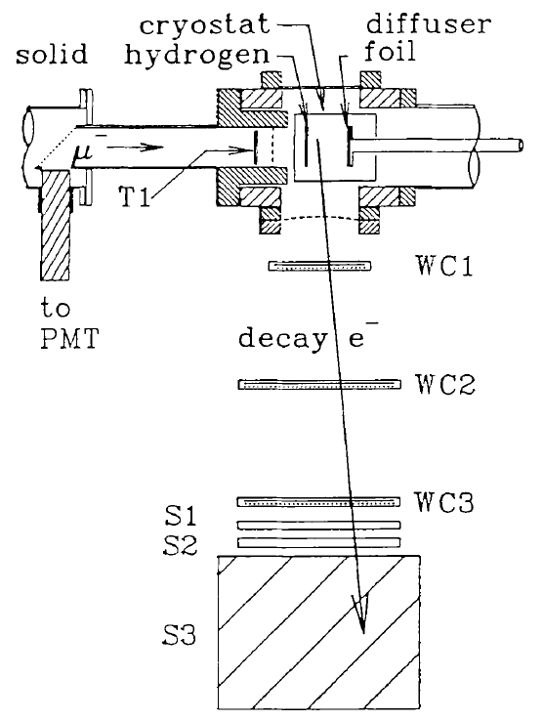
Hot dμ detection setup:
Past TRIUMF dd-μCF setup
The purpose of this experiment is to detect slow (Ramsauer minimum of about 1 eV) dμ.
  The similar setup can be used for the Hot dμ detection.
Detection system: 3 layer tracking WC, TOF of T1(start)+S1,2(stop, coin. for decay-e), and energy measurement by S3 NaI to evaluate muon decay position.
Target is H/D layer (about 1 mm^{t}) + D₂ layer (about 1 μm^{t}) formed onto the cold gold foil.
B.M. FORSTER et al. Hyperfine Interactions 65(1990)1007

Slide 12
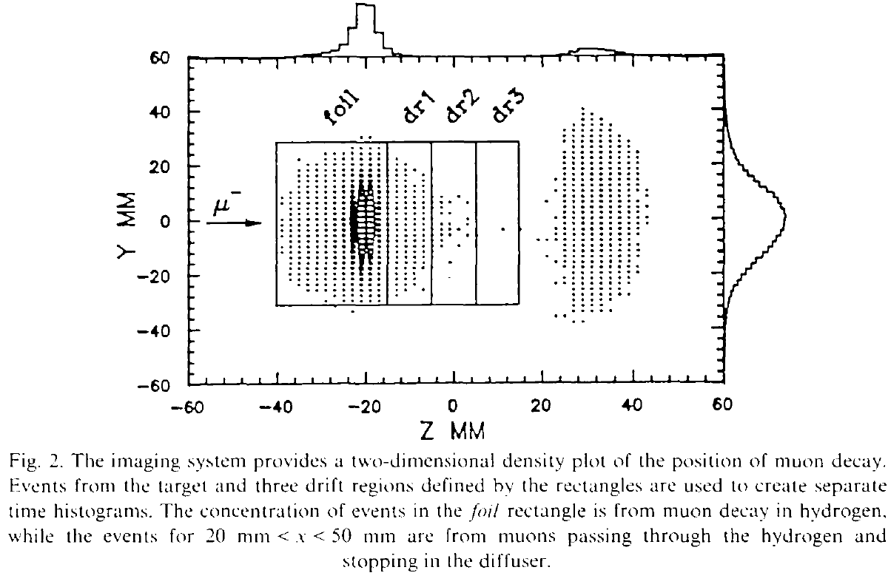
Past TRIUMF ddmuCF result
B.M. FORSTER et al. Hyperfine Interactions 65(1990)1007
They successfully measured the slow dμ of 1.1 eV which is near the Ramsauer minimum.
They also confirmed the Ramsauer-Townsend effect by changing the H/D film thickness.
Their set up has relatively short dμ drift length of about 45 mm because they aimed to measure the slow dμ.
Hot dμ energy is expected to be about 1 keV(～30 cm /1 μs). Even if there is a Hot dμ, it will be stopped at the diffuser. Background discrimination is difficult with this setup.
To measure the Hot dμ, removable diffuser is necessary to secure over 10 cm drift region.

Slide 13
Summary
Three Key Measurements
  Maximization of the muonic molecular formation rate via radiation-chemical effects
  Investigation of radiative decay processes using TES detectors
  Investigation of non-radiative decay processes through hot muonic atom detection
Observables and Detection Methods
  Fusion products
    3 MeV protons → SSB
    2.5 MeV neutrons → NE213, OGS, etc.
    3.5 MeV alpha particles → SSB
    14 MeV neutrons → NE213, OGS, etc.
  He sticking X-rays (6–10 keV) → SDD
  Excited muonic molecule X-rays (<2 keV) → TES
  Recycling muons (~10 keV) → Dedicated setup
  Hot muonic atoms (~1 keV) → Dedicated setup

Slide 14
spares

Slide 15
ORTEC SSB

Slide 16
Techno AP SDD

Slide 17
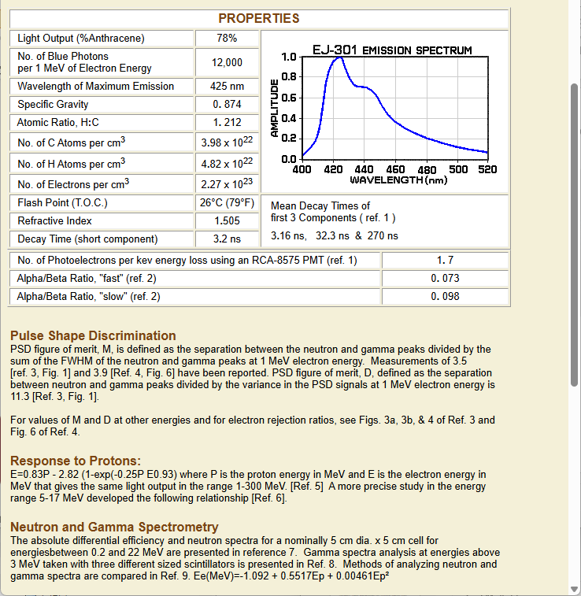
NE213/EJ301

Slide 18
Alternative setup of dtμCF in solid
Similar to past Toyoda’s ddμCF experiment
Diffuse D/T gas onto the cold (4 K) silver foil and form the thin solid foil
Measure 3.5 MeV fusion alphas or 14 MeV fusion neutrons to determine the fusion rate.
Both DC beams and pulse beams are fine.
Other detectors: plastic scintillators, the X-ray detector
There is no target cell, so that we need to prepare double layer tritium confinement system.

Slide 19
dd-muCF experiment for non-radiative decay
H₂D₂ layer
1 mm^{t}
thin D₂ layer
2 μm^{t}
Chamber
Cryostat
ラムザウアからのdμは1 eVぐらい,epithermalも同等なのに対して、ddμ*からのHot dμは1 keV程度と高い。1 eVのdμの速度は1 cm/μsなので100 mmも離せばすべてHot dμだけになる。
recycling muonが効いてくるようであれば、磁場もしくは電場を掛けてsweepする必要がある。 dμは電気的に中性なので影響を受けない。
SSBsでΔE-Eを測ると必然的にcoincidenceを取ることになる。適切に置くことで上流標的からのdd-muCFの影響を受けずにHot dμからのddμイベントだけ見ることができる。
ddμCFはrateが低いので2回目のサイクルの影響は少ない。
標的間隔を変えてデータが取れると面白い。
Beam
Hot dμ
SSBs
～100 mm
Ag foil
movable
diffuser

Slide 20
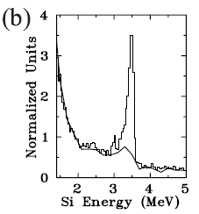
過去の参考になる実験2: 藤原さんのTRIUMF実験
M.C. Fujiwara, et al., Phys. Rev. Lett. 85, DOI: https://doi.org/10.1103/PhysRevLett.85.1642

Slide 21
dt-muCF experiment for non-radiative decay
H₂D₂ layer
1 mm^{t}
thin T₂
2 μm^{t}
Chamber
Cryostat
1枚目標的をthin T₂にすれば、dtμ*からのHot tμによるfusion rateおよびdtμ*の量を測定可能。fusion productであるHe(3.5 MeV)を測る。n(14 MeV)も。
下流標的からはddμによるfusion productsがあるが、energy/粒子が違うので分離できる。
上流標的へのSSBs1の立体角は小さくできる。
下流標的へのSSBs2の立体角は小さくできる。こちらのfusion productはdtμ1回分と残りはttμ。dtμがどの程度起こったかを評価。
藤原さんのTRIUMF実験では、上流がH/T layer(～1 mm)にthin D₂ layer(tμのdegrader)で、下流がthin D₂ layerだった。目的が違う実験。ΔE-Eも測っていない.ラムザウア効果を使っている
SSBs2
Beam
Hot tμ
SSBs1
～100 mm
Ag foil
movable
diffuser

