Slide 1


Future perspectives of muCF studies in Relation to COMET
Satoshi MIHARA
KEK/J-PARC

Slide 2
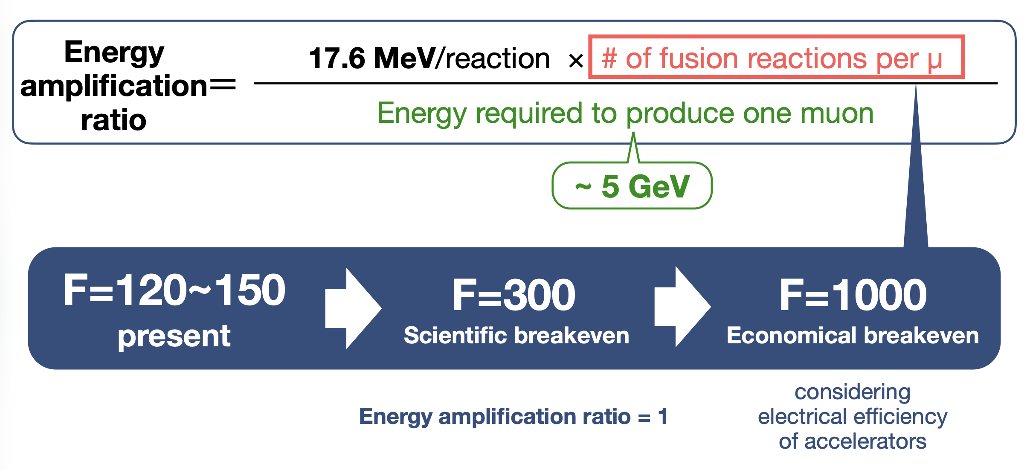

Slide 3
muCF studies in COMET
Muon production efficiency is (extremely) high compared to other muon facility thanks to the capture solenoid magnet and curved solenoid muon transport
  Revise “energy required to produce one muon ~ 5GeV”?
Thick target and/or degrader is necessary to stop as many muons as possible.
Muon focusing after the exit of the transport magnet will increase the muon stopping density.
  Study of the radiation chemical effect
Huge neutron and gamma backgrounds due to the COMET muon production/collection scheme

Slide 4
COMET Facility Introduction

Slide 5
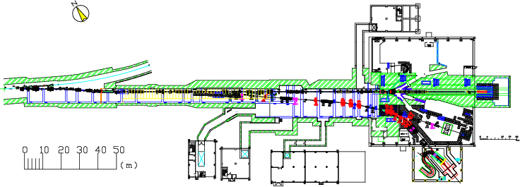
Proton transport Beamline Overview
Lambertson +
2 x Septum magnets
MR
A-line (existing)
B-line (high-p/COMET)
New B-line is constructed for high-p/COMET experiments
The branch is realized by a Lambertson magnet at Phase-I.
(for simultaneous operation of high-p experiment and A-line experiment)

Slide 6

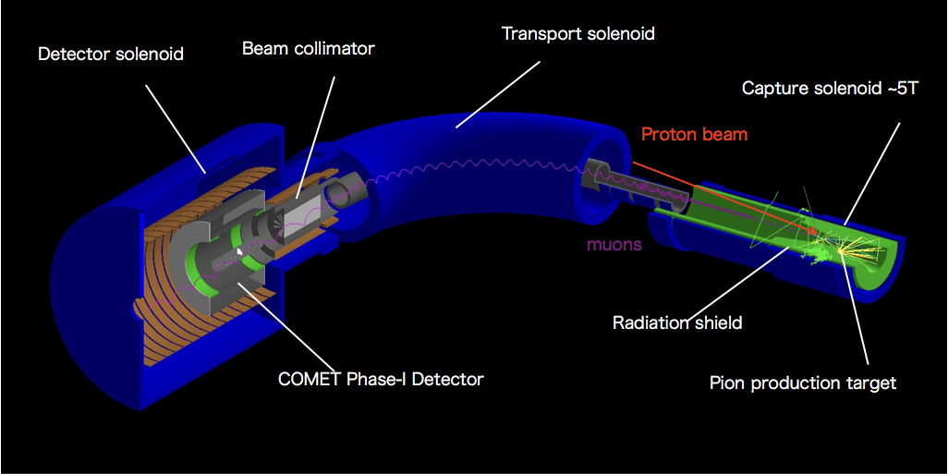
COMET Phase-I detector
Muon stopping target (17 Al disks) at the center of the detector solenoid magnet
Measure 105MeV signal electron momentum with the CDC
Triggering counter at both ends of the CDC

Slide 7
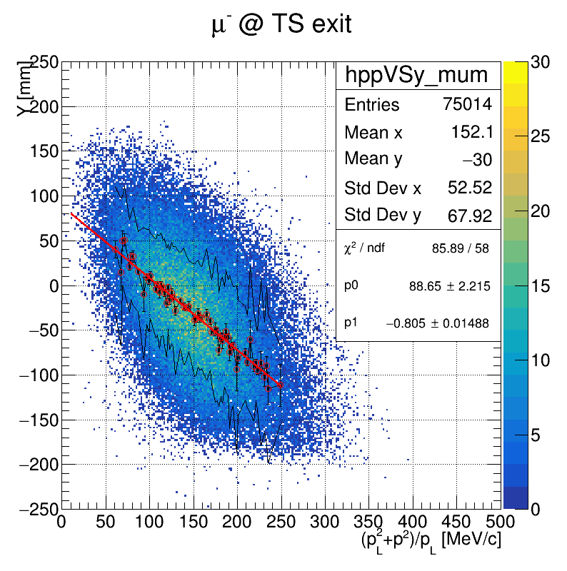
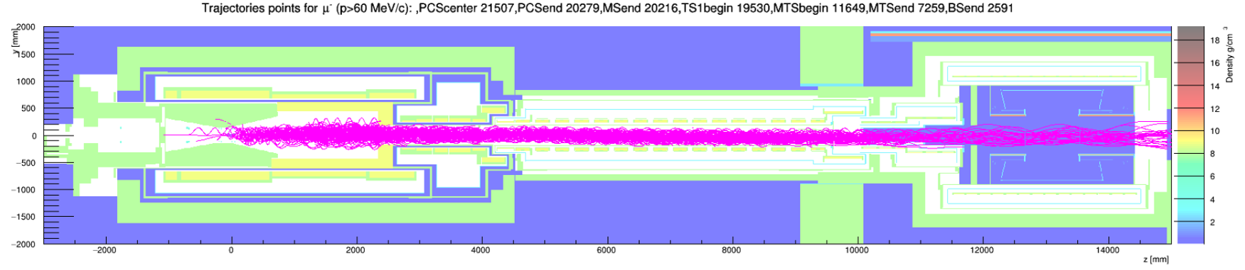
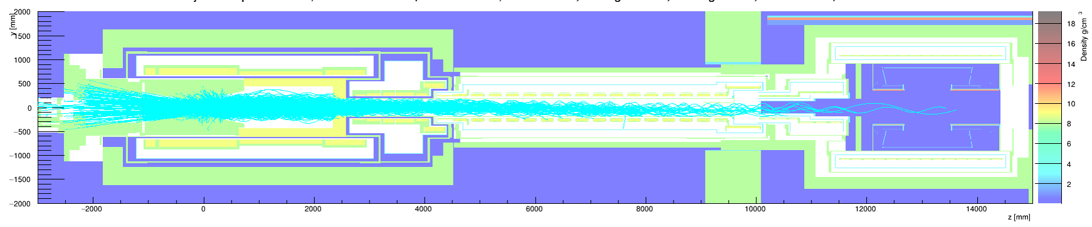
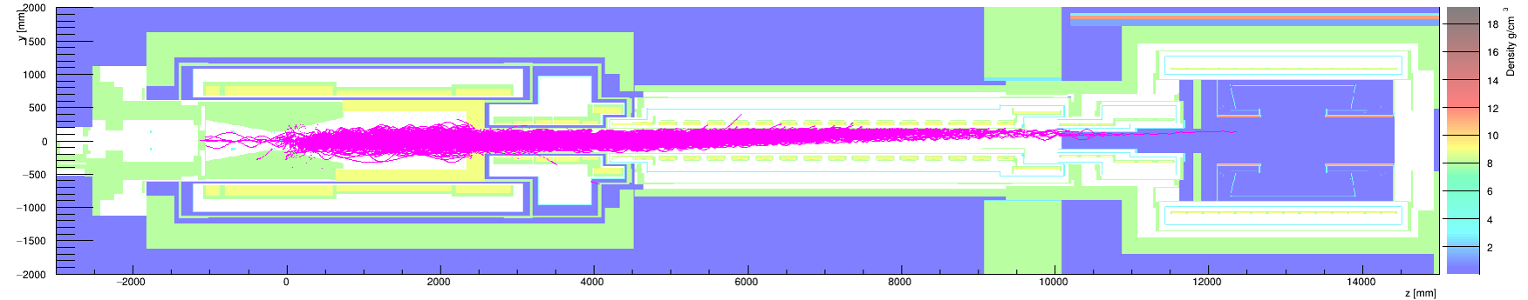

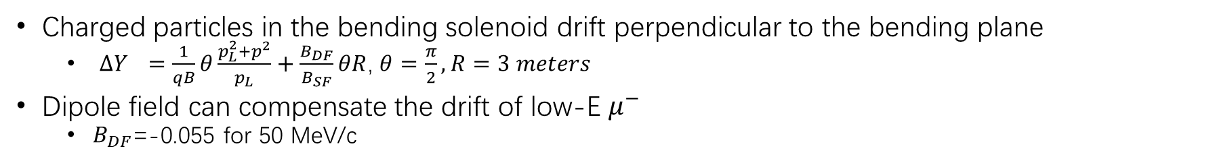


COMET Muon Beam - Bending Solenoid
Charged particles in the bending solenoid drift perpendicular to the bending plane
  ${ΔY}_{}=\frac{1}{qB}θ\frac{p_{L}^{2}+p^{2}}{p_{L}}+\frac{B_{DF}}{B_{SF}}θR$, $θ=\frac{π}{2},R=3 meters$
Dipole field can compensate the drift of low-E $μ^{−}$
  $B_{DF}$=-0.055 for 50 MeV/c
$$μ^{−}$$
TS exit
$$π^{−}$$
$$μ^{+}$$

Slide 8
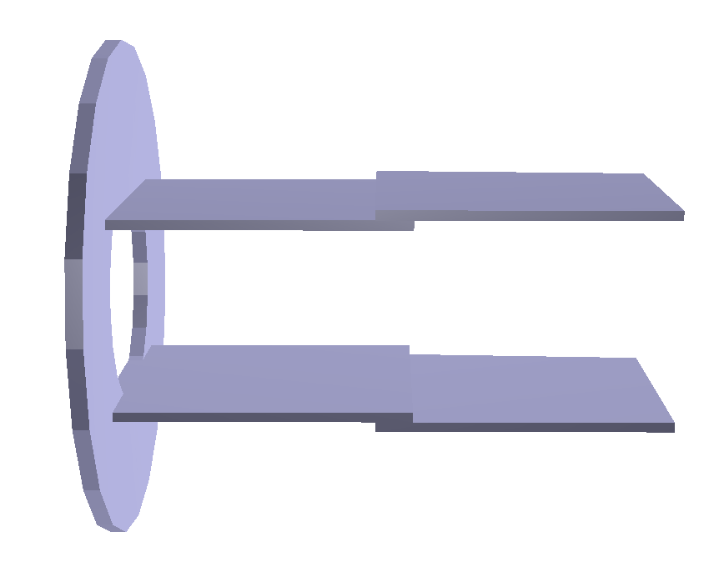
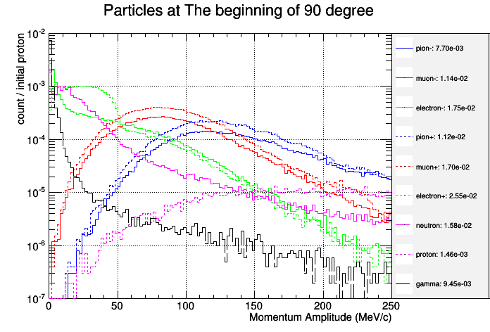
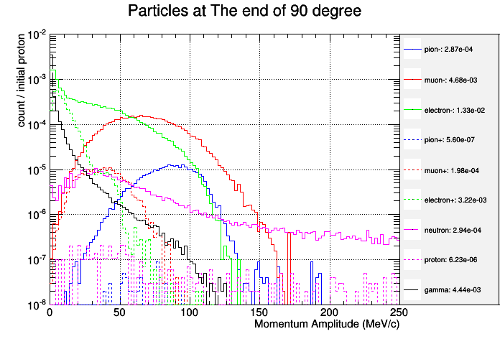


COMET Muon Beam - Collimator
Plate-shape collimator: placed at the end of MTS
  To reduce beam background and beam flash
$$μ^{−}$$
90 degree bending
Muon Transport Solenoid
Entrance of MTS
Exit of MTS
Suppressed
+Collimator
$μ^{−}$ yield not influenced

Slide 9
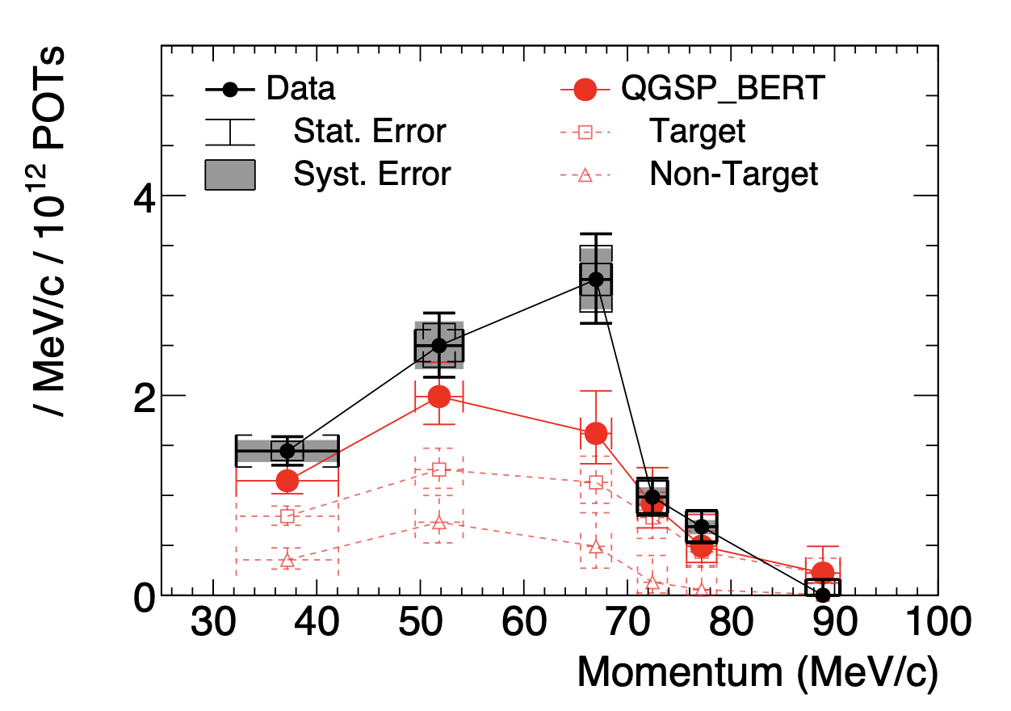
COMET Engineering Run in 2023
Physics beam starts in 2028

Slide 10
Muon beam focusing study
Muon beam size is about 200mm in diam. at the exit of the COMET muon transport.
Focusing by adding another solenoid magnet with stronger magnetic field.
  Optimization is necessary as too strong magnetic field would reflect the muons!
Initial look on possible designs using G4beamline.

Slide 11
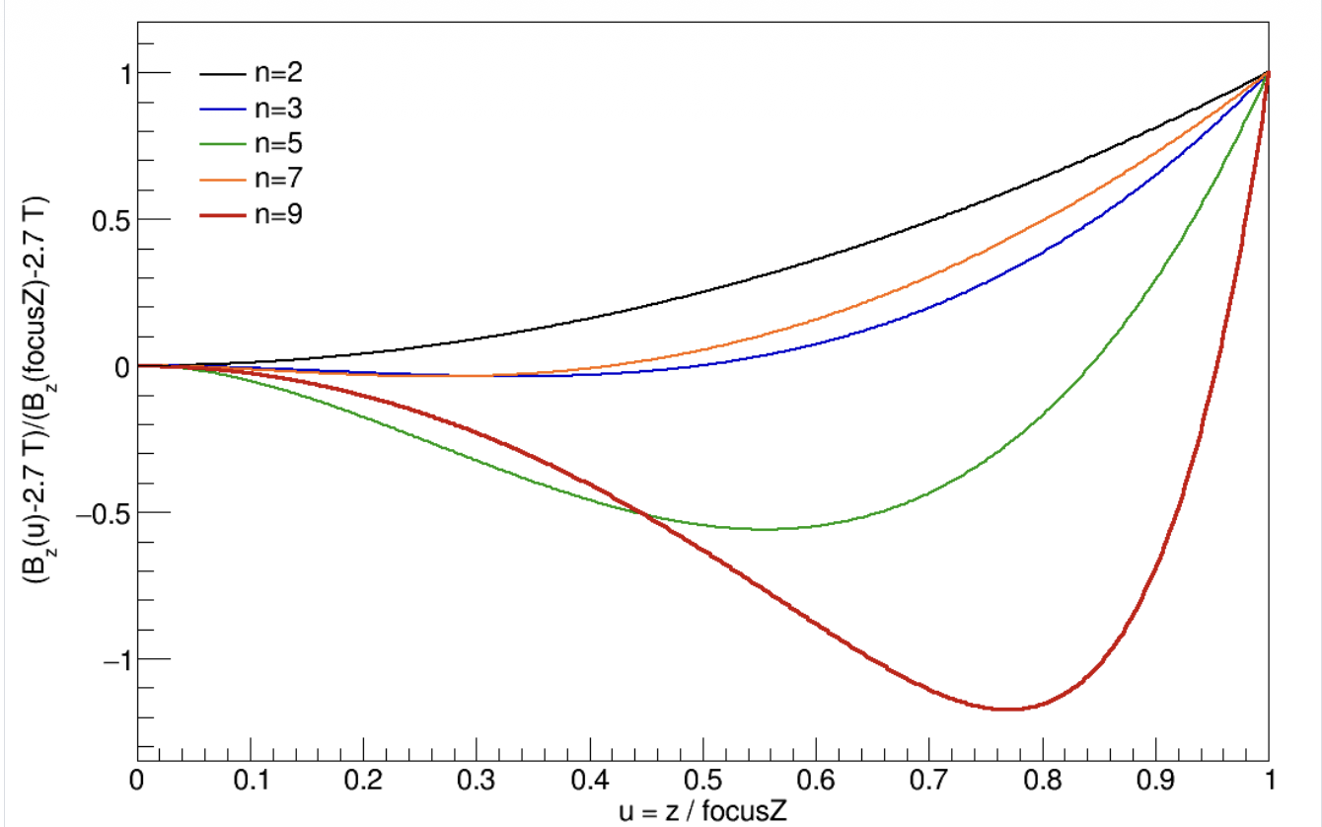
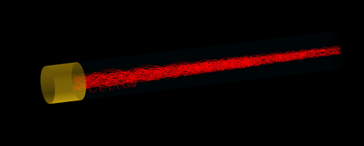
Muon Focusing
(study by Kou OISHI)
Exit of the transport solenoid
3.2T
5T
Install a new virtual magnet
3m long & 3.2T-5T magnetic field
Optimize the gradient of the solenoidal field change of 3.2T-5T.
New solenoid magnet with a length of 3m

Slide 12
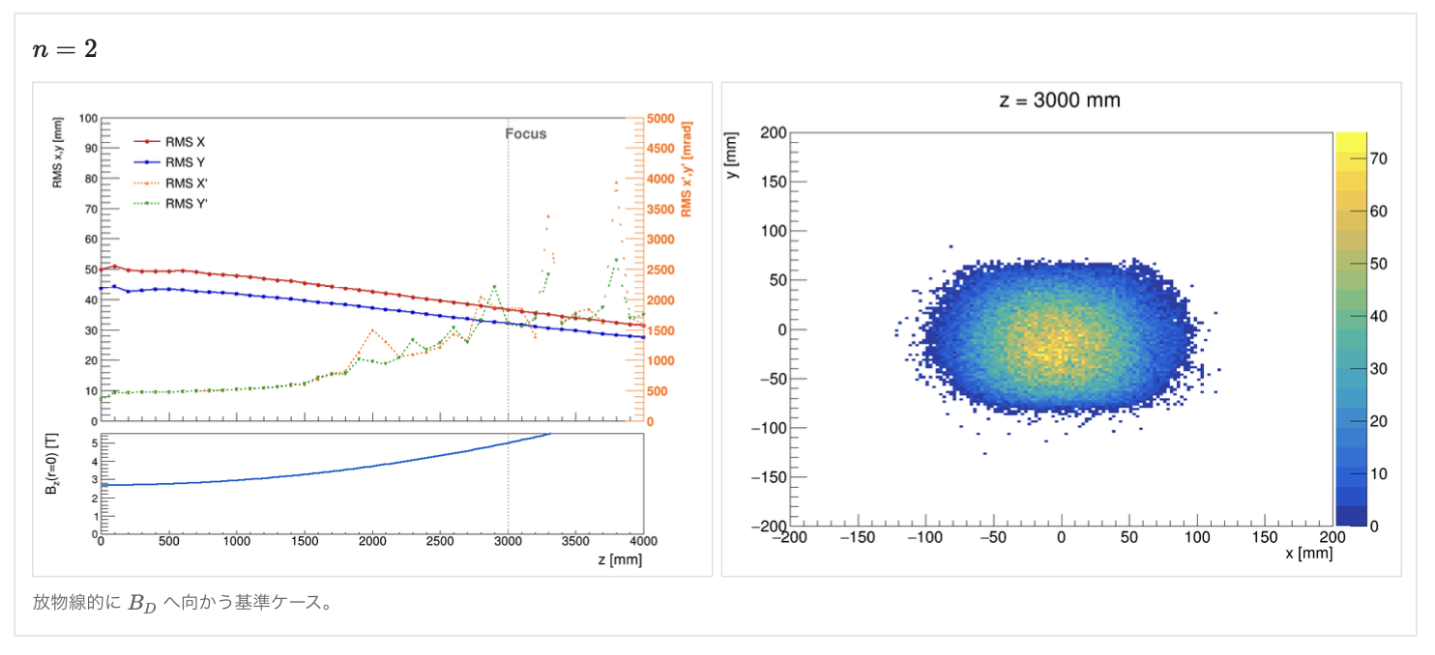
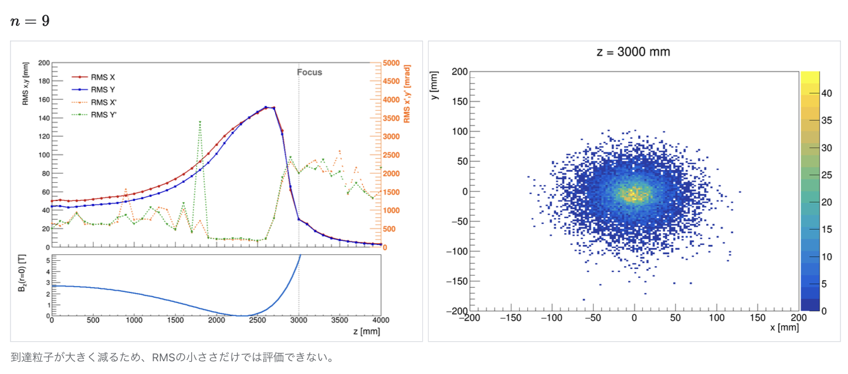
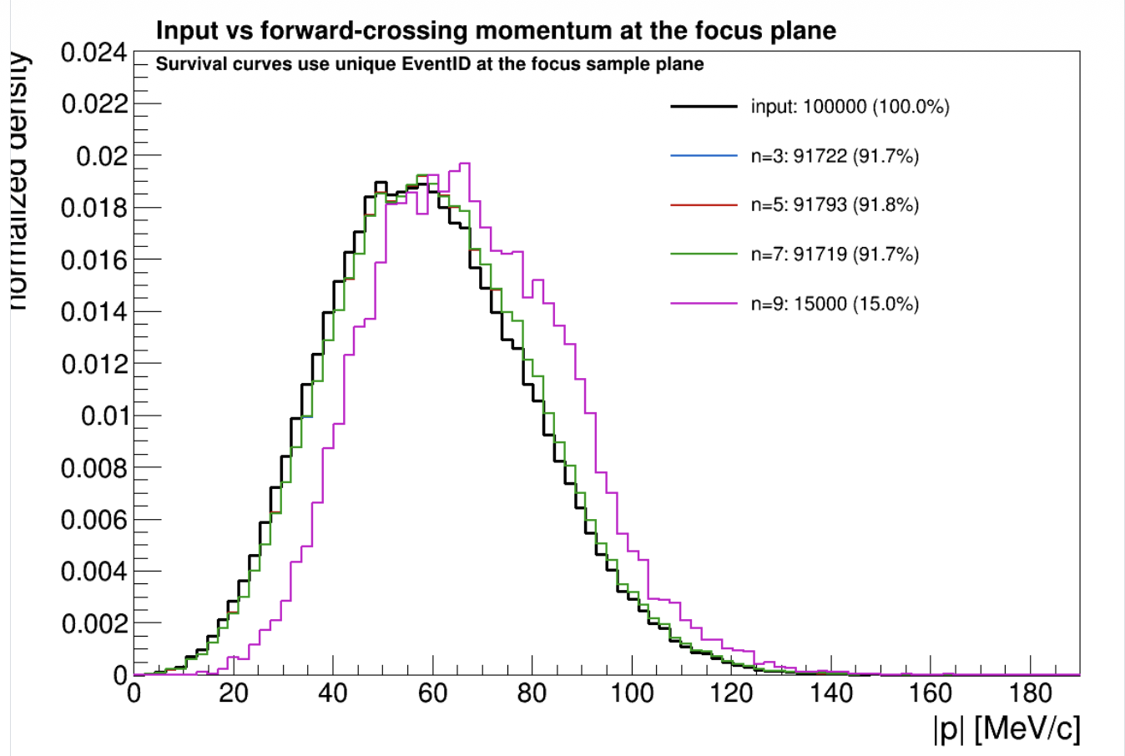
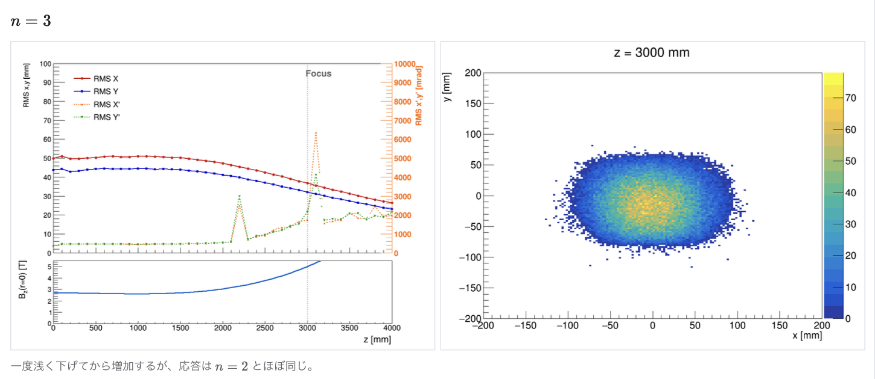
Results

Slide 13
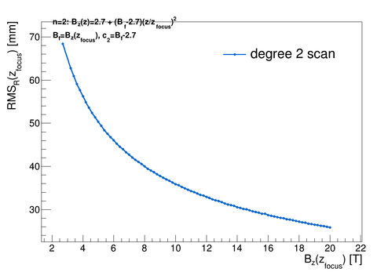
Stronger magnetic field cases

Slide 14
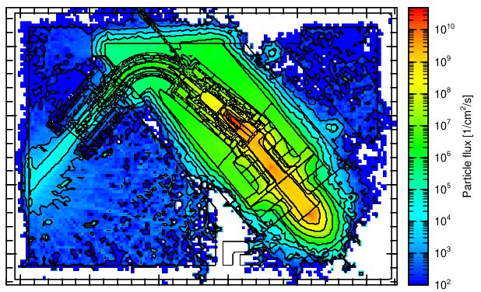
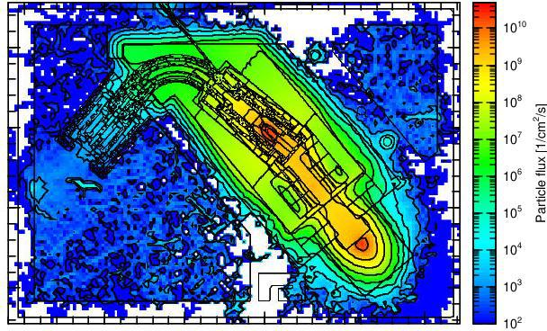
Neutron and Gamma Background
Neutron
Gamma

Slide 15
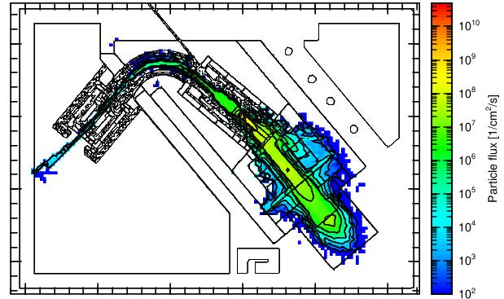
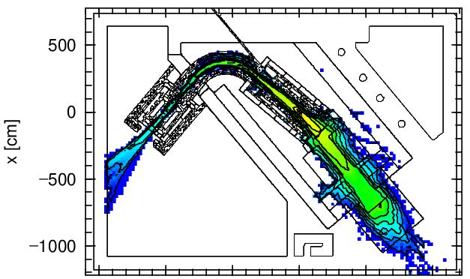
Pions and muons
Pion
Muon

