Slide 1
Higgs Pair Production at the FCC
Lennox Wood, Jordy Degens
19/08/26

Slide 2
The Higgs Boson
In 2012 at ATLAS and CMS experiments at the LHC, we observed the Higgs boson.
We’ve learnt a lot about the Higgs since 2012 through single Higgs production.
But what’s better than a single Higgs boson being produced?
More than one Higgs boson being produced!
Currently one of the main focuses of ATLAS and CMS physics programmes are processes that produce Higgs boson pairs (HH).

Slide 3
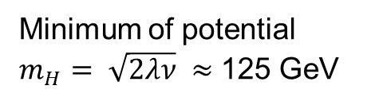
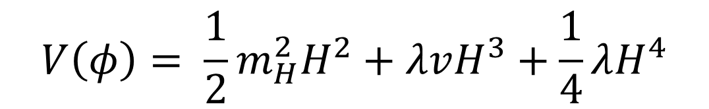
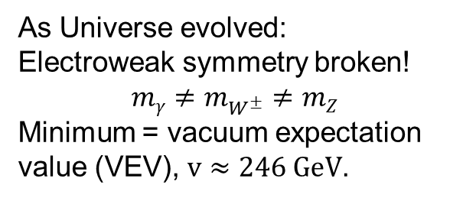


Higgs Field
Why are multiple Higgs events interesting?
Higgs pair production is the only way to measure the Higgs self-coupling (λ). Which defines the shape of the Higgs potential.
Beginning of Universe:
$$mγ=m_{W^{±}}=mZ$$
$$V\left(φ\right)= \frac{1}{2}m_{H}^{2}H^{2}+λvH^{3}+\frac{1}{4}λH^{4}$$
[1]
Minimum of potential
$m_{H}= \sqrt{2λν} ≈$ 125 GeV
As Universe evolved:
Electroweak symmetry broken!
$$mγ≠m_{W^{±}}≠mZ$$
Minimum = vacuum expectation value (VEV), $v≈246 GeV$.
$λ$ can only be directly measured through HH production
Knowing more about the shape of this potential is the ultimate test of electroweak symmetry breaking.
Can tell us about the stability of the Universe and its ultimate future!
But HH processes are 1000 times rarer than single Higgs events, making this quite difficult to study!

Slide 4
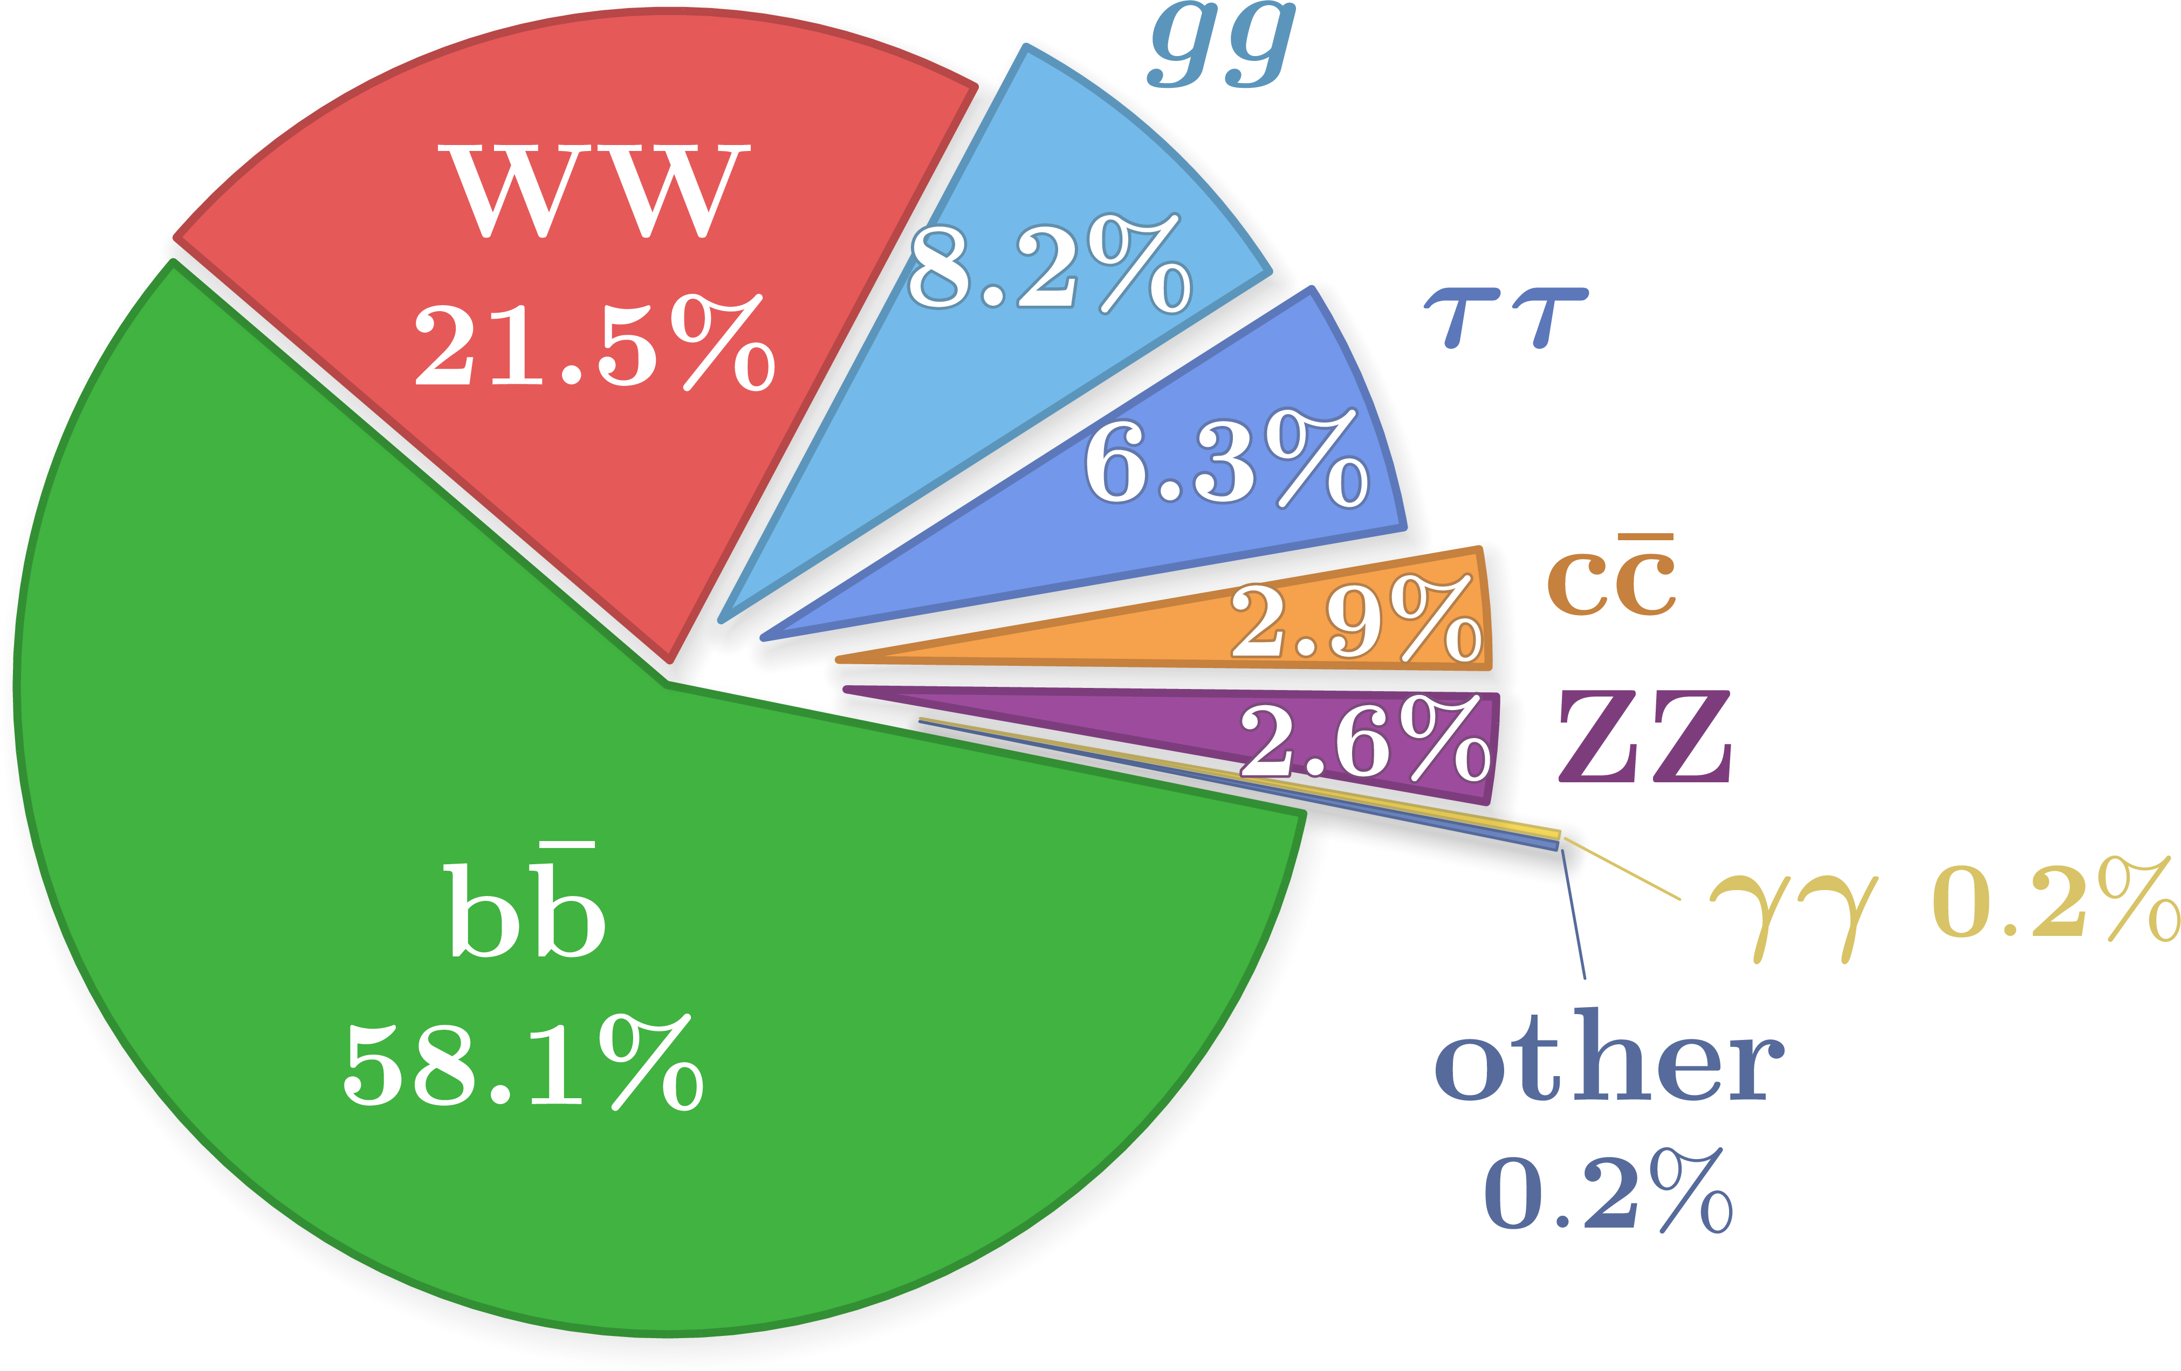
Di-Higgs Final States
We are part of one of these analyses at Liverpool with a final state of two b-quarks and two tau leptons (HH → bbττ).
Single Higgs Branching Ratios
HH Branching Ratios
[2]
HH → bbττ is a compromise that offers relatively low amounts of background and high decay fraction. Making it the most sensitive HH channel!

Slide 5







Within the ATLAS Detector
Tau lepton pair
Further decays with a decay length of ~2 mm
Proton
[3]
Higgs Boson
Initial State
Collision
Higgs Boson Decay into Final State
Initial State
Collision
Higgs Boson Decay into Final State
Initial State
Collision
Higgs Boson Decay into Final State
Lifetime of 1.6x10⁻²³ s!
Only travels 50-60 fm before decaying!
These particles then go through the rest of the detector.
Beam Path
Higgs Boson
Bottom quark pair which
hadronise and decays into a spray of particles called a jet with a decay length of ~4 mm
Proton

Slide 6
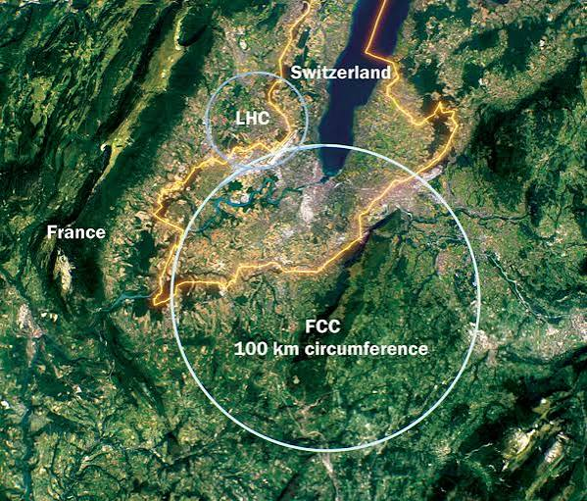
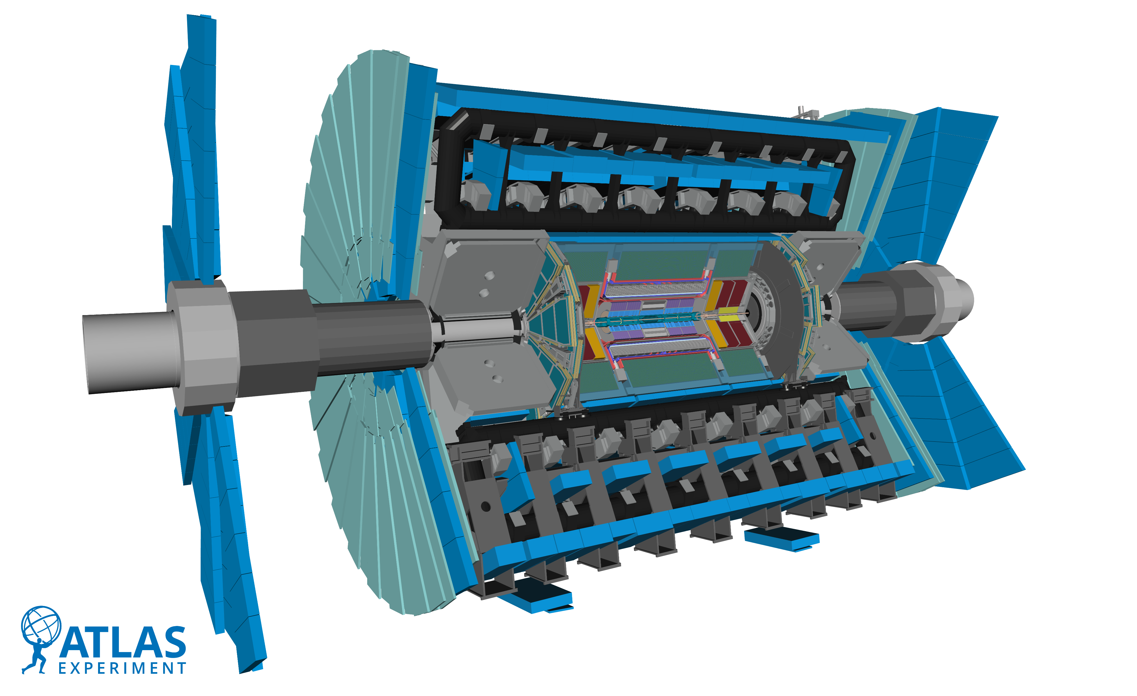
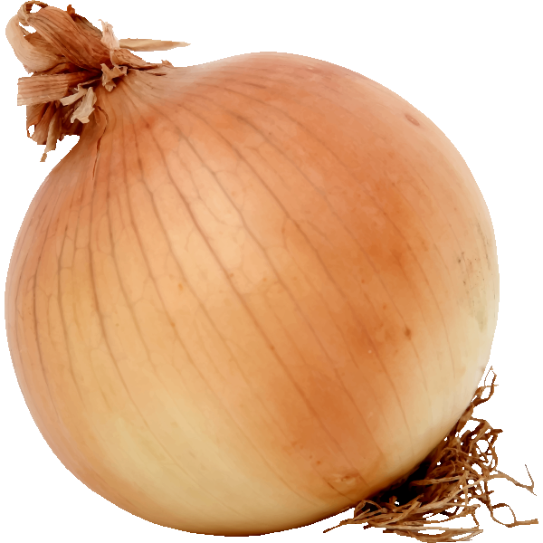
The FCC and the detection of particles
The FCC-hh is planned to be the next generation particle detector
Larger than current LHC:
More collisions 2-3ab (10x more than LHC)
Higher energies of 100TeV (10x more than LHC)
The detector: Imagine the detector as a giant onion; every layer is a different type of sensor for different particles.
Hadronic tau decay jets
Neutrinos
[4]
Muon Spectrometer
Hadronic Calorimeter
The ATLAS Experiment is ~500 onions tall!
Electromagnetic Calorimeter
Bottom-quark jets
Inner Detector

Slide 7
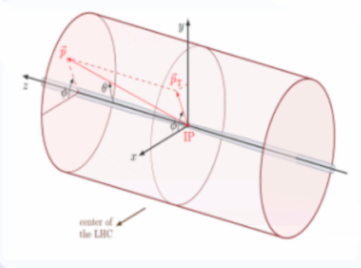
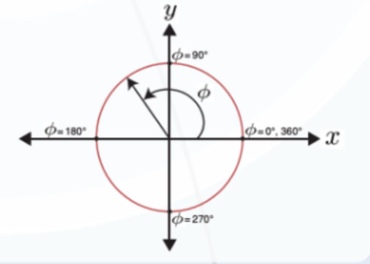
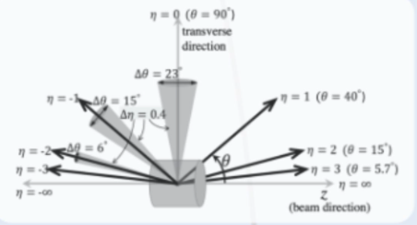
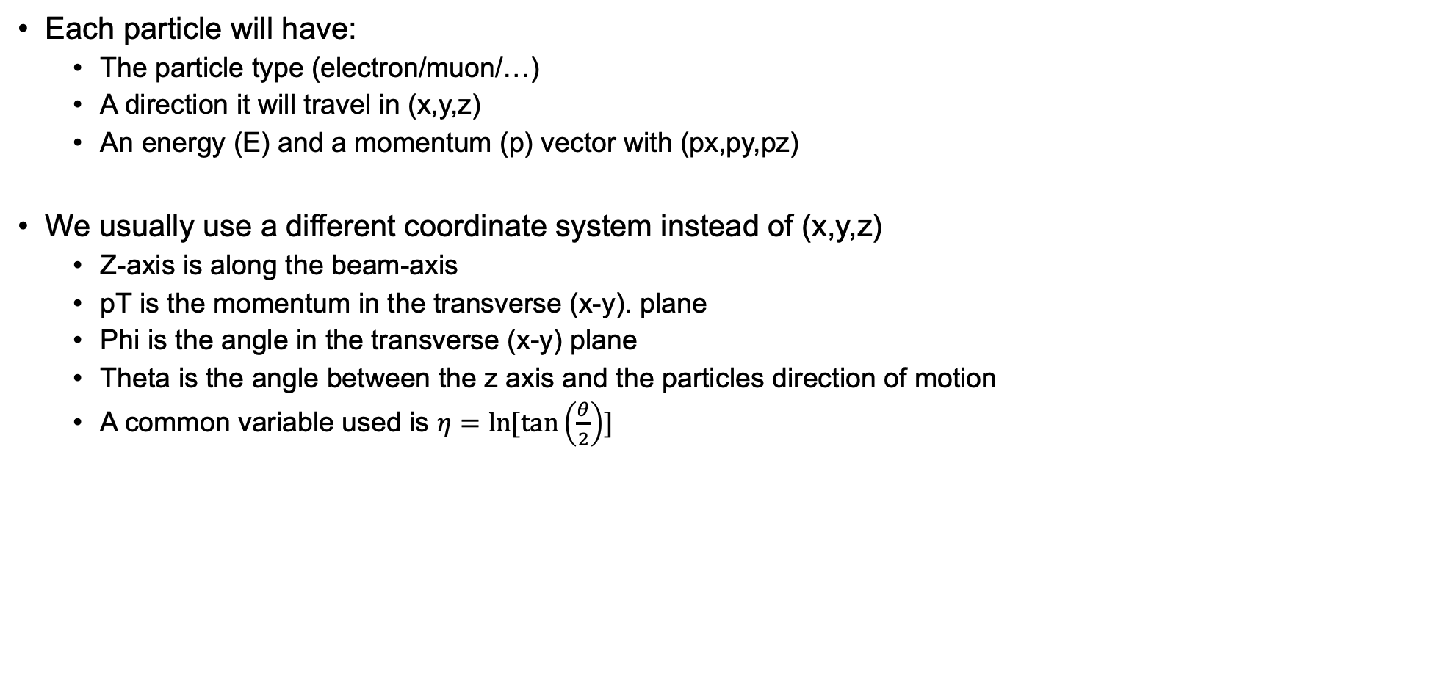
Event properties and coordinate system (https://atlas.cern/node/39013 )
Each particle will have:
  The particle type (electron/muon/…)
  A direction it will travel in (x,y,z)
  An energy (E) and a momentum (p) vector with (px,py,pz)
We usually use a different coordinate system instead of (x,y,z)
  Z-axis is along the beam-axis
  pT is the momentum in the transverse (x-y). plane
  Phi is the angle in the transverse (x-y) plane
  Theta is the angle between the z axis and the particles direction of motion
  A common variable used is $η=ln⁡[tan\left(\frac{θ}{2}\right)]$

Slide 8
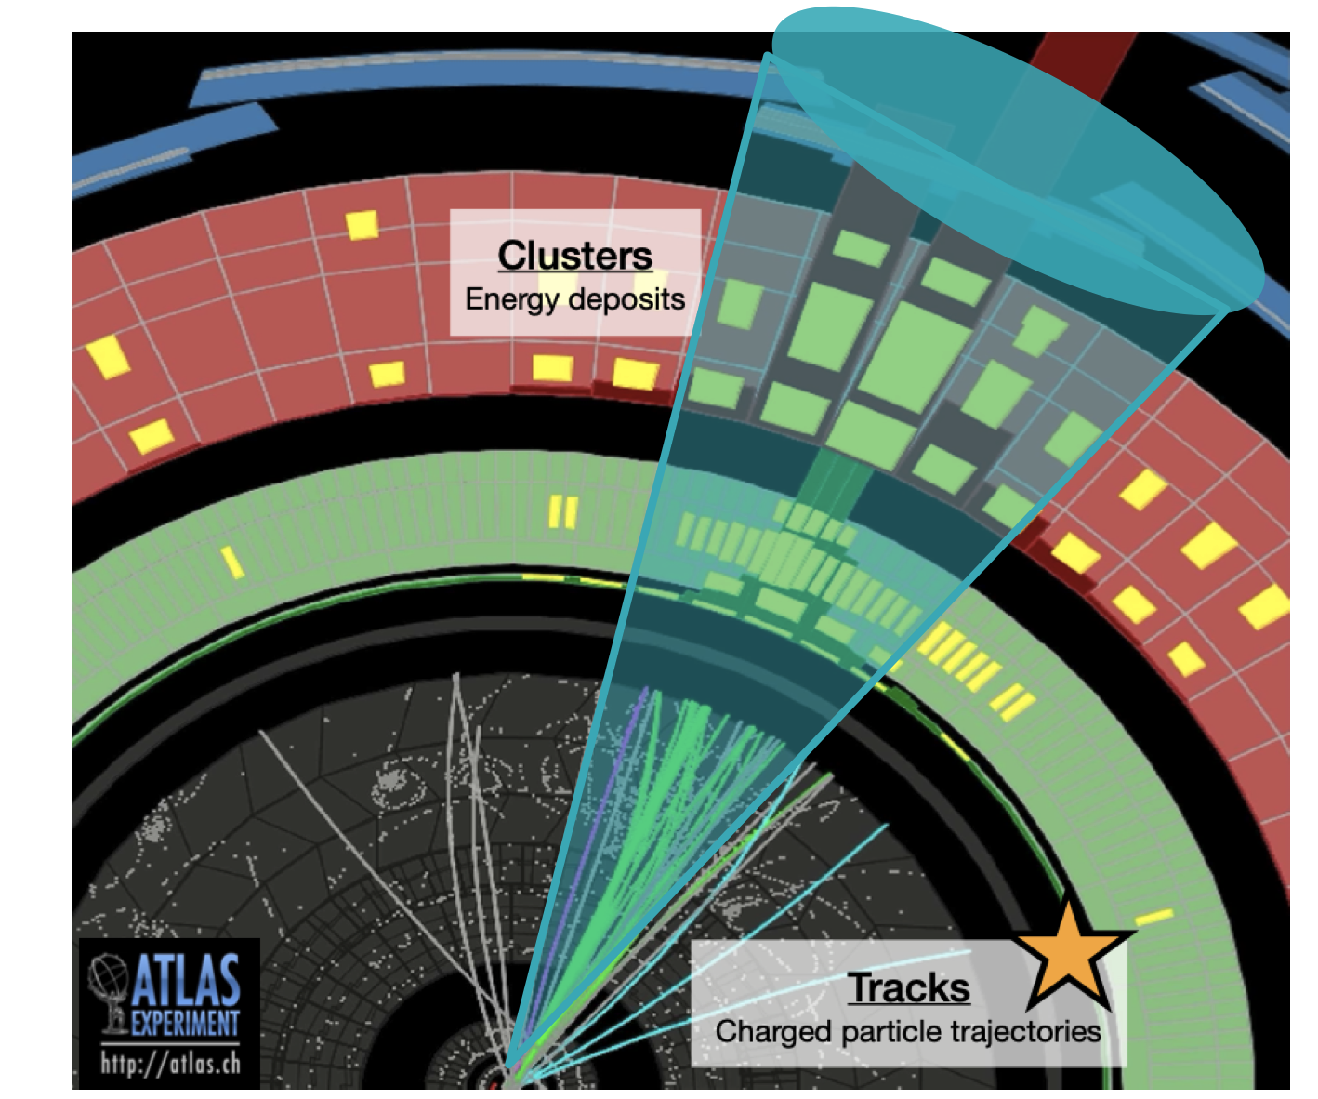
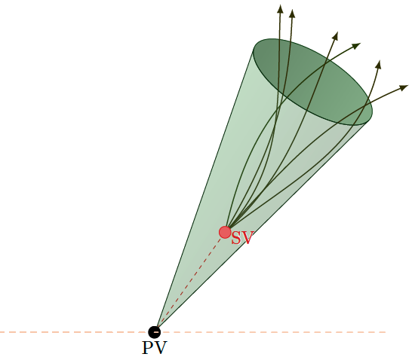
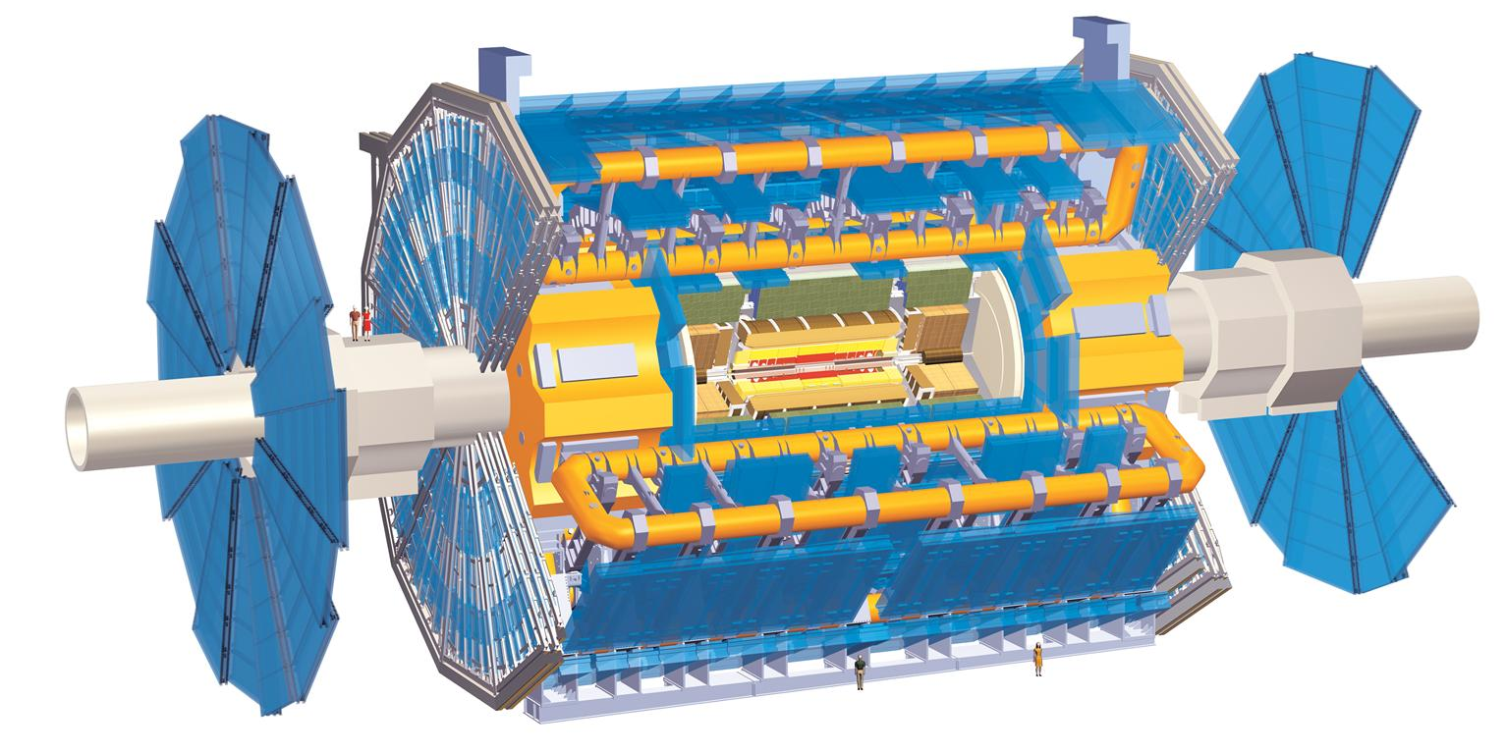
Reconstruction of b-jets
Quarks and gluon can not live freely in nature —> collimated spray of neutral + charged particles referred to as a jet
  charged particles: tracks + calorimeter deposits
  neutral particles: no track but calorimeter deposits
In the detector we see a collimated spray of tracks and energy deposits
  Run algorithm (anti-ktR0.4) that clusters tracks and energy deposits into a jet
B-jets are specific as they travel a few mm before they decay into stable particels

Slide 9
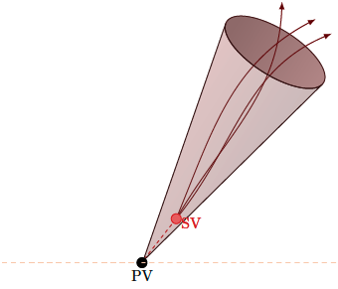
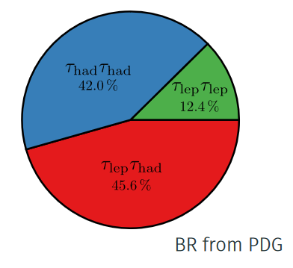
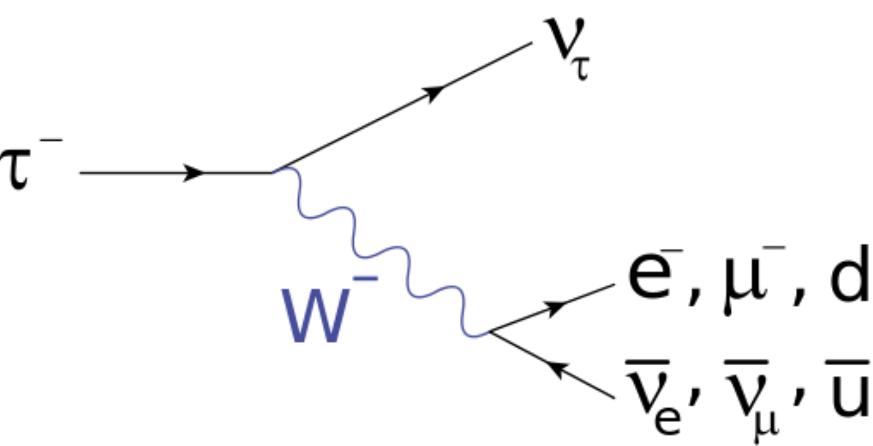
Reconstruction of taus
The tau also decays after traveling a few mm in the detector
  We will focus on the final state where both taus decay into
  hadrons + 1 neutrino
  The neutrino leaves the detector undetected
  The Hadron final state also creates a jet in the detector
    We can distinguish b-jets and tau-jets.
Tau decay modes:
Credit: Izaak Neutelings

Slide 10
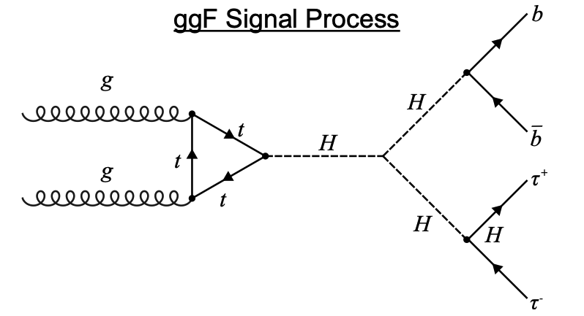
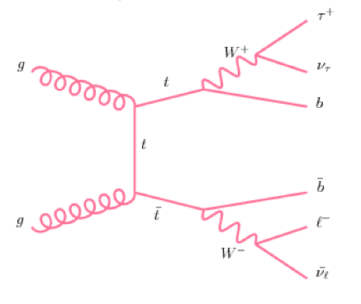



HH production
HH production creates 2 b-jets and 2 (hadronic) tau-jets + neutrinos (MET) in the detector
The biggest background for HH in the bbtautau final state is the production of 2 tops (ttbar) decaying subsequently into 2 b-jets, 2 taus + 2 neutrinos → It has exactly the same final state
We will difference in event kinematics to isolate HH from ttbar events
On the second day we will use Neural Networks/Deep Learning to isolate HH events
b
b
$$τ$$
b
$$τ$$
$$τ$$
$$τ$$
b

Slide 11

The scope of the project
We have simulated HH and tt events and how they will interact with a detector
We already reconstructed the taus and the bjets
The first exercise will explore different variables and how they differ between tt and HH production
The 2nd bonus exercise will train a neural network to distinguish signal (HH) from background (tt)
The project instruction can be found here: https://github.com/jdegens/fcc_ml_project/tree/main

Slide 12
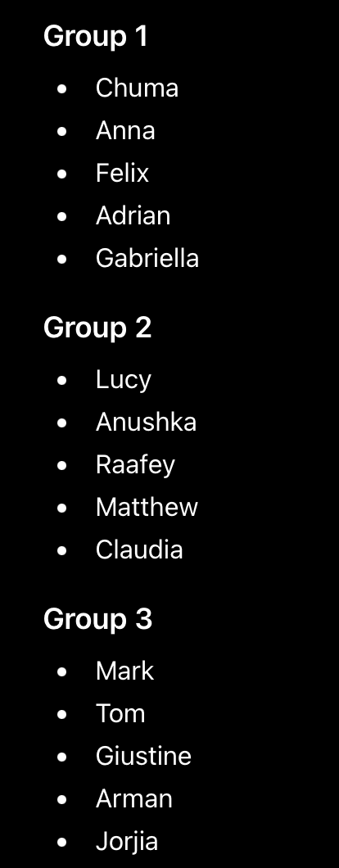
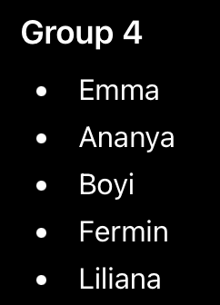
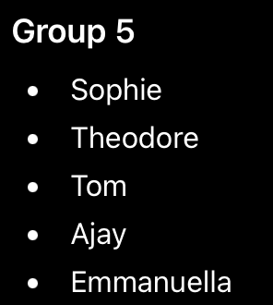
Tomorrows projects
The Idea is to come up with a new particle physics experiment with infinite money that tries to answer one of the most fundamental questions
However it has to be build and commissioned when you would be a professor (~30-50 years)
Some examples of things to answer:
  Does antimatter really fall down and with the same strength as normal matter
  Why are neutrinos massless?
  Can we find dark matter with a new accelerator? What energy would we need, where do we build it, how would the detector look like?
We split in groups of 5 and you will give a 5 minute presentation on Friday morning

Slide 13
Backup

Slide 14
Within the ATLAS Detector
Hadronic tau decay jets
Neutrinos
[4]
Muon Spectrometer
Hadronic Calorimeter
The ATLAS Experiment is ~500 onions tall!
Electromagnetic Calorimeter
Bottom-quark jets
Inner Detector
Imagine the detector as a giant onion; every layer is a different type of sensor for different particles.
ATLAS Parameters | Run-1 (2010-12) | Run-2 (2015-18) | Run-3 (2022-26) | HL-LHC Run-4 Expected. (2029+)
Centre-of-mass Energy [TeV] | 7-8 | 13 | 13.6 | 14
Integrated Luminosity [fb⁻¹] | ~25 (2.5x10¹⁵ proton collisions) | ~140 (1.4x10¹⁶ proton collisions) | ~300 (3x10¹⁶ proton collisions) | ~3,000 (3x10¹⁷ proton collisions)
Expected Amount of HH Events (→bbττ) | ~250 (~30) | ~4,300 (~590) | ~10,000 (~1,370) | ~120,000 (~16,400)

Slide 15
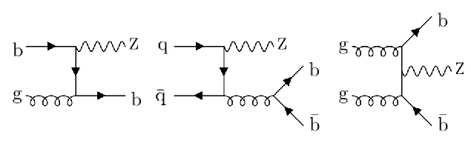
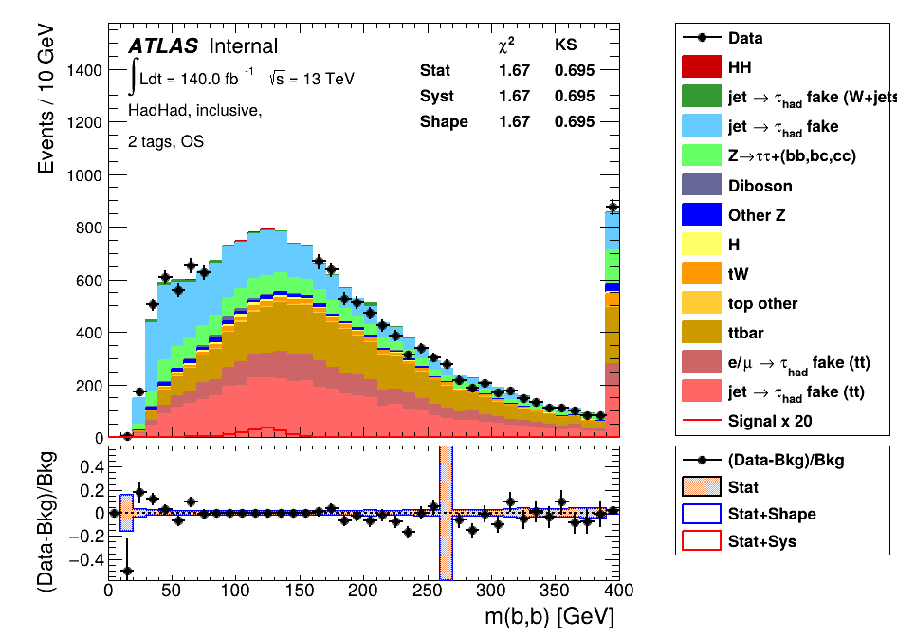
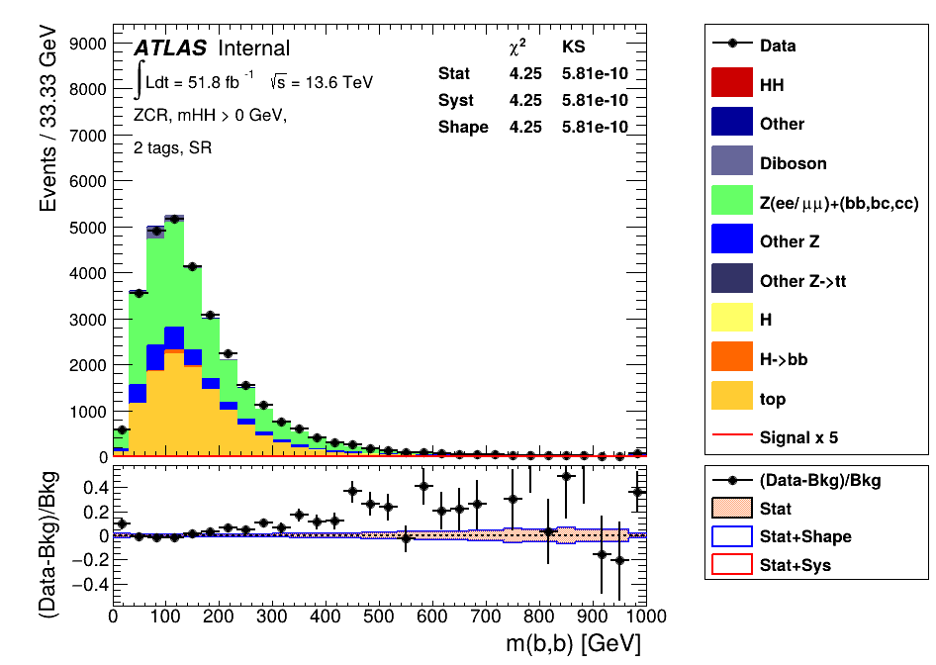
My Contribution So Far
So, we expect HH events, why haven’t we observed them yet?
We still have a lot of background processes that dwarf our signal, even after basic cuts on our data, we cannot claim we have seen any HH events.
Z+Heavy Flavours:
What I’ve work on so far…
data is blinded here
Our HH signal (x20)!

Slide 16
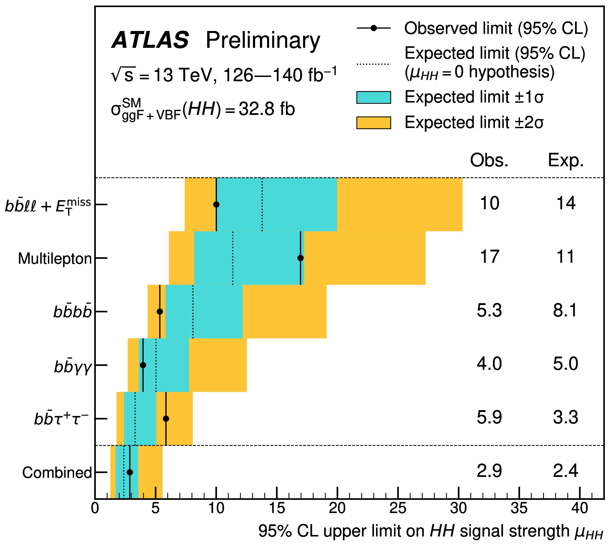
Previous Results
Results from run-2 [link]:
Expected to squeeze the signal harder than any other channel.
Expected to constrain μ_{HH} the most
Roughly a factor of 2.4 from SM sensitivity.
If we could see HH production as SM theory predicts, μ_{HH} would be at 1. Reminder this is run-2 alone.

Slide 17
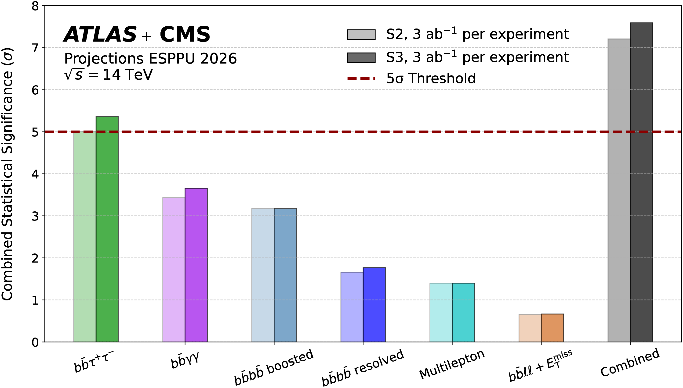
Projected Results
For full evidence, we need the high luminosity upgrade to the LHC (run-4, 2029+).
Combination searches assuming:
S2: improvements to theoretical and experimental uncertainties.
S3: S2 + improvements to b-jet-tagging (+5%) and tau_{had}-identification(+5-10%).
[5]
Shows that we will achieve discovery after run-4 with combined data.

Slide 18
Summary
An observation of Higgs pair production will allow us to know more about how the universe evolved and its ultimate end!
Studies of this process are done with ATLAS and CMS experiments at the LHC.
At the end of run-3 we expect to see some first evidence of this process.
  This analysis would be my main PhD topic.
Developing state-of-the-art tau_{had} identification is crucial for this process.
  I am responsible for validating performance of new tau_{had}-id.
After the HL-LHC upgrade, we are expected have enough data for discovery significance of this process.

Slide 19
References
[1] - https://tikz.net/mexican-hat/
[2] - https://tikz.net/sm_decay_piechart/
[3] - all particle images can be found at https://higgstan.com/particle-image/
[4] - https://atlas.cern/Resources/Schematics
[5] - https://cds.cern.ch/record/2925853

Slide 20
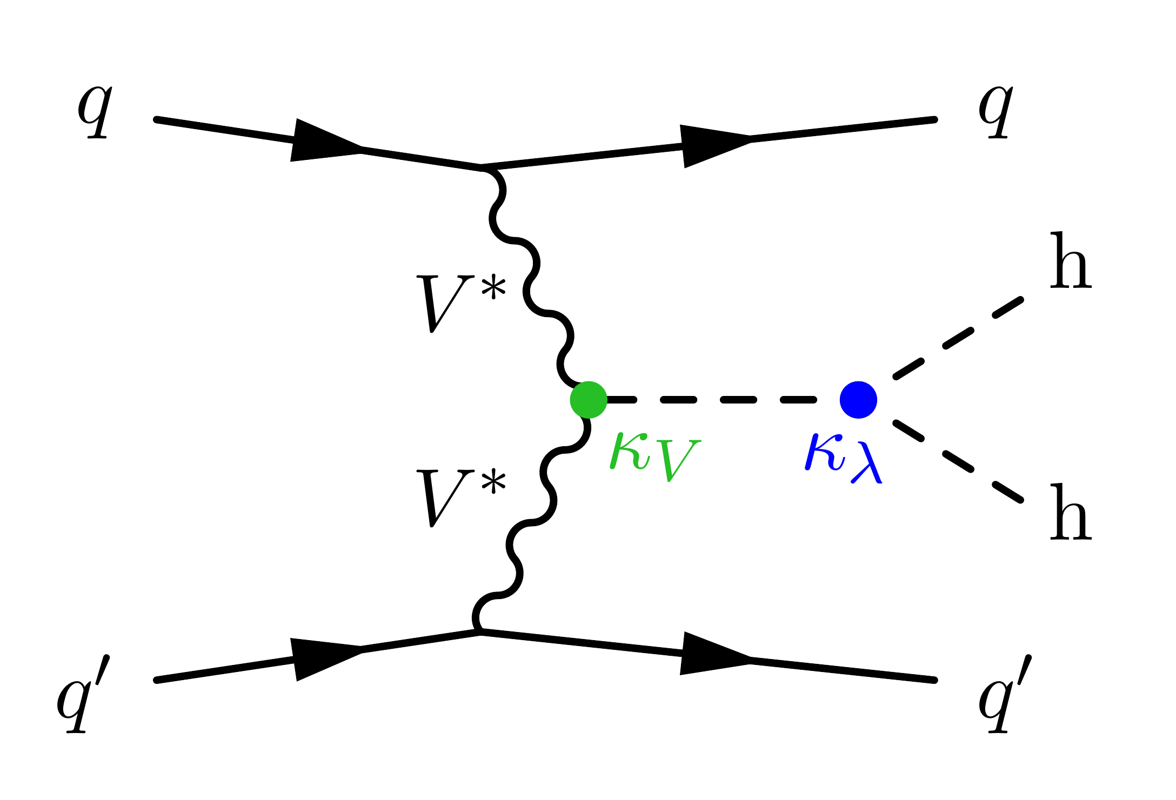
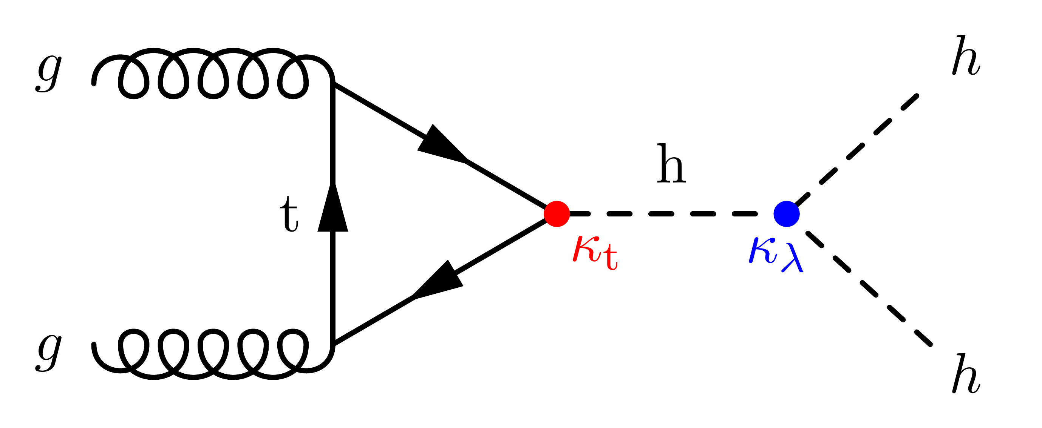
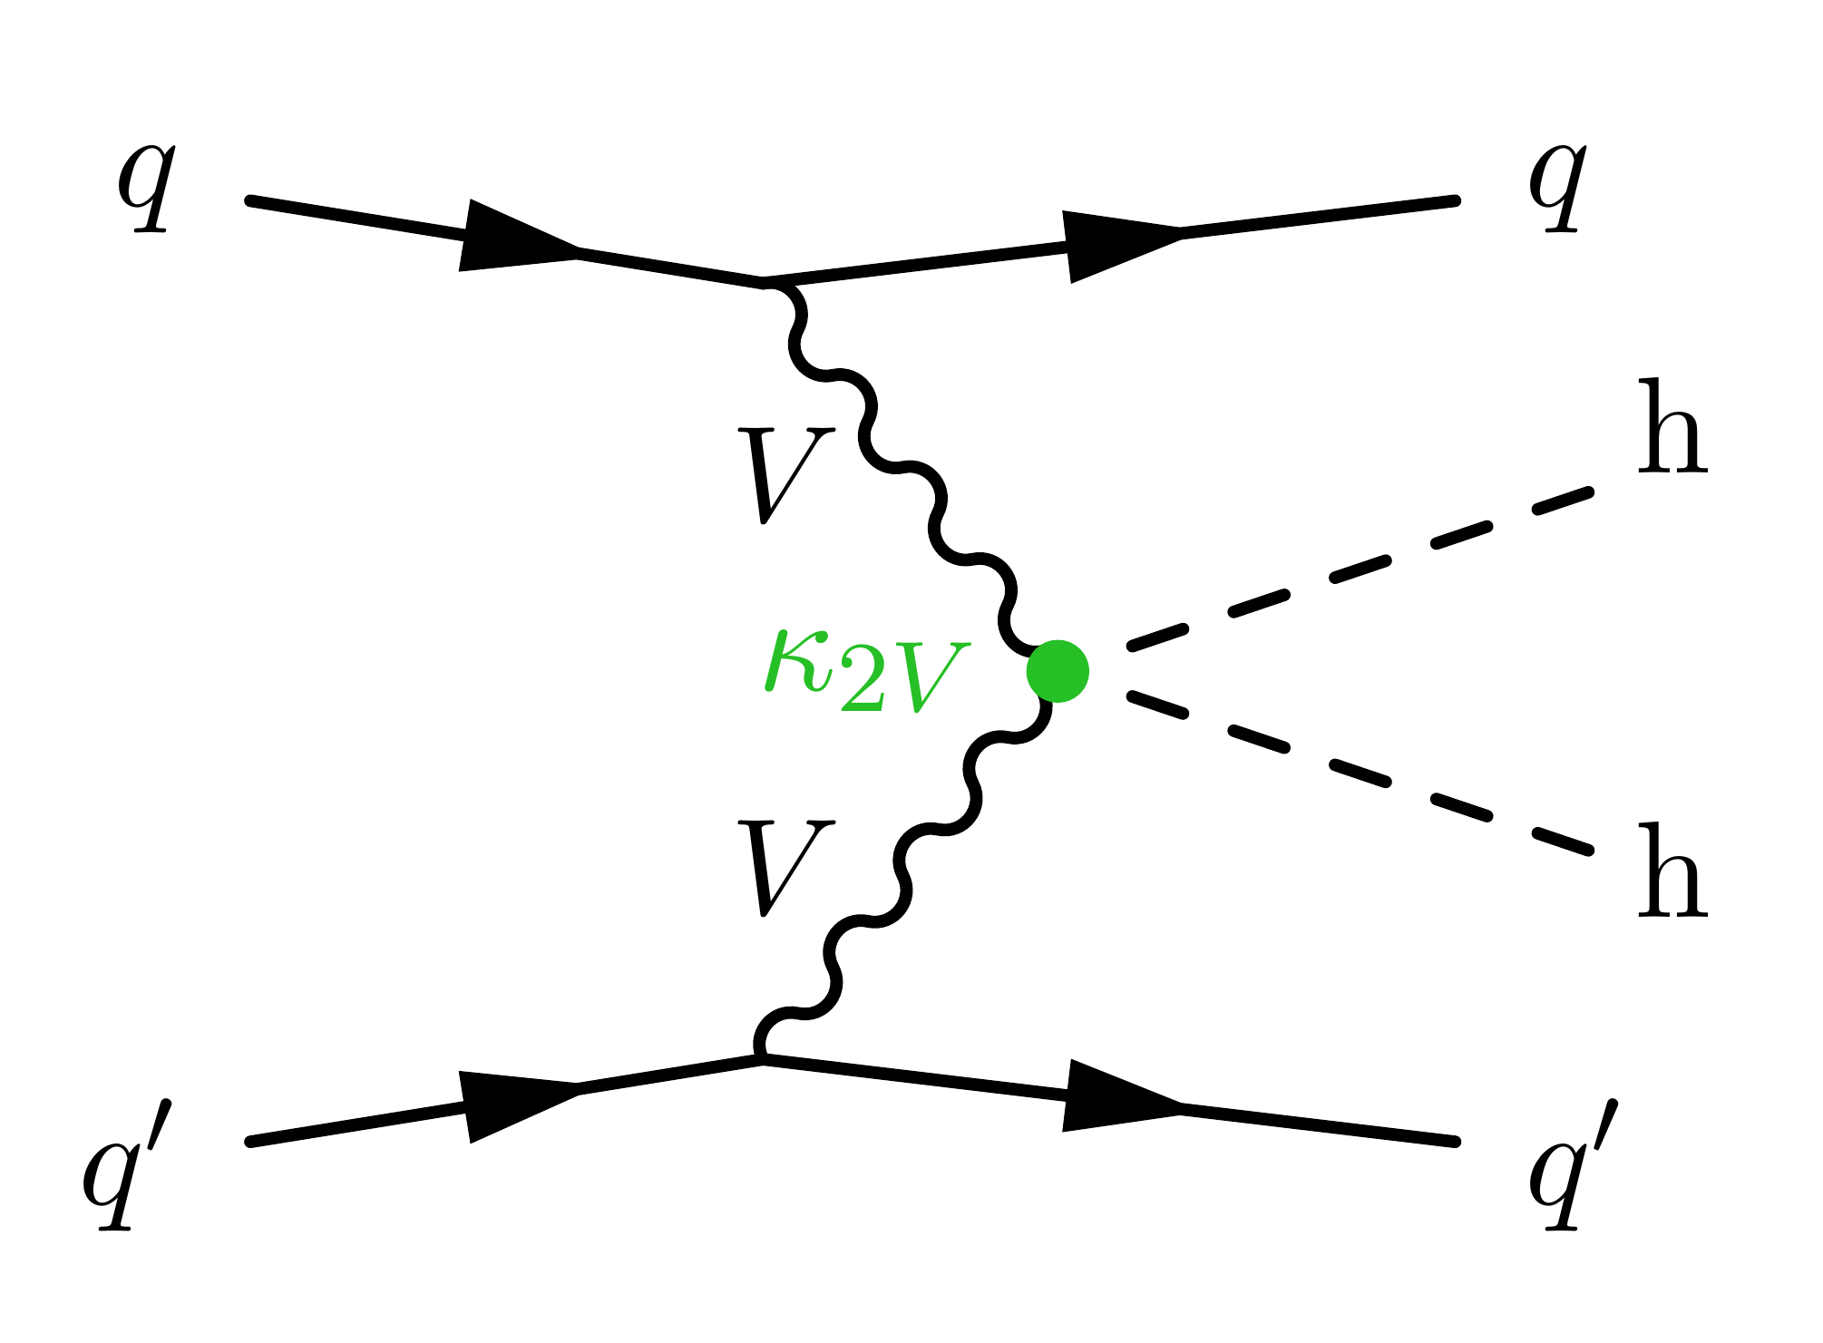
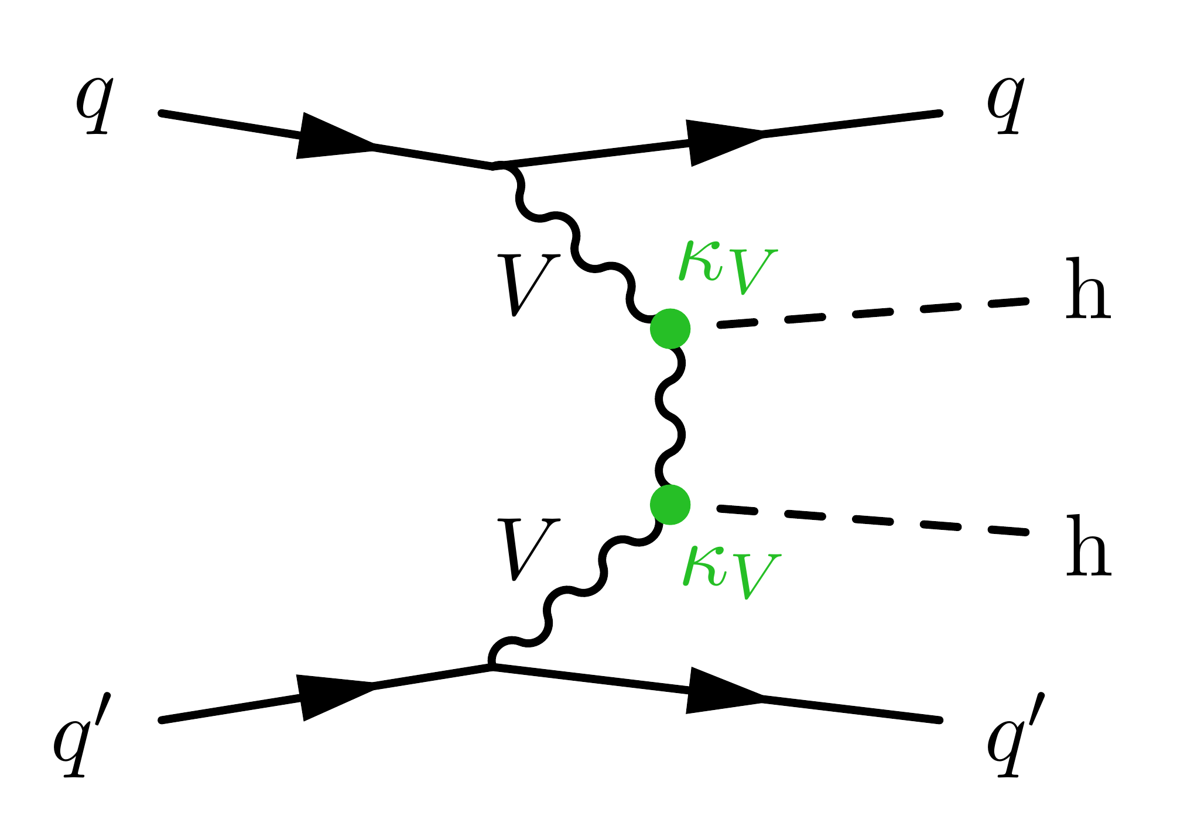
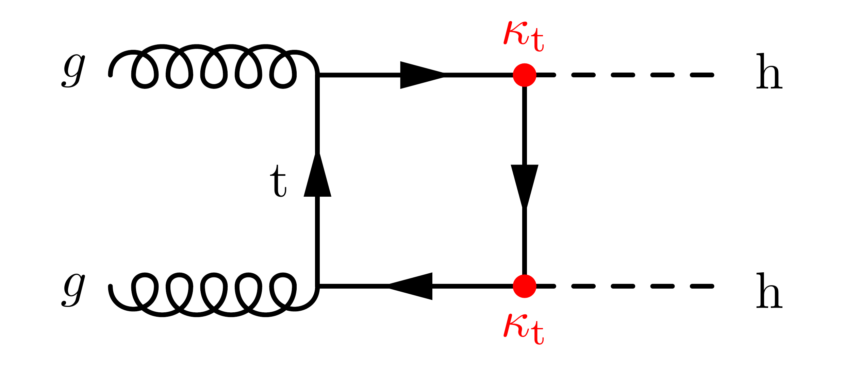
ggF Box and VBF HH Production
Diagram earlier showed gluon-gluon fusion (ggF) HH production, this is not the only way that Higgs pairs can be produced.
https://feynm.net/gallery/
ggF Triangle Diagram
Various vector boson fusion (VBF) processes.
ggF Box Diagram
Relatively easy to split these processes from ggF as there are extra quarks that hadronise in final state. Only one of these diagrams is sensitive to self coupling.
Box diagram is not sensitive to trilinear self-coupling constant. We take a cut on m_{HH} to try and suppress these processes.

Slide 21
LepHad and HadHad Channels
We further divide our HH → bbττ channel into two regions depending on how the tau-leptons decay.
Within our analysis, we only look at the case where both taus hadronically decay (τ_{had}τ_{had}) and the case where we have one leptonic and one hadronic (τ_{lep} τ_{had})
Hadronic (τ_{had}) decays:
quarks
Leptonic (τ_{lep}) decays:
electron/muon + neutrino

Slide 22
Graph Neural Networks
Our MVAs take object kinematics and variables calculated from the kinematics such as:
● m_{bb} ● m_{HH} ● ΔR_{ττ} and so on…
For the current analysis we use graph neural networks (GNNs):
Example Graph Object
Hidden Layers
Input Layer
Output Layer
h₁
h₁
x₁
h₂
h₂
x₂
Used as a classifier, gives a “score” of how signal-like a graph is.
y₁
h₃
h₃
…
Each graph representing a single event.
…
…
x_{n}
h_{n}
h_{n}
…

