Slide 1

Evolving Particle Physics Masterclasses at National Laboratories
Using evaluation to refine successful programmes
Phill Day & Sophy Palmer
UK Particle Physics Masterclass Network Meeting
11 September 2026
Notes:
This is a story about how evaluation helped us improve and mature successful masterclass programmes at RAL and DL.

Slide 2
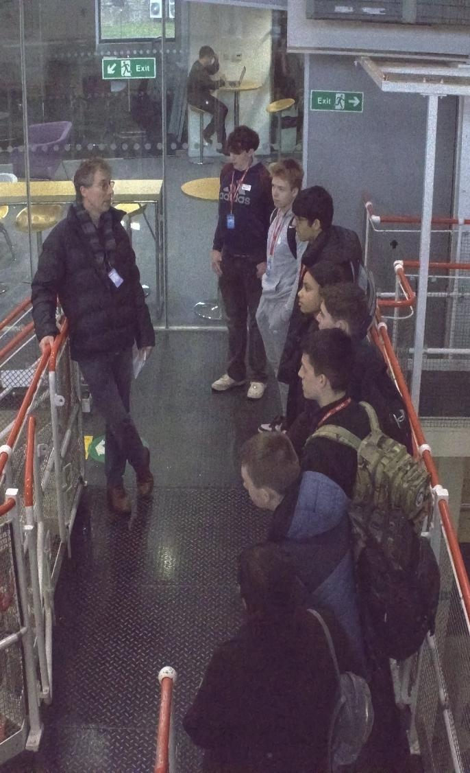
Introduction
      Particle Physics Masterclasses have been delivered at STFC national laboratories for more than 25 years.
      The core aims (of inspiring students, supporting teachers in a ‘scary’ A-Level topic, and encouraging students to feel that STEM is ‘for them’) remain unchanged; however delivery has evolved significantly.
      Changes have been informed by sustained evaluation and participant feedback.
      Today we'll share:
      examples of changes implemented at DL and RAL
      the evidence that drove those changes
      lessons that may be useful for other providers
Notes:
To replace with a photo of your own: Right click on centre of image select ‘Change picture’ click ‘from file…’ and choose your image.

Slide 3

Evidence Base
Notes:
To edit the background image, select ‘Format’ from the PowerPoint menu and ‘Slide Background’ from the drop-down menu. Within the new list of options that appears on the right of the screen, select the ‘File’ button under ‘Insert picture from’ and select your image from your file browser.

Slide 4

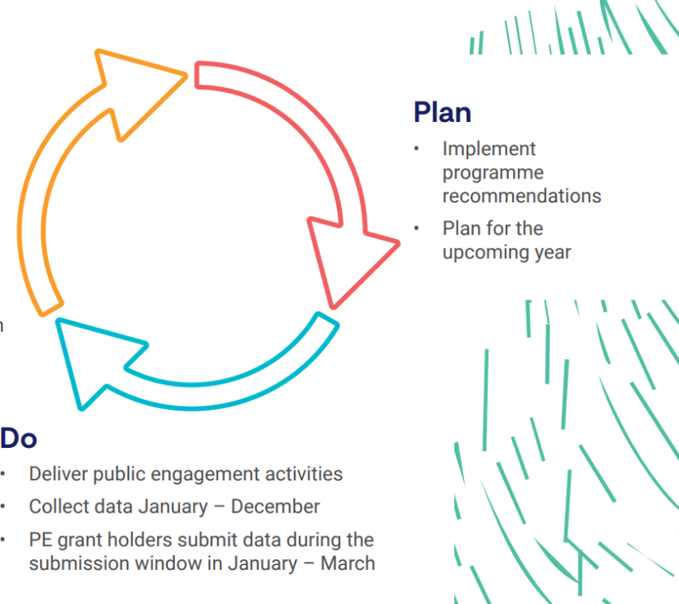
STFC Public Engagement Evaluation Framework
In participating in the RAL and DL Particle Physics Masterclass programmes, students will:
Feel inspired by STFC science, technology or people.
Feel that STEM is relevant to their lives.
Seek out further opportunities to engage with STEM.
      Feel that STEM careers are an option for them.
Plan
Implement programme recommendations
Plan for the upcoming year
Review
Collate and review data
Make programme recommendations
Do
Deliver public engagement activities
Collect Data
Notes:
Add outcomes and Questions
Also need to flag Slido as a means to gather evaluation and improve participation

Slide 5
Online Engagement
Notes:
To edit the background image, select ‘Format’ from the PowerPoint menu and ‘Slide Background’ from the drop-down menu. Within the new list of options that appears on the right of the screen, select the ‘File’ button under ‘Insert picture from’ and select your image from your file browser.

Slide 6

Improving online engagement
      Challenge
      Many students are reluctant to ask questions publicly.
      Masterclasses events typically generated 10-15 questions across the day.
      What Changed?
      During COVID-19, delivery moved online via Zoom, enabling online text-based Q/A.
      Question volume increased to around 4× previous levels, suggesting students were more comfortable engaging digitally.
      Slido was introduced to manage Q&A and provide a consistent tool for both online and in-person events.
Total Participants
172
Total Questions
126
Named authors
51
Stats taken from Online Particle Physics Masterclass - Tuesday 10 March 2026
Notes:
Engaging independly with students rather than through their teacher digitally does lead to additional things to consider including safeguarind – not covered here but happy to field further questions about this later

Slide 7
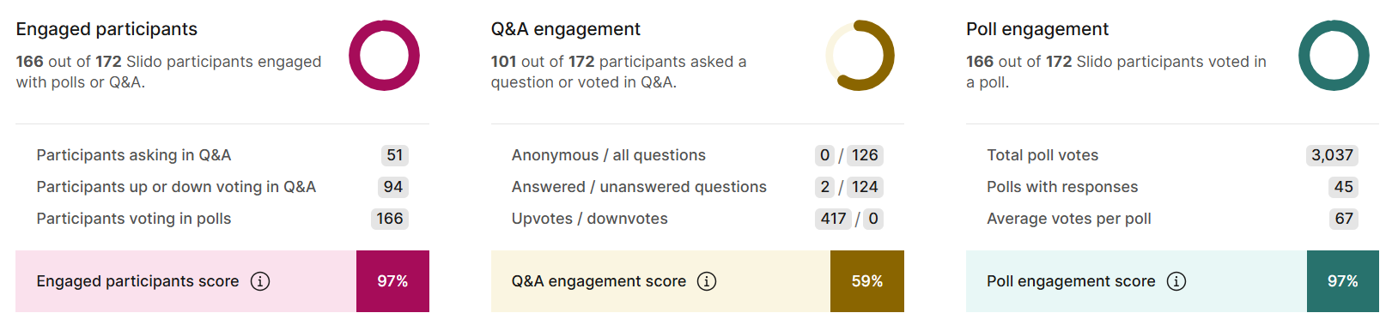
Improving online engagement
      Impact
      Increased student participation and interaction.
      Reduced barriers for quieter or less confident students.
      Enabled question up-voting.
      Created a more student-led and responsive experience.
      Key Learning
      Digital engagement tools do not simply capture more questions; they empower more students to participate.
      Anonymous interaction is not enabled, for safeguarding purposes
Notes:
Engaging independly with students rather than through their teacher digitally does lead to additional things to consider including safeguarind – not covered here but happy to field further questions about this later

Slide 8
Masterclasses at Daresbury
Notes:
To edit the background image, select ‘Format’ from the PowerPoint menu and ‘Slide Background’ from the drop-down menu. Within the new list of options that appears on the right of the screen, select the ‘File’ button under ‘Insert picture from’ and select your image from your file browser.

Slide 9
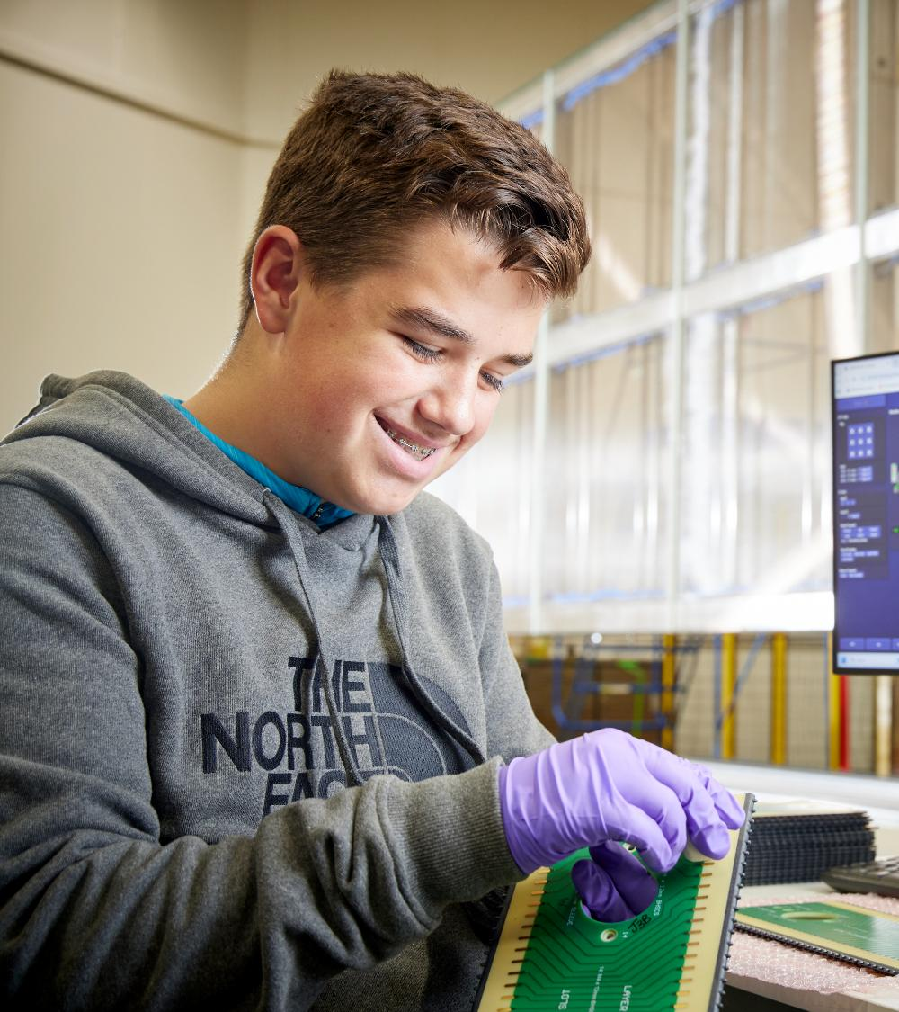
Evolving a Successful Programme
      Daresbury Masterclass 2025
      85 students attended in person
      ~60 students attended online
      8 schools involved in each event
      Satisfaction: 4.63/5 in person
      Satisfaction: 4.45/5 online
      94% inspired by the science and technology
      90% felt STEM careers were an option
      57% reported being more likely to engage with STEM opportunities
Notes:
The challenge wasn't improving outcomes. It was improving participant experience.

Slide 10
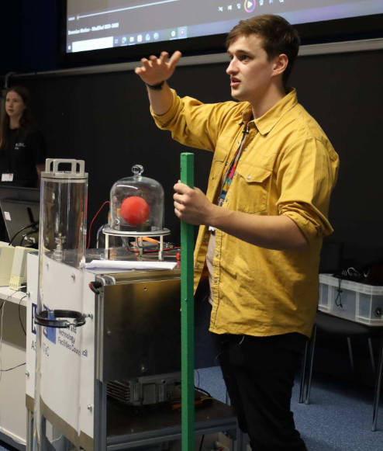
What Evaluation Told Us
Participants valued
✅ Tours
✅ Careers engagement
✅ Demonstrations
✅ Expert speakers
Participants wanted
"More interactive sessions would be great...“
"The time from 9.20 till 10.35 was very long..."
Notes:
Keep the science. Increase the interaction.
Student attention and engagement varied during long lecture-based sessions.
Online experiences weren't fully replicating benefits of in-person delivery.
Teacher confidence in supporting activities was variable.
Demand for interaction with scientists remained consistently high.

Slide 11
What Did the 2025 Masterclass Look Like?
Online Day
Presentations:
Story of Particle Accelerators at DL
Particle Sources
Electromagnetism for Accelerators
Boulby live link and Virtual Tour
Vacuum Demonstrations
Fred Loebinger lecture "Quarks, Gluons and the Higgs Boson"
CLARA update talk
In-Person Day
Presentations:
Story of Particle Accelerators at DL
Electromagnetism for Accelerators
Boulby live link and Virtual Tour
Fred Loebinger lecture “Quarks, Gluons and the Higgs Boson”
CLARA update talk
Activities
3x Facility tours
Accelerator demonstrations
Early Careers Panel
Activities
Surfatron
Lancaster Particle Physics Package
Early Careers Panel
Notes:
The event already included strong interactive elements, but still contained substantial blocks of seated delivery.

Slide 12
How We Redesigned 2026
Online Day as an addition to In-Person Day
Moved contextual content online and significantly reduced content:
Daresbury introduction
Boulby virtual tour
Diamond virtual tour
CLARA virtual tour
Careers session
In-Person Day
Moved rapidly into activities:
3x Facility tours
Careers & demonstrations
NEW: Accelerate Escape Workshop
Retained:
Welcome
Fred Loebinger lecture
CLARA update talk
Notes:
Design Principle:
Move information online. Use on-site time for experiences that cannot be replicated virtually.
Key changes:
Evolution of online provision.
Removal/reduction of traditional presentations.
Increased interactive elements.
Revised timetable and pacing.
Greater opportunities for discussion and engagement.

Slide 13
How Much Did the Format Change?
Change | 2025 | 2026
Lecture introduction | 55 mins | 10 mins
Activity rotations | 30 mins | 60 mins (3x 20 min tours)
Activity streams | 4 | 3 Main + 3 tour sub streams
Presentation-led content | 155 mins | 95 mins
Notes:
39% reduction (60 minutes) in presentation-led delivery
while retaining the highest-valued talks.

Slide 14
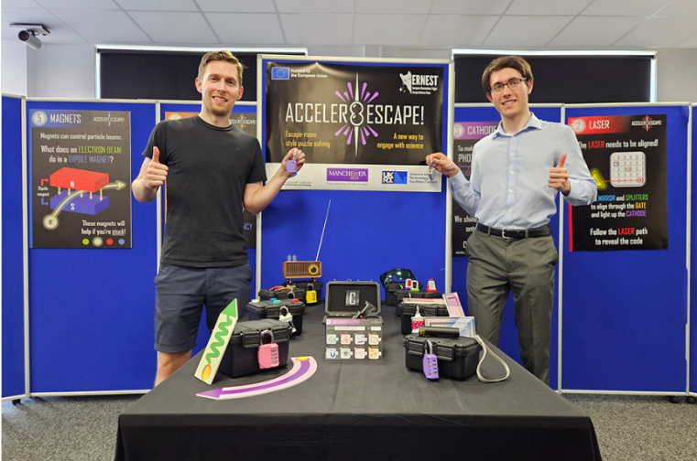
New Interactive Addition: Accelerate Escape
Why?
Teamwork
Active problem solving
Applying accelerator concepts
More participant-led learning
Feedback
"Great way to incorporate science and fun.“
"Students really enjoyed this and it helped reinforce some key knowledge."
Notes:
Not all learning has to take place through presentations.

Slide 15
What Happened?
Outcomes
Satisfaction increased: 4.63/5 → 4.9/5
Inspiration remained very high: 94% → ~90%
Participants still valued Fred's lecture
"Highlight of the day was Prof Loebinger..."
Notes:
Reducing lecture time did not reduce impact.
It improved
Evaluation results following changes.
Improved enjoyment.
Increased engagement.
Improved perceived learning.
Positive teacher feedback.
Better participation throughout the day.
participant experience while maintaining educational outcomes.

Slide 16
Masterclasses at RAL
Notes:
To edit the background image, select ‘Format’ from the PowerPoint menu and ‘Slide Background’ from the drop-down menu. Within the new list of options that appears on the right of the screen, select the ‘File’ button under ‘Insert picture from’ and select your image from your file browser.

Slide 17
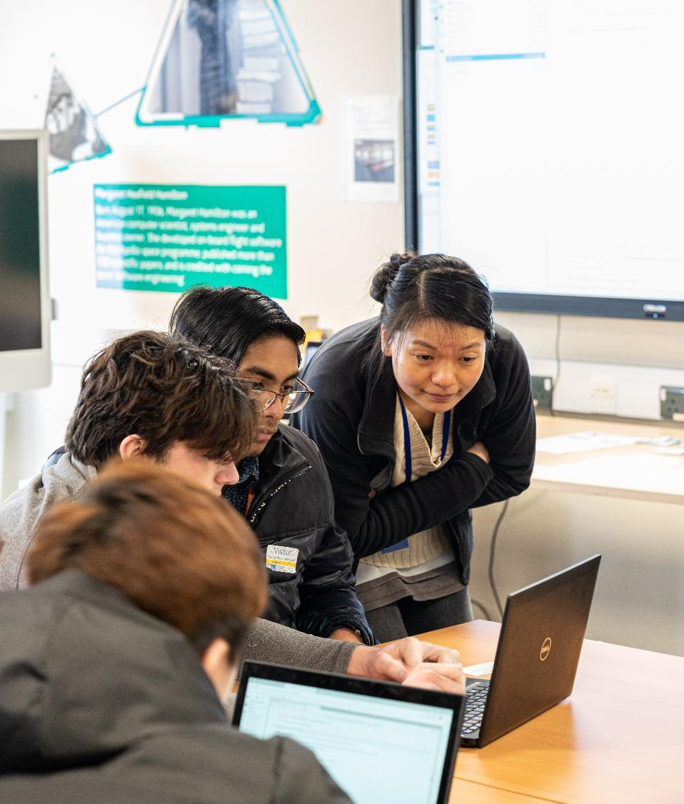
RAL’s masterclass
Structure:
One online day (two lectures, virtual tours, data workshop)
Three in-person days (four lectures, tours, data workshop, quiz)
Lectures are streamed online on one of the in-person days
Participation:
300 online for the full day
180 in person each day
200 online for ‘in-person’ lectures
2,200 applicants, 1,000 participants in total

Slide 18
RAL’s masterclass
Feedback:
96% felt the science and technology they saw was important to their life
  90% felt inspired by the science and technology they saw
  28% are more likely to pursue STEM
  Rating 4.8 / 5
  “Only to repeat what a brilliant experience this was for our year 12 students, and its close relevance to the A level physics content, and the way it was delivered with interesting lectures, a challenging and very worthwhile computer workshop on interpreting collider data, and the tour that helped to bring all that information to life. All of those involved in delivering the workshop were professional and importantly inspired many of our students into considering this as a career option. Thank you for a memorable day!”

Slide 19
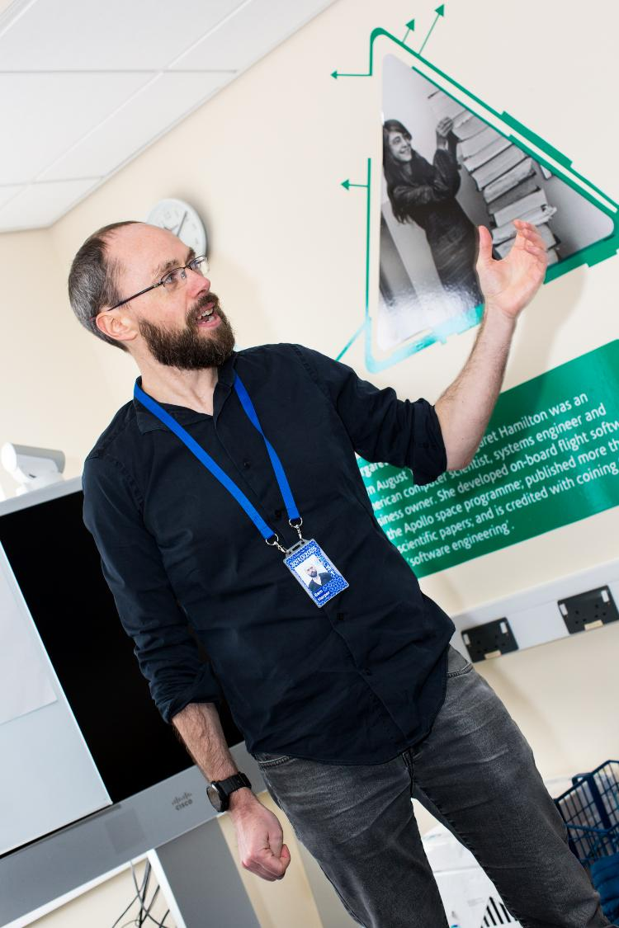
RAL’s workshop
Content:
Introduction: talk & demonstration
Helpers – in person and via text – to answer individual questions
During COVID, switched to Jupyter notebooks
Feedback:
“It was very interesting, but I struggled a bit with the programming aspect.”
“It was difficult to keep up for those who had never used python or done any coding before”
“I really loved using the coding - made me feel like I was really involved within the Physics.”
“It would have been helpful to have some more instruction on the practical aspects”

Slide 20
RAL’s workshop
Content:
Introduction: talk & demonstration
Helpers – in person and via text – to answer individual questions
During COVID, switched to Jupyter notebooks
Feedback:
 | Workshop | Overall
Rating (/5) | 4.1 / 5 | 4.6 / 5
Level (3=‘just right”) (5=“too hard”) | 3.74 | 3.2

Slide 21
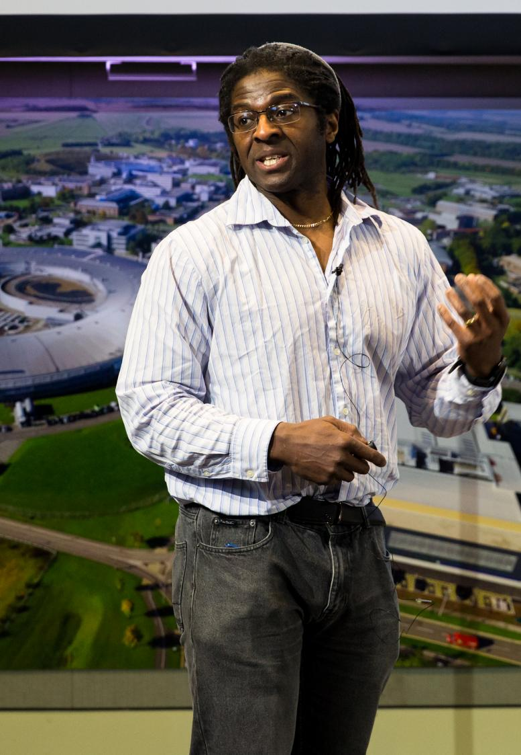
RAL’s workshop
Adaptations:
Introduced teacher ‘drop-ins’ before the masterclass
For online attendees: Created detailed step-by-step guides for accessing the content, as well as multiple back-up options
Increased explanations, slowed the pace
Side-Quest: IRIS and Oxford
Big Data: ATLAS project- “Empower your students with the skills to unravel the mysteries of the Universe and find evidence of the Higgs boson.”
Long-term research project for students
https://researchinschools.org/projects/big-data-atlas/

Slide 22
RAL’s workshop
Adaptations:
Introduced teacher ‘drop-ins’ before the masterclass
For online attendees: Created detailed step-by-step guides for accessing the content, as well as multiple back-up options
Increased explanations, slowed the pace
Outcomes
Fewer technical issues
Slightly improved rating (4.2 / 5) and slightly more appropriate level (3.69)
“too much information to be accessed from too many sources”

Slide 23
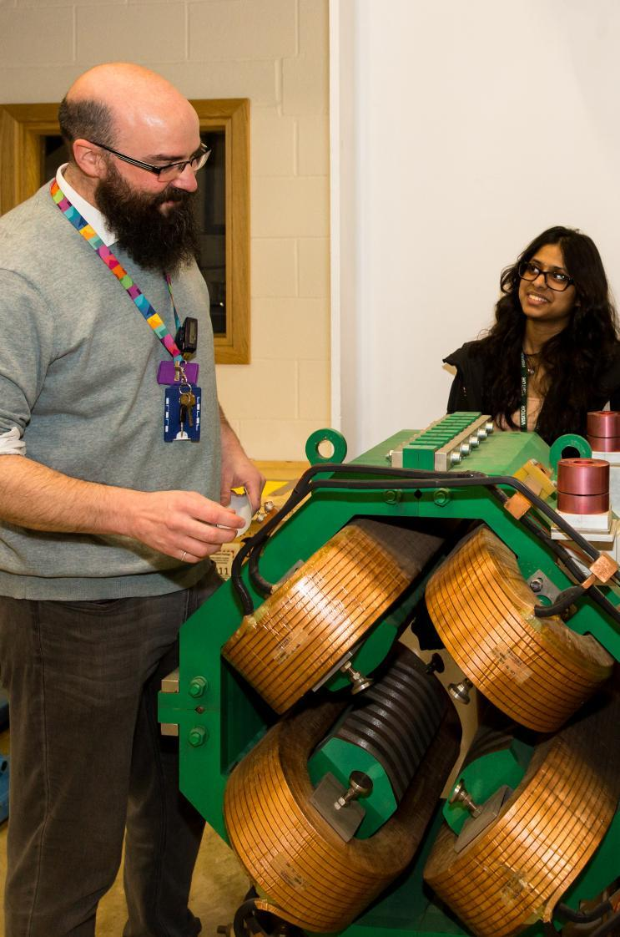
RAL’s workshop
Adaptations:
Continued teacher ‘drop-ins’, sharing recordings and step-by-step guides
New interface and adapted introduction
Outcomes
Improved rating (4.7 / 5) and appropriate level (3.30)
“Having participated in several similar, but using much less sophisticated analytical tools, I can confirm that this year's system was much more accessible for the students.”
“It was SO much better than previous years! It was really intereative and visually appealling.”
“As we get stuck in the task then everything became clear. I also liked how in practical setting you demonstrated value of collaboration.”

Slide 24
Key questions
Notes:
To edit the background image, select ‘Format’ from the PowerPoint menu and ‘Slide Background’ from the drop-down menu. Within the new list of options that appears on the right of the screen, select the ‘File’ button under ‘Insert picture from’ and select your image from your file browser.

Slide 25
Key Questions to ask about your programmes
What are your participants telling you?
Which elements of your Masterclass create the most value?
What content genuinely needs to be delivered in person?
How are you using evaluation to shape future programmes?

