Slide 1
Engaging Secondary-Aged Students: A Liverpool Perspective
Charlie Devlin, Michael Jones and Chris Marchant
On behalf of the SoPS Outreach Team

Slide 2

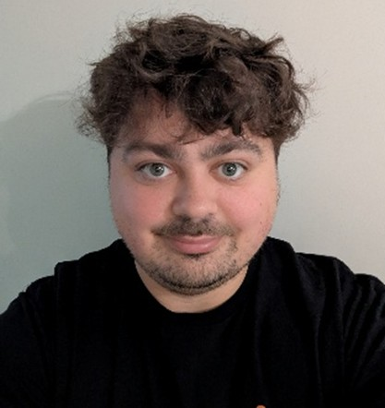
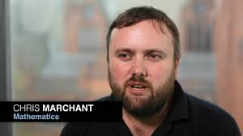
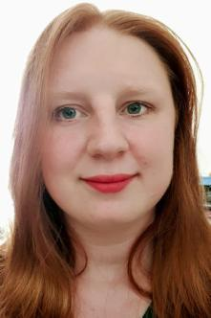
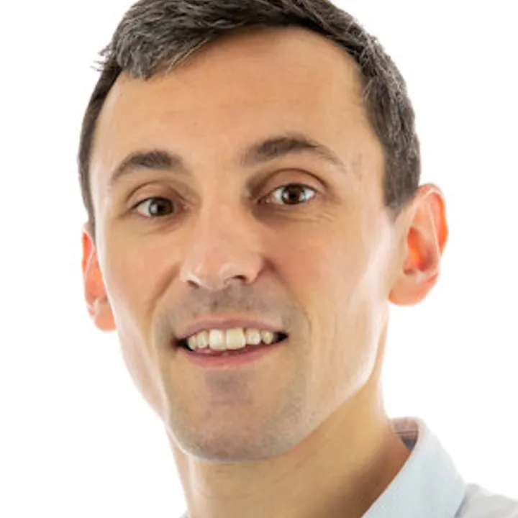
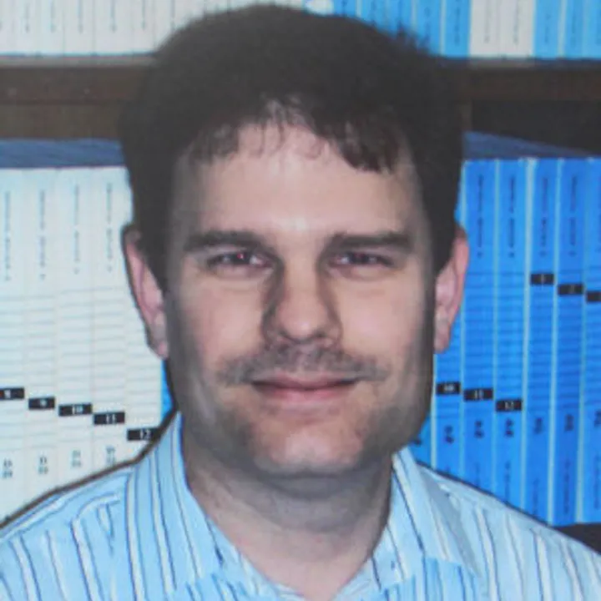
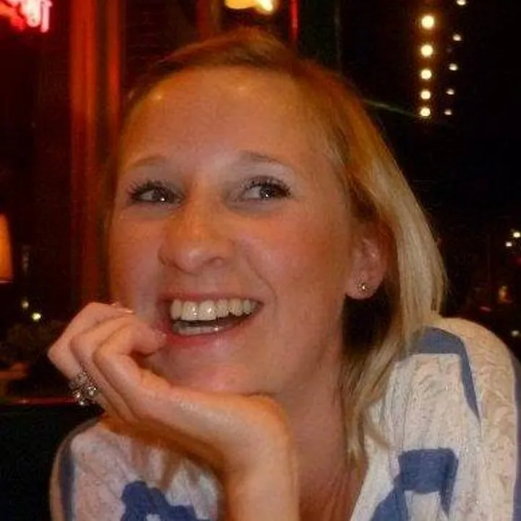
Meet the Team
Dr Charlie Devlin
Faculty Lead for Outreach and Widening Participation
Physics Outreach Lead (Academic)
cdevlin@liverpool.ac.uk
Chris Marchant
SoPS Outreach Lead (PS)
marchant@liverpool.ac.uk
Michael Jones
SoPS Outreach Coordinator (PS)
mgjones@liverpool.ac.uk
Dr Cate Cropper/ Dr Gina Washbourn
Chemistry Outreach Lead (Academic)
ccropper@liverpool.ac.uk
Dr Chris Edmonds
SoPS Outreach Lead
cse@liverpool.ac.uk
Dr Thomas Eckl
Maths Outreach Lead (Academic)
Thomas.eckl@liverpool.ac.uk

Slide 3

Challenges to engagement
Access to pupils
Time constraints
Teenage apathy / lack of enthusiasm
Wide range of abilities
Limited resources
Cost to schools
Institutional buy in

Slide 4
Higher Tier
Aspiring Tier
Middle Tier / KS3
Maths Club
Masterclasses
Girls in Maths
Year 9 STEM Days
Research in Action

Slide 5
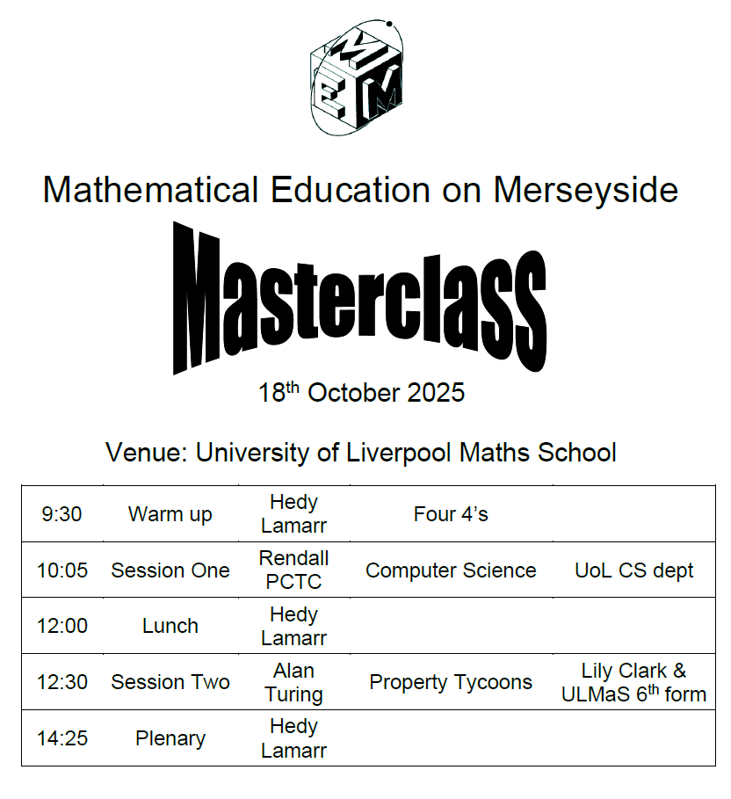
Higher Tier
MEM Masterclasses
  Collaboration between HEIs and schools
  Aimed at high-attaining Y8 & Y9 pupils
  Shared hosting across 4 Saturdays
  Emphasis on hands-on activities
Maths Club
  Monthly Saturdays in term time
  Designed for GCSE & A-Level students
  Talks from staff and PhD students across the School of Physical Sciences & external speakers
  Physicists adapt talks to a mathematical audience

Slide 6
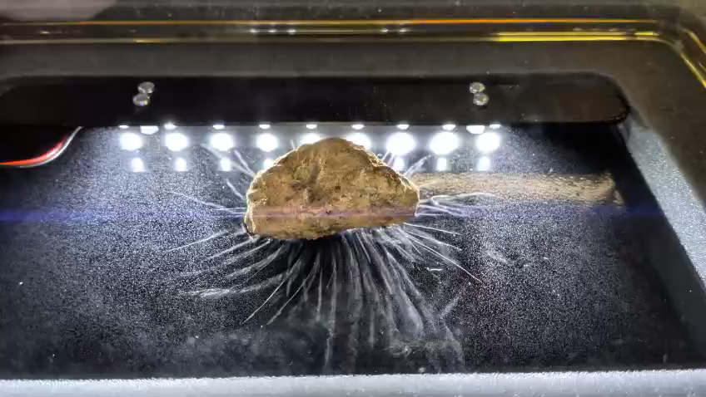
Aspiring Tier
Y9 STEM Days
  Encourage pupils to study higher-tier Maths and separate sciences at GCSE
  Led by School of Physical Sciences with cross-Faculty participation
  Features "What Has Radiation Ever Done For Us?"
  3 workshops plus careers session
Girls in Maths
  Audience is Y10 female students
  Promote A-Level Maths as gateway to STEM degrees and careers
  Female-led event
  Links to careers via role models from within the University and local industry

Slide 7
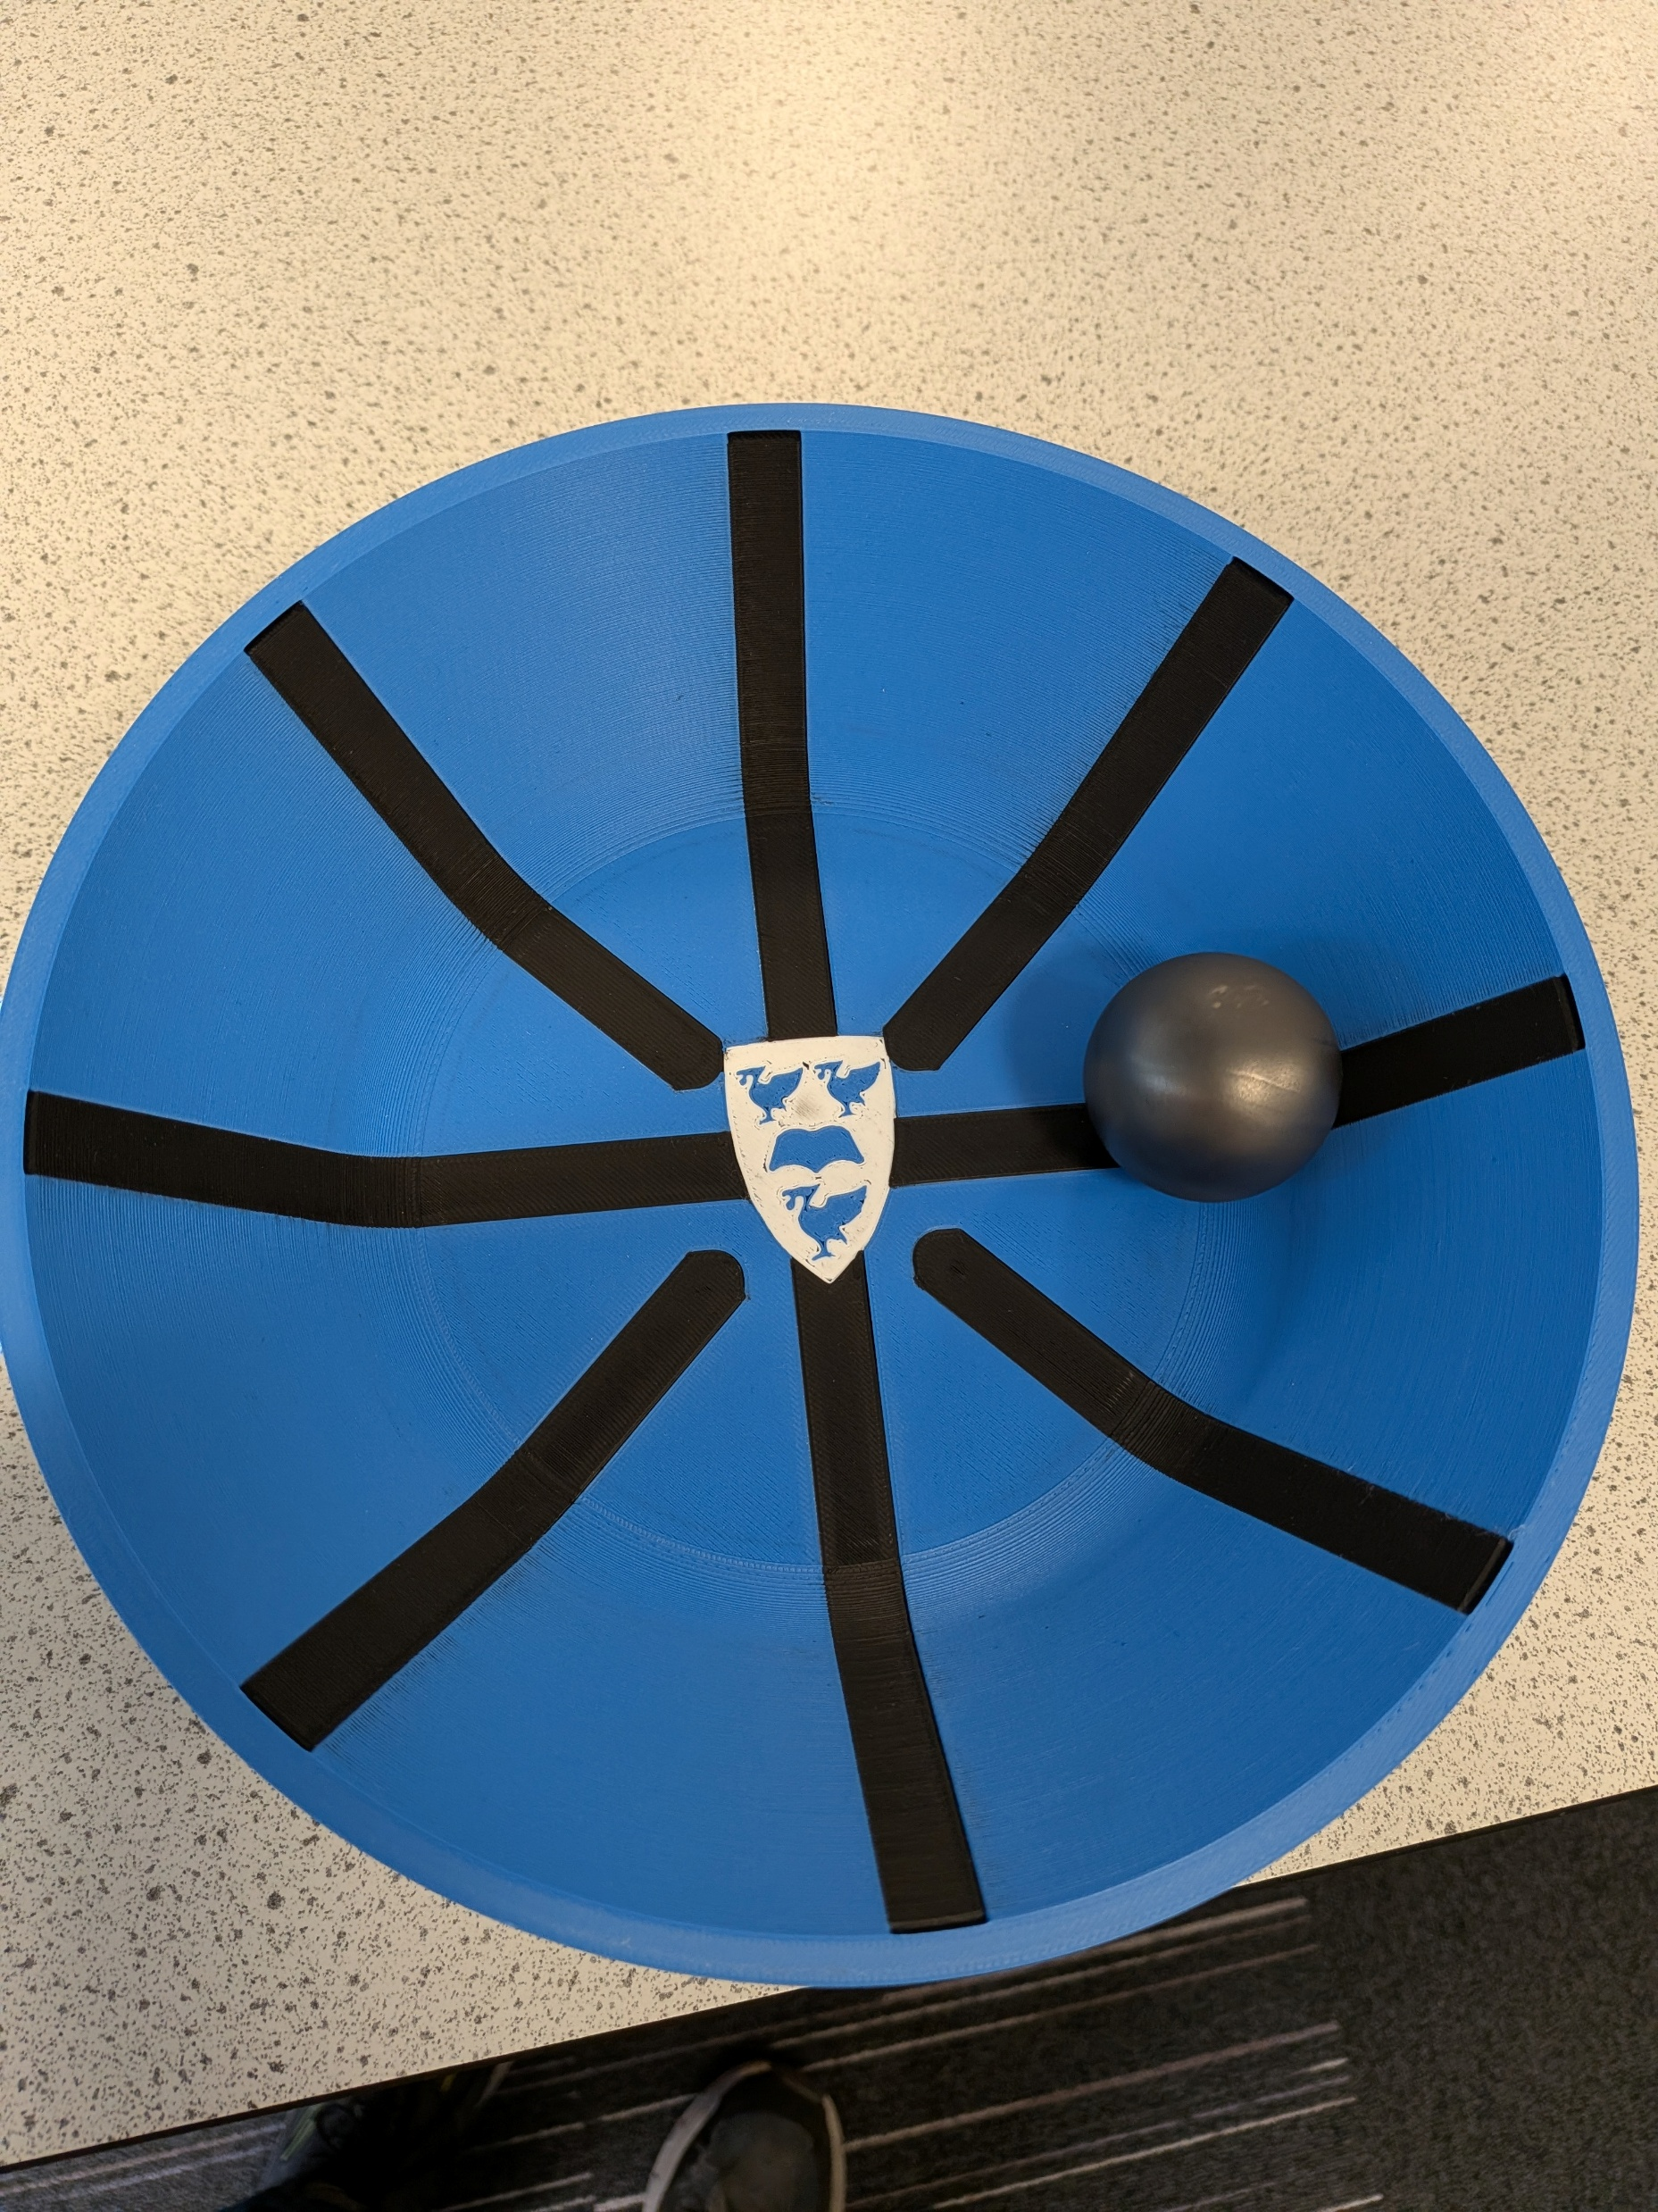
Middle Tier / KS3
Research in Action
Schools often struggle to deliver high-quality practical physics due to lack of specialist teacher knowledge
This is exacerbated by disadvantages schools who lack substantial practical equipment
Aim: address these problems by empowering teachers with easy-to-use resources, practical equipment and links to cutting-edge research

Slide 8
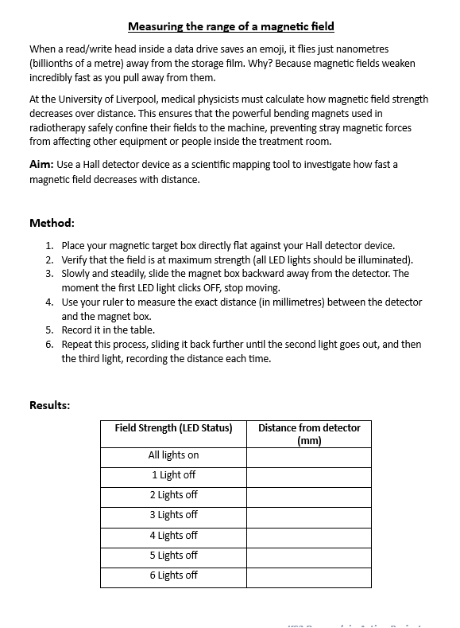
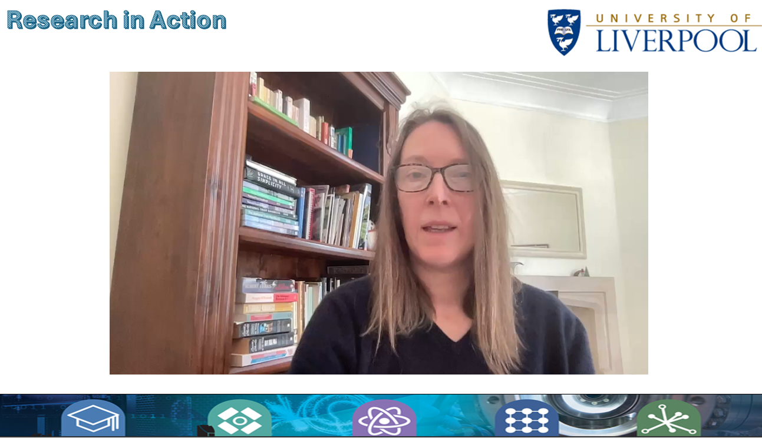
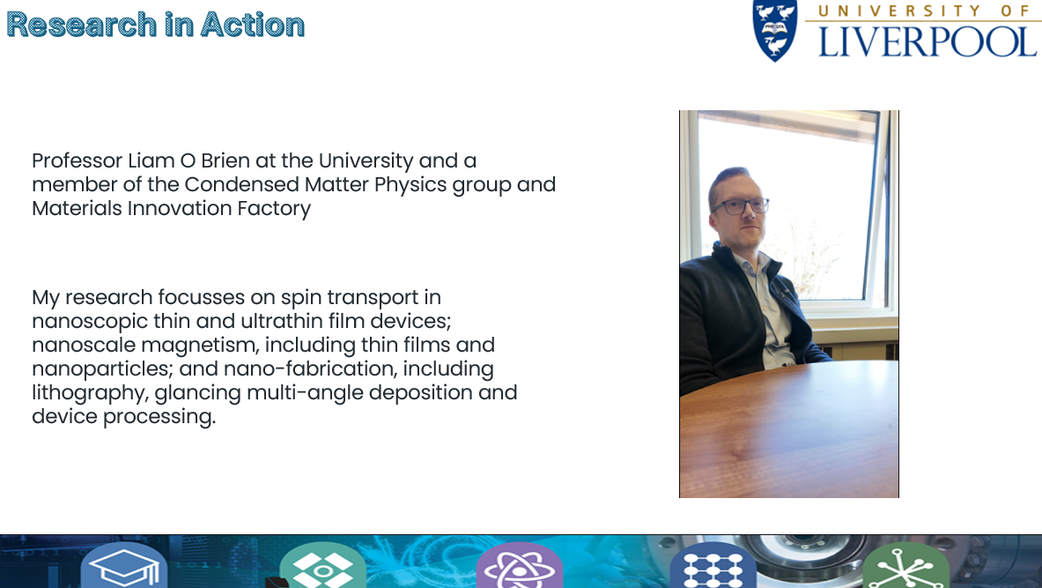
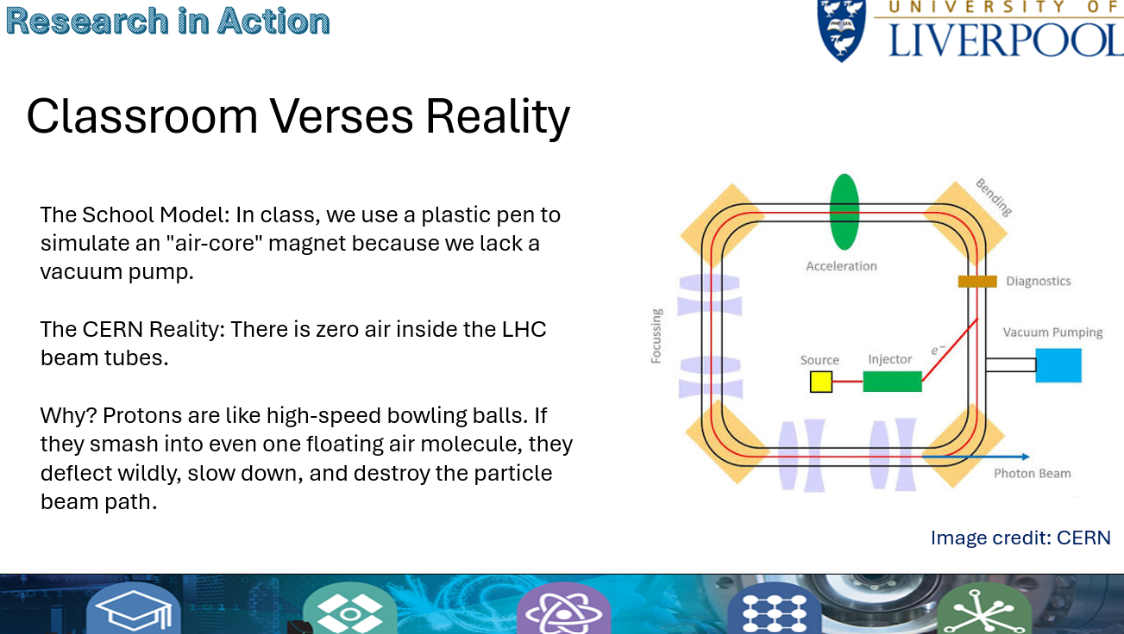
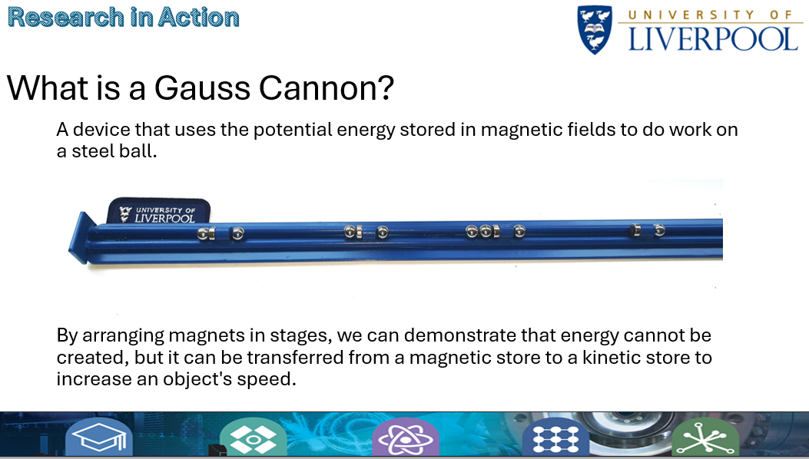
Middle Tier / KS3
Research in Action
Lesson One:
Magnetic Fields
Lesson Two:
Magnetic Fields in Accelerators
Lesson Three:
Electromagnets
Lesson Four:
Electromagnets in Motion
Applications of Magnetism

Slide 9
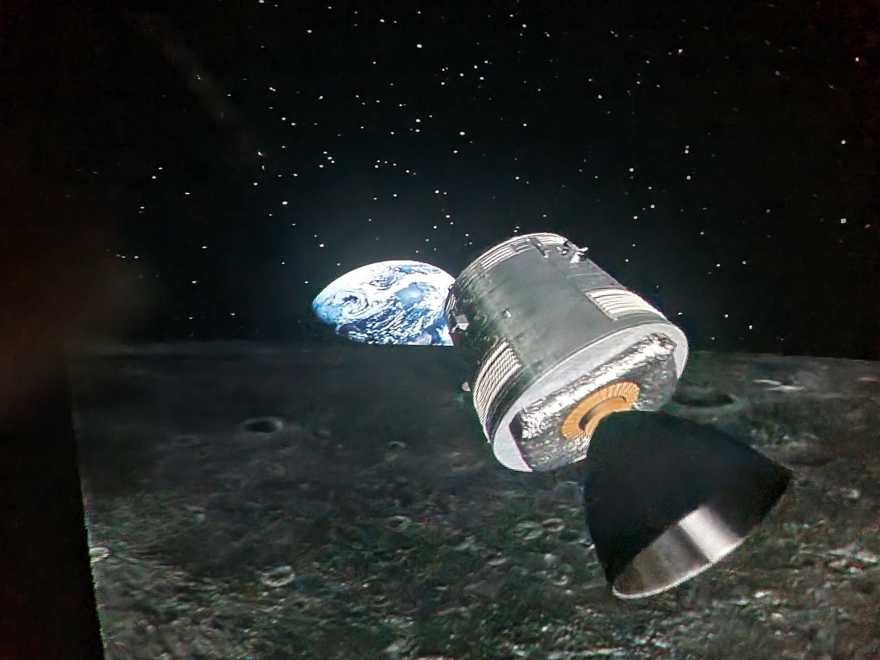
Higher Tier
Aspiring Tier
Middle Tier / KS3
Multi tiered approaches
  GCSE revision
    Aimed at 7/8/9 or A/A*
    Aimed at 4/5 or C/D
  Whitby Science Day
    Long standing partnership
    3 different activities
      Dragon Quiz - higher
      Science is cool – middle
      Planetarium – small groups so ideal for SEND groups

