Slide 1
Priorities for Realistic Control System Simulations with JANUS/Virtual Accelerator
Matt King
ML4Accelerators

Slide 2
Questions to Discuss
How close to the real machine do we need a virtual control system to be?
  Do different applications have different needs?
Which pieces of hardware are a priority to simulate?
  Are there common priorities for several applications?
How would you expect them to be developed?
  DIY?
  Contribute?
  Pass onto main developers?

Slide 3
Examples of Control System Simulation
Setpoints → Readbacks:
  Basic update, but not necessarily realistic
  On the real machine: Do they update instantaneously? Do we need delay?
Noise around a value:
  Basic update, may need to be tuned to match physical hardware
Processes that chain values together:
  "Beam on screen" for clara: enum → position setpoint → delayed readback → camera acquiring → image arrays being set.

Slide 4
Common hardware interactions
Magnets:
  Current, K, Power status (on/off), CS limits, Interlocks
Cavities:
  Phase, Off-crest Phase, Crest Phase, Power, Gradients, Interlocks, Timings
Screens:
  Devices, Device setpoints, motor setpoints, motor readbacks, set multiple axes, interlocks
Cameras:
  Acquisition, Image saving (multiple formats), ROI settings, Live analysis?

Slide 5
LAURA
Python package for creating, translating, and manipulating particle accelerator lattices
Standardized, extensible data model for:
  elements
  sections
  layouts
  full machine models.
Complete with translator modules for writing to simulation codes
Control System variables are embedded in element definitions
  Names
  Data types
  Write Access
  Links to other variables (simulation or control system)
  Dynamics on how to update values with custom functions
astec-stfc/laura: LAURA: Lattice Architecture for a Unified Representation of Accelerators

Slide 6
SARABI
Python package designed to create virtual soft IOCs using PVA/CA from YAML configuration files
Based on the LAURA format for lattice descriptions
Creates python classes for IOCs using Jinja templating (designed to be overridden by user)
Fills in control system information using LAURA contents
Creates main.py for running all IOCs
Simulates control system updates using defined dynamics and links in LAURA
astec-stfc/sarabi

Slide 7
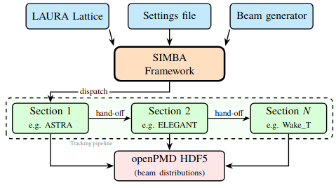
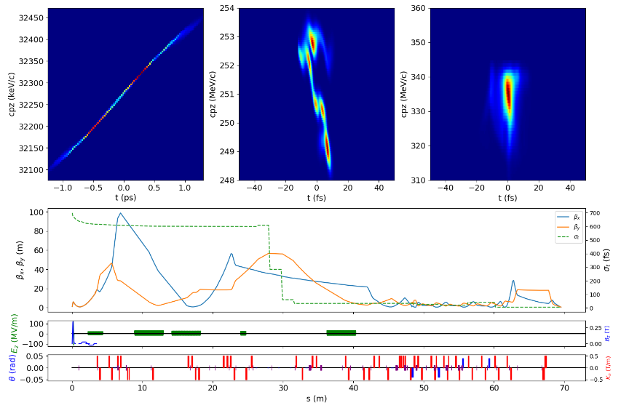
SIMBA repo
SIMBA
SIMBA is a python package to enable simulations of (linear) particle accelerators.
The lattice is derived from the LAURA structure.
Abstract away the details of underlying tracking codes:
Consistent beam tracking across multiple beam physics modalities (i.e. RF gun, linac, FEL, plasma...).
Does not require expertise in multiple codes!
Can also call ML models of lattice sections.
Data flow in SIMBA
SIMBA
Abstract input files away
Interact only with python methods
Code-agnostic input/output
Convert input/output data to standard formats
Learn new “abstract” code
Start-to-end CLARA simulation

Slide 8

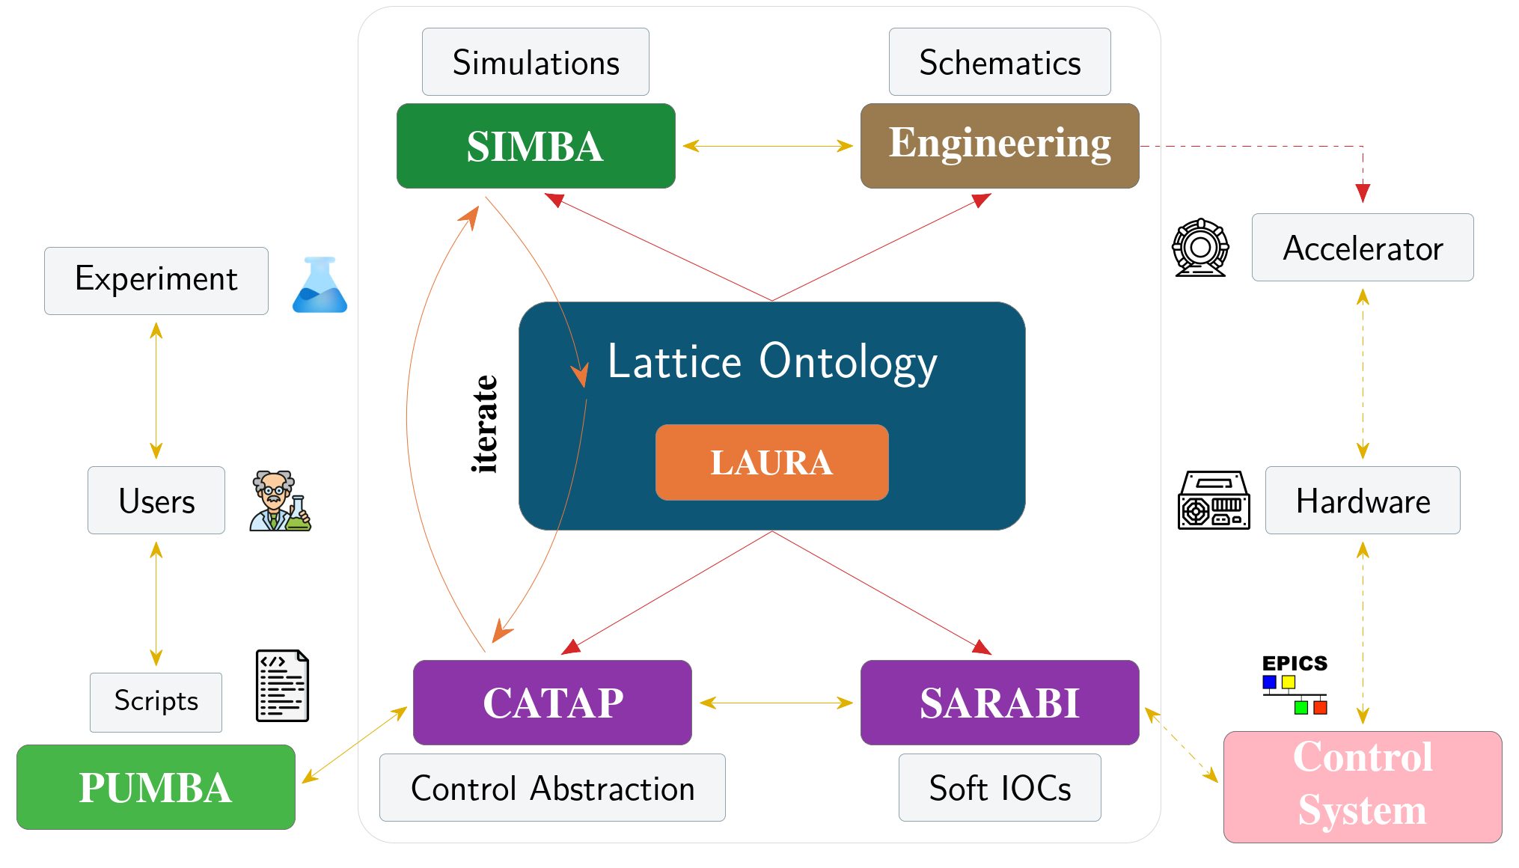
JANUS
Combining particle tracking simulations with control system simulations.
Full pipeline generated from LAURA definitions.
Ability to swap between beam-based surrogate models and tracking codes.
JANUS Server
Lattice DB
JANUS Client
Lattice API
EPICS to Lattice
Control System
Lattice to EPICS
Lattice to SIMBA
SIMBA to Lattice
Web Frontend
User Application
SIMBA API
ML Models
Tracking Codes
GENERATES
CATAP
[Control system middle layer]
LAURA
[Lattice Definition]
INGESTS
SIMBA
[Simulation framework]
Papers:
CATAP: arXiv:2509.19794
SIMBA/LAURA: arXiv:2604.19103
JANUS: arXiv:2604.19101
GENERATES
SARABI
[CA/PVA IOC generator]

Slide 9
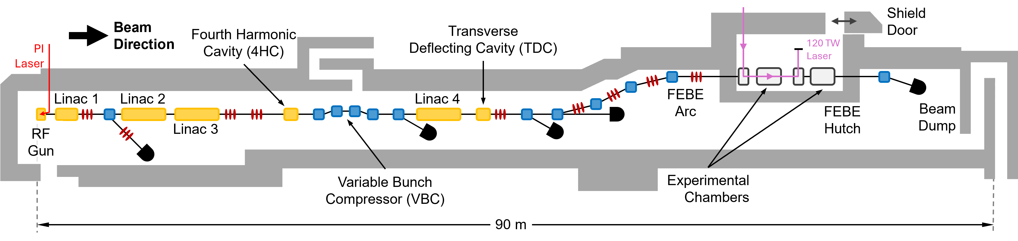
CLARA FEBE Layout
CLARA FEBE Layout
Example Technical System | CLARA Front End (35 MeV) | CLARA (250 MeV) | CLARA FEBE (250 MeV)
RF Structures | 2 | 7 | 7
Magnets | 22 | 77 | 126
Diagnostic Systems | 13 | 65 | 94
Vacuum Gauges and Pumps | 57 | 109 | 155
First experiments in the
Full Energy Beam Exploitation (FEBE) user area took place
in early 2026
First experiments in the
Full Energy Beam Exploitation (FEBE) user area took place
in early 2026

