Slide 1
Particle Astrophysics Roadmap
PAAP: Stephen Fairhurst, Sergey Burdin, Ed Daw, Laura Kormos, Jon Lapington, Chris McCabe
STFC: Karen Clifford, Ailsa Johnstone

Slide 2
Purpose of today’s meeting
We will present top level summary of input and initial recommendations
Seeking community input. Will have two breakout sessions:
By science theme, looking for feedback on priorities and recommendations
Across science theme, discussing general goals, challenges, etc
Will use today’s input, as well as questionnaires, proformas and other reviews to complete the draft roadmap

Slide 3
PA Roadmap Input
2016 PA Roadmap
APPEC Roadmap 2017-2026
Discussions from January PA town hall
Interactions with PPAP
17 completed proformas from Particle Astrophysics experiments
101 individual submissions to questionnaire

Slide 4
Science Goals
Update science goals to reflect progress since 2016
Directly reflect the top-level STFC science challenges https://stfc.ukri.org/research/science-challenges/
Will include CMB in the 2021 PA Roadmap, update science questions accordingly
Ensure that Dark Matter discussion is sufficiently broad, reflecting current experimental efforts
Update GW astronomy goals to include: primordial black holes, BH mass and spin population, neutron star structure
Emphasize multi-messenger astronomy nature of particle astrophysics, including kilonova observations and origin of heavy elements

Slide 5
A. How did the universe begin and how is it evolving?
Particle Astrophysics can help to address every question.

Slide 6
B: How do stars and planetary systems develop and how do they support the existence of life?
Mostly outside of PA, some input from solar neutrinos, heavy element formation

Slide 7
C: What are the basic constituents of matter and how do they interact?
Significant input to a subset of questions

Slide 8
Preliminary Recommendations and Questions

Slide 9
Gravitational Waves
Priorities
Upgrades of aLIGO (to A+ and post-A+ sensitivities) and exploitation of LIGO-Virgo-KAGRA data for GW observations remain highest priority
Vital that the UK retains a leading role in next generation GW observatories (Einstein Telescope and Cosmic Explorer).
UK participation in the LISA mission is funded by UKSA. STFC supports preparation for science exploitation. This support must be maintained and potentially increased nearer to launch.
Questions
Should STFC support generic research towards next generation GW observatories, or explicitly support one of ET or CE? Does this change now that ET is included in the ESFRI roadmap?
We did not receive a submission on Pulsar timing for GW observations. Is this a priority to be included in the roadmap?
Field has evolved significantly since 2016 –from 1st detection to 100 observations of BH-BH, BH-NS and NS-NS mergers, including multi-messenger observation of neutron star merger

Slide 10
Dark Matter
PAAP 2016 DM recommendations mention LZ, G3, ADMX and Directional detector R&D. Since then, the community has grown with new initiatives and experiments being proposed.
Dark Matter Strategic Review 2020
Experimental submissions:
LZ (Data taking 2021 – 2025)
DarkSide (Data taking 2024 – 2030)
Low-mass dark matter search at Boulby (Possible timescale 2026 – 2030)
Argo (Exploitation 2030 – 2040+)
DarkSphere (Construction in 2024)
XenonFuture (Construction in 2025)
Quantum Sensor Dark Matter Projects
Questions:
Discussion of Dark Matter Strategic Review Recommendations
DM searches in WIMP mass range
Extensions to lower mass ranges: MeV and axions
Alignment with PPAP roadmap
How to integrate the DM searches with Quantum Sensors
Sergey Burdin and Ed Daw

Slide 11
Dark Matter
Dark Matter Strategic Review 2020​
Current levels of support must be maintained and ideally expanded.​
Maintain and develop R&D diversity beyond the larger-scale WIMP experiments through bids for low-level seedcorn capital and resource investment. ​
STFC should maintain and capitalise on the strong expertise and experience of direct dark matter detection research in the UK. In a limited funding climate, significant investment should only be made in a single next-generation experiment (investigate Boulby feasibility).​
In the short-term focus on synergies and areas of commonality in R&D in the path towards either an argon or xenon next generation experiment, for example a common R&D SiPM UK dark matter consortium.​
Proposals for the optimal technology for a future construction will require a strategic decision which should be taken on a similar timescale to the global prioritisation exercise in Europe and the US​
Sergey Burdin and Ed Daw

Slide 12
Dark Matter
PPAP 2021 draft DM recommendations​
The STFC should seek opportunities to grow funding in the broad Dark Sector to support initiatives that can demonstrate their uniqueness, complementarity, or world-wide competitiveness.​
The UK should maintain leadership during R&D, construction and exploitation of Direct DM Detectors, and should seek opportunities to grow funding to support projects with sensitivity to low mass DM (below 1 GeV), particularly those planned to be constructed within the UK.​
The UK should secure future support of dark sector experiments based on successful demonstration of quantum technologies with funding outside the current STFC core programme.​
The UK community of theorists and phenomenologists, collider experimentalists, and direct and indirect detection experimentalists should establish an interdisciplinary programme to explore a synergic approach in DM studies, with greater communication and idea exchange.​
Sergey Burdin and Ed Daw

Slide 13
Theory
Theory provides crucial support for all aspects of particle-astro research (in setting directions, ensuring data is fully exploited…)
Lots of concerns about funding:
Concerns particle-astro theory is badly-served by current funding model: fears that world-leading research not even fully considered for funding as Astronomy says apply to Particle, and vice-versa. How widespread is this concern?
All QTFP projects funded with theory support. How will this be sustained? [Through theory consolidated grants - but will the explicit link to the project remain? Is there expertise on grants panels to assess interdisciplinary QTFP-theory applications]
PDRAs per funded member of academic staff is 0.17 in theory [0.69 in particle physics experiment, 0.53 in astronomy]. Concerns that it is increasingly hard to attract and keep leading PDRAs
Chris McCabe

Slide 14
Theory
Concerns raised about decoupling from EU/EU funding. Does there need to be more engagement with EuCAPT (The European Consortium for Astroparticle Theory)?
Concerns raised that there is too much dispersion of knowledge across UK groups. There is a UK centre coordinating activities in particle physics (IPPP). Suggested that there should be a particle-astro centre too, possibly associated with a national lab. Is there more widespread support for this?
Vertical integration is working - theorists are talking to experimentalists within the same field. Is there a desire for more cross-theory discussion (a UK version of EuCAPT)? If so, is PAAP the forum to drive that?
Chris McCabe

Slide 15
VHE Gamma-rays
Priorities
Continue the UK’s leading role in CTA
Maintains UK position in gamma-ray science and instrumentation
Guarantee return on STFC investment
Maximize community engagement with CTA
Extensive UK participation in Key Science Projects
Full exploitation of UK observation time
Maintain expertise and leadership in gamma-ray instrumentation
Continue CTA involvement beyond observatory “alpha” configuration – e.g. Small Sized Telescope array extension, camera performance upgrade
Funding for projects beyond CTA - e.g. Southern Wide-field Gamma-ray Observatory
Jon Lapington

Slide 16
VHE Gamma-rays
Recommendations
CTA participation: UK involvement in CTA in construction phase
Fund at the anticipated level of ~£5M
Gamma-ray science: Find a better, fairer way to fund rapidly growing PA science
Currently PA science activities fall between AGP and PPGP funding
Establish a ring-fenced PA specific funding pot
Build on UK strengths: Maintain PA instrumentation heritage and expertise
New fellowship opportunities with focus towards instrumentation
Maintain expertise and skills in longer term - funding for future projects e.g. SWGO
Jon Lapington

Slide 17
Cosmic Microwave Background
Very strong heritage in CMB instrumentation, analysis and theory in the UK (Planck etc.)
Still great discovery potential in CMB post-Planck with high-resolution measurements of temperature and polarisation anisotropies and spectral distortion measurements
Physics of the early universe/origin of structure
Neutrino properties and other relativistic particles
Mapping mass and gas in the universe
Time-variable mm-wave sky
Anthony Challinor

Slide 18
Cosmic Microwave Background
UK priorities laid out int 2016 UK CMB white paper/roadmap
Key priority: secure major UK involvement in the Simons Observatory
Several previous proposals (ERC Synergy, UKRI Infrastructure Fund) unsuccessful; ~£370k seed corn funding through PPRP
About to submit PPRP proposal (~£10M) for instrumentation, UK data centre and software pipeline development for SO
STFC considering enhanced proposal for putting forward to UKRI Infrastructure Fund
Other priorities:
Work towards full engagement in the CMB-S4 project ($600M+ US-led project)
Capitalise on major contributions to Planck by fully contributing to development and execution of future satellite missions (new opportunities now for LiteBIRD and ESA Voyage 2050 recommendations)
Question: Are these priorities still appropriate, or do they need updating in 2021?
Anthony Challinor

Slide 19
Neutrino Astronomy
None of the experiments dedicated specifically to neutrino astronomy are explicitly funded by STFC at present. Minimal funding is provided in some cases through the consolidated grants. UHE neutrinos are a key component of multi-messenger astronomy.
The UK has involvement in current and future experiments:
IceCube/IceCube-Gen2 – from 2018 used UHE neutrinos as part of multi-messenger astronomy, identifying blazars. IceCube recently reported (Nature 591) the detection of a particle shower at the Glashow resonance at ~6 PeV. Gen2 is expected to see many more.
ANITA/PUEO – the most stringent constraints on UHE neutrinos with E > 10¹⁸ eV, ruling out neutrino production models and providing multi-messenger astronomy. (PUEO elected for further design study by NASA, proposed launch 2024.)
Some experiments are primarily in the PP remit but also do PA
SNO+ - solar neutrinos, supernovae (soon on SNEWS).
SK, T2K, HK, DUNE – solar and astrophysical neutrinos, diffuse neutrino background, supernovae, dark matter, CPT and Lorentz Violation.
Laura Kormos

Slide 20
Neutrino Astronomy
Other future neutrino astronomy experiments
P-ONE: a new initiative for the staged construction of a multi-cubic-kilometre neutrino telescope in the deep Pacific Ocean underwater west of Victoria BC Canada. German, Canadian and US involvement, some UK involvement. Monitoring and testing of the site is ongoing.
Top Priorities
Funding for at least one neutrino astronomy experiment.
Funding for novel technologies – can be combined with UK industry expertise e.g. oceanic infrastructure, reusable energy can be related to ocean-based neutrino telescopes.
Better funding for PDRAs who work on novel technologies that take more than 3 years to develop.
Questions (based on PAAP surveys/previous Town Hall)
Should the UK host a neutrino telescope?
Should the UK host an underground PA lab including neutrinos experiment and theory group?
Are there other neutrino astronomy experiments that we should be involved in?
Laura Kormos

Slide 21
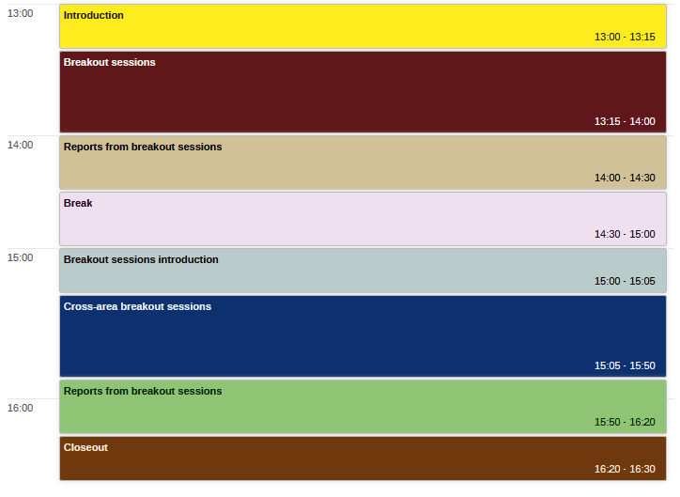
Today’s timetable

