Slide 1
Particle Astrophysics Roadmap
PAAP: Stephen Fairhurst, Sergey Burdin, Ed Daw, Laura Kormos, Jon Lapington, Chris McCabe
STFC: Karen Clifford, Ailsa Johnstone

Slide 2
PA Roadmap Input
2016 PA Roadmap
APPEC Roadmap 2017-2026
Discussions from January PA town hall
Interactions with PPAP
17 completed proformas from Particle Astrophysics experiments
101 individual submissions to questionnaire

Slide 3
What changes or activities could increase diversity, equality and inclusion in this field?
“The diversity in PAAP is abysmal and it is far from even being recognised let alone acted upon. There are many schemes other nations are trialling, with great success, to address this. The odd sentence about ED&I in roadmaps and documents are transparent and patronising to minority groups - there needs to be serious resource behind any such activities. It is not a case of 'promotion', it is about structural inequalities that need to be addressed.”
Discuss.

Slide 4
Infrastructure: computing
Computing plays a key-role across many (all?) projects. Yet computing-related comments were barely raised in the individual questionnaire.
Does that mean that the current computing infrastructure is working well? Are there any issues on the horizon?

Slide 5
Infrastructure: developing the Boulby Underground Laboratory
-- “Expanding Boulby and turning it into an international recognised facility with a diverse science programme would be the ideal scenario to ensure UK leadership."
-- “Hosting a large dark matter experiment in the UK would no doubt be attractive - but this would be an infrastructure project that does not involve the scientific community directly and should be no replacement for support to the actual experiment(s).”
-- “I am worried by the STFC policy of ‘G3 (dark matter) at Boulby or bust’, which is very dangerous; flag-waving trumping science.”
Is the broader PAAP community aware of discussions to expand Boulby? This would be a large investment by the UK. Is an expansion broadly supported?

Slide 6
How could STFC support the development of critical underpinning technologies? What are the barriers for creating a healthy career pathway?
-- “Instrument/detector development is not rewarded. Detector-focussed early career scientists do not compete well in the existing Fellowship schemes (UKRI, STFC, URF). A dedicated instrument/detector development fellowship allocation would help.”
-- “STFC's support for scientists focussing on detector development is poor. We need positions and funding for this specific purpose.”
Does the current Fellowship model work for our community? If not, how could it be improved?

Slide 7
Training and community building
“I think it's a great time for research in astroparticle and cosmology. It is a major area of UK strength, with many significant discoveries on the horizon.
The field is clearly multidisciplinary linking e.g. quantum gravity, particle cosmology, astro-particle and neutrino properties.
A dedicated UK Summer School in Astroparticle Physics could give our field more of an identity that is distinct from the much larger Particle Physics and Astronomy groups.”
Do current schools already serve our PhD students well? Is there a broader appetite for this type of shared school/activity?
(Extension question: the IoP high-energy and astro-particle conferences are usually together. Should that continue?)

Slide 8
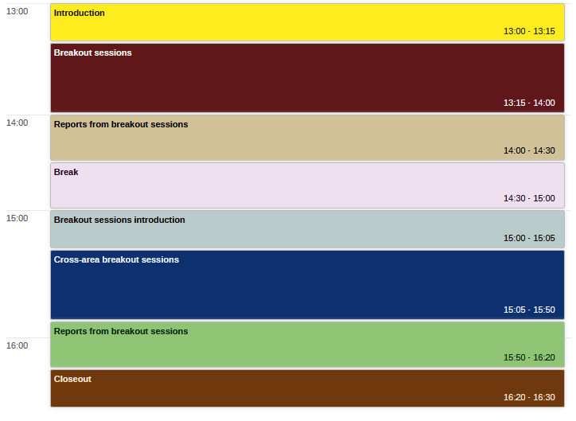
Today’s timetable

