Slide 1



Novel Acceleration Activities in the QUASAR Group
Dr. Joseph Wolfenden

Slide 2


Overview
Discussion!
Targets for the future – research strategy
Examples
Core areas of activity

Slide 3
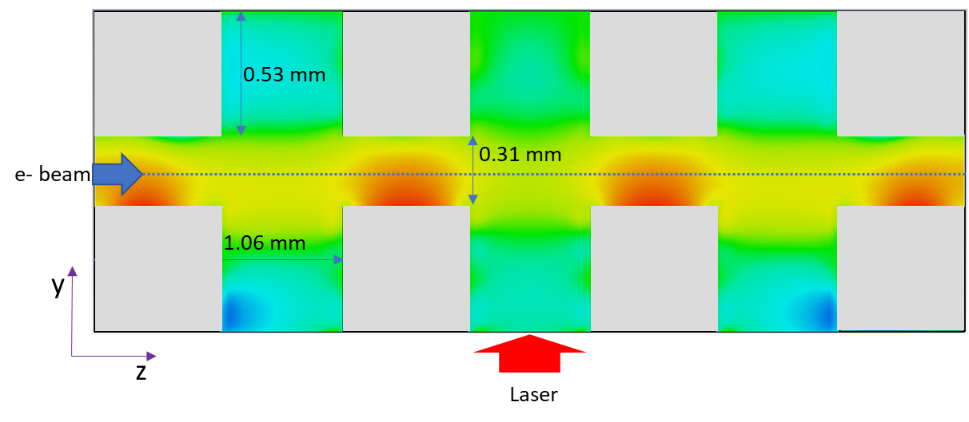
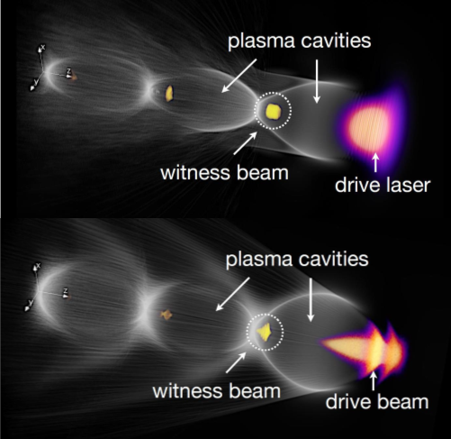

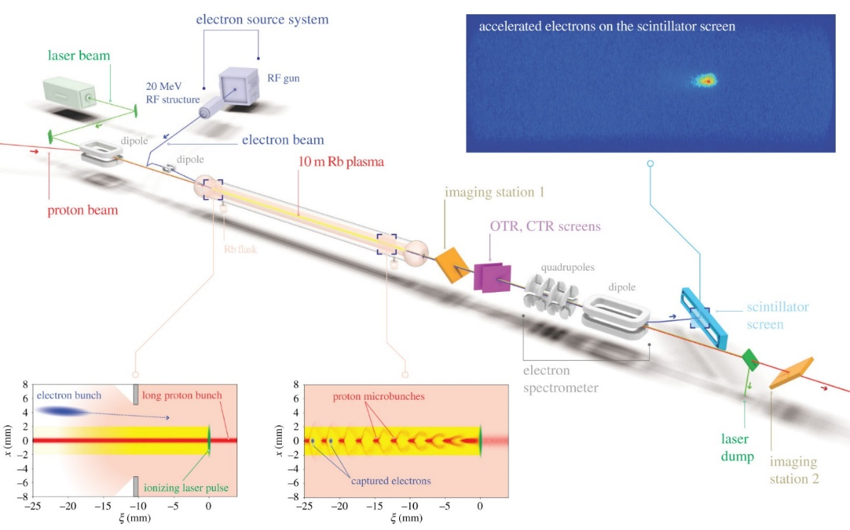

Core Areas of Activity
Structure-based
EuPRAXIA
AWAKE

Slide 4
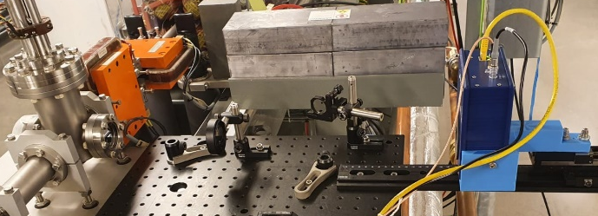
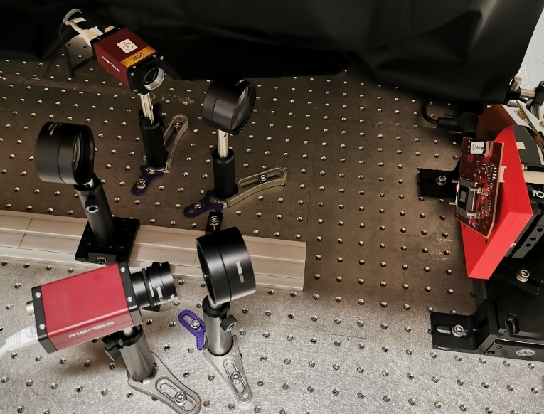
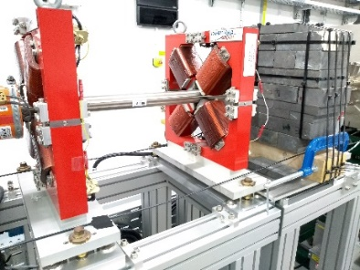
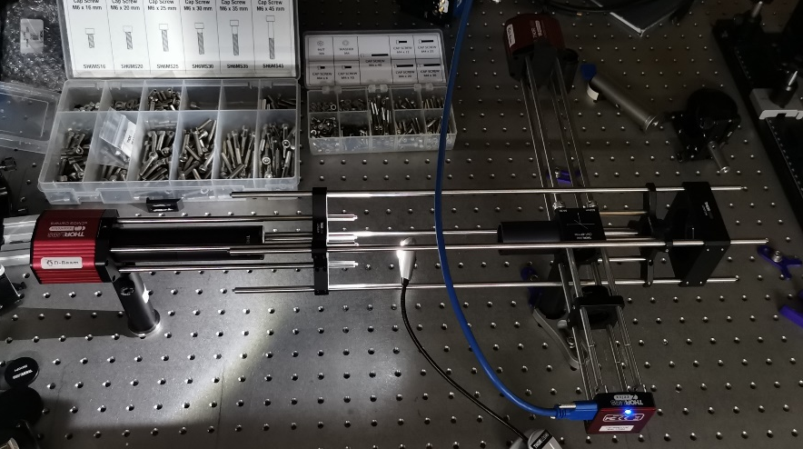
AWAKE - Diagnostics
Spatial camera
Pre-plasma electrons
Pre-plasma electrons
Pre-plasma electrons
Incoming radiation
DMD
Angular camera
13
Diagnostic
Systems
Diagnostics
Accelerated electrons
SSM Protons
Accelerated electrons
SSM Protons

Slide 5
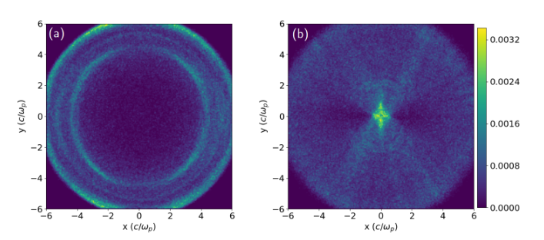
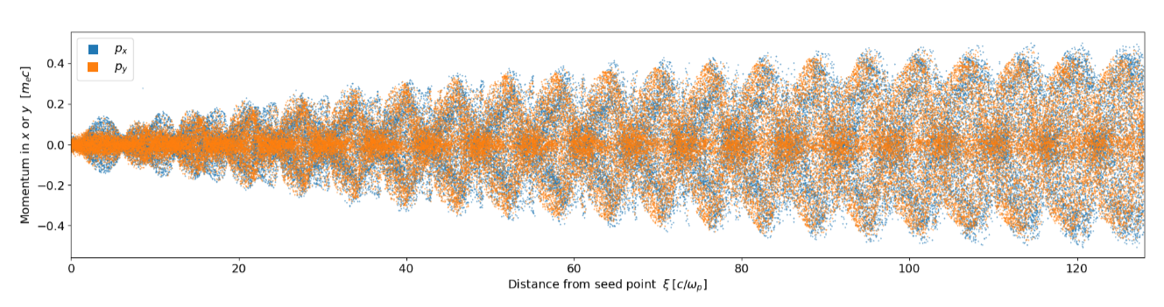
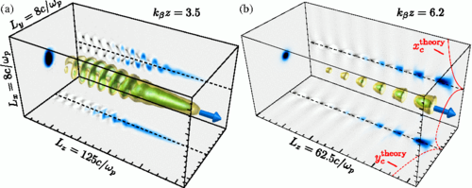
AWAKE - Simulations
Simulation
Studies

Slide 6
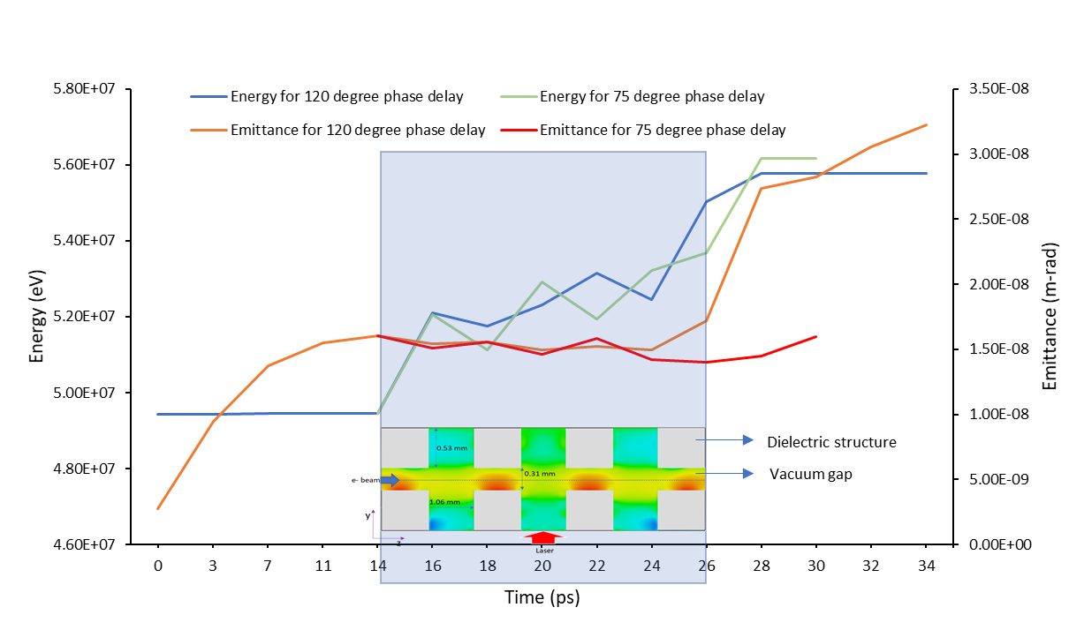
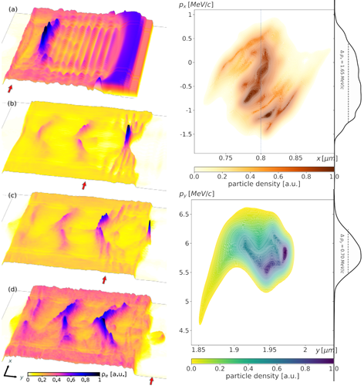
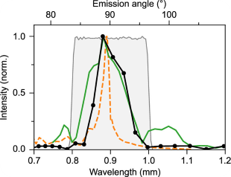
Structure-based
CNT/Graphene
Structure-based
acceleration
Dielectric

Slide 7
EuPRAXIA
LWFA
PWFA

Slide 8
Future targets – Research Strategy
In the next decade we will focus on the LHC at CERN, where we lead work on the development of gas jet monitors for the high luminosity upgrade, and other collider options; on the exploitation of the CLARA facility on Daresbury campus to explore next-generation FEL technologies; on the development and exploitation of the new facilities PERLE and RUEDI; and on the optimization of low energy beam transport and efficient injection into traps at the Antiproton Decelerator, in particular contributions to the AEgIS project.
As part of the AWAKE project, we will continue our efforts on novel (high gradient) acceleration techniques. Following the successful demonstration of proton-driven wakefield acceleration in 2018, we are leading the development of novel diagnostics that will give more detailed insight into the physics of the acceleration process and also benefit other large scale plasma accelerator projects such as EuPRAXIA. We will also expand simulation and experimental studies into micro-accelerators using carbon nanotubes and dielectric structures. (CDT)
For impact, we will carry out R&D into least invasive beam and dose monitors, to help improve patient treatment and medical accelerator operation; continue to develop and optimize novel low dose 3D X-ray imaging systems with Adaptix; develop compact accelerators for rock art discovery; drive quantum technologies for accelerator applications; grow our spinout company D-Beam, targeting a product portfolio that benefits accelerator facilities around the world.
A backbone of all three areas above will be our continued leadership in Data Intensive Science through LIV.DAT and LIV.INNO.
In the next decade we will focus on the LHC at CERN, where we lead work on the development of gas jet monitors for the high luminosity upgrade, and other collider options; on the exploitation of the CLARA facility on Daresbury campus to explore next-generation FEL technologies; on the development and exploitation of the new facilities PERLE and RUEDI; and on the optimization of low energy beam transport and efficient injection into traps at the Antiproton Decelerator, in particular contributions to the AEgIS project.
As part of the AWAKE project, we will continue our efforts on novel (high gradient) acceleration techniques. Following the successful demonstration of proton-driven wakefield acceleration in 2018, we are leading the development of novel diagnostics that will give more detailed insight into the physics of the acceleration process and also benefit other large scale plasma accelerator projects such as EuPRAXIA. We will also expand simulation and experimental studies into micro-accelerators using carbon nanotubes and dielectric structures. (CDT)
For impact, we will carry out R&D into least invasive beam and dose monitors, to help improve patient treatment and medical accelerator operation; continue to develop and optimize novel low dose 3D X-ray imaging systems with Adaptix; develop compact accelerators for rock art discovery; drive quantum technologies for accelerator applications; grow our spinout company D-Beam, targeting a product portfolio that benefits accelerator facilities around the world.
A backbone of all three areas above will be our continued leadership in Data Intensive Science through LIV.DAT and LIV.INNO.

Slide 9
Future targets – Research Strategy
AWAKE
Structures
EuPRAXIA
Data Science

Slide 10





Discussion!
Group Feedback – 10’
Future Work – 25’
Challenges & Opportunities – 25’
Current Status of our Research – 25’
Introduction/Setup – 5’

Slide 11
Thank you!
Discussion time!

Slide 12
Feedback
Possible plasma diagnostic applications of existing diagnostics
ToF diagnostics for AWAKE
Possible micro-structure experiments in the near future to target
  DLA ML structures at FEBE
  CNT at OMEGA
  DLA for diagnostics -> related work ongoing at FEBE
CNT for laser quality/diagnostics
“Easy” collaborations – UoL Stephenson, Hartree/NVIDIA
SCAPA for LWFA EuPRAXIA work?
A mixture of “Blue Sky” and “Application Driven” research is crucial to generating meaningful impact
Data science
  Under-utilising unsupervised learning – e.g. pattern recognition for different beam species
  Symbolic regression – physics built into ML
  Repositories for codes – github
  Lectures at the early stage to better integrate machine learning from the start – contact experts with more specific requirements

