Slide 1
Spinout Journey
Mohammed Belal
+ 44 (0) 75900 78039
Mohammed.belal@stfc.ac.uk

Slide 2
Outline
01
Start with the Why?
04
Importance of focus
02
My Journey with MIRICO
05
Business skills: sales, fund raising, leadership
03
The Eco System
06
Summary

Slide 3
Why?

Slide 4
Why Commercialise?
The Why?

Slide 5
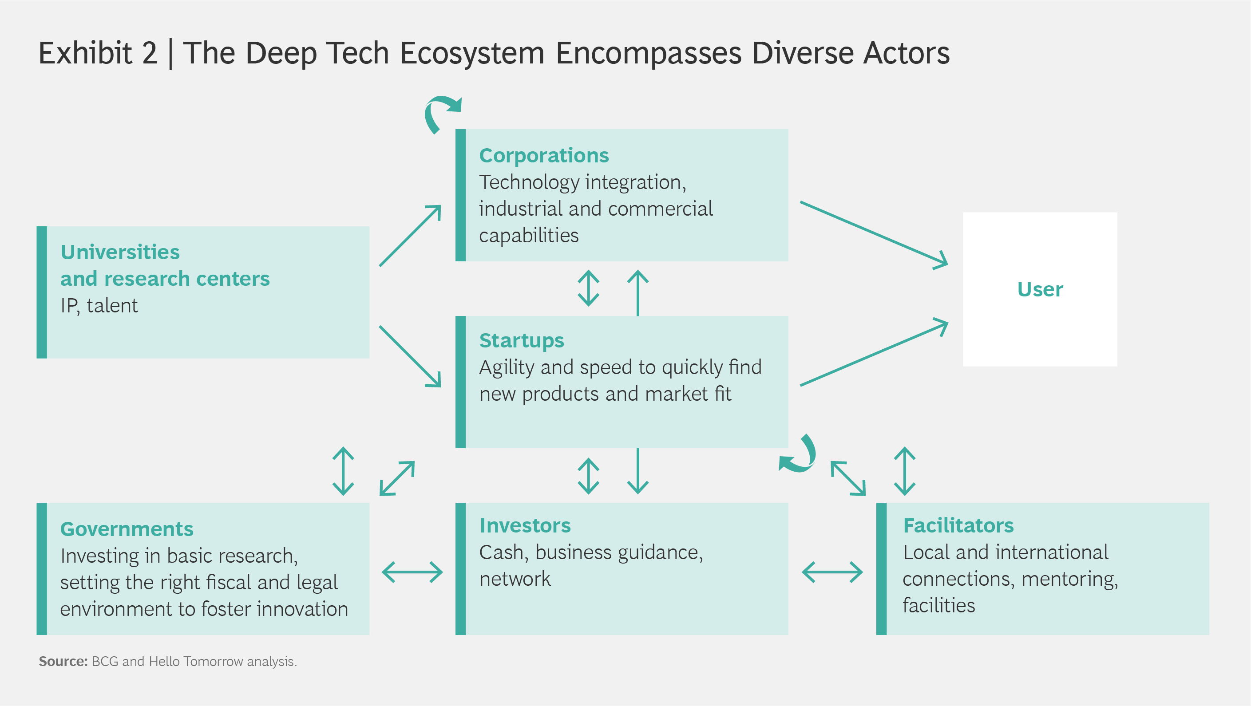
The Why?
Source: BCG - How deep tech can help shape the new reality

Slide 6
The Why?
Past: closed innovation model where corporate innovation used to be all internal
Today: Open innovation where integrating external knowledge is imperative to keeping ahead
Research Projects
Products &
Markets
Research Projects
Products &
Markets
Research
Development
Commercialization
Research
Development
Commercialization

Slide 7
The MIRICO Journey

Slide 8
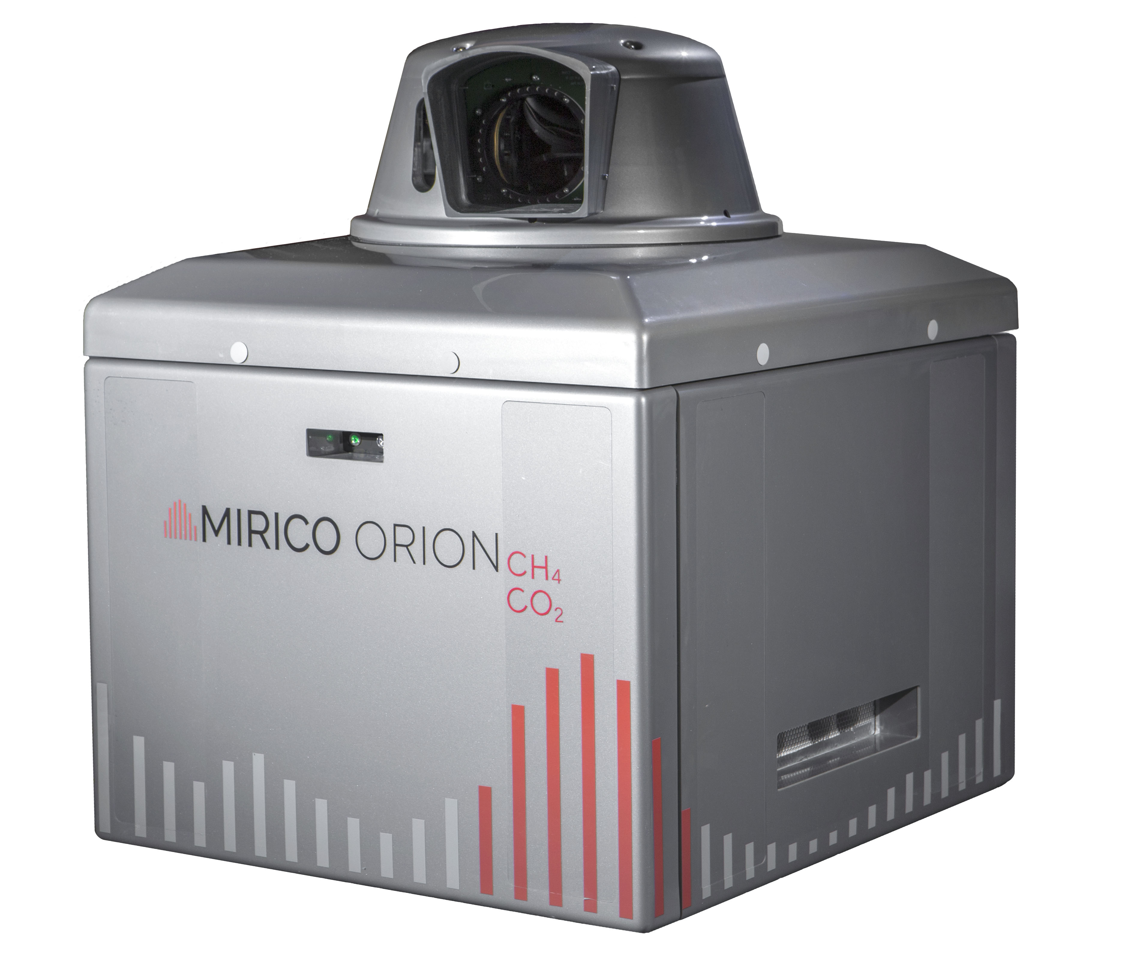
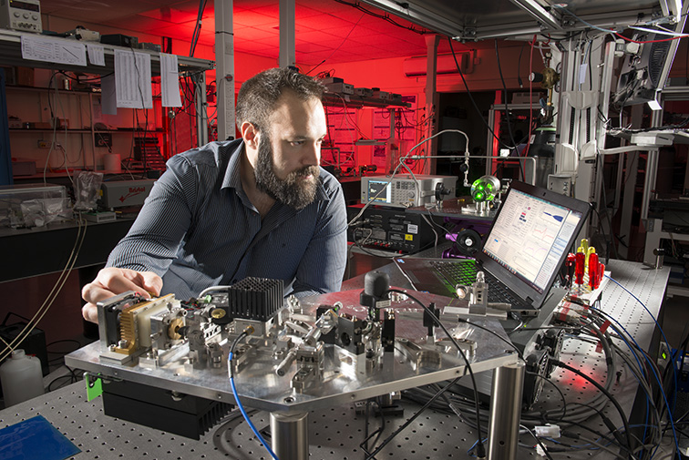
From lab to product
MIRICO

Slide 9
Numerous challenges: IP, team, market engineering, sales…..
MIRICO

Slide 10
Know your audience
Communication
MIRICO Original Message….
“We’ve developed a new laser spectroscopic technique that measure the phase change of the transmitted beam as opposed to intensity, this makes it more sensitive and less effected by transmission losses…. Bla bla bla … “
What we ended up with….
We offer autonomous, all weather leak detection, localisation and quantification for more profitable, safer and environmentally friendly operations

Slide 11
From technology to solution

Slide 12
Building commercial and technical milestones
MIRICO
Commercial milestones:
1. Number of LOI’s
2. NRE payments to build something
3. Customer pays for PoC
4. Paying customer for product
5. More paying customers
Engineering milestones:
1. Use of data from other sources to prove concept
2. Requirements and feasibility review
3. Hardware simulation
4. PoC testing of actual hardware in benign environment)
5. System design review
7. Testing system in
8. Critical design review
9. Product Launch
10. Production spacecraft – will be replicated to form constellation

Slide 13
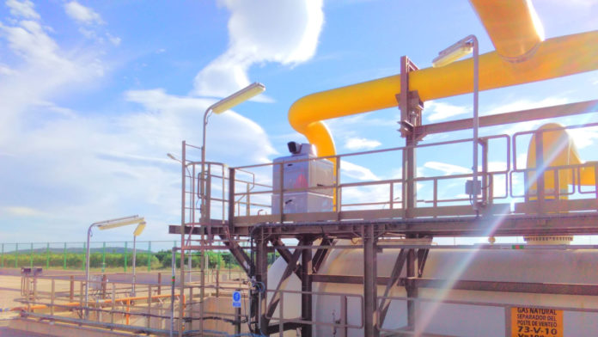
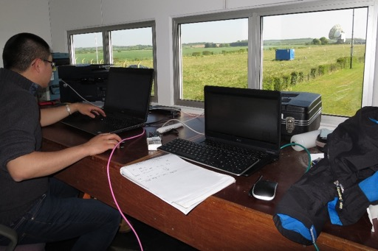
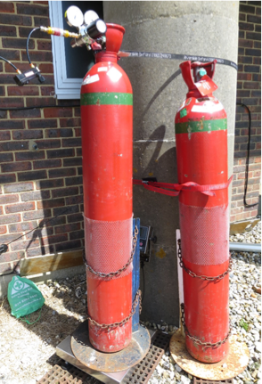
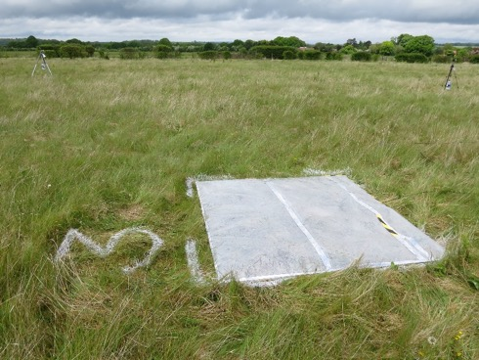
Evolving through milestones
MIRICO
Aug 2020
Dec 2015
Aug 2017
Mar 2022

Slide 14
Product Market Fit

Slide 15
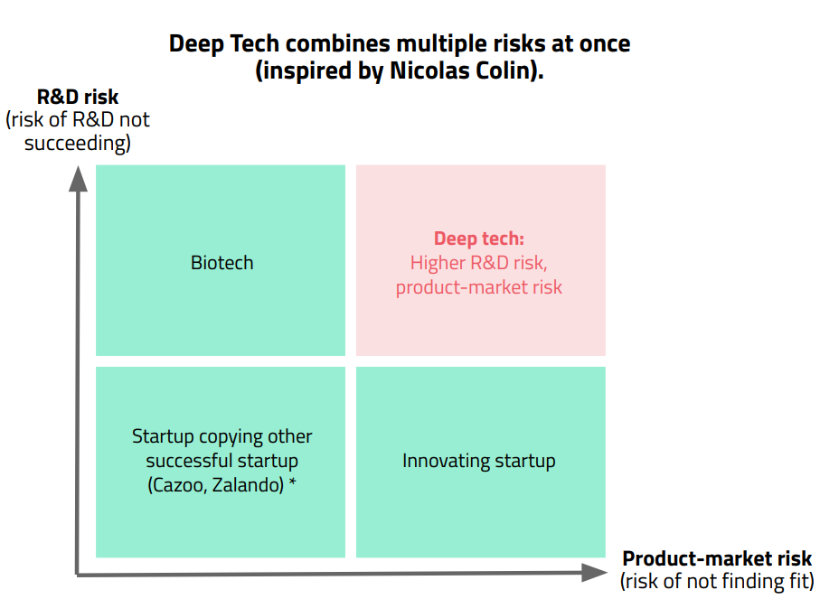
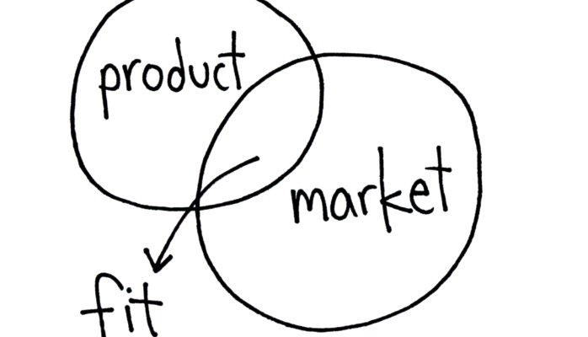
High risk and challenges
Product Market Fit

Slide 16
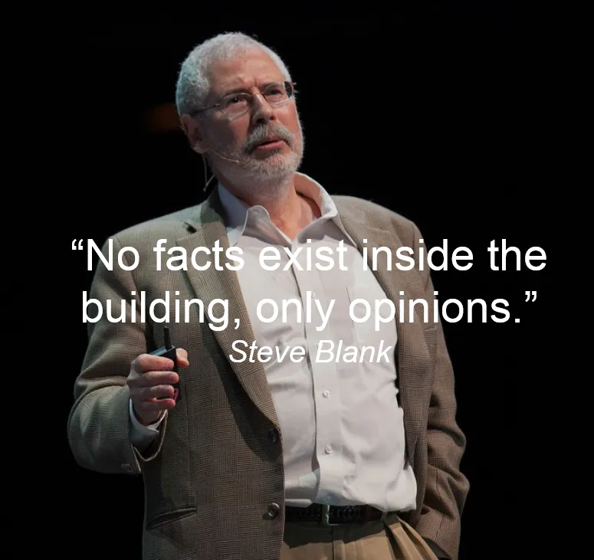
Don’t assume anything
Product Development

Slide 17
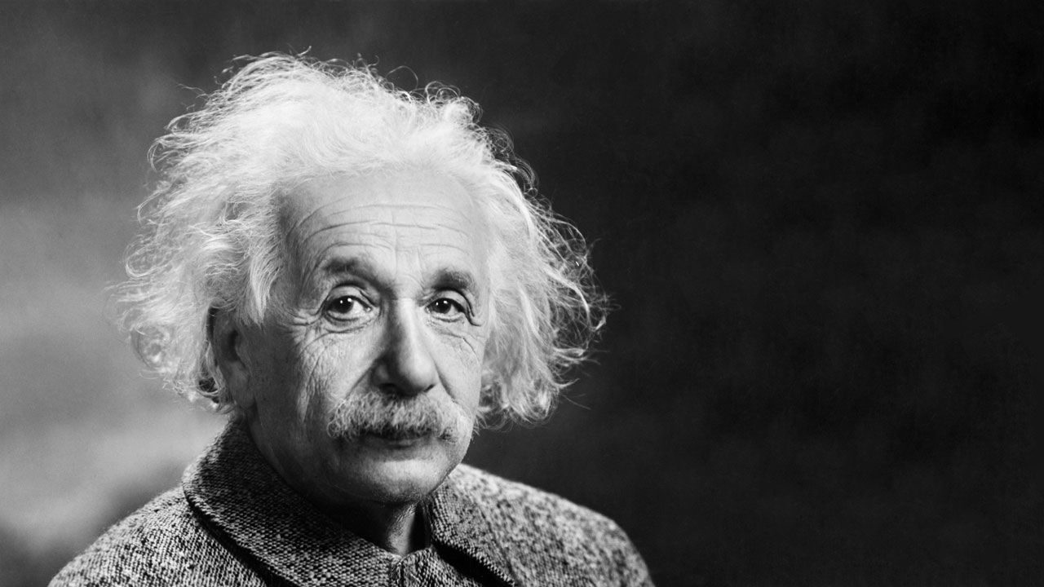
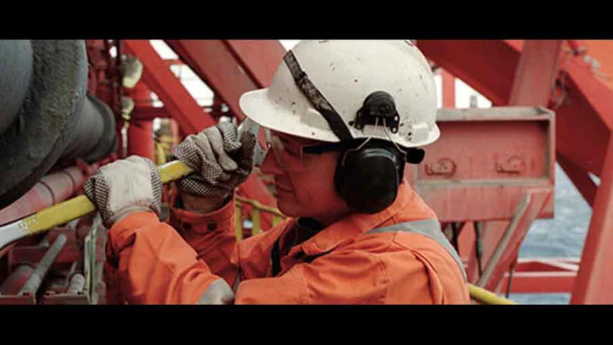
One of the hardest function
Value Proposition & Sales
Economic Buyer
Technical Buyer
User Buyer

Slide 18
A messy reality
Large Corporates
Ideal World
Reality
CEO
CEO
CFO
COO
CTO
VP
VP
VP
VP
VP
Find a champion within the corporate that has a shared vision, decision making responsibility, and can link leadership/departments. Don’t expect coordination within a corporate.

Slide 19
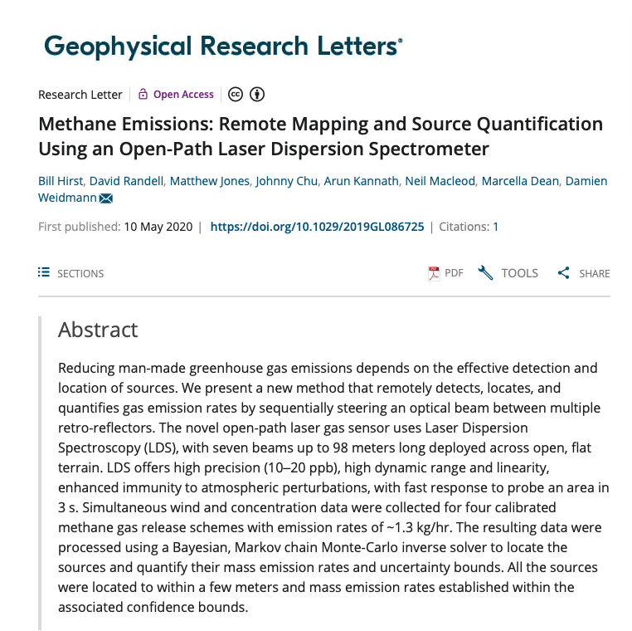
The MIRICO Journey
Technical Buyer

Slide 20
Funding

Slide 21
The Valley of Death
Funding
Funding
Valley of death
high
Challenges: Identifying transitional funding, clarifying business case, gaining end user buy in, collaboration with end users
Discovery
Fundamental Research
Concept & applied R&D
Technology Transfer
Development
Product Launch
Success as new product
Success as a business
Academic Research
(Funding streams;
CEOI, ESA H2020)
Industrial Application
(Funding streams;
Venture Capital, Innovate UK, ESA ARTES, C&G, GSTP)
low
Cashflow
Demonstrating Innovation
Steps from lab to application
Commercialisation

Slide 22
Typical VC process
Fundraising
(5,000+)
(650+)
(40)
(29)
(18)
Receive Opportunity
Review
Initial Meeting
Initial D.D.
Meet Managing Partners
Term sheet
Final D.D.
I.C. & Completion

Slide 23
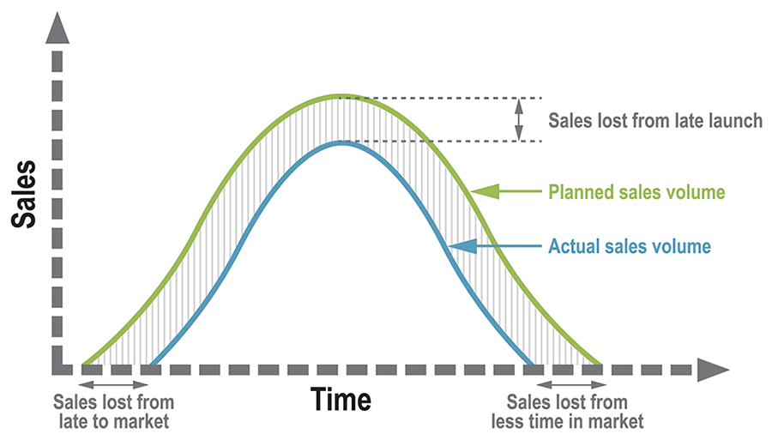
Speed is of the essence
Time to Market

Slide 24
Thank you
Mohammed Beal
mksbelal@gmail.com
07590078039

Slide 25
Supporting Slides

Slide 26
Building Partnerships
 |  | Objectives
 |  | Visibility | Resources | Customers | Develop | Markets | Investment | Acquisition
Corporate Engagement | Competitions
 | Free tools Co-working
 | Incubation Acceleration
 | JV, Co-dev Procurement
 | CVC
 | M&A
Understanding your objectives will guide you to the type of engagement and the appropriate parties, don’t expect a corporate’s department to be internally communicating

Slide 27
Small Company Vs. Big Corporates
 | Startup and Corporate Collaboration Models by Stage
 | Early Stage |  | Intermediate Stage |  | Late Stage
Phase (TRL 1-9) | Exploration (1-2) | Experimental PoC (3-4) | Functional Prototyping (6-7) | MVP (6-7) | Industrialization (8) | Commercialization (9)
Objective | Explore opportunities around disruptive tech | Prove Feasibility and gain missing knowledge | Determine success criteria and get user feedback | Proof of traction | Design for manufacturing | Identify distribution channels and sales
Partnership Format |  |  |  |  |  | Procurement Distribution Licensing
Checklist | Defined research fields Signed NDA Defined IP ownership | Tech validation Tech specs Clear problem/solution Complementary teams | Validate PoC learning Clear value prob IP landscape analysis | Functional prototype Clear market/biz model hypothesis Key tech risks addressed | Proof of traction Industrial capacity ready Key internal risks identified | Functional prototype Clear market/biz model hypothesis Key tech risks addressed
Key Success Factors | Continuous assessment of opportunities, goals, and roadmap alignment Definition and implementation of the appropriate KPIs at the right stages Progressive integration of new capabilities
 | Understanding markets potential Understanding of business and technical needs | Involvement of technical staff | Business adhesion Agility to refine prototype | Business adhesion Agility to refine MVP | Business adhesion Readiness of the corporate organization | Business adhesion

