Slide 1

Achieving impact through industry collaborations
Constantinos Astreos
c.astreos@liverpool.ac.uk

Slide 2

Why engage with industry?
Engaging with industry is a key way to achieve research impact, defined as “the demonstrable contribution of research to changes that bring benefits to the economy, society, culture, public policy or services, health, the environment or quality of life”.
Engaging with the private, public or third sectors can help us:
• Achieve impact with our research;
• Provide additional income to fund the Department of Physics 's activities (e.g., conference attendance, outreach events, applied research projects);
• Lead to academic publications;
• Grow contacts and networks relevant to the department’s research.

Slide 3




Mechanisms for Collaborative R&D
Collaborative research
Contract research
Student projects
Consultancy
Notes:
PARTNERSHIP DEVELOPMENT
Knowledge Exchange, Impact and Public Engagement Voucher Scheme 2019/20: maximum of £10k per project to support a range of activities to generate knowledge exchange, create impact or engage the public with research. Closing date for applications is 16th Sept.
RESEARCH
Summer Placements
Undersgraduate: PHYS309, BSc student projects
Postgraduate: MPys projects, MSc in Radiometrics Instruments and Modelling and NTEC programmes, Phd (industry placements for Liv.Dat)
PDRA: STFC IAA, KTPs, various schemes, e.g. Innovate UK
CPD, TRAINING: Radiometrics short courses; opportunity for others?
COMMERCIALIZATION:
Liverpool Intellectual Property (LIP) support: licenced research outputs,
Managed by the STFC Business Incubation programmes:
STFC CERN Business Incubation Centre
European Space Agency Business Incubation Centre
European Space Agency Technology Transfer Network
CONSULTANCY PROJECTS

Slide 4

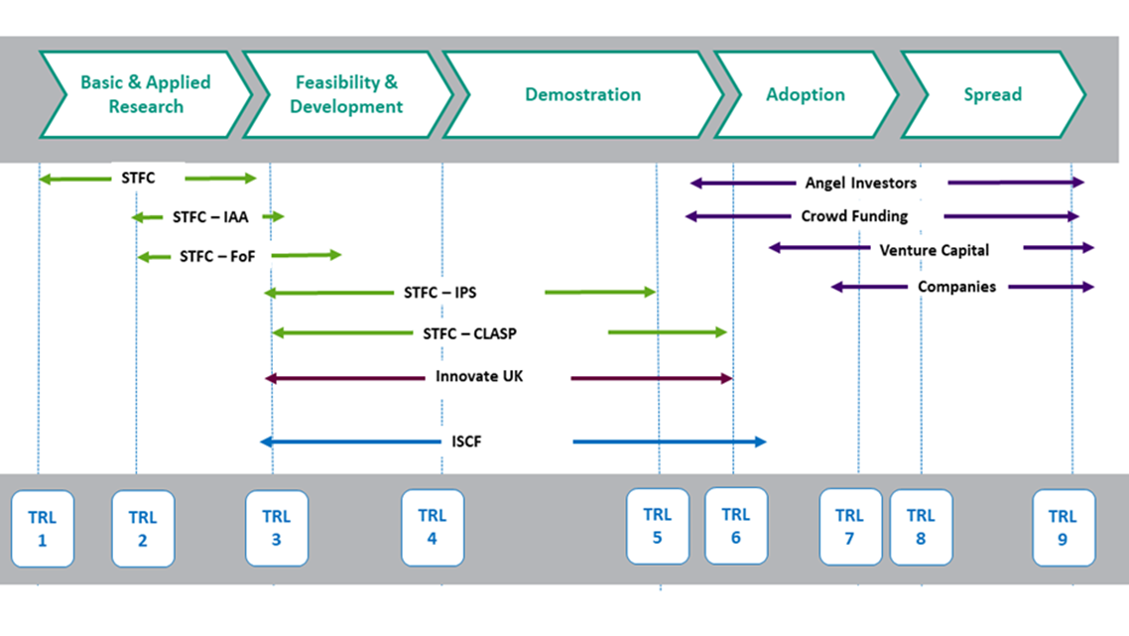
Impact Acceleration Account (IAA)
Implementation of the Department of Physics Research, Impact and Industry Strategy
Supports key areas of activities which will accelerate the impact with external organisations.
Offers a unique opportunity to support novel ideas to further funding for R&D
Issue two calls per year for Proof of Concept projects
Pathway to Knowledge Exchange and Innovation
Notes:
Develop ideas to be commercialised or generate impact
Use IAA to develop ideas and move them along the TRL scale
We issue 2-3 calls per year for PoC projects and Stakeholder engagement funding
IAA funding has helped us establish a large number of new industry links which now form the basis for new PoC projects across our research clusters; the IAA also helps us open up new opportunities for student and staff placements.
Level of support can be provided (manpower, hardware, travel).

Slide 5
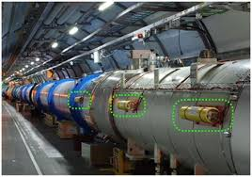
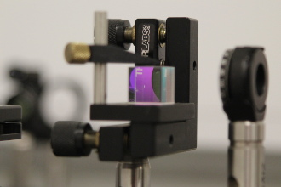

Example of collaborative R&D – D-BEAM Ltd
Developed proof of concept projects in collaboration with D-BEAM Ltd
Development of innovative non-invasive diagnostic technologies for particle accelerators via the applications of coherent radiation imaging and Digital Micro-mirror Devices (DMDs)
Development of new techniques of measuring the absolute density profile of gas jets in use at particle accelerator facilities.

Slide 6
JetDose – Developing a Proof of Concept project
In 2019 funded a PoC project with D-Beam: Proof of concept measurements for an online non-invasive simultaneous dose and profile monitor for therapy. Measurements were realised at the University of Birmingham cyclotron, using existing gas-jet technology within the department and expanding its use towards medical applications. Results fed directly into an STFC CLASP application.
The IAA funding proved to be the catalyst for this next stage of work, enabling the development of an online, single shot, non-invasive monitor for gas jet profile measurements, and commercialisation of the technique with D-Beam Ltd.
Notes:
Develop ideas to be commercialised or generate impact
Use IAA to develop ideas and move them along the TRL scale

Slide 7

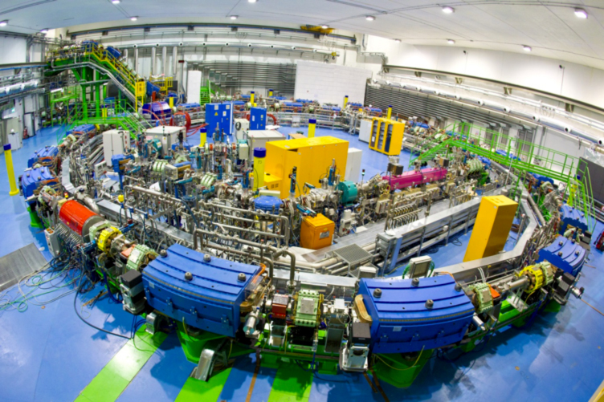
Hadron beam therapy
The challenge/problem: Hadron beam therapy
Clear healthcare benefits for certain cancer types;
Significant investment through NHS and private facilities in the UK;
Optimization of Medical Accelerators (OMA) network identified key R&D challenges:
  Significant time goes into Q&A
  New technology solutions needed for novel treatment modalities such as FLASH
  Desirable machine operation modes not currently possible due to lack of non-invasive (online) diagnostics
CNAO Synchrotron, image courtesy CNAO.

Slide 8
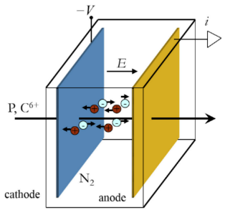
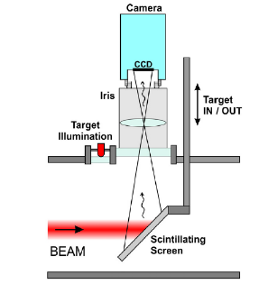
Existing diagnostics
High resolution
Reliability
Validity
Interceptive
Ongoing calibration
Beam perturbation
Limited live feedback
B. Walasek-Höhne, GSI and G. Kube, DESY
S. Giordanengo & M. Donetti, arXiv:1803.00893

Slide 9


JetDose – Novel diagnostic solution
Non-invasive Gas Jet In-Vivo Profile Dosimetry for Particle Beam Therapy
1
2
No mechanical parts interact with the beam
All key parameters monitored remotely
Significantly reduced maintenance
Minimally invasive
Significantly reduced calibration time
No beam perturbation
Online monitoring
Superior error detection
3
2
Enabling technology for FLASH and Mini-Beam treatments
Active machine regulation based on live feedback becomes feasible
Novel treatments and improved operation
1
USP
3
N. Kumar, C.P. Welsch, et. al, Physica Medica 73, p 173-178 (2020).
S. Jolly, C.P. Welsch, et al., “Technical challenges for FLASH proton therapy“, Phys Med 2020 – Galileo Galilei Award, best paper in 2020
“Non-Invasive Gas Jet In-Vivo Dosimetry for Particle Beam Therapy”, contributed talk at IPAC21

Slide 10




JetDose – Market size and route to market
Currently 111 hadron therapy facilities worldwide;
99 proton therapy and 12 carbon therapy
Based on IBA’s market penetration, serviceable market consists of 51 hadron therapy facilities
TAM
Estimate initial deployment of JetDose in 19 of IBA’s new and under construction facilities
SAM
SOM
Initial target will be market share of OEM partner IBA; opportunities through other OEMs will be exploited in the future
Market Share
Notes:
TAM or Total Available Market is the total market demand for a product or service.
SAM or Serviceable Available Market is the segment of the TAM targeted by your products and services which is within your geographical reach.
SOM or Serviceable Obtainable Market is the portion of SAM that you can capture.

Slide 11
JetDose - Summary
JetDose will apply cutting edge STFC technology to a key healthcare challenge;
Clearly identified clinical benefits – opening opportunities for novel cancer treatment modalities such as FLASH and improved ways to operate existing and future facilities;
Project will be realized by consortium with long-standing collaborative links who are recognized leaders in their respective area;
Exceptional international network for collaboration and dissemination established through OMA leadership.

