Slide 1
Quasar R&D: Frontier Accelerators
Quasar Away day
Hao Zhang

Slide 2
Current activities
Diagnostic development for LHC and HLLHC
  Gas jet, Beam induced fluorescence monitor for high intensity beams. HLLHC
  Beam halo measurement
  Machine-learning in Secondary Emission Monitor (SEM) optimization
  Beam loss calibration and pattern recognition algorithms for the LHC beam loss instrumentation detectors
  Longitudinal Density Monitor for the Large Hadron Collider
Diagnostic development for other machine
  An novel optical fibre analysis system for particle accelerators
  Optical transition radiation diagnostics for low energy ion beams
  Reconstruction of Transverse Beam Distribution using Machine Learning
Beam dynamics study
  Space charge dominated low energy beam dynamics in high current Energy Recovery Linacs
  Beam transport for AD and elena
Other Activities
  Growth and Characterisation of Thin Film and Alkali Metal Photocathodes for the Generation of High-Brightness Electron Beams
Notes:
In the next decade we will focus on the LHC at CERN, where we lead work on the development of gas jet monitors for the high luminosity upgrade; on R&D into the exploitation of the CLARA facility on Daresbury campus to explore next-generation FEL technologies; and on optimization of low energy beam transport and efficient injection into traps at the Antiproton Decelerator.
Potential for high quality outputs
Potential for Impact Case Studies
Funding opportunities
Opportunities to obtain leadership roles
etc

Slide 3
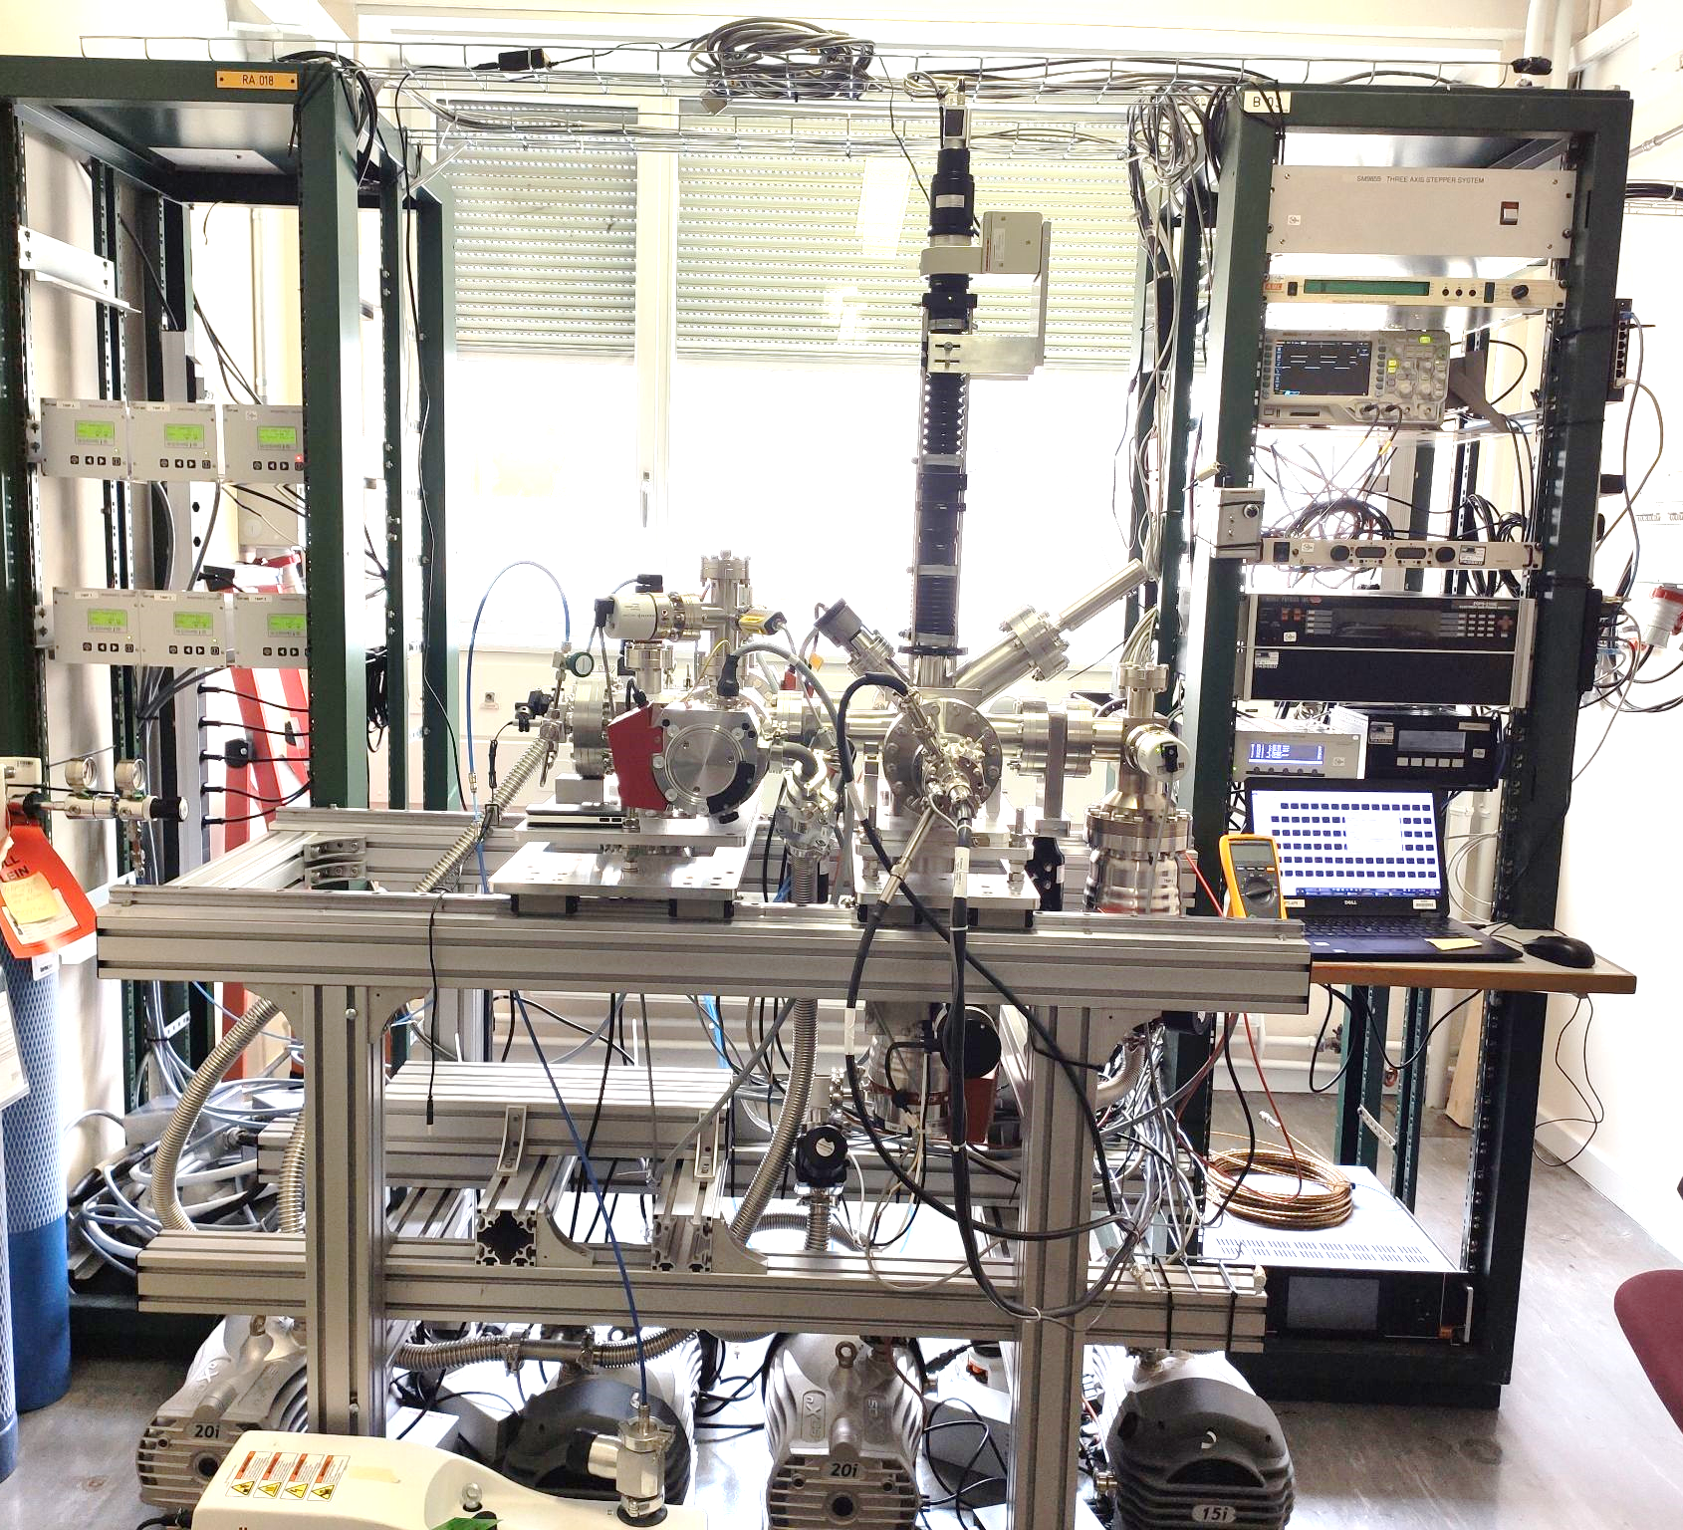
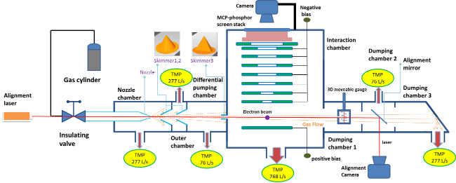
Beam diagnostics: Gas jet monitor
High intensity beams
Currently for LHC and HEL (HLLHC)
V. Tzoganis, et al. Appl. Phys. Lett. 104, 204104 (2014)
V. Tzoganis, et.al, VACUUM, 109, 417-424 (2014)
V. Tzoganis, et al. Phys. Rev. Accel. Beams 20, 062801,
A. Salehilashkajani, et.al , Appl. Phys. Lett. 120, 174101 (2022)

Slide 4
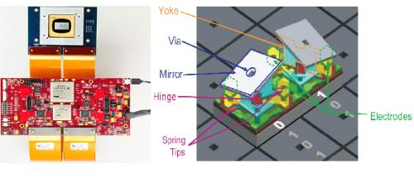
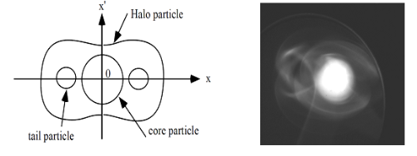
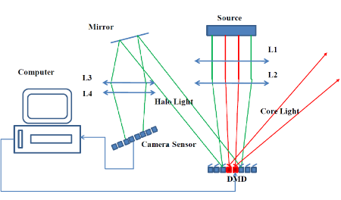
Beam diagnostics: Beam halo measurement
Beam halo vs beam core
High dynamic range (>10⁵)
DMD
H. D. Zhang, et.al., Phys. Rev. ST Accel. Beams 15, 072803
H. D. Zhang, et.al., NIMA, 817, 2016
J. Egberts, C.P. Welsch, JINST 5 P04010

Slide 5
Beam diagnostics: Beam loss monitor
SiPM Technology
  ~10 um diodes
  FWHM ~10 ns pulse
RF breakdown detection and superconducting quench detection
Particle bunch
Screen
Simplified oBLM operating principle
v
Beam pipe
Sensor Unit
Optical-fibre
Charge shower
Cherenkov radiation
S. Vinogradov, et.al., Nucl. Instr. Methods A (2015), pp. 148-152;
S. Vinogradov, Nucl. Instr. Methods A (Dec. 2014)

Slide 6
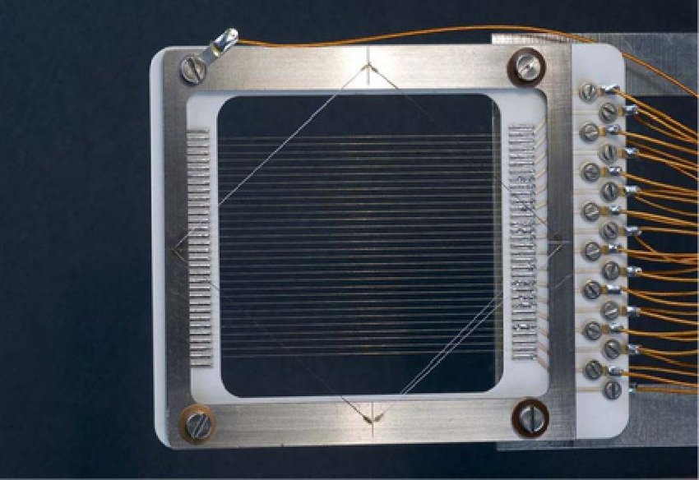
Beam diagnostics using machine learning: SEM and profile
Secondary emission monitor.
Intensity, profile
Challenge
  Device aging
  calibration
Pepper-pot
Phase space tomography

Slide 7
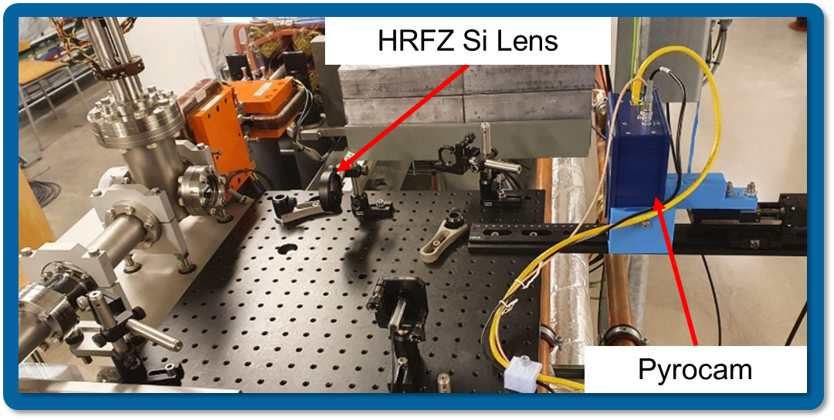
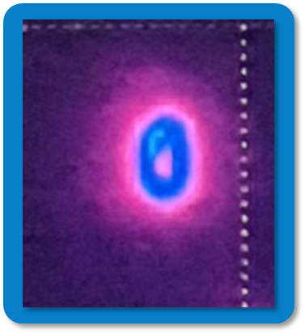
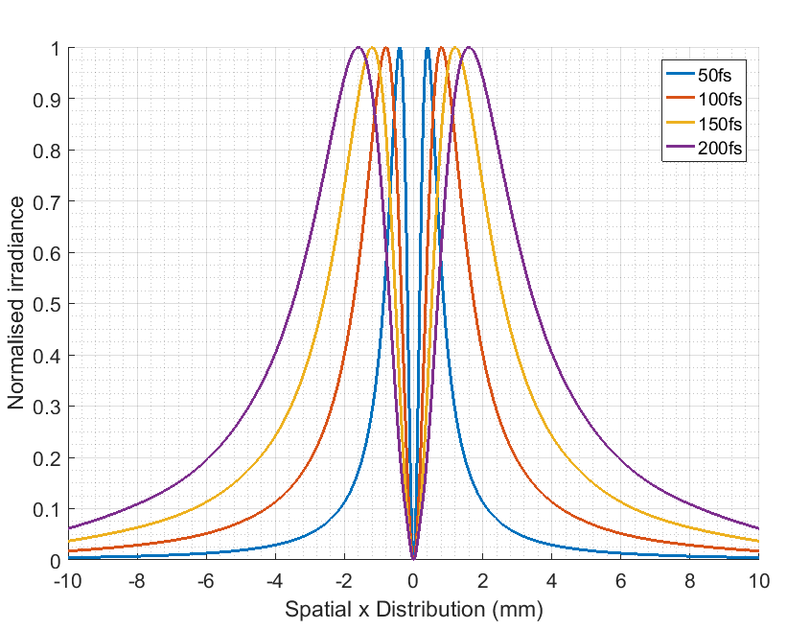
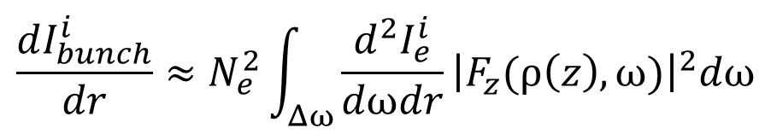
Optical transition radiation diagnostics
CTR as Bunch length monitor
Measure very small beam

Slide 8
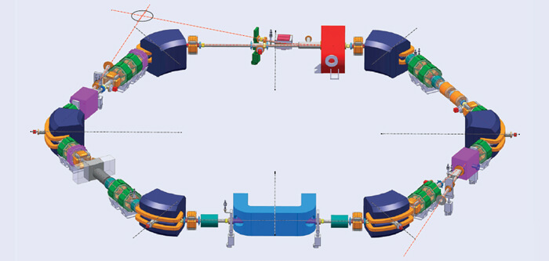
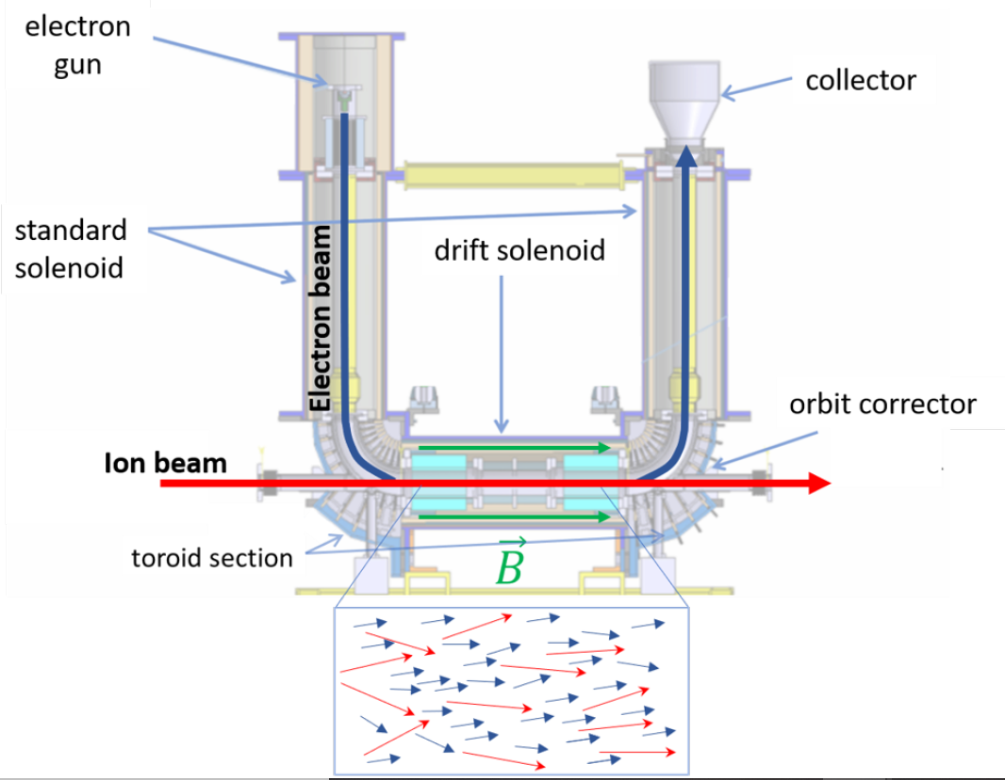
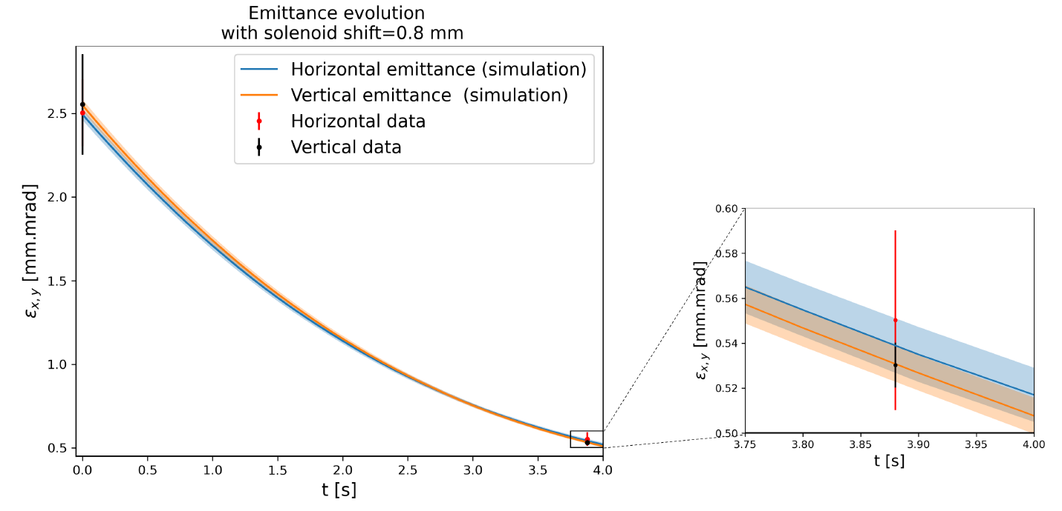
Beam dynamics: ELENA Beam
Tailored ELENA beam dynamics simulation including electron cooling, heating effects and machine imperfections.
  Validation of the model on LEIR.
  Comparison to measurements.
The Extra Low ENergy Antiproton storage ring
Identification of the most suited cooling force model for the ELENA case. Modified cooling force formula for negatively charged ions.
The ELENA simulation model helped to identify the presence of a solenoid error in the cooler: enabling performance improvements.
[“The Effect of Beam Velocity Distribution on Electron-Cooling at ELENA”, contributed talk, IPAC21]

Slide 9
Questions
Main technological problems of the next 10 years? (10 mins)
What is our strength? (10 mins)
  Beam dynamics?
  Beam diagnostics?
What machines shall we focus on? (10 mins)
Any new tools we can use to advance our research? (20 min)
  Lasers, new materials?
  Machine learning?
Potential for high quality outputs and impact Case Studies? (10 min)
Funding opportunities? (5 min)
Publication strategy? (5 min)
Notes:
REF target:
Following the processes described above, we have refined our strategic priorities as follows:
SP1: further develop and lead research on physics questions of international significance;
SP2: grow cross-cluster collaboration and promote interdisciplinary research initiatives.
SP3: build and enhance a research environment which develops our people and embodies Equality, Diversity and Inclusion, including Juno and Athena SWAN principles;
SP4: develop impact as an integral outcome of our research activities in our focus areas of Energy, Health, Security, and Society.

Slide 10
SPARE SLIDES

Slide 11
Discussion
Facilities based opportunities
  CERN (LHC, CLEAR, ELENA)
  ESS
  CLARA, FEL
  RUEDI
  FAIR

Slide 12
Discussion
Our Strength
Resources
  Jacow
  PRAB, NIMA
  PRL, APL, Nature physics, Nature, science
Fundings
  Research professional

Slide 13
Discussion
Topic based opportunities
  Beam diagnostics
  Beam dynamics

