Slide 1
Introduction: Accelerator Applications
Narender Kumar
Narender Kumar
Accelerator Applications

Slide 2
Overview
Our Current Research Activities
Background and R&D
Research Strategy
Accelerator Applications
QUASAR GROUP AWAY DAY, 23rd May 2022

Slide 3
Our Current Research Activities
Non-Invasive Beam Monitors
Gas Jet Profile Monitors
Gas Jet Monitor for HL-LHC
Dosimetry for Medical Accelerators
Optical Beam Loss Monitor
1. Complete solution : Beam loss monitoring, RF Breakdown and Quench detection
Quantum Technologies for Accelerators
QuantumJet Scanner for profile monitoring
qHAM for Microscopy applications
3D X-rays Imaging system
D-Beam Ltd: OASYS, JETDOSE, qHAM, QuantumJet
LhARA Collaboration Meeting
QUASAR GROUP AWAY DAY, 23rd May 2022

Slide 4
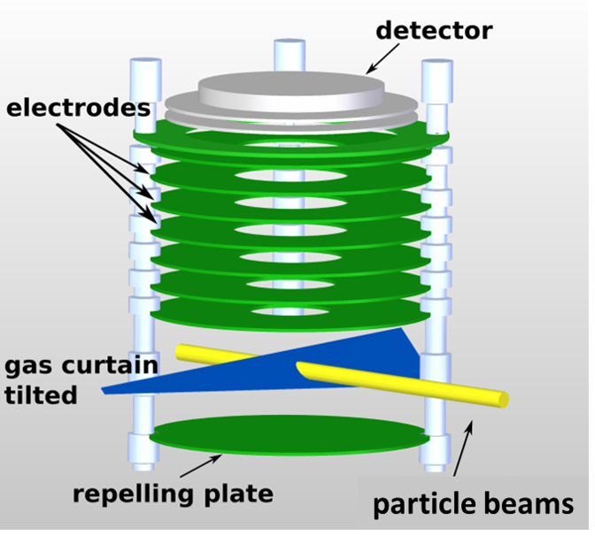
STFC-funded Gas Jet technology
Detector
Visible light
Phosphor screen
MCP
Ion extraction
Ionization
Gas jet shaping
LhARA Collaboration Meeting
QUASAR GROUP AWAY DAY, 23rd May 2022

Slide 5
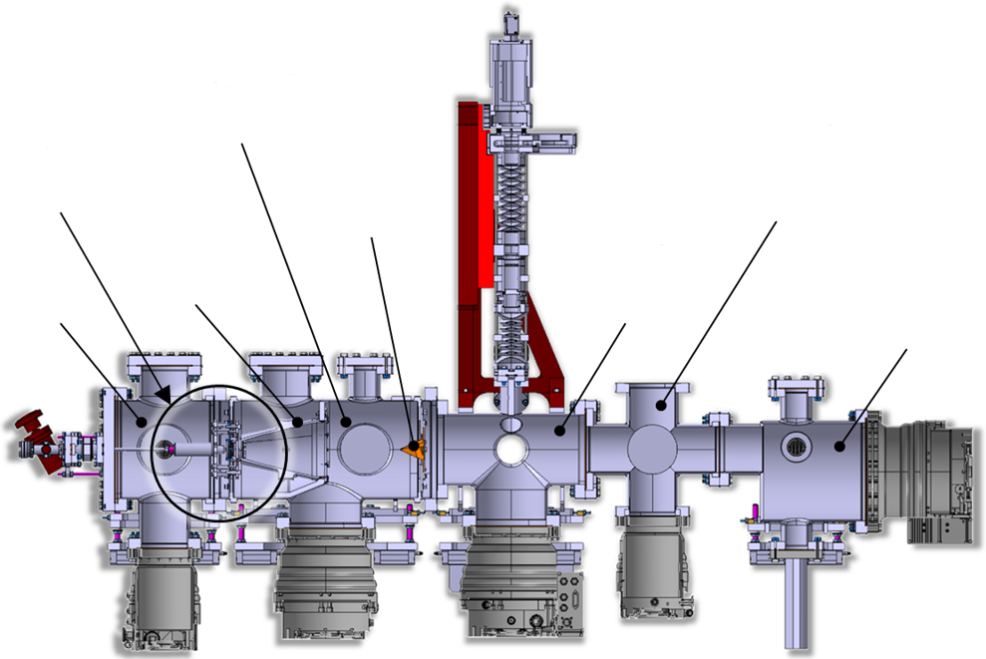
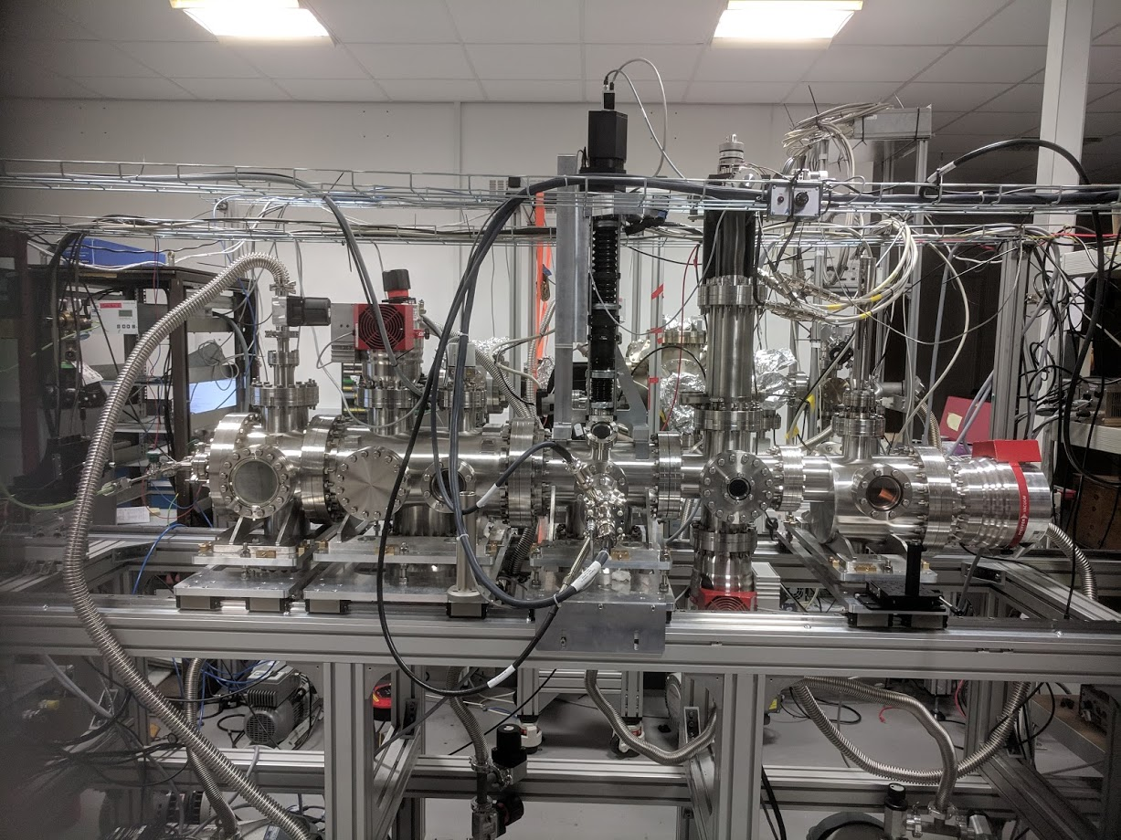
STFC-funded Gas Jet technology
Skimmer Chamber
Imaging System
Moveable Gauge Chamber
Skimmer Assembly
Third Skimmer
Nozzle Chamber
Gas Separator
Interaction Chamber
Dump Chamber
~3 m
“Gas jet monitor R&D is world leading” – CI SAC (2019)
LhARA Collaboration Meeting
QUASAR GROUP AWAY DAY, 23rd May 2022

Slide 6
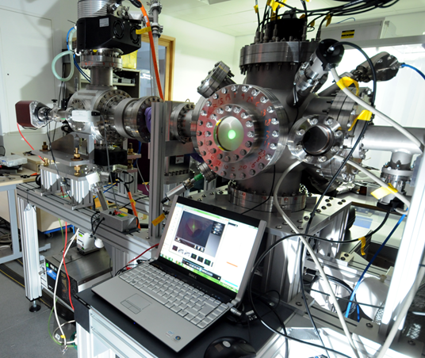
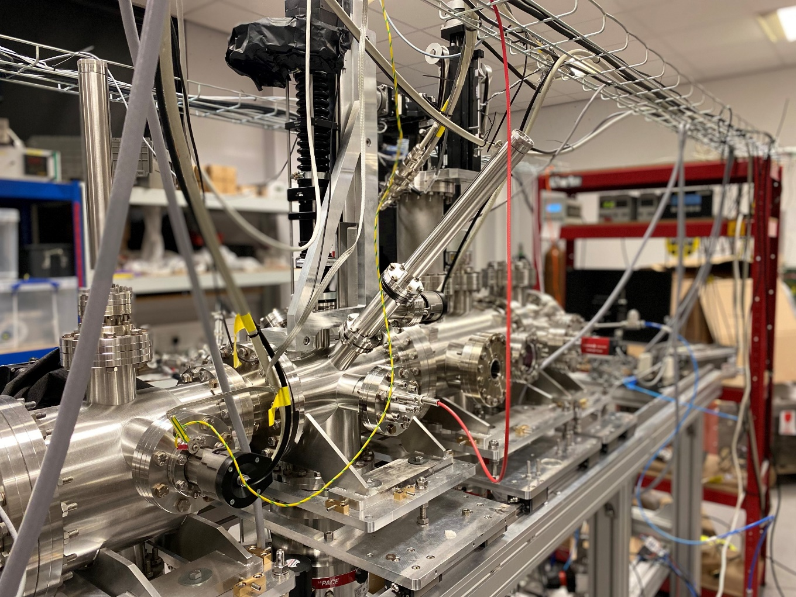
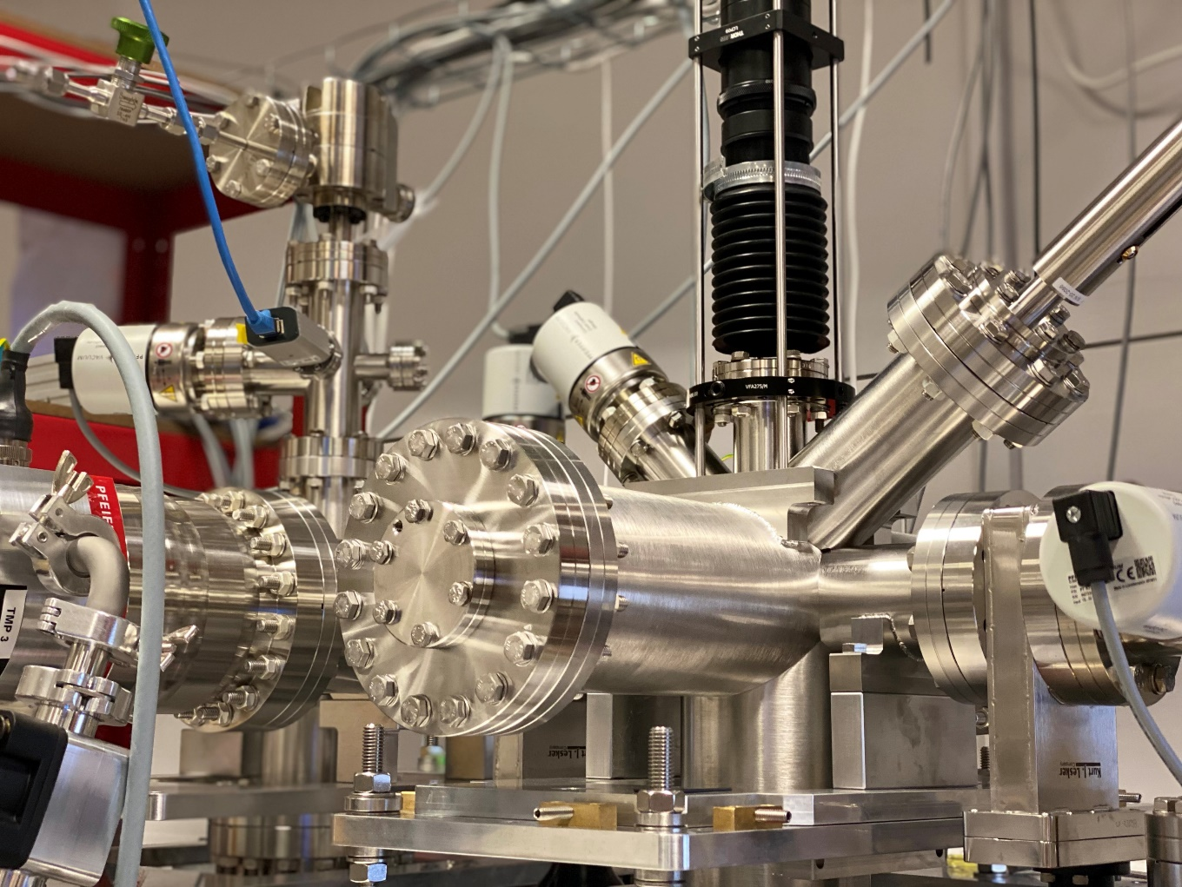
Different setups at the Cockcroft Institute
Monitor for keV beams
HLLHC prototype
HLLHC working instrument
LhARA Collaboration Meeting
QUASAR GROUP AWAY DAY, 23rd May 2022

Slide 7
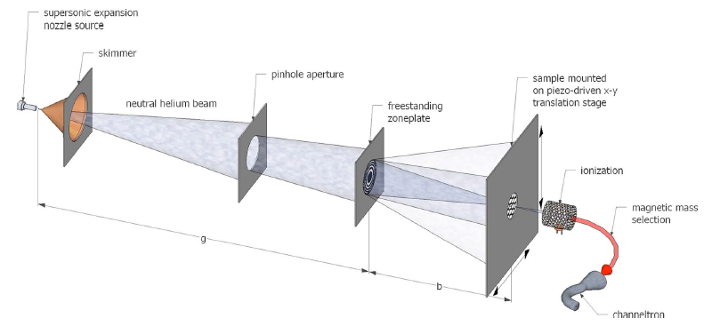
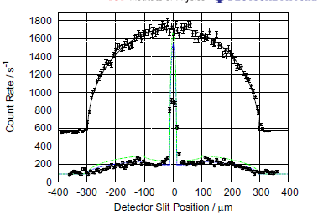
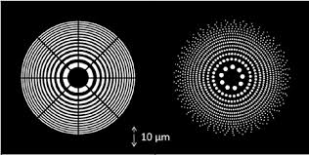
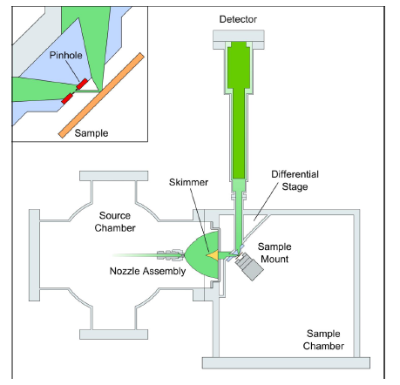
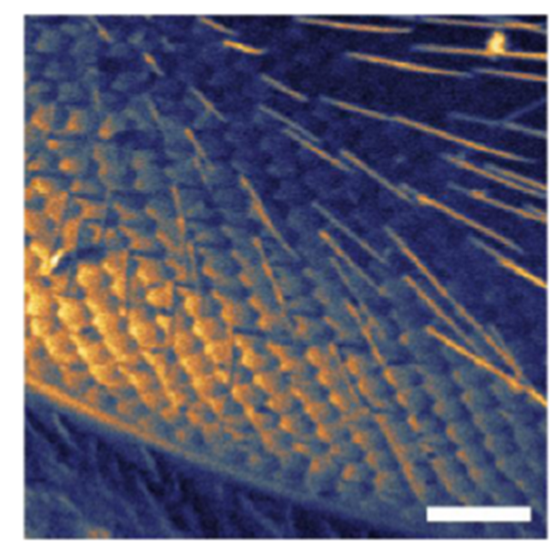
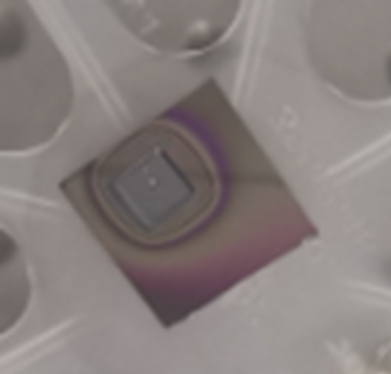
Quantum Technologies for Accelerators
QuantumJet Scanner for applications in high power accelerators, plasma sources, high precision targets (STFC IPS FoF)
qHAM for high resolution, table top, compact and non-destructive imaging (InnovateUK)
Gas Jet
Quantum Gas Jet
Fresnel Zonal Lens
Nozzle
QUASAR GROUP AWAY DAY, 23rd May 2022

Slide 8
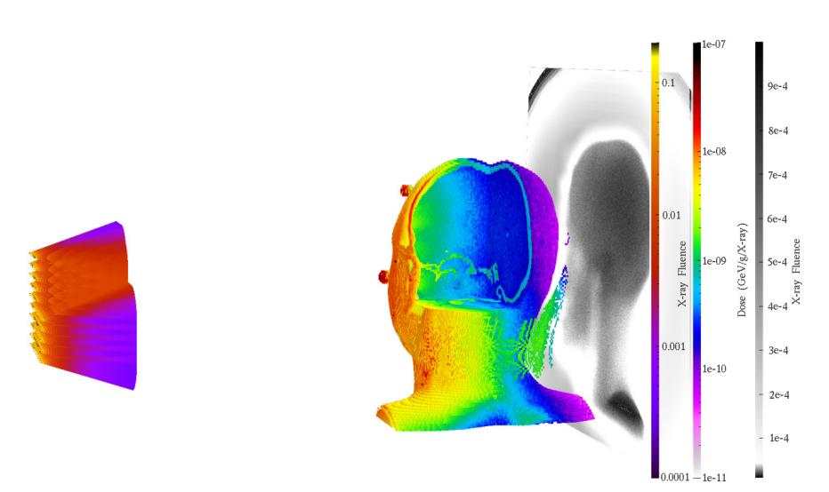
3D X-ray Imaging System
We started our collaboration in 2011, joint STFC-funded PhD project since 2017.
E Skordis and C P Welsch
A Monte Carlo Approach to Imaging and Dose Simulations in
Realistic Phantoms Using Compact X-Ray Source
Proc. IPAC17, Copenhagen, Denmark. (2017)
T G Primidis, V Y Soloviev and C P Welsch
Accuracy of the independent atom approximation in digital
tomosynthesis Monte Carlo simulations
Biomed. Phys. Eng. Express 7 055016 (2021)
R&D into detailed Monte Carlo models and algorithms for the flat panel X-ray source array.
Goal: Optimization of overall system, image analysis and signal processing.
QUASAR GROUP AWAY DAY, 23rd May 2022

Slide 9
OBLM-a complete diagnostic solution for particle accelerators
Optical beam loss monitor developed by UoL and CERN.
RF Breakdown and Quench detection
Particle bunch
Screen
Particles lost inside a beam pipe create a shower of charged particles
Simplified oBLM operating principle
v
Some of these charged particles pass through the optical fibre generating Cherenkov radiation
Beam pipe
Optical-fibre
Sensor Unit
Charge shower
This is collected and loss location is measured via either accurate time-of-flight measurements or calibration
Cherenkov radiation
Insensitive to x-rays and magnetic fields
QUASAR GROUP AWAY DAY, 23rd May 2022

Slide 10
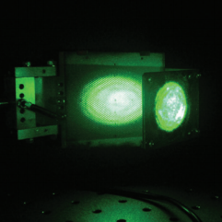
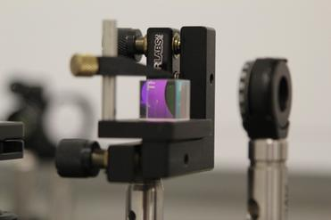
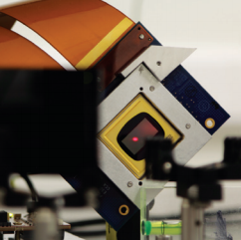
D-Beam Ltd: Our Industrial Partner
www.d-beam.co.uk
University of Liverpool spin out company incorporated in December 2015
Commercialisation of innovative diagnostic solutions based on (UoL) R&D
STFC-CERN Business Incubation Centre alumni since 2017.
ASTeC technology highlight of the year in 2018/2019
Commercialization of beam diagnostics : Optical sensors, Beam loss monitors, adaptive optics for profile measurement, Machine protection and Gas jet technology
R&D funding awarded by EU and STFC including IAA, Innovate UK, CLASP, IPS FOF
Growing partnership with many other industrial partners.
QUASAR GROUP AWAY DAY, 23rd May 2022

Slide 11
Research Strategy
R&D least invasive beam and dose monitors: to help improve patient treatment and medical accelerator operation.
To continue the develop and optimize novel low dose 3D X-ray imaging systems with Adaptix.
Develop compact accelerators for rock art discovery
Drive quantum technologies for accelerator applications.
Grow our spinout company D-Beam, targeting a product portfolio that benefits accelerator facilities around the world.
QUASAR GROUP AWAY DAY, 23rd May 2022

Slide 12
Thank you for your attention

Slide 13
Questions
Is there any field/area which is similar or closely related to our research activities on which we can start working or planning something for future activities? (i.e. from gas jet beam monitor to microscopy)
Any challenges (technical, commercial, etc.) on which we should focus for the next research strategy.
Any other emerging or popular research activities all around the world on which we can focus in the near future.
Possible collaborations and funding opportunities.
How to improve our existing research and development program? (i.e. training programs, workshops, etc.).
Challenges of data science/AI in applications for accelerators.
LhARA Collaboration Meeting
QUASAR GROUP AWAY DAY, 23rd May 2022

