Slide 1
Communication and Outreach: Social Media
Group discussion
QUASAR Group Away Day, 23 May 2022

Slide 2
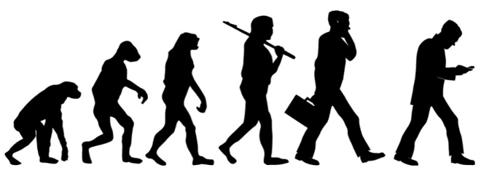
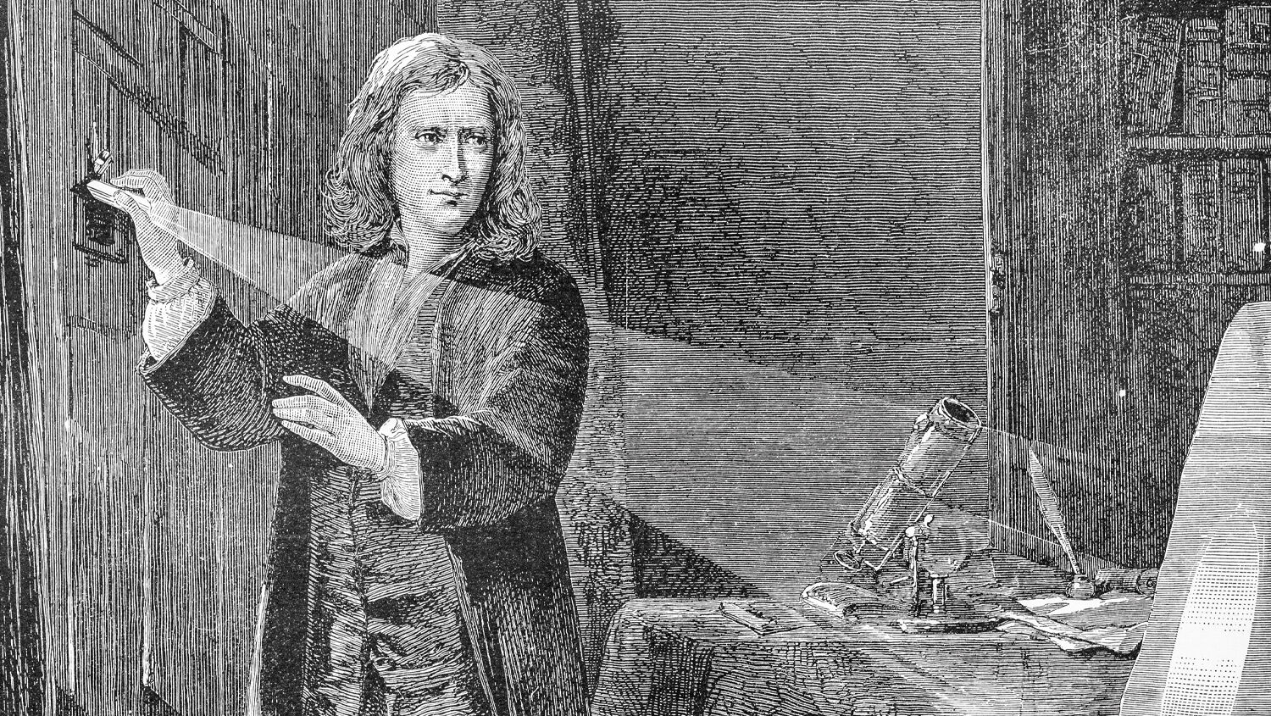
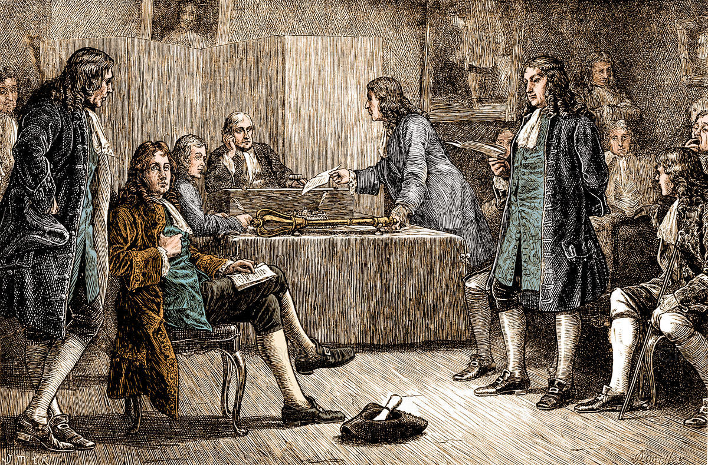
The evolution of science
“Plato is my friend, Aristotle is my friend, but my greatest friend is truth.”― Isaac Newton

Slide 3
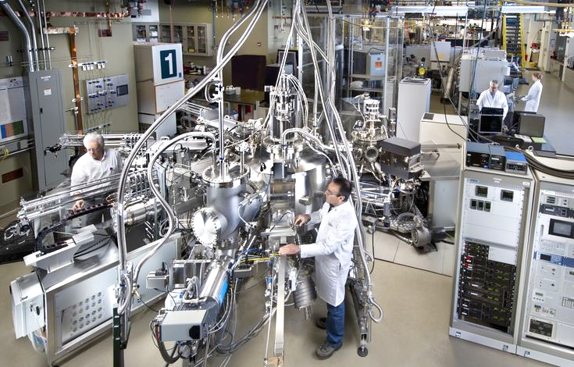
The evolution of science
“Publish or perish” – Anonymous

Slide 4
The evolution of science
2 million papers per year
50% of them are only read by the authors
“Publish or perish” – Anonymous

Slide 5
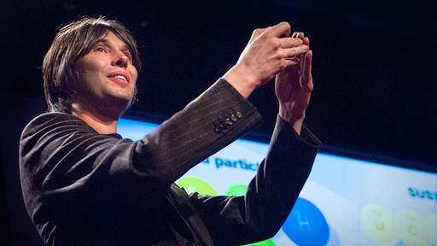
The evolution of science
“Please press the ‘subscribe’ button” – Anonymous

Slide 6
The case for social media
Contractual requirement from funding agencies.
Inform the public of what is done with their taxes.
Educate the public and especially the younger generation.
Attract more funding and collaborations.

Slide 7
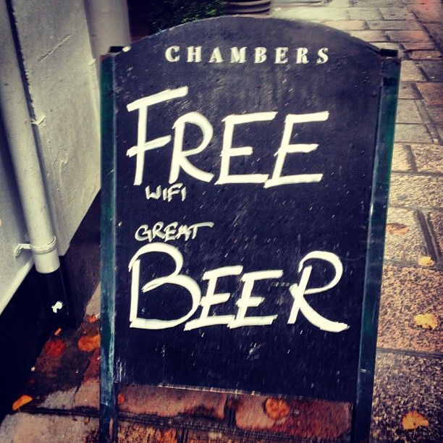
How to stand out from the noise

Slide 8
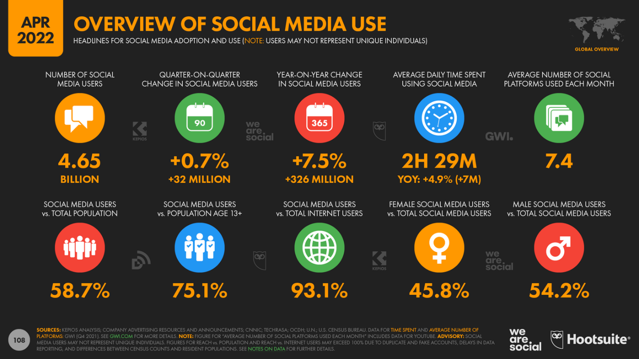
The social media landscape

Slide 9
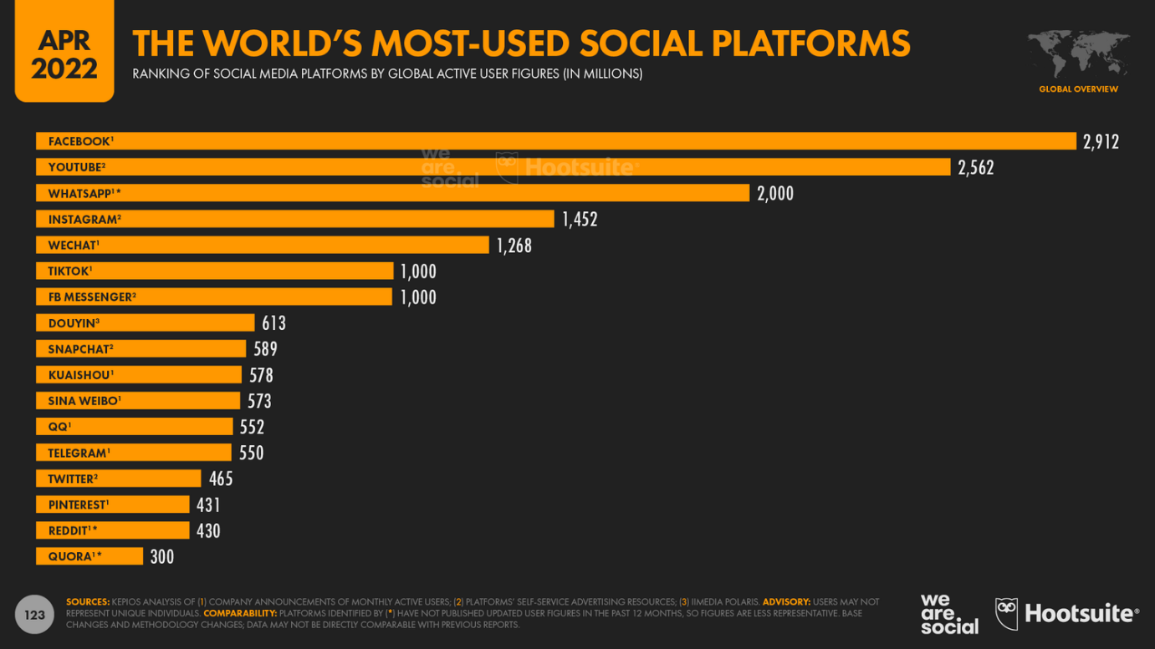
The social media landscape

Slide 10
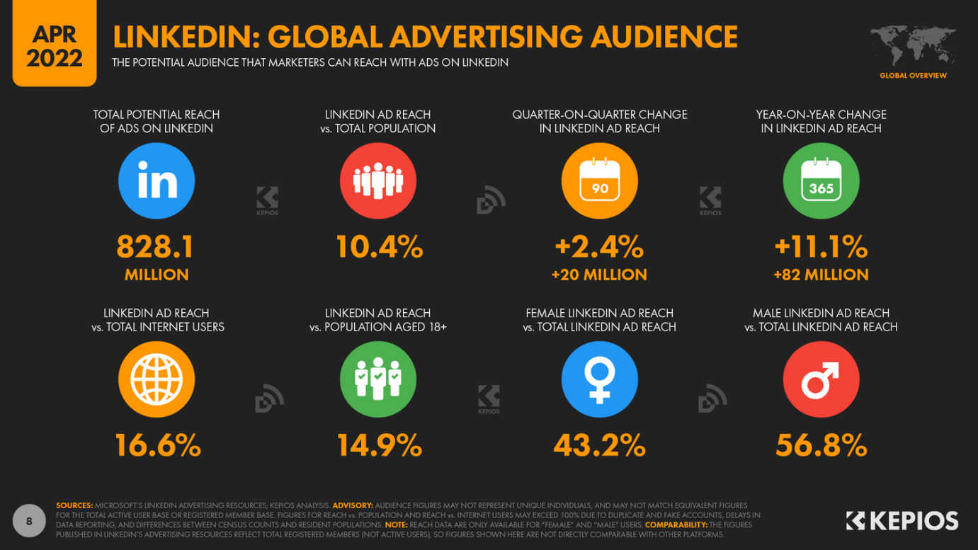
The social media landscape

Slide 11
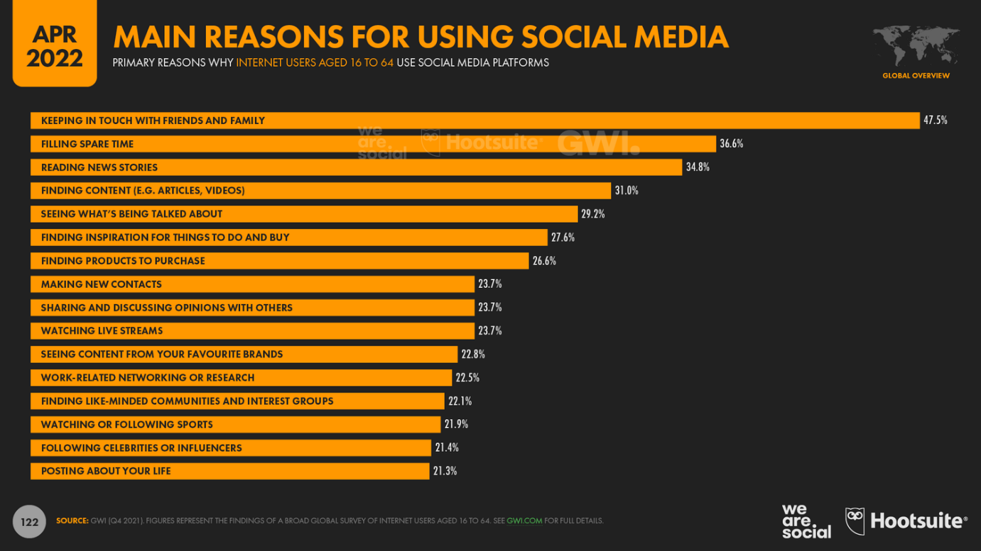
The social media landscape

Slide 12
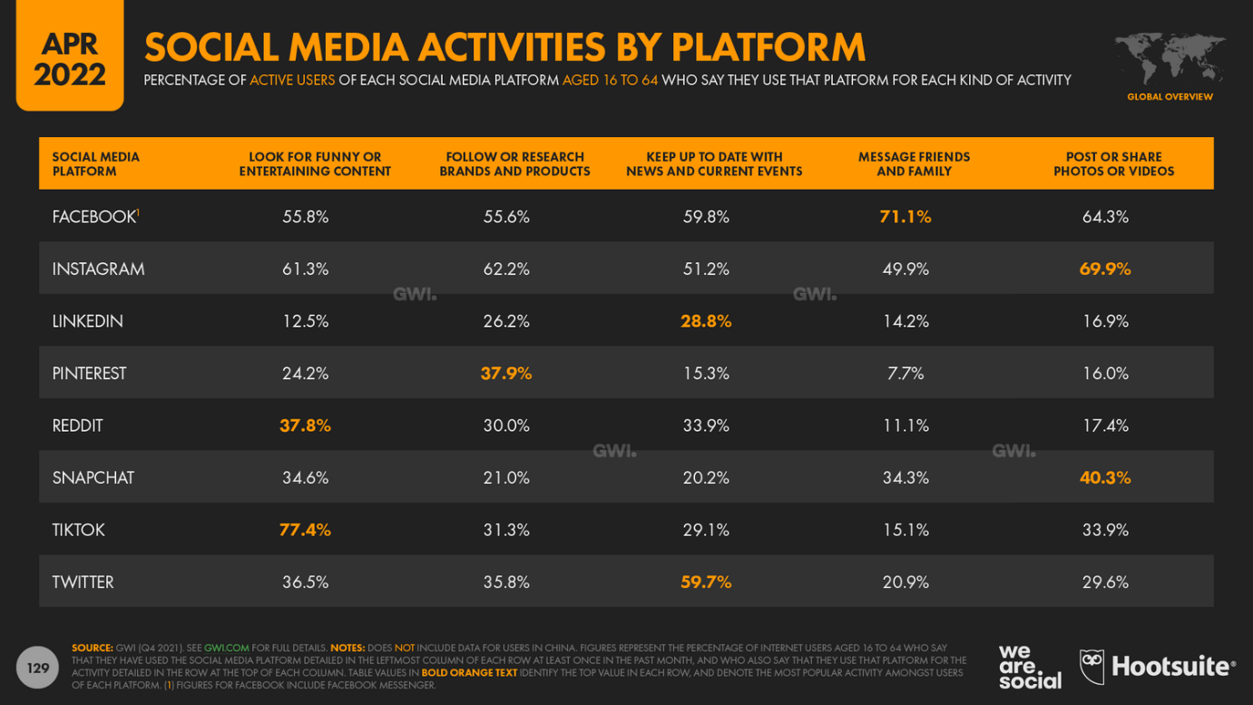
The social media landscape

Slide 13
The social media landscape
Founded in 2004
2.912 billion users (April 2022)
4.75 billion items shared per day

Slide 14
The social media landscape
Founded in 2006
465 million users (April 2022)
500 million tweets / day

Slide 15
Context
 | 748,874 | 2.5 M | 261 K | 158 K
 | 520 | 1086 | 269 | 13
 | 131,268 | 75.1 K | 212 K | 6.38 K
 | 234 | 563 | 25 | 334 K views

Slide 16
QUASAR Group Campaigns
 | Year
Star Wars Day | 2018 | 165 K | 62 K
Marie Curie Day | 2018 | 2 K | 58 K
Women in Science | 2018 | 1 K (QG only) | 35 K
EuPRAXIA Symposium | 2019 | 11 K | 102 K
Star Wars Day | 2019 |  | 63 K (*)
World Cancer Day | 2020 | 3.6 K | 96 K
Women in Science | 2020 |  | 47 K
CI Women in Science | 2022 | 8.2 K | 8 K
(*) 115 K via CERN

Slide 17
Group Discussion
What do we want – Objectives
Where do we stand – Evaluation
What should we do – Plan

