Slide 1
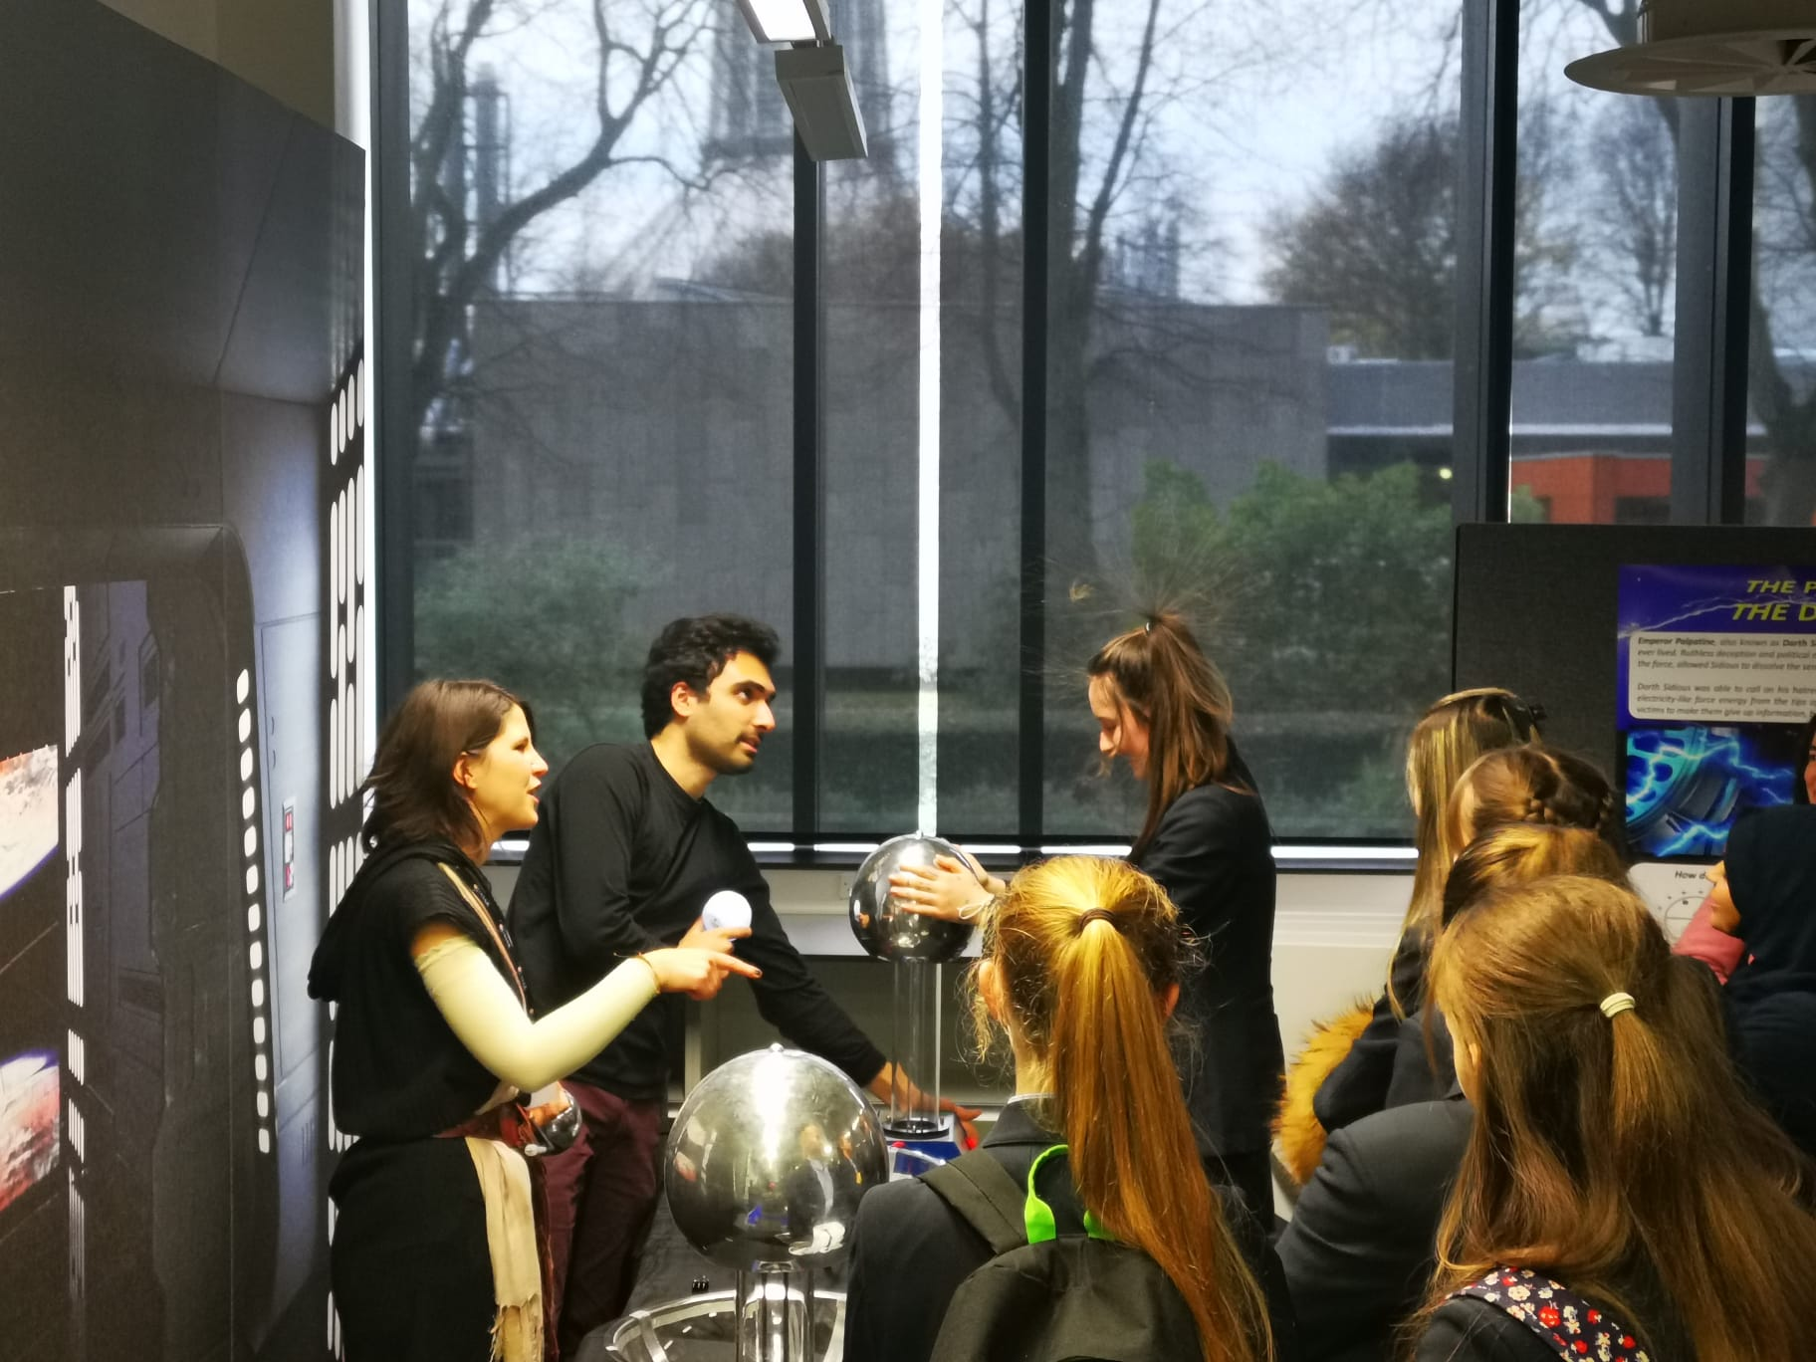
Communication and Outreach
Engagement with schools

Slide 2
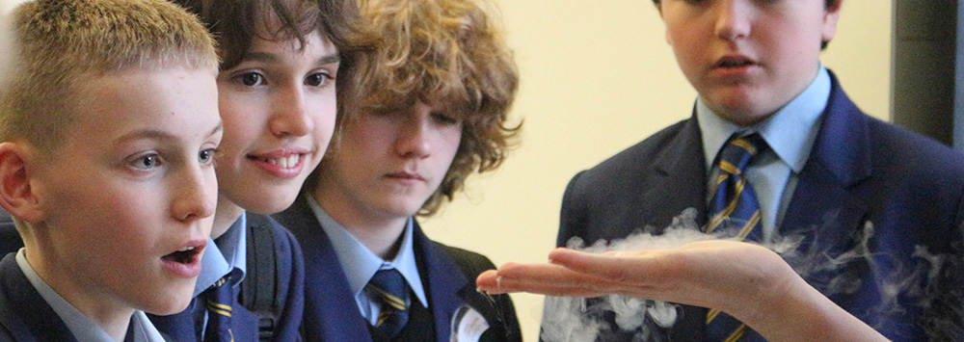
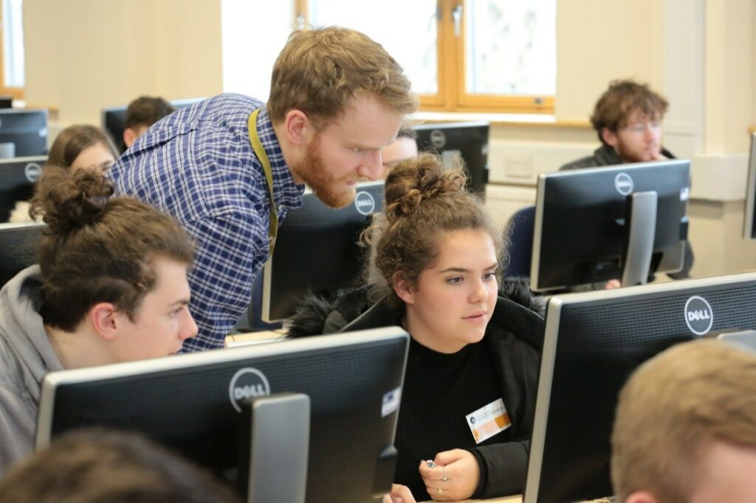
Schools outreach
Offers students enriching opportunities to become more familiar with science, in terms of how it relates to their daily lives and with respect to possible career paths that they might want to follow. Through the pupils you can reach their families as well
Engagement is a two-way process, involving interaction and listening, with the goal of generating mutual benefit.
Opportunity to develop and put into practice your skills, build confidence and widen your research horizons.

Slide 3
Dos and Don’ts
Understand the audience and their interests.
Practice the activity beforehand in the most similar environment as possible.
Be ready to any possible kind of question (kids can be so creative) and be patient!
It’s not just your research that is interesting – you are interesting too (they are going to ask). Share stories about what it’s really like to be a researcher.
Find out what the pupils are currently studying that’s relevant to your subject.
Be interactive and imaginative to get the pupils involved – the more hands on the better!
Don’t forget the teachers, they are most probably interested too and will be able to answer the kids questions.

Slide 4
Discussion points
Which resources are already available? Are they suitable for schools? Upgraded needed?
New hands-on activities to present for in classroom demonstrations/ University open days/ Symposia.
Feedback from past events? Contact with the school about their expectations and how to improve.
Space for testing the demos.

