Slide 1
Data Science at LJMU
Phil James, Head of Astrophysics Research Institute

Slide 2
Data Science at LJMU
This activity is all contained within the Faculty of Engineering and Technology;
Faculty Pro-Vice Chancellor is Prof. Nduka Ekere.
Representatives here today from the Astrophysics Research Institute and the School of Computer Science and Mathematics; other schools in FET are Civil Engineering and Built Environment, and Engineering.

Slide 3
Astrophysics Research Institute
The Astrophysics Research Institute grew out of the Astronomy Group, initially founded in 1992.
63 staff: 21 academic, 11 research-only Fellows & PDRAs, 14 technical staff, 5 admin & 6 outreach, 6 visitors; & 39 PhD students; 102 total
One of the largest astrophysics centres in the UK
Long relationship with University of Liverpool; undergraduate Joint Degree since 1998
We deliver activities in 4 areas:
Research;
Teaching;
Technology;
(iv) Engagement

Slide 4
Astrophysics Research Institute
MSc programme in Data Science, delivered jointly with staff from Computer Science and Mathematics, running since 2017.
Collaborated on the LIV.DAT Doctoral Training Network with University of Liverpool – funded 7 ARI PhD students
Our research expertise includes several data-intensive areas, including cosmological simulations and time-domain observational astrophysics:

Slide 5
Cosmological simulations
Use simulations to understand how structure formed and evolved in the Universe
Probe nature of Dark Matter and Dark Energy
ARI researchers in Virgo Consortium, recently awarded 0.5billion core hours on DiRAC network, £8.4m cost equivalent
Our own ‘mini DiRAC’, PROSPERO, 2300 cores

Slide 6
The Liverpool Telescope
World’s largest fully robotic telescope: owned and operated by LJMU and nationally funded by Science and Technology Facilities Council
Time-Domain Observatory, working on supernovae, gamma-ray bursts, novae, active galaxies and exoplanets

Slide 7
New Robotic Telescope
4 metre-class optical telescope
Joining the LT on La Palma
Designed for rapid follow-up of time-domain objects
Rapid time-to-target of 30 seconds (from receipt of trigger to data acquisition)
PDR successfully completed in early 2022
First light in 2026
Engineering & data handling challenges; outreach opportunities

Slide 8
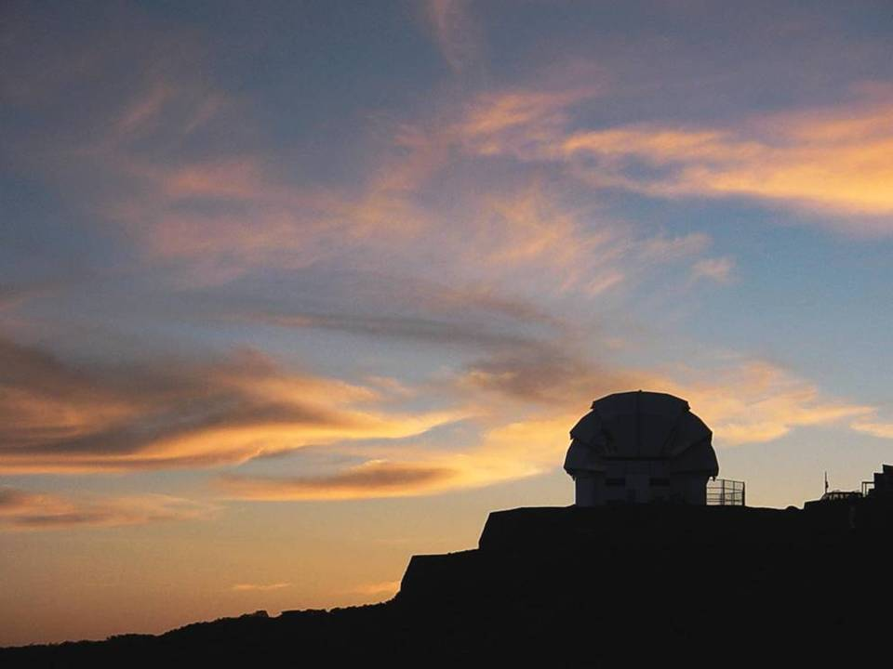
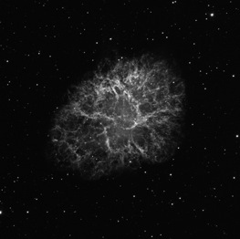
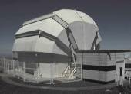
The National Schools’ Observatory
www.schoolsobservatory.org.uk
The 100,000th observation
NSO: web-based project allowing school pupils access to astronomical data from the LT for projects within classrooms – inspires interest in astronomy, IT, mathematics etc.
Central to LT Success and
NRT motivation
~2,500 UK schools
now members
100,000+ schools’
observations
Liverpool Telescope
ARI Ambition: Encompass majority of UK secondary schools and broaden to other STEM areas: with NRT, NSO could be a World-leading resource for STEM subjects

