Slide 2


Slide 3
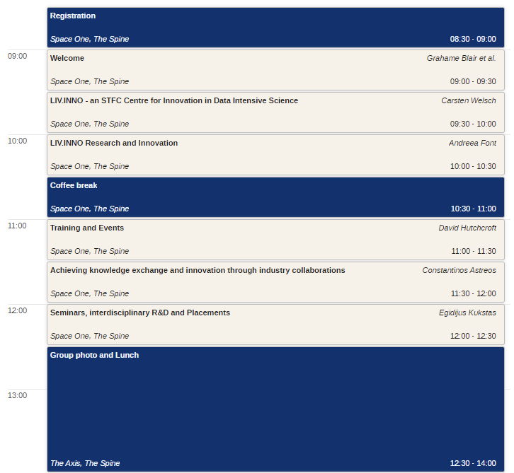
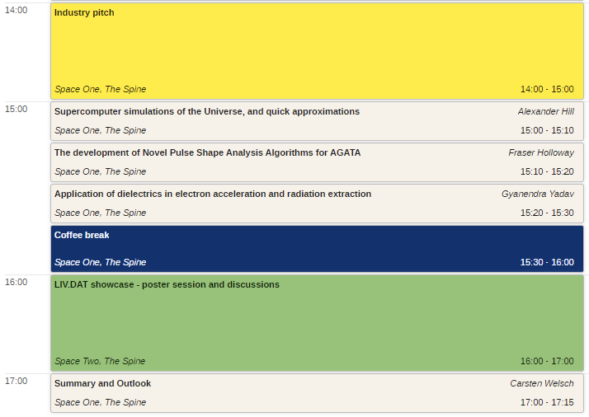
Agenda

Slide 4


Notes:
Rules and guid

Slide 6
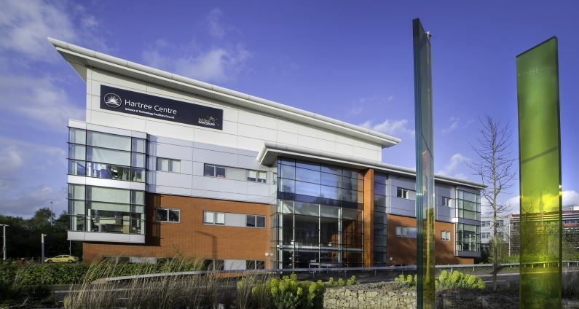
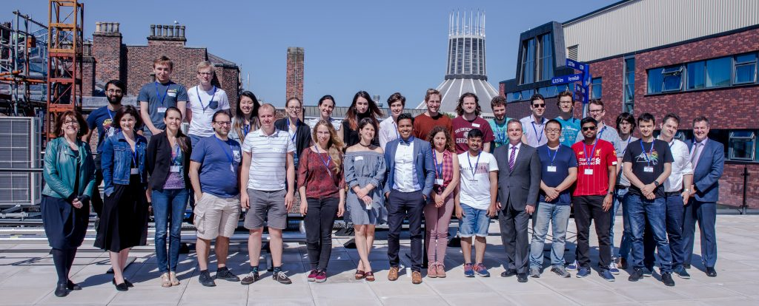
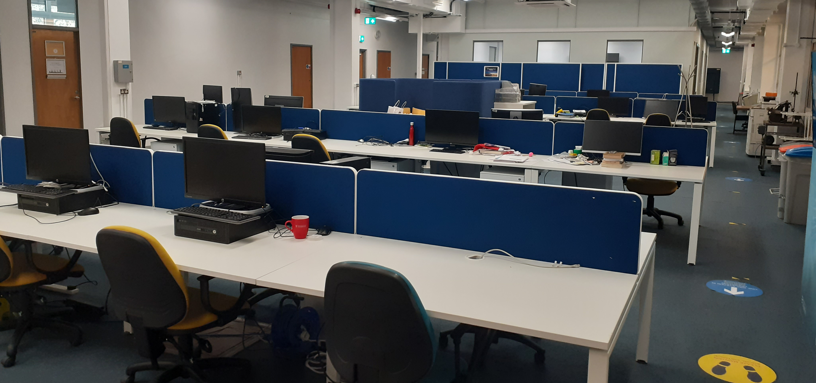

Training environment
Liverpool has outstanding track record in postgraduate training
Cohort-based training in data science, research and innovation, complementary skills, and courses offered by partners
Inclusive environment that offers some unique opportunities for LIV.INNO students (e.g. CUWIP)
More in David’s talk
Notes:
overall quality of the research training environment and cohort approach to training focused on the student experience. For example, how specific training on data intensive science techniques and innovation will be delivered on a cohort basis
degree to which you are supporting a healthy and inclusive research and innovation culture, including the approach to equality, diversity and inclusion.

Slide 7





Leadership in PGR education
5 Marie Curie ITNs, ~100 Fellows
STFC CDT in Data Science, LIV.DAT, 36 students
Lead or partner in EPSRC CDTs
STFC Education Training and Careers Committee

Slide 8
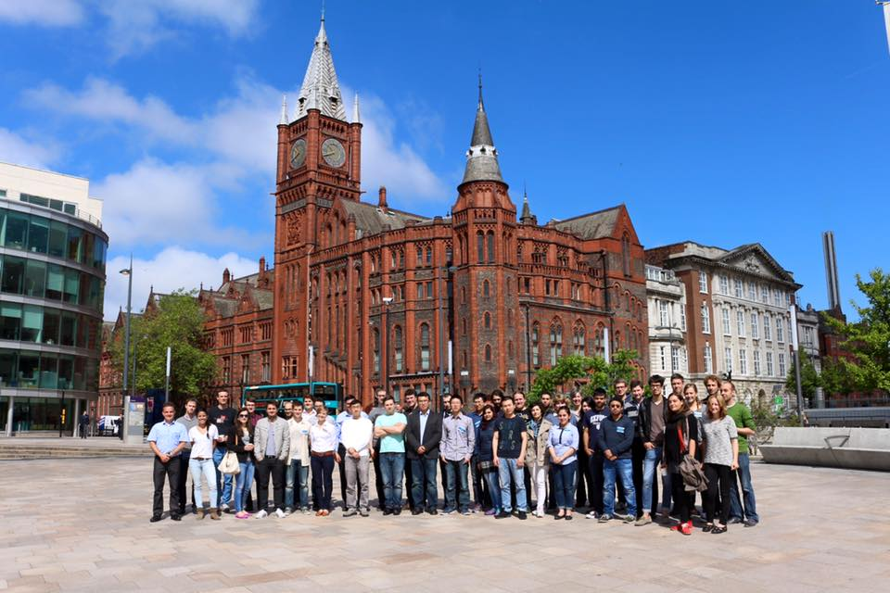
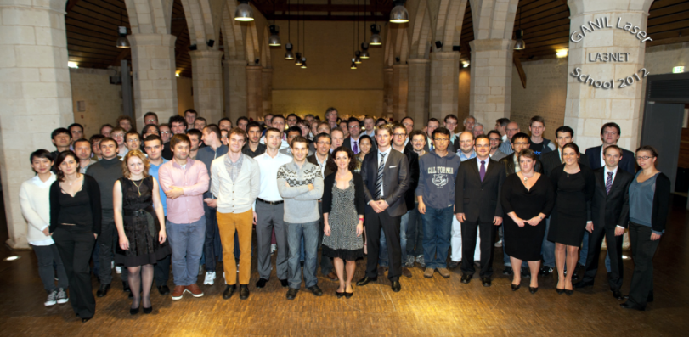
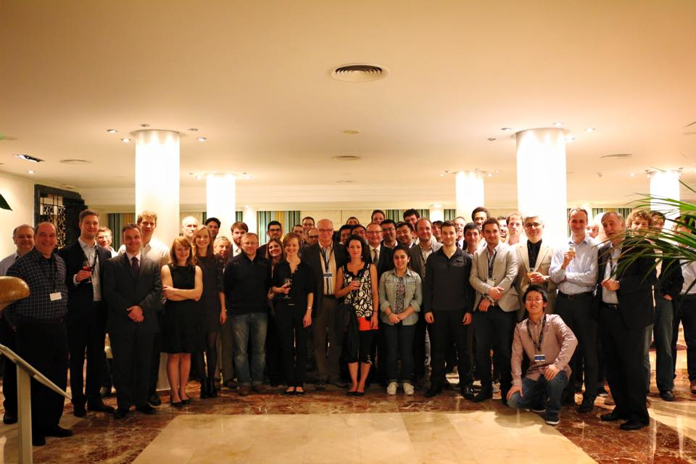
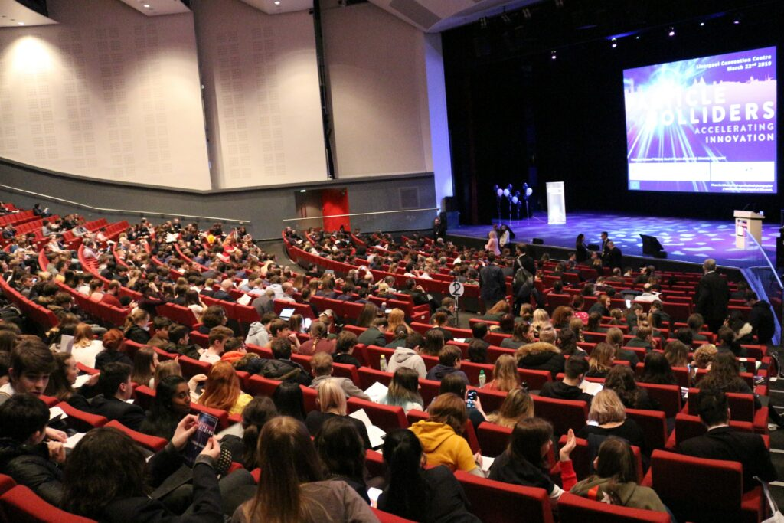
Impact on research community
> 20 International Schools
> 30 Topical Workshops on focused R&D areas for 30-120 experts;
3 International Conferences
2 Symposia…expect much more in LIV.INNO!

Slide 9
Training time line (2022 cohort)
Year 1
Year 2
Year 3
Year 4
 | Taster placements | Industry placements
Complementary Skills School Canvas course Data Science |  | School on Data Science and Applications | Advanced Skills School
 | CUWIP 2023 | Outreach Symposium | Careers Workshop
PGCert in Big Data |  | Data Science in Healthcare Workshop
Cohort visit to the STFC Hartree Centre | LIV.INNO Student Seminars
PGR training courses by clusters and LIV.INNO Virtual Seminars
Specialist courses by Hartree and Nvidia |  | DataAid
Development Needs Analysis, updated quarterly

Slide 10
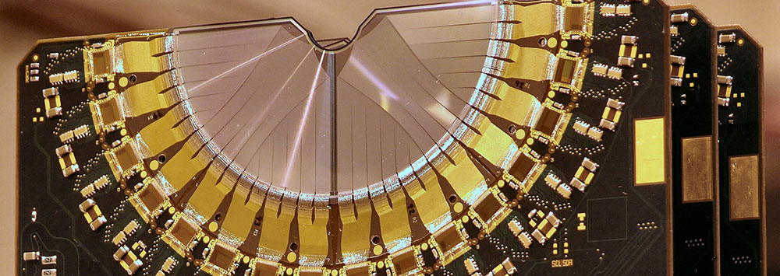
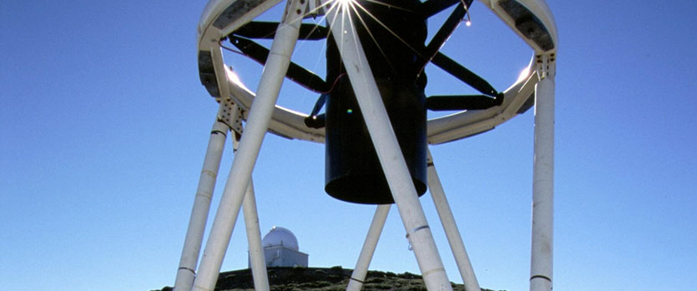
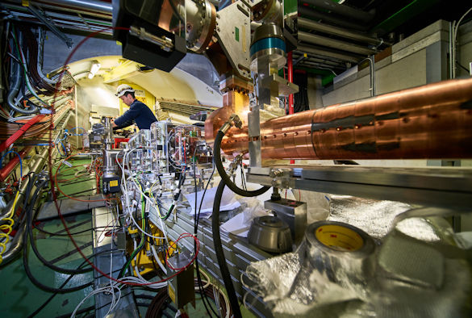
Research environment
LIV.INNO will focus on innovation in STFC science and industry applications.
Perfectly aligned with institutional DIGITAL research themes, benefiting from Virtual Engineering Centre, new £12M Digital Innovation Facility, and LJMU’s robotic telescope.
Wider impact through placements, outreach symposium, and “DataAid”.
LIV.INNO Research & Impact Board will support responsible research and translation.
More in Andreea’s presentation.
Notes:
the quality and diversity in the scientific areas to be addressed by the centre, including appropriateness with regards to data intensive science
the alignment of the centre to wider host institution strategies
the potential impact which could arise as a result of the centre’s success, both in terms of academic and scientific benefit, and wider economic and societal benefit
the extent to which responsible research and innovation will be supported and delivered in the centre’s research activities.

Slide 11
LCR Key Data (ONS2020 for 2018)
BEIS-commissioned LCR+ Science and Innovation Audit highlighted world-leading assets and capabilities in HPC and AI.
The Digital & Creative sector in LCR produced over £2.2bn of output, £1.96bn from Digital Technology.
Output from the Digital & Creative sector grew by 41% from 2008 to 2018 in LCR, compared to 33% growth in England.
3,980 Digital & Creative workplaces in LCR (2,680 Digital Technology) employing 21,150 people (15,750 in Digital Technology).
Since 2010 LCR has become home to an additional 1,000 Digital & Creative workplaces; with 73% in Digital Technology.
Labour productivity in the Digital & Creative sector in LCR has grown 55% since 2009 to £104,214, compared to 17% growth nationally.

Slide 12
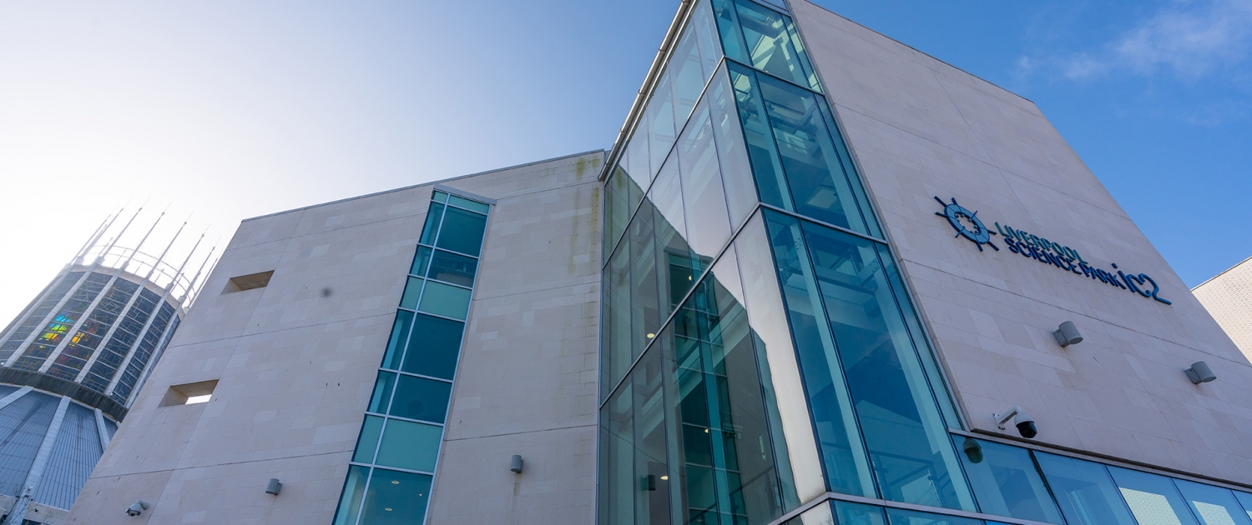
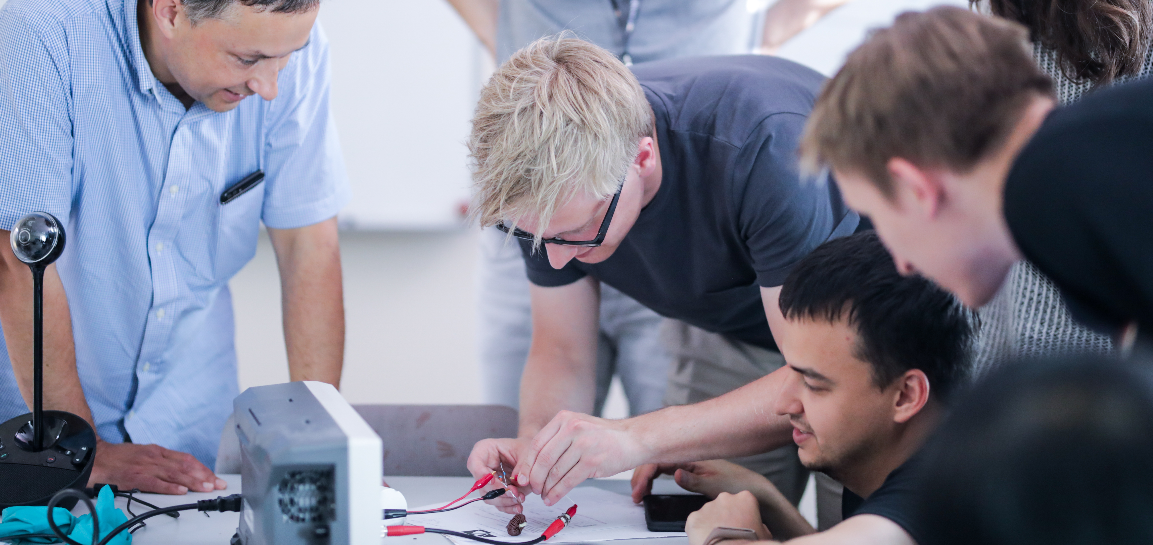

Partnership & engagement
Long-standing collaboration between UoL and LJMU
Strategic partnership with STFC Daresbury
Strong links with research centres and SMEs.
Partners co-define PhD projects, act as co-supervisors and mentors, and provide important input to LIV.INNO management.
Get involved!
Notes:
relevance and strength of the links formed with other organisations (particularly local small and medium enterprises) and other potential users
extent of their involvement in determining and providing input to the proposed training programme, in mentoring and co-supervising students and in exploiting the outcomes of the research and training, and overall involvement in helping to manage the centre
- evidence of what plans are there to match students to placements and monitor their progress, and strength of the research innovation arising from those placements.

Slide 13











Support for LIV.INNO
Excellent commitments from partners and universities:
    Large number of studentships confirmed;
    Fantastic placement opportunities and joint projects;
    Bespoke student areas and training spaces;
    Centre Manager and admin support.
At least 12 LIV.INNO students will start this year!
Notes:
Strong commitment from partner institutions
The level of funding, in addition to that provided by STFC and UKRI, that would be available for supporting additional studentships and associated training activities. This includes any support offered to fund placements, contributions from external sources, and the level of commitment from the institutions applying to host the centre.

Slide 14
Implementation
Management Board
Research & Impact Board
Overall management of the CDT. MB monitors progress, particularly training, R&D results, communication, dissemination and IP.
Members:
Director and Work Package Leaders
Chair Research & Impact Board
Training Coordinator
Elected Student Representative
Industry Representative
Hartree Representative
Partner Liaison
Outreach Coordinator
EDI Leader
Admission and Graduate Tutor
Supported by Project T.E.A.M.
Research strategy, identification of new funding and partnership opportunities, prioritization of PhD studentships, oversight of recruitment.
Members:
Deputy HoD (Research)
Physics Business Development Manager
LIV.INNO Fellow
Cluster/Partner Representatives
Receives input from identified external expert advisors.
Notes:
effectiveness of the plans for the management and governance of the centre, including the suitability and commitment of the director and senior management team
plans for obtaining independent strategic oversight
involvement of students in the management process.

Slide 15
External Advisors
High-level scientists that will provide strategic guidance to our Research and Impact Board :
Prof Alison Kennedy (Director Hartree)
Dr Dennis Kehoe (AIMES CEO)
Prof Erich Griesmayer (CEO CIVIDEC)
Prof Simon Maskell (Director EPSRC CDT)
Senior representatives from DiRAC and IBM

Slide 16
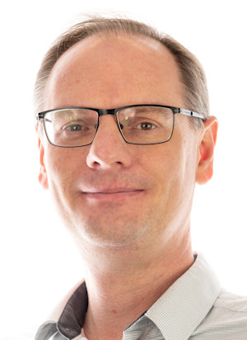
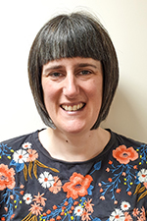
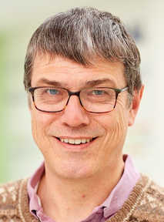
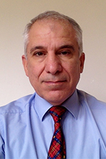
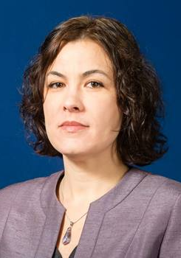
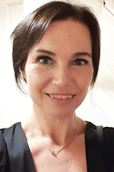
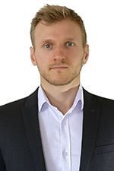
LIV.INNO
…

Slide 17


Digital as focus: Other CDTs
EPSRC CDT on Distributed Algorithms
University of Liverpool Doctoral Network in AI for Future Digital Health
Lead: Prof Simon Maskell
https://bit.ly/381Ulqa
Lead: Dr Vitaliy Kurlin
https://bit.ly/39B9Aa6

Slide 18
Summary
LIV.INNO to become leading Centre for Innovation in Data Intensive Science.
Our research will drive STFC science and is expected to have a structuring effect on LCR with high economic and society impact.
Our structured training will boost the employability of our students.
Today marks the start of a major initiative – get involved!

