Slide 1
Training programme
David Hutchcroft

Slide 2
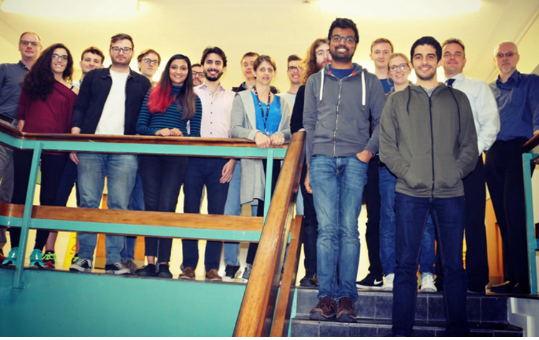
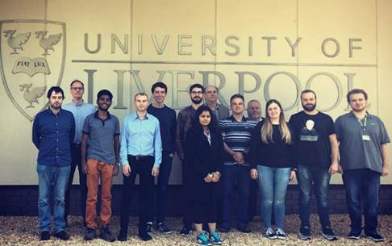
Why train students?
The PhD training programme is designed to give the students
Subject specific training
General training in data intensive science
Preparation for working in teams, writing reports and networking skills
This is to make the graduates have the best opportunities
STFC wants to show that the fundamental science it funds has wider societal benefits

Slide 3
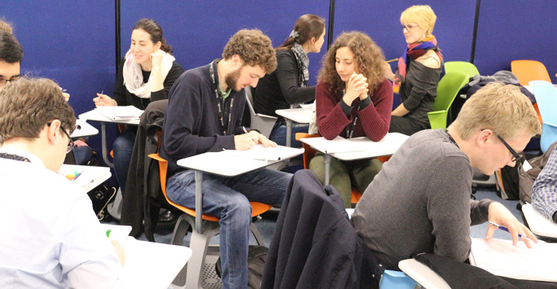
Main topics of training
Focused research skills and techniques
Cutting edge R&D projects
Broader scientific experience
Placements, workshops and Schools
Research project management, communication and presentation skills
A complementary skills School in the first year
Outreach activities
Understanding of the benefits of an inclusive environment
integrating Equality, Diversity and Inclusion (EDI) in all aspects of the CDT
Interpersonal skills, accepting responsibility, working in teams, networking
Project work, a student-organized charity event, and involvement in events
Awareness of private sector constraints and Intellectual Property rights
Industrial mentors and secondments, the Business Development Manager (BDM) based in UoL Physics
Career management, CV writing, interview techniques, proposal preparation and entrepreneurship

Slide 4
Inclusivity and Diversity
All PhD activities should be available to all
Every schedules activity will be recorded for students unable to attend in person or at the delivered time
The staff at both universities are signed up for the national HE and Institute of Physics charters on inclusion and diversity
https://www.advance-he.ac.uk/equality-charters/athena-swan-charter
https://www.iop.org/about/IOP-diversity-inclusion/project-juno
This is an ongoing process and we applied to get recognition of our improved status in both earlier this year
All of our PhD students will be trained in and held to the same high standards around EDI

Slide 5
Subject specific training
The students need to be good researchers by the end of their PhDs
Condensed matter Particle Physics Accelerator Science Nuclear Science
Astrophysics Theoretical Physics Computer Science

Slide 6
Student specific training
There is always subject specific knowledge and only the experts in the field can deliver that
They will be integrated with the training of the other PhD students in their fields
Trips to international laboratories
National and international summer schools
Delivering conference talks on their results
This is training we deliver to all PhD students, not just on CDT members

Slide 7
Using Masters courses in Computer Science
Both UoL and LJMU have suitable courses to which are apposite: from:
Data Science and Artificial Intelligence MSc
https://www.liverpool.ac.uk/study/postgraduate-taught/taught/data-science-and-artificial-intelligence-msc/overview/
MSc Data Science
https://www.ljmu.ac.uk/study/courses/postgraduates/data-science-msc
Modules from these courses will be the main taught components for the students

Slide 8
All cohort training
 | Compulsory 90 credits
Semester 1 | Data Science Learn about current challenges and opportunities in Data Intensive Science and expand research skills in key areas. Connect with other students and staff through Forum | Semester 2 | Data Mining Develop a critical awareness of current problems and research issues in Data Mining and the ability to address Data Mining research issues in an original manner
 | Big Data Computing Develop skills in computing techniques for high performance analysis of large data sets and understanding of how to translate analysis problem to best exploit such techniques |  | Transferable skills training Students will be joined by others from the faculties and receive training in project management, scientific writing, presentation skills and IPR with Fistral.
 | C++ programming, MC techniques and group project Hands-on C++ programming and MC training, single project undertaken by entire cohort |  | Individual data skills project Individual project addressing a data intensive science challenge set by supervisors.

Slide 9
Project specific training
Project-specific choice of one 15-credit module | Data-science choice of one 15-credit module
Particle Physics Nuclear Physics Accelerator Science Astrophysics Theoretical Physics Computer Science | Multi-core Programming Applied Algorithmics Theoretical Physics + other Computer Science MSc and Physics MPhys modules
The PhD thesis topics will determine which of the courses is most useful for each student

Slide 10
Data science schools
Intensive week long schools on specific topics are a cornerstone of PhD training with almost all of the students in a national cohort together, typically attending two over a PhD
In 2020 LIV.DAT put on the STFC Data Intensive Science School, 12-16 October 2020, online only due to the pandemic
https://indico.ph.liv.ac.uk/event/103/overview
Now used as the basis for a MOOC (massively open online course)
https://liverpool.instructure.com/courses/44542
As part of the commitment to providing training to all potential data scientists

Slide 11
LIV.DAT summer school timetable 2020
Monday | HEP NN training | ScikitKeras |  | Introduction to ML
 | Posters
Tuesday | Big Data Python ecosystem for HEP | Demystifying "Big Data" |  | Preparation of large datasets for machine learning
 | Posters
 | Public talk on Health data science
Wednesday | Git Demystified | Virtual universes vs. the real thing | Virtual universes vs. the real thing
 | Live astronomy with the Liverpool telescope
Thursday | Big data case studies
 | Project management
 | International collaboration
 | Industry careers workshop
 | Online Escape Room
Friday | Kaggle competition: www.kaggle.com/competitions/lhcb-jet-data-separation
 | Talk by previous student on their experience
 | Prize giving & Close

Slide 12
LIV.INNOS events
The full programme of events will evolve over the seven years of the initially CDT funding
Seminars
Speakers from industry, research and computing: drawn from around the world
LIV.DAT Virtual Seminar Series - Spring 2022 [indico.ph.liv.ac.uk/event/589/]
LIV.INNO student seminars
2nd and 3rd year students will present their work to the cohort, staff and interested undergraduate students

Slide 13
Recent & upcoming LIV.DAT seminars
The Crystal Isometry Principle
Dr Vitaliy Kurlin Reader in the Computer Science Department and Materials Innovation Factory, University of Liverpool
How computers have changed science and predictions on how that will continue
Dr Joanna Leng Senior Research Software Engineer, University of Leeds
Physics-informed neural networks for solving Gray-Scott systems
Prof Salvatore Cuomo Associate Professor of Numerical Analysis, University of Naples Federico II
Tuesday 14 June 2022 at 14:00 BST
https://indico.ph.liv.ac.uk/event/589/page/27-physics-informed-neural-networks-for-solving-gray-scott-systems

Slide 14
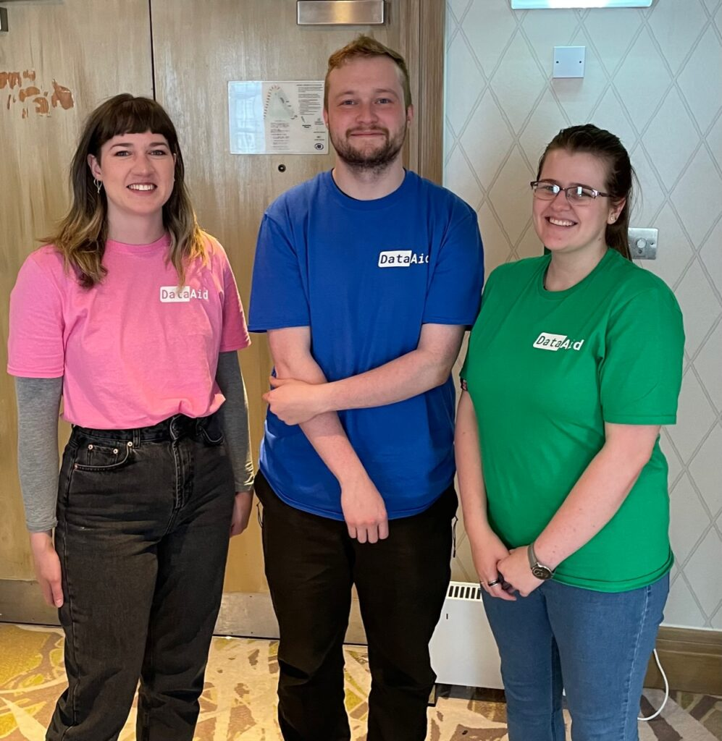
2 day charity hackaton each year
Inspired by a student-led initiative started during lockdown
Using the charity’s own data
Students will be involved from the start with
organization of the event
selection of charity partners
advance preparation of the data
Gives experience in dealing with real-world noisy and incomplete data, privacy issues, and client relations
Under the STFC DataAid programme:
https://data-intensive-cdt.ac.uk/?page_id=607

Slide 15
Contributions from partners all activities
We are looking for speakers and workshops from our partners
For all of the previously discussed activities we would welcome events lead by you
Seminars
Workshops
MOOC classes
DataAid suggestions and support
Symposiums on public engagement
Nvidia have already committed to giving a workshop and we welcome other contributions

Slide 16
Thank you for listening
Questions?

