Slide 1


Slide 2
Achieving knowledge exchange and innovation through industry collaborations
Constantinos Astreos
Business Development Manager,
Department of Physics,
University of Liverpool

Slide 3
Summary
  The Digital theme at Liverpool
  LIV.INNO’s role
  Importance of partnerships and industry engagement
  How Liverpool Physics engages with industry and supports innovation

Slide 4
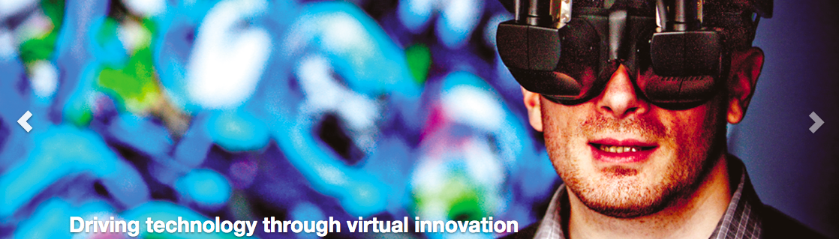
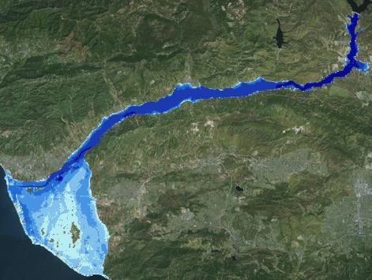
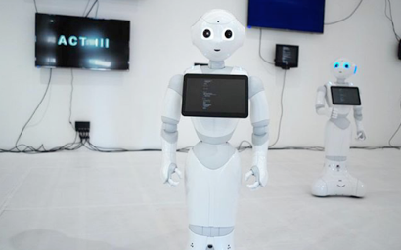

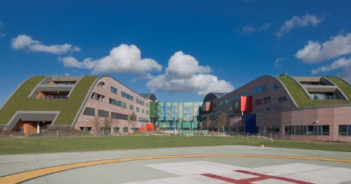
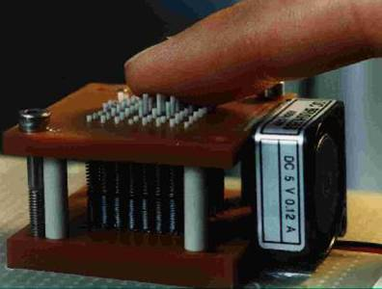
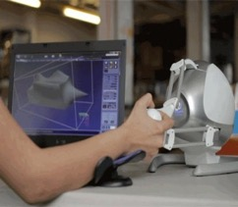
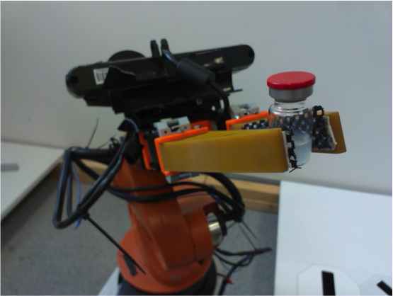



Digital theme at Liverpool
Virtual engineering
Dynamic environments
Digital humanities
Geographic Data Science
Genomics
Digital Health
Internet of Senses
Networks and
Wireless Comms
Digital
Robotics for Chemistry
LegalTech
Autonomous
Systems
Big data
and more…!

Slide 5
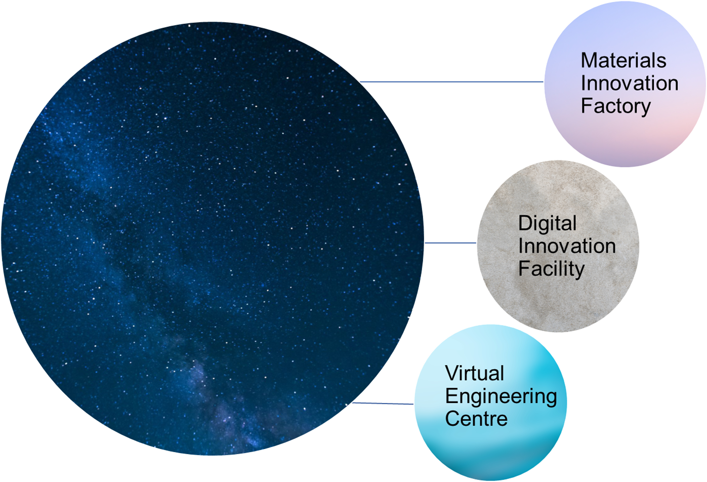
Unique innovation assets at the university of Liverpool
Opened 2017
A world-leader in the computer and robotics assisted discovery and design of materials
The University of Liverpool excels in research computation (including AI, game theory and prediction), sensors, satellite observations, life sciences and advanced materials
Opened May 2022
State-of-the-art lab spaces to develop partnerships across multiple academic disciplines including robotics, AI and data analytics
Established 2010
Leading centre of virtual engineering technology integration for industrial and commercial applications including advanced modelling and simulation

Slide 6



Why LIV.INNO matters?
Perfectly aligned with institutional DIGITAL theme, benefiting from Virtual Engineering Centre, new £12M Digital Innovation Facility, and LJMU’s robotic telescope
LIV.INNO aims to become a leading Centre for Innovation in Data Intensive Science.
Our research will address big data research challenges and is expected to have a structuring effect on Liverpool City Region with high economic and society impact.
Our structured training will boost the employability of our students.

Slide 7
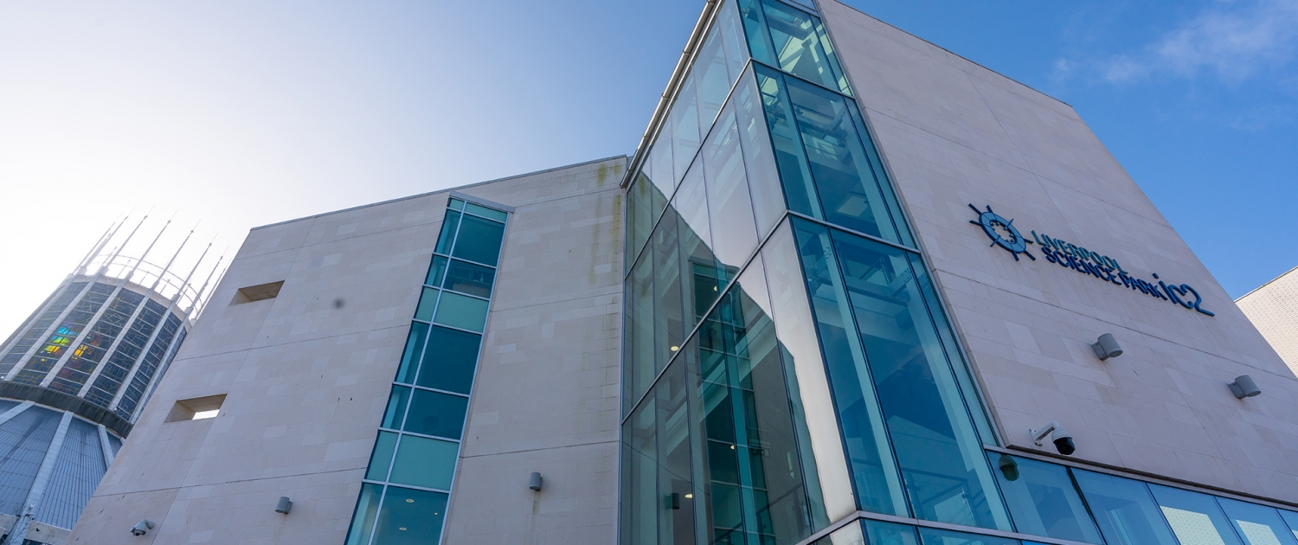
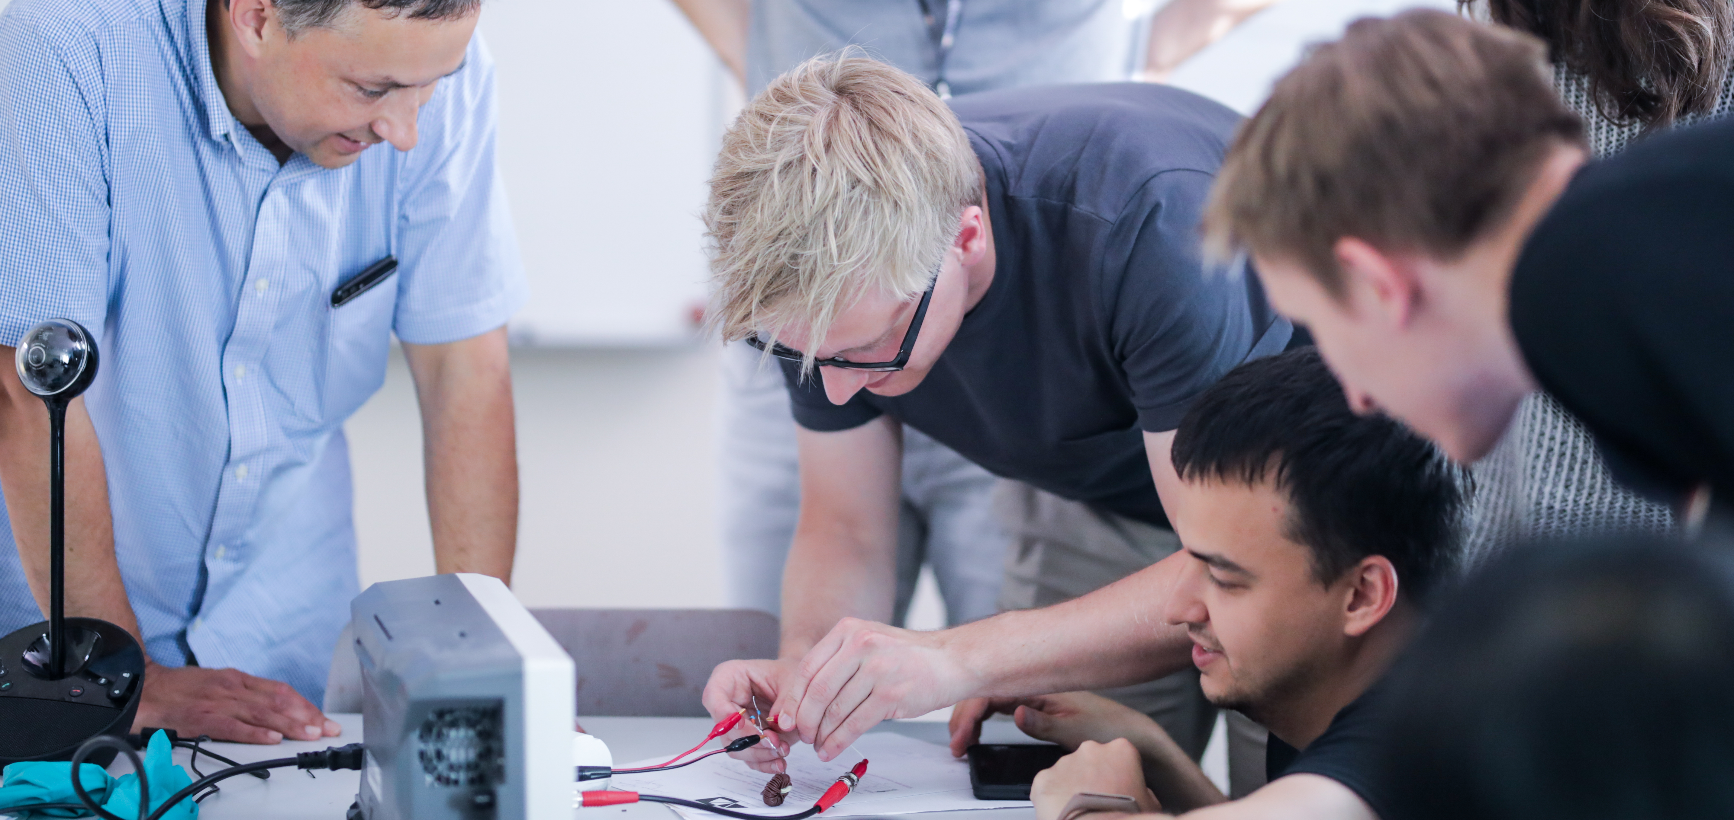
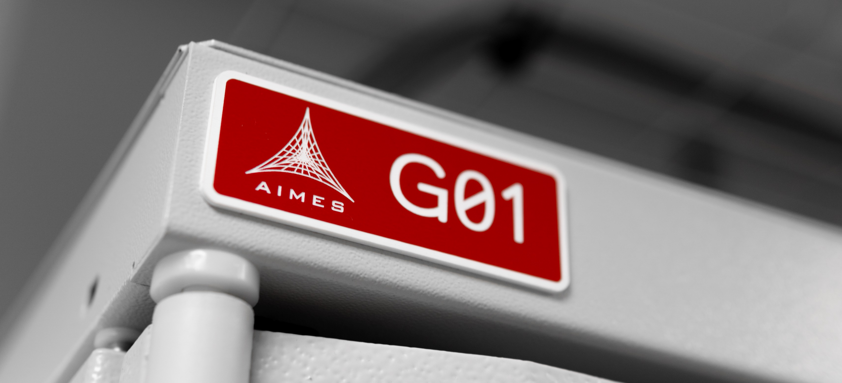
Partnerships & Industry engagement
Long-standing collaboration between UoL and LJMU
Strategic partnership with STFC Daresbury
Strong links with research centres and SMEs.
Partners co-define PhD projects, act as co-supervisors and mentors, and provide important input to LIV.INNO management.

Slide 8




How do we collaborate and engage with industry?
Industry workshops
Collaborative R&D
Spin-outs & commercialisation
Student projects

Slide 9
Pathway to knowledge exchange and innovation at Liverpool Physics
Basic & Applied Research
Feasibility & Development
Demonstration
Adoption
Spread
STFC
Angel Investors
STFC – IAA
Crowd Funding
STFC – FoF
Venture Capital
STFC – IPS
Companies
STFC – CLASP
Innovate UK
ISCF
TRL 1
TRL 2
TRL 3
TRL 4
TRL 5
TRL 6
TRL 7
TRL 8
TRL 9

Slide 10

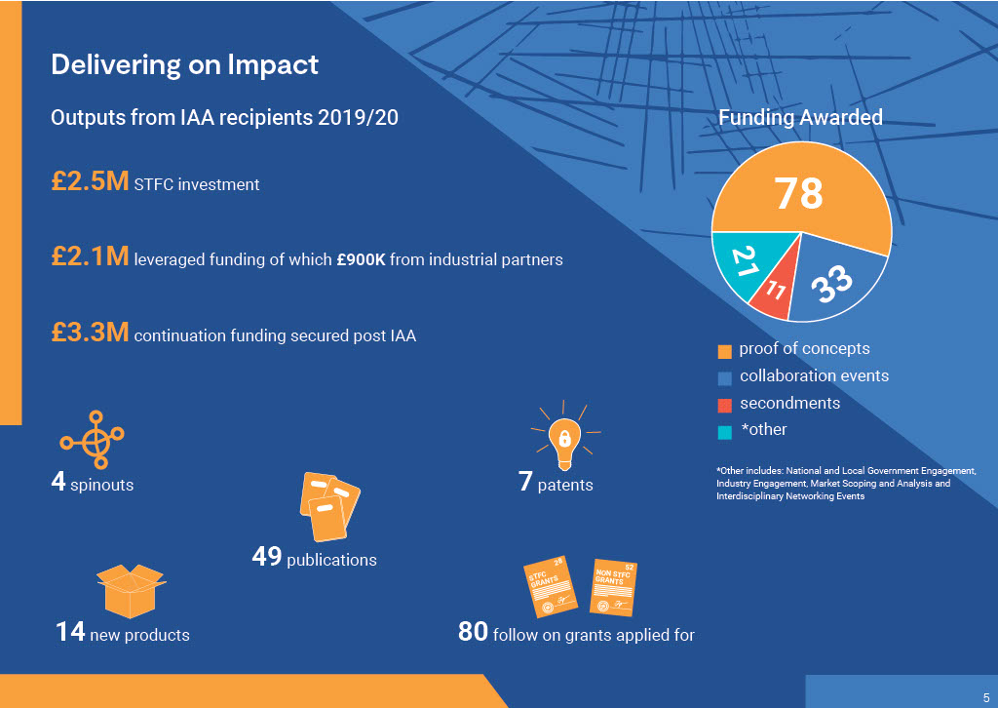
Impact Acceleration Account (IAA)
Supports key areas of activities which will accelerate the impact with external organisations.
Offers a unique opportunity to support novel ideas to further funding for R&D
Issue two calls per year for:
  Proof of Concept projects
  PDRA secondments funding
  Stakeholder engagement funding

Slide 11





Support research collaborations with industry
Working together with external partners accelerates the impact of our research achievements in the UK, global economy and society
Development of Proof-of-Concept projects – STFC Impact Acceleration Account (IAA)

Slide 12
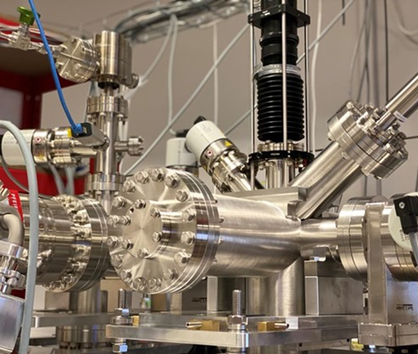
Collaborative R&D
Example: JetDose project
In 2019 funded a PoC project with D-Beam: Proof of concept measurements for an online non-invasive simultaneous dose and profile monitor for hadron therapy.
This IAA proved to be the catalyst for this next stage of work, enabling the development of an online, single shot, non-invasive monitor for gas jet profile measurements, and commercialisation of the technique with D-Beam Ltd.
In 2021, awarded STFC CLASP funding to develop a novel non-invasive beam and dose monitor in collaboration with D-Beam Ltd and received support from Clatterbridge Cancer Centre, CNAO and IBA Ltd

Slide 13
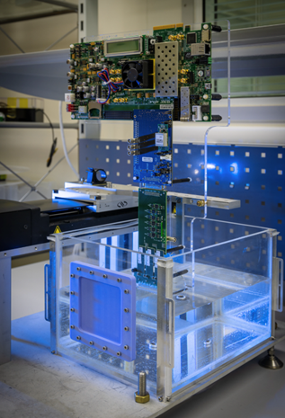
Collaborative R&D
Example: Water Phantoms for particle therapy using technology from CERN.
Imaging Phantoms are used as stand-in for human tissue in medical physics to ensure that imaging equipment is working correctly and to undertake quality control.
Funding provided by the Impact Acceleration Account (IAA) to the Department of Physics at the University of Liverpool enabled the development of further enhancements to the water phantom.

Slide 14

Create new companies
AIMES - part of the Arrow Group
Founded on the basis of and underpinned by Liverpool University’s Particle Physics research and IP, AIMES hasgenerated economic and healthcare impacts since 2014 that include:
Increased the company’s annual turnover by 96% to £4.5M in 2019/20, significantly exceeding the UK’s national average turnover for small companies, and created 21 new jobs
Contributed to the improvement of health service design and commissioning through its data centre and deployment of its cloud infrastructure
Delivered improvements for NHS cost and resource efficiency through the use of its cloud infrastructure

Slide 15

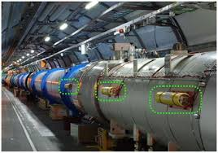
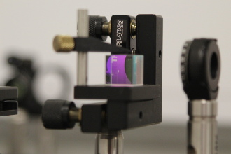
Create spin-out companies
D-BEAM Ltd
Developed proof of concept projects in collaboration with
Development of innovative non-invasive diagnostic technologies for particle accelerators via the applications of coherent radiation imaging and Digital Micro-mirror Devices (DMDs)
Development of new techniques of measuring the absolute density profile of gas jets in use at particle accelerator facilities.

Slide 16

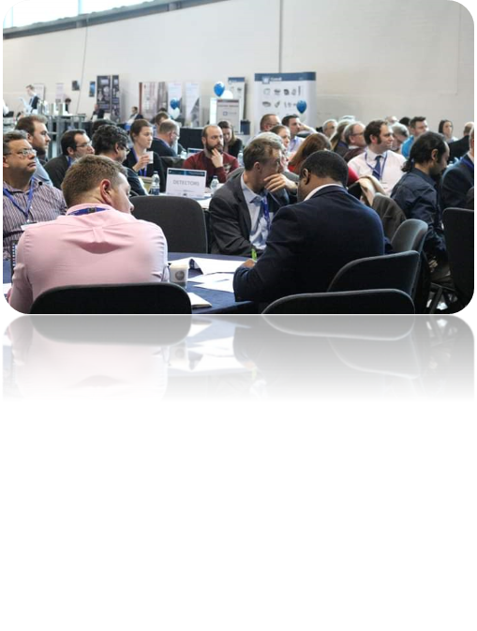

Workshops with industry
International Symposium ‘Particle Colliders - Accelerating Innovation’
Showcased technical challenges of Future Circular Collider study (FCC), the technological innovations envisaged within the project, and the benefits for industry in terms of project involvement and product commercialization.
Working groups around each of the relevant communities were formed to discuss specific opportunities for collaboration and funding.
Several academia-industry projects were started as a direct result from the event.
https://indico.cern.ch/event/747618/

Slide 17

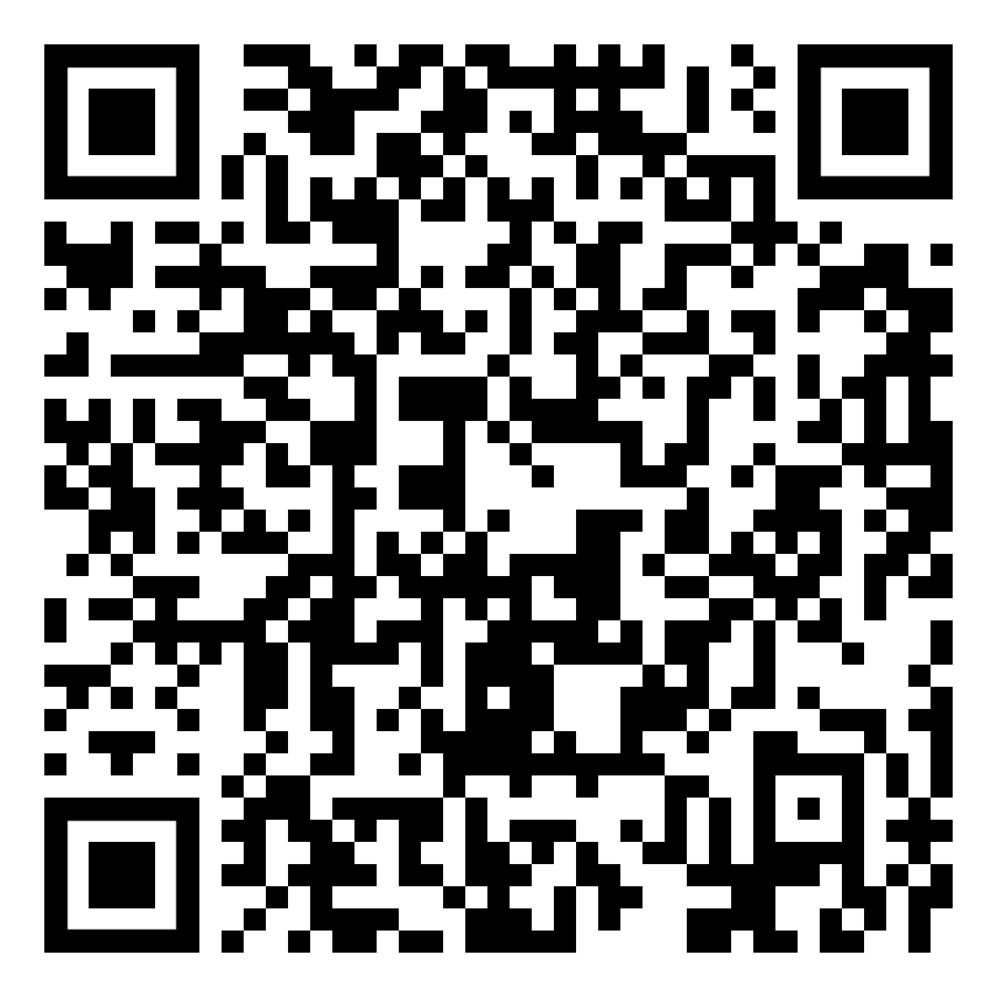
Workshops with industry
Healthcare Instrumentation workshop
Brought together medical device technology companies, organisations which use and apply such devices in the medical field (e.g. Medical physicists in NHS Trusts) and academic researchers in Physics, to identify the key research challenges
in this area and build collaborations to develop applications for future research funding.
Discussion topics:
Meeting the challenges of Data science /AI in healthcare instrumentation
Effective diagnosis and treatment of medical conditions
Optimisation of sensor technologies for improved beam diagnostics and patient treatment planning in radiotherapy
https://bit.ly/3po99mA

Slide 18


Student projects
Physics Research Internship work
4 weeks full time in June-July for year 2 to Year 3 students (Bachelor or Master students), ca. 6.5 hours per day (full time) work on a shorter STEM-related project with a focus on skill to enhance employability.
Physics Year in Industry Placement
8 to max. 12 months placement for year 2 to Year 3 students (Bachelor or Master students), ca. 7-8 hours per day (full-time) with a focus on skills to enhance employability and a detailed STEM-related project.
MPhys curriculum Projects
final Year 4 project work, 2 days per week for 20 weeks starting from mid-October to beginning of May. Open-ended, research-led projects with the option for multi-disciplinary team work.
Summer Placements
any extra-curriculum 4-6 weeks full time project work open for all year 1 to Year 4 students. Placements up to 4 weeks maximum can be unpaid.
Bachelor of Science curriculum Projects
final Year 3 project work, about 1 day per week for about 12 weeks starting from end of January to the beginning of May. More confined and selected (not open ended) projects. Option for multi-disciplinary team work.
Bachelor of Science curriculum Group projects
final Year 3 project work performed in small teams of 3 to 6 students, about 1 day per week for about 12 weeks starting from end of January to the beginning of May. Option for multi-disciplinary team work.
MSc in Radiometrics Instruments and Modelling and NTEC
Programmes
Project work full time from June until mid-September with a number of partner companies. Option for multidisciplinary team work.
PhD placements
Computer/big data-based industry placements for LIV.INNO students up to 6 months for PhD students.

Slide 19
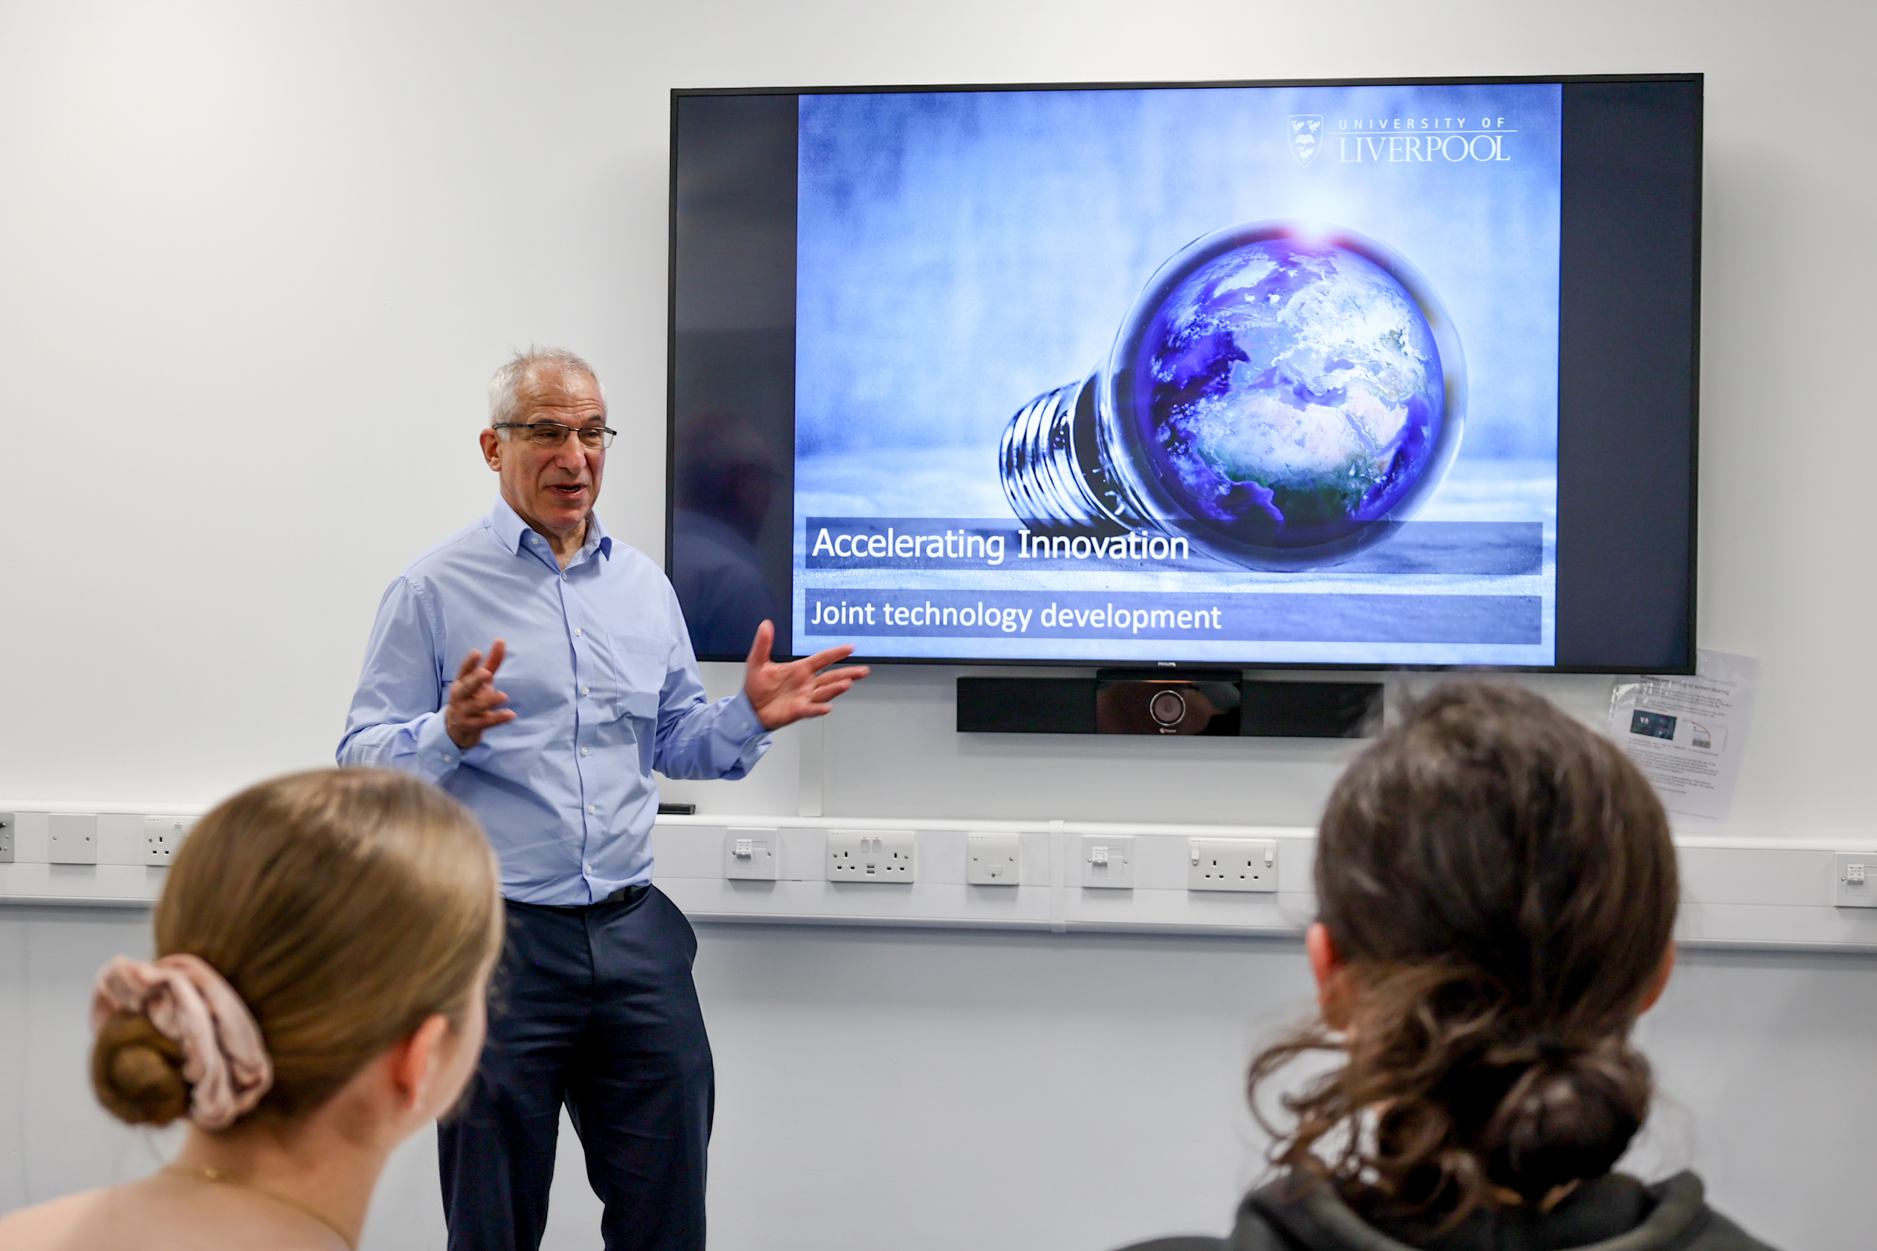
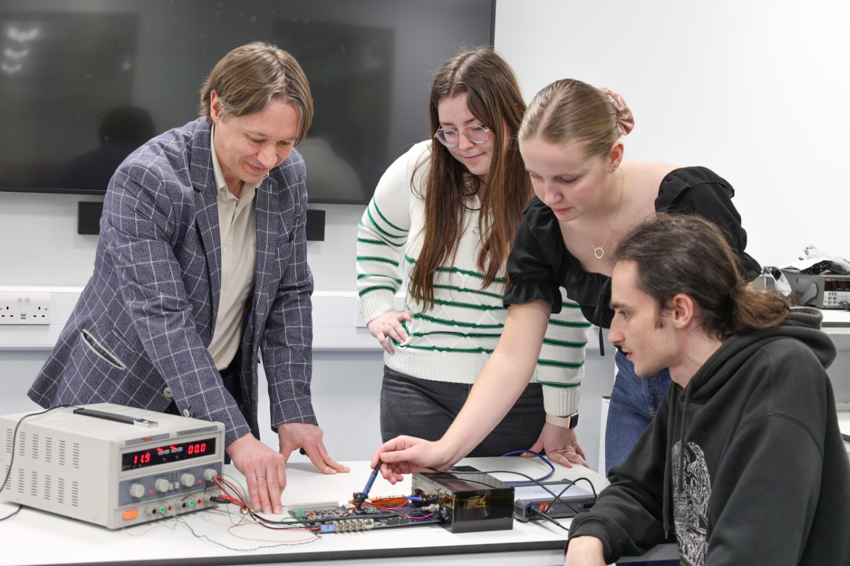
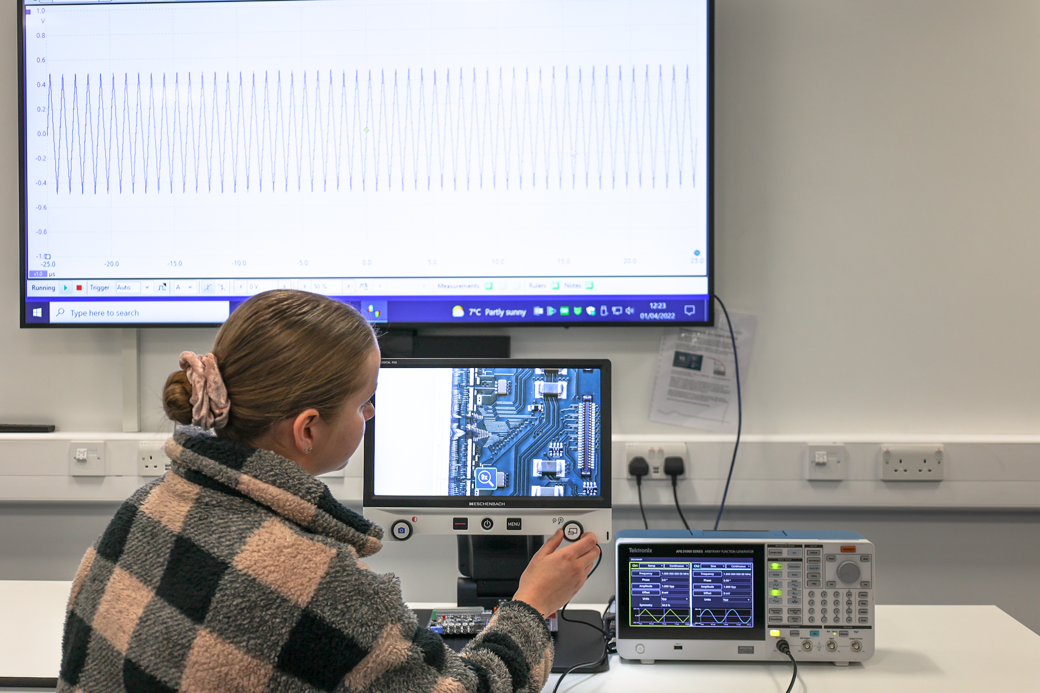
LIV.HUB - Multi-purpose teaching and industry hack space
Multi-user innovation facility at the Oliver Lodge Building, Department of Physics at the University of Liverpool for the use of academic researchers and industry partners.
Collaborative space for industry-academia projects.
Facilitating workshops, seminars and other small group training events.
Joint technology development, de-risking investment into new product solutions.

Slide 20
Ideas and opportunities for future collaboration
Please contact:
Constantinos Astreos
c.astreos@liverpool.ac.uk

Slide 21
SPARES
SPARES

Slide 22
Digital ambitions
  + Centre of excellence in Digital research and innovation
  + Strong internal networks, yielding external collaborations and partnerships
  + Local, national and global visibility and reputation
  = Strengthening our ability to mobilise interdisciplinary research groups to tackle real world challenges
  = Leading the way in nurturing talent for future leaders in Digital
  = Attracting investment from a wide range of sources to support our interdisciplinary Digital research
Notes:
+ Strong internal networks, yielding external collaborations and partnerships i.e. our achievements to date with you (our industry partners in LIV.INNO), DIF and future collaboration

