Slide 1
Interdisciplinary R&D in Data Intensive Science
Egidijus Kukstas
Fellow in Data Intensive Science

Slide 2
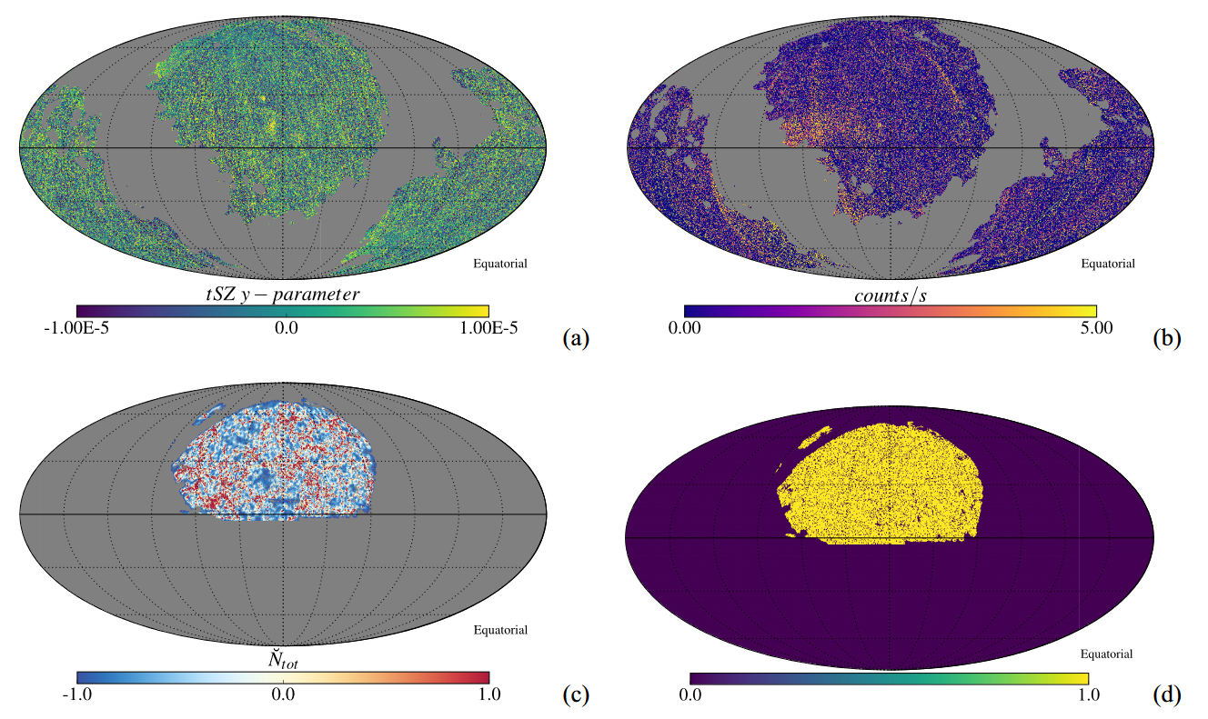
My background
MSci in Physics with Astrophysics (U. of Glasgow)
PhD in Astrophysics (LJMU)
Currently a LIV.DAT Fellow in Data Intensive Science
  Collaborate on projects in:
    Novel acceleration techniques
    Diagnostic measures for accelerators
    Antimatter accelerators
    Medical device development
  Work with our industrial partners:
    Adaptix
    ViBo Health
    D-Beam
  Engage in student training:
    Workshops
    Seminars
    Discussion forums

Slide 3
My experience so far
    Had to become comfortable with not being an expert in the subject area
      Fortunately, have experts there to advise me
    Was given the chance to participate in new initiatives and responsibilities
      Developing projects
      Mentoring students
      Ongoing student training and exchange of knowledge
      Developing new ways of teaching: MOOC spun out of our ‘researcher skills school’
    Worked with many people from very different backgrounds
      Students
      Academic staff and project supervisors
      Project T.E.A.M
      Industrial partners
    I brought my “outsider’s perspective”
      Skills and methods
      Ways of doing things
      Ask the simple questions

Slide 4
Overview of research projects carried out by LIV.DAT students
Projects undertaken as part of LIV.DAT focus on addressing data intensive problems in the fields of nuclear, particle, accelerator physics, as well as astronomy and astrophysics.
The common link between them all is that of data. Novel techniques are necessary in order to handle, analyse, and interpret it. Our students have carried out sophisticated modelling, simulation, machine learning, and statistical analysis work in order to make advancements in their fields.
Here is a short overview of some of the projects in more detail.

Slide 5
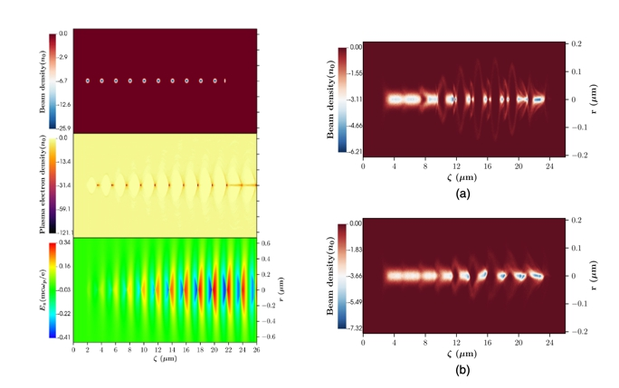
Resonant excitation of very high gradient plasma wakefield accelerators by optical-period bunch trains
Plasma Wakefield Acceleration is a promising new technology which would allow for efficient particle acceleration in a relatively small amount of space
Careful control of the ionising laser, leading “drive” beam of particles, and the following “witness” beam are necessary
Particle-in-cell numerical simulations are ideally suited for exploring and understanding the various effects
Credit: Monika Yadav

Slide 6
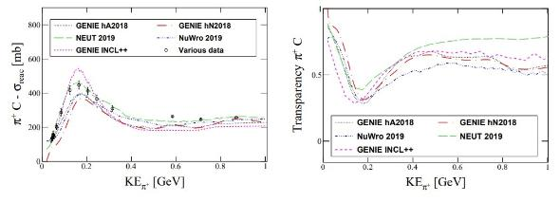
Physics Simulations to Underpin Discoveries in the Neutrino Sector
Discoveries over the past half-century have put neutrinos, the most abundant matter particles in the universe, in the spotlight for further research into several fundamental questions about the nature of matter and the evolution of the universe
Experiments, such as DUNE, study neutrino interactions
Careful modelling and simulation of the interactions is necessary to interpret the measured results
Credit: Júlia Tena Vidal

Slide 7
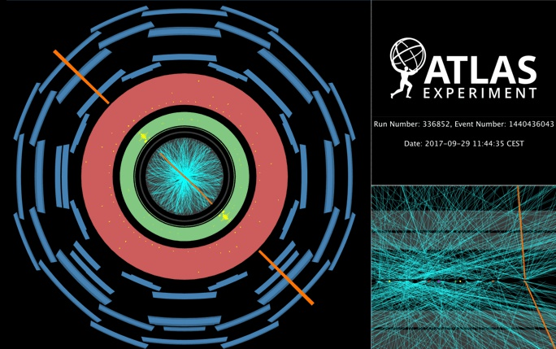
High-mass dilepton searches in the ATLAS experiment
Neutral and charged vector bosons in the ATLAS experiment provide a crucial benchmark to test our knowledge of the Standard Model, being well-known processes for which highly accurate theoretical predictions are available.
The Run 2 ATLAS dataset, consisting of an integrated luminosity of 139 fb⁻¹ proton-proton collisions collected during the years 2015 and 2018 at Large Hadron Collider, provides wealth of data to explore regions of the kinematic space that had never been measured before.
Handling and analysing this enormous amount of data requires specialised tools and methods.
Credit: Ricardo Gonzalez Lopez

Slide 8
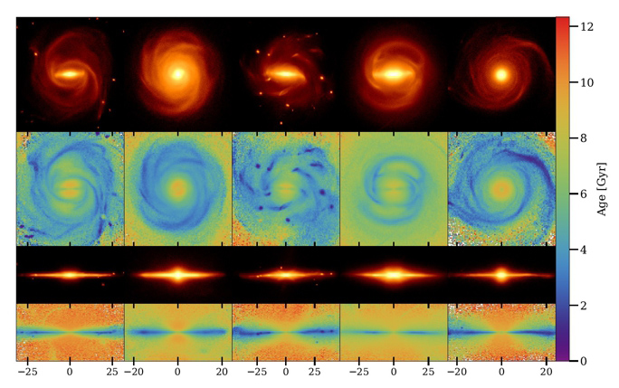
On the Flaring of Thick Discs of Galaxies: Insights from Simulations
Missions like Gaia and experiments like MUSE are providing an unprecedented amount of high-quality data about the Milky Way and nearby galaxies
This data will help unravel the formation history of our galaxy
In order to interpret this data, numerical simulations are necessary, where virtual analogues can be created and studied.
Various formation scenarios can be explored and mock observations compared against the real measurements.
Numerical simulations are an essential tool in modern-day astronomy.
Credit: Joaquín García de la Cruz

Slide 9
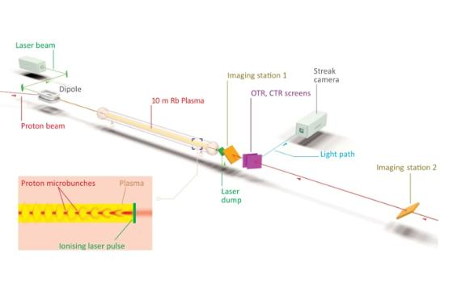
Proton beam defocusing in AWAKE: comparison of simulations and measurements
In proton-driven PWFA at AWAKE, a 12 cm-long beam of protons is diverted into a narrow channel of plasma where it excites an electrostatic wave (a plasma wakefield) which can in turn be used to accelerate an externally injected electron beam to very high energy.
Because of its length, the proton beam must first be broken up into shorter ‘micro-bunches’ by the wave in a process called seeded self-modulation (SSM), which in turn enhances the plasma wakefield.
Extensive simulation efforts are necessary to understand the self-modulation properties and make predictions for the experiment.
Credit: Aravinda Perera

Slide 10
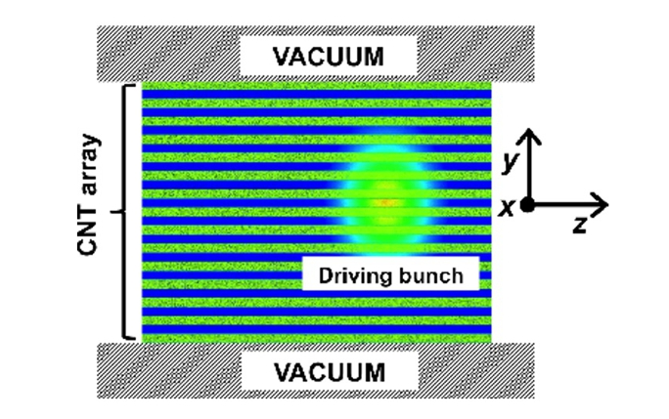
Towards Particle Acceleration in Carbon Nanotube Arrays
Novel acceleration techniques such as plasma wakefield acceleration (PWFA) have in recent decades made much progress in producing particle accelerators that are, pound-for-pound, up to a thousand times stronger than conventional radio-frequency accelerators.
Extrapolating such techniques to solid-state media could have the potential to produce even more intense and compact “ultra-high” accelerating fields.
Detailed numerical simulations are necessary to understand how arrays of carbon nanotubes can be used to shape, direct and accelerate particle beams.
Credit: Aravinda Perera and Cristian Bontoiu

Slide 11
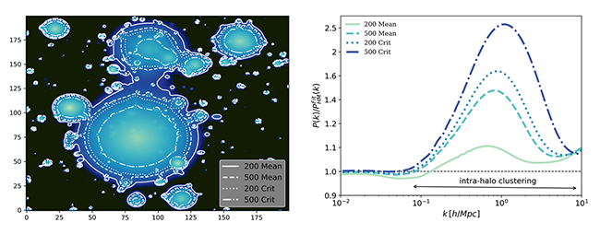
Prediction of non-linear matter power spectrum
The knowledge of how matter (dark and ordinary) is distributed in galaxies and in the large-scale structures in the Universe is the main goal for next-generation cosmological observational surveys
To assess the cosmological information obtained through these surveys, one must be able to predict the matter clustering using simulations and analytical methods to a similar accuracy level (below 1%) for a given cosmology
Both numerical simulations and analytical models will make predictions of matter clustering and, in turn, allow for data from future telescopes to be interpreted
Credit: Alberto Acuto

Slide 12
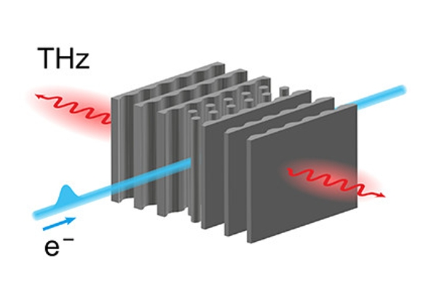
Inverse-Designed Narrowband THz Radiator for Ultrarelativistic Electrons
Particle acceleration by THz lasers through a dielectric material have the potential to unlock small, low-cost, table-top accelerator devices for the use in medicine, material research, and communication.
The acceleration process and beam quality heavily depend on the dielectric structure, specifically, the form-factor of the internal surfaces.
Inverse-design technique is an approach which does not rely on pre-defined shapes. Instead, the algorithm constructs a structure which maximises a chosen set of objective quantities.
Such Finite-Difference Frequency-Domain simulations allow for the exploration of the full parameter space without relying on the imagination of the user.
Credit: Gyanendra Yadav

Slide 13
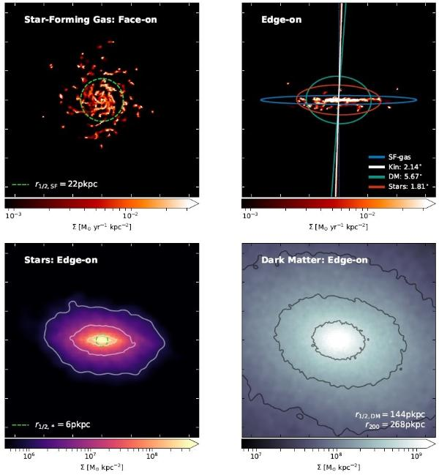
The morphology of star-forming gas and its alignment with galaxies and dark matter haloes
Imaging of galaxies in the radio continuum enables weak lensing experiments that complement traditional optical approaches.
Radio emission may be traced in simulations by tracking the star-forming gas, allowing studies of systematic uncertainties in lensing, such as the intrinsic alignment of galaxies.
This allows for a systematic study of the expected shapes and orientations of the cold gas of galaxies and host dark matter halos ahead of future observations.
Credit: Alex Hill

Slide 14
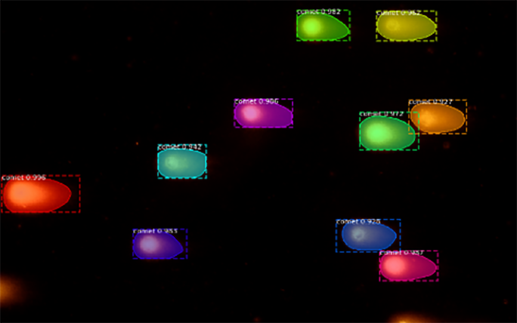
The Modelling and Analysis of Comet Assay
Data
Comet Assay is a technique of measuring the amount of DNA damage induced by exposing cells to ionising radiation
The procedure can be greatly improved (both in the speed of processing and accuracy) by employing machine learning and computer vision algorithms
By modelling the objects, it is possible to learn a lot about the interaction between radiation and DNA
The combination of the two approaches could result in revolutionary advances in cancer treatment
Credit: Selina Dhinsey

Slide 15
Industrial placements: going beyond academia
6-month placements which must be different from their field of study
Students free to choose the host company, encouraged to step outside the comfort zone
Allow them to see the full spectrum of opportunities outside of the University environment
Apply their existing technical and soft skills
Learn new skills and technologies
Experience the environment from within
Partners gain highly motivated and ambitious interns
Bring their skills from a very different discipline
Provide a low-risk opportunity to explore new directions and opportunities in R&D

Slide 16

Ricardo’s work with Unilever
Ricardo works on new heavy gauge boson searches and interpretations at the ATLAS experiment, one of the main detectors at LHC.
In early 2020, Ricardo worked on bringing Machine Learning techniques to two of the robots at MIF to reduce the amount of manual input required in their image processing system.
“I’ve learnt a lot during these months, not only programming skills I didn’t have before, but also knowing what is like to program something that will be used by someone else, getting to know the developer-user feedback cycle, as well as how working in industry differs from working in academia”.
Unilever, a multinational consumer goods manufacturer, maintains and active partnership with the University of Liverpool at the Materials Innovation Factory. The centre bridges industry partners like Unilever with the University’s expertise in material chemistry, tackling common challenges in academia and industry to deliver innovative products.

Slide 17

Phil’s placement at OnTrac
Phillip works on a project focussed on Deep Learning applications on data from the LHCb Detector.
During the first 6 months of 2020 he applied his skills at a placement with OnTrac, a company that creates software products for the railway industry.
“… we produced a dashboard using Microsoft Power BI to visualise the data and prototype a product that could help contractors see if they were meeting targets for productivity, and importantly - safety, without having to collect and compile data manually from their employees, which is the case now. A highlight for me was being able to demonstrate my prototype to a key client in order to get opinions on what they liked and what could be improved.
OnTrac specialise in the area of track worker safety and produce a system that enables contractors to plan work safely on live railway lines.

Slide 18

Selina’s time at Chanua
Selina works on a computer vision project, aiming to automate the process of quantifying radiation-induced damage to cell DNA.
During her placement, she worked with a start-up service Chanua, developing their latest mental health and wellbeing platform aimed at young people.
“I’ve spent a lot of time becoming familiar with the Amazon Web Services architecture, and seeing how they can aid data analytics. Some work I’ve done has even surrounded the social media and YouTube realm, something that I really didn’t expect but have thoroughly enjoyed.”
Chanua supports and develops initiatives that empower people to improve their health, mental health and wellbeing. They create services and products that foster healthy connections, mixing human centred approaches, technology, psychology and good design.

Slide 19
Joaquín’s time in the travel industry
At LIV.DAT, Joaquín studied the formation and evolution of Milky Way-like galaxies from both a theoretical and an observational point of view.
In 2020, he spent 6 months with online travel company eDreams Odigeo where he worked within the Data Science department’s fraud team.
“The best aspect of this placement is that I created a deliverable that I know the company will continue to use in the future and it will be very helpful. My placement had a positive impact on the company and will continue to do so in the future. In addition, I got to know different programming tools and coding libraries they have internally developed, as well as a real grounding in SQL which I found really valuable.”
eDreams ODIGEO is one of the world’s largest online travel companies and one of the largest European e-commerce businesses.
Operating in 44 markets, they are globally the 2nd largest flight retailer and the largest in Europe. They serve over 17 million customers per year, connecting them with over 690 airlines.

Slide 20
Seminars
Goal: to expose our students to ideas and concepts that they would not encounter every day
Virtual seminars to maximise the potential speaker variety
Common theme: data analysis, computing, machine learning
We’ve been running spring and autumn series since LIV.DAT launched
Speakers: junior and senior researchers, industry representatives
Topics:
  Nano-electronics Design Gravitational Wave Analysis
  Cardiovascular Risk Prediction Sea Surface Temperature Observations
  Nuclear Power Generation Transport and Electricity Infrastructure
  Distributed Computing Cancer Drug Testing
  Industrial Data Science and more…

Slide 21
Looking Back and Going Forward
With students having graduated or about to graduate, LIV.DAT has proven to prepare students for a wide range of careers
This is expected to continue and evolve with LIV.INNO:
Projects remain the central part of the PhD
New addition of 50:50 studentships with industrial partners – early planning and agreement is crucial
Innovative and unconventional project ideas are welcome: LIV.INNO is moving away from the traditional disciplines towards interdisciplinary challenges, informed by industry needs
Placements have fulfilled their objectives and will continue; new partners welcome
Student training will, of course, continue with seminars, workshops, specialised schools, etc.
More focus on asynchronous learning to better suit the varying schedules of students

Slide 22


