Slide 1
The Development of Graph Accelerated PSA Algorithms for AGATA
Fraser Holloway

Slide 2
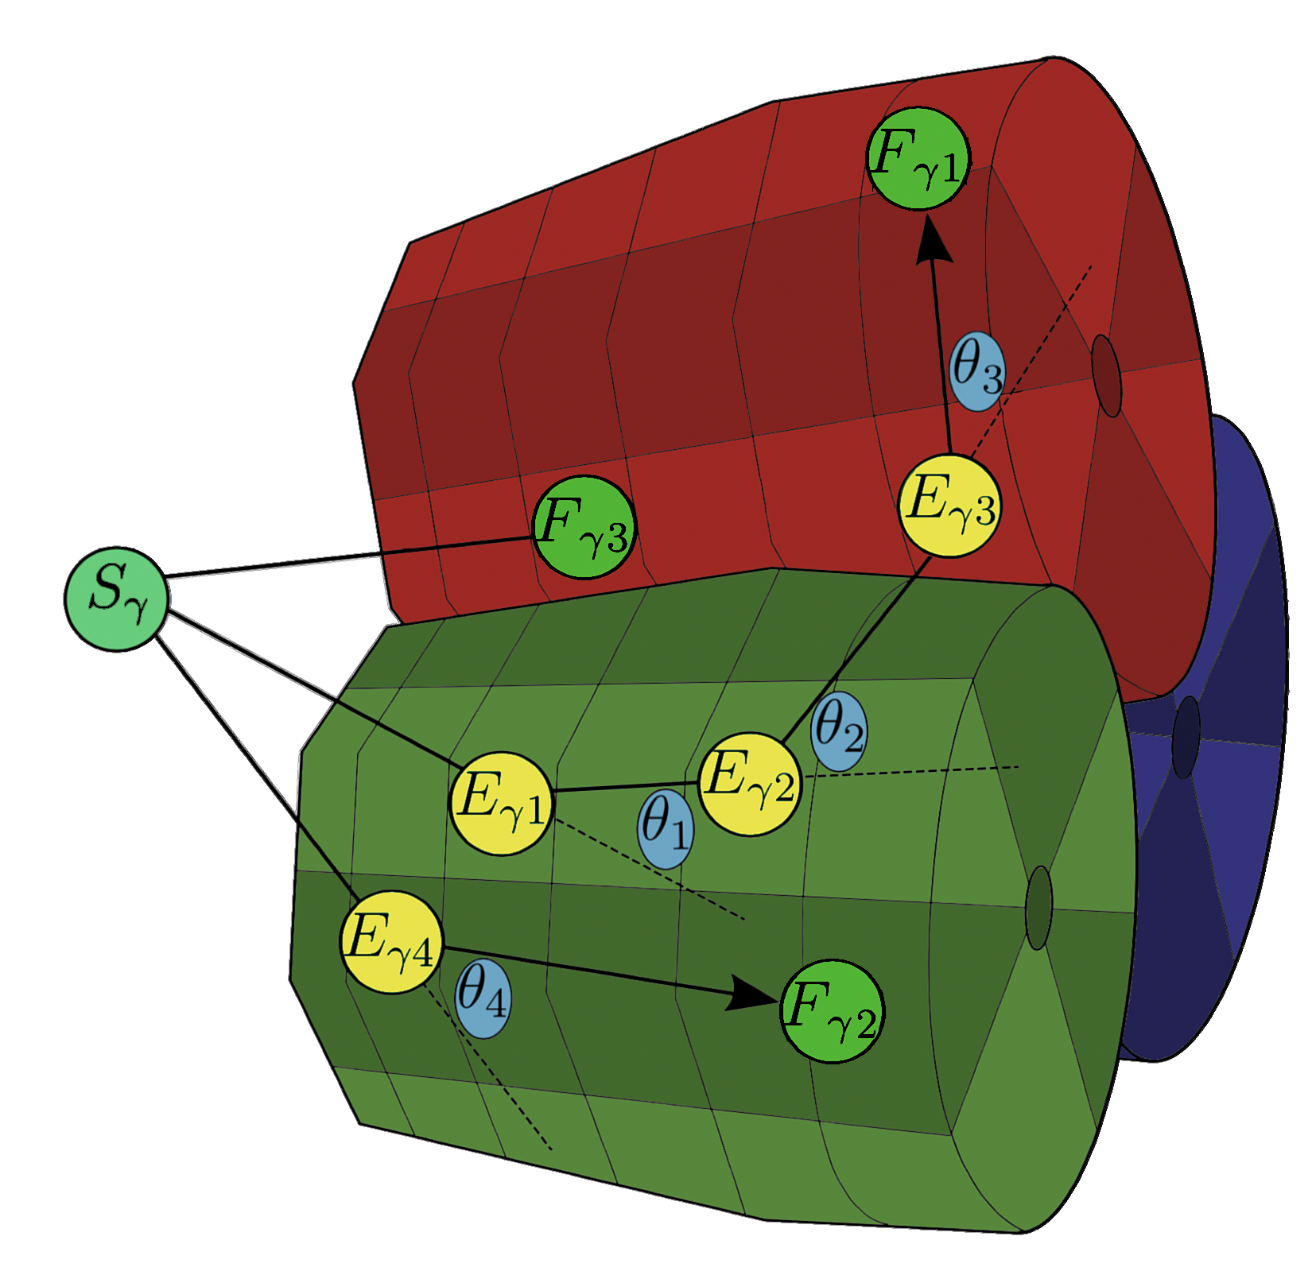
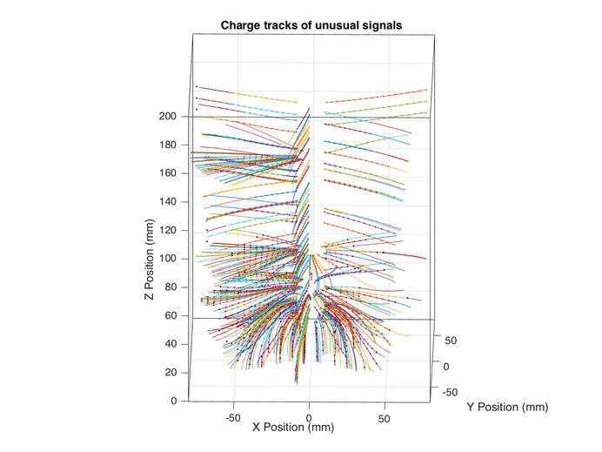
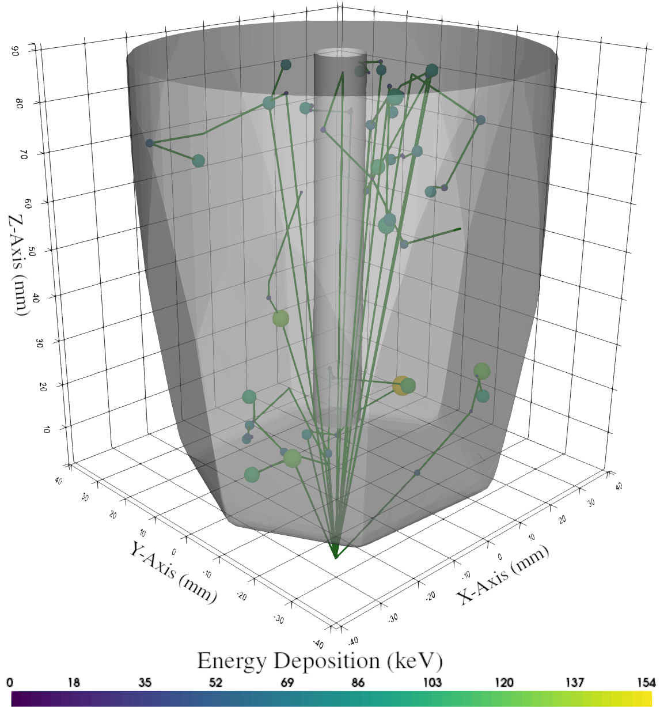
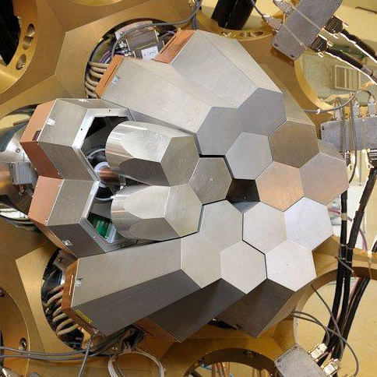
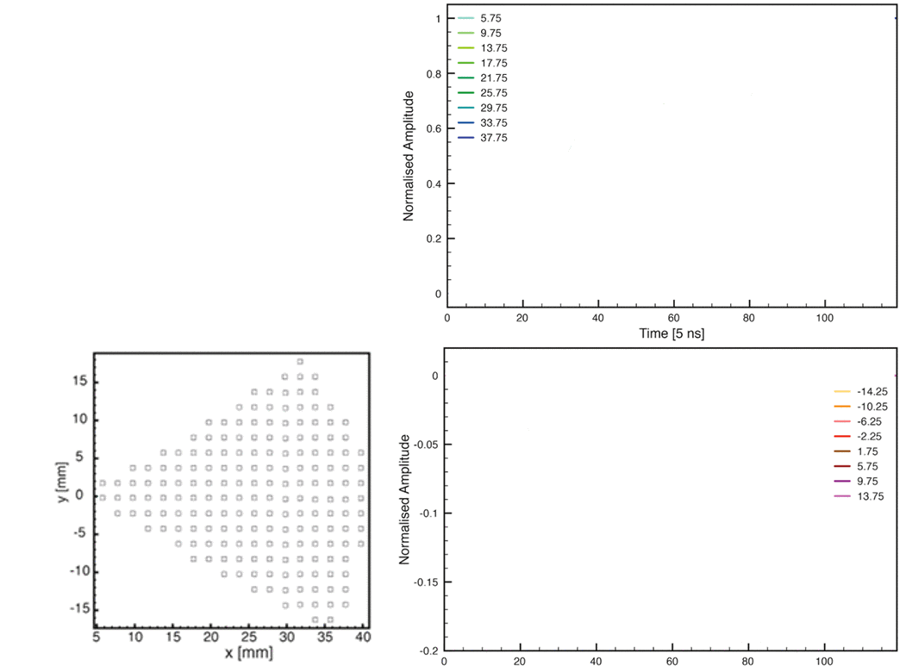
What is AGATA, GRT & PSA?
AGATA is the Advanced Gamma Tracking Array
Supported by 200 researchers & 30 institutions.
It is used for studies into nuclear structure at RIB facilities.
Gamma-ray tracking (GRT) is used to track photons passing through the array & reconstruct their energy.
AGATA uses Pulse Shape Analysis (PSA) to perform GRT
PSA compares experimental & simulated signals to quickly localise interactions.
Complex simulation is required:
GEANT4, Electrodynamics, condensed matter.
AGATA produces a significant amount of data:
~360GB/s raw data rate
My PhD was focused on developing PSA methods.
Hit Segment
Transient Segment
AGATA 15-crystal configuration
$γ$-ray tracking in AGATA
B.Bruyneel – Eur. Phys. J. A (2016)

Slide 3
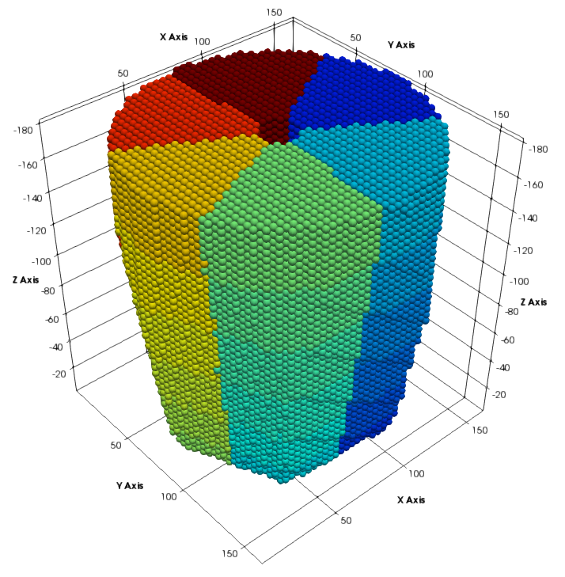
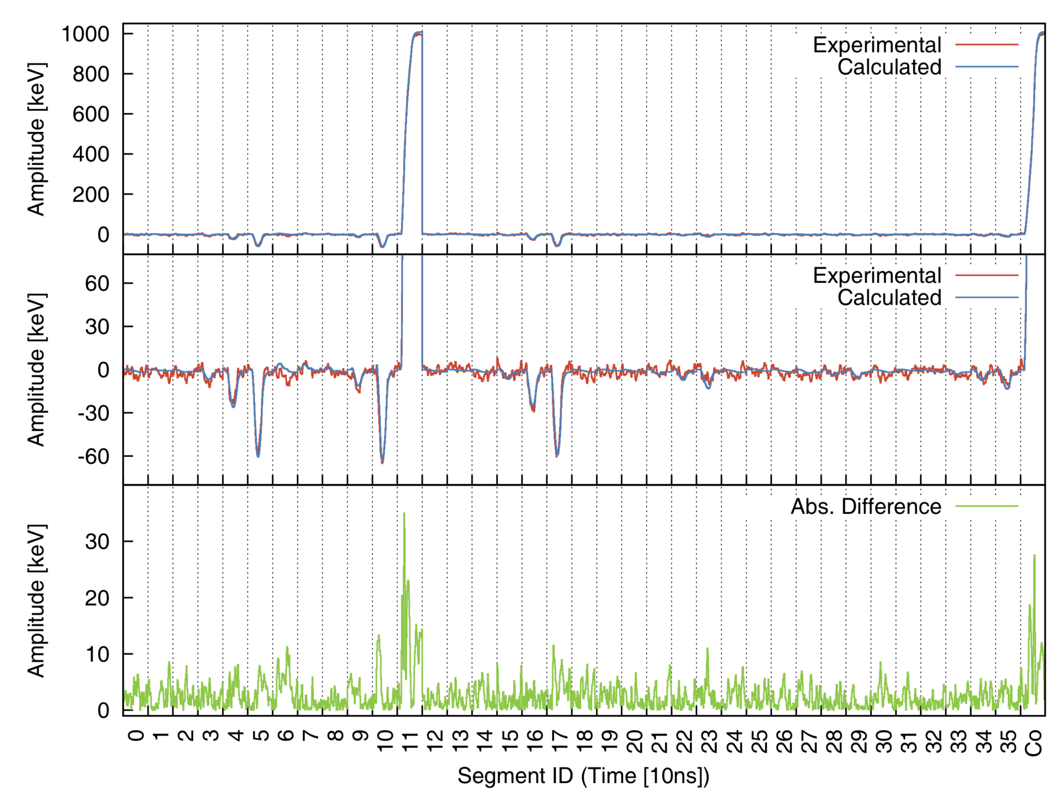
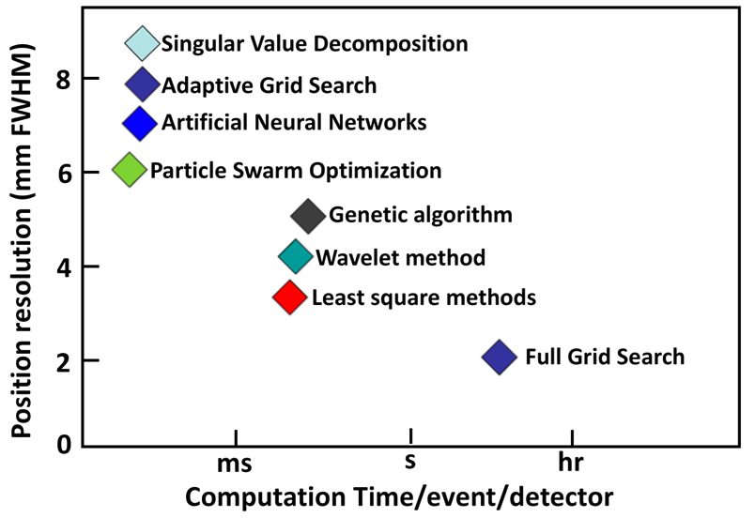
Pulse Shape Analysis in AGATA
Pulse Shape Analysis is used to quickly localise $γ$-ray interactions by comparing experimental signals against a precomputed response.
Every crystal is simulated to generate a full volume response (basis).
PSA must find the closest match in the basis reliably (< 2.5mm FWHM) at > 2.5kHz per crystal.
Otherwise the signal must be stored and processed offline at great cost to the end user.
The significant requirements for effective PSA have proven difficult to achieve for over a decade.
A LIV.DAT project was created to provide new perspective on the problem & apply methods not common to Nuclear Physics.
AGATA Basis

Slide 4
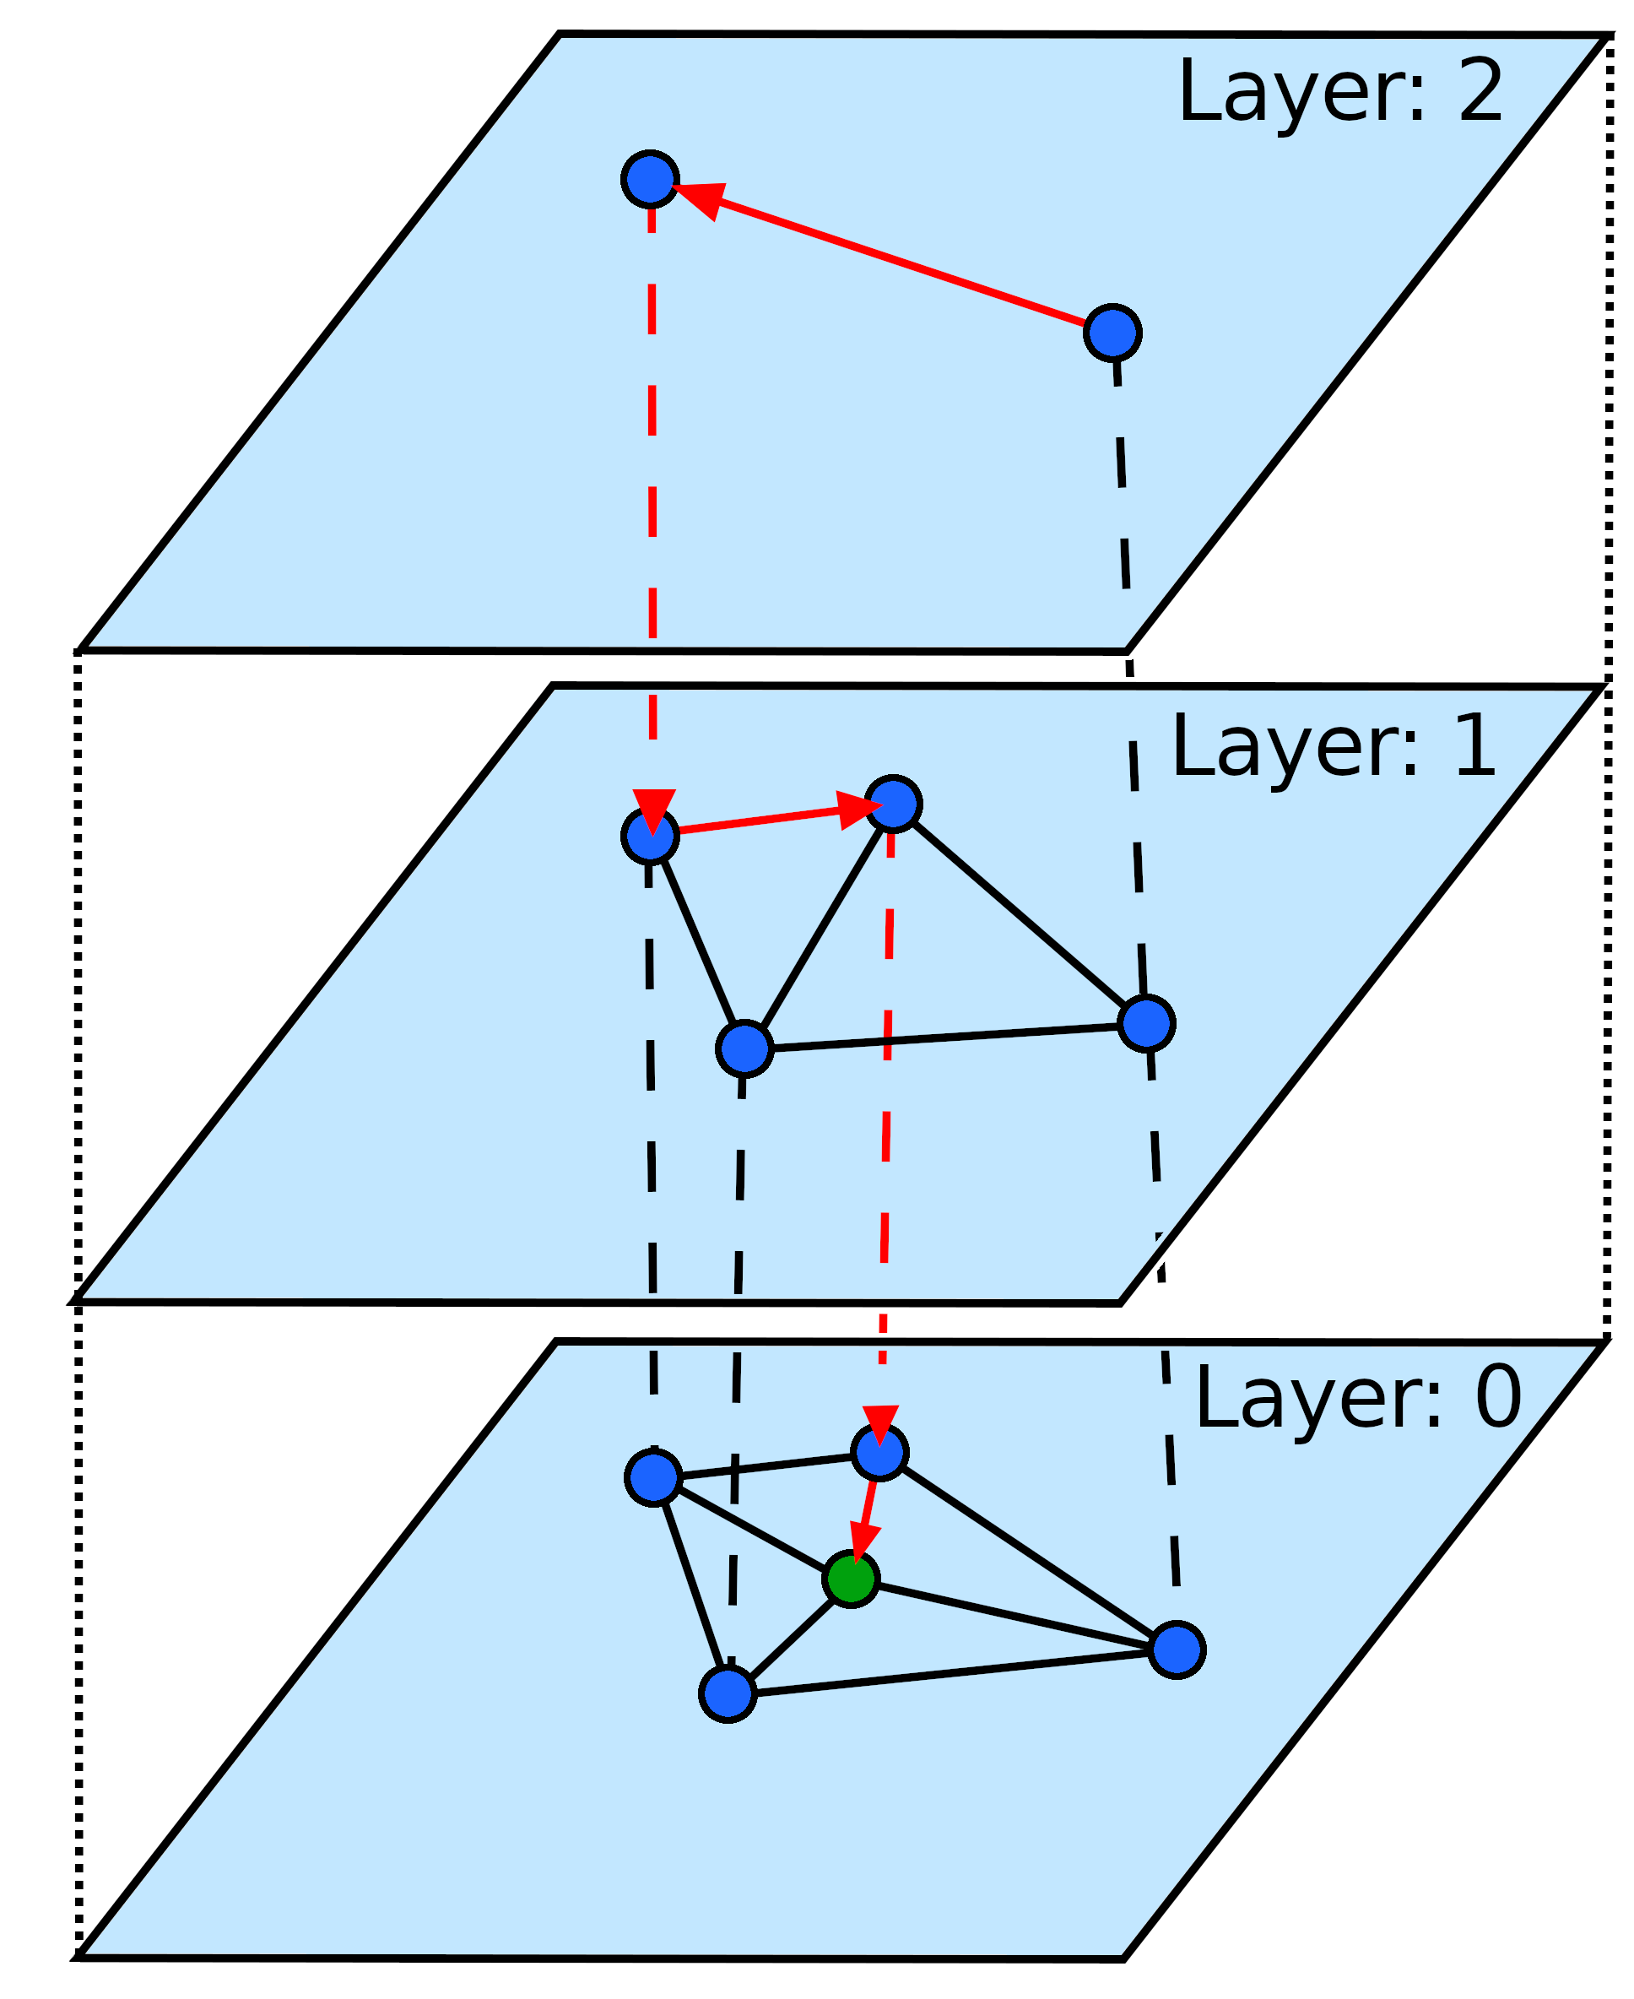
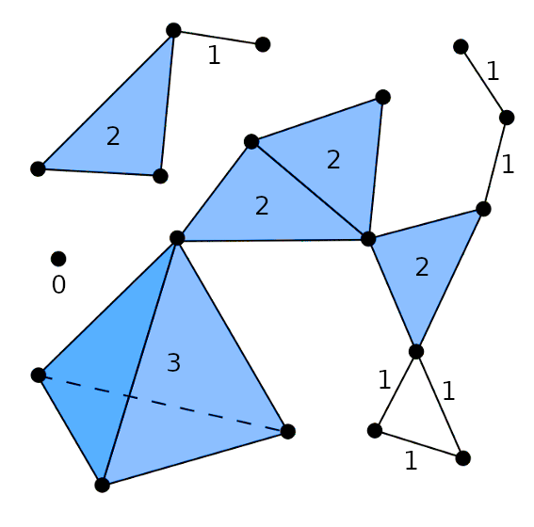
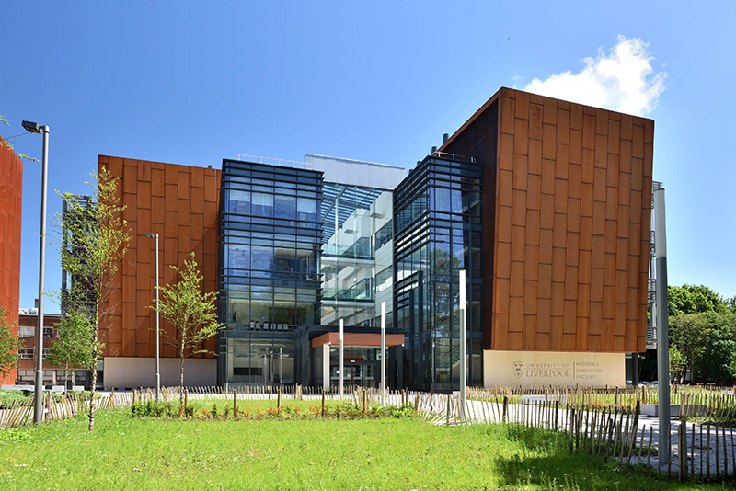
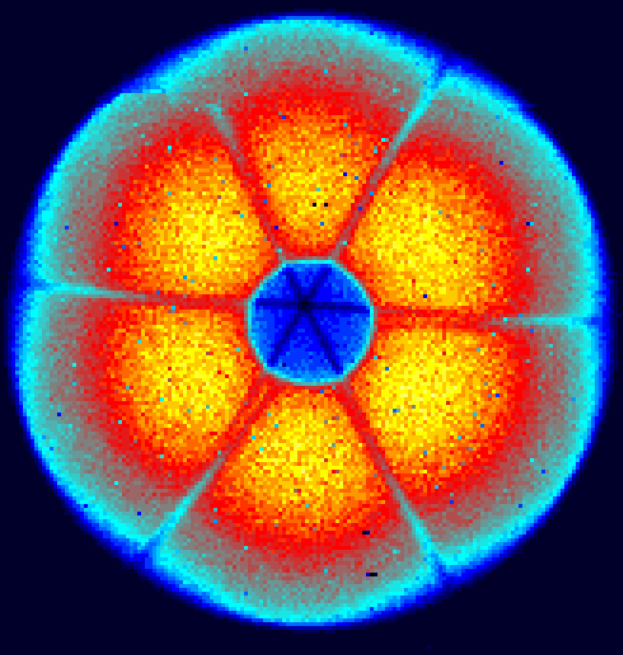
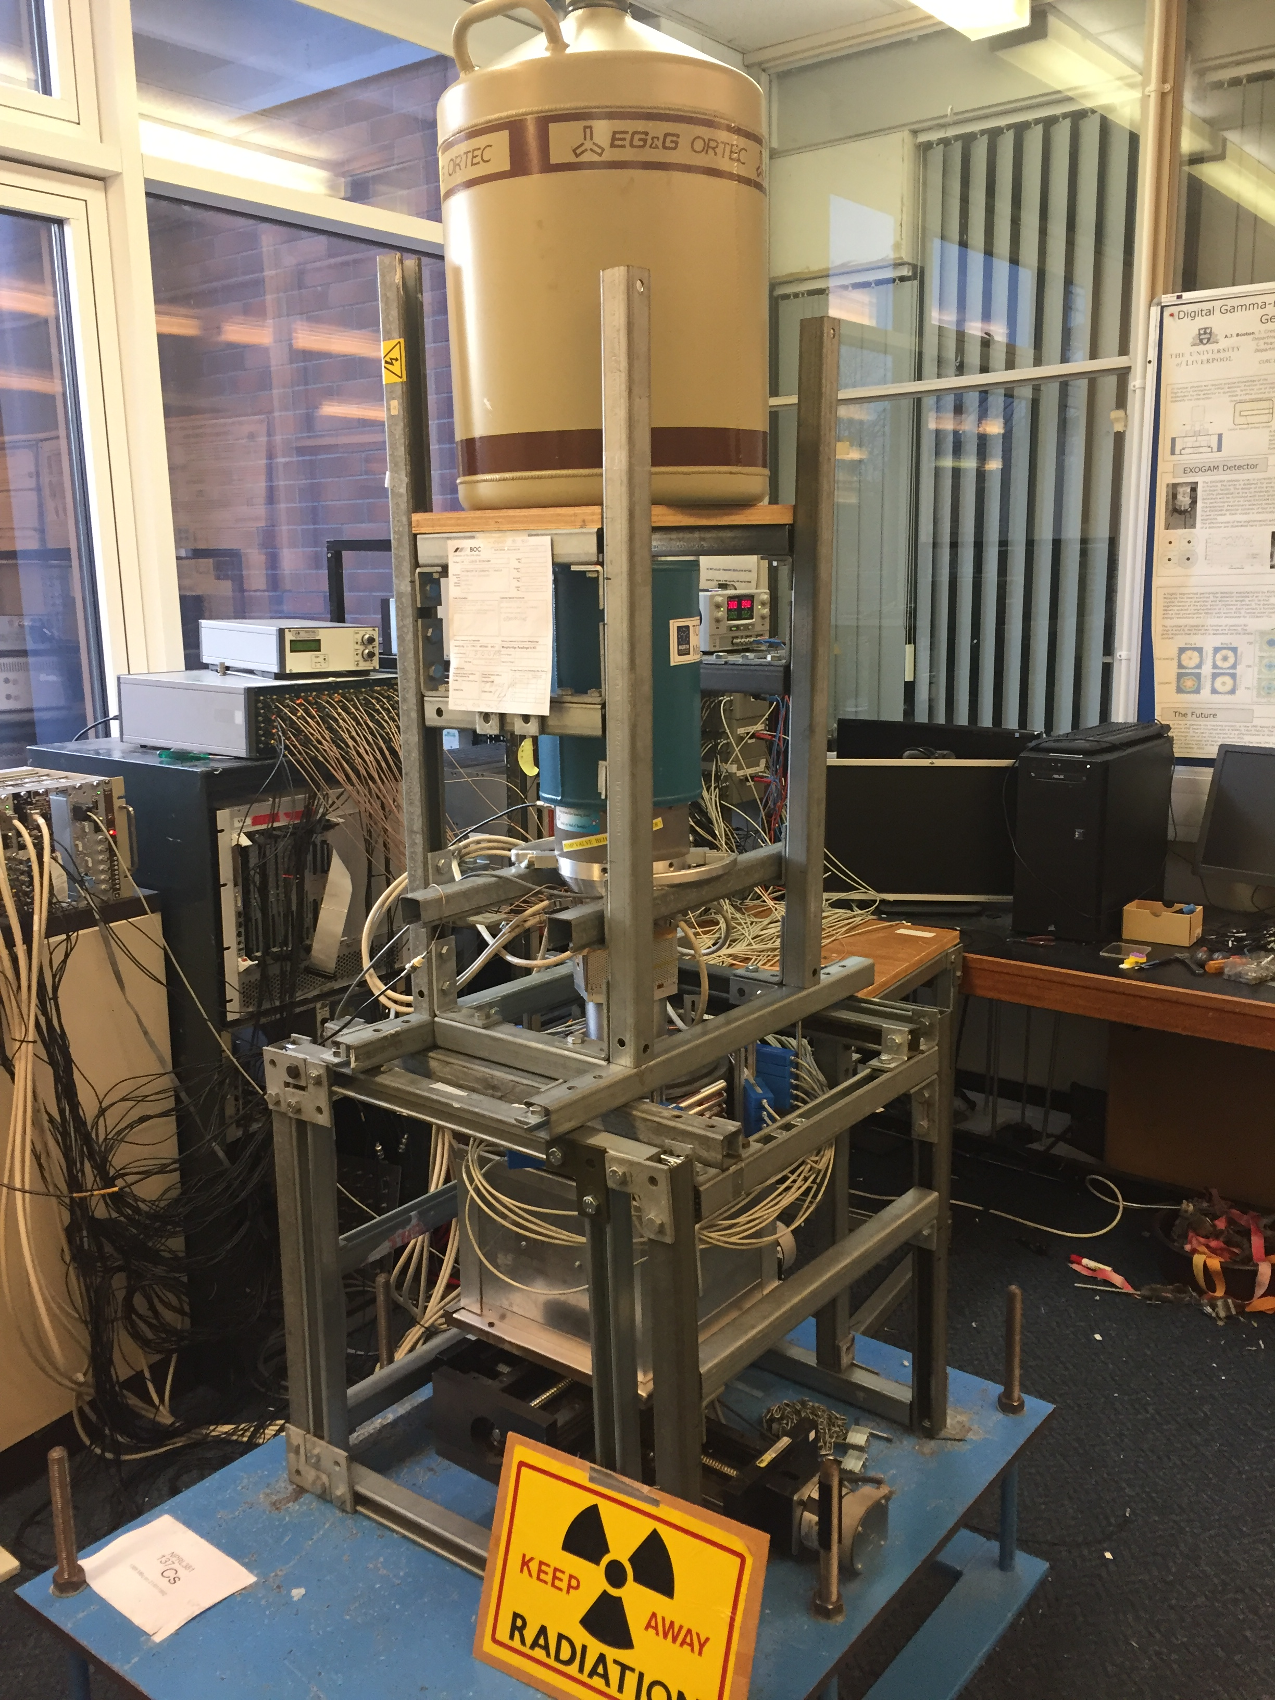
Nuclear Physics & Data Science
Due to the data-centric focus of my PhD I was paired with colleagues in the Materials Innovation Factory.
Linked with Comp Sci for strong industry-academic collaboration with world-leading facilities.
They specialise in data analytics and Topological Data Analysis for crystal compositions.
This allowed for a dual-discipline approach to my PhD.
Experimental:
Hands-on data acquisition
Scanning
Characterisation
Conceptual:
Novel algorithm development
Interpreting & visualising data

Slide 5
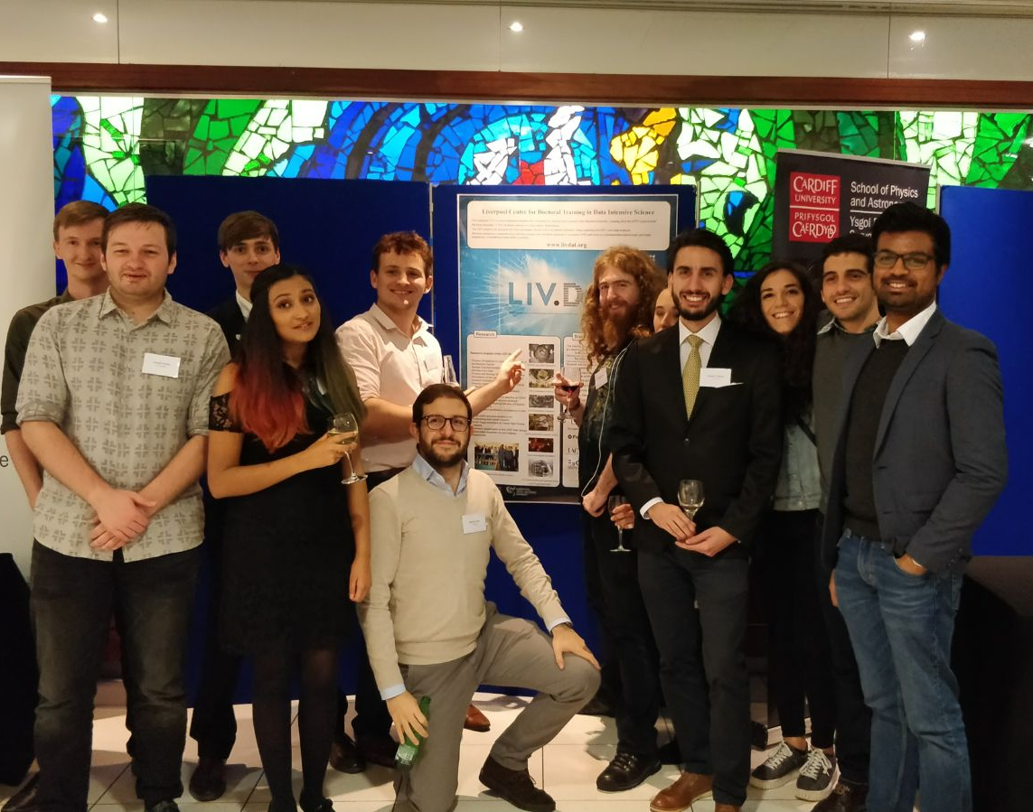
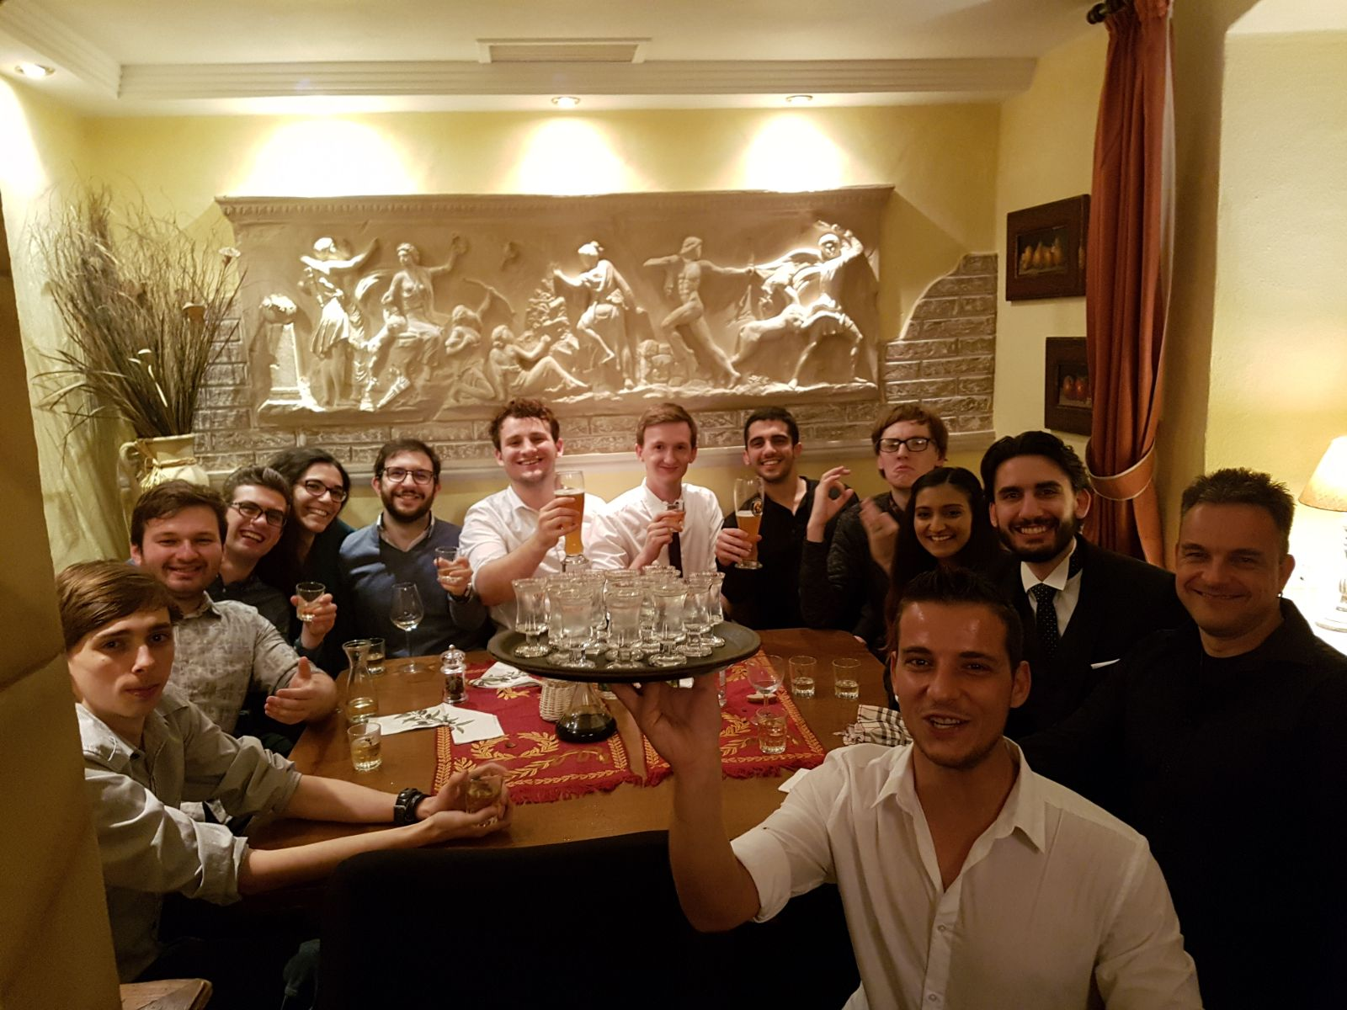
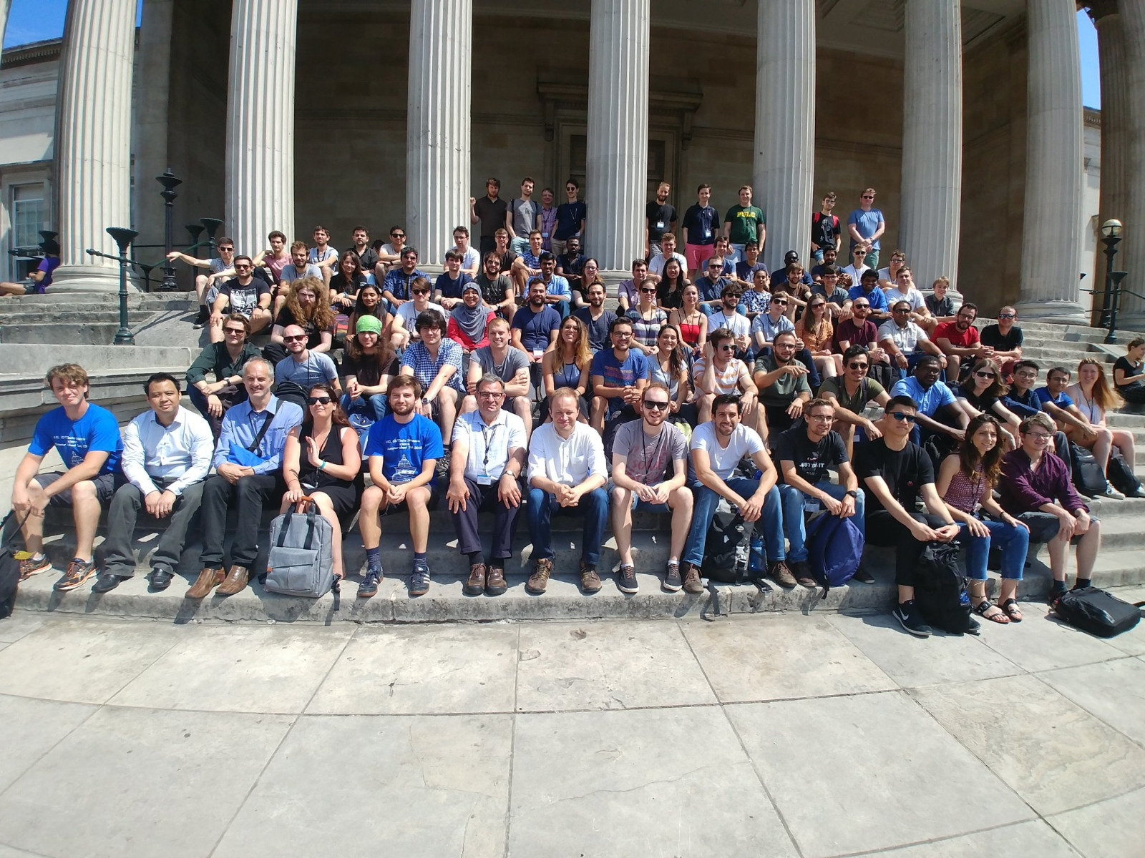
Data Specific Training
LIV.DAT provided a lot of data-specific training courses:
60-credits of Comp-sci courses at UoL & JMU
CDT week in Cardiff
Monte-Carlo & simulation school in Munich
Machine Learning school at UCL
HPC school with Tech-X
PhD skills & communication week at UoL
Poster & outreach days
LIV.DAT seminar series
Everything was cross-discipline to compliment field-specific training.
Helped build strong friendships & support across research clusters.

Slide 6
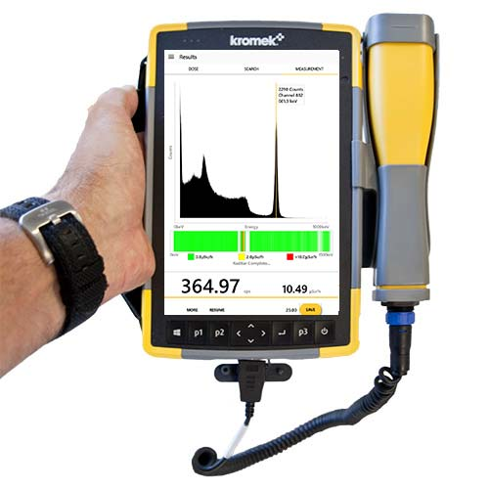
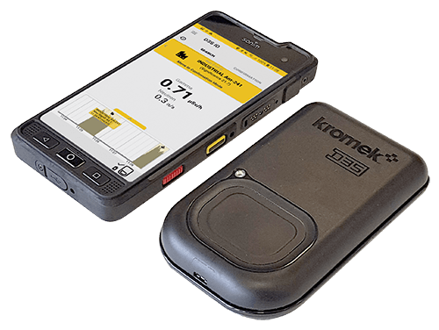
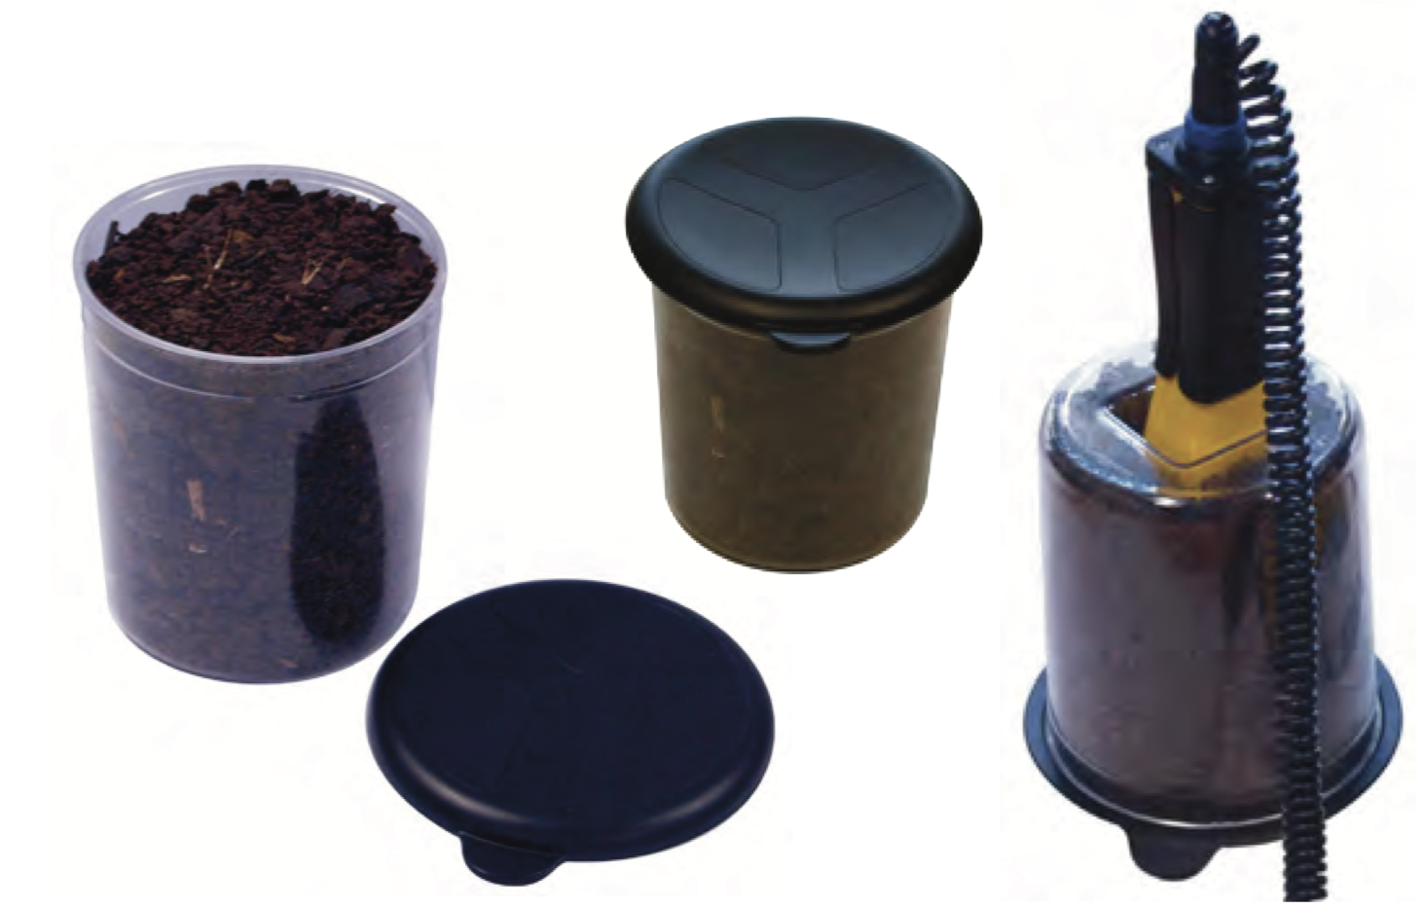
Improving Links with Industry
All LIV.DAT students completed a 6-month industrial placement as part of their funding requirements.
I was paired with Kromek, a company that manufactures radiation detectors for security applications.
My work was on detecting harmful materials in X-ray images.
The placement provided valuable insight into work outside academia.
Helped me learn more standardised practices.
Promotes further collaboration with Kromek on future projects.

Slide 7
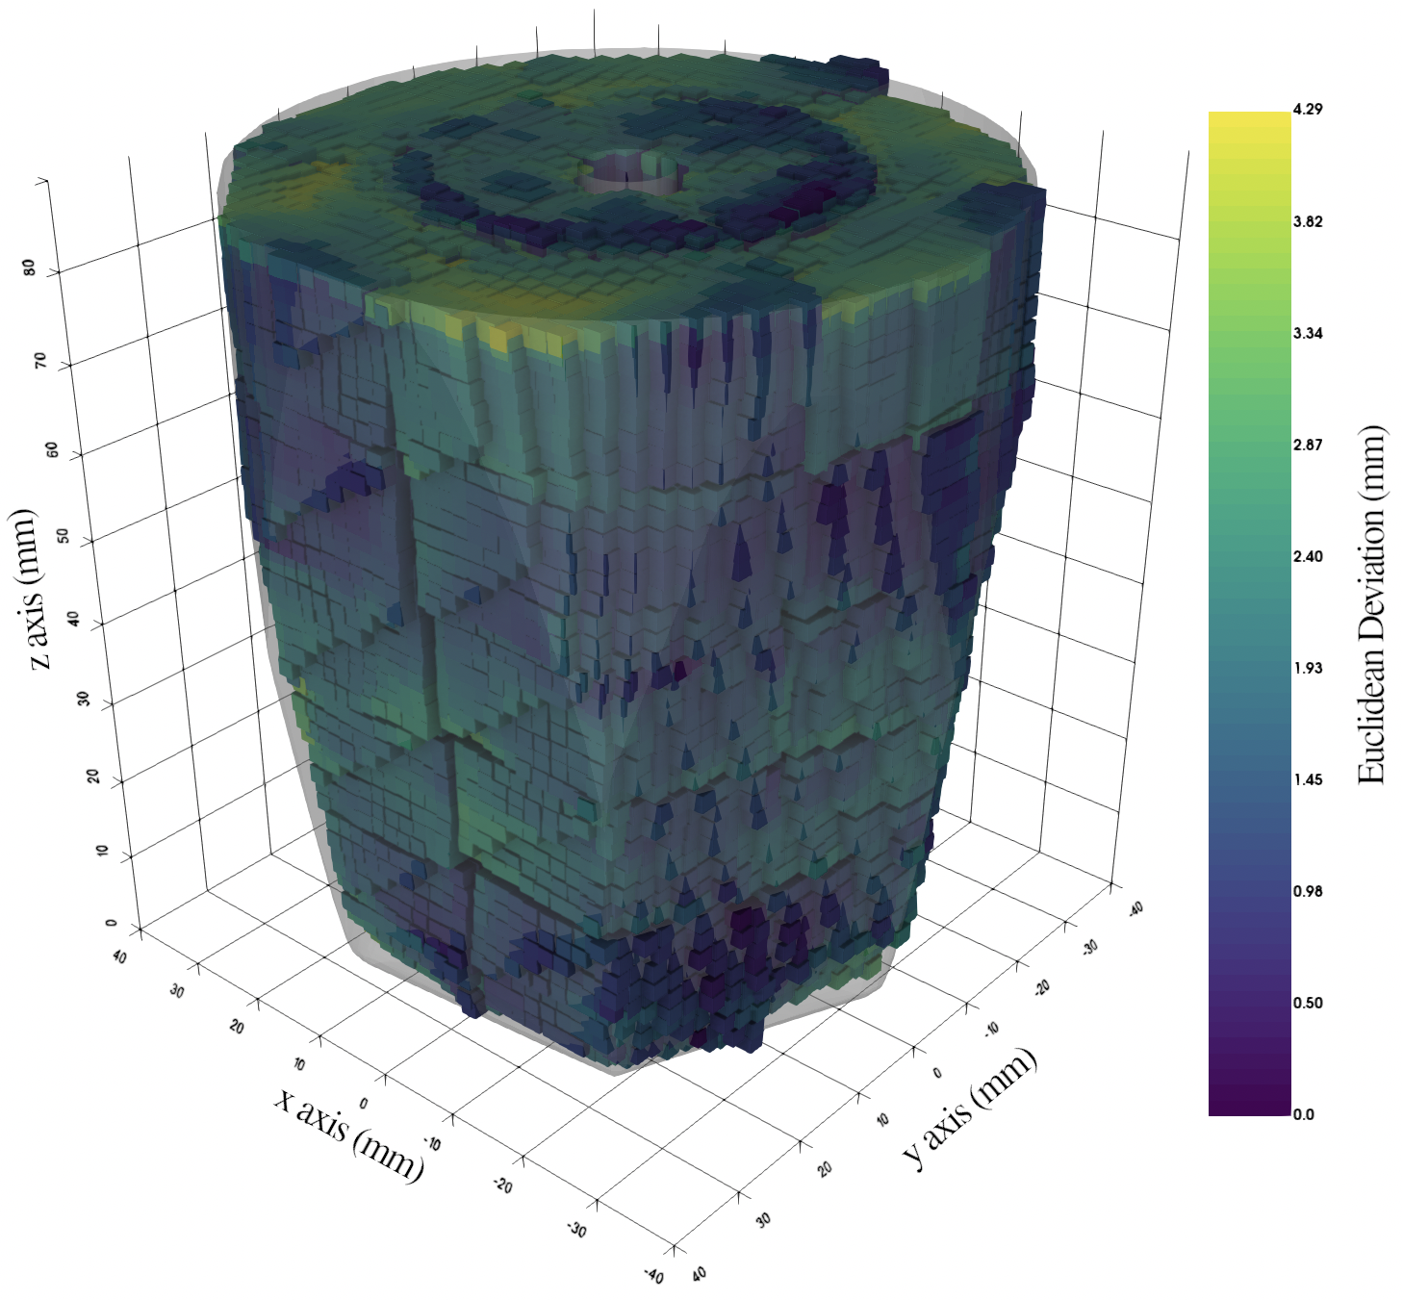
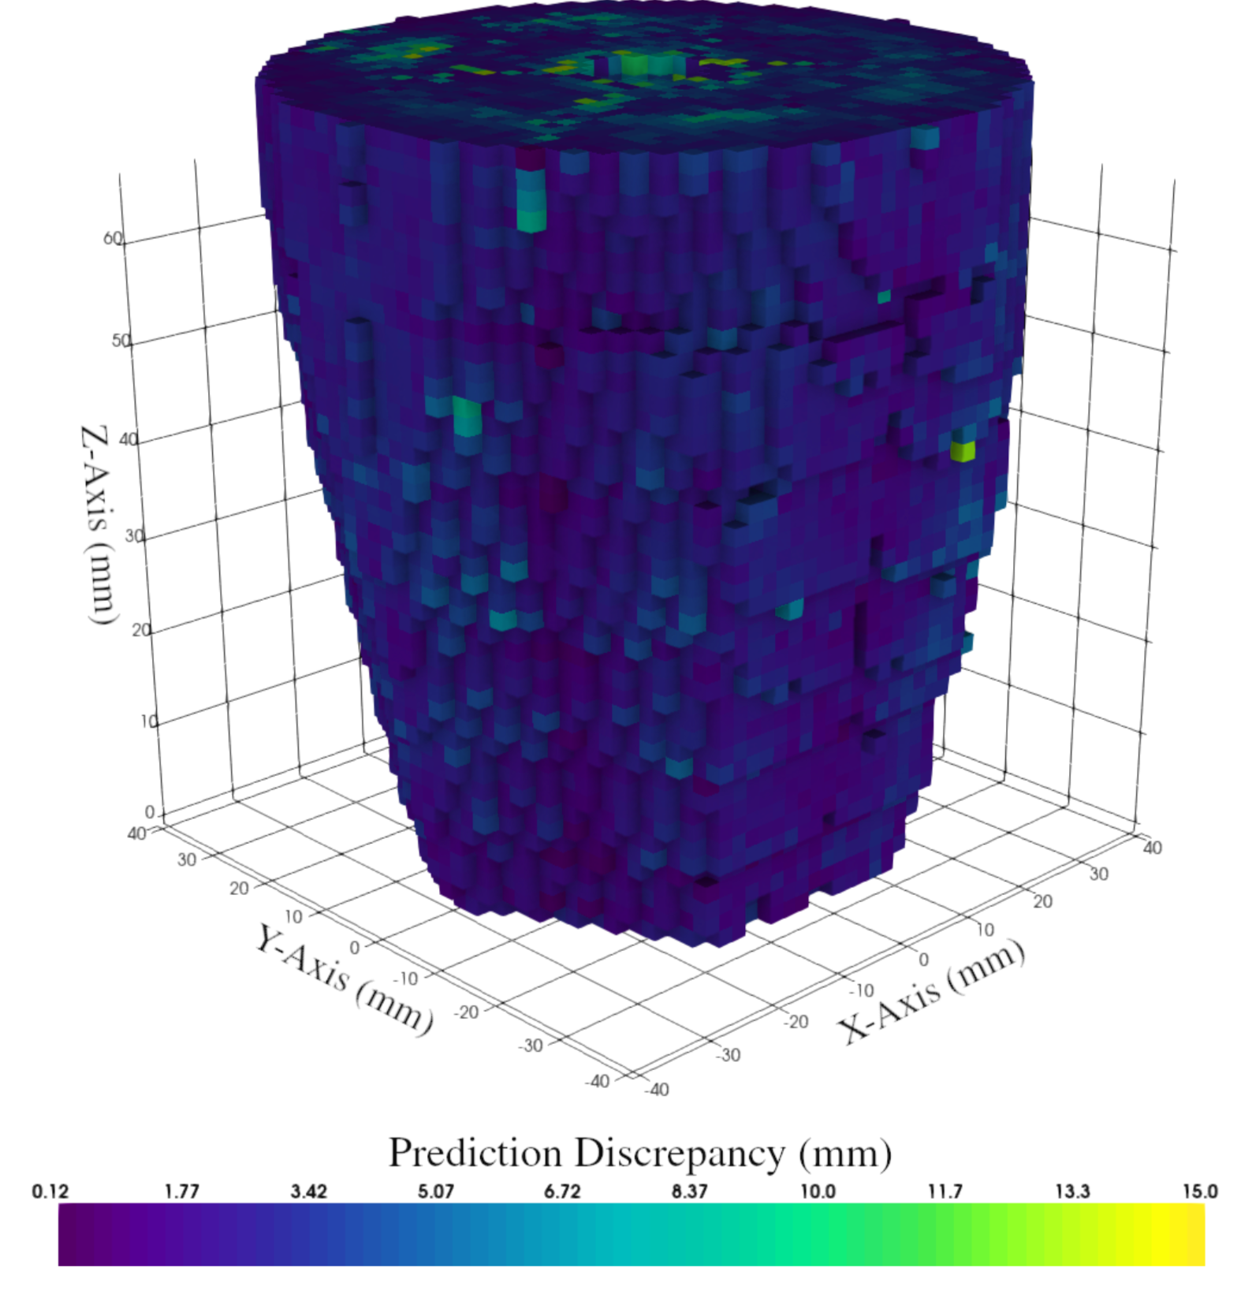
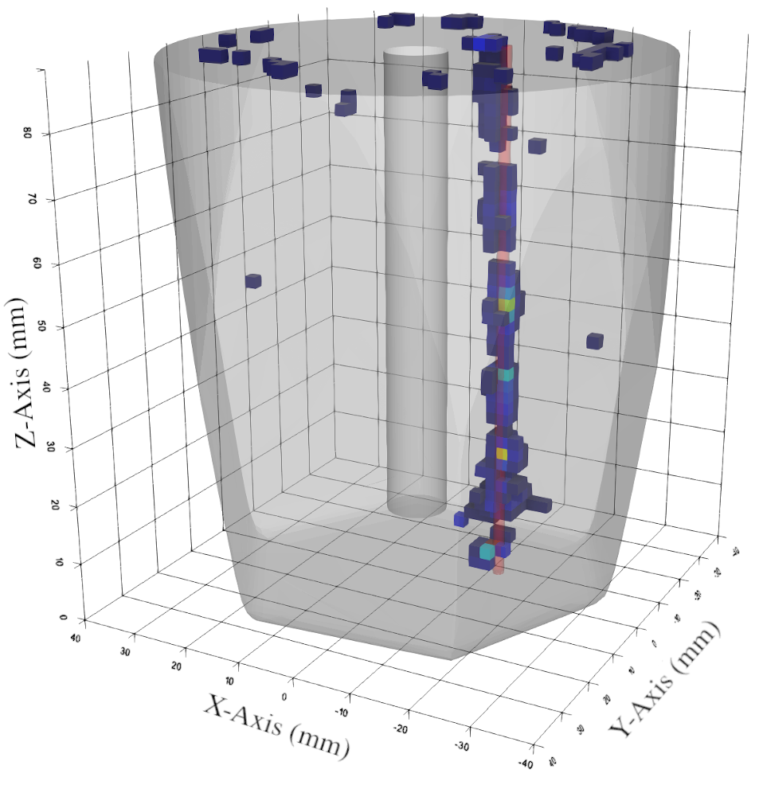
Pulse Shape Analysis in AGATA
I developed & profiled several methods in my work:
Graph-accelerated techniques:
$k$D-Trees
Maximum Kernel Search
Locality-Based Sensitivity Hashing
NanoFLANN
HNSWLib
FAISS
$M$-Trees
Machine Learning techniques:
FF-CNNs
Auto-Encoders
Manifold Learning
Method | Execution Rate | 1-recall at $σ$ = 0.05
AGS | 1.5kHz | 76.2%
True Exhaustive | 1.5Hz | 88.5%
100D Exhaustive | 200Hz | 84.7%
CNN | 1.5kHz | N/A
$k$D-Tree | 8.0kHz | 82.2%
LSH | 25kHz | 79.6%
MKS | 12.5kHz | 79.6%
HNSWLIB | 180kHz | 80.1%
NanoFLANN | 20kHz | 80.2%
FAISS (CPU) | 5.0kHz | 80.4%
FAISS (GPU) | 430kHz | 80.4%

Slide 8
Research Outcomes & Future Developments
As a direct consequence of my work the AGATA collaboration are moving forward with my PSA algorithm suggestions.
I am working on GPU-accelerated High-Fold PSA for AGATA as part of a 2.5yr Postdoc position.
We are investing in GPU-accelerated hardware and optimising our processing pipeline to properly utilise modern hardware.
The improvement in processing rates has opened up new avenues of research:
More advanced detector bases
Complex Gamma Tracking methods
Self-calibration techniques
This work will continue to put AGATA at the forefront of Nuclear Physics research.

Slide 9
Thanks for Listening
Any Questions?

