Slide 1
Application of dielectrics in accelerators and radiation extraction
Gyanendra Yadav
PhD student, University of Liverpool

Slide 2
Electron acceleration in free space
CAS Sesimbra, March 2019

Slide 3
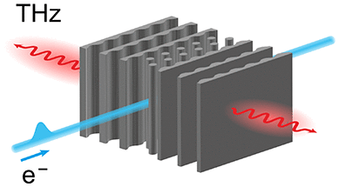
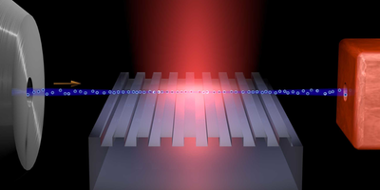
Smith Purcell and inverse Smith Purcell effect
Compact and cost-effective alternative for THz generation and electron acceleration
H. Benedikt et al, ACS Photonics, 2022
J. Breuer and P. Hommelhoff, 2013
Notes:
The typically used single-sided gratings emit a broadband spectrum, (15) which is dispersed by the Smith–Purcell relation. Dielectrics can sustain higher electric fields than metals (due to electric breakdown) enabling stronger interaction between electrons and the structure and higher efficiencies.

Slide 4
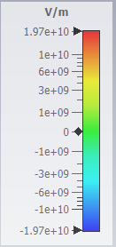
Accelerator’s phase space optimization study
Grating geometry and general parameters
Laser parameters: wavelength = 1.06 mm, Pulse duration = 20 ps, intensity ≈ 10¹⁶ W/m2 , peak input field = 4 GV/m
Electron bunch parameter: Energy = 50 MeV, longitudinal rms bunch length = 30 𝜇m, transverse rms radius = 2.5 𝜇m, initial energy spread = 0.005%
Fig: Contour plot of the longitudinal electric field inside the structure
Dielectric constant = 11.59 (silicon), Parameters are optimized for maximum energy gain. CST Studio suite is used for FDTD simulation and particle tracking

Slide 5
Accelerator’s phase space optimization study
Bunch focusing at the start of the dielectric grating structure
Fig: Electron bunch is made to focus at the entrance of the dielectric grating geometry and the laser phase delay is scanned. Energy gain above 5 MeV.
At 75◦, final emittance is decreased by 12 %
At 120◦, final emittance is increased by 7 %

Slide 6
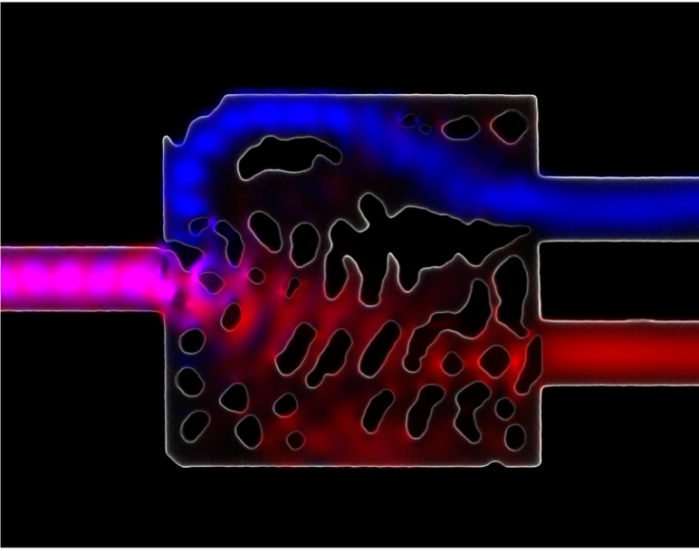
Necessity for an inverse design
Most Integrated photonic devices are still designed by hand.
Brute-force approach to optimize a handful of parameters using analytic theory.
Enormous fabrication space. For a silicon photonic device of 1 $μm$² with a pixel size of 0.1 $μm$, 2¹⁰⁰ devices possible.
Algorithm exists for design in aerospace engineering etc. but nanophotonics is relatively new.
Inverse Design of Photonics | Nanoscale and Quantum Photonics Lab (stanford.edu)

Slide 7
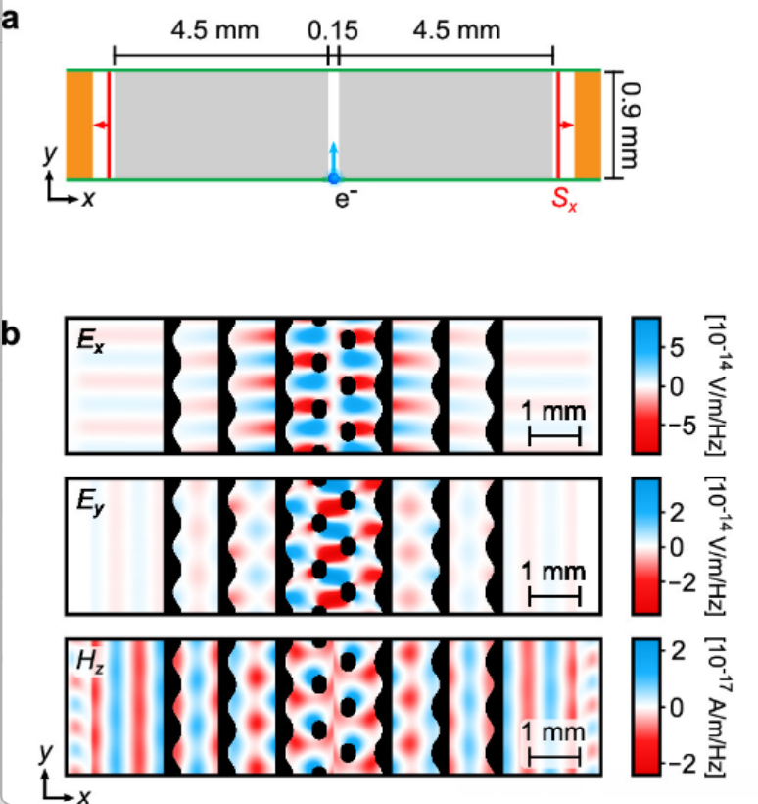
Inverse design of THz radiator
2D finite difference frequency domain (FDFD) simulation of a single grating period
The Poynting vector S_{x} was calculated outside the design region and served as the objective function of the optimization
Optimized 2D design: structure material (black), vacuum (white), and associated electromagnetic field spectral density of the transverse-magnetic mode (red-blue).
GitHub - fancompute/ceviche: Electromagnetic Simulation + Automatic Differentiation
Notes:
Periodic boundary conditions were used. Forward mode differentiation method. A key step lies in the parametrization of the structure ε(ϕ) through the variable ϕ in a way that ensures robust convergence of the algorithm and fabricability of the final design. where large values of α yield a close-to-binary design. So the algorithm provides more than one images and We restricted ourselves to shapes with round features such that we would be able to actually fabricate them in a 3D printer.

Slide 8
Fabrication by 3D printer
Laser based additive manufacturing technique
High temperature resin as a dielectric material.
Vacuum compatible
Device resolution = 140 $μ$m
Structure was scaled to 45 mm length and 6 mm hight.
Grating periodicity = 900 $μ$m
Notes:
A high-temperature resin was used as a dielectric material as it had high vacuum compatibility after being cured in a heated vacuum chamber. The resin used for this study can be heated to 235 °C. no outgassing till this temperature.

Slide 9
Results
Measured signal (black) is compared to 3D time-domain (green) and frequency-domain (orange) simulations. The gray area indicates the acceptance window of the spectrometer, defined by the angular acceptance of the Michelson interferometer. The narrowness of emission originates from the high mode density inside the micro resonator formed by the two distributed Bragg reflectors on each side of the electron channel.
Notes:
Fourier transform of autocorrelation measurement. The measured spectrum is centered around 881 μm (0.34 THz) and has a full width at half-maximum of ∼9%

Slide 10
Secondment 1: tethir
Aim: Designing high speed internet system for trains
Free space optical communication
Link budget, power budget, enhancing field of view

Slide 11
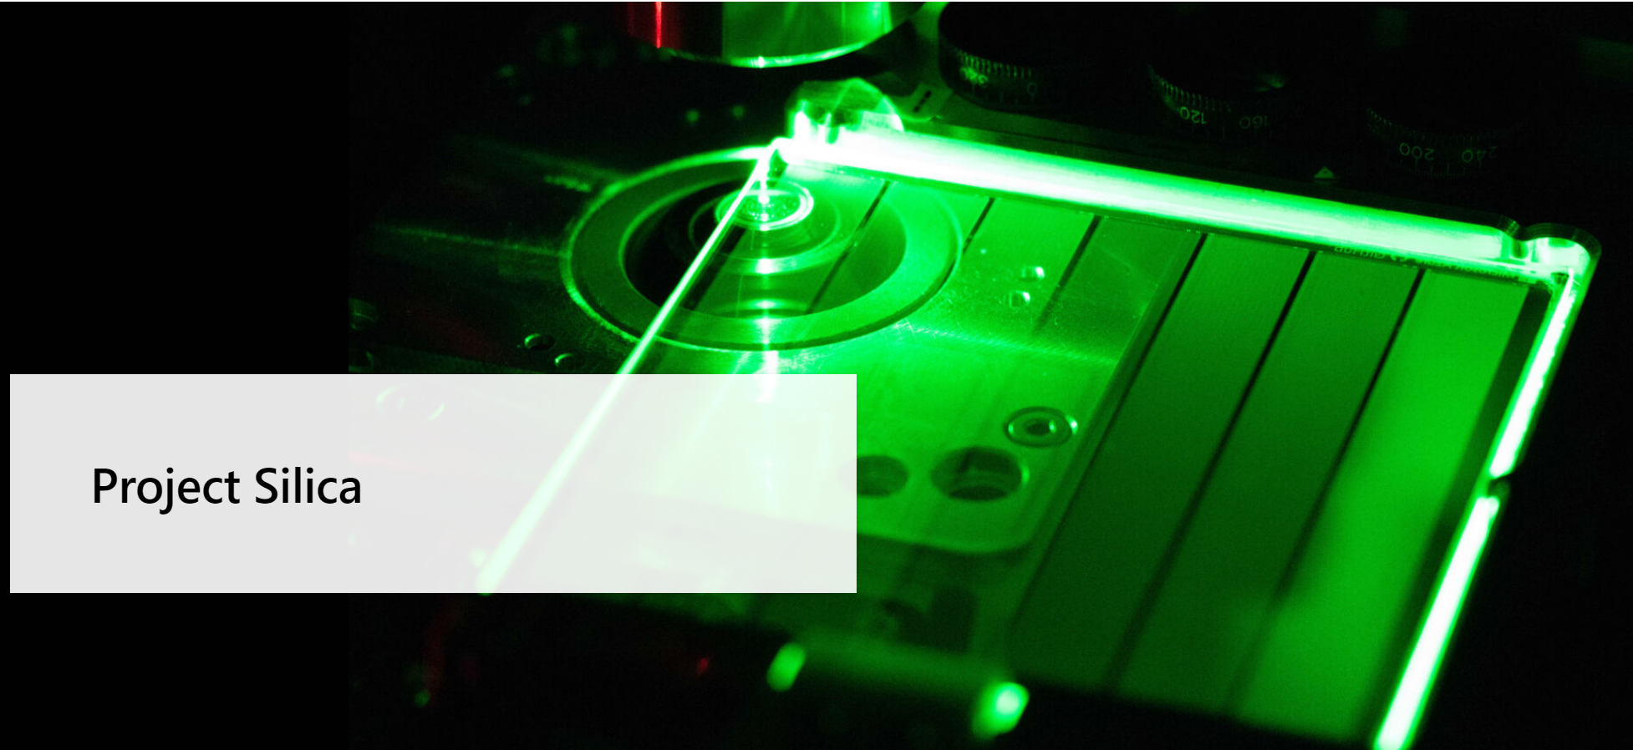
Secondment 2: Microsoft
Work at Microsoft research in Cambridge
Project Silica Another application of dielectrics!
Aim: Improving the optical data storage speed and capacity

Slide 12
Thank You
Questions?

