Slide 1
Atom Interferometry -
Progress of MAGIS-100 & AION-10
K. Bridges, J. Coleman, G. Elertas, L. Hawkins, S. Hindley, K. Hussain, C. Metelko,
J. Ringwood, H. Throssell, A. Webber-Date

Slide 2
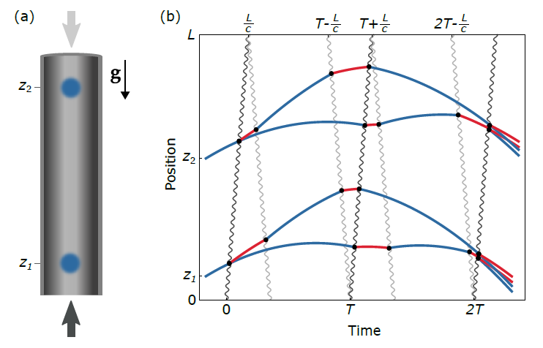
Atom Interferometry & Gradiometry
Two identical atom interferometers are run simultaneously using the same laser sources
Signals is a differential measurement
Enables the cancellation of noise common to both interferometers
Measured phase difference is proportional to the gradient of the local gravitational force
Notes:
Signals is a differential measurement that enables the cancellation of noise common to both interferometers

Slide 3
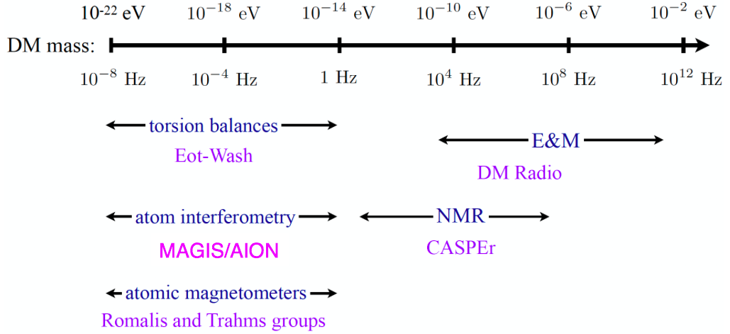



Searches for Light Dark Matter
Dark matter could be coherent waves of light bosons
Many detection techniques, e.g. atom interferometers
DM coupling causes time-varying atomic energy levels:
DM induced oscillation
Dark matter coupling
Time

Slide 4
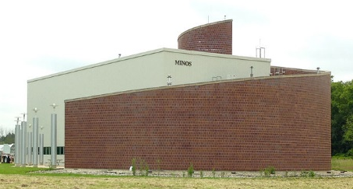
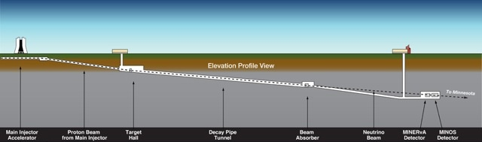
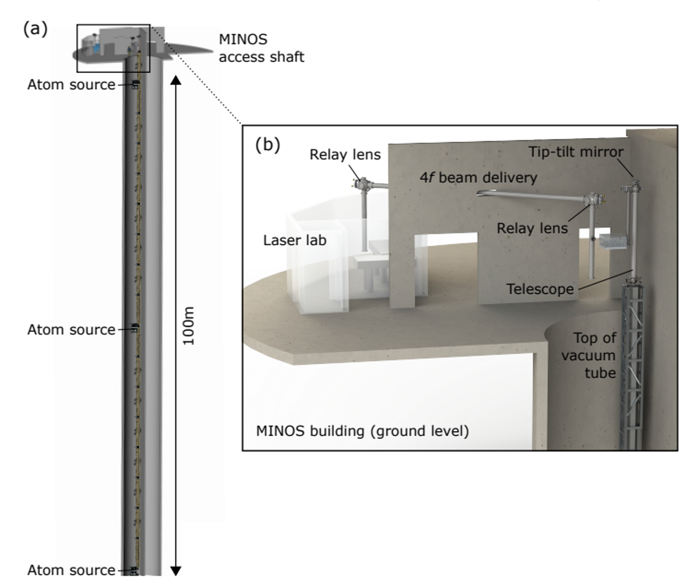
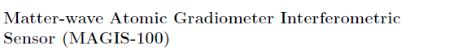








MAGIS-100: DM & GW detector prototype at Fermilab
MAGIS-100: DM & GW detector prototype at Fermilab
Matter wave Atomic Gradiometer Interferometric Sensor
100-meter baseline atom interferometry in existing shaft at Fermilab
Started construction year and a half ago
Clock atom sources (Sr) at three positions to realize a gradiometer
Intermediate step to full-scale (km) detector for gravitational waves
Probes for ultralight scalar dark matter beyond current limits
https://arxiv.org/abs/2104.02835
Notes:
MAGIS = Matter wave Atomic Gradiometer Interferometric Sensor
Add photo of area….
John Hopkins Logo, STFC, DOE, Kavli

Slide 5
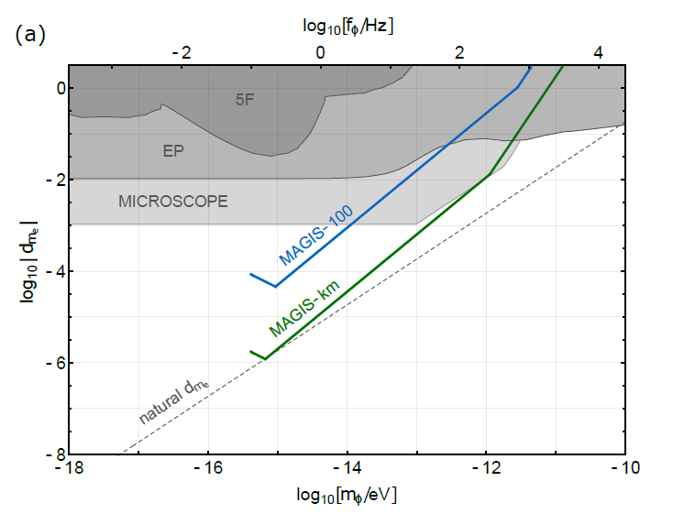
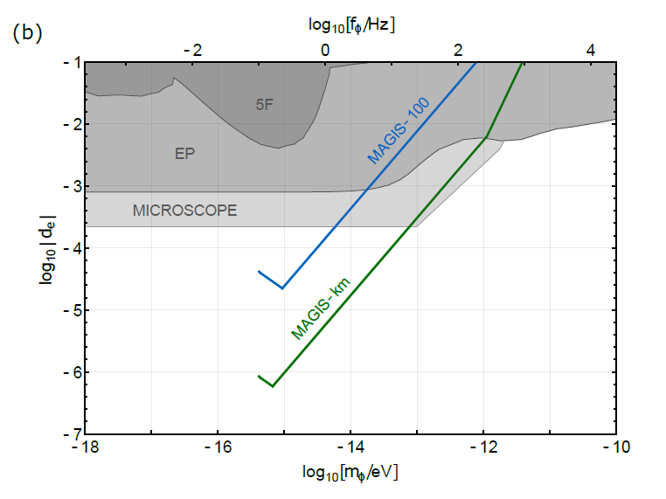
Projected Sensitivity to Dark Matter
Run plan from 2023
  1 year of data taking in scalar DM configuration
  Assuming shot-noise limited phase resolution
  Acts a proof of concept for GW detector
Next step looking for vector DM
Sensitivity to ultralight scalar dark matter coupled via electron mass a) and fine structure constant b)

Slide 6
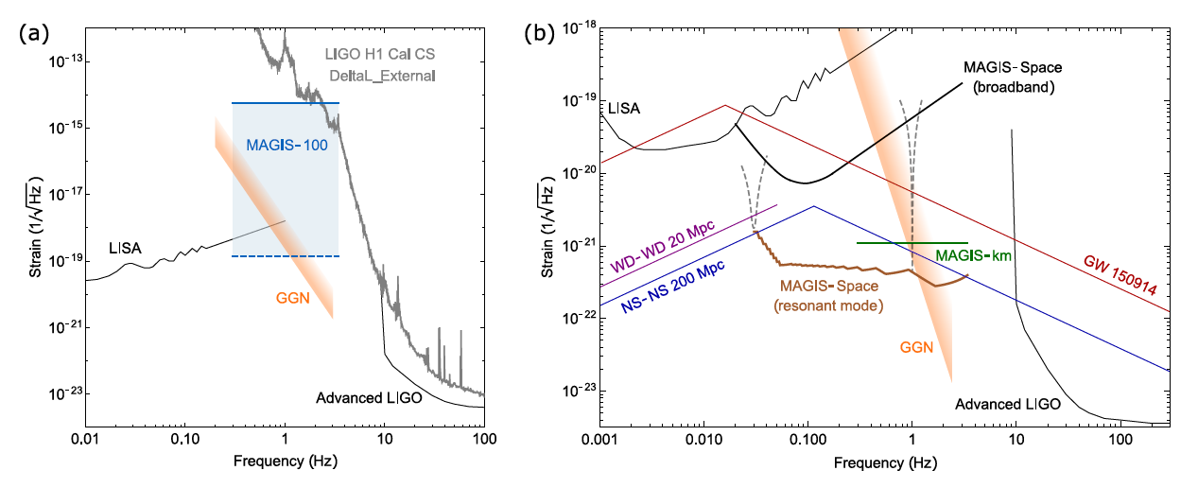
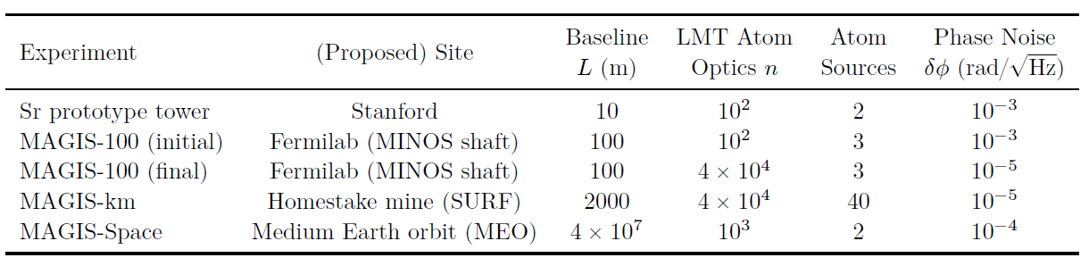
Testbed for GW sensor
Recent discovery of 150 solar mass black hole merger by LIGO is encouraging as heavier mergers would occur in the mid-band frequency range.
Notes:
As a technology demonstrator, MAGIS-100 is not expected to be sufficiently sensitive to detect known candidate sources of gravitational waves. Nevertheless, within its frequency range it aims to achieve a record sensitivity, improving on the current bounds.
Additionally, the recent discovery by LIGO of a binary black hole merger with a total mass of 150 solar masses motivates further studies of intermediate mass black holes. Earlier observations of such binaries at lower frequencies (including mid-band frequencies) would provide valuable astrophysical insight. Moreover, even heavier black holes than the LIGO observation, hundreds of solar masses and above, would merge in the mid-band. Therefore, this would be the ideal band to discover such black holes, if they exist.

Slide 7
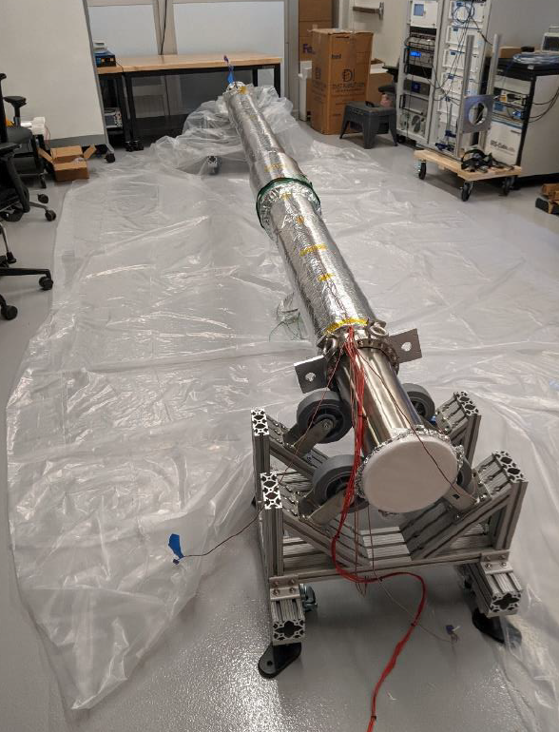
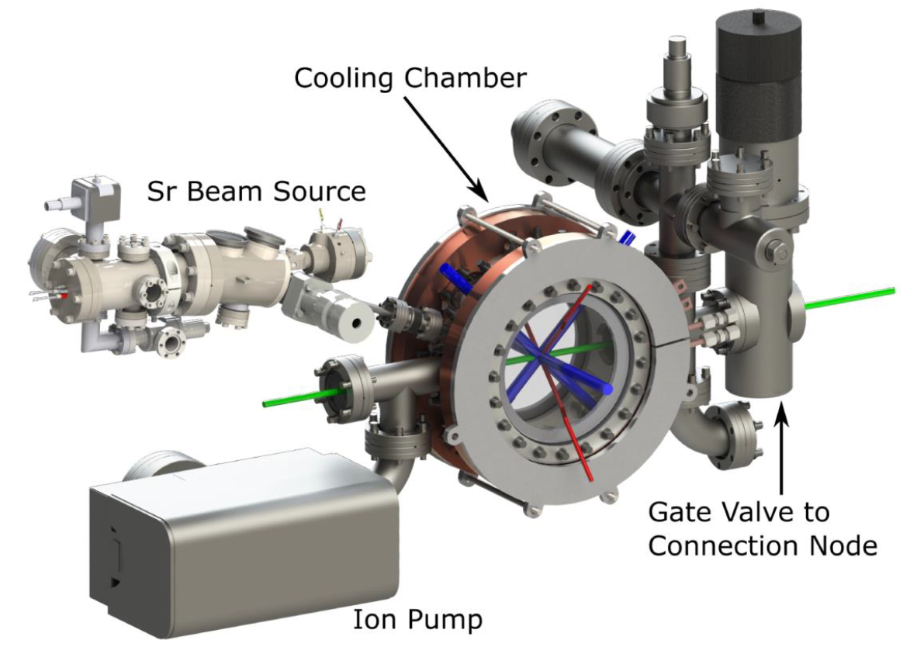
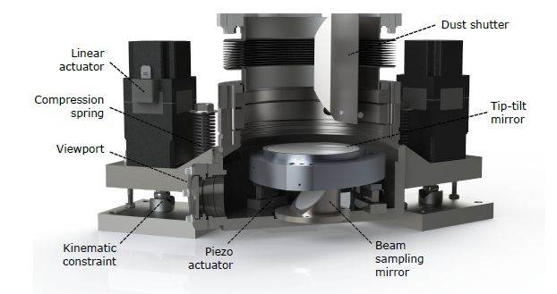
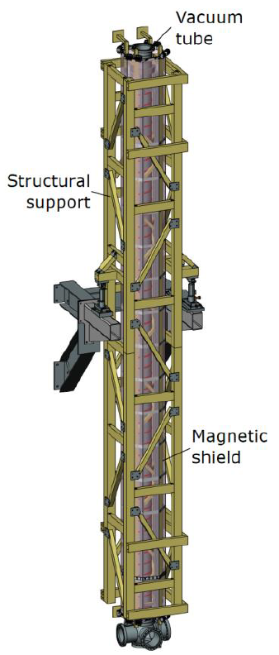
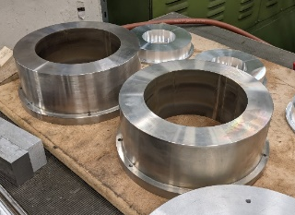
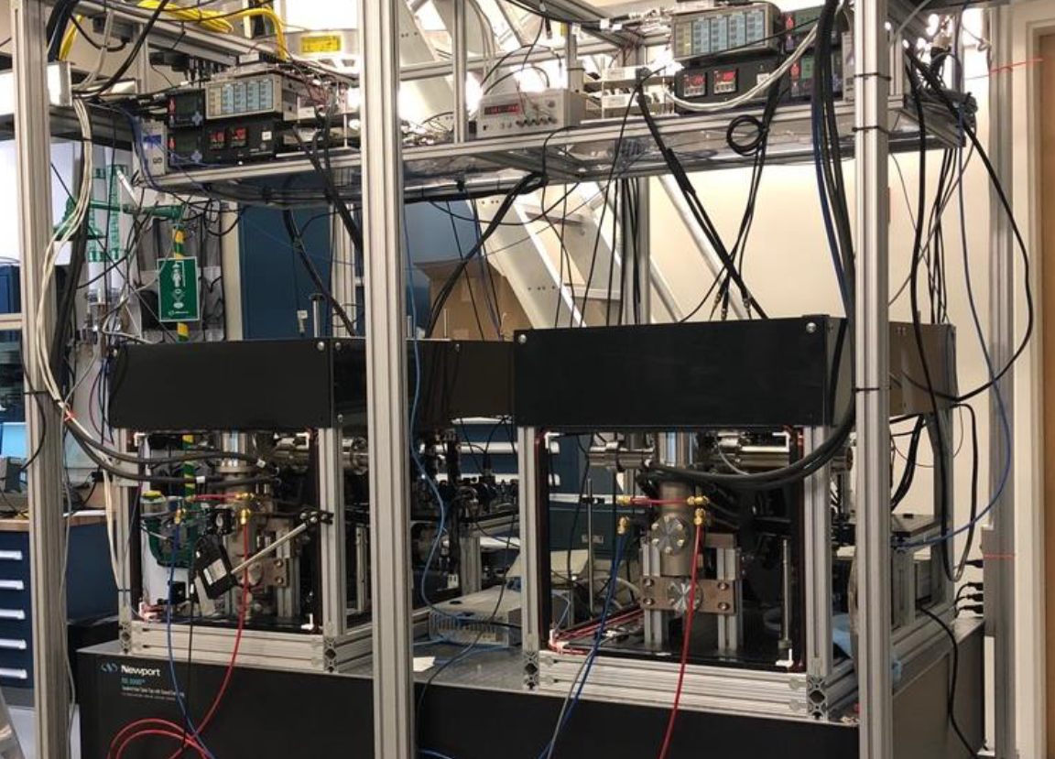
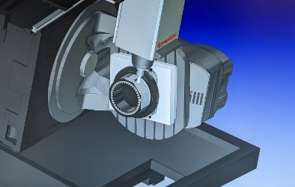
Progress on MAGIS-100
Atom source design & construction
Retro chamber being machined at Liverpool
Mechanical support structure
Beam pipe section

Slide 8
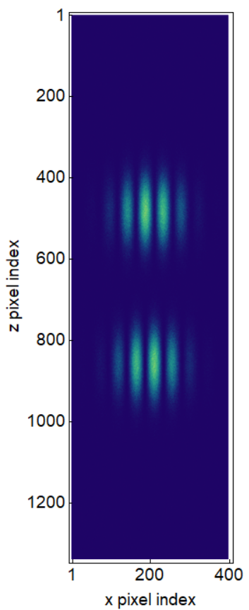
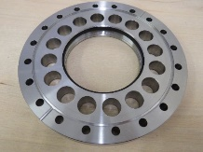
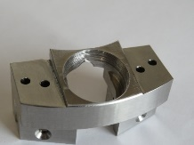
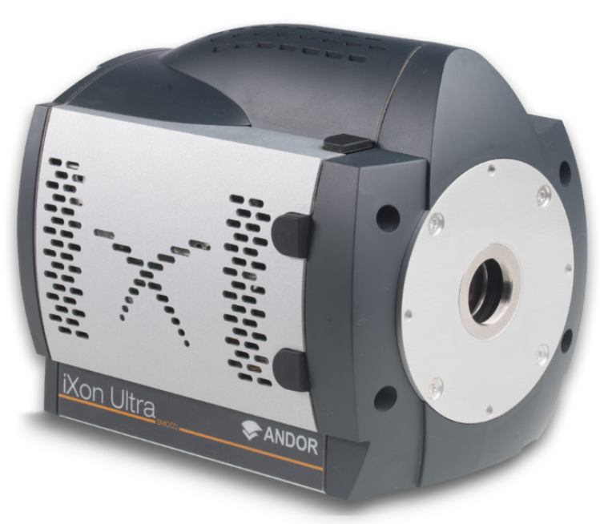
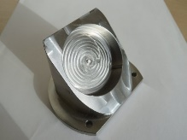
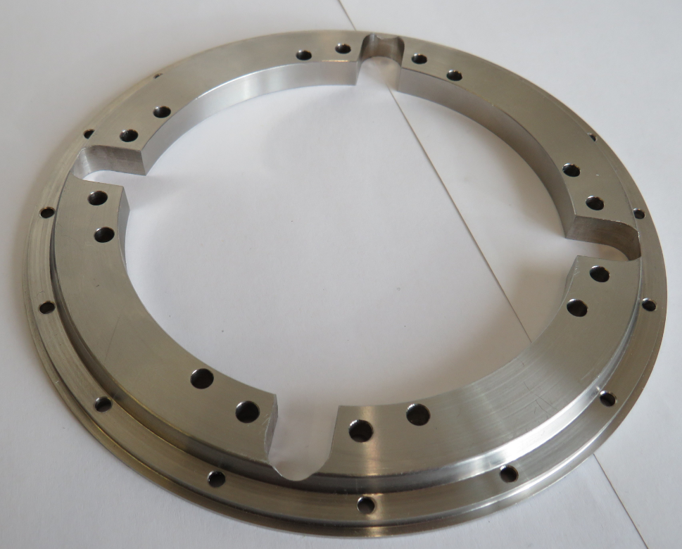


MAGIS-UK
UK to deliver the detection sub-system
Liverpool:
  Develop phase shear imaging platform
  In-vacuum opto-mechanics
Oxford:
  Deliver detection cameras
Cambridge:
  DAQ and computing
UK contributing to physics simulations
  Modelling signal, noise & systematics
Lens flange mount
In-vacuum mirror mount
In-vacuum beam sampling mirror mount
Heavy duty groove grabber plate

Slide 9
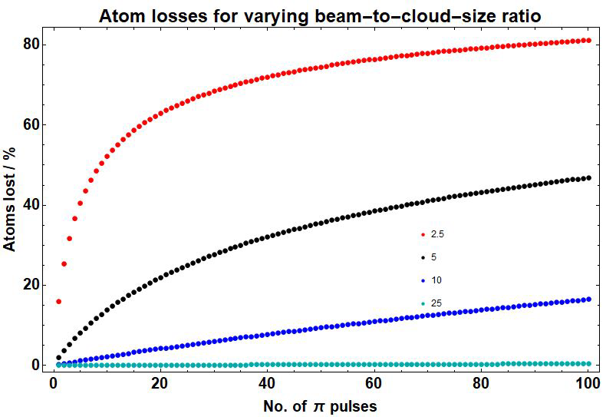
Horizontal Drift Study
Rabi efficiency varies along the interferometer beam because beam intensity has Gaussian profile
Atoms have a distribution of positions and velocities, these evolve over time
With each LMT pulse atoms are being lost if they are outside high efficiency region
Beam to cloud size ratio is a key parameter to mitigate this effect
Work of Sam Hindley
More on simulations see Leonie Hawkins talk

Slide 10
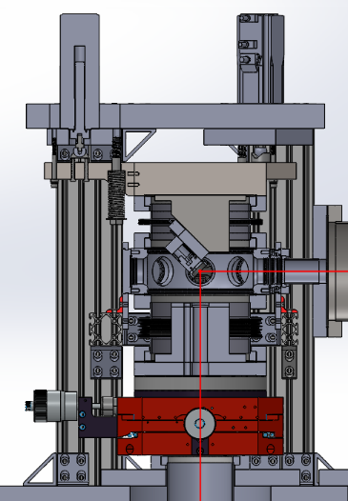
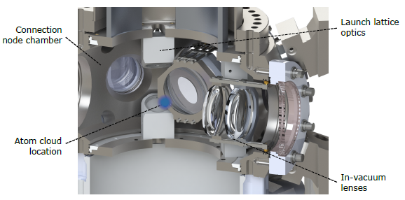
MAGIS - Liverpool
Detector mechanics
Vacuum optics and support
Novel vacuum chambers
Retro-reflection phase-shear platform
Steering chamber
Made in Liverpool Workshop
Coleman - UK PI & Detection Lead
Retro-reflection phase-shear platform
Steering chamber
Detection area

Slide 11
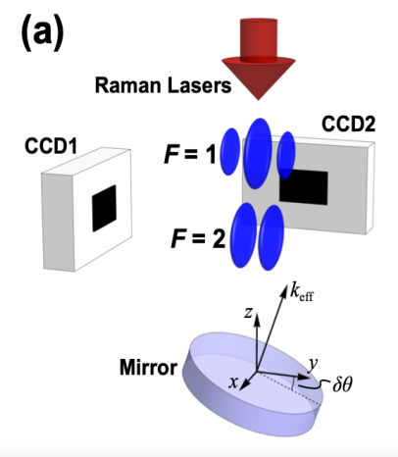

Retro-reflection Phase-shear Platform
UHV chamber housing retro-reflection mirror
Mirror needs precise control for
  Interferometry beam monitoring and alignment
  Coriolis corrections
  Phase-shear imaging
Phase-shear imaging allows for single shot phase and contrast readout

Slide 12
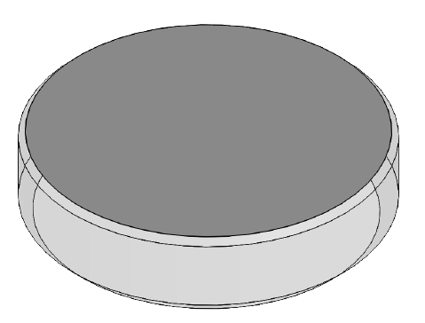

High Precision in Vacuum Optics
University of Liverpool sourcing high precision in vacuum optics for interferometry beam
Highly specified 2 lenses and 5 mirrors:
Specs:
  λ/1000 flatness (5 mm radius at the centre of optics)
  AR coated for 6 different wavelengths
  UHV compatible
  Custom sizes and shapes
Vendor found -
4 inch mirror

Slide 13
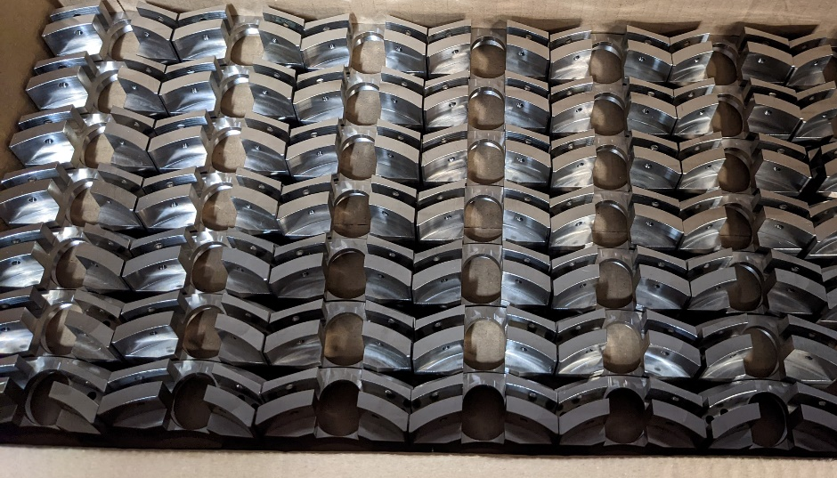
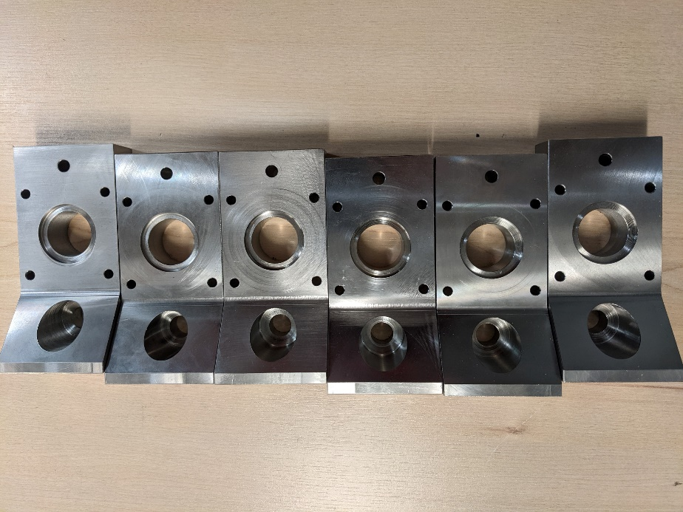
Parts made by Liverpool Detector Development Manufacturing Facility
Vacuum chamber legs
In-vacuum mirror mounts
I would like to thank Liverpool Physics Workshop which is making many components for MAGIS & AION and K. Bridges for his expertise in design!
Notes:
Add 4th pic

Slide 14

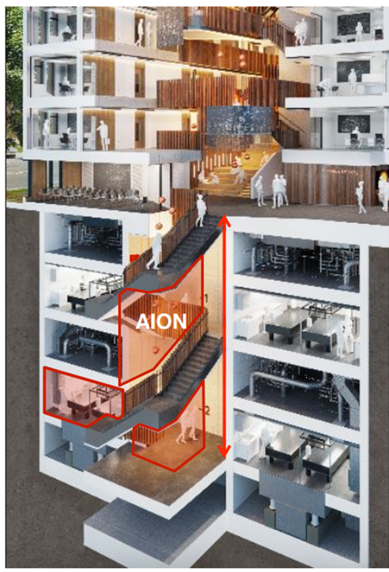
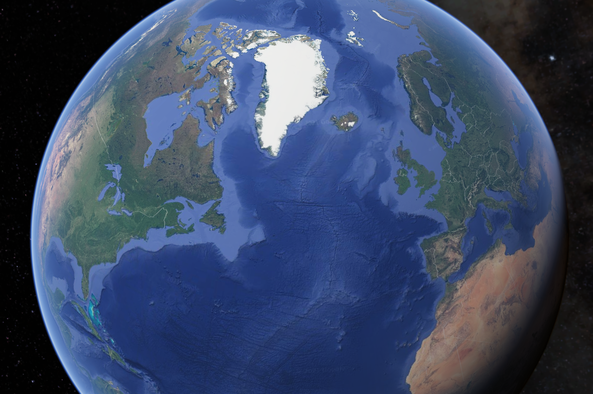






Atom Interferometer Observatory
& Network
5 new Sr labs established
Currently constructing prototype (AION-1)
AION-10 planned construction at Beecroft building, Oxford
Location of AION-100 TBD (Daresbury, Boulby, CERN…?)
  Network with MAGIS for improved sensitivity to DM & GWs
AION
MAGIS
AION Paper (2018)
https://arxiv.org/abs/1911.11755
Notes:
100m baseline – MINOS access shaft – LARGE NOT LARGEST
Sensitivity proportional to interrogation time
3 interferometers, 3 Sr atom sources
Differential measurements
Networking with AION in UK

Slide 15
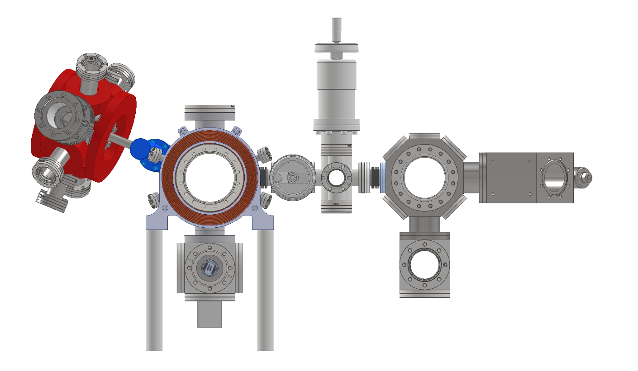
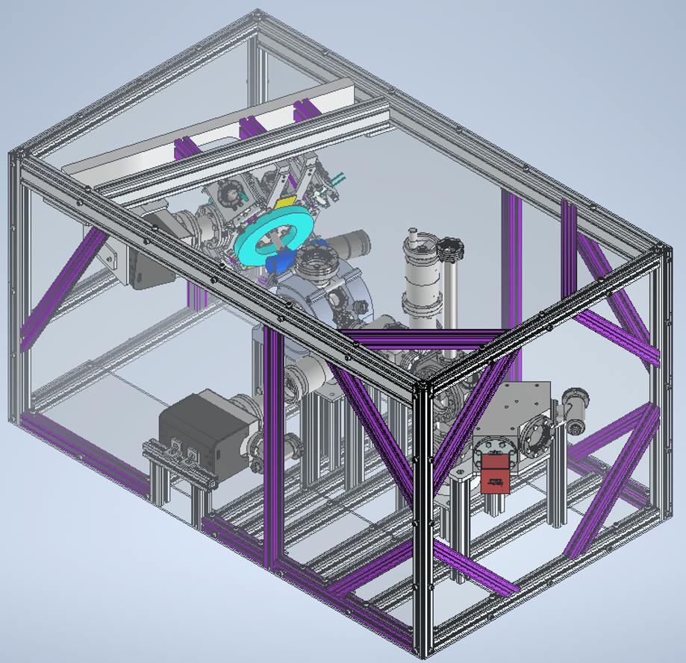
Progress on AION
AION prototype under construction
  Demonstrate interferometry with Sr
Each institution is responsible for subsystem
  Develop technology for 10m & future 100m devices
  Oxford, Liverpool, Cambridge, Imperial College, Birmingham, RAL & Kings College
Interferometry demonstrator vacuum system assembled at Daresbury next month delivering at Cambridge
Vacuum system & support frame for prototype under construction

Slide 16
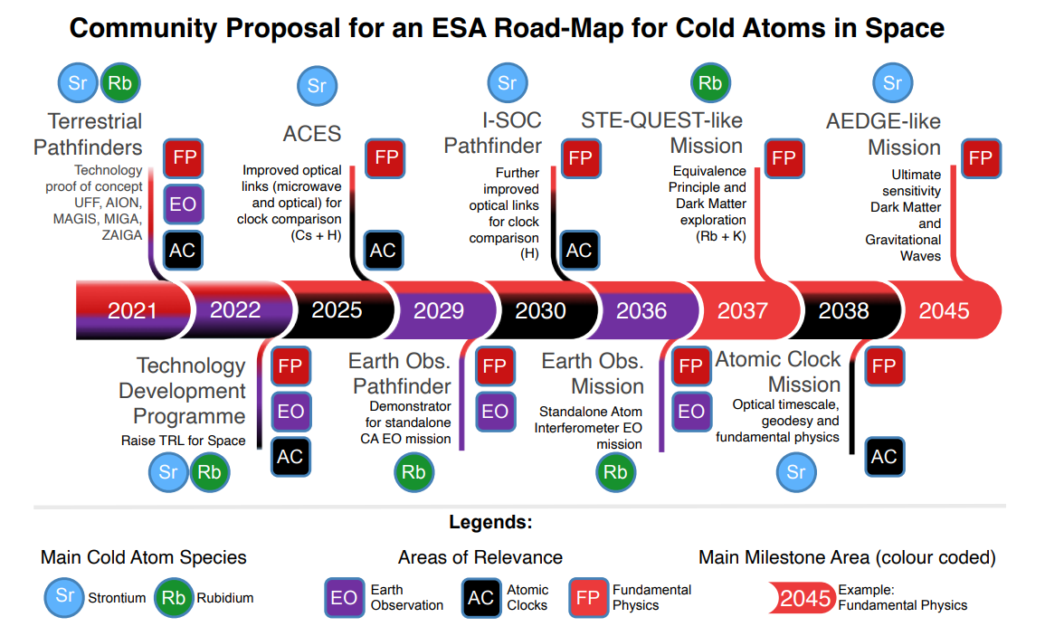

Cold Atoms in Space
Future of atom interferometry is space
  Small gravity gradient noise
  Free fall → long interferometry time
  Potential of extremely long baselines
Liverpool is well positioned with expertise on both Rb and Sr
Liverpool has now a studentship with
Cold Atoms in Space
https://arxiv.org/pdf/2201.07789.pdf

Slide 17
Present Status
Using Atom Interferometry to:
  Explore the dark sector
  Prototype for a mid-band gravity wave detector
MAGIS-100 is a new experiment in construction at Fermilab
  Potential for larger scale detector ~1 km at SURF
AION adds additional arm for unequivocal discovery potential
  Five Sr labs established across the UK
  Finishing building the vacuum systems for 4 out of 5 labs, other systems ready to go
Liverpool is key contributor for both MAGIS and AION, delivering retroreflection system and in-vacuum optics
Cold atom experiments are going to space!

Slide 18
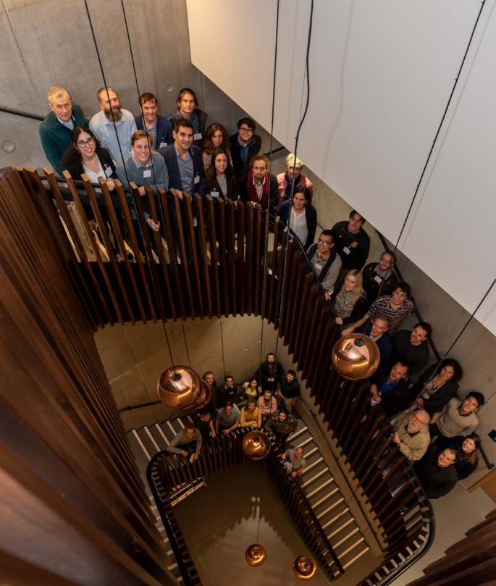
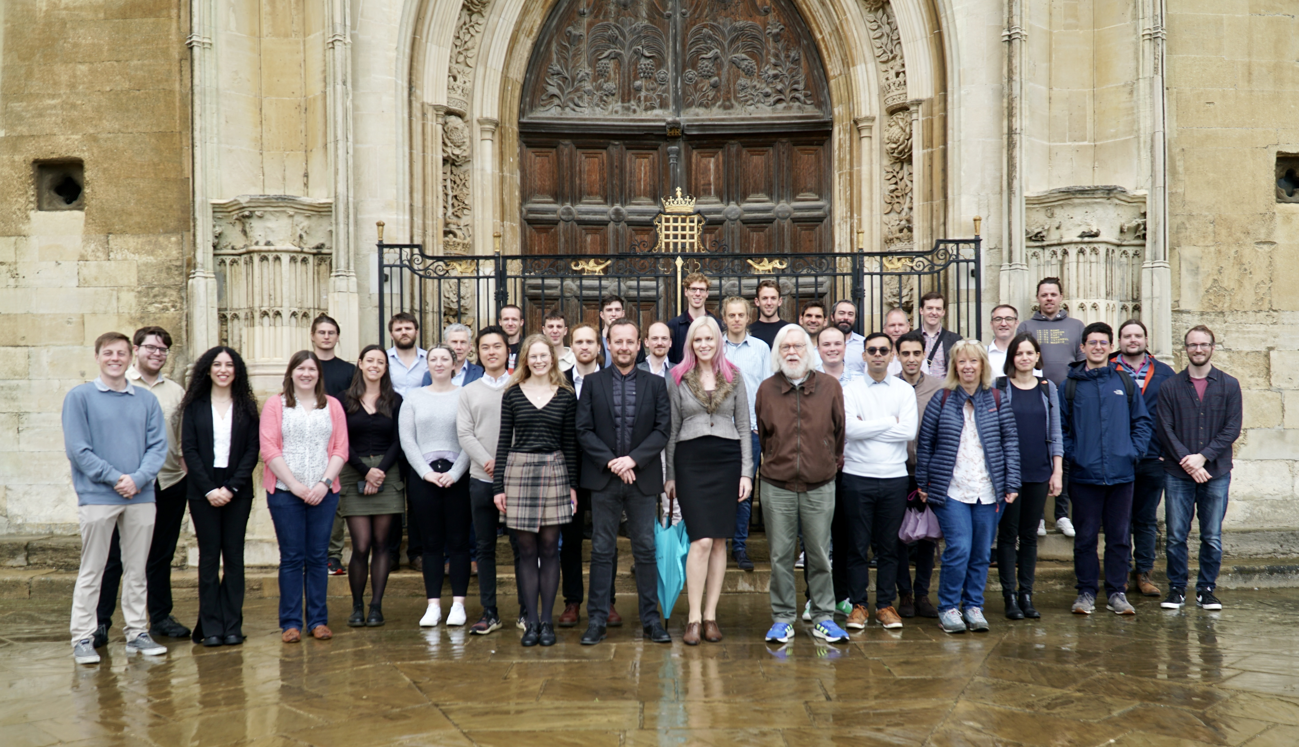
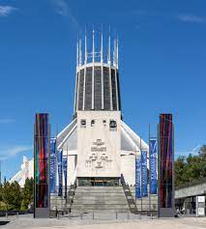
Thank you for attention
AION days Cambridge 2022 May
AION days Liverpool
2022 Autumn
AION days Oxford
2021 November
Notes:
100m baseline – MINOS access shaft – LARGE NOT LARGEST
Sensitivity proportional to interrogation time
3 interferometers, 3 Sr atom sources
Differential measurements
Networking with AION in UK

Slide 19
Backup slides

Slide 20
MAGIS-100 & AION
Novel strontium atom interferometers for fundamental science research
  MAGIS-100 under construction at Fermilab
  AION just established 5 strontium laboratories across the UK
Liverpool delivering for both MAGIS & AION
Retro-reflection phase-shear platform
Steering chamber
Detector mechanics
High precision in-vacuum optics

Slide 21
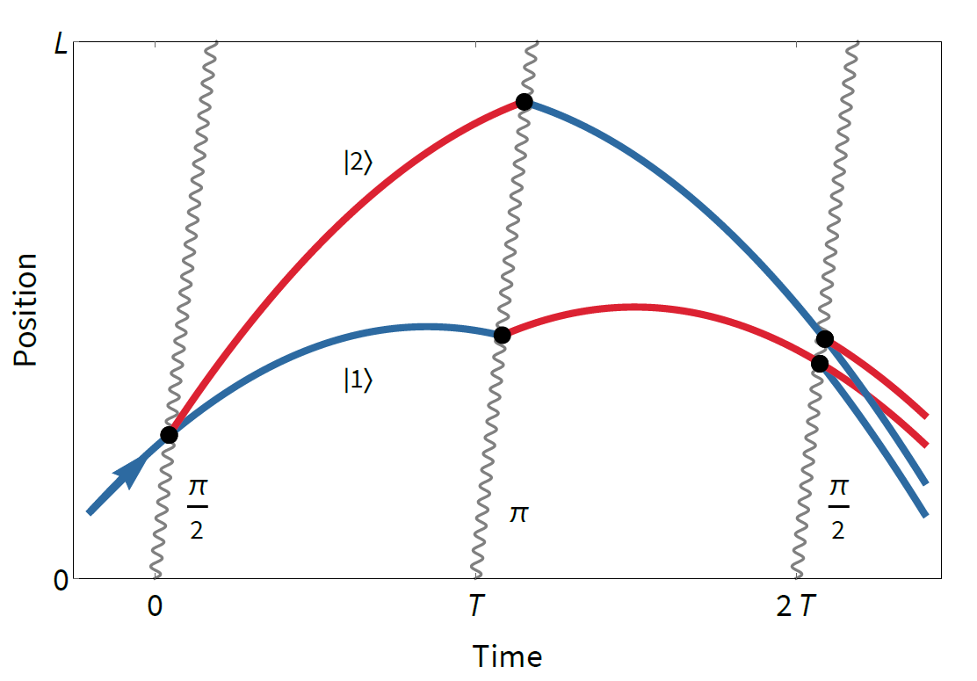
Light pulse atom interferometry
Light pulses serve as beamsplitters & mirrors for matter waves
Atoms follow two paths (superposition)
Paths overlap and interfere
Measured phase difference is proportional to the fields that interacted with atoms (e.g. for gravity Δφ=kgT²)
π
Example matter wave fringes
Example matter wave fringes
π/2
π/2
CCD/PD

Slide 22
Ultralight scalar dark matter
Ultralight dilaton DM would act like a classical field (e.g., mass ~10⁻¹⁵ eV)
+ …
DM scalar field
Electron
coupling
Photon
coupling
e.g., QCD
DM mass density
DM coupling causes time-varying atomic energy levels:
DM induced oscillation
Dark matter coupling
Time

Slide 23
Science Case
A new ‘telescope’ for Unexplored Phase Space
Tests of quantum mechanics at long time / length scales
Equivalence principle tests
Lorentz invariance tests
Ultralight dark matter (e.g., axions, dilatons, etc.)
  Mass ~10⁻¹⁵ eV
  Would act like a classical field
Testbed for future gravity wave detection in the mid-band frequency range

Slide 24
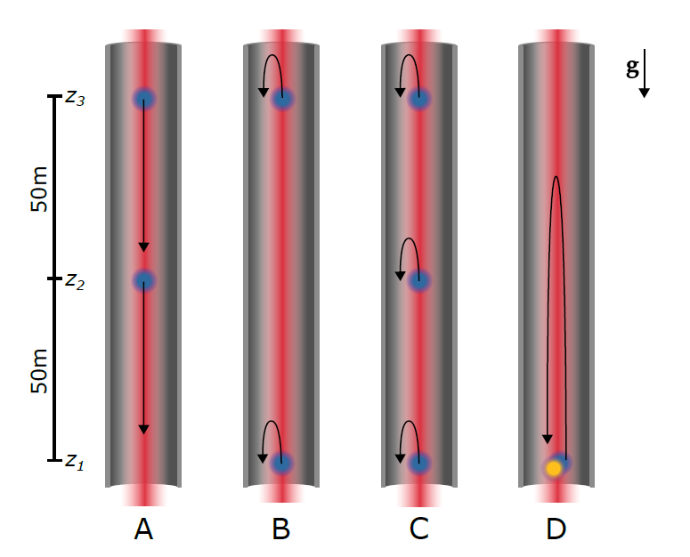
MAGIS-100 Operating Modes
Maximum gradiometer drop time
Maximum gradiometer baseline
Gravitation gradient noise (GGN) characterization
Dual-isotope launch, maximum possible free fall time
Notes:
Figure 6. The MAGIS-100 detector features four distinct operating modes (A-D), using the three
atom sources that connect to the 100 m vacuum tube at locations z1, z2 and z3. At these locations,
atom clouds can be prepared, dropped, launched, and detected. Light pulses (red beam) travel
along the vacuum tube in both directions and interact with the atoms (blue clouds) while they are
in free fall.
Mode A: Maximum gradiometer drop time. Atoms are dropped from locations z3 and z2 over 50 m and are detected at locations z2 and z1, respectively.
Mode B: Maximum gradiometer baseline. Atom clouds are launched for several meters from z1 and z3 and then detected at their
initial launch positions.
Mode C: GGN characterization. All three sources can be used with short launches in order to explore Newtonian noise variation along the baseline.
Mode D: Dual-isotope launch. In this alternative dark matter detection mode two Sr isotopes (blue and orange clouds) are
simultaneously launched from z1.

Slide 25
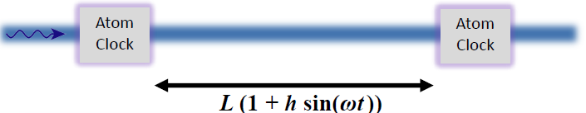
GW Measurement Concept with AI
Light propagates across the baseline at a constant speed
Atoms are good clocks and good inertial proof masses (freely falling in vacuum, not mechanically connected to earth)
Clocks read transit time signal over baseline
GW changes number of clock ticks associated with transit by modifying light travel time across baseline

Slide 26
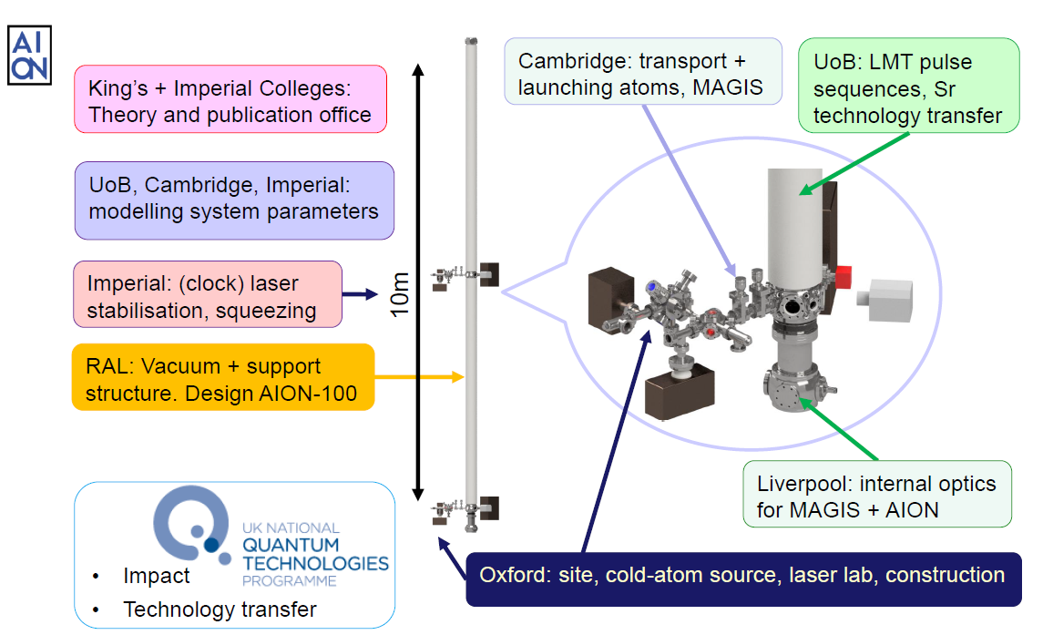
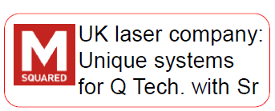
AION – team roles
Taken from:

Slide 27
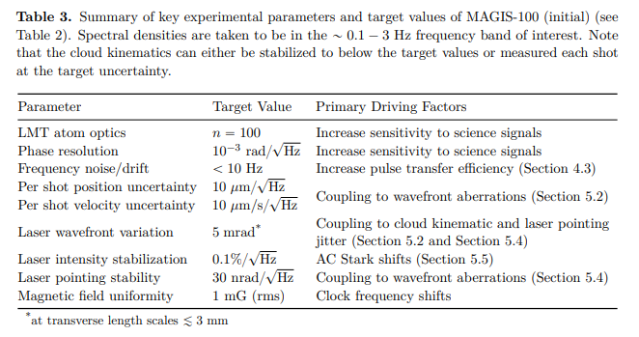
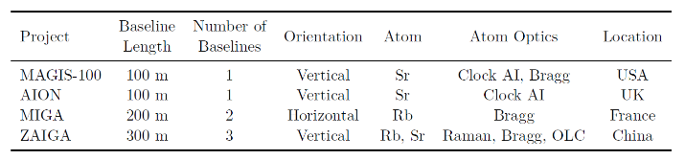
MAGIS-100 specs and other experiments

Slide 28
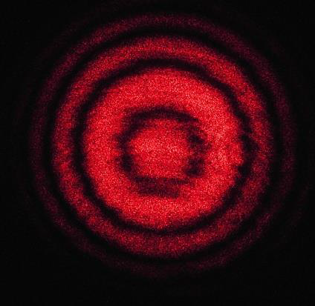
Atom Interferometry 101
Light Interferometer
Light fringes
https://www.coboltlasers.com/applications/lasers-for-interferometry
Notes:
https://www.coboltlasers.com/applications/lasers-for-interferometry/ ref to light fringes

Slide 29
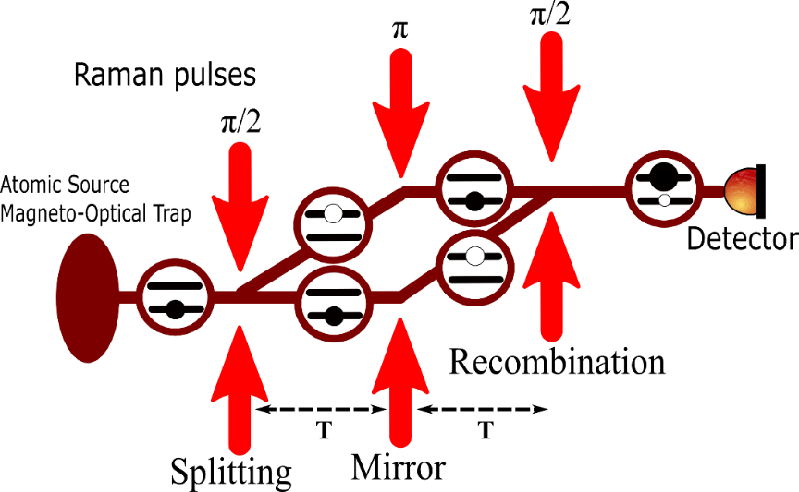

Atom Interferometry 101
Atom Interferometer
Atom fringes
Atom Interferometry in a 10m Fountain, PhD thesis, A. Sugarbaker, Stanford University, 2014
Notes:
https://www.coboltlasers.com/applications/lasers-for-interferometry/ ref to light fringes

Slide 30
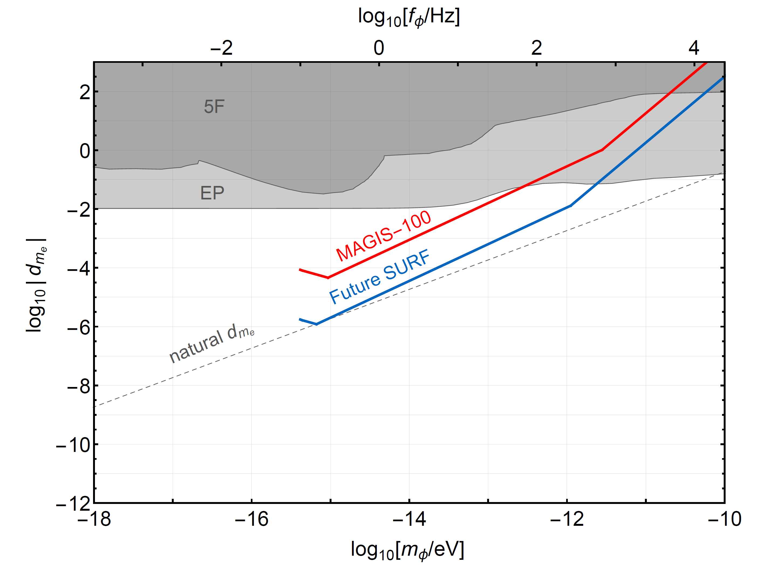
Projected sensitivity to dark matter
~ 1 year data taking
Assuming shot-noise limited phase resolution
Sensitivity to B-L coupled new force
Sensitivity to ultralight scalar dark matter
Static EP tests
Graham et al. PRD 93, 075029 (2016).
Arvanitaki et al., PRD 97, 075020 (2018).

Slide 31
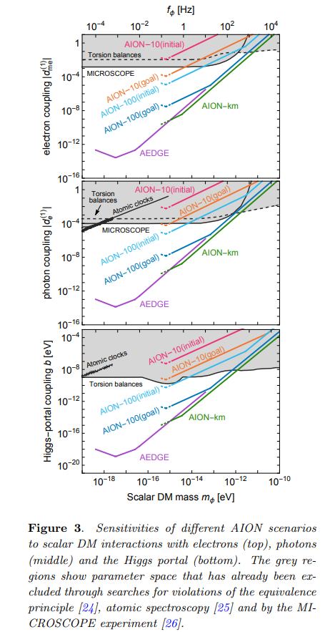
AION Dark Matter Search

Slide 32
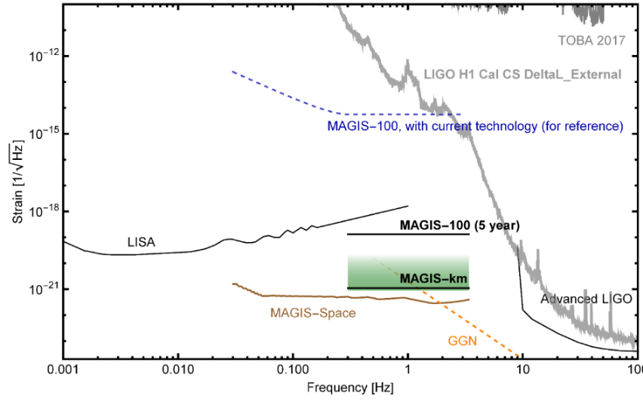
GW Sensitivity development plan
Phase noise improvements in 5 years:
10x from higher flux
10x from spin squeezing
MAGIS-km additional factor of 3x improvement in phase noise from flux + quantum entanglement (spin squeezing)

Slide 33

MAGIS and AION Network

Slide 34

AION Helping LIGO/VIRGO

