Slide 1
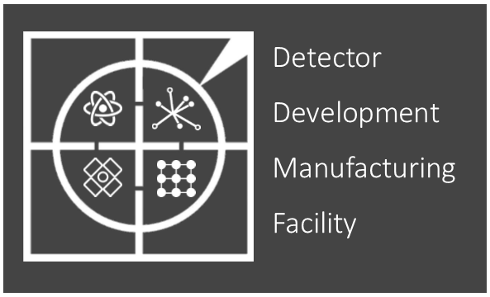
2021-22 Review
Mark Whitley

Slide 2
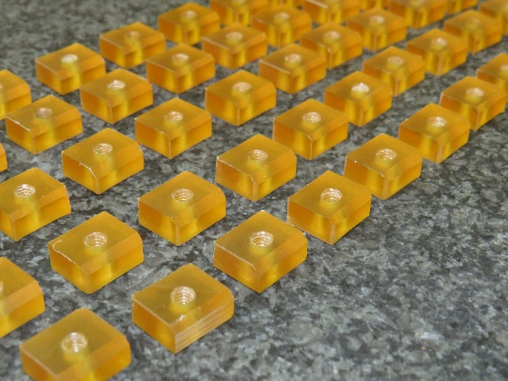
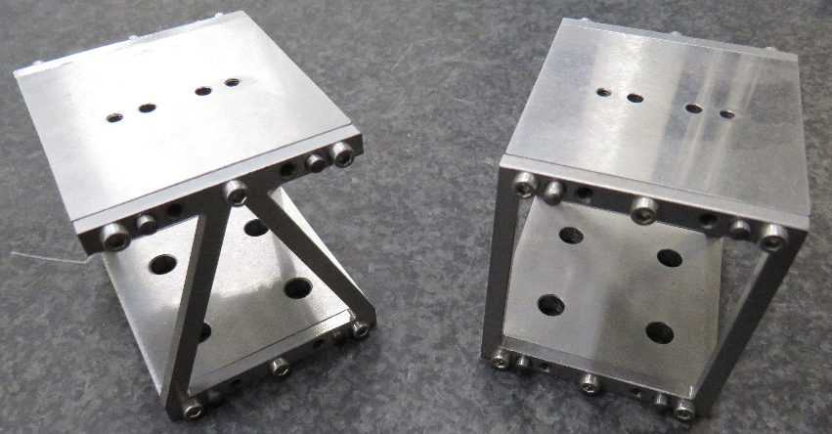
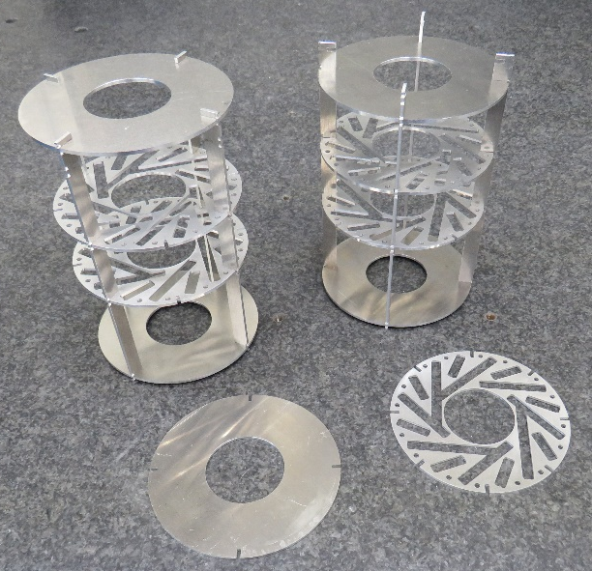
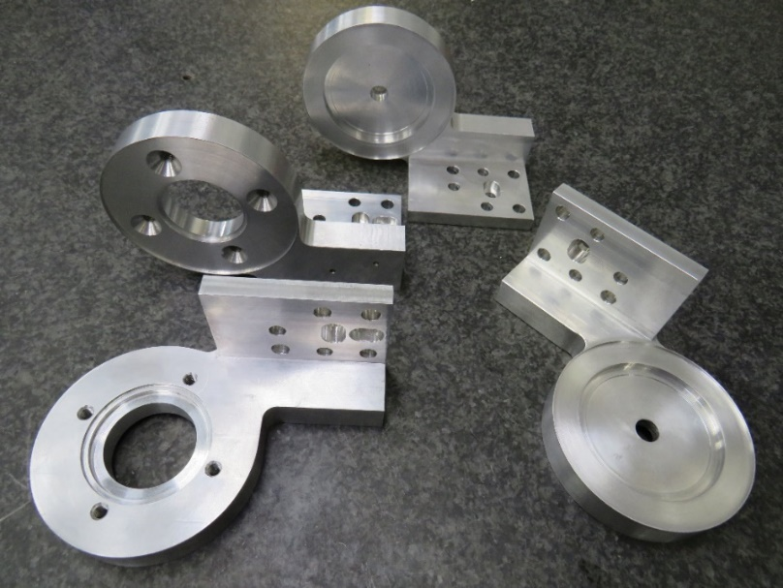
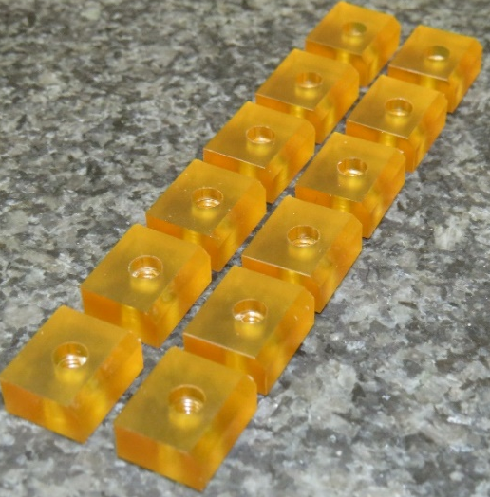
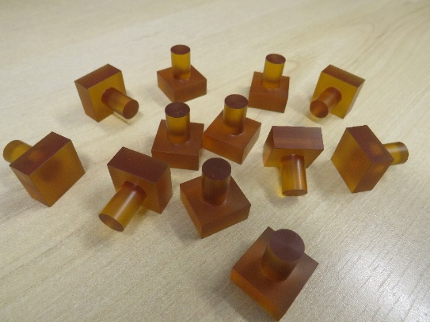
Showcase
Components and test structures for Atlas Pixels and Strip
Final prototype hinges for CTA
Notes:
2
Here you can see examples of the work that has been carried out during 2021/2022.

Slide 3
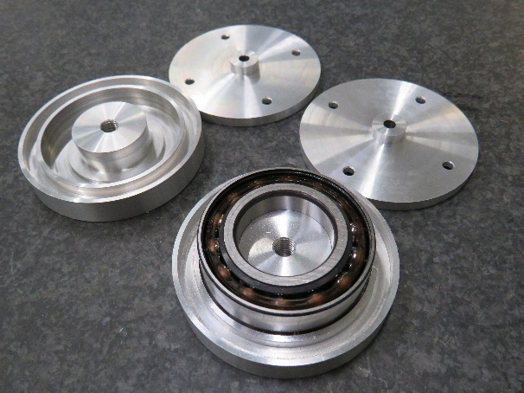
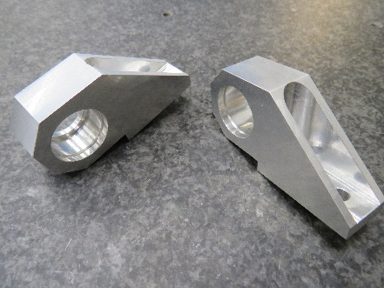
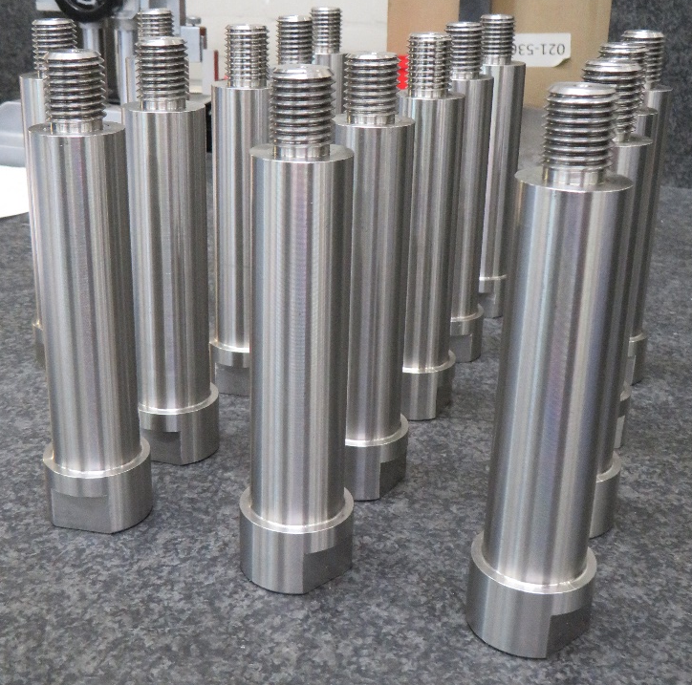
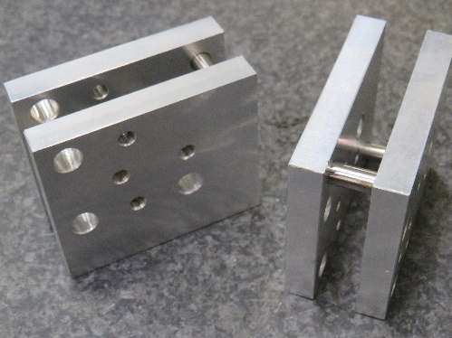
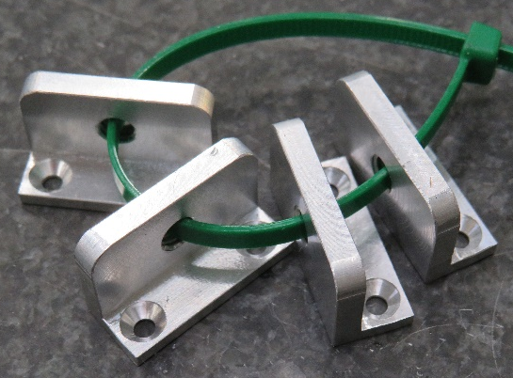
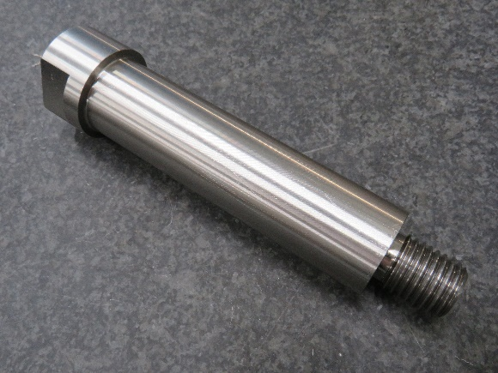
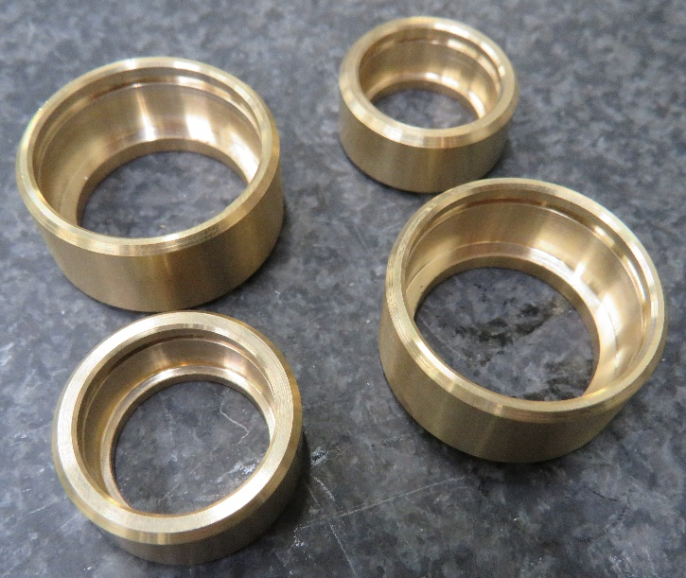
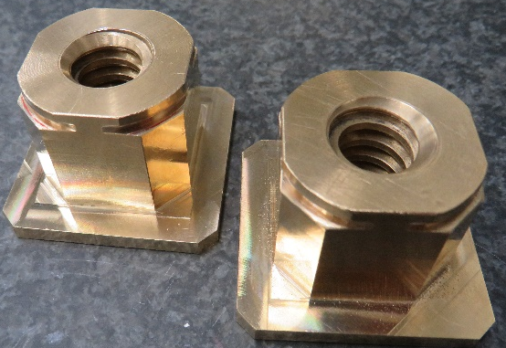
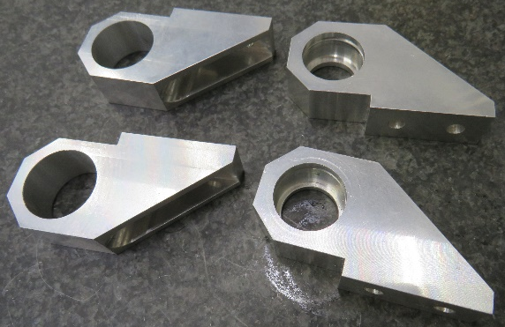
Showcase
Components for AGATA, LHCb, CTA and DUNE
Notes:
3
This shows more components required from various projects.

Slide 4
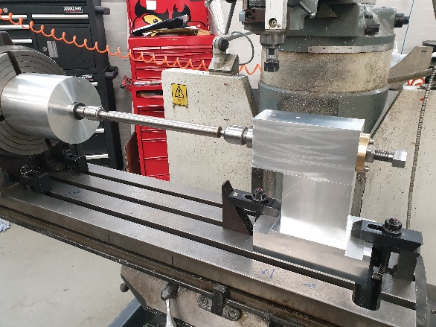
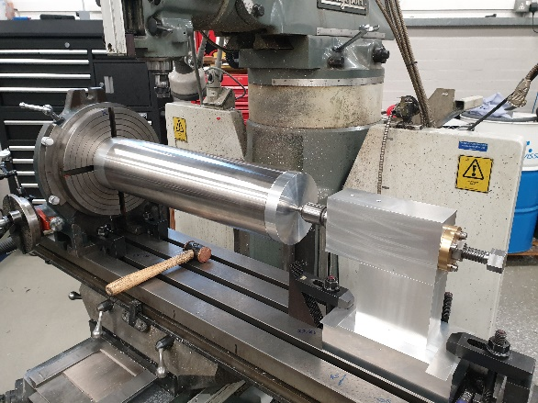
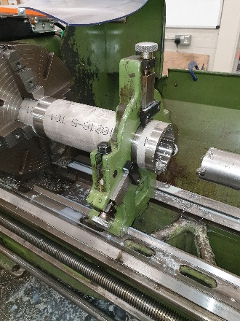
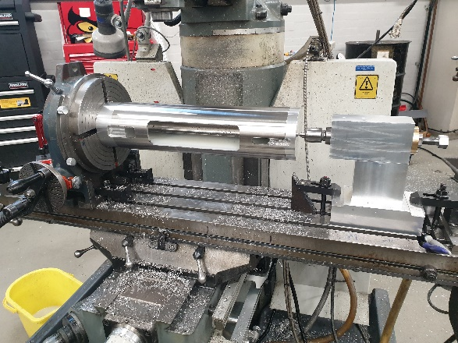
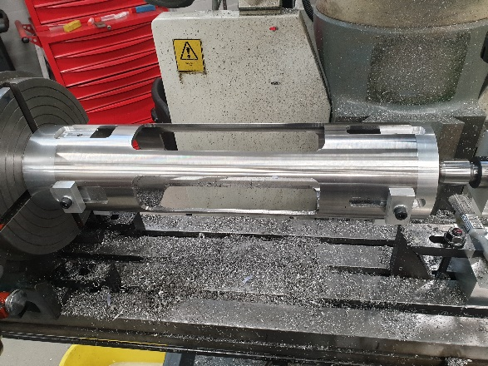
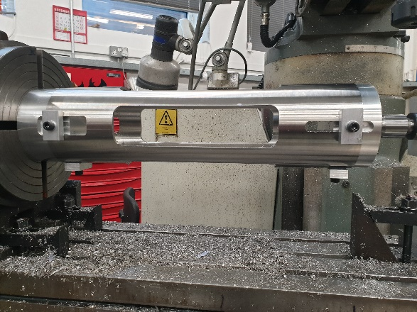
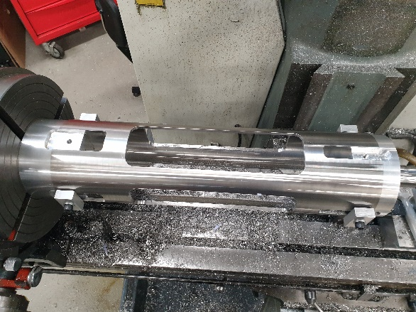
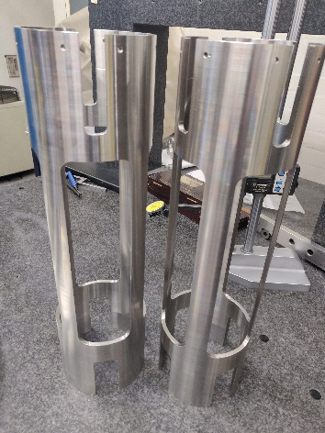
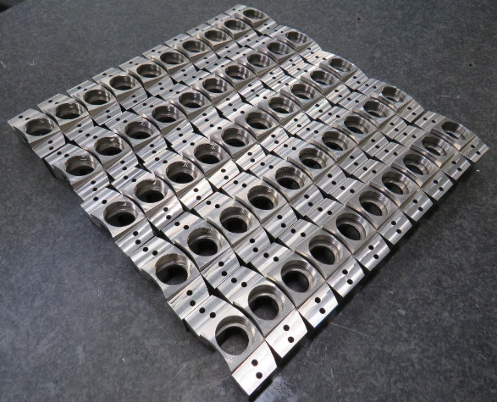
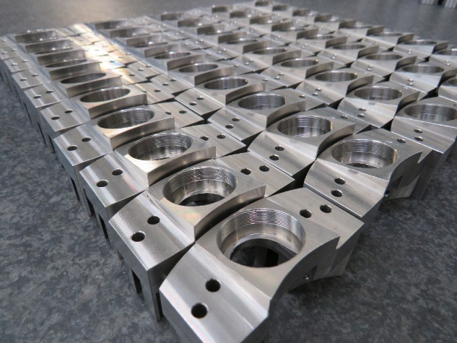
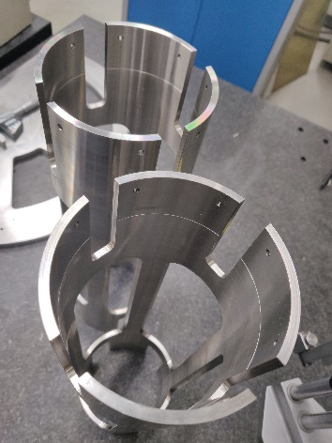
Showcase
Magis Lattice scaffold
Various stages of production
40 Lattice concave
mirror mounts
Notes:
4.
These photos show the evolution of the Magis lattice scafolds.

Slide 5
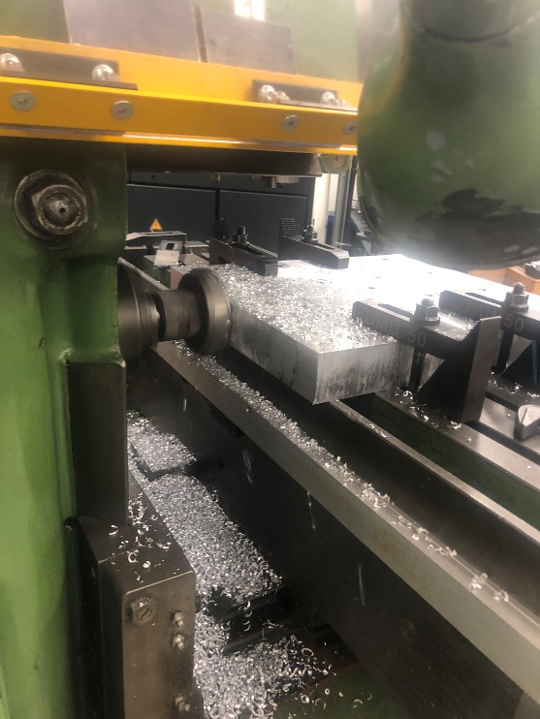
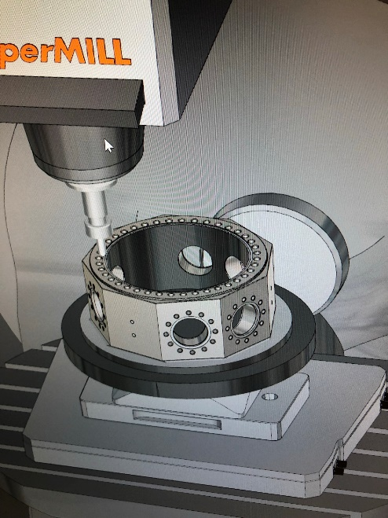
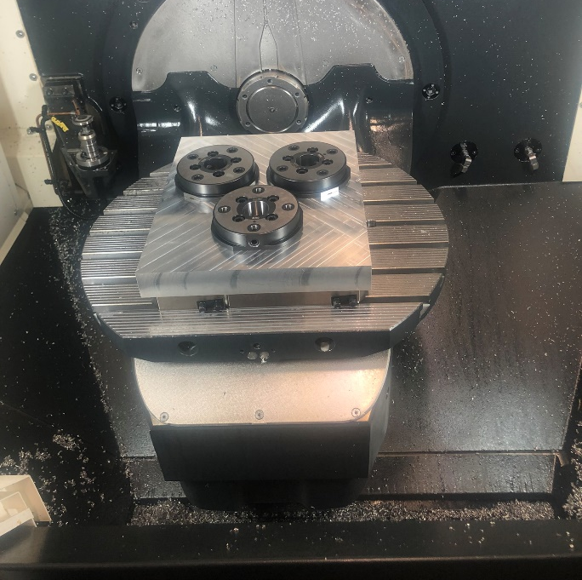
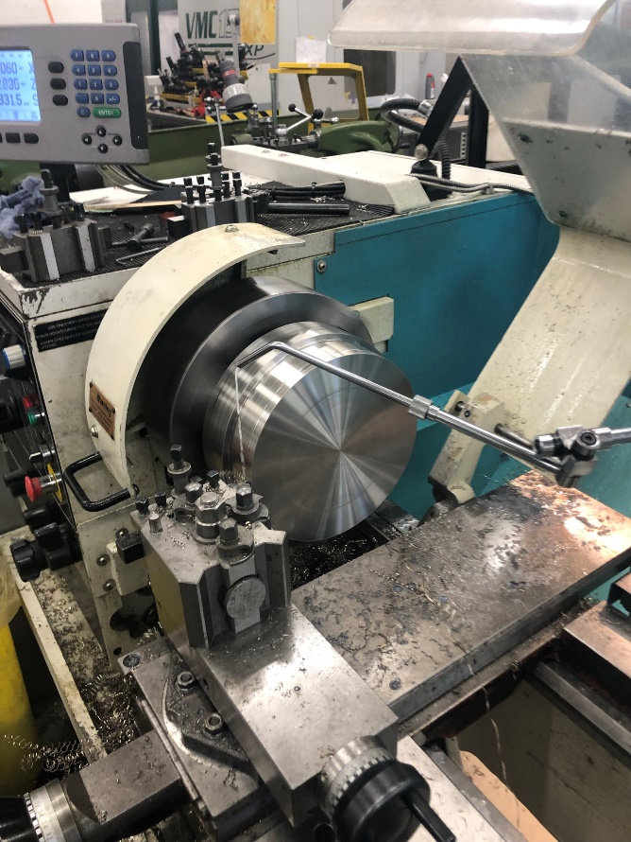
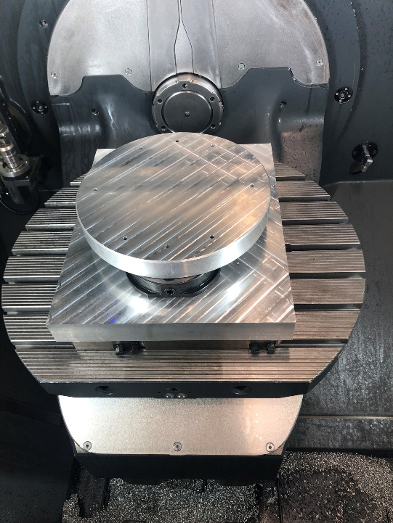
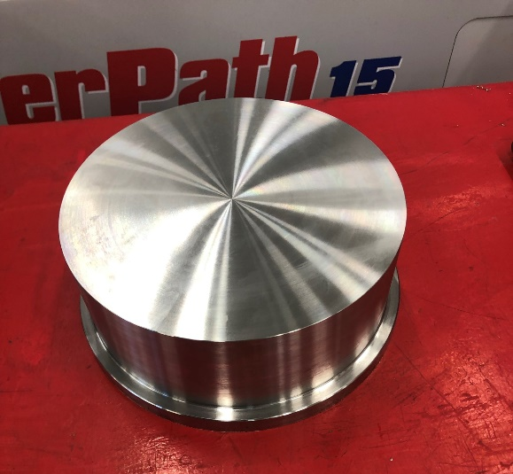
Showcase
Magis 100 Retro chamber body
Milling baseplate to suit zero point clamping system
Various stages of production
CAM programming and simulation
Fixture is made to lift the workpiece from the machine bed allowing the tools to have full 5-axis access.
Turning stock material and preparations for mounting to fixture
Notes:
5.
Here we see the very early stages for the manufacture of a vacuum chamber for Magis. In this case we needed to make a fixture to raise the workpiece from the machine bed to allow 5-axis movement.

Slide 6
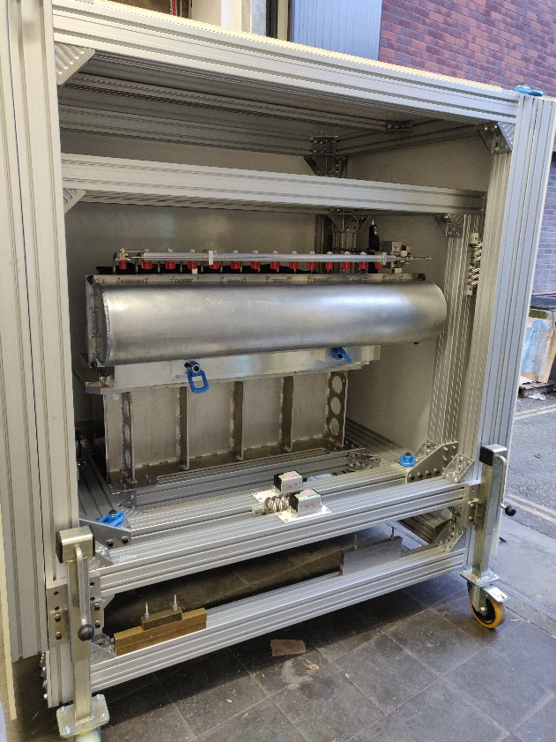
Showcase
Just Time for a team photo before it leaves
Last side to go on after the shock sensors have been positioned
Notes:
6
Here we have the first half of the LHCb VeLo being loaded on to the lorry next stop CERN

Slide 7
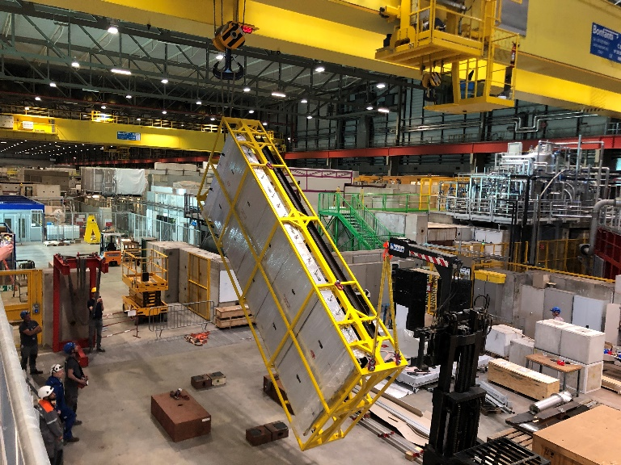
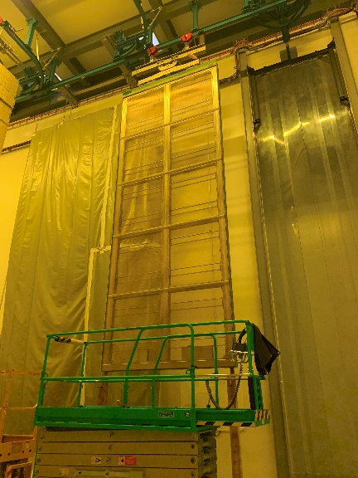
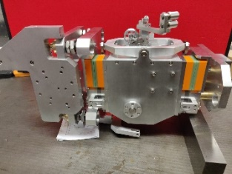
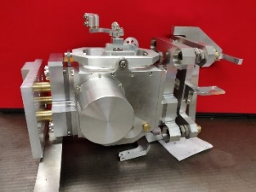
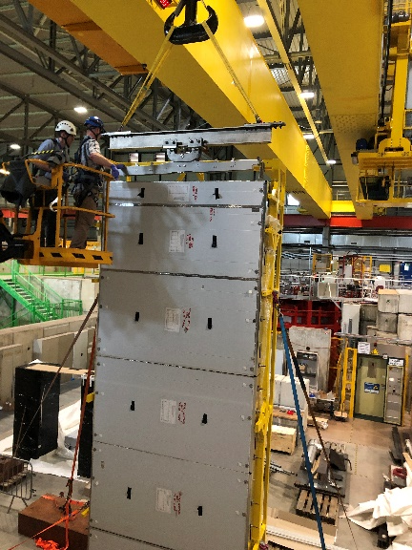
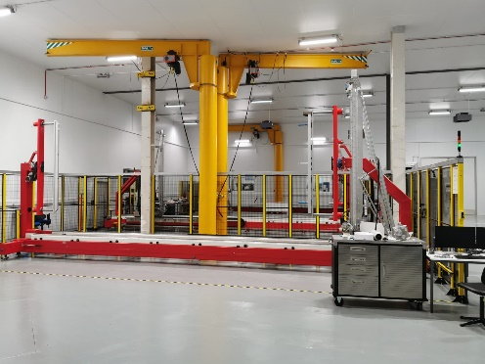
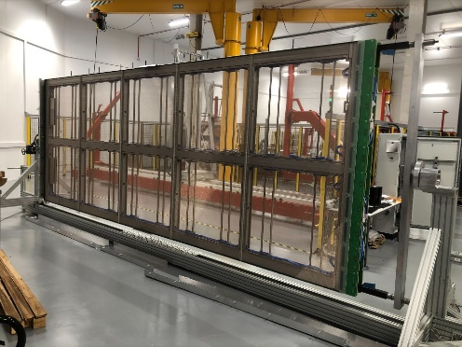
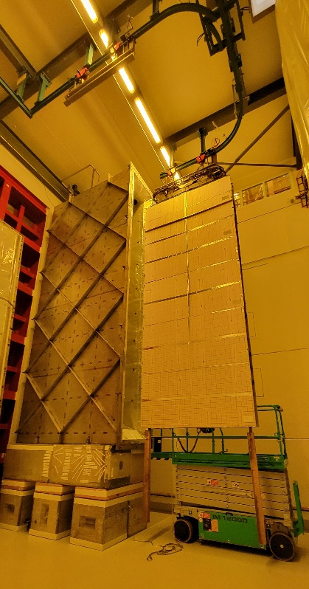
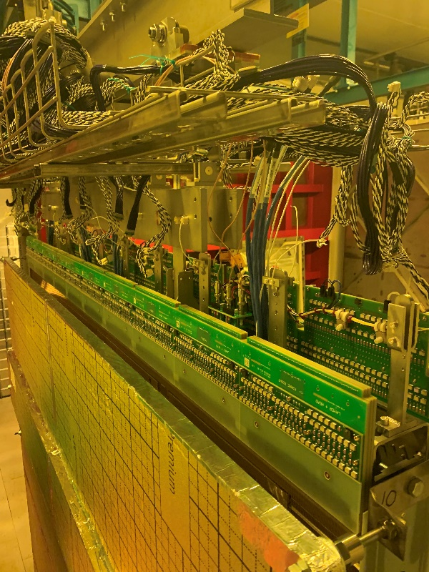
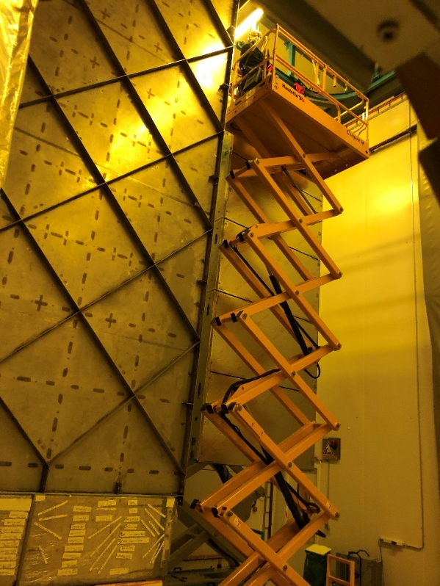
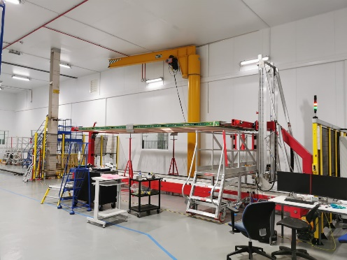
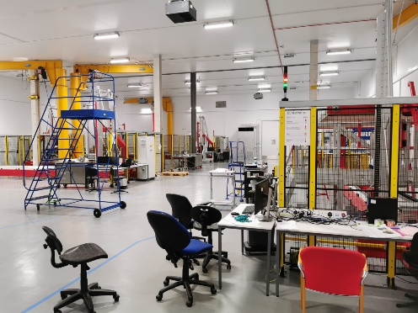
DUNE
Showcase
Winding heads made in Liverpool, used to produce detectors in Daresbury which were then taken to CERN.
Matt has spent quite some time at CERN assisting with the testing
Thanks to Tony, Matt and Emlyn for their efforts in detector assembly taking place at Daresbury
Notes:
7
This year we have been supporting the build stages for the APA detector’s, this has meant that both Matt and Tony and Emlyn have spent time working in Daresbury. Matt has travelled across and spent some time helping with the test installation.

Slide 8
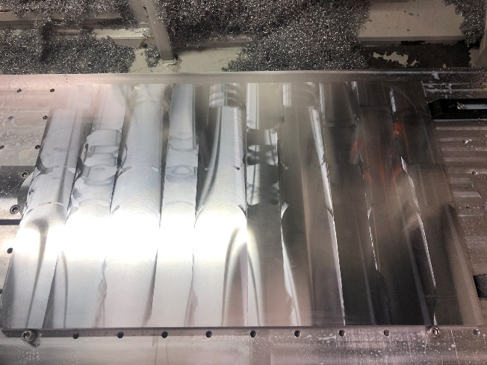
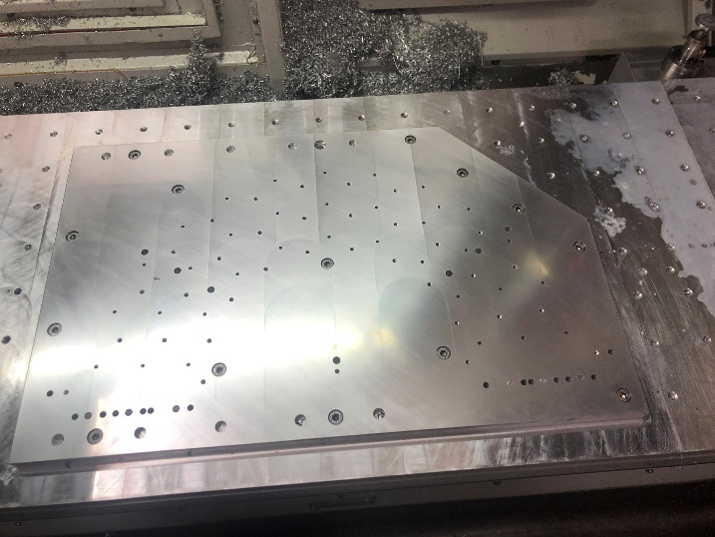
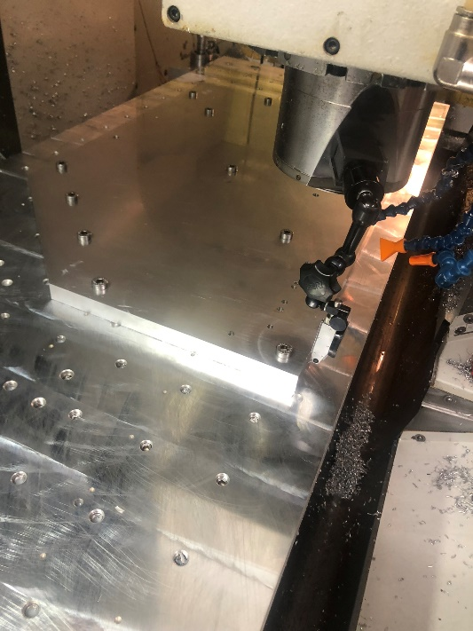
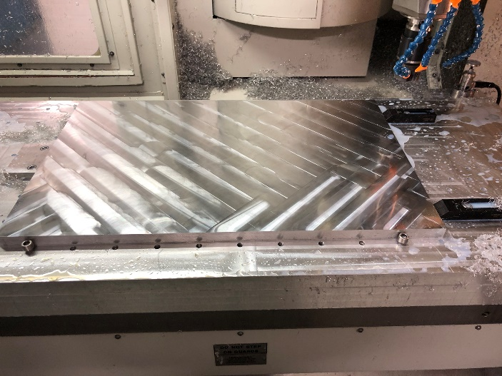
Showcase
Parts for Atlas half cylinder assembly
Notes:
8
These are parts for the Atlas half cylinders. Although they look quite simple they are in fact had very tightly tolerances. 25µm on thickness with 50µm on parallelism. Thankfully Dan has been very careful in his procedures and has achieved this well.

Slide 9
Showcase
Celebrating G-2’s success
Notes:
9
Several members of our team were heavily involved with the manufacture of the G-2 detectors so it was fitting that we also produced the mementos to celebrate the first runs success.

Slide 10
Future enhancements
We have been fortunate in the last round of capital investment we are looking at different options for a large 5-axis milling machine which will replace some older equipment that we have
Space is a real issue for us, so we are looking at how best to relocate equipment to enable a more efficient working environment
Notes:
10
We have been incredibly fortunate in receiving funding for a new large area milling machine. We are only able to position a machine of this size in one place within our machine shop, this means that walls need moving in the coming year and many if not all of our machines will need to be repositioned. This will cause considerable disruption, we will endeavour to keep at least one lathe and milling machine operational during this period and we ask for your patients.

Slide 11
Onyx (Nylon + chopped Carbon fibre) 3D printed parts
AML
Co-curing using carbon foam core structures
Mu3e
Notes:
11.
Here we see co-curing this is where the foam core is bonded to the carbon fibre which then goes on to be bonded into the main layup. We also see 3D printed parts which is also impregnated with carbon fibre. Finally we have Mu3e structure which has a tensioning assembly made from carbon fibre.

Slide 12
AML
Prototypes for Atlas half cylinders
Notes:
12.
AML have continued to produce Prototype Half Cylinders for Atlas. Here you can see the various stages of production using tooling provided by the DDMF.

Slide 13
Moving on
Congratulations Matt
Matt joined us a few years ago and made a positive impact to our team.
Matt is always happy to take on challenges and always produced precision parts in a very professional manner.
We are all very happy that Matt has been able to continue his career with us in Physics, we look forward to working with him in his new capacity as a Design Engineer for Particle Physics.
Notes:
13
Congratulations to Matt Brown. Matt is leaving the machine shop and is taking a seat upstairs in the design office. We wish him the best of luck!

Slide 14
None of this would be possible without…
Daniel Hollywood
Rob Malley
Mark Farrell
Tony Watling
Matt Brown
Paul Sinclair
Kieran Bridges
Paul Cook
John Kervin
Emlyn Jones
And Kevin McCormick
A massive thank you to them for their excellent effort, help and support throughout what has been another challenging year
Notes:
14
Obviously, none of this is possible without all these people. I would like to give a really big thank you to all of them. So, Thank you.

Slide 15
That’s all folks
thanks for listening
Notes:
15

