Slide 1
Atom Interferometry for Fundamental Physics
Henry Throssell
Supervisors: Jon Coleman & Carl Metelko
14/06/22

Slide 2
Atom Interferometry
Analogous to optical interferometer.
Superposition of atoms are each arm of the interferometer.
Pulses of laser beams act as beamsplitters and mirrors.
Phase differences arise from external interacting fields.

Slide 3
Ultra-Light Dark Matter and Gravitational Waves
Strain sensitivity of MAGIS-100 to gravitational waves.
Sensitivity of DM coupled to the mass of the electron.

Slide 4
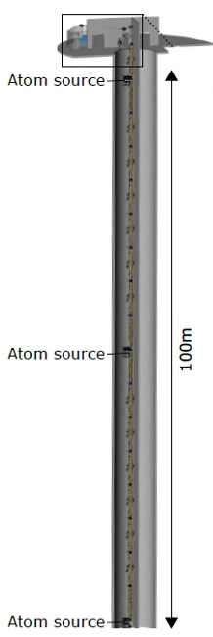
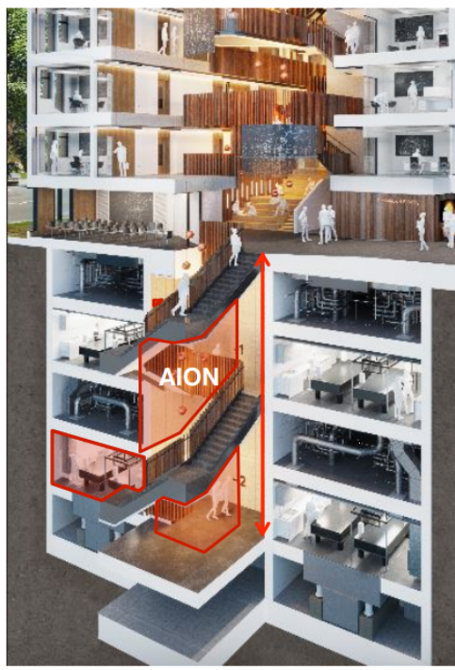
MAGIS and AION
MAGIS-100: Testbed for a kilometre baseline detector.
AION-10: Prototype for 100m + kilometre baseline detector to take simultaneous measurements with MAGIS
Both use Sr atomic clock technology.

Slide 5
Upgraded Interferometer at Liverpool
Rb⁸⁵ atomic fountain.
1m Baseline.
R&D for interferometer technology.

Slide 6
Retro Reflection Chamber
Out-of-vacuum chamber for the upgraded interferometer.
Interferometry beam reflection.
Beam diagnostics.
Phase shear readout.
Tip tilt mirror with 1.3mrad range and 50nrad precision.
Positioned on an active vibration isolation platform.

Slide 7
Vibration Isolation Platform
Seismic data with different levels of vibration isolation
Photo of experimental set-up in the VC room

Slide 8
Conical Mirror Magneto Optical Trap
Novel source of cold atoms for interferometry.
Decreases 3D MOT loading time and reduces background.
Magnetic scans used to deduce optimal MOT/atom beam conditions.

Slide 9
Shim Coil Characterization
Schematic of conical mirror atom trap
Calculation of Anti-Helmholtz coils
Effect of adding a shim coil to the Anti-Helmholtz in the Z-direction

Slide 10
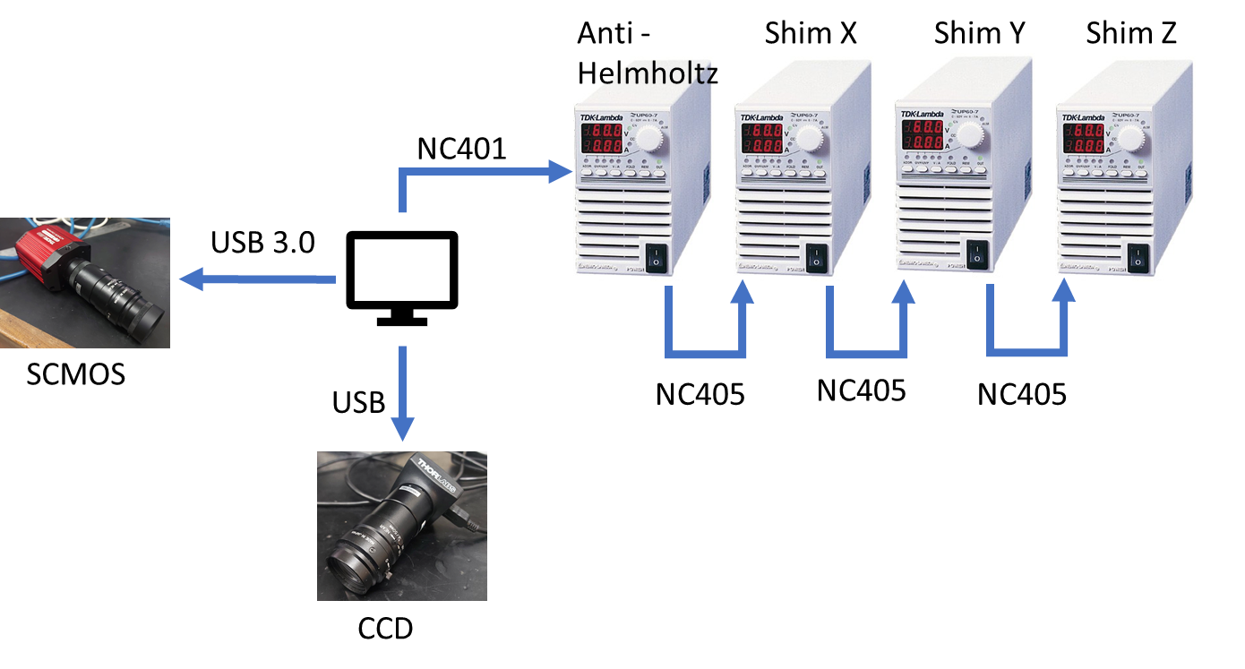
Cold Atom Beam Control System

Slide 11
Back Up Slides

Slide 12
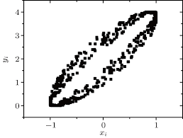
Phase Shear Readout
Additional tilt to final interferometry pulse imprints a fringe pattern.
Interferometry phase can be inferred from fringe pattern.
Allows for single-shot detection.
Conventional interferometry requires 100s of sequences for single measurement.

Slide 13
MOT and Atom Beam Imaging
Photo of illuminated Axicon
Subtracted image of an interference pattern on the axicon

Slide 14
Future Work
Characterize atom beam from the conical mirror trap.
Assemble retro reflection chambers for MAGIS + Liverpool.
Take initial data + analysis for MAGIS + Liverpool

