Slide 1

Future Sensors for Precision Physics
Gianluigi CASSE
Silicon sensors are the most diffuse position sensitive device in particle physics experiments and countless applications in science and technology. They had a spectacular progress in performance over almost 40 years since their first introduction, but their evolution is now slowing down. The position resolution for single particle hits is larger than a few microns in the most advanced sensors. This value was reached already over 30 years ago. The minimum ionising path length a sensor can detect is several tens of microns. There are fundamental reasons why these limits will not be substantially improved by further refinements of the current technology. This makes silicon sensors unsuitable to applications where the physics signature is the short path of a recoiling atom and constrains the layout of physics experiments where they represent by far the best option (such as high energy physics collider experiments). In perspective, the availability of sensors with sub-micron spatial resolution, in the order of a few tens of nanometres, would be a disruptive change for the sensor technology with a foreseeable huge impact on experiment layout and various application of these devices. For providing such a leap in resolution, we propose a novel design based on a purely digital circuit. This disruptive concept enables pixel sizes potentially much smaller than 1µm² and a number of advantages in terms of power consumption, readout speed and reduced thickness.

Slide 2
OUTLINE
Silicon detector technology
Tracking:
  Expected challenges
  Obsolescence
  Emerging trends
  New concept
Photodetection:
  Status

Slide 3
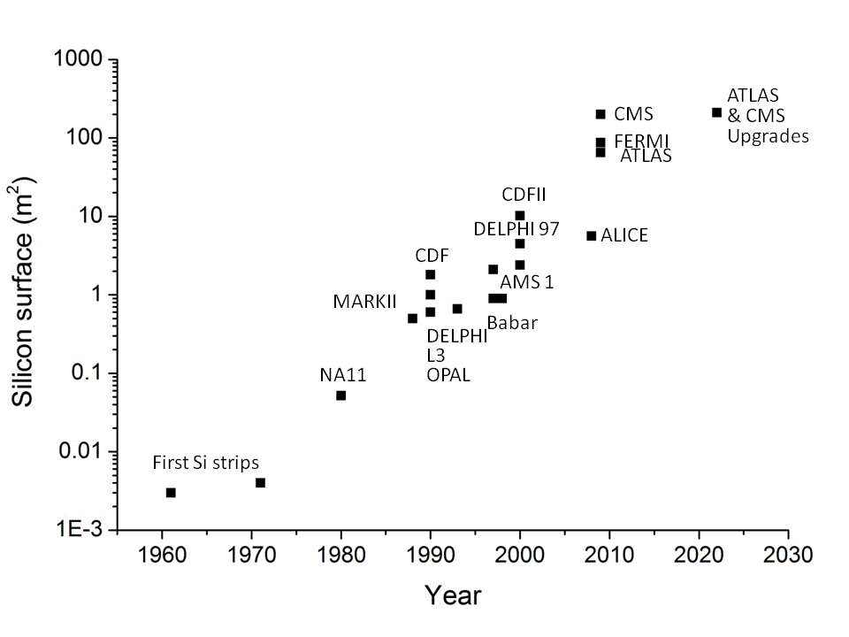
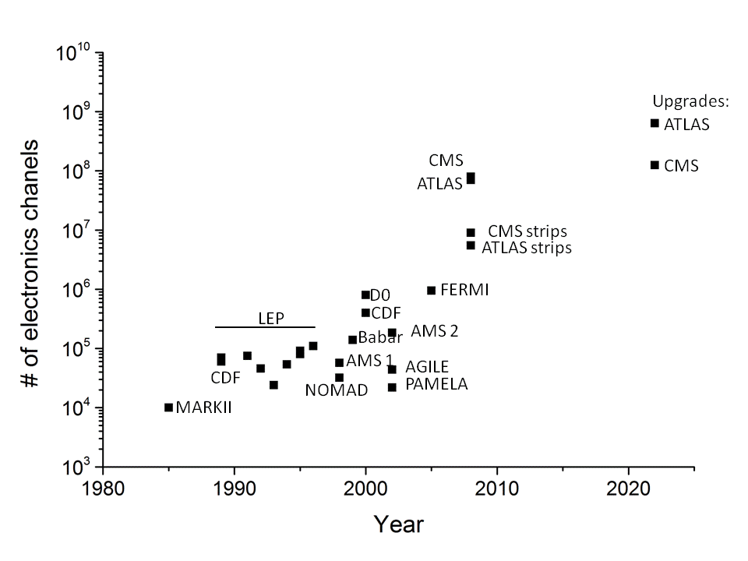
The Spectacular success of Silicon detectors
UA2

Slide 4
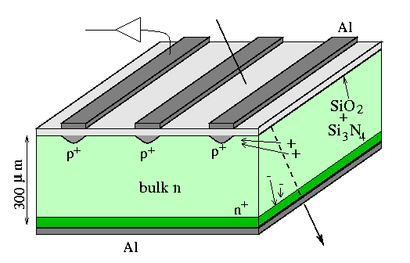
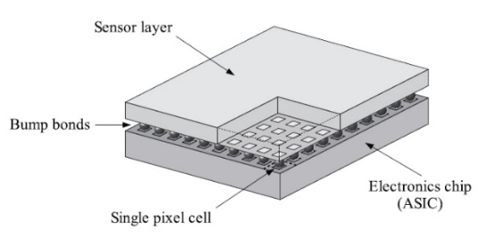
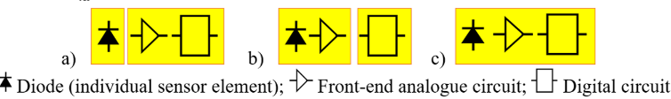
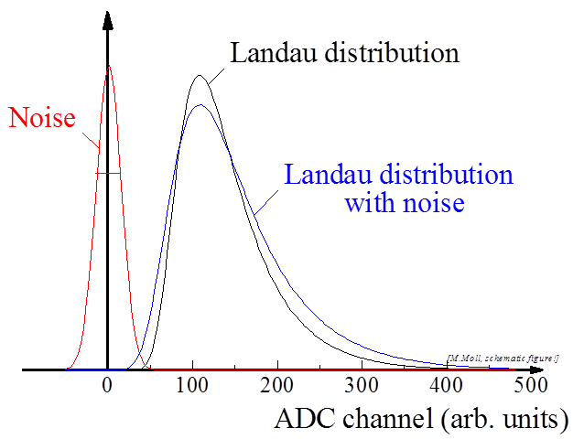
Signal and electronics chain:
Reverse-biased diode collects ionisation charge.
Analogue amplification
Digital processing circuits.
These 3 functional blocks can be on separate chips (hybrid) or on the same chip (monolithic).

Slide 5
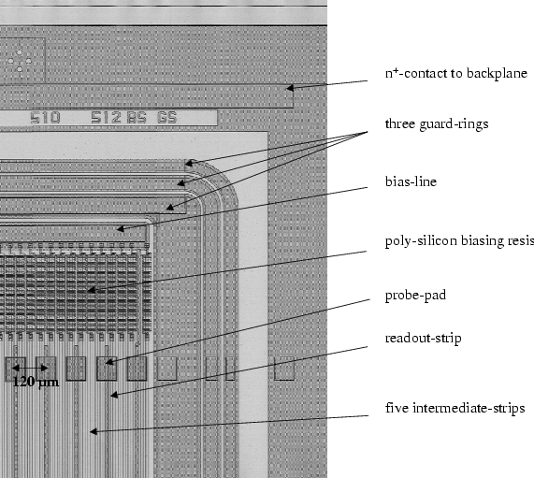
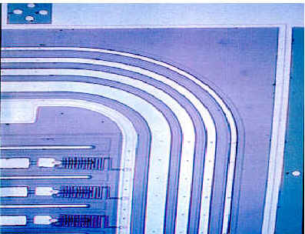
The most used sensor type
  Backplane contacts
  Guard rings
  Bias resistors
  P-strips
  Al readout strips
  Coupling capacitors
  …
Large potential difference at a sharp edge, gives high field, i.e. discharges.
Multiple (floating) guard-rings to between bias and ground (notice smooth corners)

Slide 6
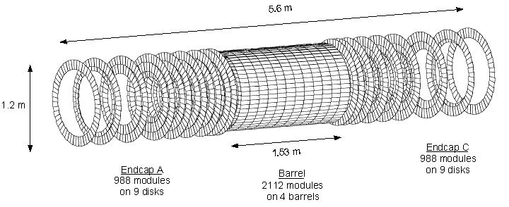
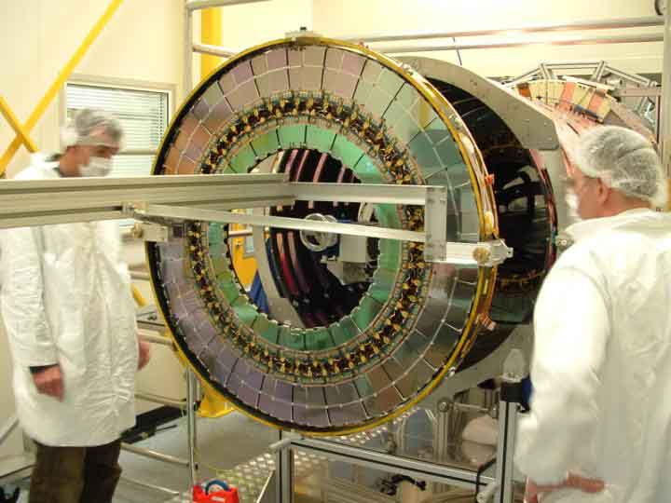
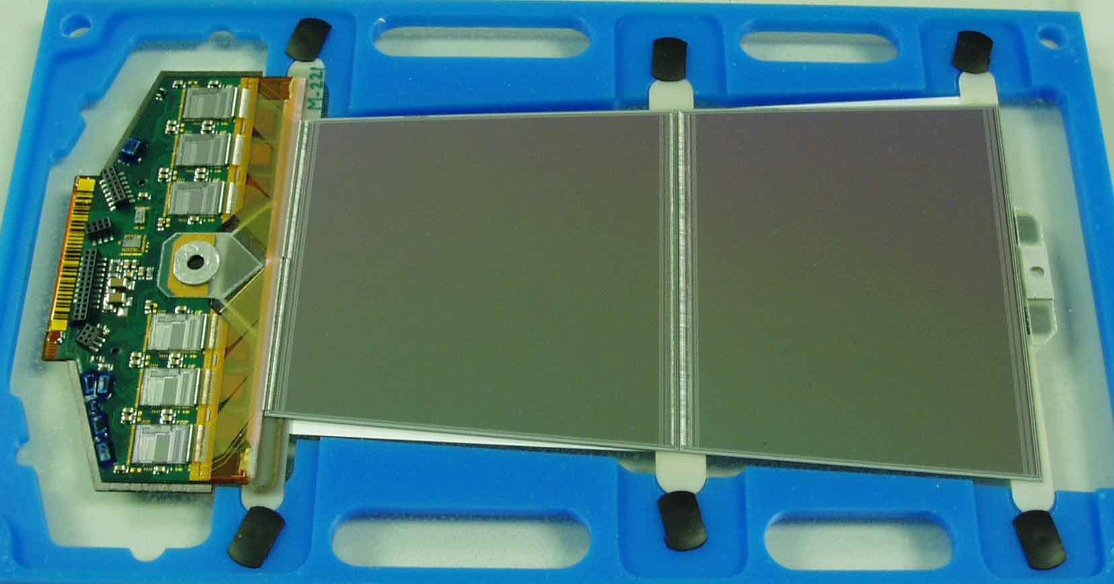
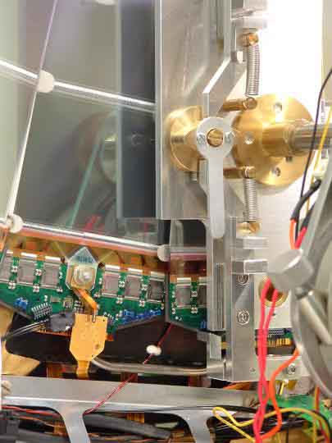
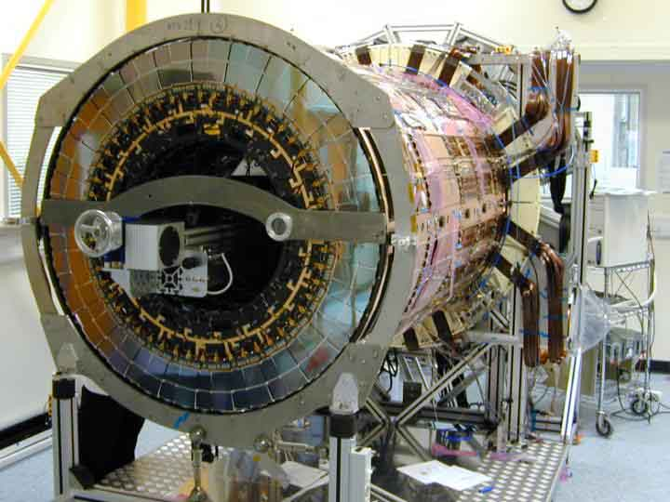
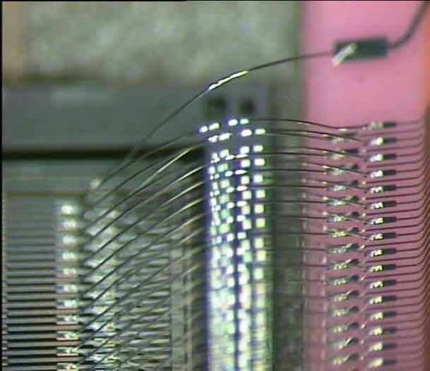
ATLAS SCT
ATLAS SCT
Large area (~60 m²) of silicon tracker
>4000 modules, ~6 Million channels
Resolution: rφ ~ 16μm

Slide 7
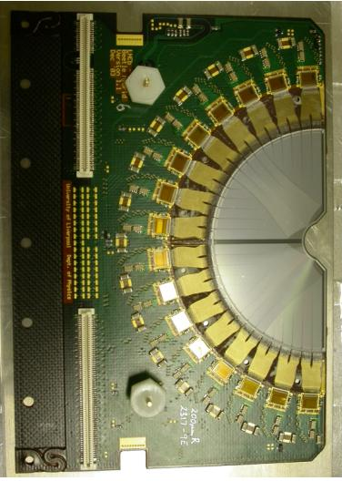
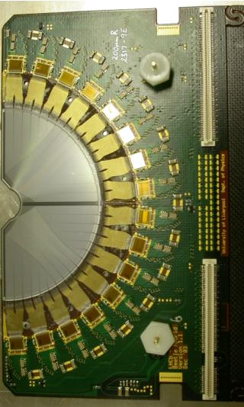
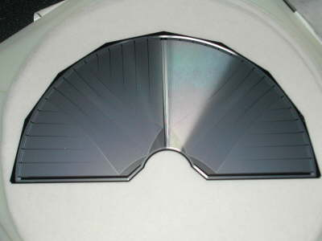
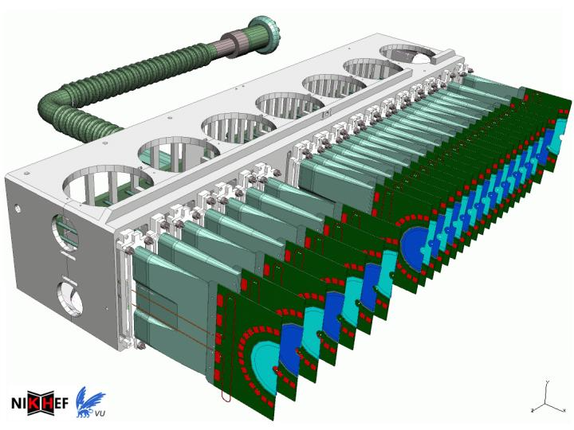
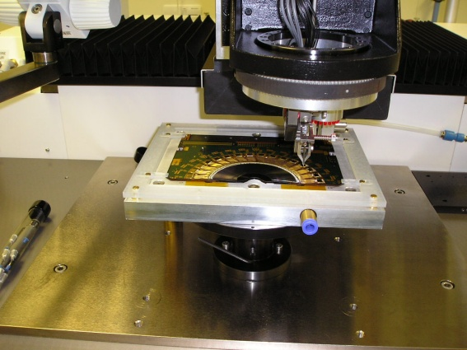
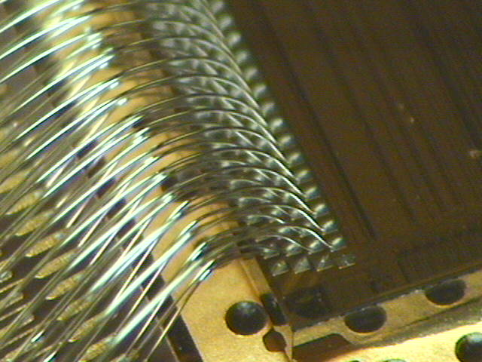
LHC-B Vertex Locator
Beam
Trigger on b-decay vertices:
in high rate environment
inside secondary vacuum close to the beam .
Silicon strip detector with 21 stations that move close to the beam.

Slide 8
Are silicon microstrip detectors phasing out?
Advantages:
Thin (ish)
Extremely mature technology
Produced mostly by niche manufacturers and HPK
Disadvantages
Problematic in high density track environments
High resolution and timing depends on ROC analogue performance
Produced mostly by niche manufacturers and HPK

Slide 9
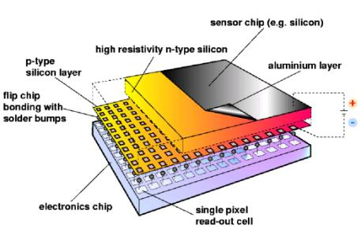
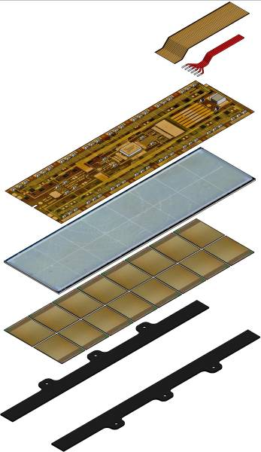
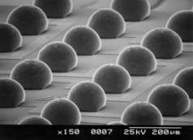
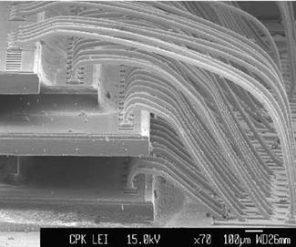
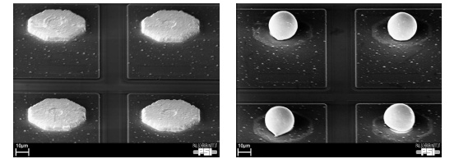
The most used sensor type in high multiplicity environments

Slide 10
Hybrid pixel optimal solution for inner layers?
Advantages:
Can be made thin (ish)
Mature technology
Pixel size down to 50x50 µm
Potential for high speed readout
Radiation tolerant
Disadvantages
Problematic ROC
Expensive technology, bump bonding can be limiting factor
High power required
Produced mostly by niche manufacturers and HPK

Slide 11
Emerging solution: D-MAPS
Monolithic active pixels emerge as best solutions in a number of experiments, current and future.
Advantages:
Can be made really thin
Technology improving at good pace
Pixel size down to 30x30 µm
Potential for high speed readout
Potential for radiation tolerance
Easier support and service structures
Lower power consumption wrt hybrid pixels
Produced by CMOS industrial manufacturers
Disadvantages
Technology dependence on specific CMOS processing

Slide 12
State of the art ASICs, ALPIDE

Slide 13
A lot of flexibility is offered by D-MAPS

Slide 14
Crucial for radiation tolerance and timing : very high voltage, back side bias

Slide 15
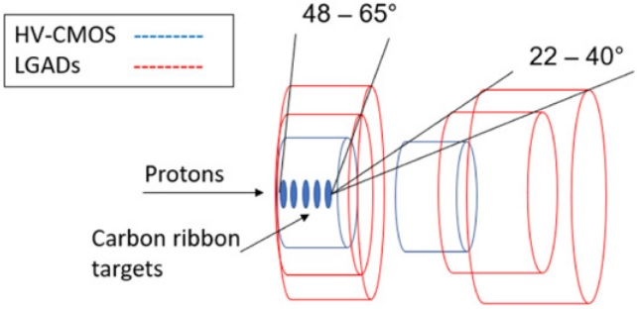
Dual silicon technology – LGADs + High Voltage CMOS
proton Electric Dipole Moment (pEDM)
New experiment to make an improved measurement of the pEDM
Proposed by the JEDI collaboration at the COSY synchrotron in Germany
Dual silicon technology detector
Thin HV-CMOS sensors for accurate tracking
Picosecond-fast Low Gain Avalanche Diodes (LGADs) for accurate timing
In-vacuum operation
To measure the emission angle and energy (from time-of-flight information) of scattered protons
J. Gooding, JINST 2022
LGAD telescope
Notes:
-) The requirement on timing is much beyond the capabilities of improved HV-CMOS sensors;

Slide 16
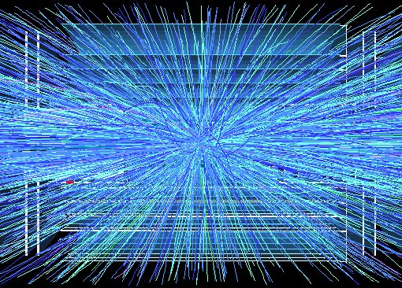
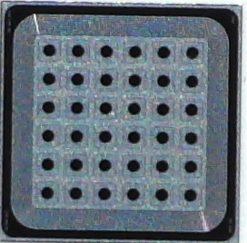
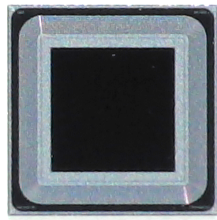
Emerging technologies: 4D tracking
Low Gain Avalanche Diodes
Simulated and reconstructed vertices in a 200 pileup event with a MIP timing detector.
4D silicon sensors developed before the expression of interest of experiments (within CERN RD50).
Example of virtuous synergy between sensor R&D and physics needs.
A silicon detector that looks like a normal pixel or strip sensor, but with a much larger signal
High signals also with thin silicon substrates
Better timing performance
Improve SNR of the system (When the sensor shot noise is not dominating)
Low gain -> low excess noise
Available in different formats (pixels, strip sensors, single pads)
Single pad
Pixel Array

Slide 17
LGAD
n⁺⁺
LGAD = Silicon detector provided with internal Gain in the range
~ 10 - 20
P-type substrate
P-stop
Gain Layer P+
N-deep
The basic structure is based on a standard p-i-n planar junction
A “multiplication region” or “gain layer” is included in the structure
(local doping enrichment)
High-Field region: Electric Field > 2e5 V/cm to activate the impact ionizing multiplication

Slide 18
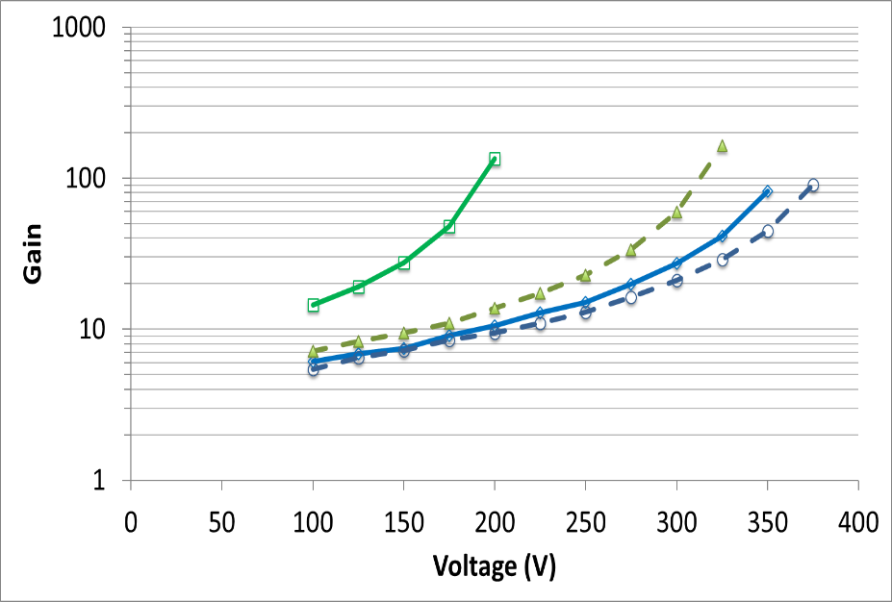
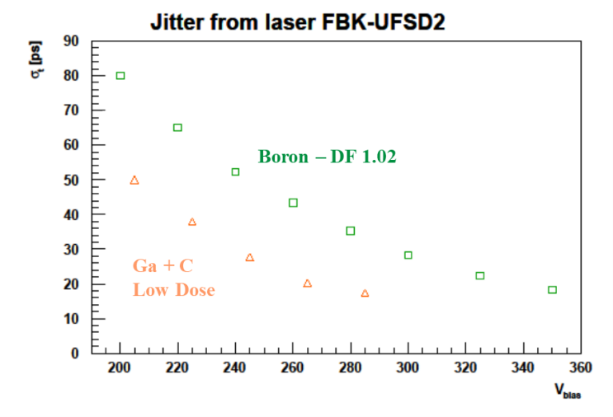
LGAD – Gain and timing
The Detector Gain depends on:
  implantation dose of the Gain layer
  Bias Voltage
Samples with higher dose have higher gain at lower Voltage
Gain vs Bias Voltage
Split 4
Split 3
Split 2
Split 1
1x1 mm2 pads with different split of Gain layer.

Slide 19
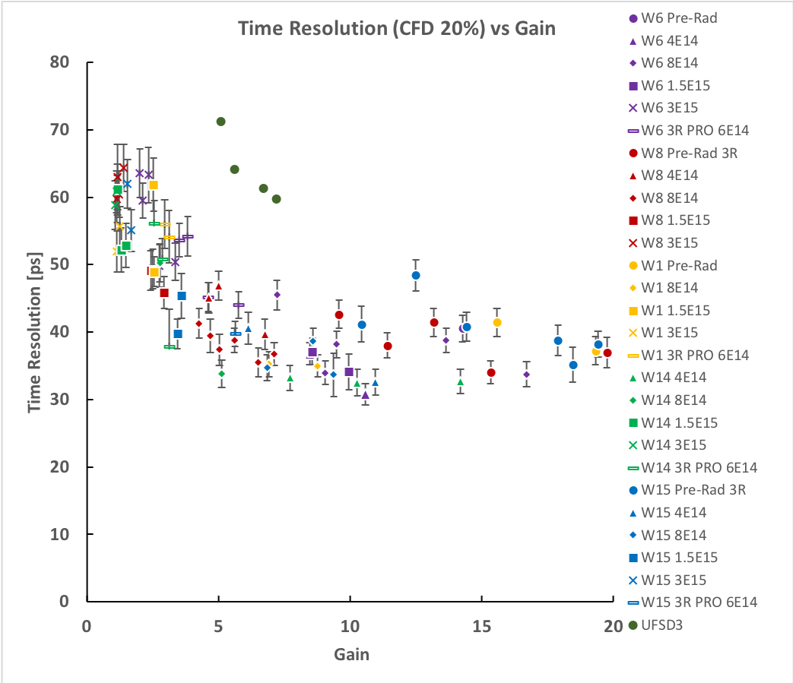
Radiation Hardness: Time Resolution
Boron + Carbon co-impantation
Carbon co-implantation mitigates the acceptor removal effect and preserves the time resolution up to 8e14 neq/cm2
Boron (wide Gain implant profile)
Boron (narrow Gain profile)
Gallium
(B+C @ 8e14 neq)
Gallium + Carbon co-implantation

Slide 20
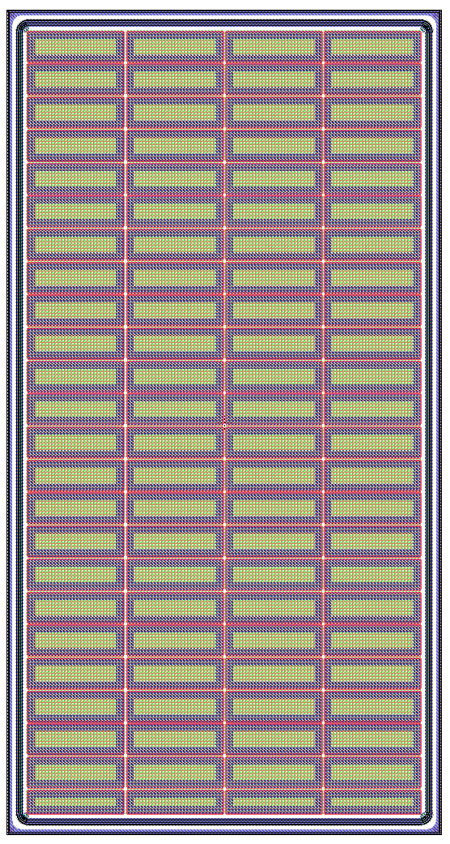
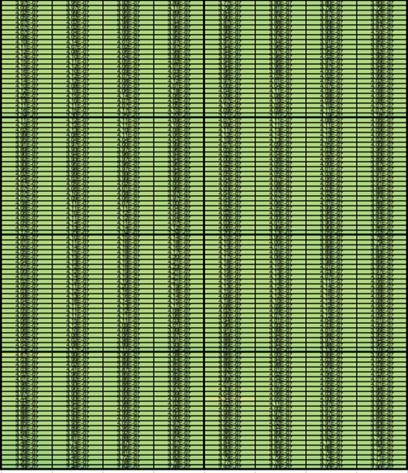
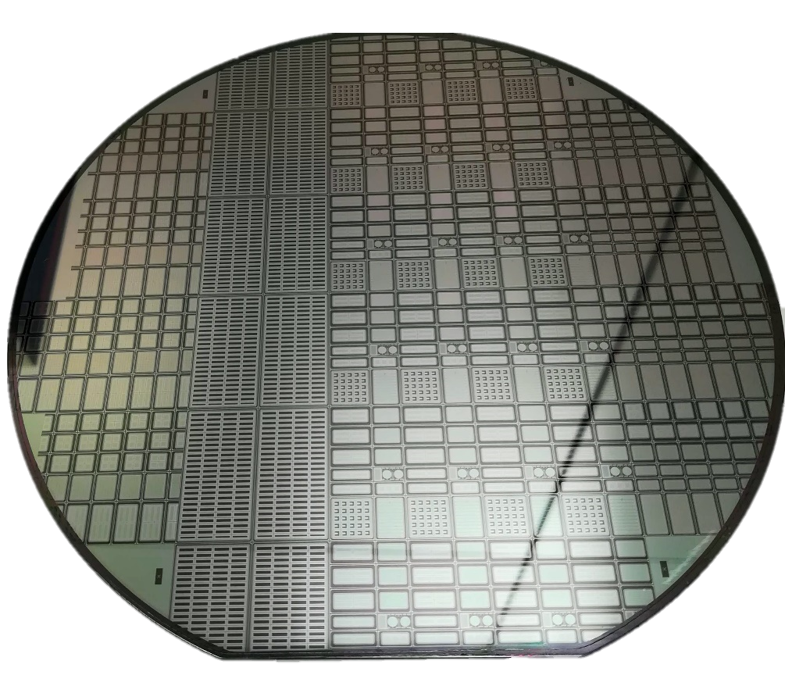
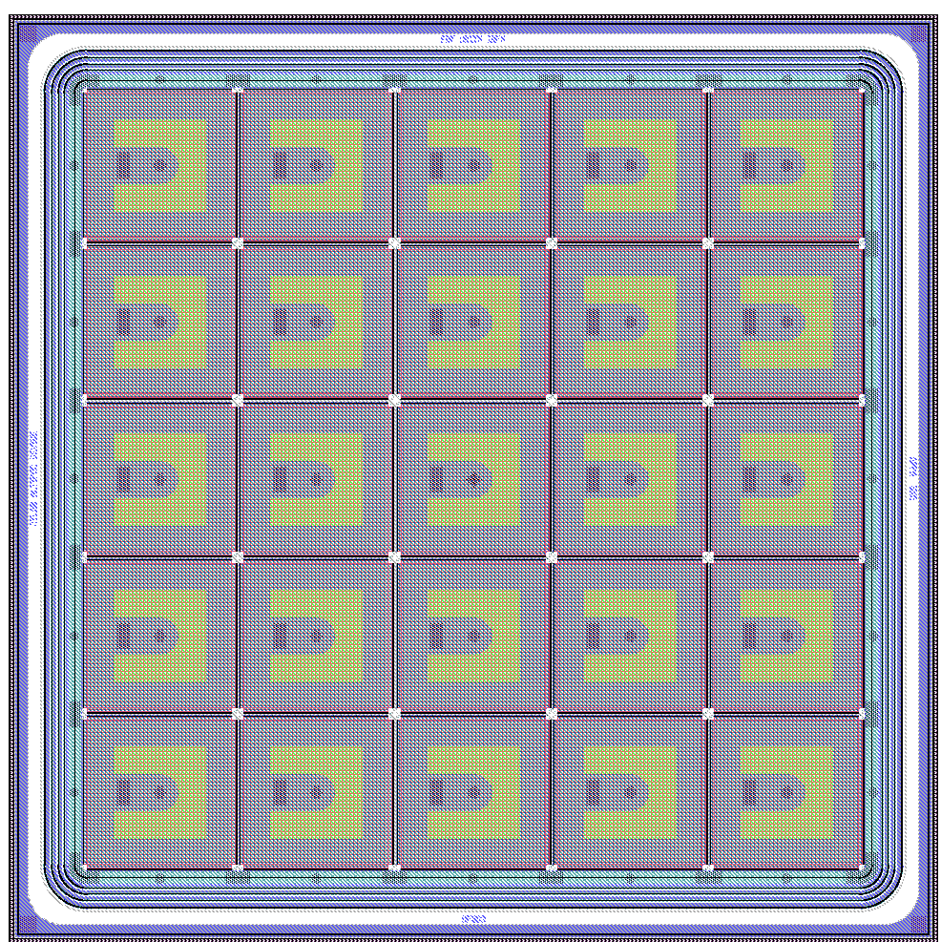
Large Area Arrays
CMS ROC
768 working channels
Pad: 3 x 1 mm²
Array 4 x 24 pads
Array Size: 13.2x25.0 mm²
8 full arrays per Wafer
ATLAS ALTIROC
Pad: 1.3 x 1.3 mm²
Array 5 x 5 pads
Array Size: 8.0x8.0 mm²
20 full arrays per Wafer

Slide 21
MAPS + Timing

Slide 22
More disruptive approaches!
Industrial 3D (2.5D) vertical integration
Digital sensors

Slide 23
Moore’s law is broken in sensor evolution.
Technology first adopted for Si sensors
Reduction of the transistor channel length (feature size, S) over the years.
First functional 65 nm ASIC produced in spring 2018 (RD53)
End of technological trajectory!
Feature size exploited for mixed signal pixel devices for particle detection.
New paradigm needed!
Pixel sizes followed Moore’s law, but this stopped at 65nm feature size.
For mixed signal devices there is little gain in going to smaller nodes.
End of technological trajectory for mixed signal devices is happening now.
Fully digital devices are the way forward.

Slide 24
State of the art devices: hybrid pixel ASICs
RD53 65 nm CMOS pixel readout chip for extreme data rates and radiation levels (V. Re et al., CERN/RD53 collaboration)
Advanced readout chip for the pixel layers of ATLAS and CMS Upgrades at CERN.
Analogue area
50 µm
Expected position resolution > 15 µm.
50 µm
Orders of magnitude more transistors per area in the digital section compared to analogue area.
The latter cannot be reduced!
Today’s pixel size cannot be reduced much further, even with smaller feature size

Slide 25
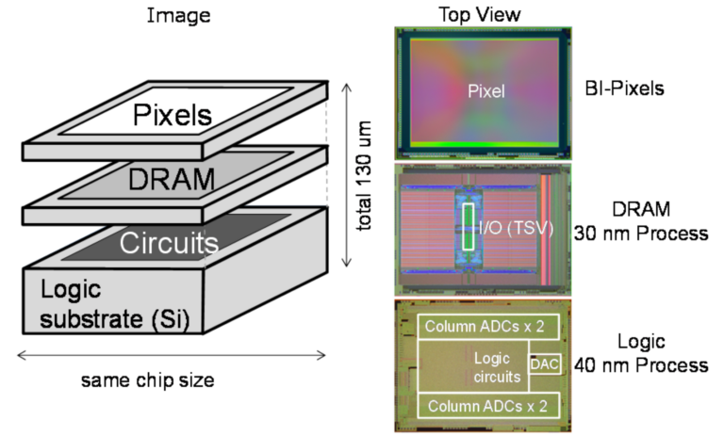
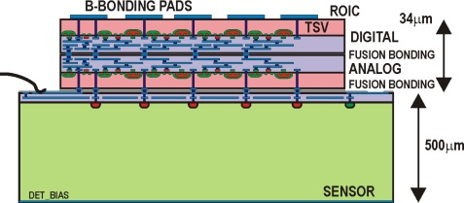
A solution yet to come ….
Vertically integrated stack: sensor, analogue, digital, low capacitance connections, low mass and low power.
This can enable use of smaller digital CMOS,
A different feature size CMOS for analogue, a segmented diode layer.
At vertical integration manufacturer (post-processing)
At foundry or post-processing
< 50 µm
< 50 µm to 500 µm

Slide 26
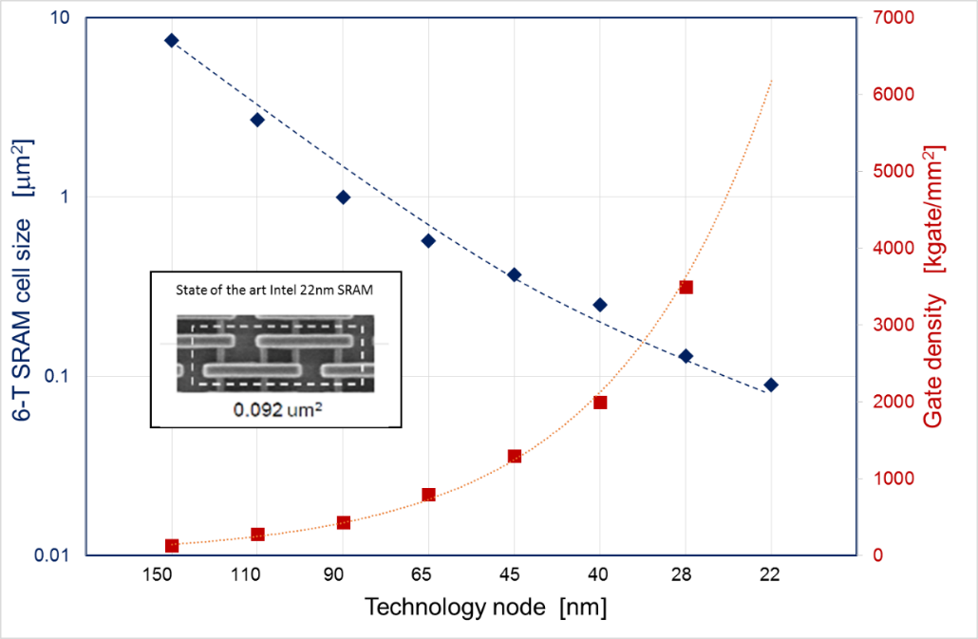
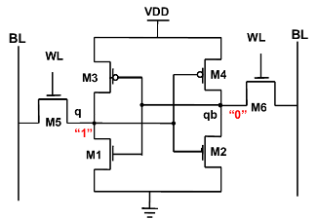
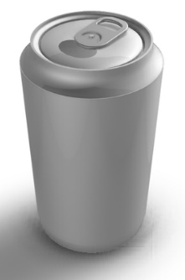
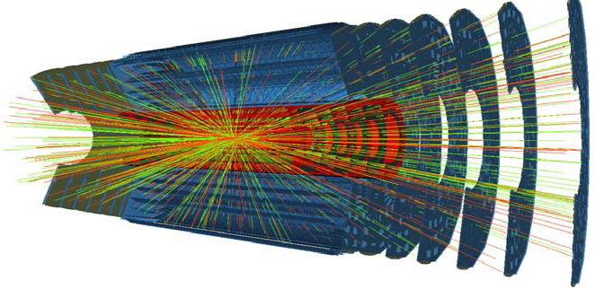
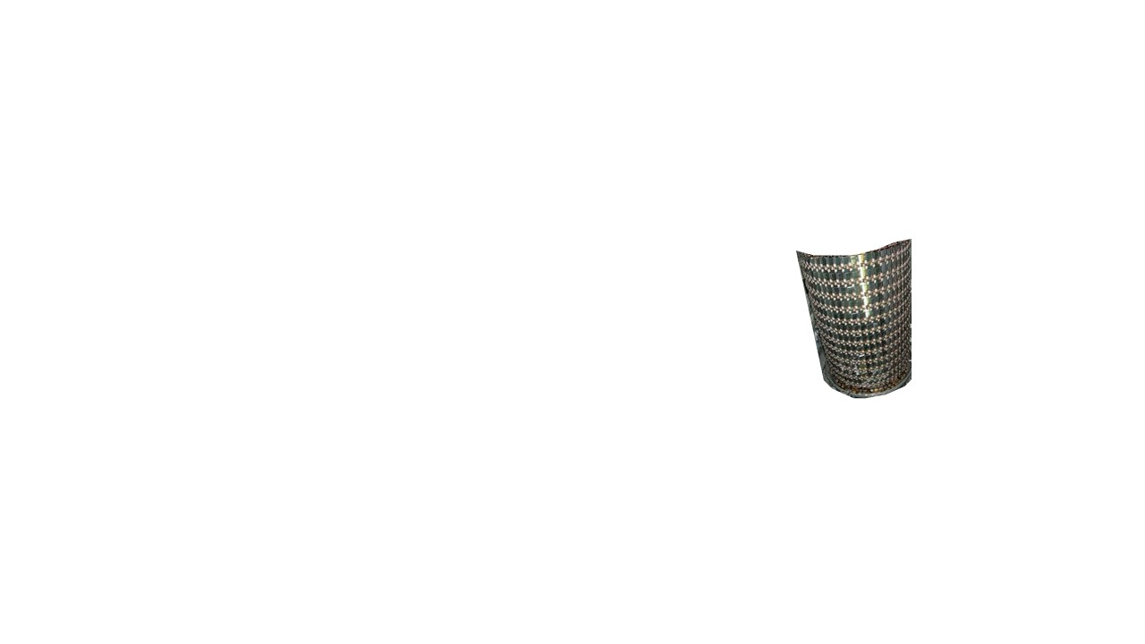
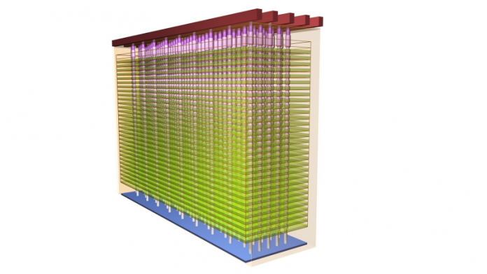
Digital sensors: inspired by stacked memory cells.
Modify cell design for susceptibility to radiation induced bit-flips
Current ATLAS silicon tracker
1.1 m
5.5 m
Digital-only sensor to bring sensor technology back on track with Moore’s law
Small pixels with reduced number of transistors per pixel
A factor 100 improvement in position resolution
Low power
Multiple detection layers
3D pixel array with sub-micron position resolution and live readout
→ Live Emulsion (LEmu) sensors

Slide 27
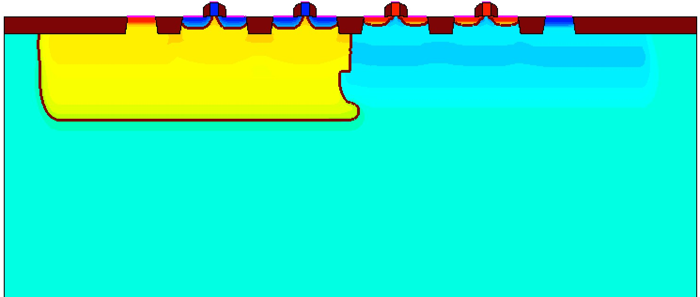
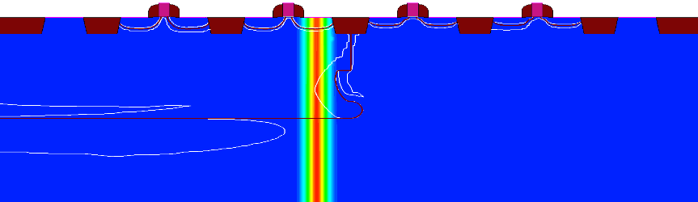
Feasibility Studies
Dependence of Threshold Charge (C_{T}) on reference voltage and CMOS feature size. TCAD and Cadence simulations (factory design kit).
Agreement is found with the two methods.
Cadence simulations, 3 transistor designs
MIP sensitivity
vdd
CLK
CLK
gnd
n+
p+
p+
p+
p+
n+
n+
n+
n+
p+
NWELL
PWELL
p-substrate, ρ = 10 [Ω∙cm]
vdd
CLK
A
B
CLK
gnd
Estimated
NWELL
PWELL
The required sensitivity to alphas, ions, recoils is reached in a 150nm process already, 65nm CMOS yields sensitivity to MIPs! Further scope for improving sensitivity:
optimised design of the sensitive nodes
pre-charging the circuit sensitive node
smaller feature size technology
p-substrate, ρ = 10 [Ω∙cm]
Minimum ionising particles (MIPs) | 80 – 800 e⁻
X-rays | 500 – 5000 e⁻
Fast alphas (1 MeV) | 3000 – 300000 e⁻
Stopping ions | 5000 – 100000 e⁻
Recoiling nuclei | 5000 - 20000 e⁻

Slide 28
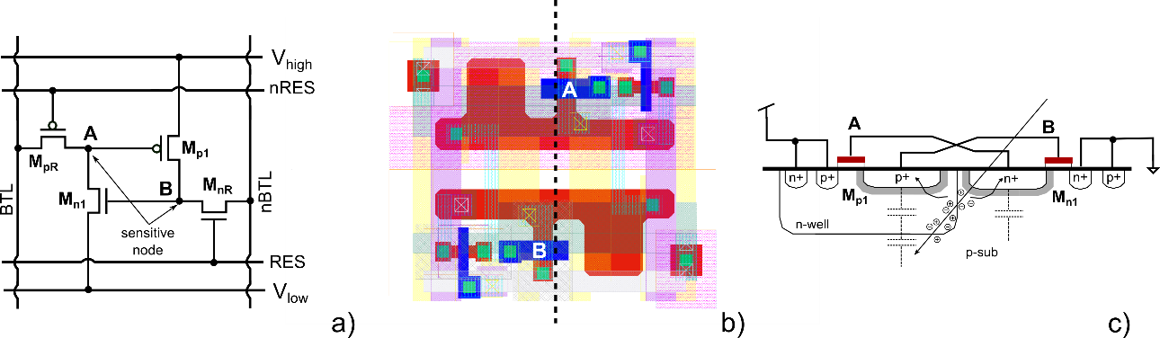
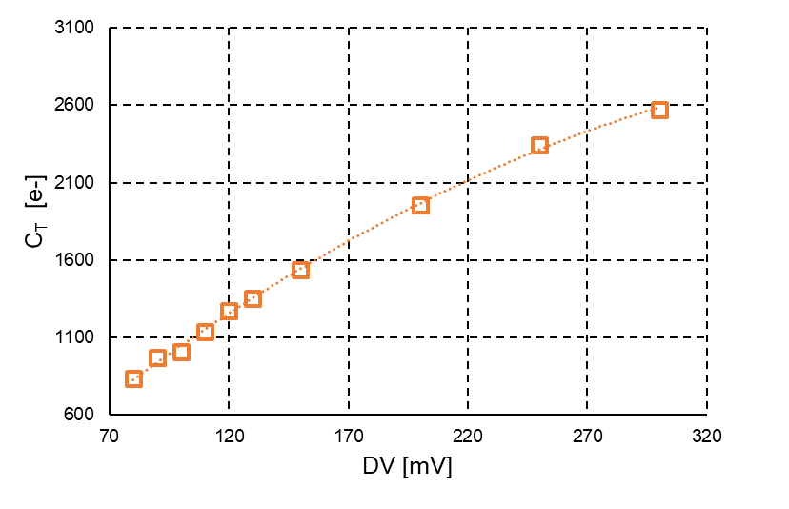
Various layout ideas: LEmu
Circuit schematic, cell layout and vertical cross section of a possible LEmu cell.

Slide 29
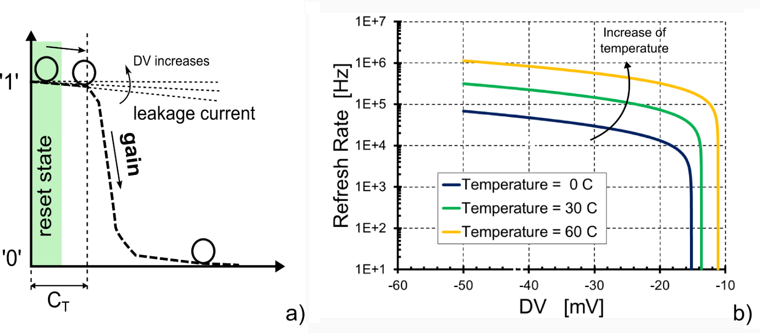
Operations of LEMU cell
c)
a) Working principle of LEmu; b) simulated refresh rate to suppress dark rate induced by leakage current at different temperatures; c) simulated Threshold charge (C_{T}) to flip the cell for two different designs.

Slide 30
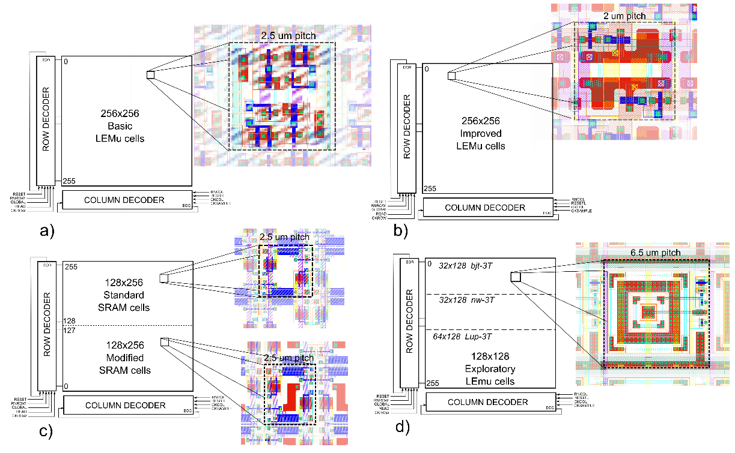
Implementing designs for an MPW UMC 65nm run
Prototype detector with four different arrays: a) 256x256 basic 8T; b) 256x256 improved 4T type; c) 128x128 standard and 128x128 modified SRAM; d) 128x128 exploratory.

Slide 31


Implementing designs for an MPW UMC 65nm run
a)
b)
Switching probability of four test pixels (Lemu circuit) as a function of the injected charge, with DV fixed at 100 mV. The value of charge at which the curves cross the 50% probability is taken as C_{T}.

Slide 32
Results: pulsed laser (410 nm) injection in LEmu
Response to laser with 10 pulses for each integration time (>DV ~ 100mV).
Response of the sensor to two and a single laser pulse (DV ~ 100mV).

Slide 33
Results: pulsed laser (410 nm) injection in the exploratory sensors
Laser spot measured with the three test sensors: Latch-up, 3T, 3T-bjt. Note that the spot diameter is about 100µm

Slide 34


Results: alpha particles (²⁴¹Am) injection
a)
b)
Lemu response to alpha particles: A metallic shield is interposed between the source and the detector in order to cover about half of the surface to the radiation.
Variation of the detected flux of particles as a function of DV.

Slide 35
Status of SiPM

Slide 36




NUV-HD-LowCT SiPM technologies in FBK
Low optical crosstalk technologies can be obtained by inserting material that absorbs or reflects secondary photons, emitted by the avalanches in the microcells.
Electric field engineering increases PDE compared to standard NUV-HD technology.
PDE at 420 nm vs. OV
Up to 70%!
PRELIMINARY
Light absorbing material is placed inside trenches, between adjacent microcells
DiCT vs. PDE
SEM image of trenches, separating adjacent microcells.
>60%
Measurements on 40 µm cell size SiPMs, with silicone resin coating
Metal in trenches is under development..

Slide 37





DarksSide-20k Experiment
> 3-year long collaboration between FBK and DarkSide to optimize performance of the NUV-HD technology for the specifications of the project.
~ 23t of UAr
TPB WLS:
emission at 400 – 450 nm
WCD
LAr TPC
LSV
2 light readout planes: 20 m²
(+ veto)
SiPM tiles
DarkSide-50
PMT-based TPC
DarkSide-20k
SiPM-based TPC

Slide 38


Primary DCR reduction
Thermal generation
25 um cell
> 7 orders of magnitude !
Standard field
Tunneling
> 20x
Low-field
0.3 counts per day per cell at 77 K!
A 10x10 cm² SiPM array would have a total DCR < 100 cps!

Slide 39


VUV–HD
R&D focused on ARC optimization: Si₃N₄ removal and preservation of surface passivation quality.
PDE vs OV (~190 nm)
nEXO experiment at Stanford
Best result reported in literature
𝜆 = 175 nm
T = -104°C (LXe)
arXiv:1904.05977

Slide 40
SUMMARY
Silicon detector technology offers many different solutions to experiments.
Research is pushing on the resolution, timing, low mass, low power limits, but many technologies are ready to instrument experiments, including the precision frontier.

