Slide 1
Straw Man BMS for MuonE
Using LHCb SALT ASIC

Slide 2
The BMS hodoscopes have a detector resolution of 1.3 mm for BM01-4 and 0.7 mm and 0.4 mm for BM05 and BM06, respectively.
The hodoscopes measure the beam only in the vertical (Y) co-ordinate. The system of bending magnets (Bend 6) consists of three 5 m vertical bends with 3.3 Tm bending power each.
“a BMS upgrade could be envisaged by replacing the existing hodoscopes
with detectors of much better spatial resolution, such as Silicon detectors ( σx = 10 – 50 μm)
Next Page
[We] show the improvement in the momentum resolution for a 160 GeV/c incoming beam using
the above method for different detector resolutions keeping the detector positions and number of detectors same.
For a detector resolution of 50 μm, achievable with a Silicon detector, a resolution of 0.35% can be expected”
CERN-PBC-REPORT-2018-002

Slide 5
Possible Si Upgrade
Dimensions to be determined … Straw Man
Build (150 micron to 300 micron thick) Si strips
Low multiple scattering (“cheap”)
Could be double sided for x,y rather than y only
Utilize a high speed strip chip (e.g. SALT from LHCb). 6 bit r/o
Usual problem of synchronous operation, to be studied
40-50 micron r/o pitch – and depending on geometry
Intermediate strips (to be simulated)
Should be able to achieve O(10 microns) – lower limit O(6microns)
Add timing – simulation
Possibility to add a high speed plane

Slide 6
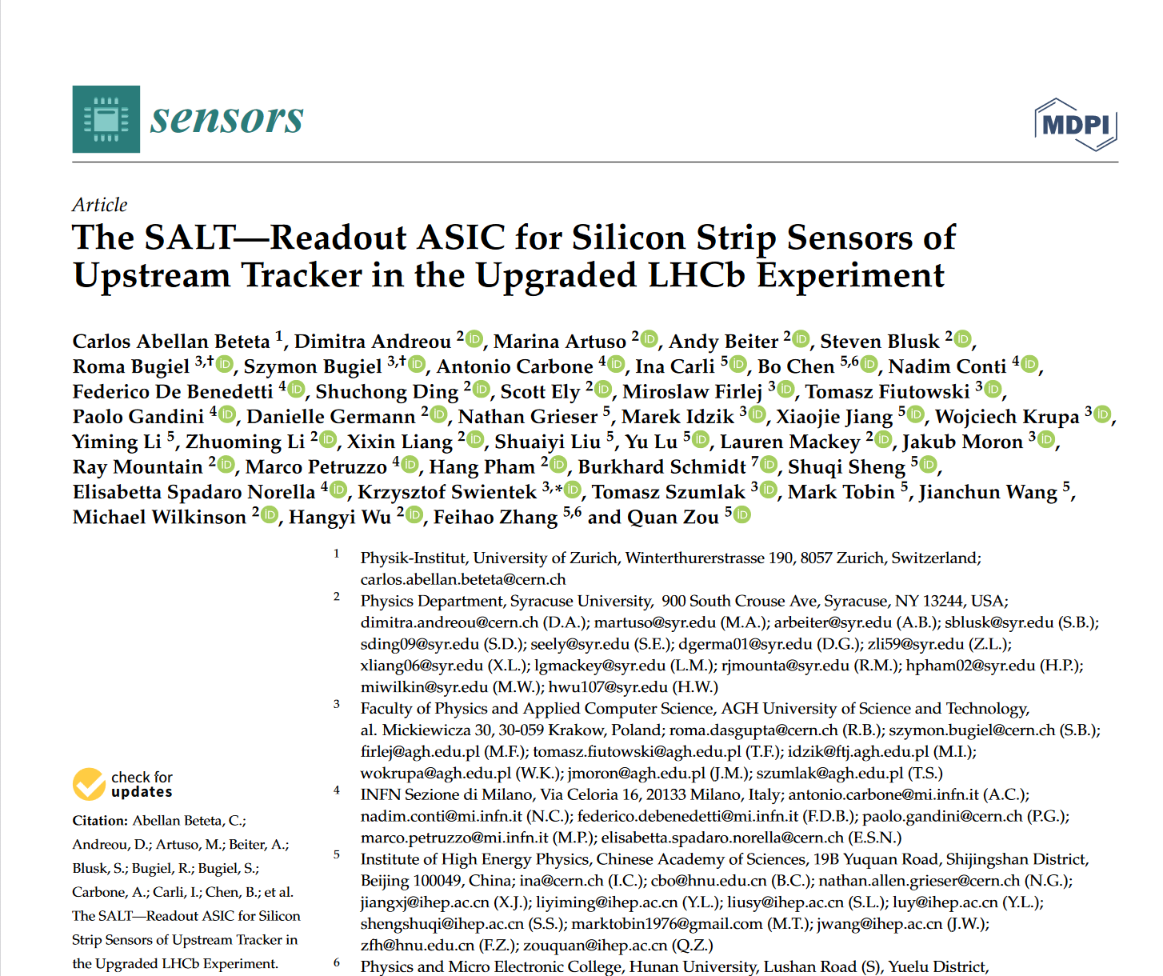
SALT Chip

Slide 7
SALT
1 fast 6bit ADC/ channel!

Slide 8
SALT – uses MiniDAQ (Lpool experts)

Slide 10
X/Y strut
Xy strut sare a simple structure easily replicated and laid up 5mm thick?

Slide 11
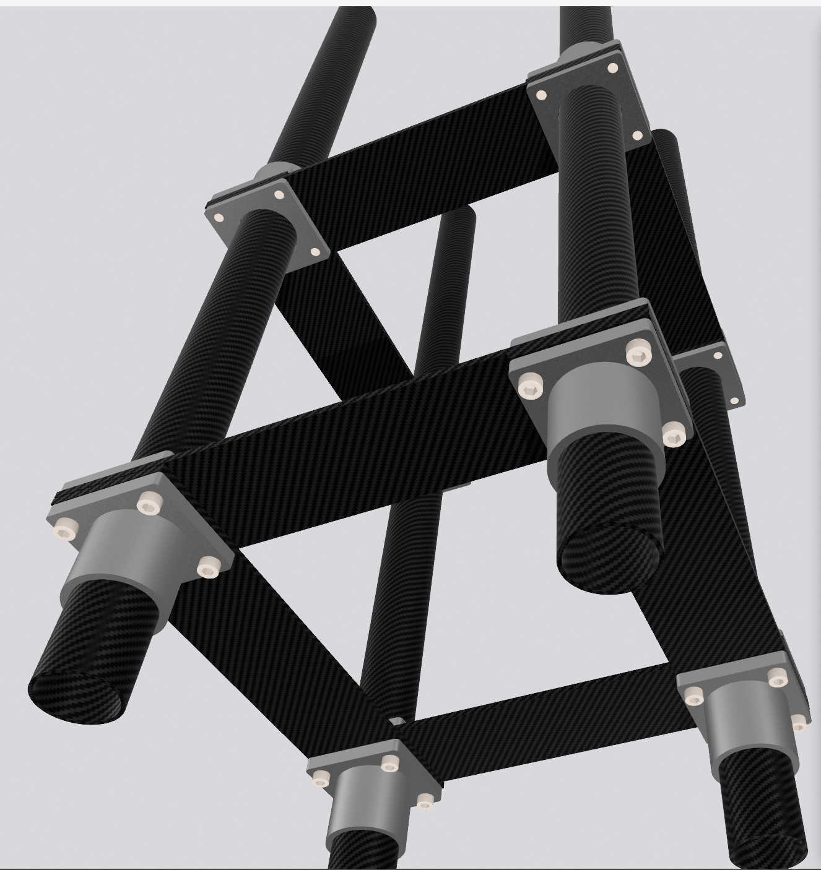
MuonE 0-CTE composite design
Outer Frame Based on large scale version of optical cube with 0CTE bars (along their length axis) giving stability to then structure
Thin bars with the 0CTE axis along their length keep the x,y coordinates fixed.
The inner frame (hybrid) could be attached via pseudo kinematic mount to this frame.
The “slides” could be locked in place with a nylon locking screw.
0 CTE

Slide 14
Layout and a few points
Multiple scattering
Rule of thumb: 1 Gev (Mip) on 300 microns Si ~ 1mR (note low energy electrons)
So expect 150/300/100 = 5 μR at high energy
We calculate @100 GeV ~ 4.9 μR (for muons)
Could (perhaps) make the detectors thinner
Adding a timing layer (!?)
Elephant in the room – no beam collisions!

