Slide 1
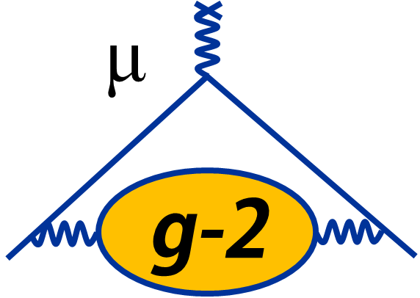
Muon g – 2 Physics Analysis Status
Kevin Labe, on behalf of the Muon g-2 Collaboration
Cornell University
Workshop on Muon Precision Physics
November 9, 2022

Slide 2
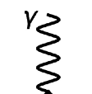
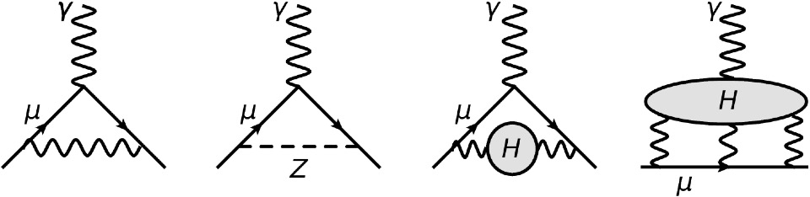
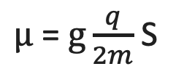
Why Muon g – 2 ?
Any new particle interacting at this vertex influences magnetic moment
$μ$ = $g\frac{q}{2m}$ S
QED
5th order
1 ppb
EW
2nd order
10 ppb
HVP
Dispersive & Lattice
340 ppb
HLBL
Dispersive & Lattice
150 ppb
Precision

Slide 3
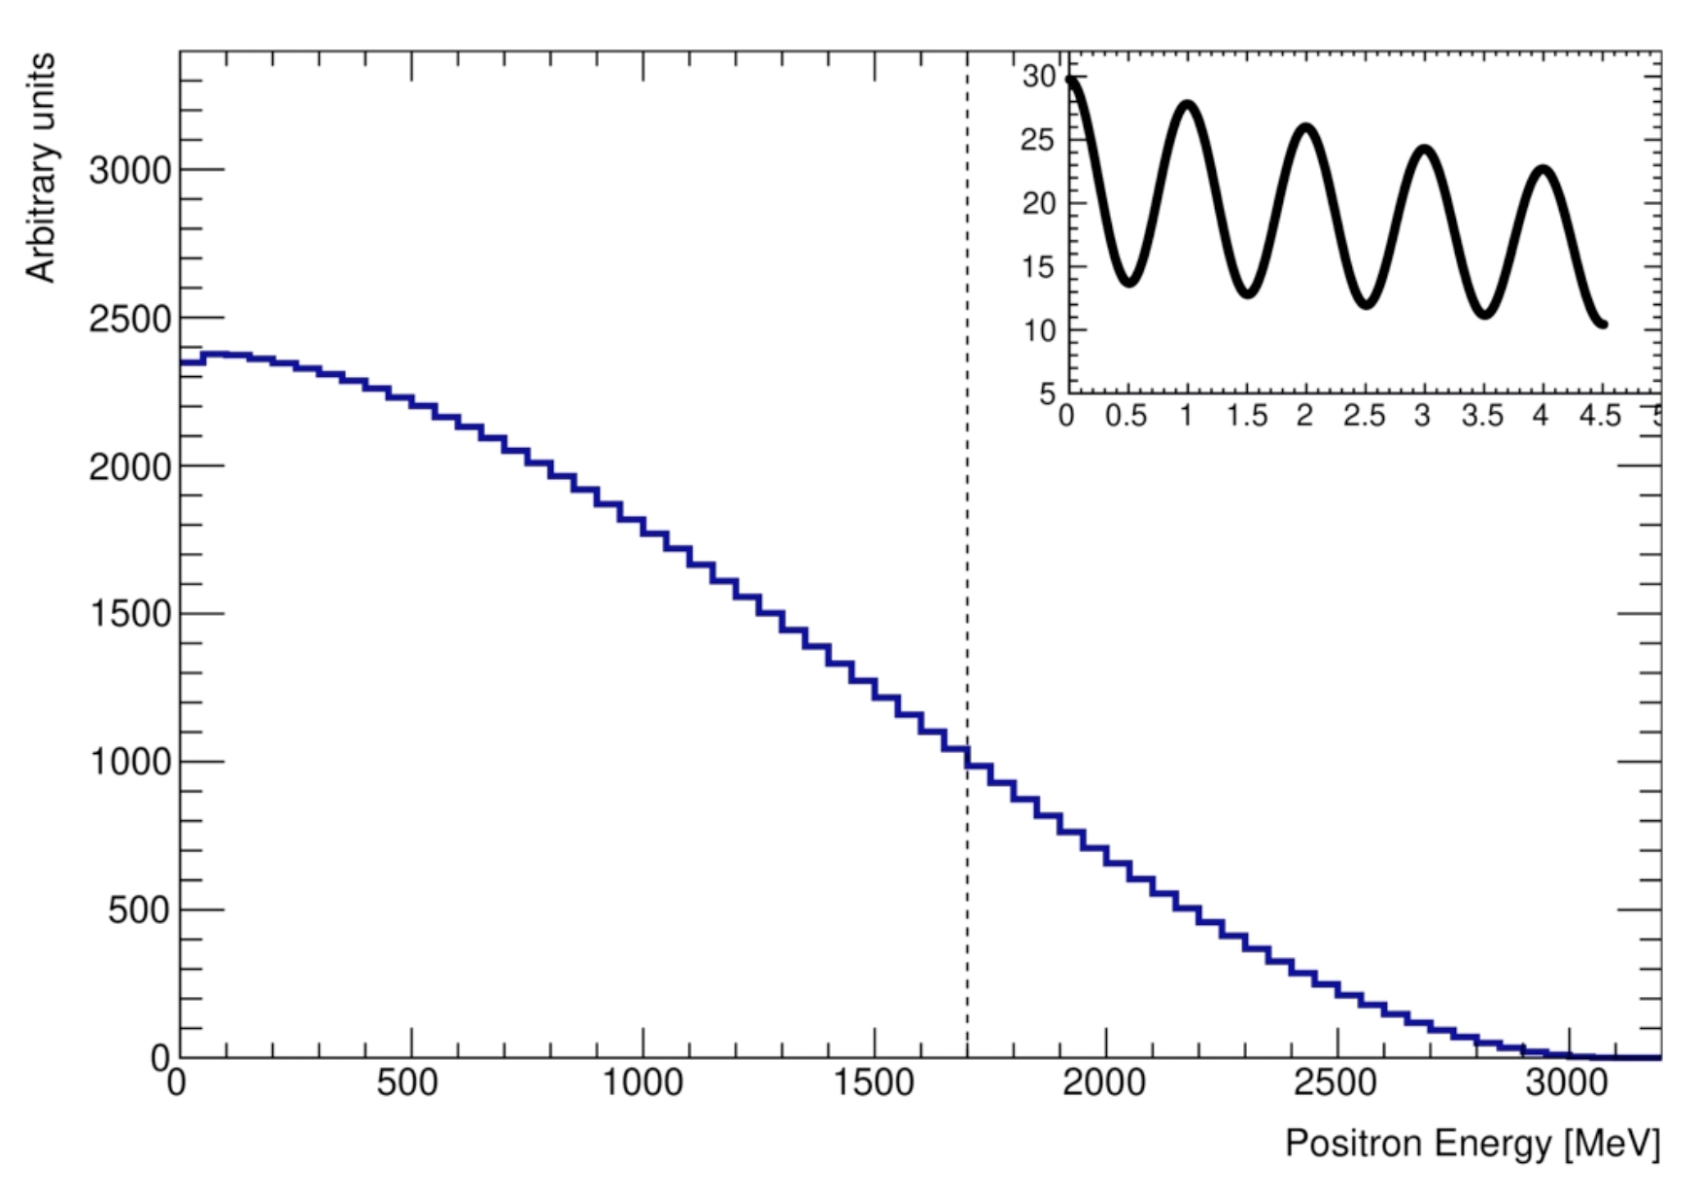
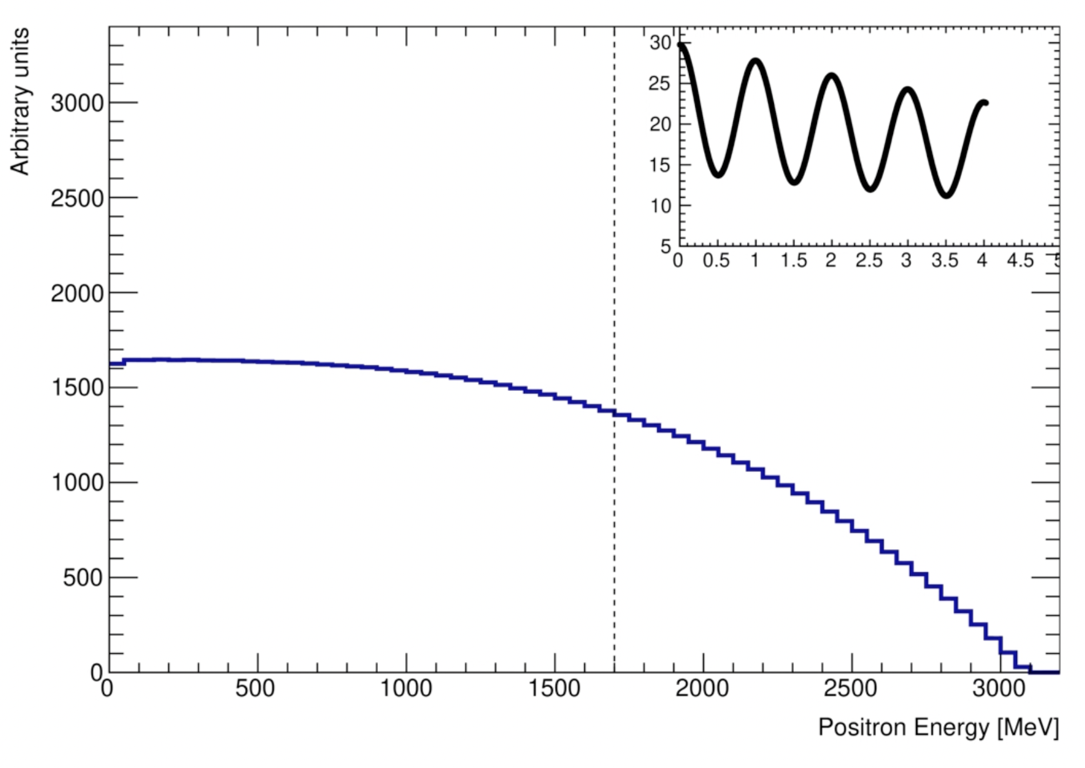
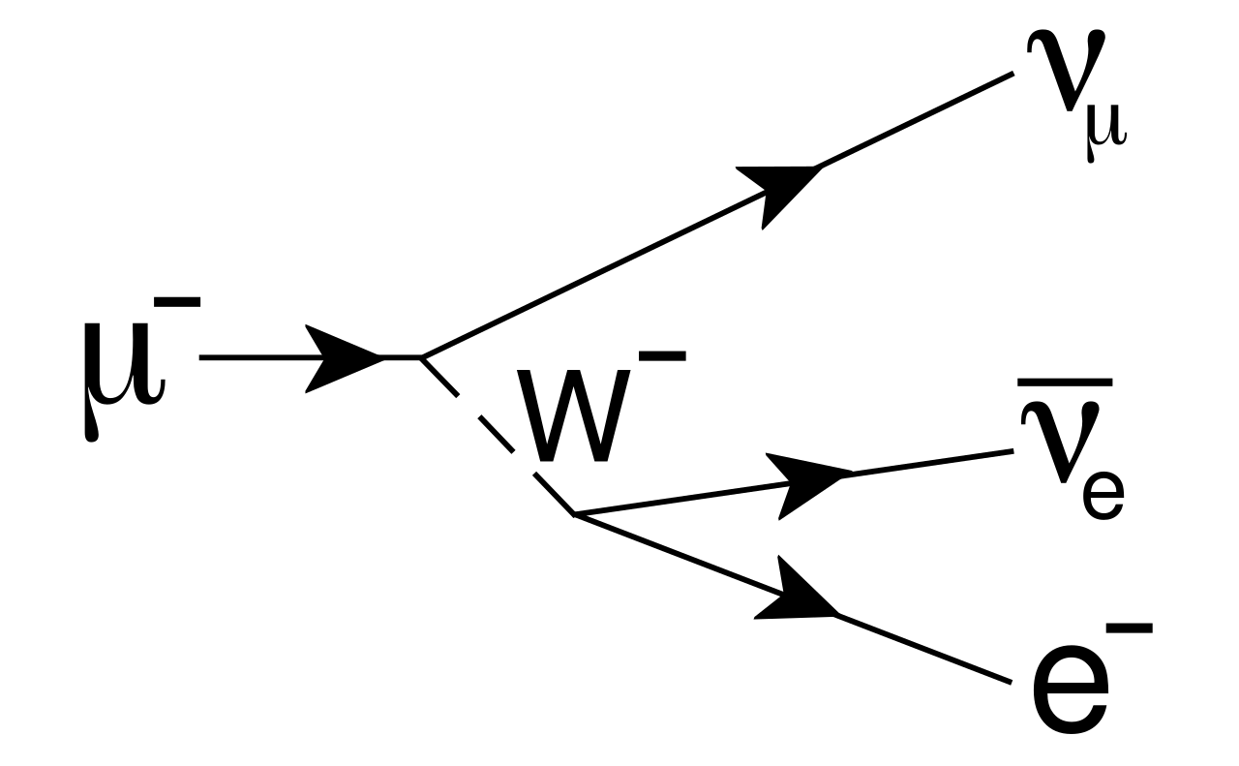
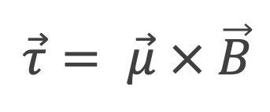
Experimental Principle
$$\vec{τ}= \vec{μ} × \vec{B}$$
Parity violation
e+ prefers μ+ spin direction
Lorentz boost
Energy enhanced along p
e⁺
e⁺
s
s
μ
μ
p
e⁺
e⁺
s
μ
μ
s
p
Muon Rest Frame
Laboratory Frame

Slide 4
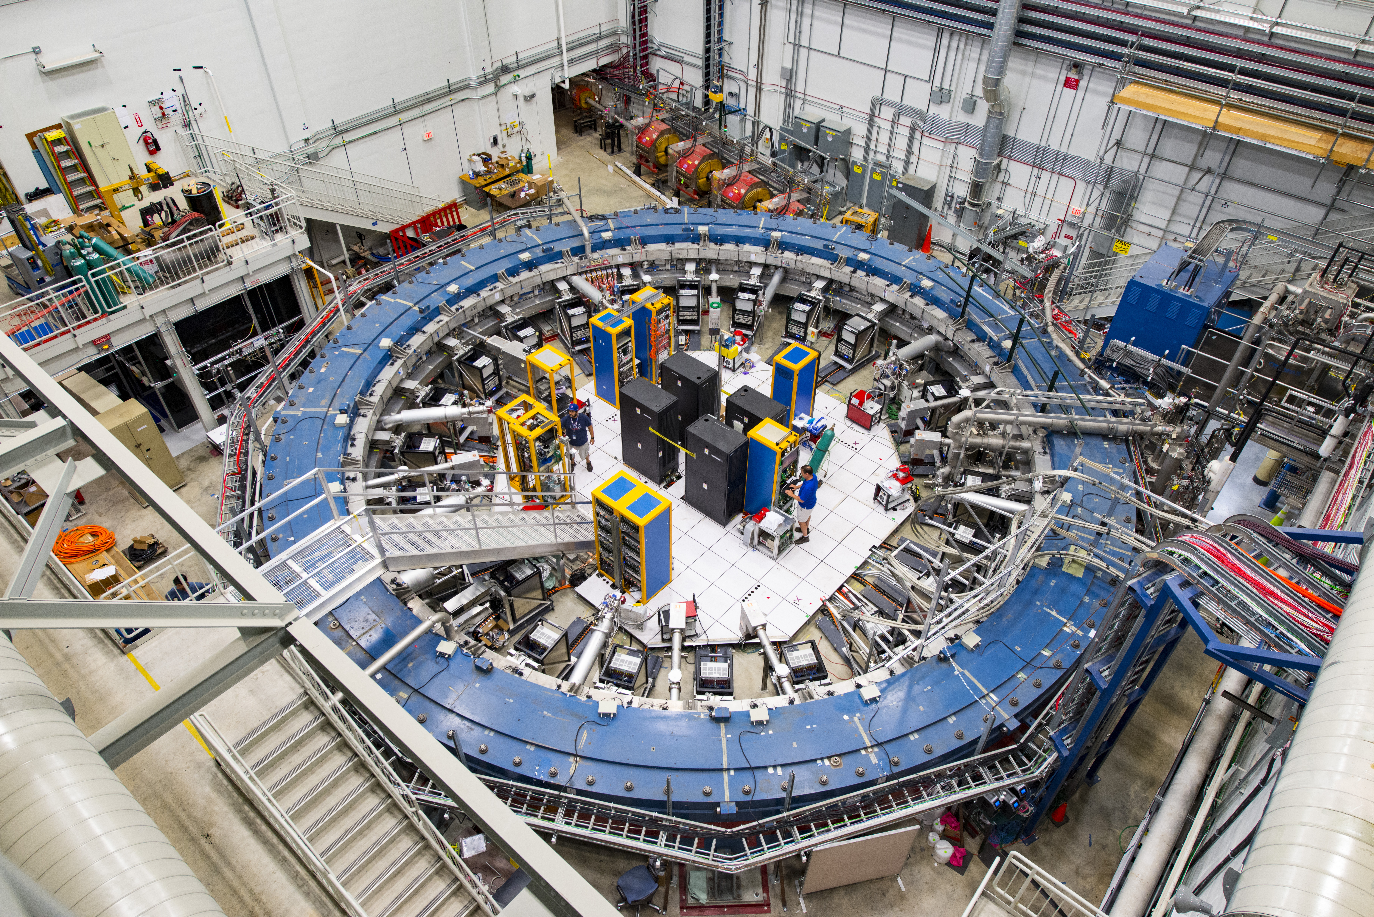
Muon
Beamline

Slide 5
Muon
Beamline
Kickers
ES Quads

Slide 6
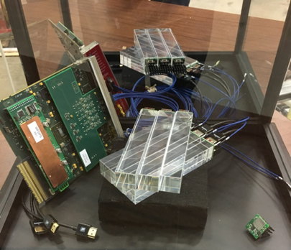
Muon
Beamline
Calorimeters
Kickers
ES Quads

Slide 7
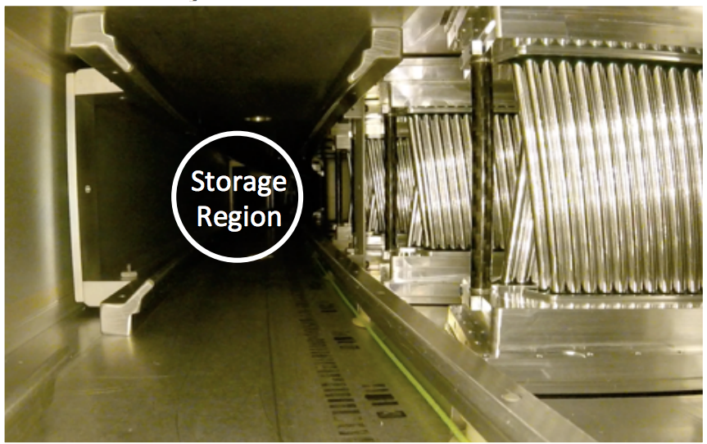
Muon
Beamline
Calorimeters
Trackers
Kickers
ES Quads

Slide 8
Muon
Beamline
Field Probes
Calorimeters
Trackers
Kickers
ES Quads

Slide 9
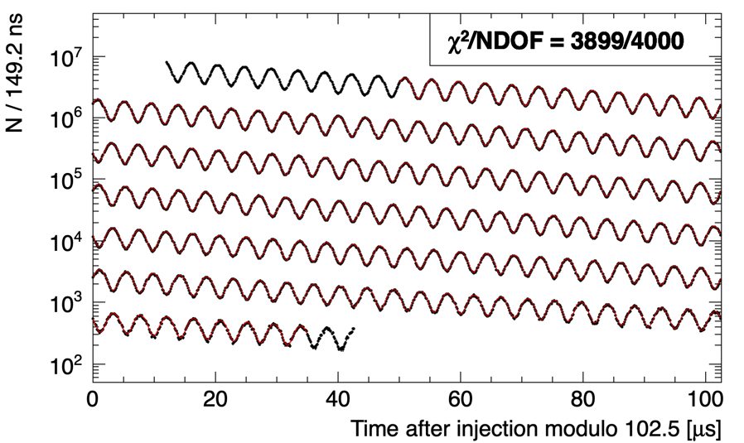
Muon precession measurement
CBO – horizontal beam osc.
VW – vertical beam osc.

Slide 10
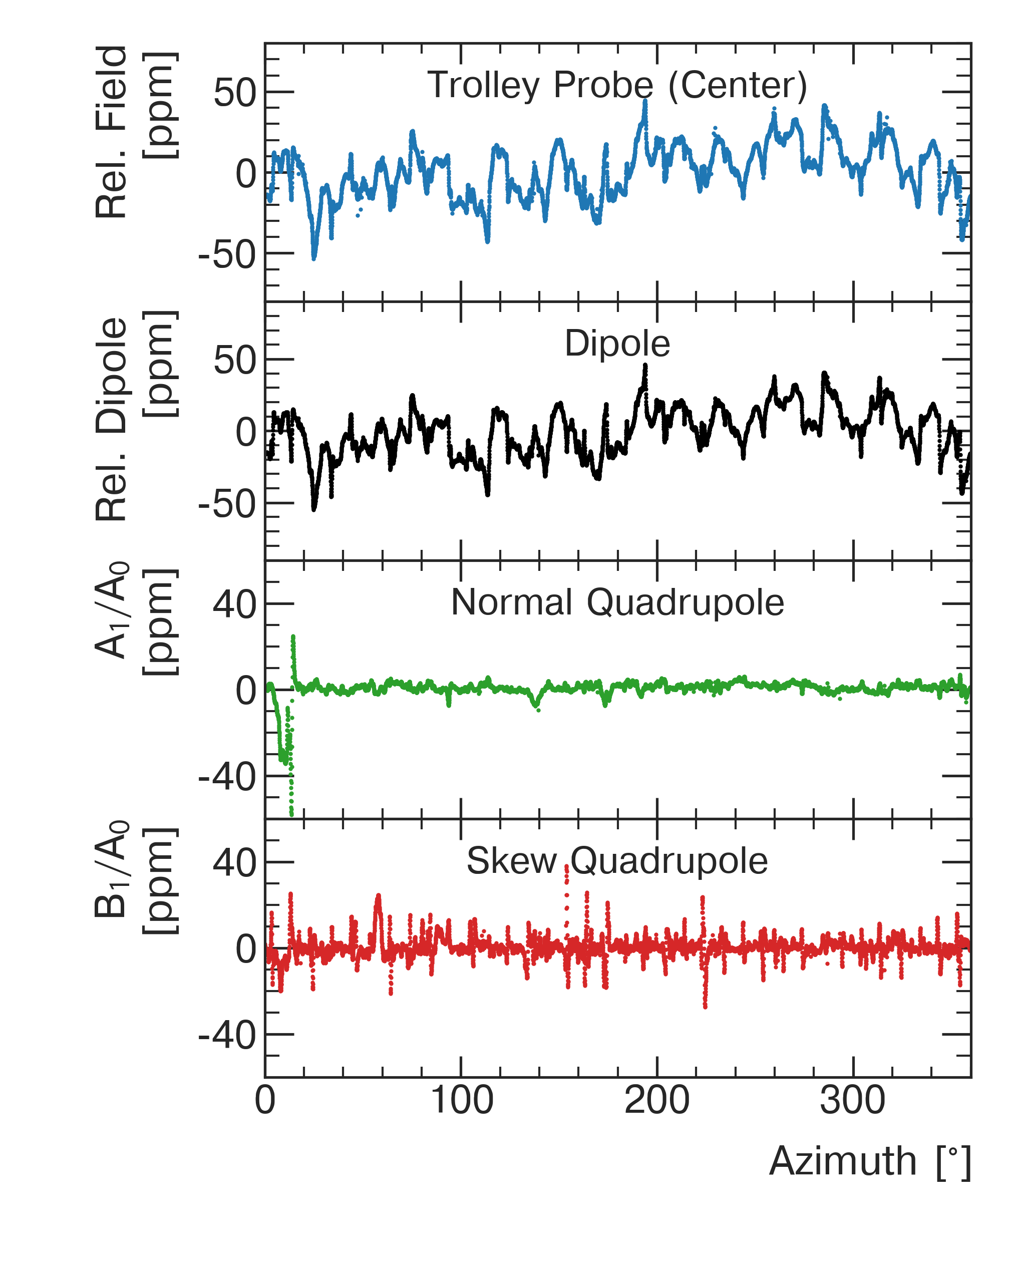
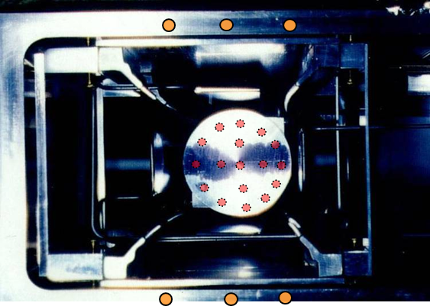
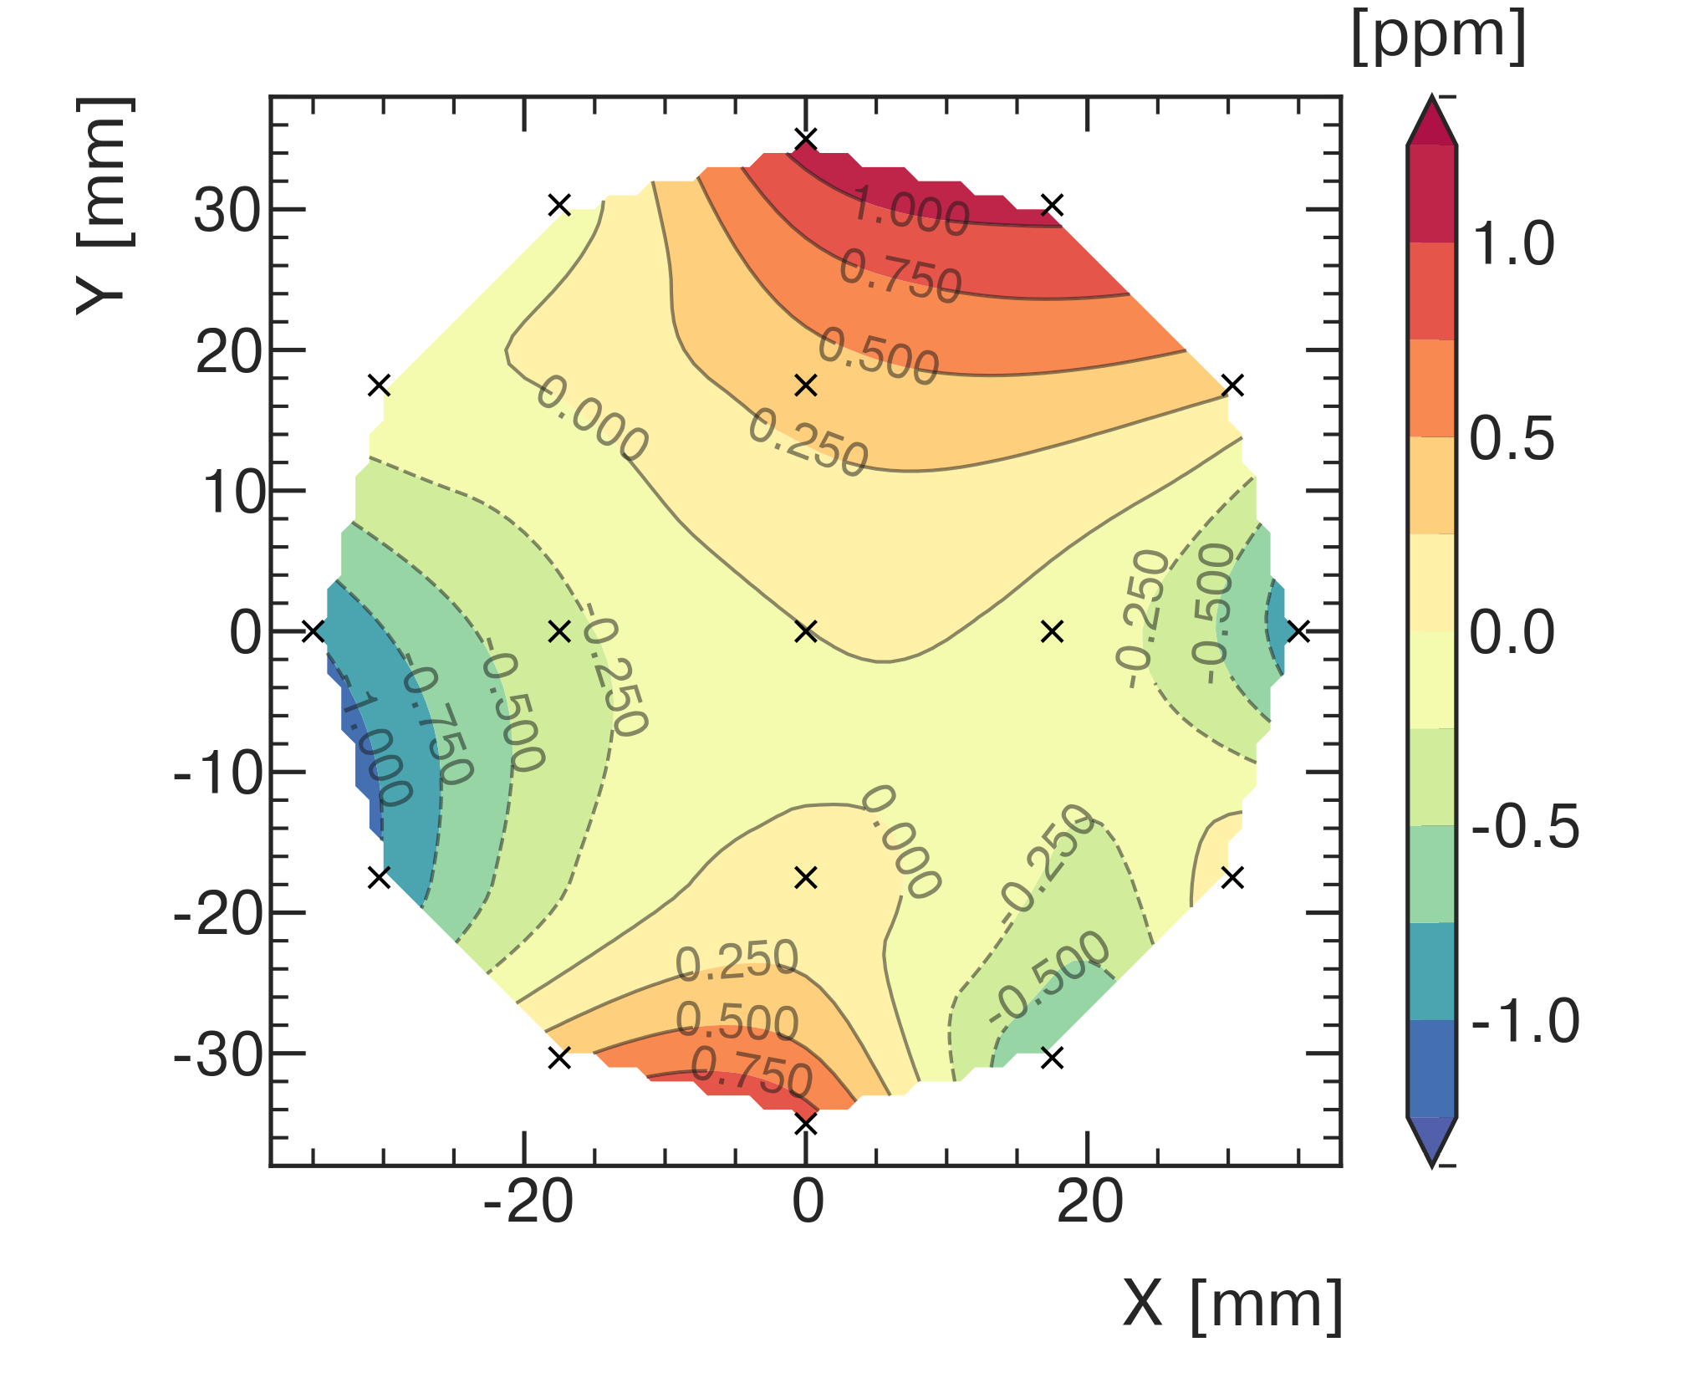
Field measurement
Trolley can access storage volume and is directly sensitive to field moments
Fixed probes interpolate field moments
between trolley runs

Slide 11

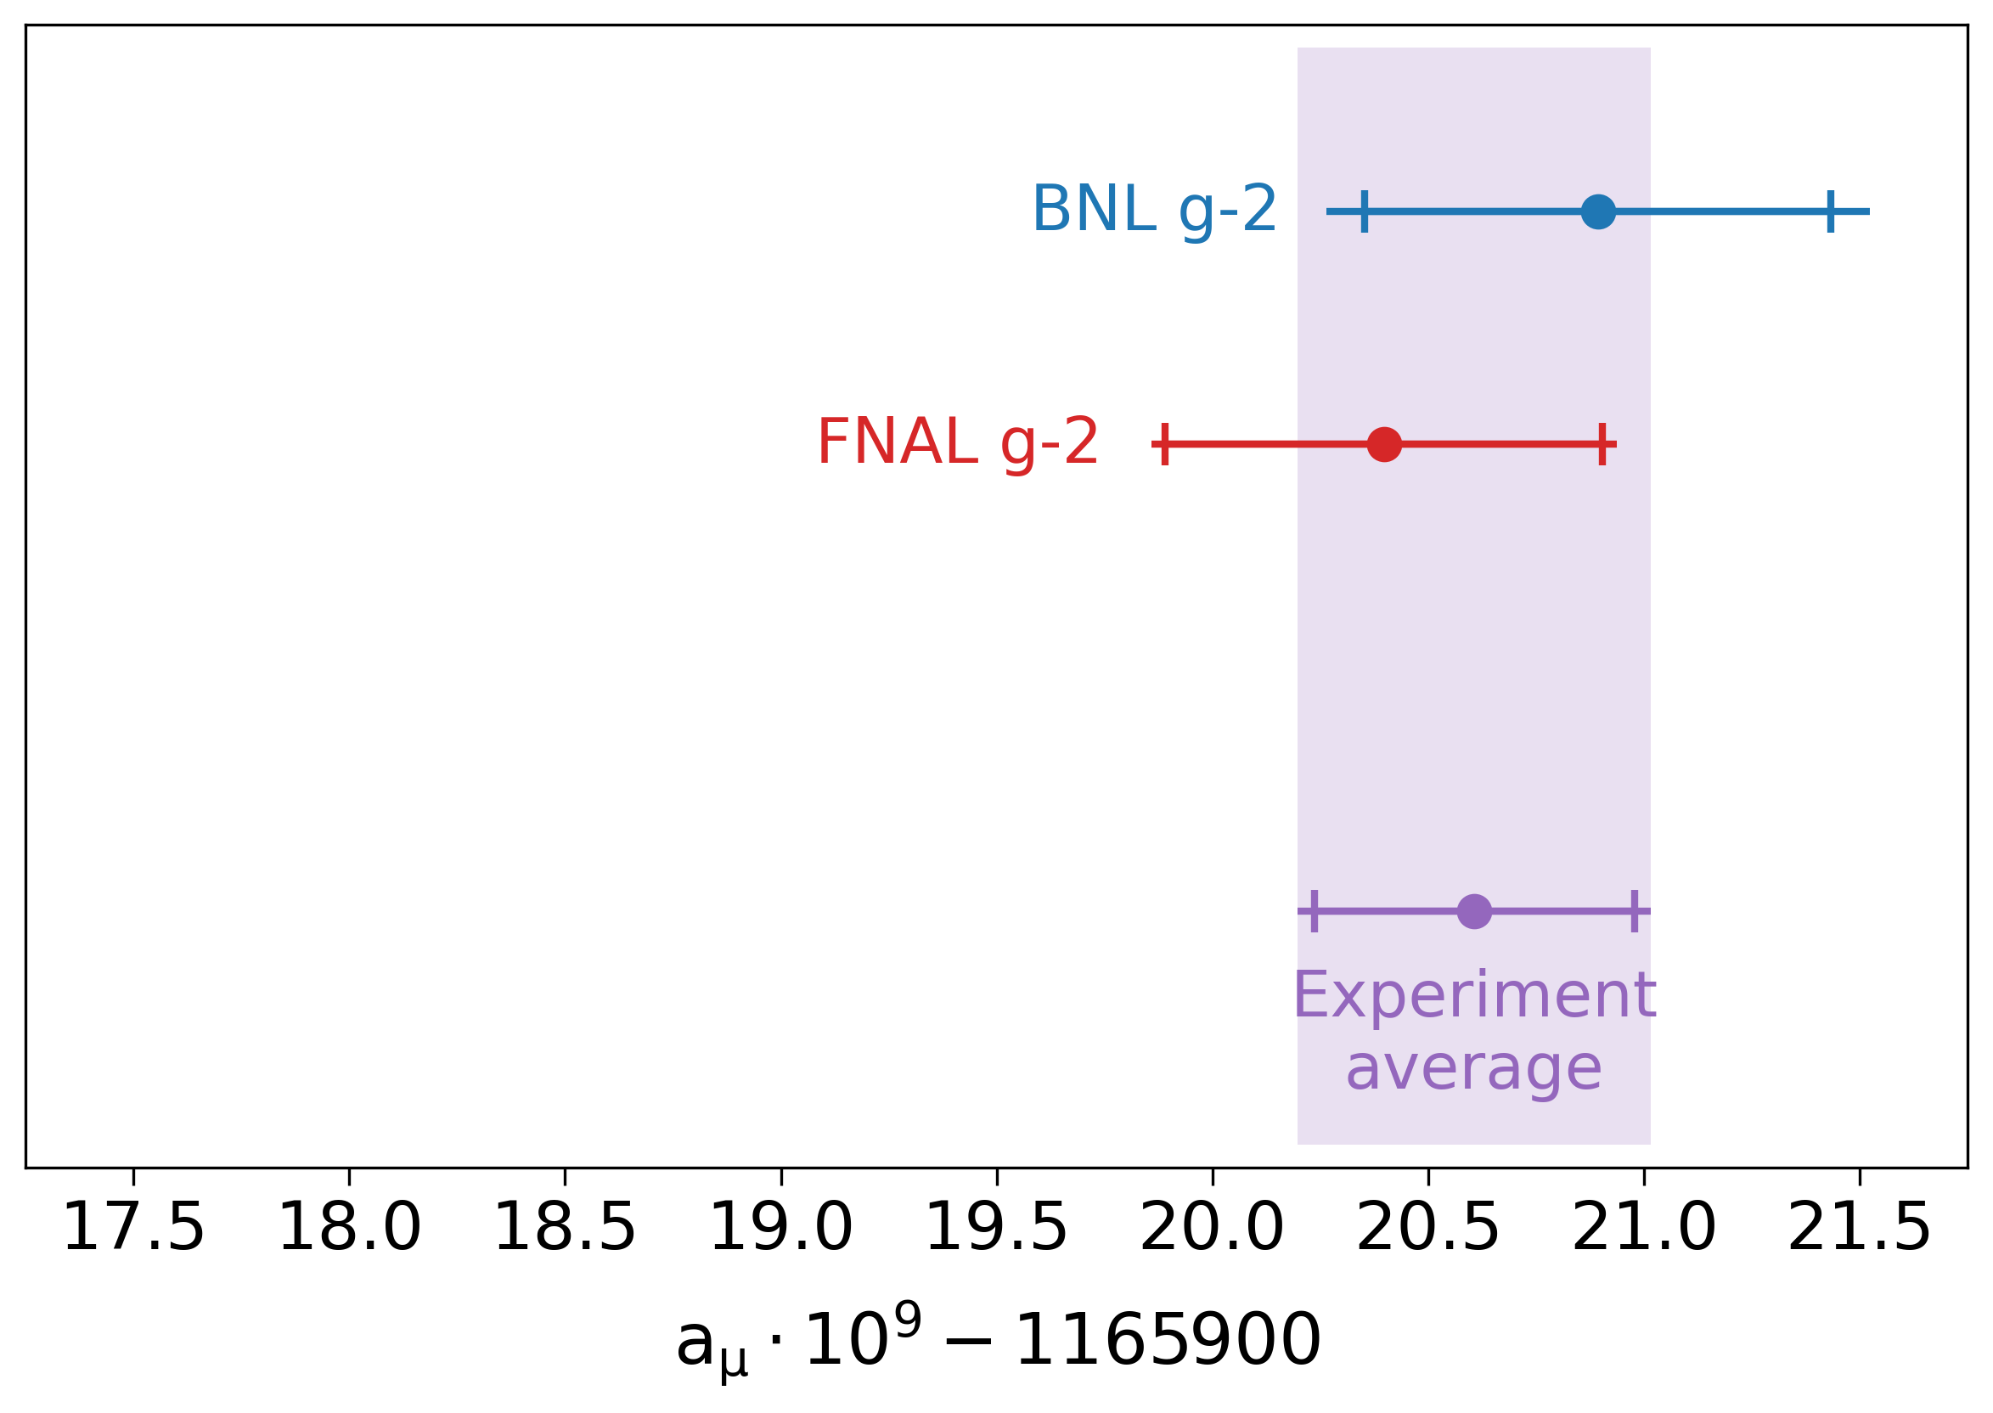
Run 1 Results
Run 1 Error Budget
Quantity | Uncertainty (ppb)
Precession (Stat.) | 434
Precession (Syst.) | 58
E field Correction | 53
Phase-Acceptance | 75
Magnetic Field | 56
Kicker Field Transient | 37
Quad Field Transient | 92
External Factors | 25
Total | 462
Dispersive Theory
Lattice
Theory
a_{μ}(Exp) – a_{μ}(WP20) = 2150 ± 510 ppb (4.2𝞂)
a_{μ}(Exp) – a_{μ}(BMW) = 920 ± 600 ppb (1.5𝞂)

Slide 12
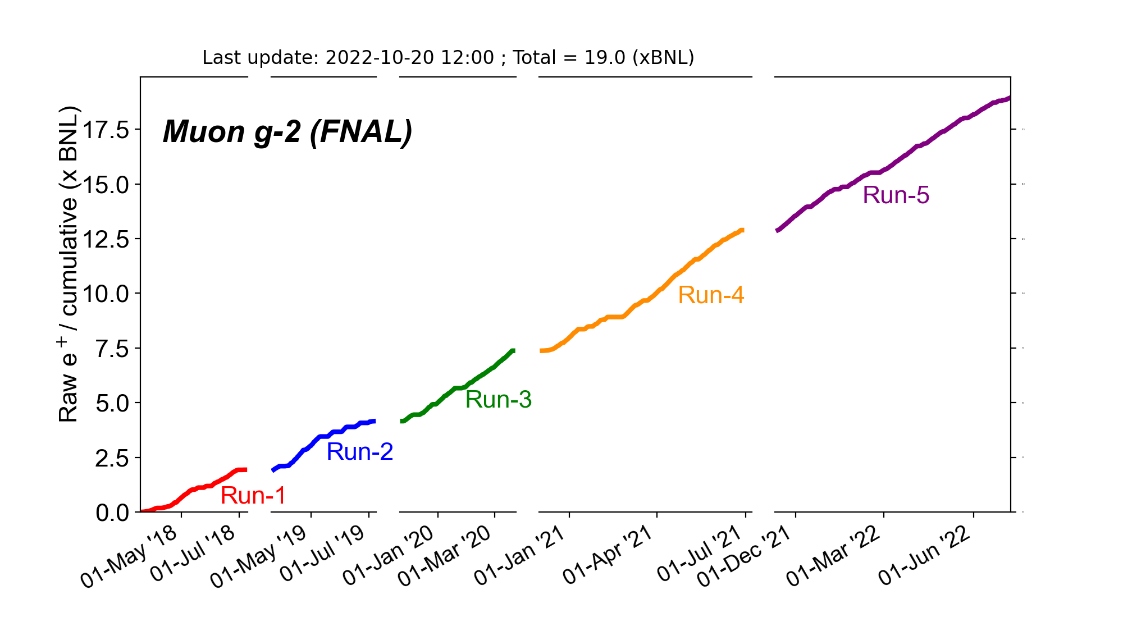
Accumulating Statistics
21x BNL target should be surpassed during Run-6
140
122
105
87
70
52
35
17
Accelerator shutdown
for COVID
Phase-acceptance
fixed
Lab Budget Shortfall
Quad RF system enabled
Kicker upgrade
Online Calibration
No quality cuts
First Publication
Billions of positrons

Slide 13
Publication Plan
2024/2025
Run 6
?
2021
2023

Slide 14
Runs 2 and 3
Run | Positrons (10⁹)
1 | 8
2 | 11
3 | 28
7 precession analysis teams
2 field analysis teams
Beam dynamics and other analyses
Finalizing systematics now
Improvements in reconstruction, pileup correction
Expected statistical uncertainty ~200 ppb
PRELIMINARY
PRELIMINARY

Slide 15
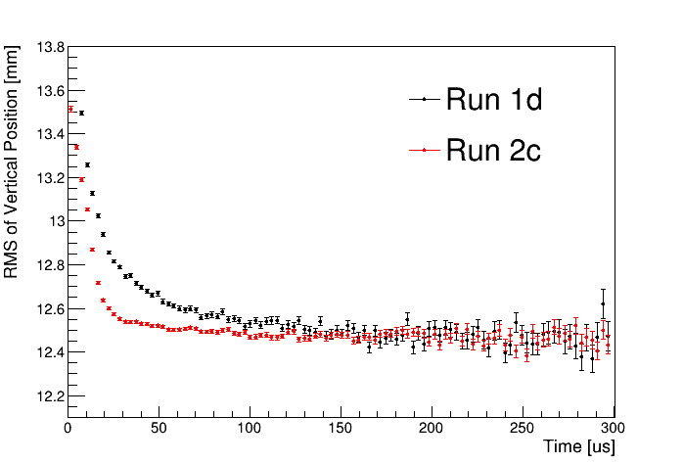
Replaced Quadrupole HV resistors
Calo acceptance effects create a phase shift as a function of decay position
This couples to beam changes to bias the observed frequency
Start of analysis
Exaggerated
PRELIMINARY

Slide 16
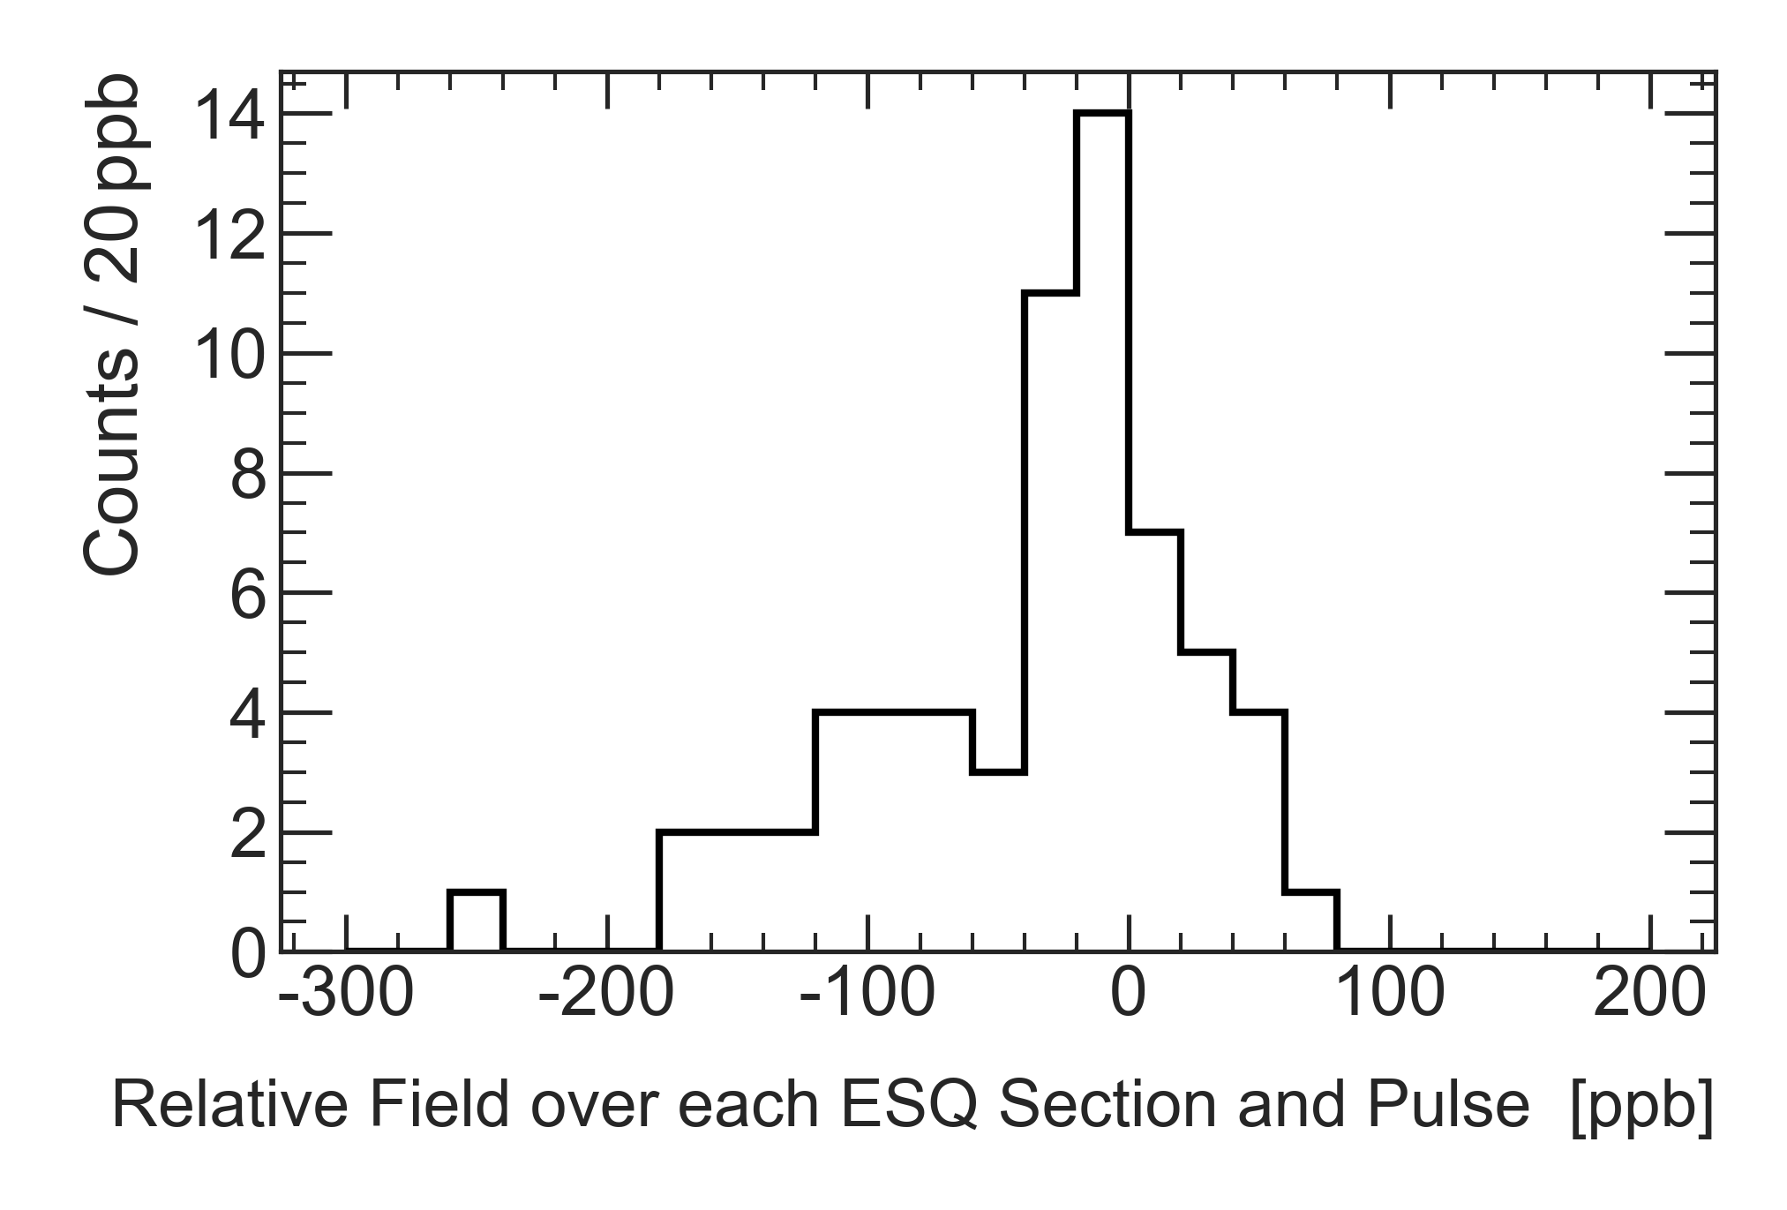
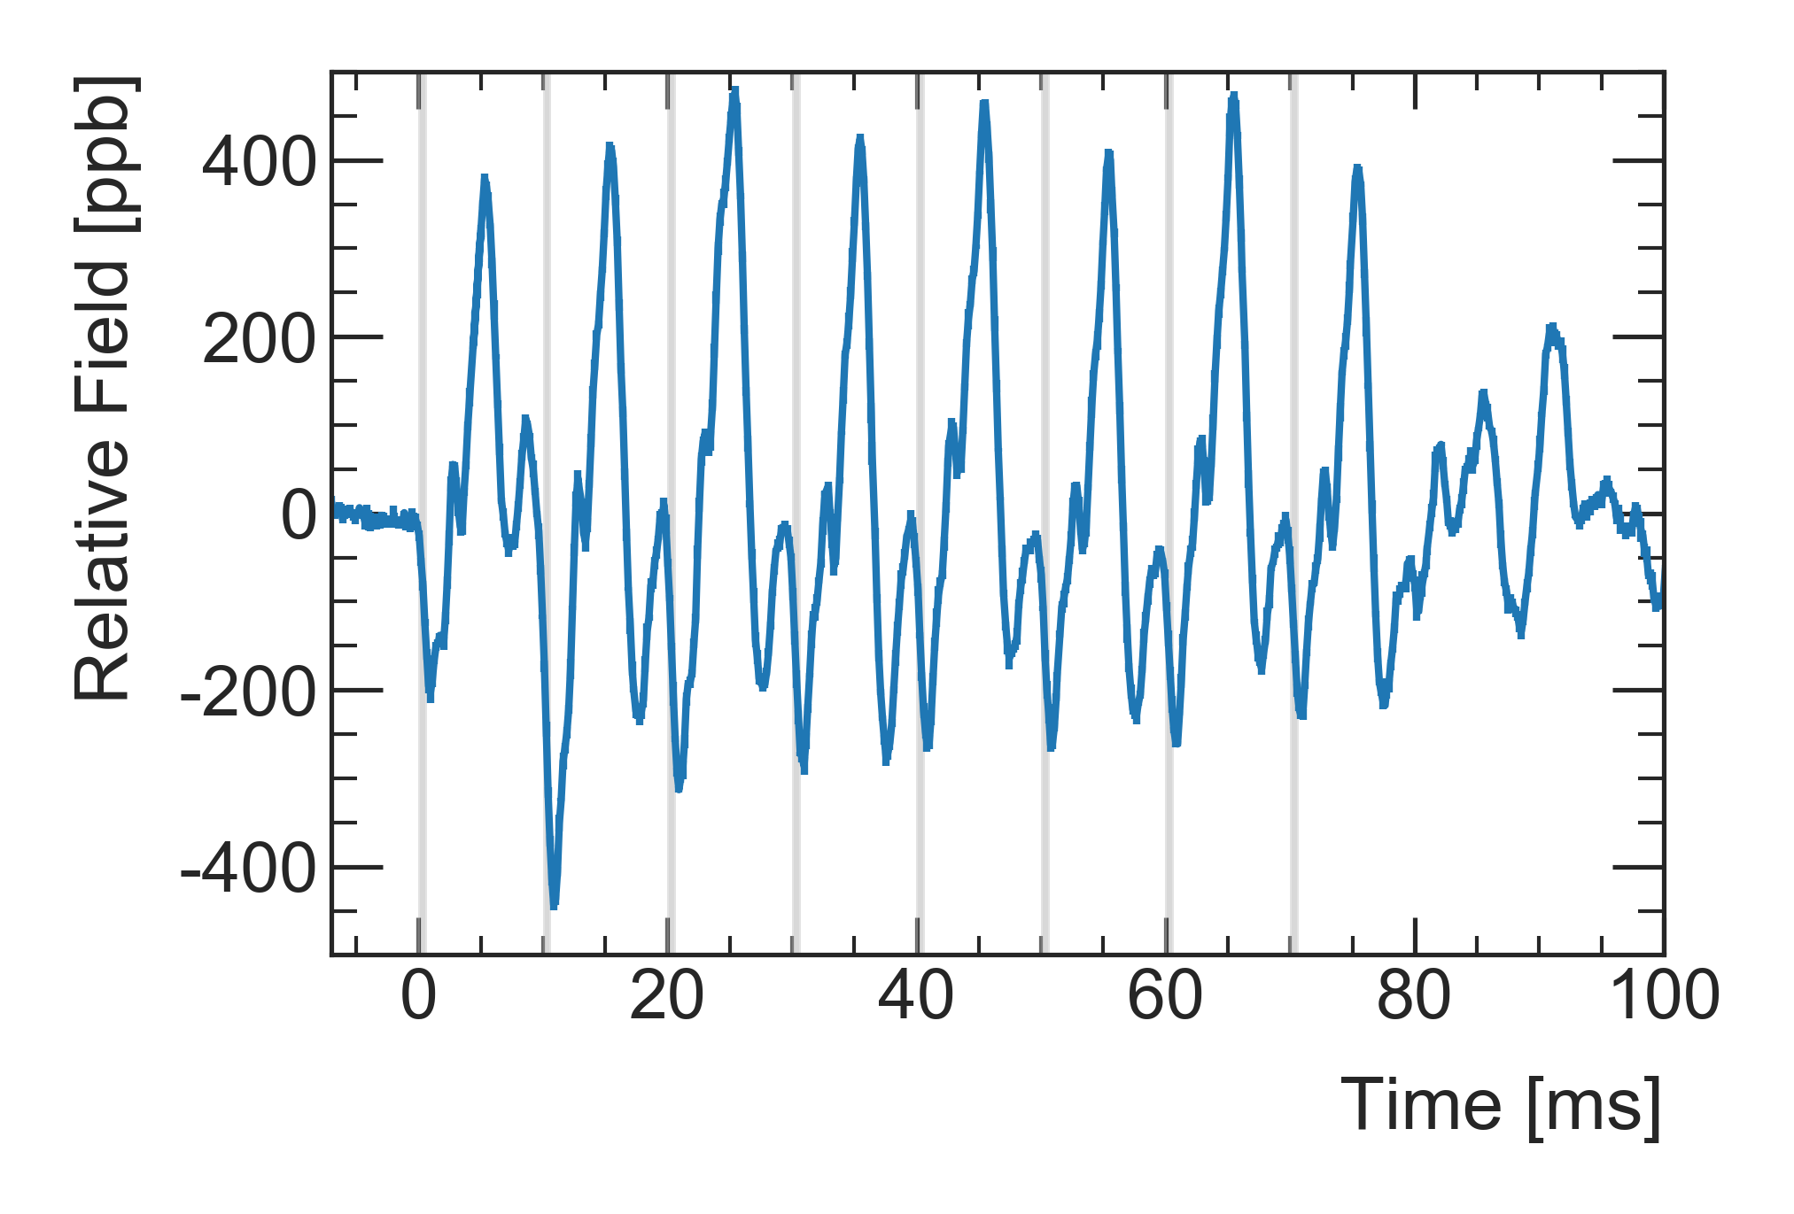
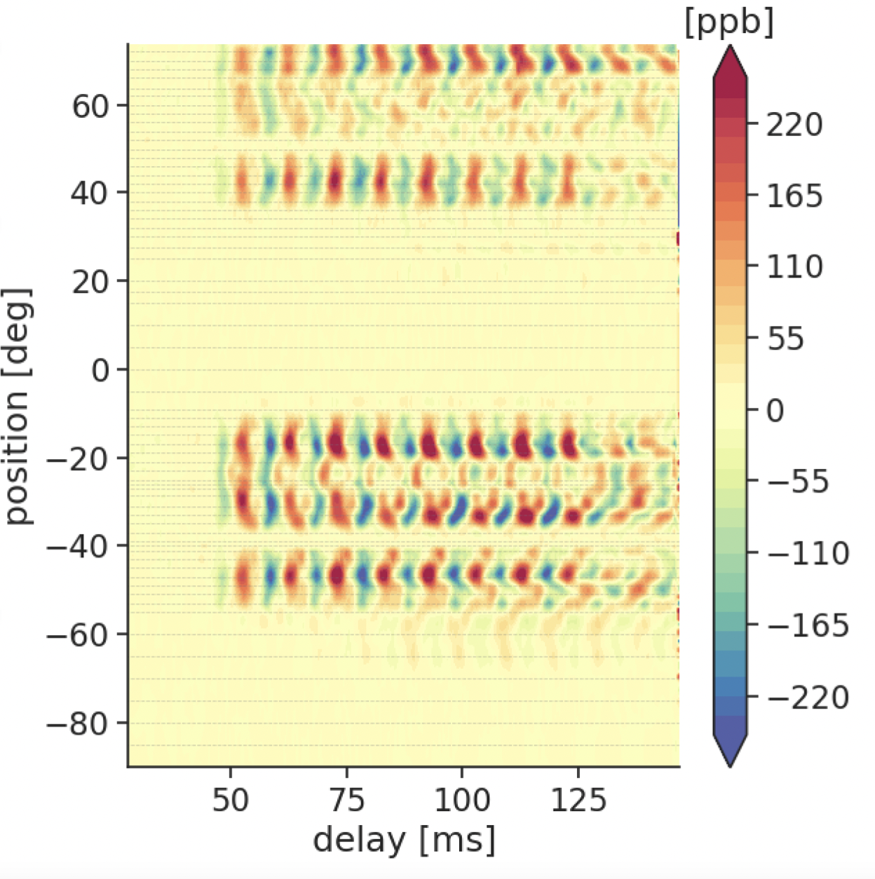
Quadrupole field transient
Run 1: 92 ppb
Mechanical vibration of pulsed quad plates drive field perturbations
Measured with dedicated probes
Now measured in both time and space
PRELIMINARY

Slide 17
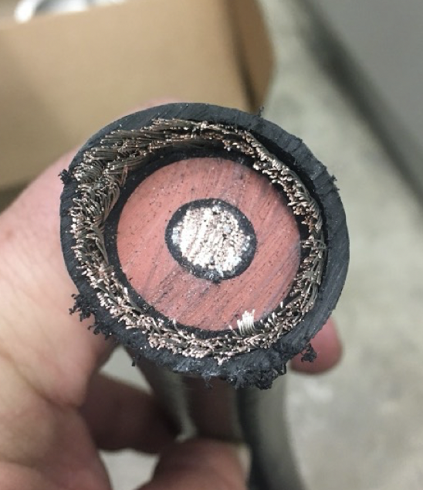
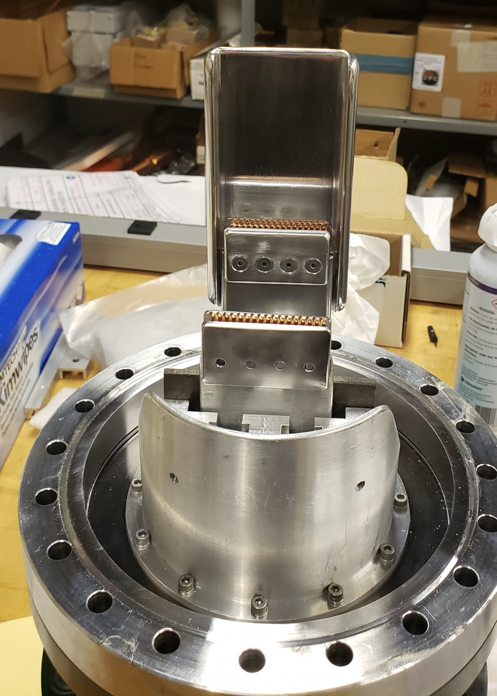
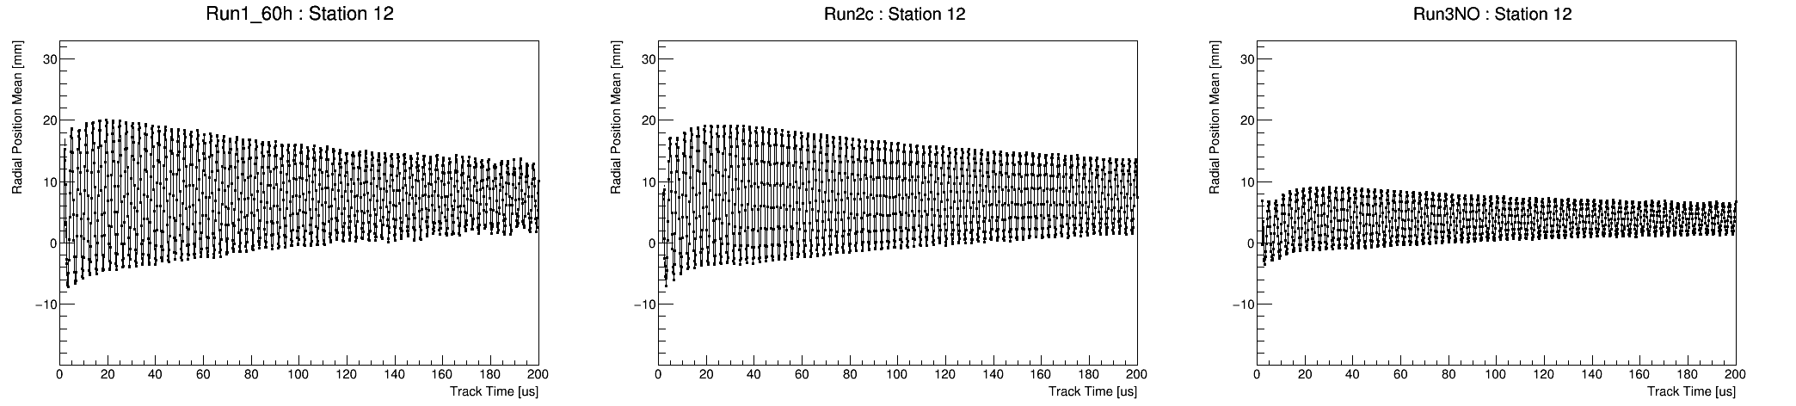
Stronger Kick
Run 2
Run 3
PRELIMINARY
Better Beam Centering
Reduced beam oscillation
Radial Position
PRELIMINARY
PRELIMINARY
Run 1
Run 2
Run 3

Slide 18
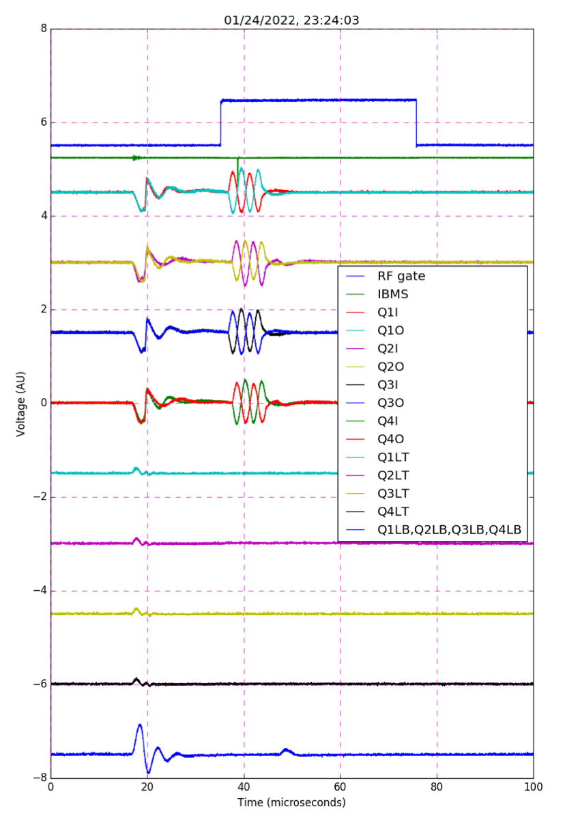
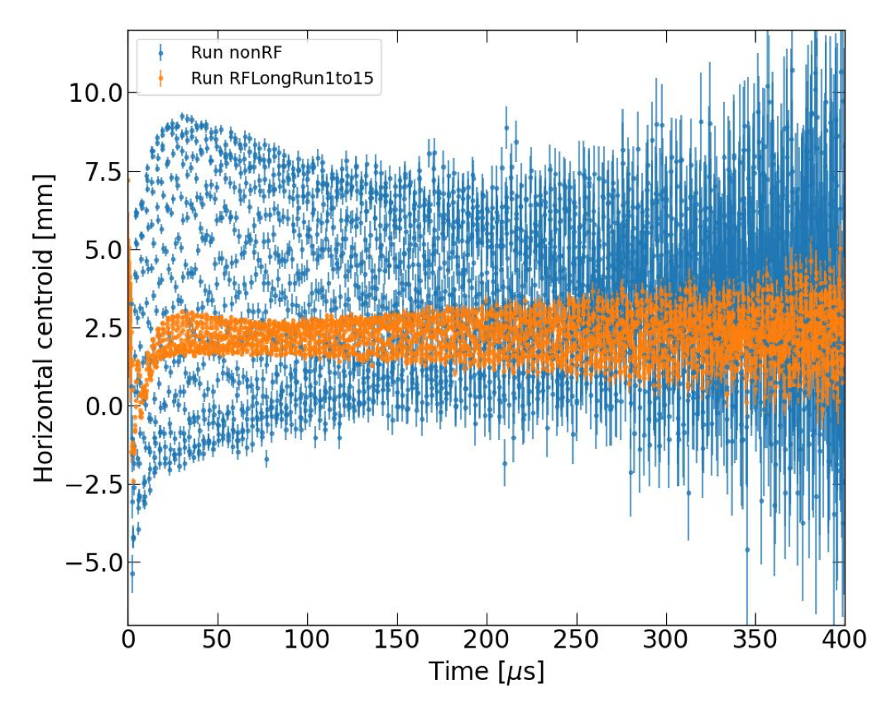
Runs 4, 5, and 6
Goal is for all data to be ready for analysis within the next year.
On track for 100 ppb statistical error.
PRELIMINARY
PRELIMINARY
RF pulse in first 10 us damps beam oscillations
System under development for many years
Full power test done at end of Run-4
Applied in Run-5 and Run-6

Slide 19
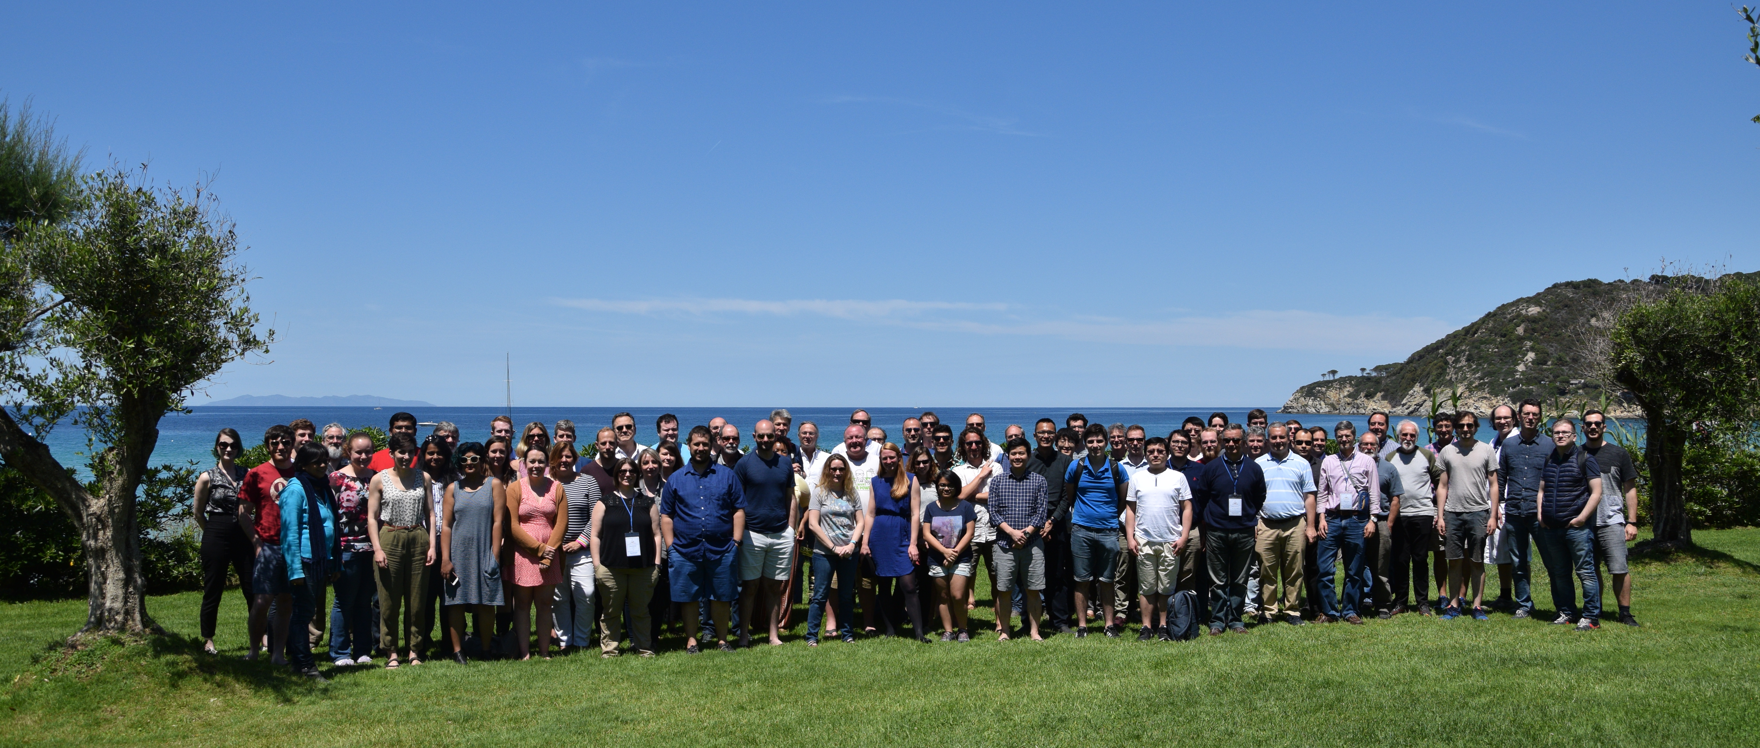

Muon g – 2 Collaboration
Thanks to my wonderful collaborators around the world

Slide 20
Muon g-2 Experiment Timeline
2001 – BNL experiment concludes after 5th run
2006 – BNL final result published
2009 – FNAL experiment proposed
2012 – FNAL experiment approved by DOE
2013 – Magnet moved to FNAL
2017 – Engineering run
2018 – First physics data
2020 – Theory Initiative White Paper published
2021 – First physics result
2023? – FNAL experiment concludes after 6th run
2023? – 2nd physics result
2025? – Final? physics result

Slide 21
Analysis Progress
Run | Data Collected | Data Processed | Data Analyzed | Data Published
1 | 2018 | 2020 | 2020 | 2021
2 | 2019 | 2021
3 | 2020 | 2022
4 | 2021
5 | 2022
6 | 2023

Slide 22
60 years of g_{μ}
g_{μ}SM = 2.002331836…
2 Dirac theory
0.002331694… QED
0.000000139… QCD
0.000000003… Electroweak

Slide 23
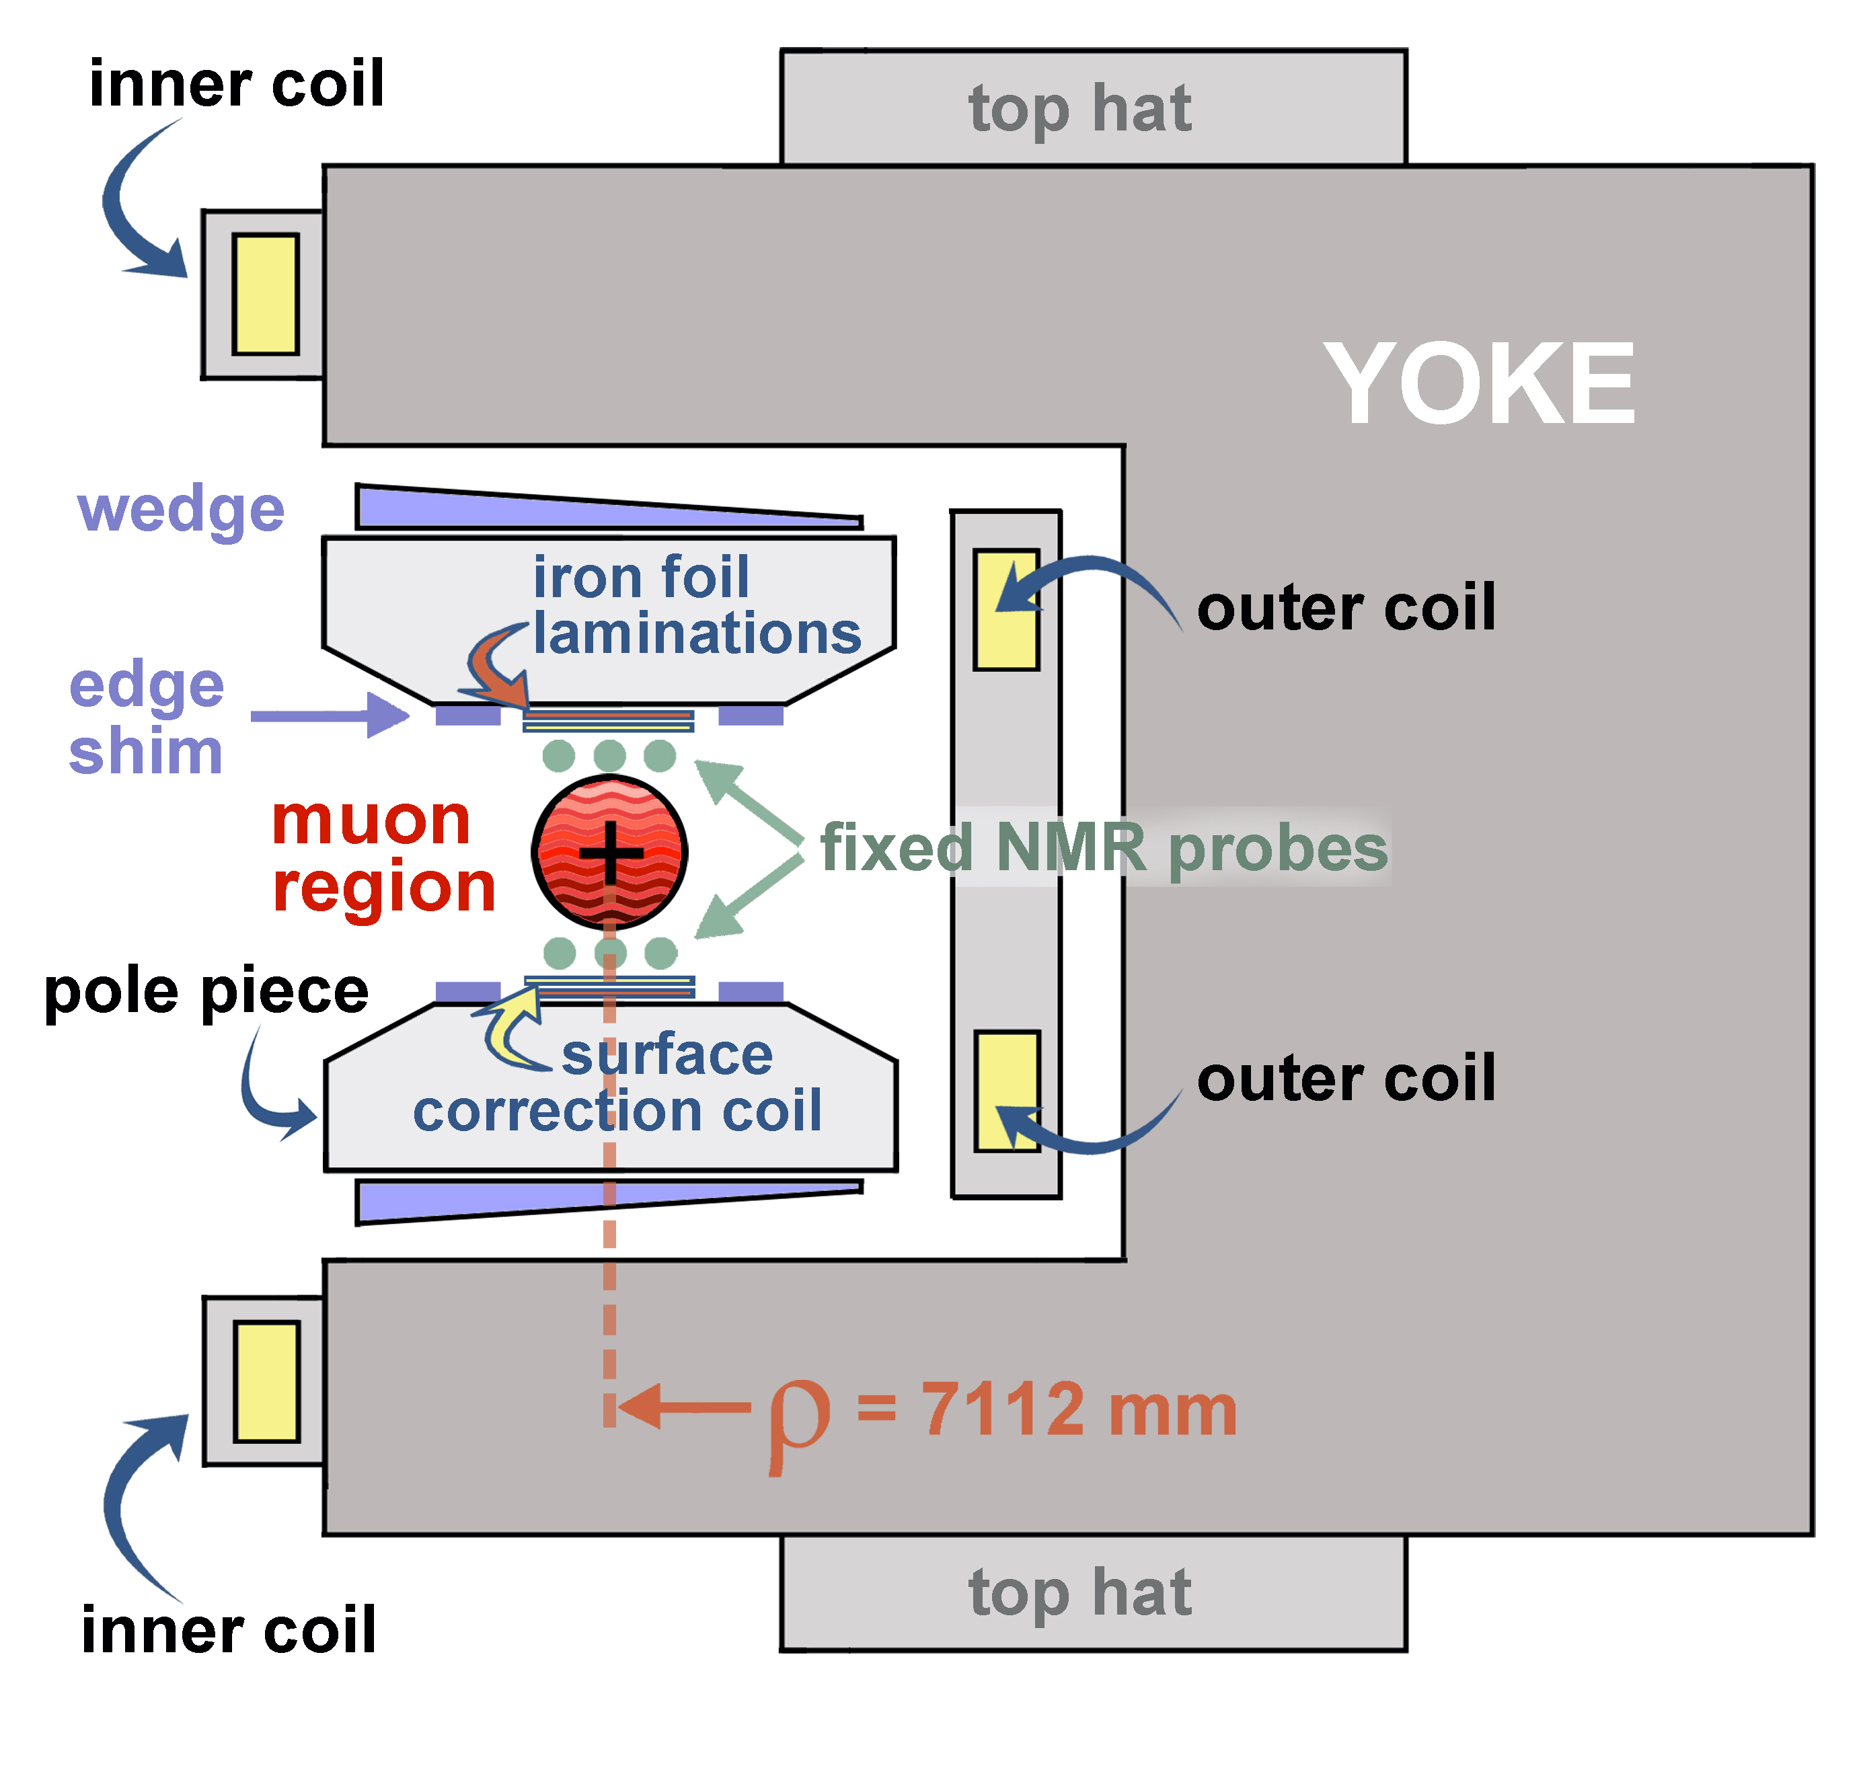
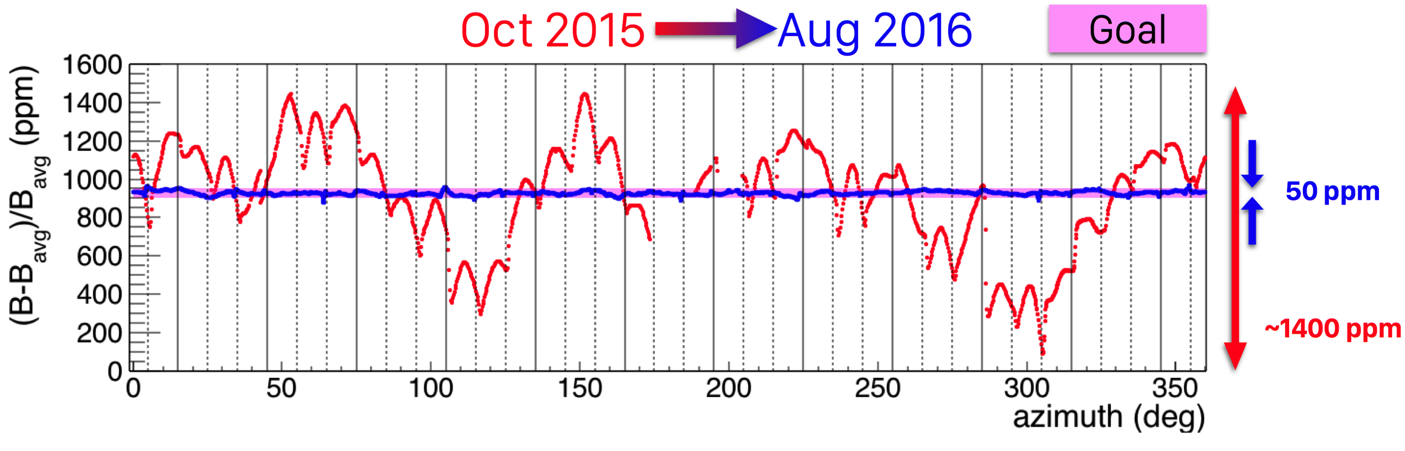
g – 2 Storage Ring
1.45T superferric magnet
Shimmed to 50 ppm uniformity
3x better than at BNL

Slide 24
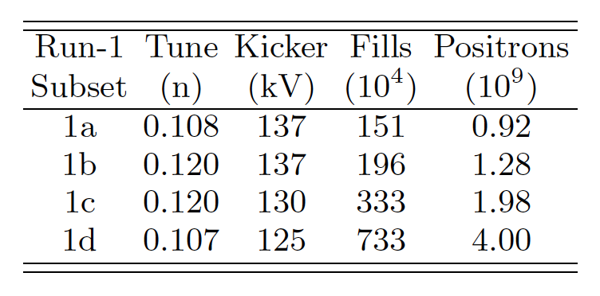
Data Analysis
Changes to quad and kicker settings
4 Run-1 data sets
April – June 2018
~6% of statistics target
3 Kinds of Blindness
Hardware blind (± 25 ppm clock detuning)
Software blind (± 25 ppm)
global or analysis-specific

Slide 25

Muon precession measurement
Template fitting of digitized SIPM waveforms
Two clustering strategies: local, global

Slide 26
Muon precession measurement
Simple model leaves out much detail

Slide 27
Muon precession measurement
Pileup
Gain
Muon Loss

Slide 28
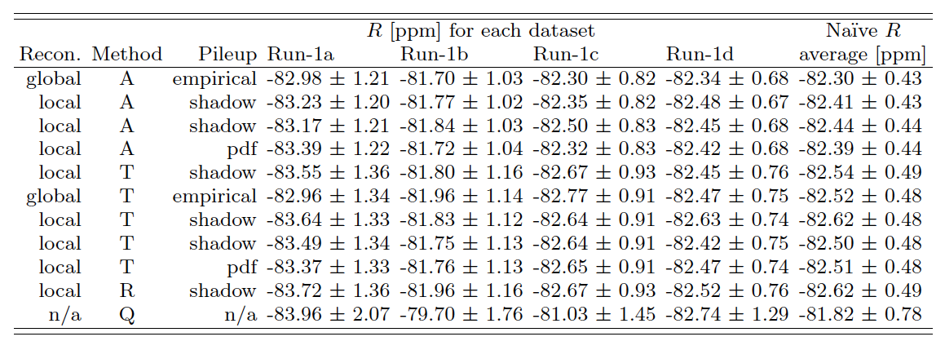
Muon precession measurement
11 (highly correlated) analyses found consistent results
4 most precise analyses averaged
conservative procedure that avoids unrealistic reduction in statistical uncertainty

Slide 29

Systematic concerns
Main concern is “early-to-late” effects
coherent from one fill to the next
Canonical example is a slow change of phase,
e.g. from a drifting energy calibration

Slide 30
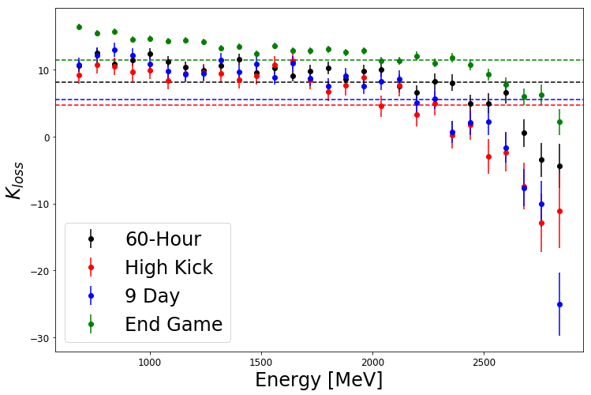
Muon precession systematics
Dataset | Run-1a | Run-1b | Run-1c | Run-1d
Gain (ppb) | 12 | 9 | 9 | 5
Pileup (ppb) | 39 | 42 | 35 | 31
CBO (ppb) | 42 | 49 | 32 | 35
Randomization (ppb) | 15 | 12 | 9 | 7
Early-to-late effect (ppb) | 21 | 21 | 22 | 10
TOTAL (ppb) | 64 | 70 | 54 | 49

Slide 31
Muon precession measurement
Fit frequency independent of...
Fit start time
Calorimeter station
Bunch number
Run number
Time of day
Energy bin
Position within calorimeter
…

Slide 32
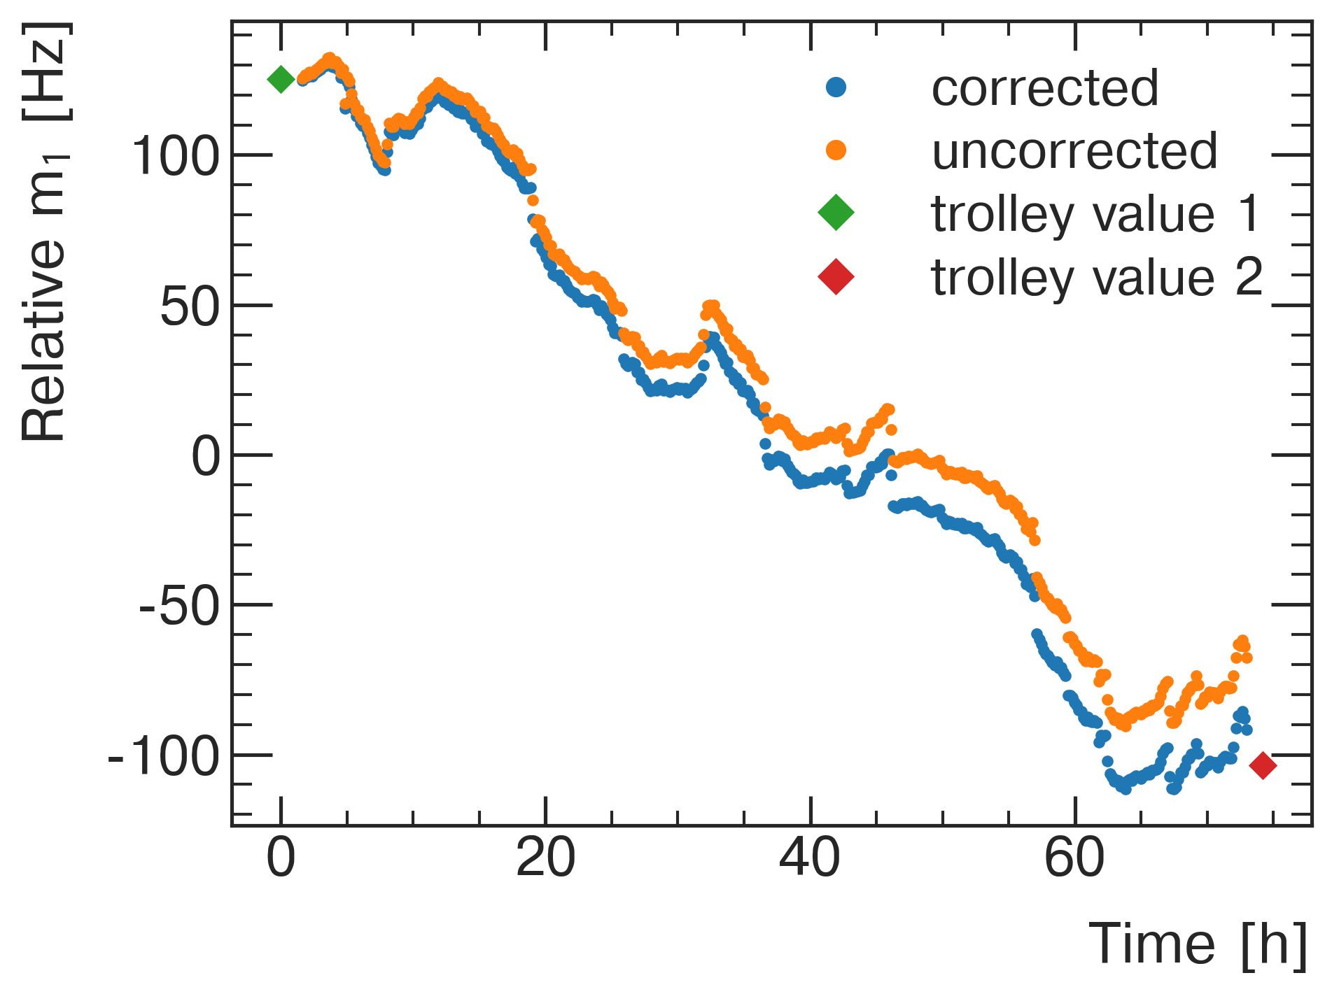
Field measurement
Field moments between trolley runs interpolated with fixed probe data
Random walk (Brownian bridge) model

Slide 33
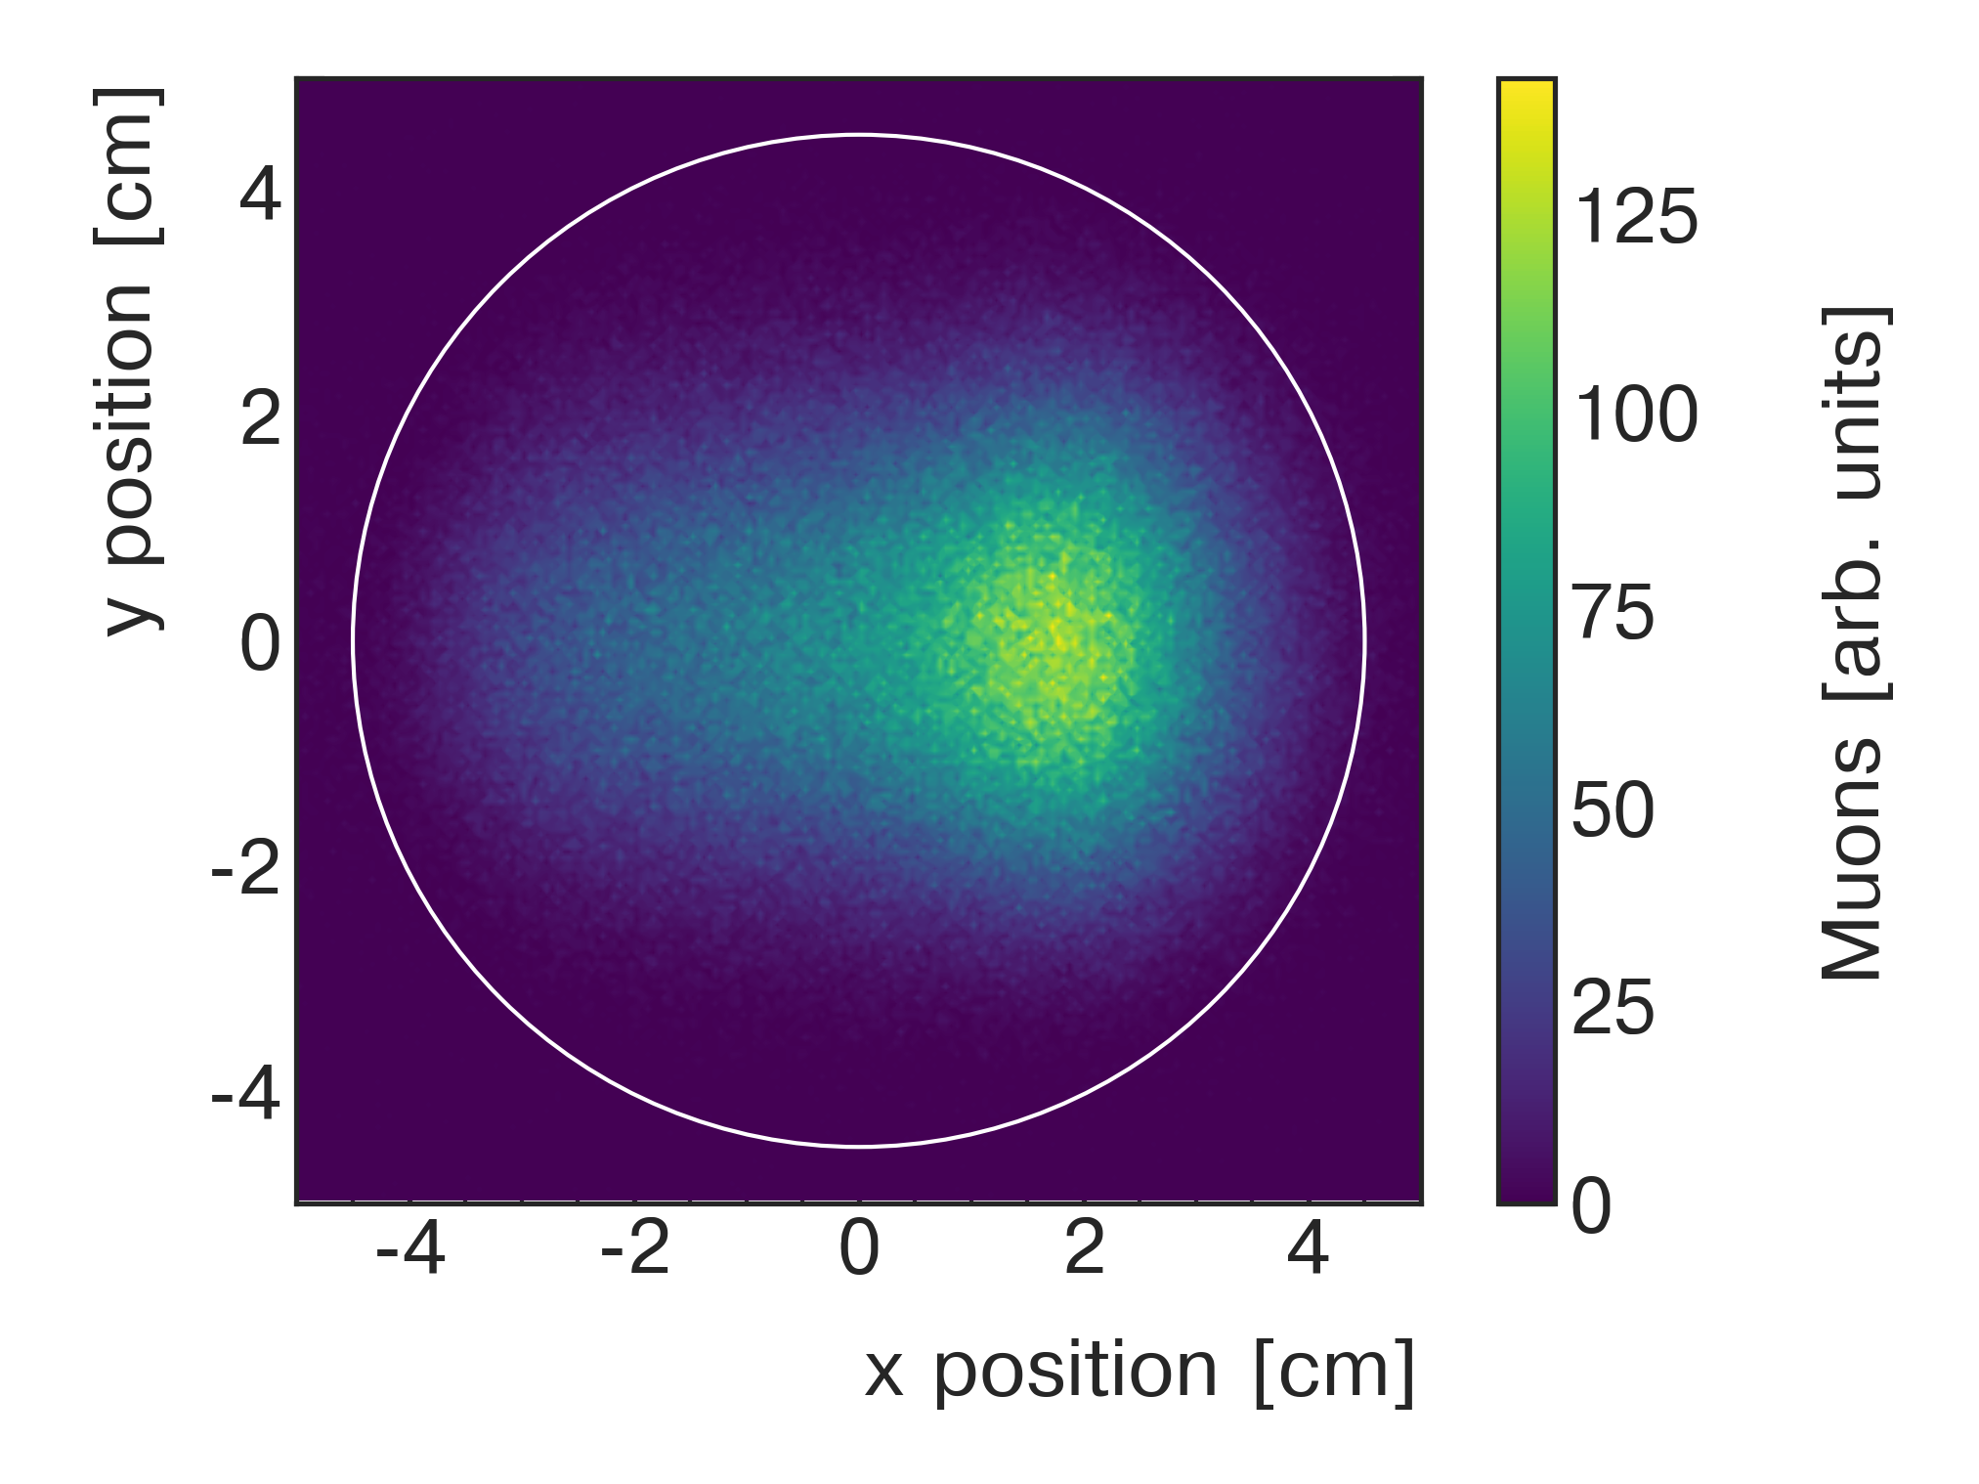
Field measurement
Muon beam moments estimated with tracker
Field and beam intensity folded at 10s scale
Field and beam moments folded at hourly scale

Slide 34
Field systematics
Dataset | Run-1a | Run-1b | Run-1c | Run-1d
Field Tracking | 43 | 34 | 25 | 22
Trolley Calibration | 28 | 28 | 28 | 28
Trolley Temperature | 28 | 25 | 21 | 15
Trolley Baseline | 25 | 25 | 25 | 25
Muon Weighting | 11 | 14 | 16 | 20
Absolute Calibration | 13 | 13 | 13 | 13
Fixed Probe Baseline | 8 | 8 | 8 | 8
Fixed Probe Runs | 1 | 1 | 1 | 1
TOTAL | 70 | 60 | 54 | 52

Slide 35


E Field and Pitch Corrections
Dataset | Run-1a | Run-1b | Run-1c | Run-1d
Correction [ppb] | 471 ± 53 | 464 ± 54 | 534 ± 54 | 475 ± 53
Dataset | Run-1a | Run-1b | Run-1c | Run-1d
Correction [ppb] | 176 ± 12 | 199 ± 14 | 191 ± 14 | 166 ±12

Slide 36
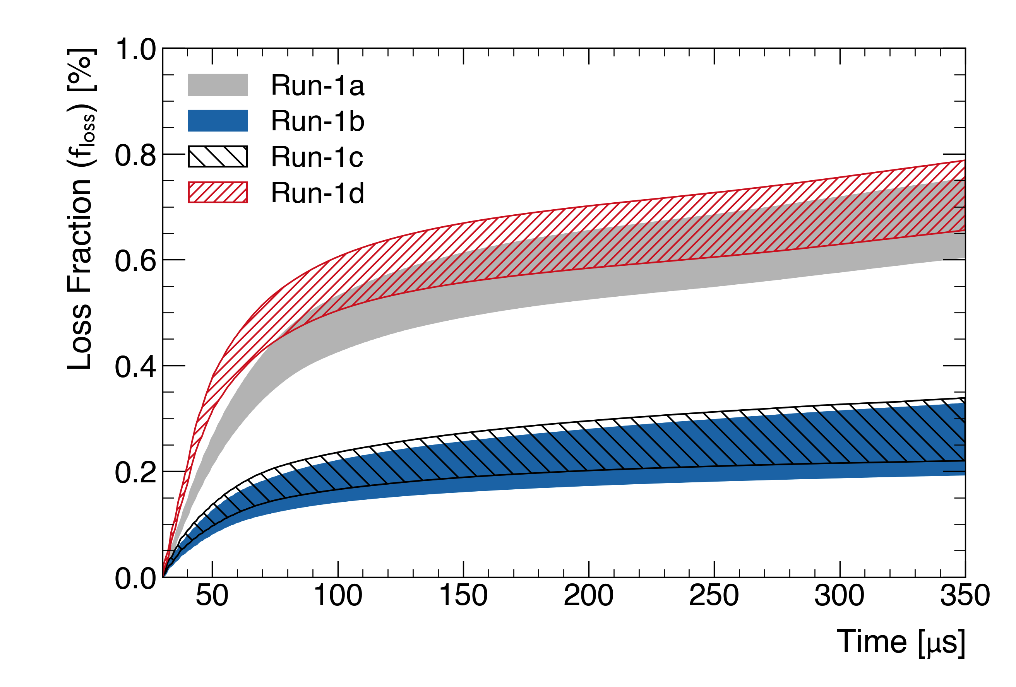
Muon Losses
p-phase correlation
+ preferential loss of low-p muons
= bias
Dataset | Run-1a | Run-1b | Run-1c | Run-1d
Correction [ppb] | -14 ± 6 | -3 ± 2 | -7 ± 4 | -17 ± 6
Usual Beam

Slide 37

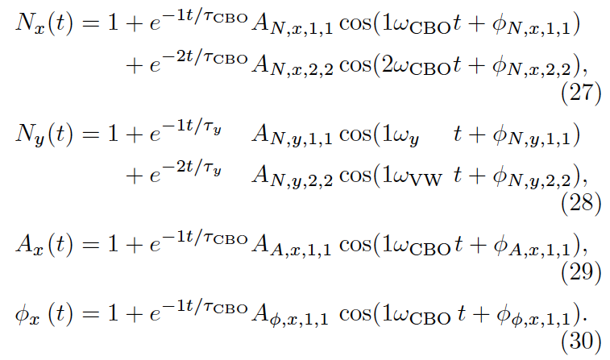
Full fit function

Slide 38
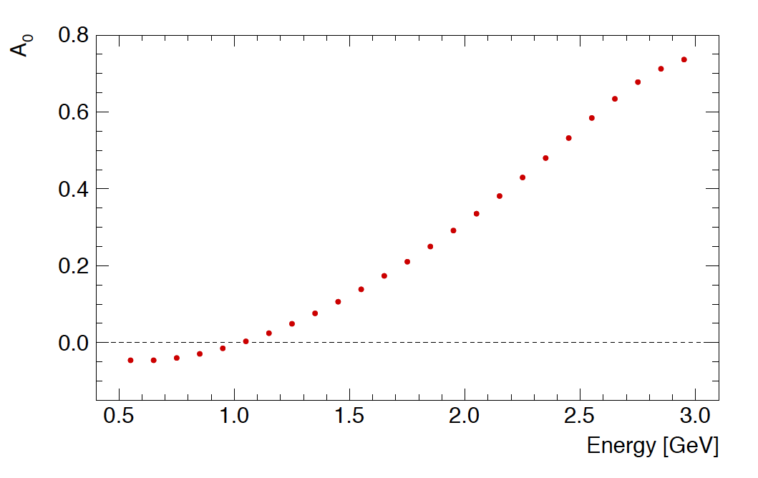
Asymmetry method
Asymmetry estimated from the data
Weighting each count by A(E) known to be most sensitive approach

Slide 39
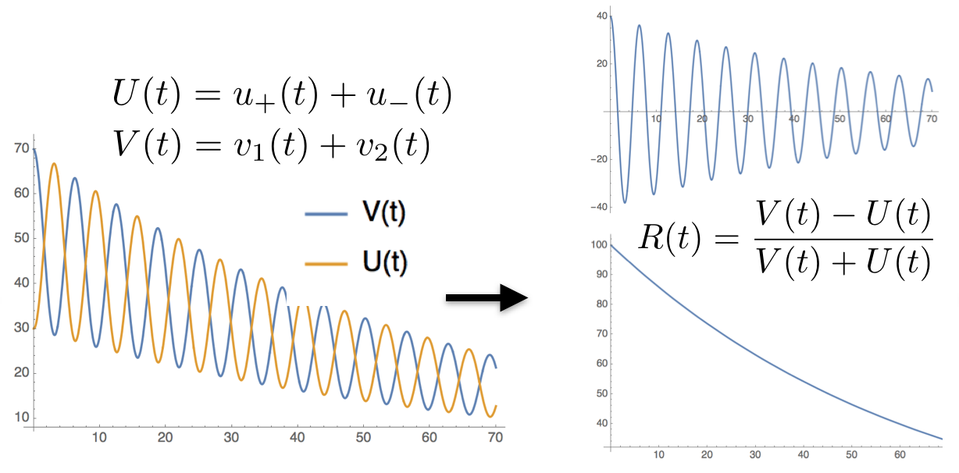
Ratio method

Slide 40
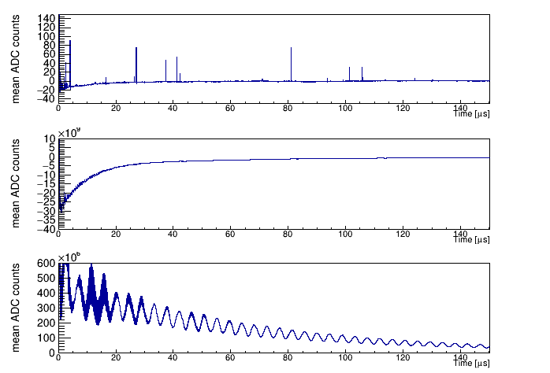
Integrated energy method
Independent data set, only 50% correlated
Very different systematics
Shorter data collection period, lower statistical precision

Slide 41
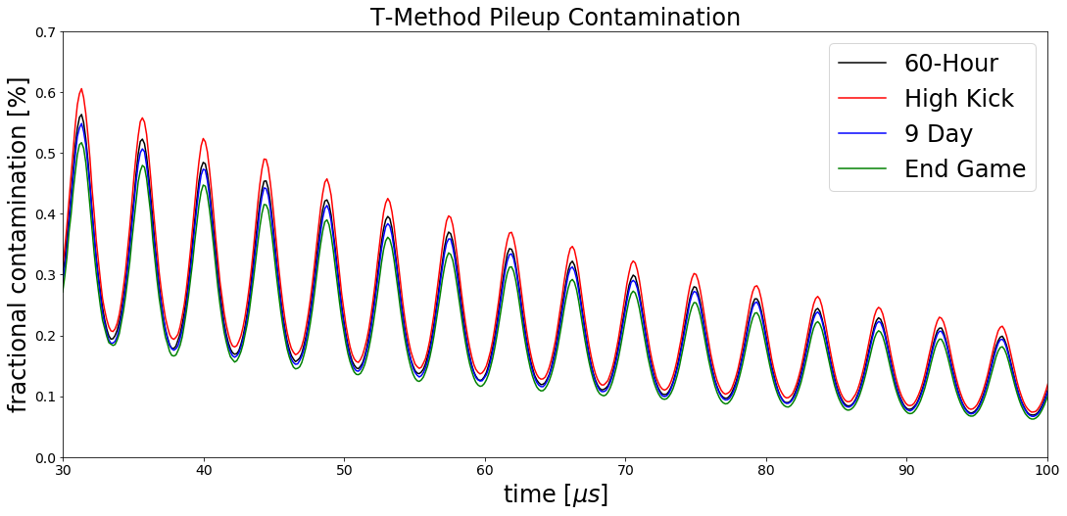
Pileup in time

Slide 42
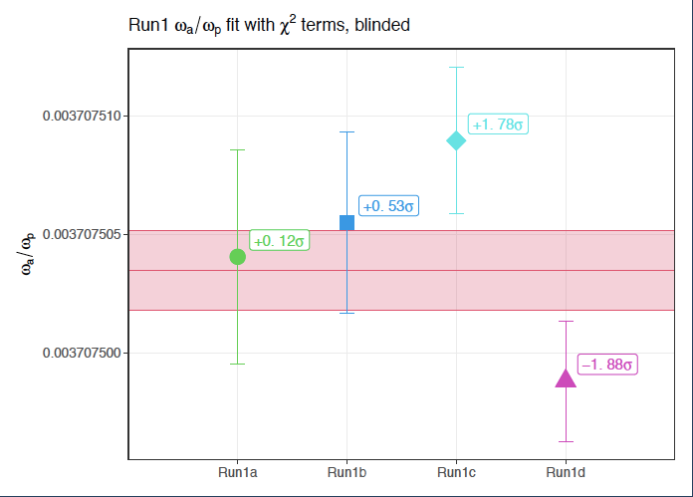
Four dataset results

Slide 43
External Constants
Proton to electron magnetic moment ratio
  W.D. Phillips, W.E. Cooke, D. Kleppner, Metrologia 13 179 (1977)
Electron magnetic moment
D. Hanneke, S.F. Hoogerheide, G. Gabrielse, Phys. Rev. A 83 052122 (2011)
Muon to electron mass ratio
W. Liu et al., PRL 82 711 (1999) (muonium hyperfine splitting)
H bound state electron magnetic moment (from QED)
P.J. Mohr, D.B. Newell, B.N. Taylor, Rev. Mod. Phys. 88(3):035009 (2016)

