Slide 1
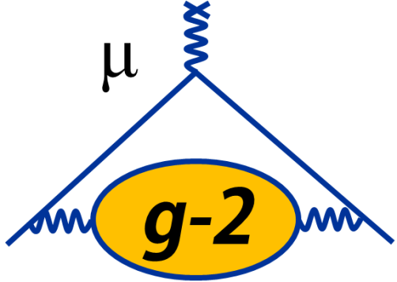





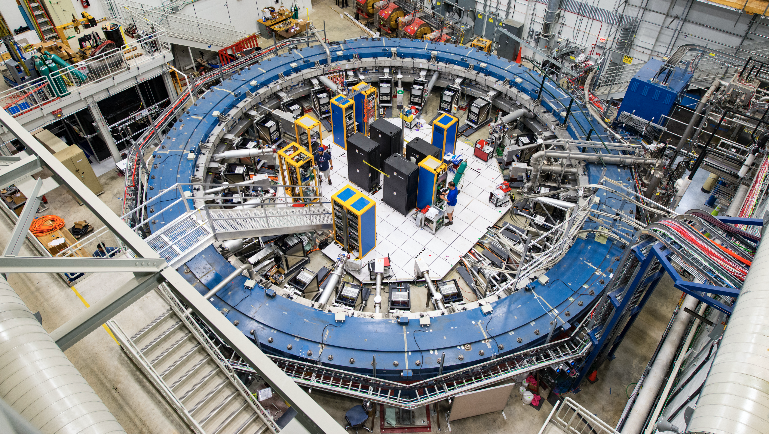
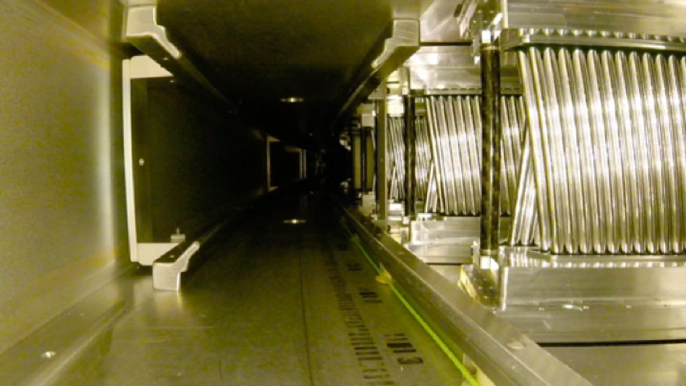
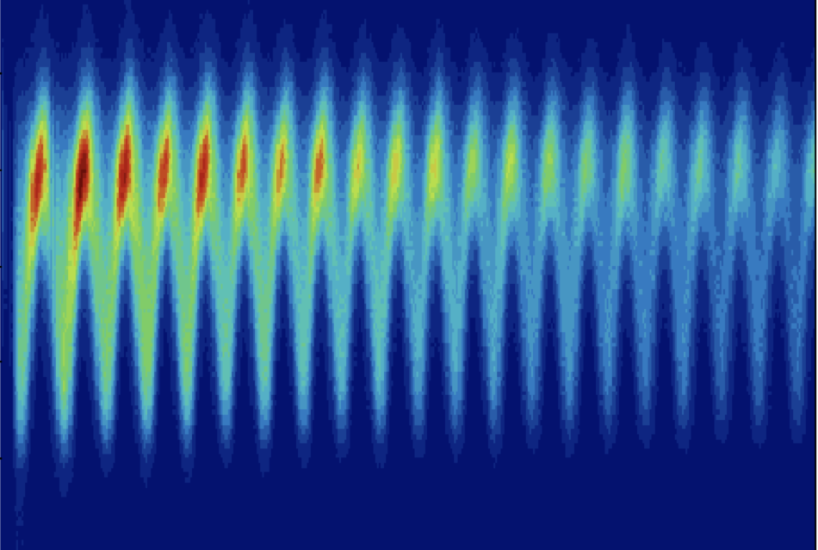
Activity on g-2 in the UK
  Saskia Charity
  Muon Precision Physics Workshop @ Liverpool
  09 November 2022

Slide 2
g-2 in the UK
Very active g-2 community in the UK
Major hardware contribution: straw tracking detectors (hardware, DAQ, tracking software)
Critical contributions and leadership in all major analysis areas of g-2 experiment
  Muon precession analysis, tracking analysis, beam dynamics, magnetic field, EDM, …

Slide 3
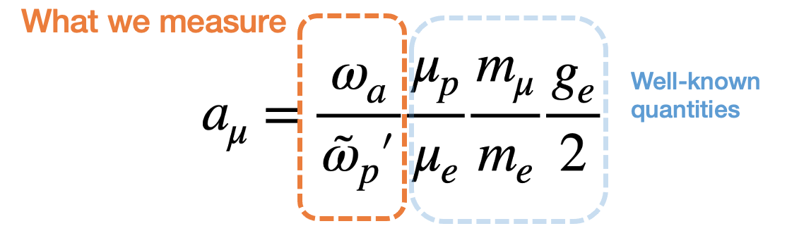
How to measure g-2
Muon precession frequency
Magnetic field (proton Larmor frequency)

Slide 4
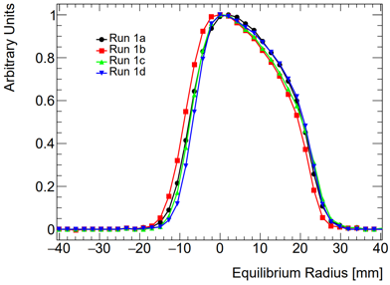
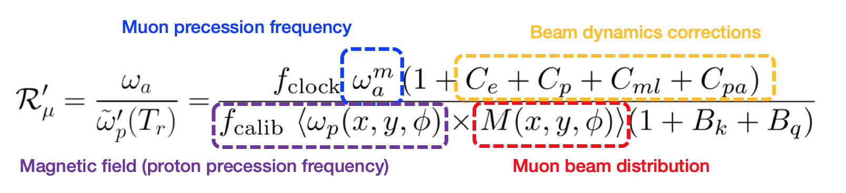
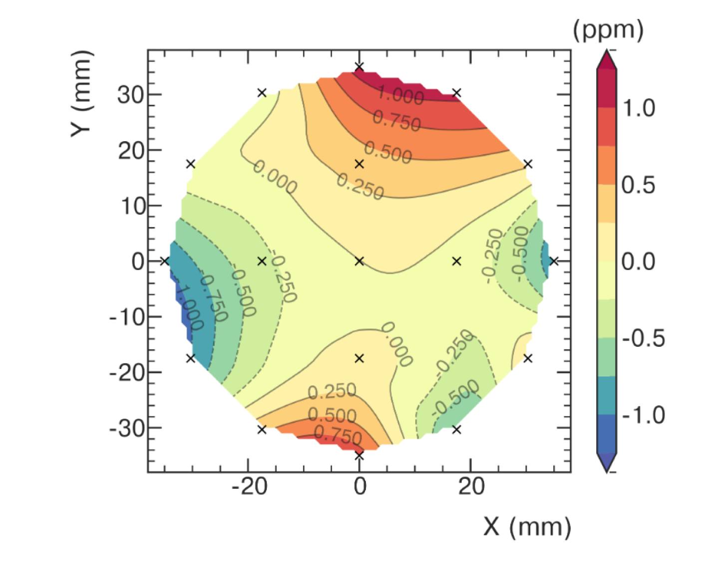
How to measure g-2

Slide 5
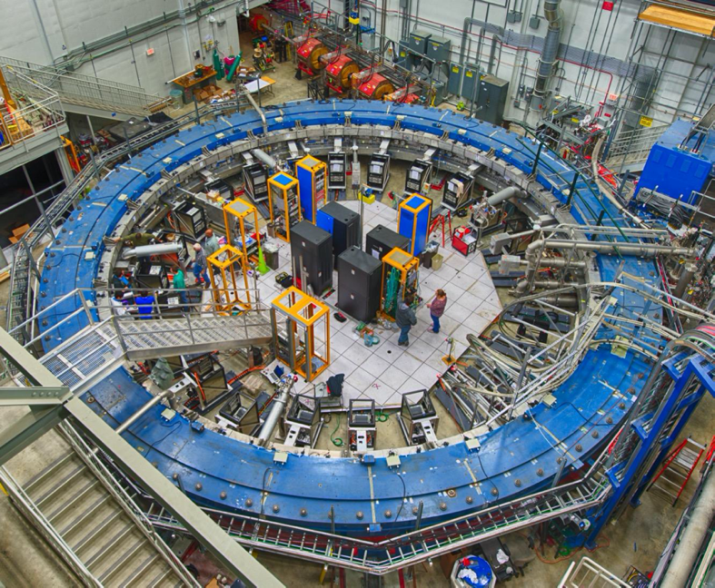
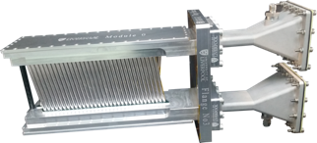
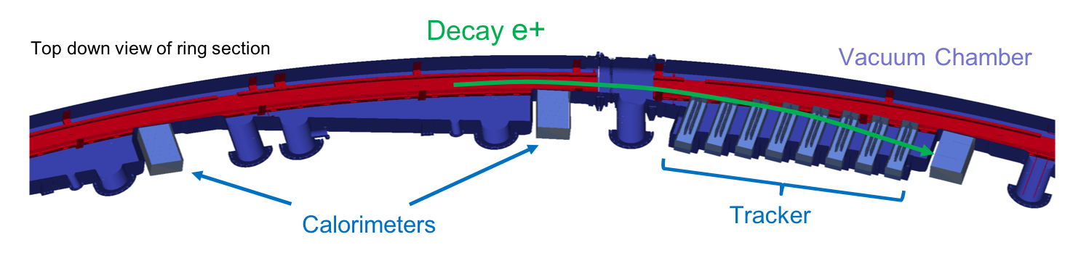
Tracking detectors
Two in-vacuum tracking stations at 180 and 270
One station = 8 modules
One module = 128 gas-filled straws, arranged in 4 layers
Measure trajectory of decay e+ to reconstruct muon beam profile
128 straws
10 cm long
15 um Al-coated mylar

Slide 6
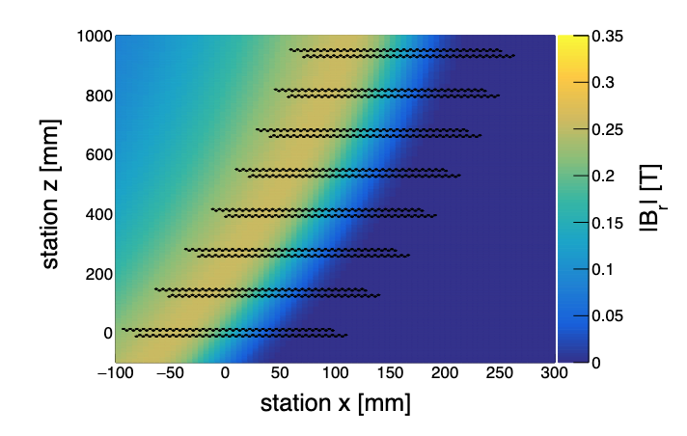
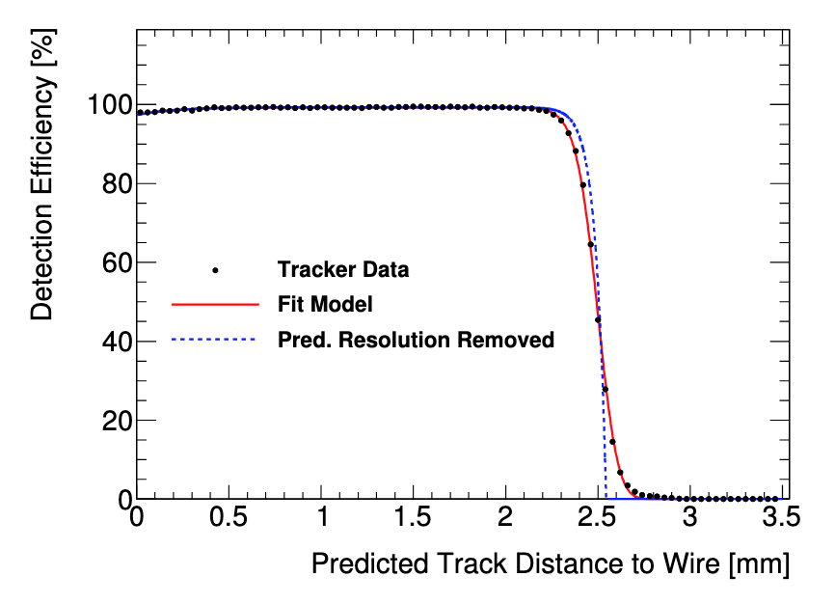
Straw tracker design & performance
Radial B field in tracker region
Low mass (reduce multiple scattering) – 15 μm wall thickness; material < 0.5% radiation length
Low leak rate to satisfy vacuum requirement (<10⁻⁶ Torr); vacuum load < 10⁻⁵ Torr L/s
Tracking in non-uniform, varying magnetic field
Hit resolution of (110 ± 20) μm
Highly efficient across straw
Full details in B.T. King et al 2022 JINST 17 P02035
Detection efficiency vs distance to wire

Slide 7
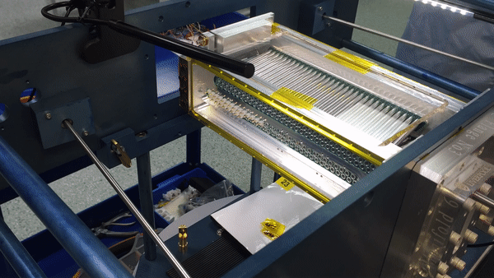
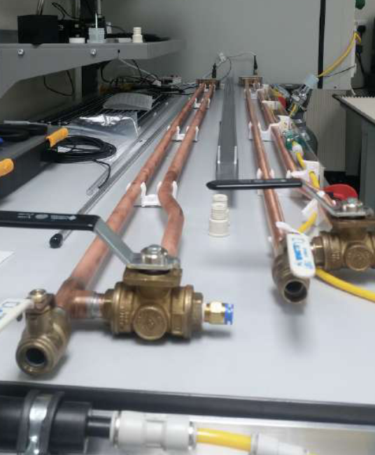
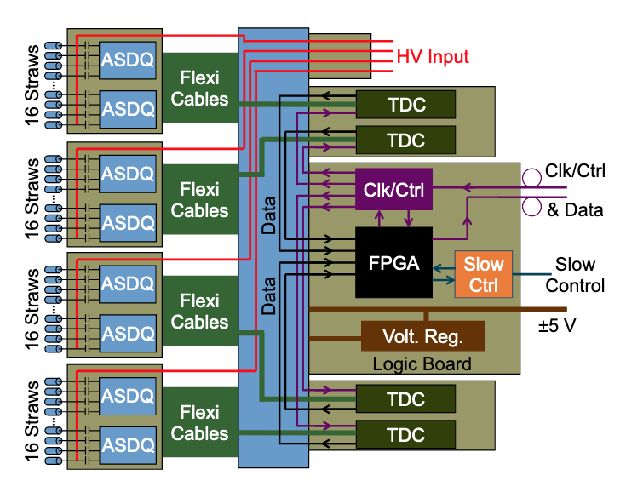
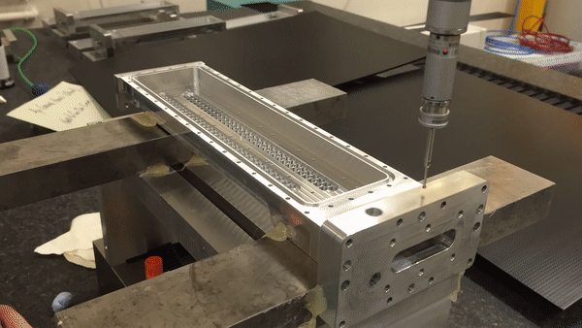
Tracking detectors: Hardware
Electronics & DAQ: UCL, Boston University
Hardware design, QA and assembly at Liverpool
Wire stringing
CMM metrology
Readout electronics (ASDQs)
Leak testing
DAQ chain

Slide 8
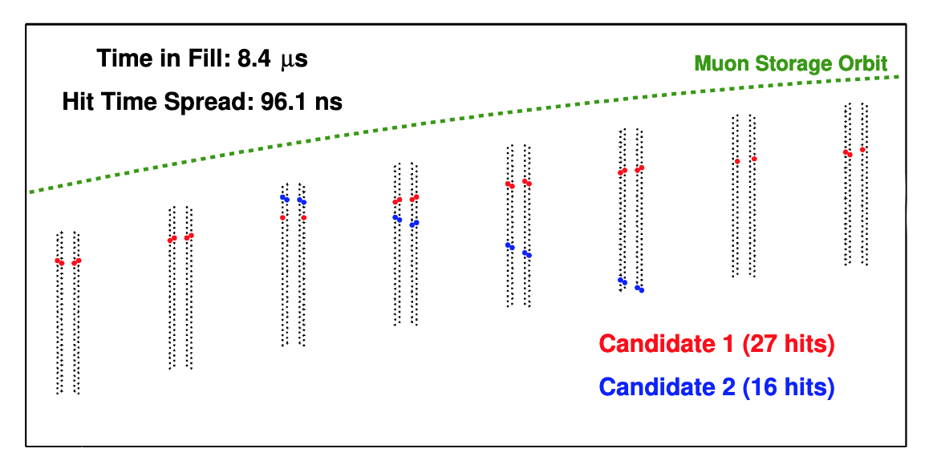
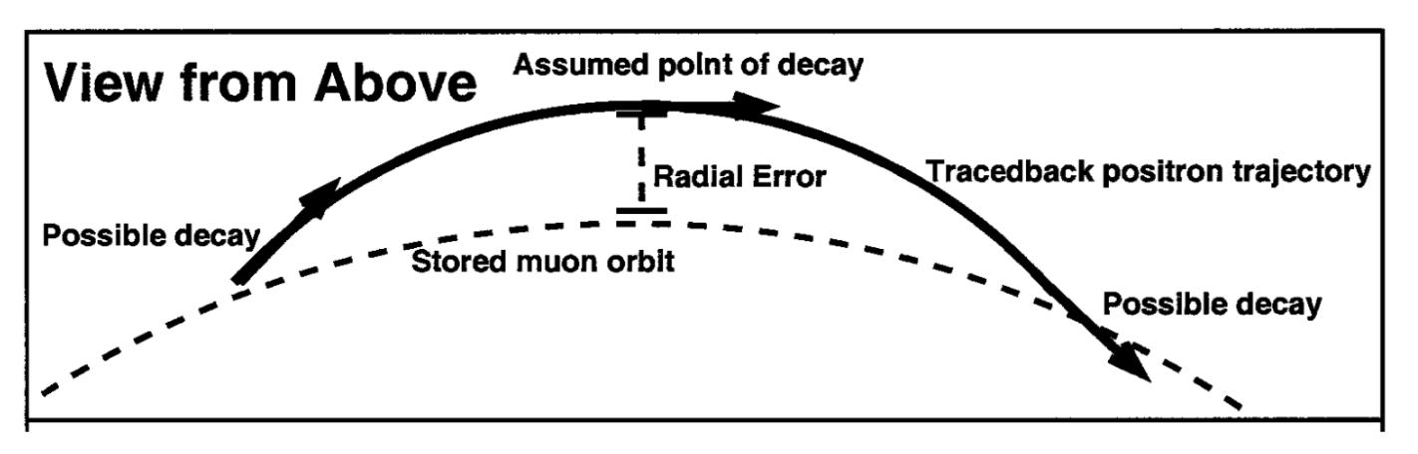
Tracking detectors: Software
Wire stringing
Track finding: group hits in time and identify track candidates
Track fitting: uses GEANE method for chi-squared minimisation – direct access to full geometry and magnetic field map
Track extrapolation: Runge-Kutta Nystrom method – extrapolate track vector to muon decay position (point of radial tangency)
CMM metrology

Slide 9
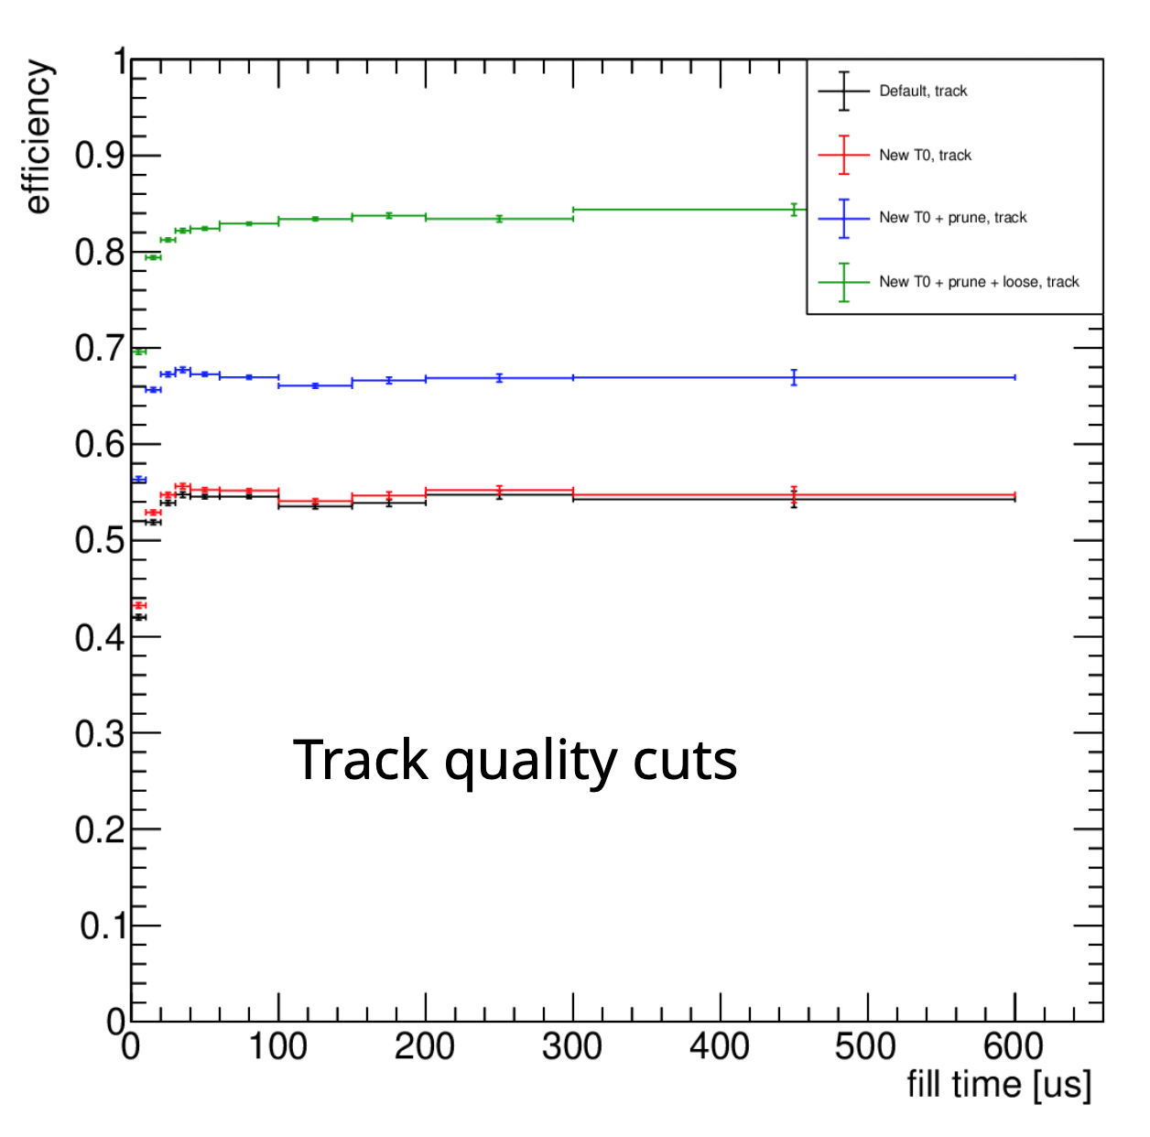
Beyond Run-1: Track efficiency improvements
In Run-1: track quality more important than statistics -- very stringent quality cuts meant low percentage of recorded tracks used in analysis
In future, want to improve this efficiency – important for EDM analysis
Revised quality selection procedure: largest gains from cutting hits with large residuals that caused poor p-value for ‘good’ tracks
Requires reprocessing tracks for all datasets
  Running on GridPP nodes
Wire stringing
CMM metrology
Work by Gavin Hesketh & Lucy Bailey (UCL)

Slide 10
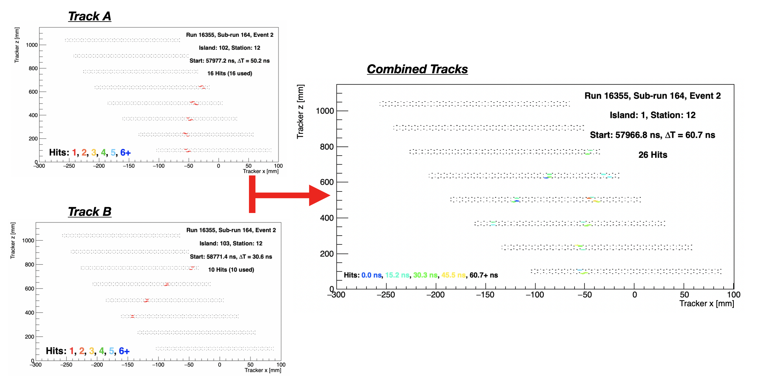
Beyond Run-1: Machine Learning techniques for tracking
Wire stringing
New approach: use ML techniques to improve track finding – particularly good for pileup events
Use overlaid selection of well-fitted, isolated tracks from data as training sample
CMM metrology
Readout electronics (ASDQs)
Work by Anthony Hibbert & Joe Price (Liverpool)

Slide 11
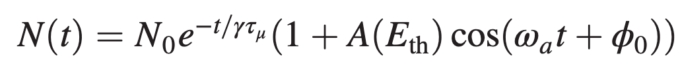
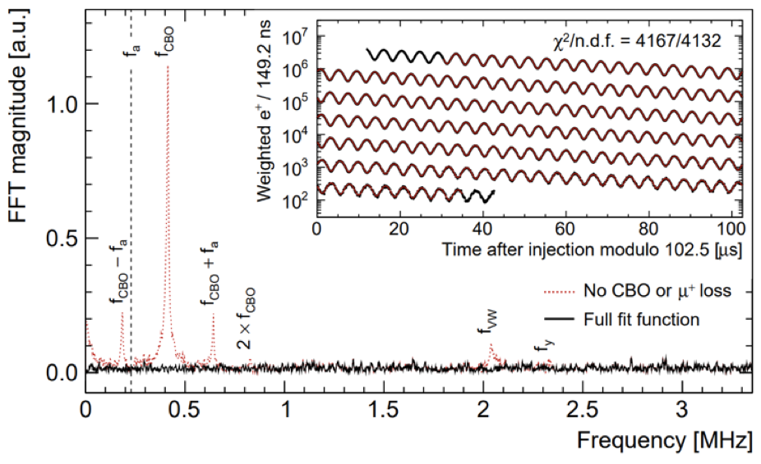
Trackers & Beam Dynamics in g-2
5-parameter fit
N(t) = number of muons in calorimeters vs time
Residuals in FFT if only 5 parameters used
Full fit function contains 26 parameters to account for beam dynamics and detector acceptance

Slide 12
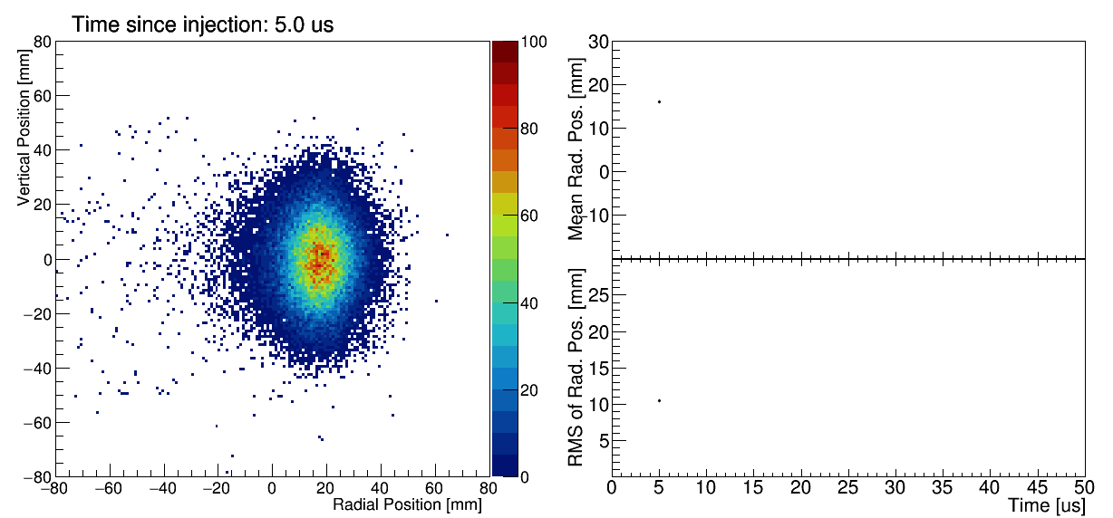
Beam dynamics with the tracker data
Measure oscillations in the radial and vertical beam distribution throughout a muon fill
Frequency/amplitude of oscillations in mean and RMS → input to ω_{a} fit
Average muon beam position over long times used to weight the magnetic field measurement

Slide 13
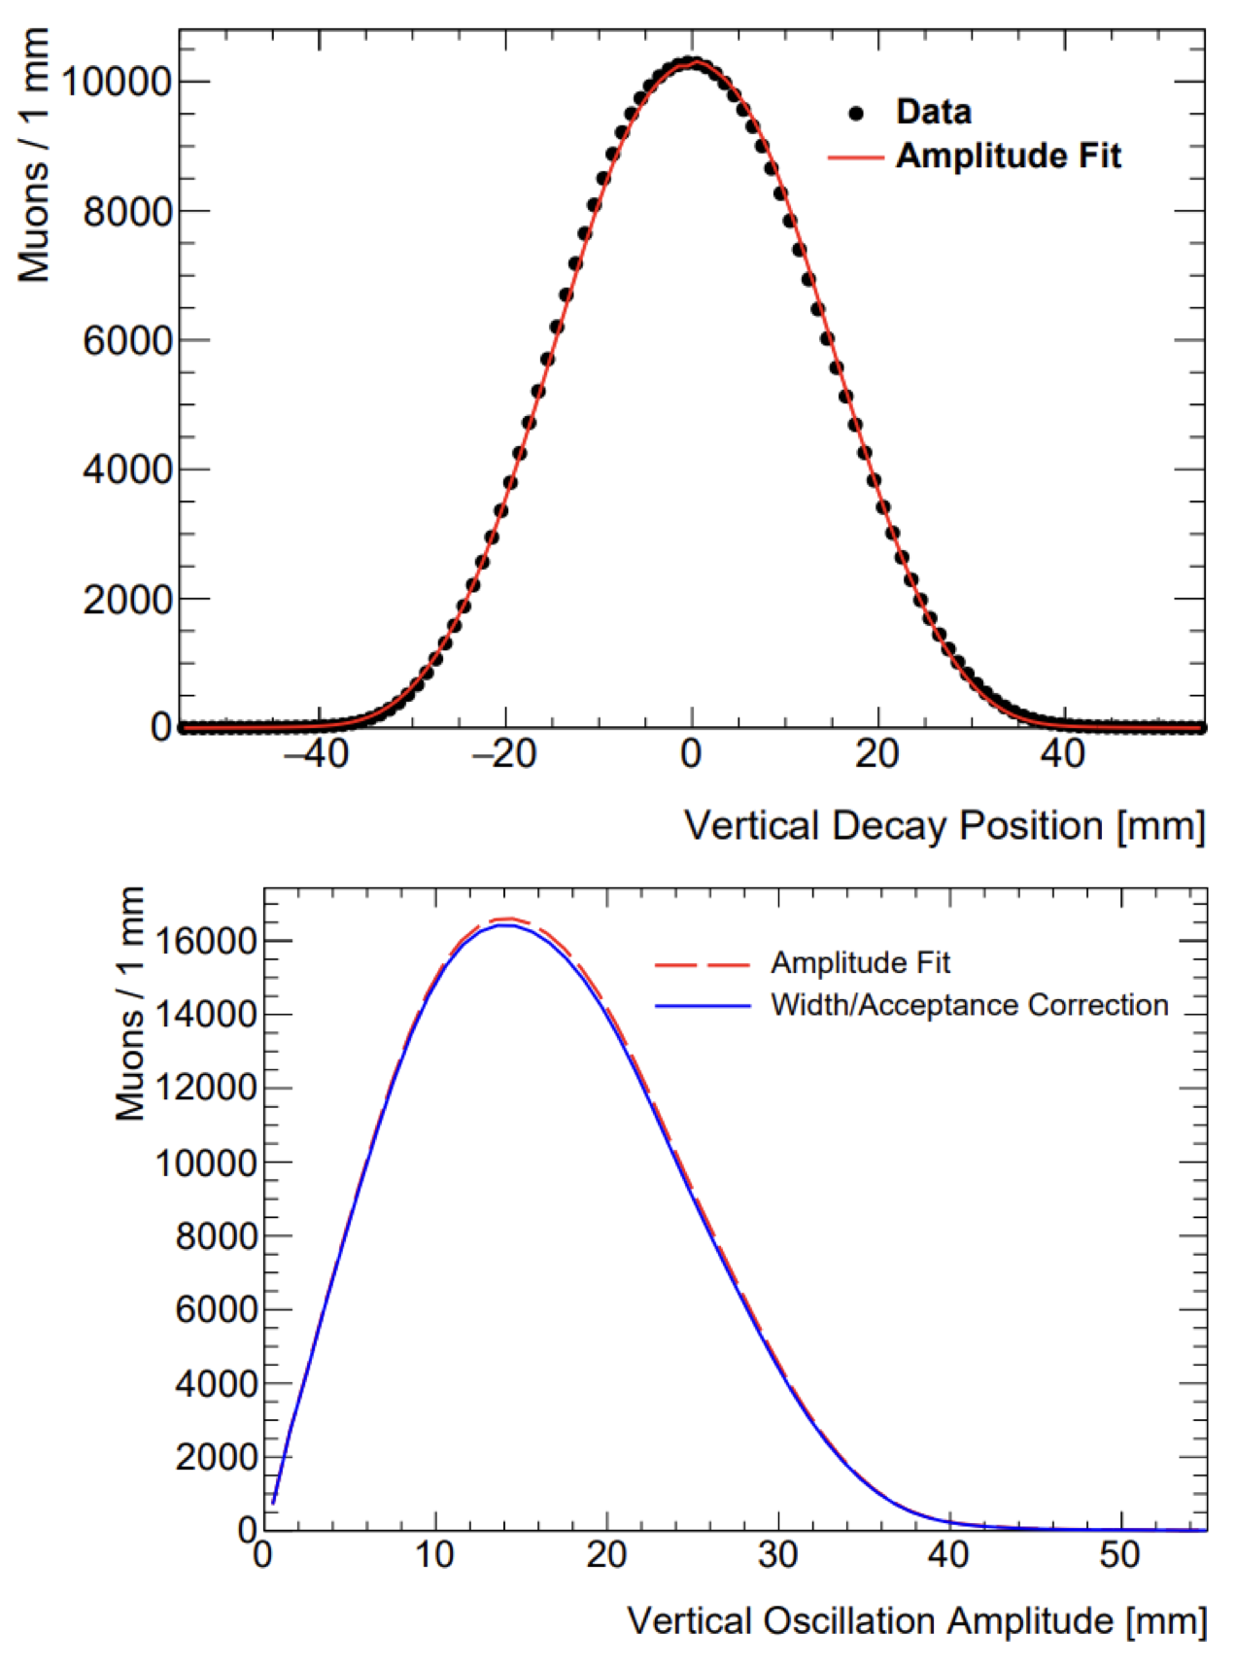
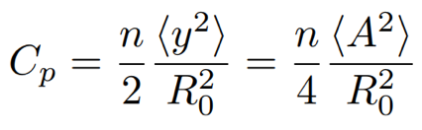
Corrections to ω_{a} in Run-1: pitch correction C_{p}
Muon beam has vertical spread
Muons “pitch” up and down as they traverse the storage ring
Muons with momentum component parallel to B field have reduced precession frequency
Measured vertical distribution used to quantify correction
C_{p} = 180 (13) ppb (Run-1)

Slide 14
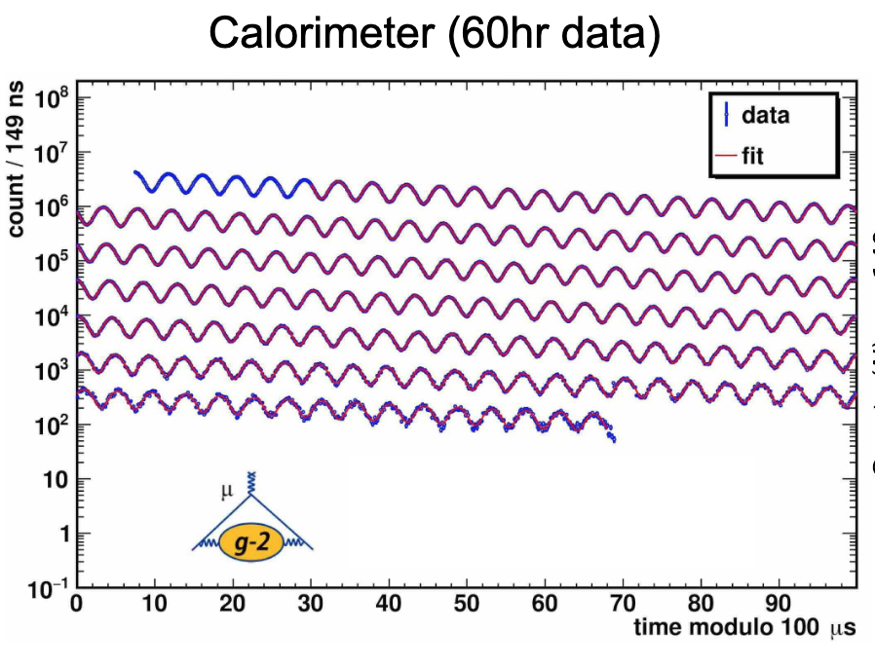
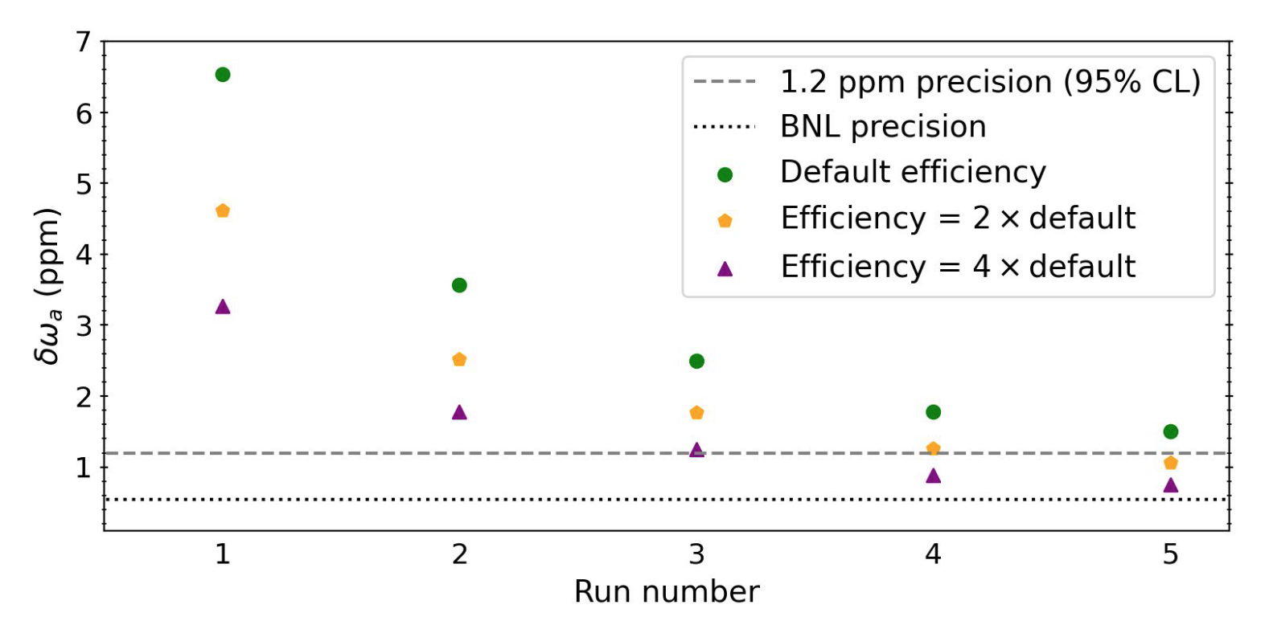
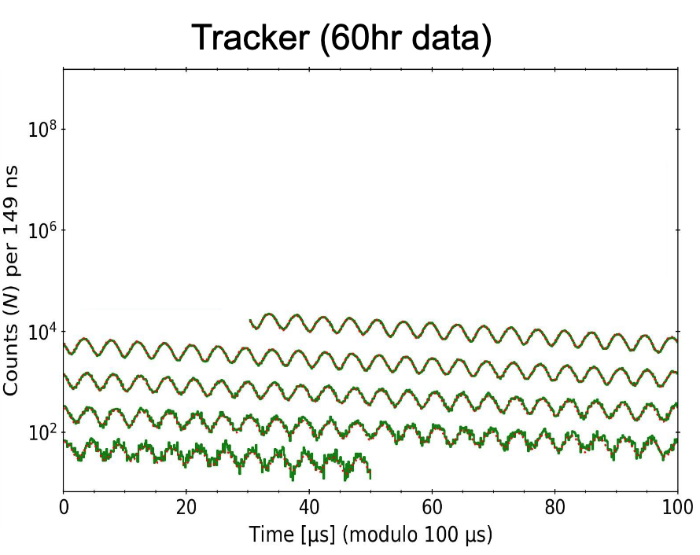
Beyond Run-1: Muon precession analysis using trackers
Tracker measurement of ωa allows cross-check with calorimeter analysis with independent systematics
Anticipate BNL-level precision with full statistics (Runs 1-5) and updates to tracking algorithm & efficiency
Wire stringing
CMM metrology
Plots from George Sweetmore (Manchester)

Slide 15
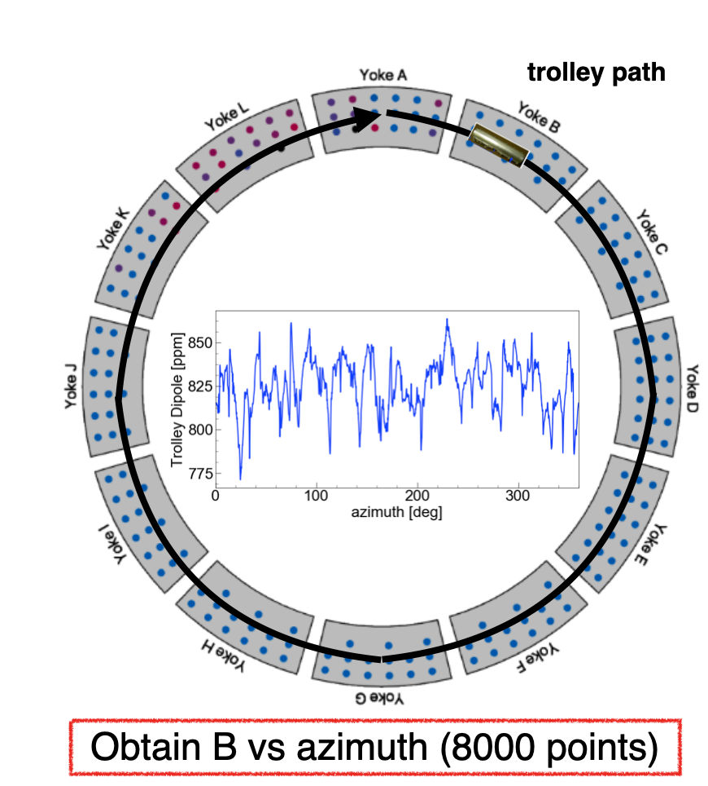
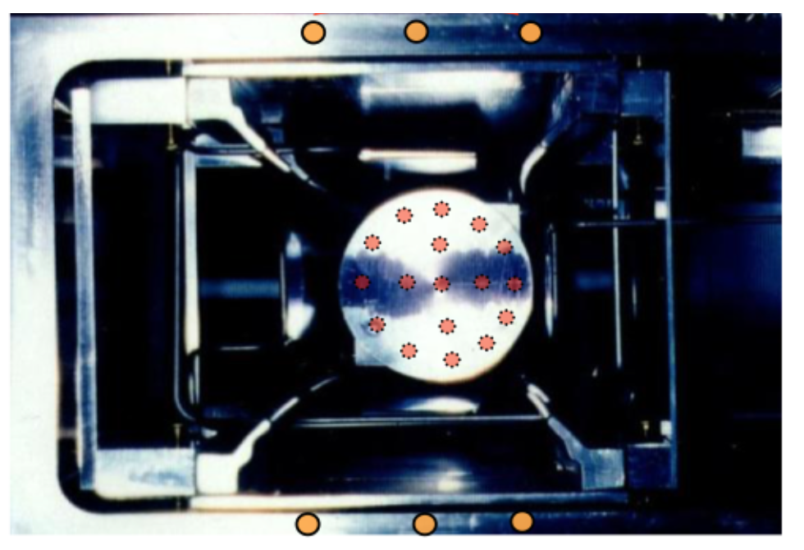
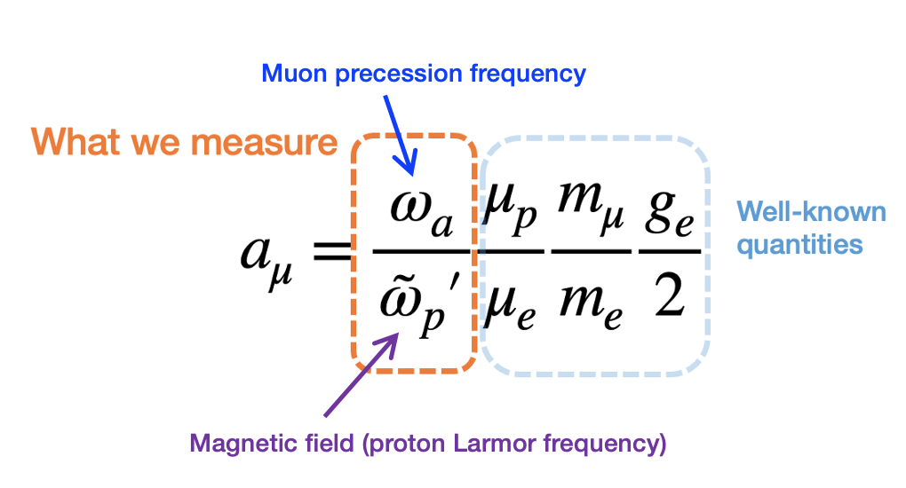
Muon-weighted magnetic field
Muon weighted B-field is 50% of uncertainty on a_{μ}
Wire stringing
CMM metrology
Measure B-field over time continuously at 72 discrete locations
Measure B vs azimuth once every 3 days
Combine magnetic field with measured muon beam profile

Slide 16
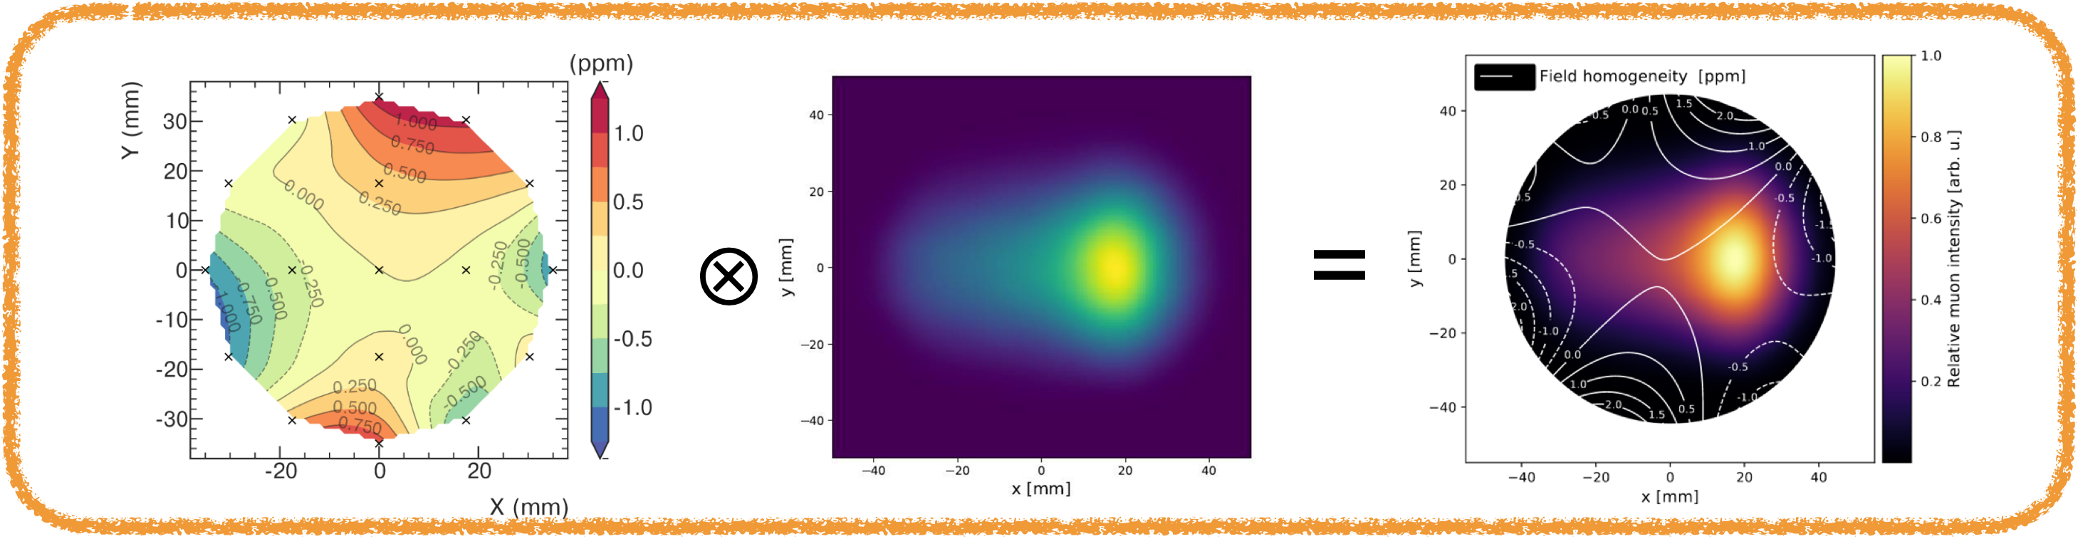
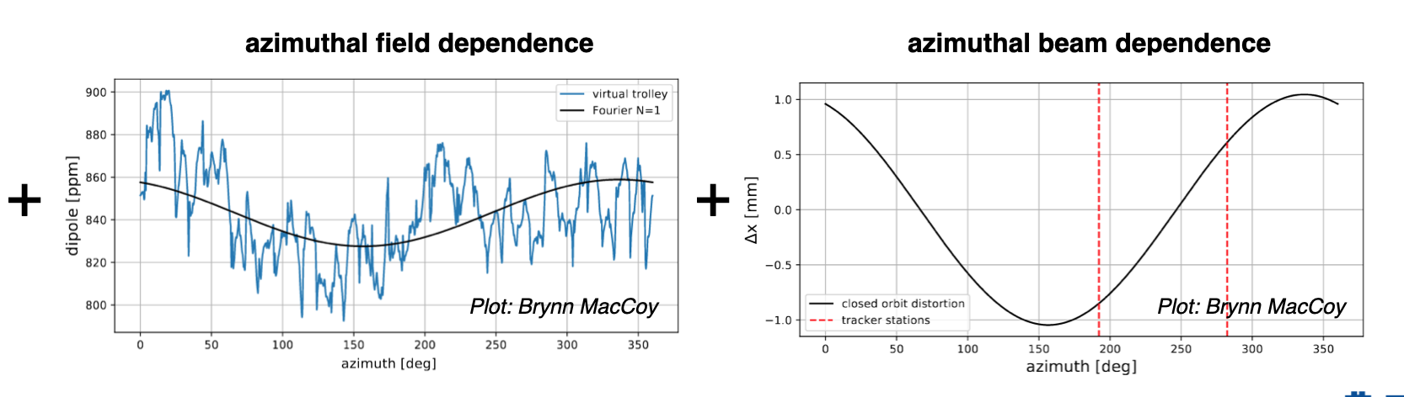
Muon-weighted magnetic field
Wire stringing
CMM metrology
Readout electronics (ASDQs)

Slide 17
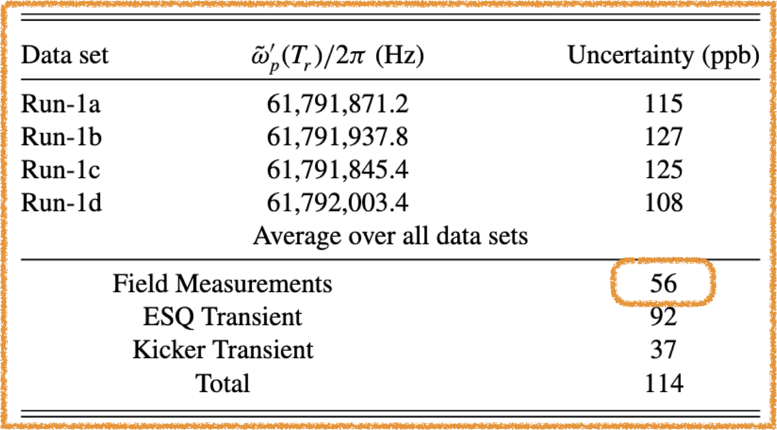
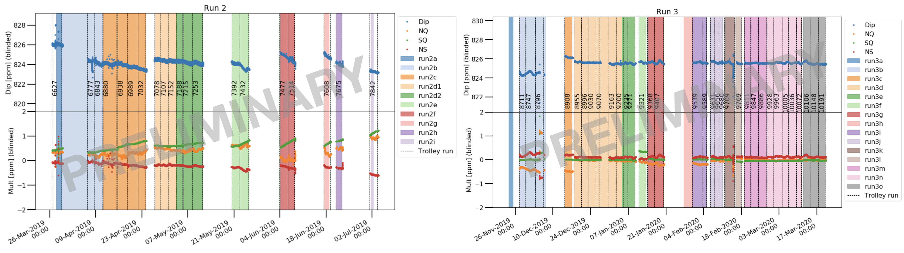
Muon-weighted magnetic field
Run-1 uncertainty from B-field analysis already sufficient for final dataset
Run 2/3 contains ~10x as many trolley runs as Run1
Rich dataset → a lot of interesting information about the magnetic field
Wire stringing
CMM metrology

Slide 18
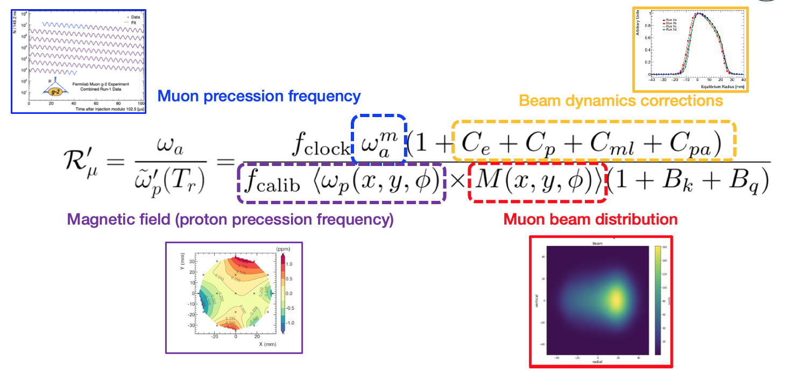
Summary
The straw tracking detectors have been crucial to the success of the g-2 experiment
Very active g-2 community in the UK, with major contributions in multiple analysis areas
Current work to improve tracking efficiency will be invaluable to the g-2 and EDM analyses
Huge datasets left to analyze with much scope for new ideas and collaboration
Wire stringing
CMM metrology

