Slide 1



Status of experimental searches on EDMs
Workshop on Muon Precision Physics
University of Liverpool, UK, 7-9 November 2022
In-person presentation
Yannis K. Semertzidis, IBS-CAPP & KAIST, South Korea
In the next decade(s) we expect significant progress in electron (eEDM), neutron (nEDM), muon (μEDM), proton (pEDM),… EDM sensitivities.
Statistics for 10⁻²⁹ e-cm for pEDM, for best hadronic EDM experiment
Systematics: using symmetries, spin-based alignment/background reduction

Slide 2
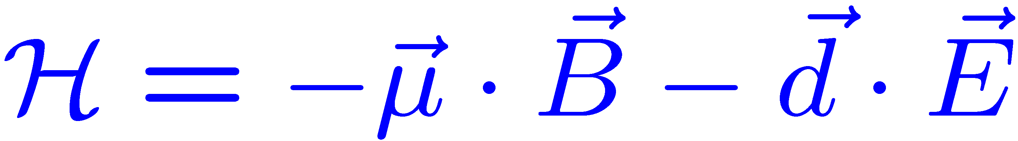




A Permanent EDM Violates both T & P Symmetries:
-
+
The EDM is caused by the spin
T
$$\vec{E}$$
$$\vec{B}$$
+
-
P
+
$$\vec{E}$$
$$\vec{B}$$
-
Reminder: batteries are allowed in the SM!

Slide 3
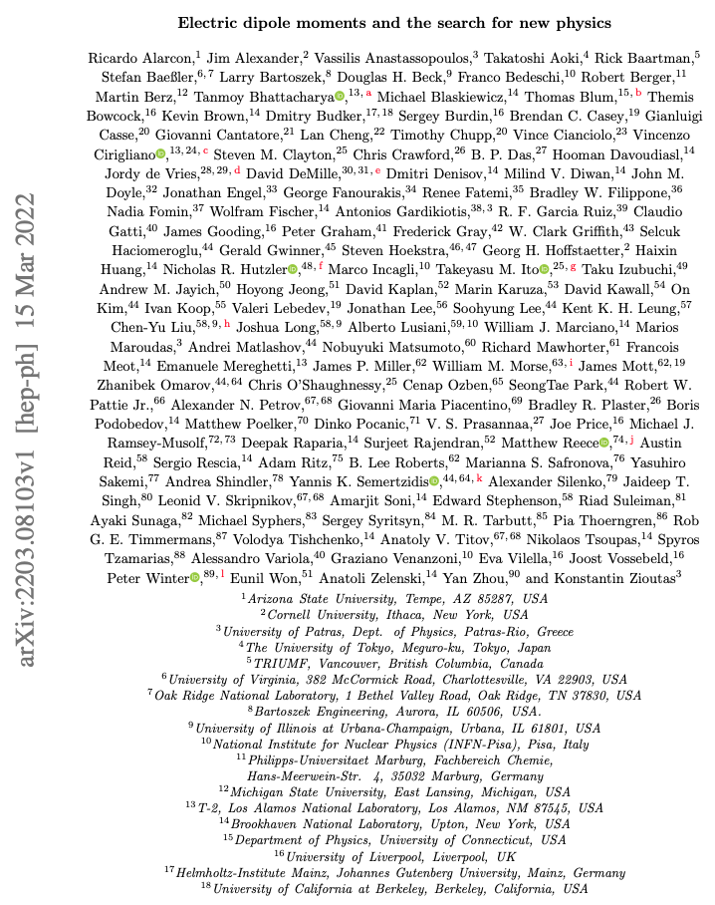
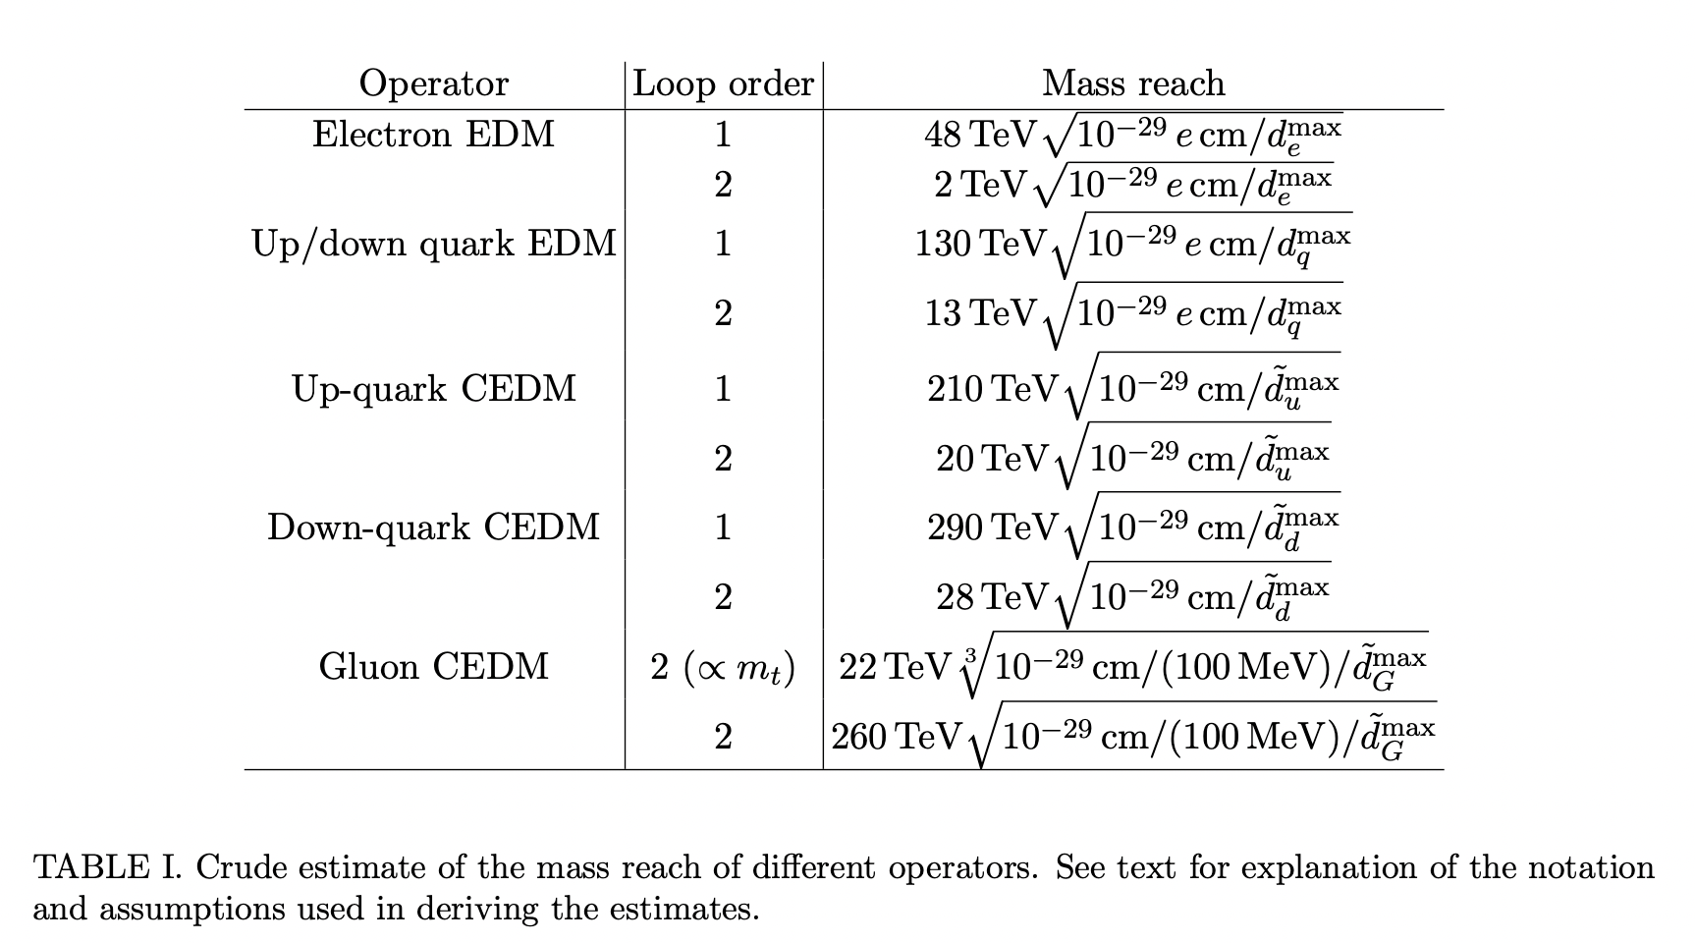
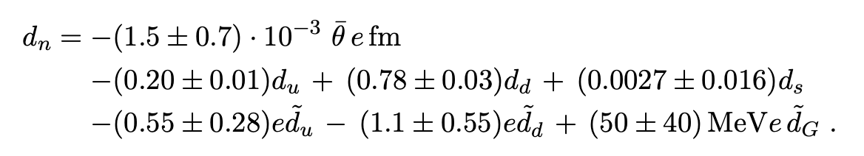
Snowmass paper on EDMs, why many EDMs:

Slide 4

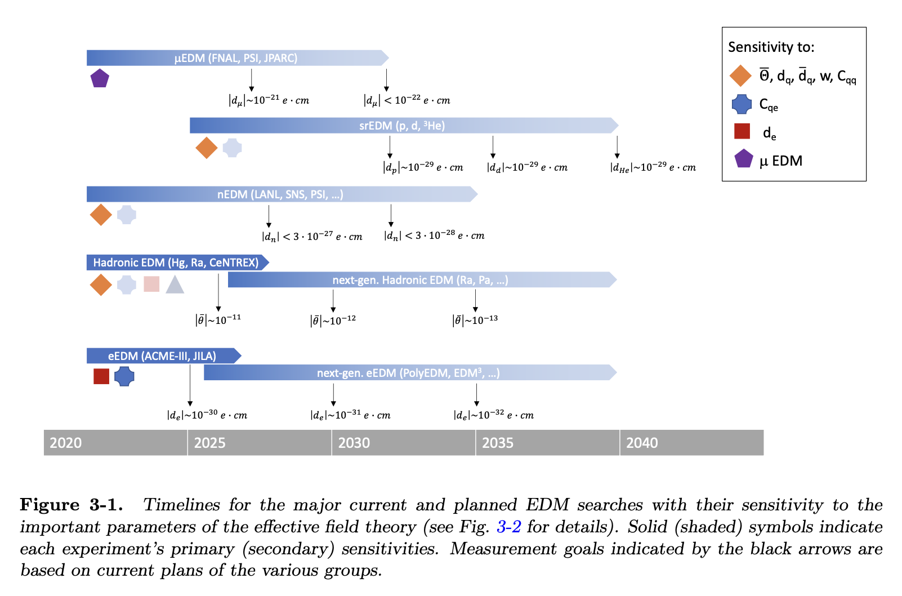
EDM timelines, from Snowmass 2021 (2022).
Blum, Winter et al.

Slide 5
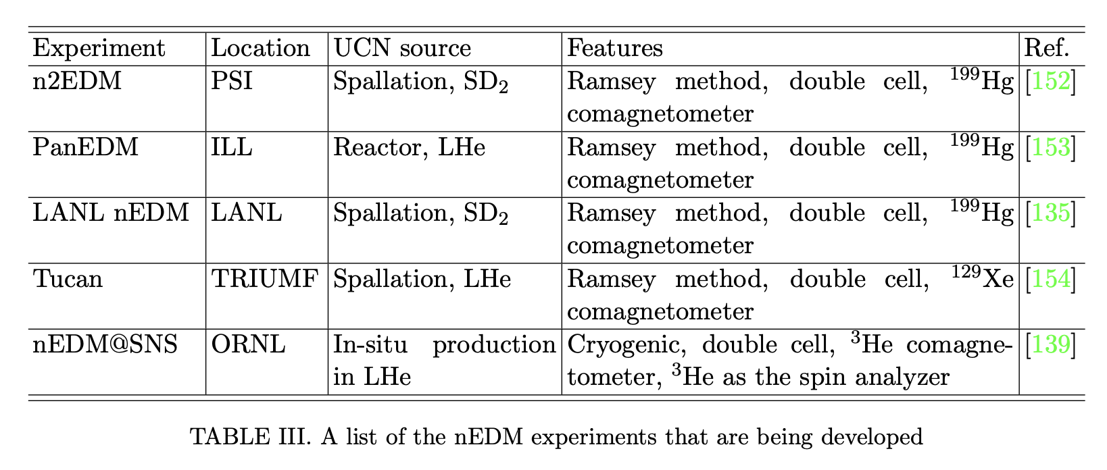
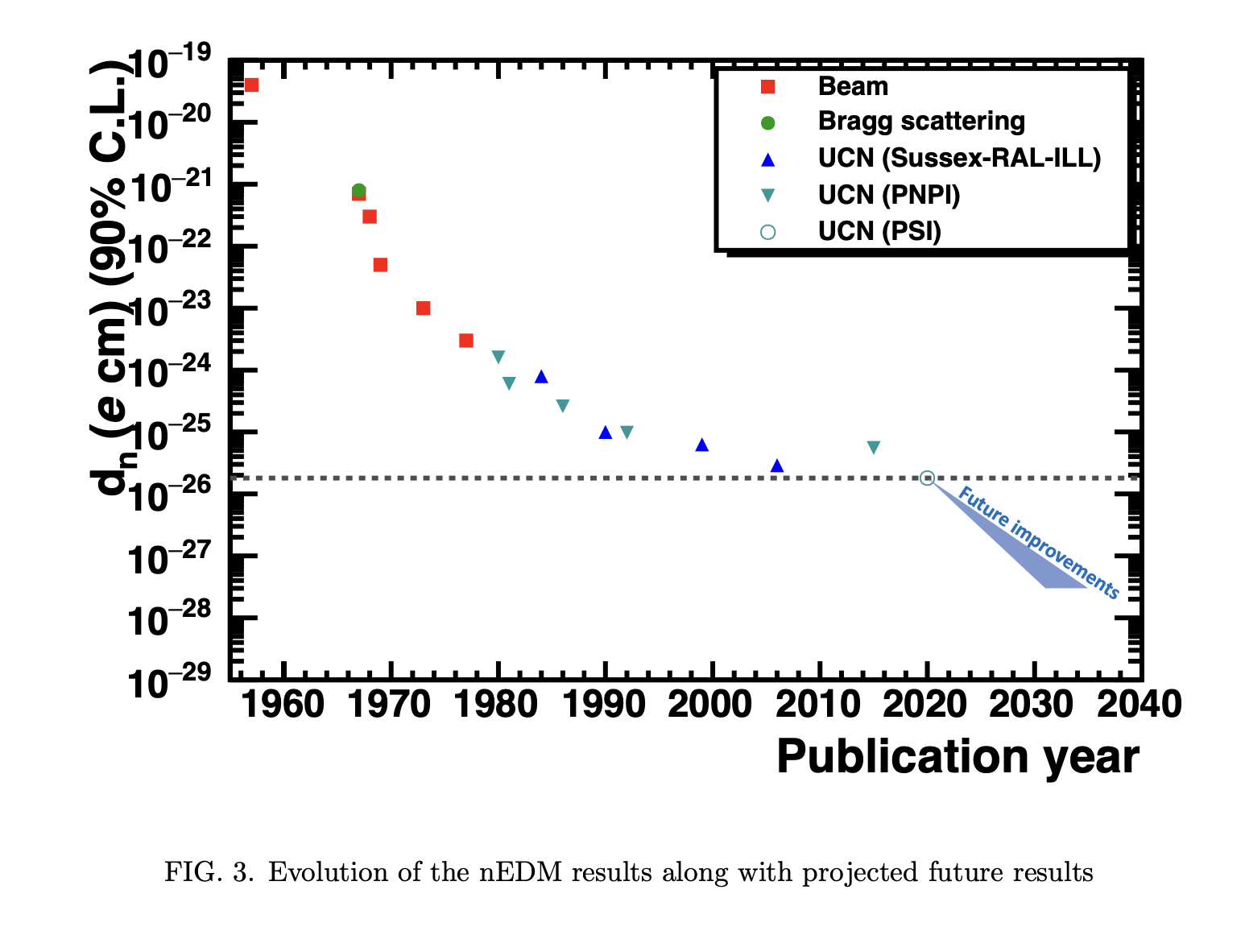
Snowmass paper on EDMs
Neutron EDM

Slide 6
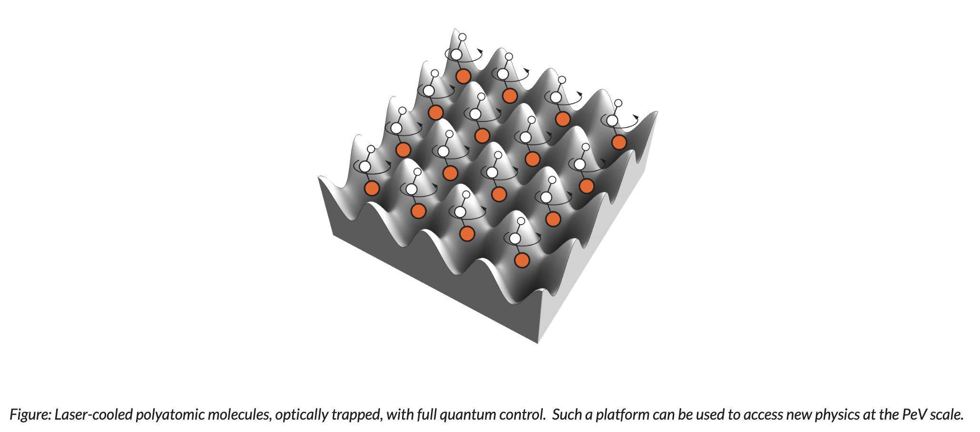
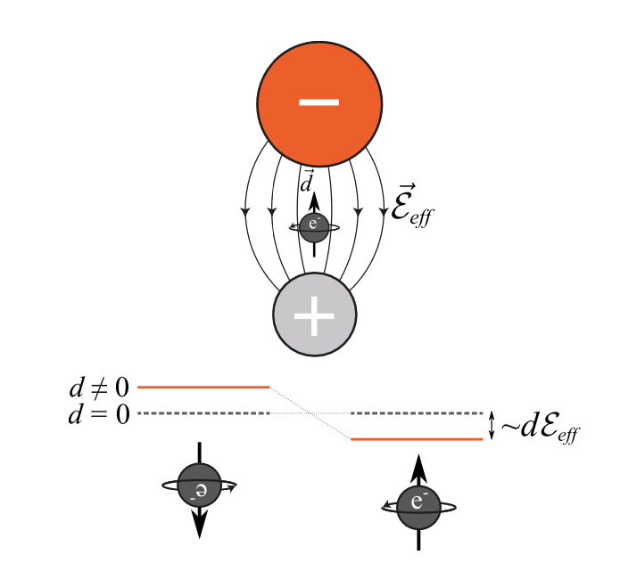

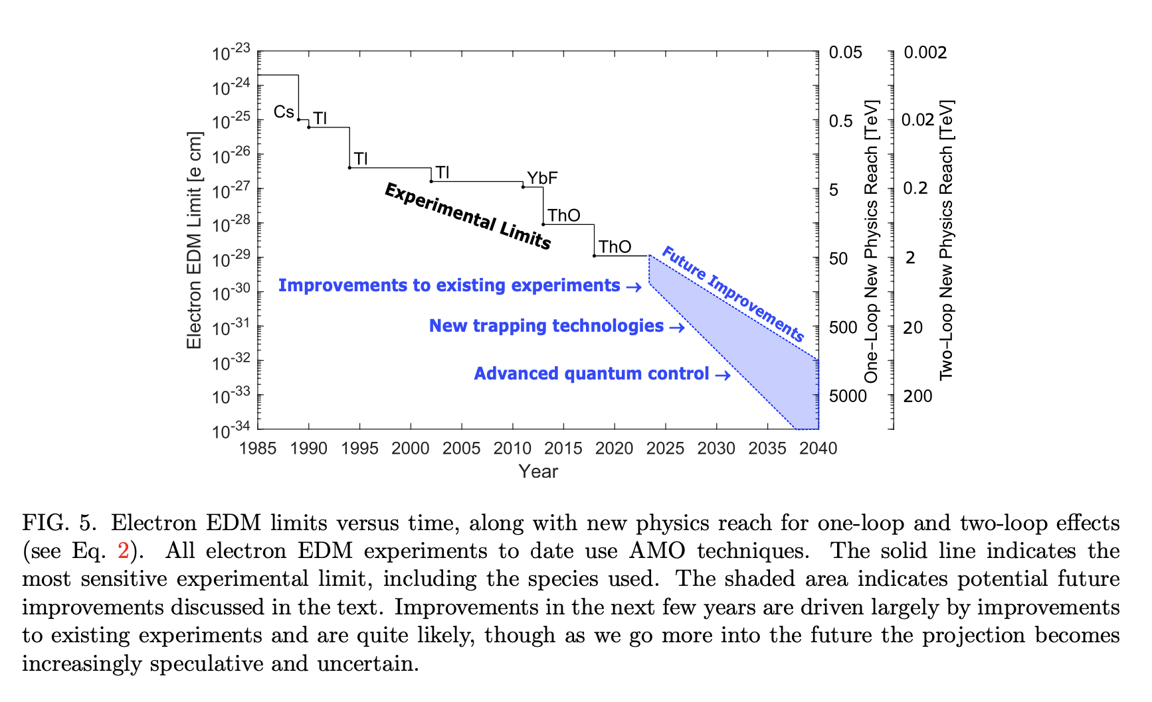
Snowmass paper on EDMs
Effective E-field with polar molecules: order GV/cm
Electron EDM

Slide 7
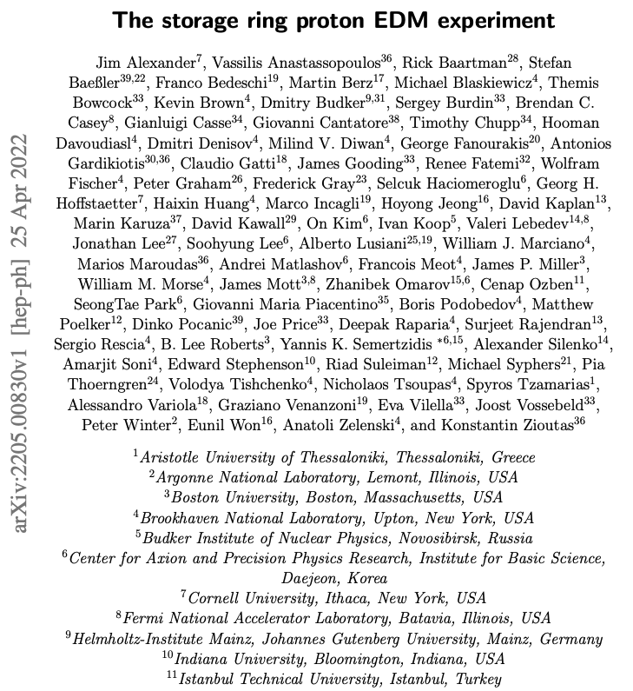
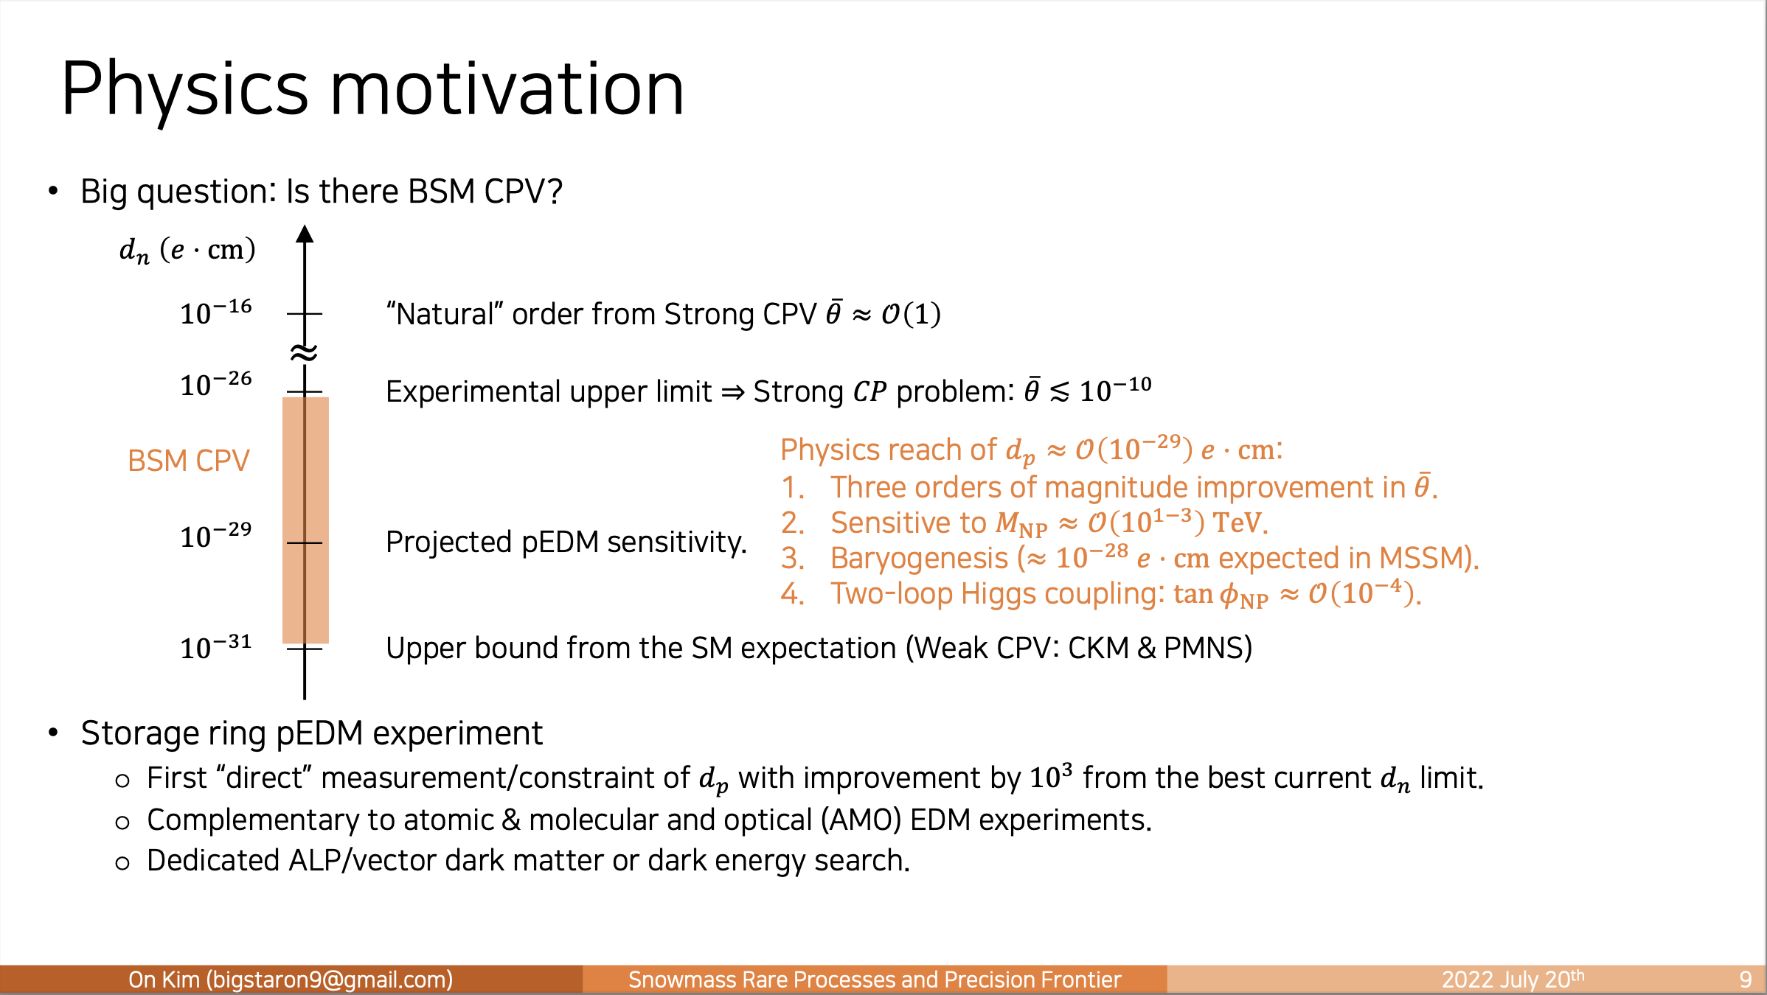
Snowmass paper on pEDM

Slide 8
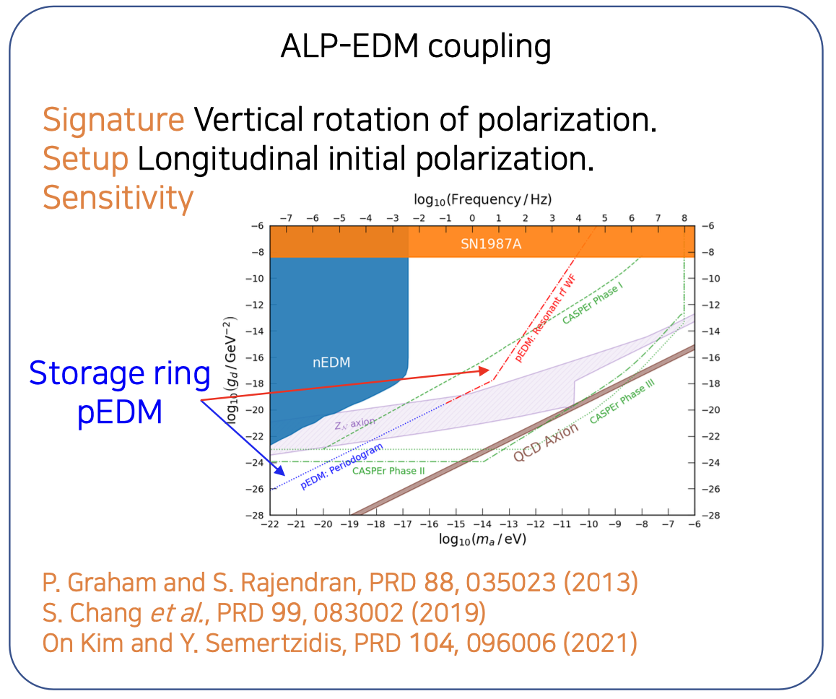
Snowmass paper on pEDM

Slide 9
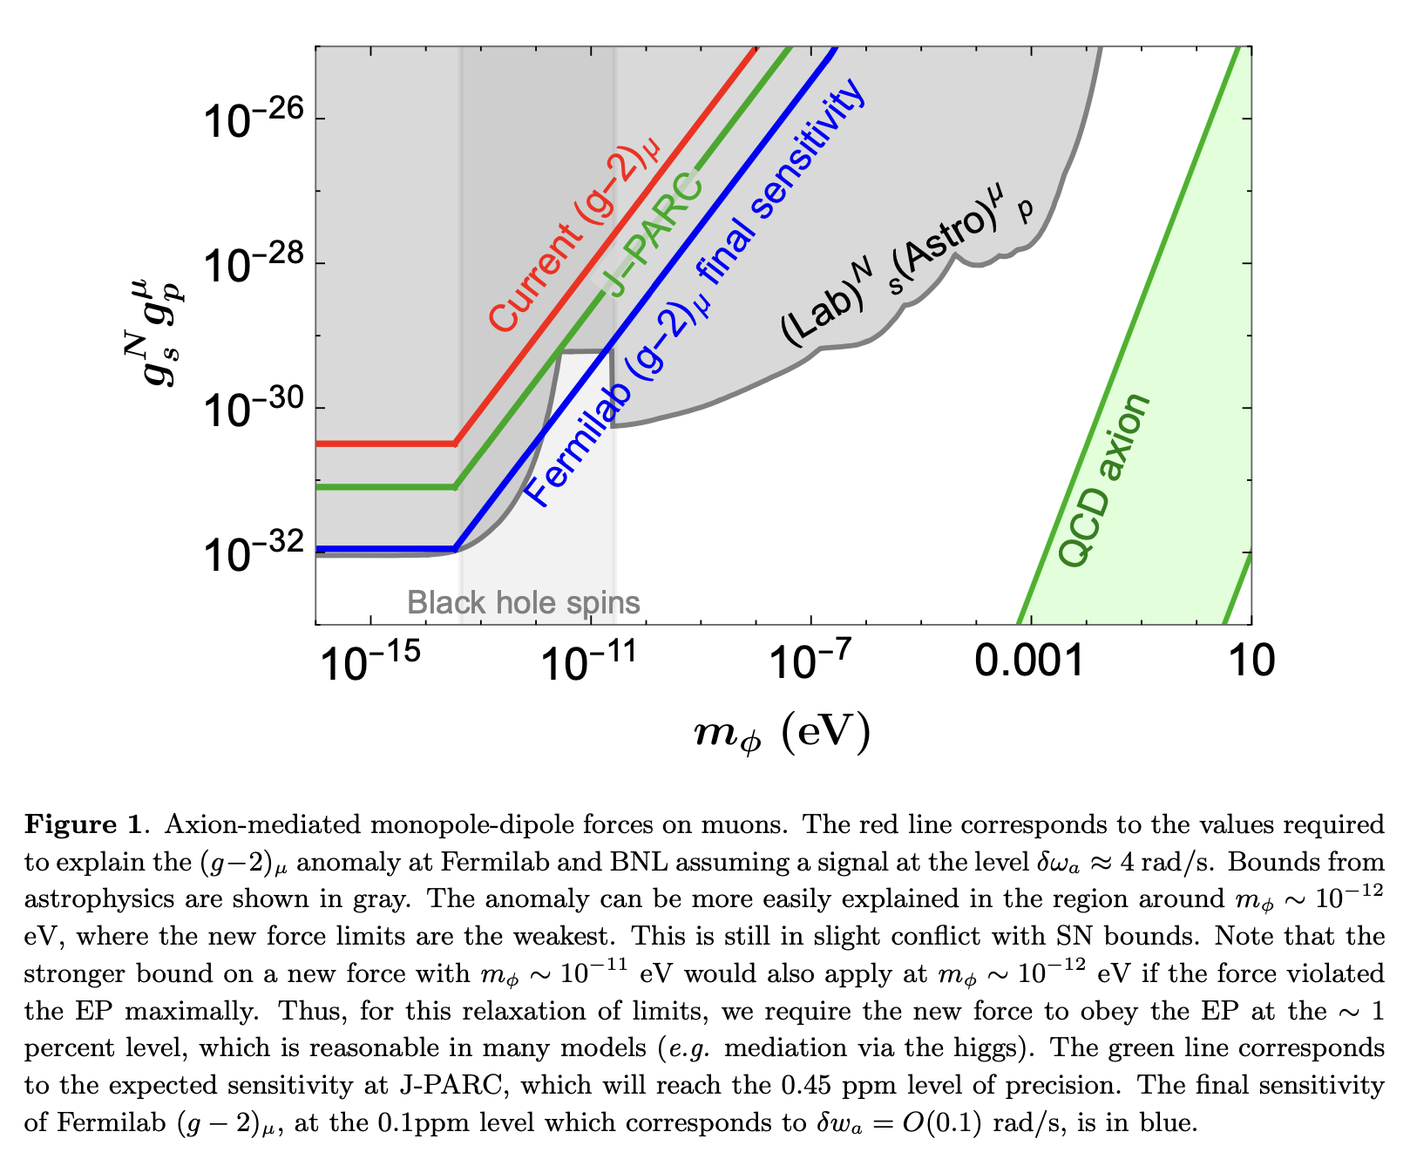
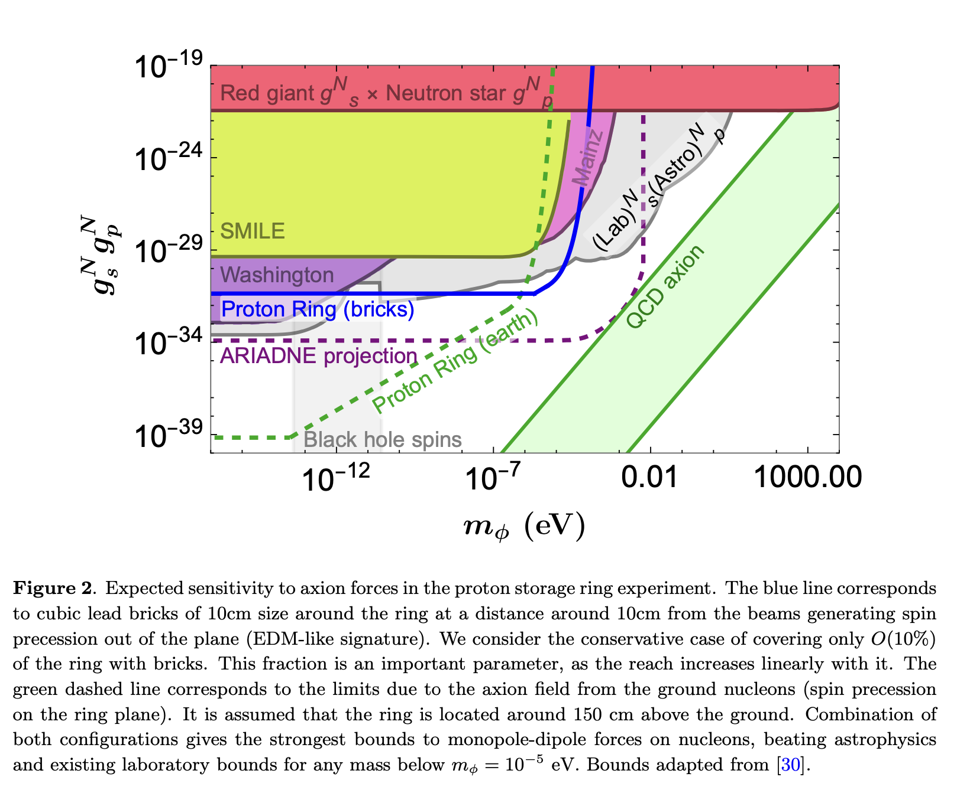
Dipole-monopole interactions for the storage ring experiments
Axion field acting on muon (g-2) and proton EDM
Inject CW vs. CCW?

Slide 10
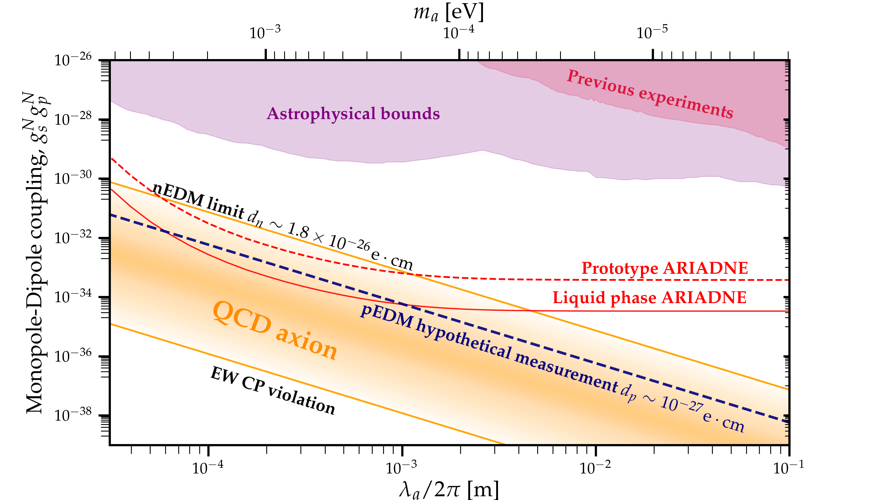
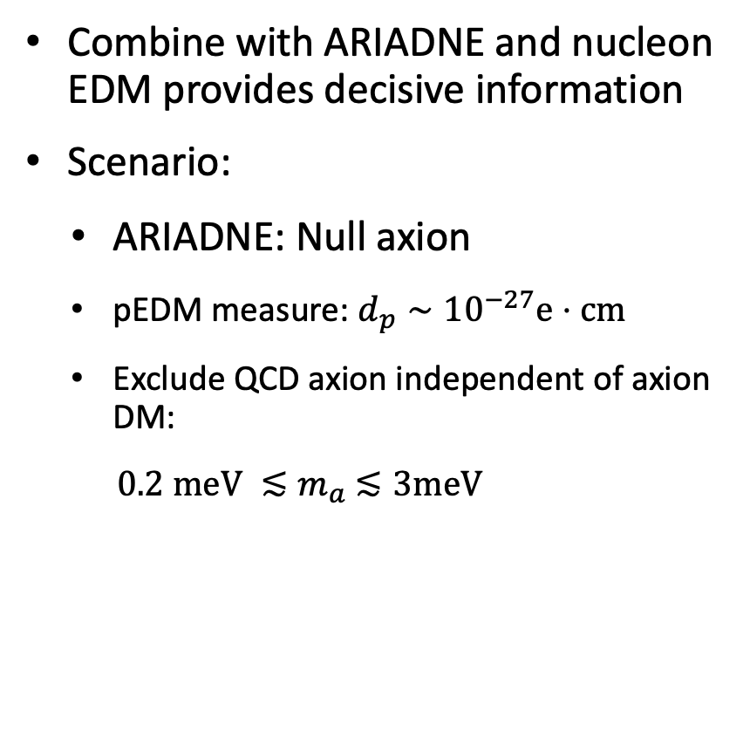
ARIADNE and nucleon EDMs
Introduction
ARIADNE
Key factors
Projected sensitivity
Summary
Combine with ARIADNE and nucleon EDM provides decisive information
Scenario:
  ARIADNE: Null axion
  pEDM measure: $d_{p}∼{10}^{−27}e⋅cm$
  Exclude QCD axion independent of axion DM:
    ${0.2 meV ≲m}_{a}$ $≲3meV$
Y. K. Semertzidis and S. Youn. , 2104.14831

Slide 11
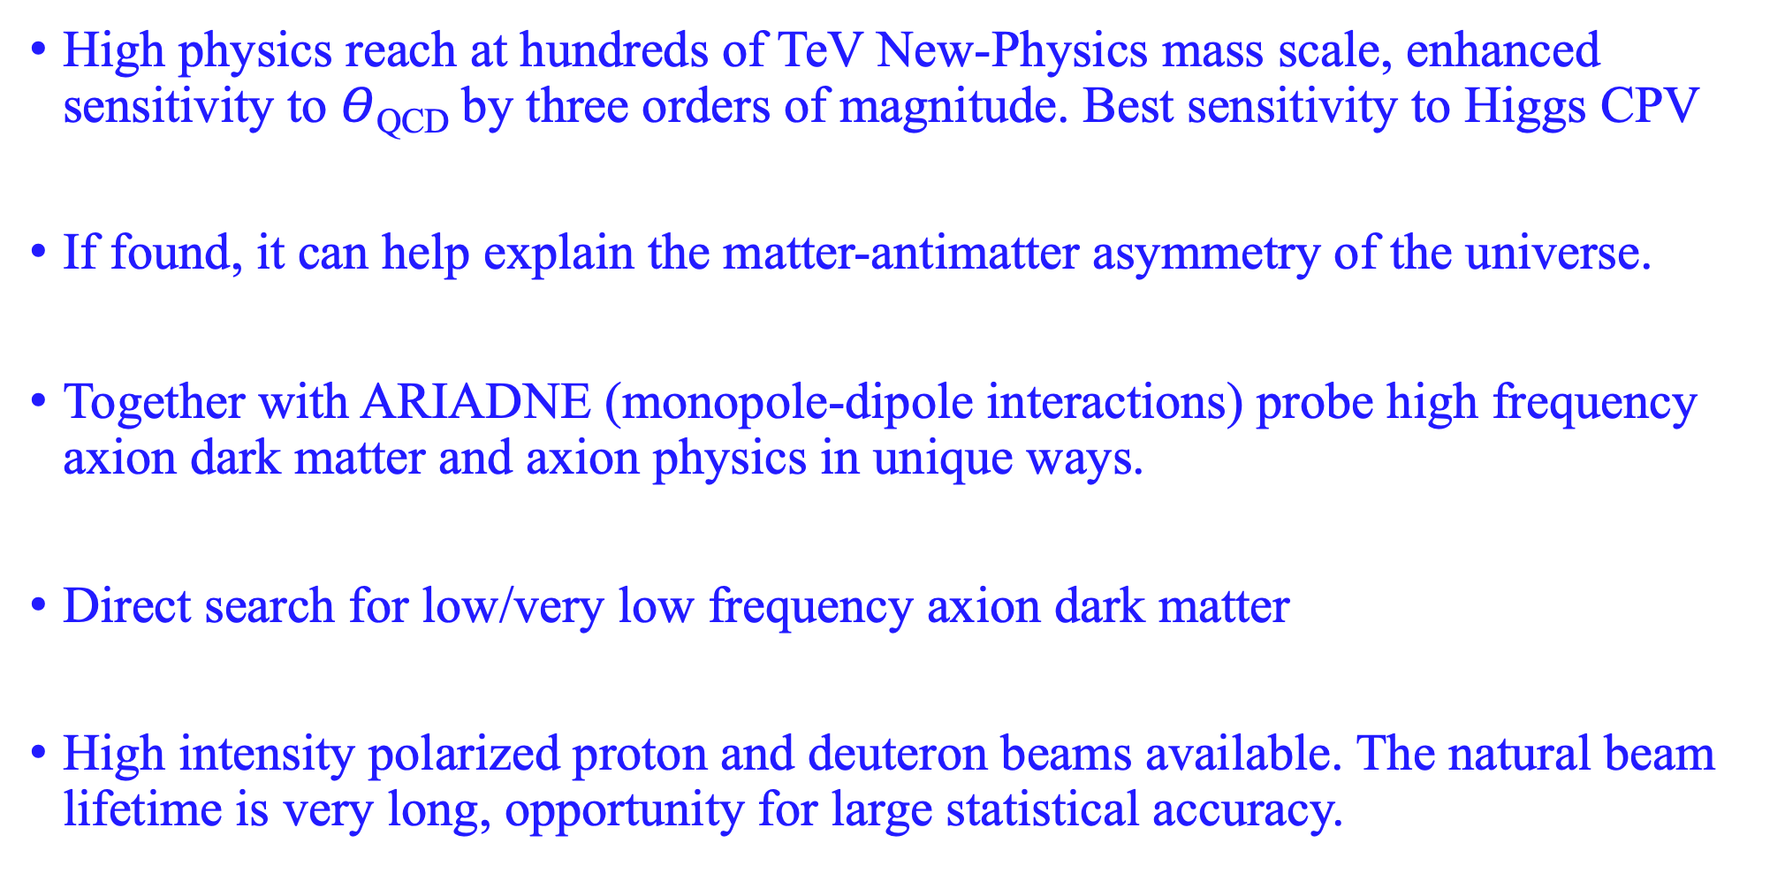
Storage ring pEDM at 10⁻²⁹e-cm, best hadronic EDM exp.
High physics reach at hundreds of TeV New-Physics mass scale, enhanced sensitivity to $Θ$_{QCD} by three orders of magnitude. Best sensitivity to Higgs CPV
If found, it can help explain the matter-antimatter asymmetry of the universe.
Together with ARIADNE (monopole-dipole interactions) probe high frequency axion dark matter and axion physics in unique ways.
Direct search for low/very low frequency axion dark matter
High intensity polarized proton and deuteron beams available. The natural beam lifetime is very long, opportunity for large statistical accuracy.

Slide 12
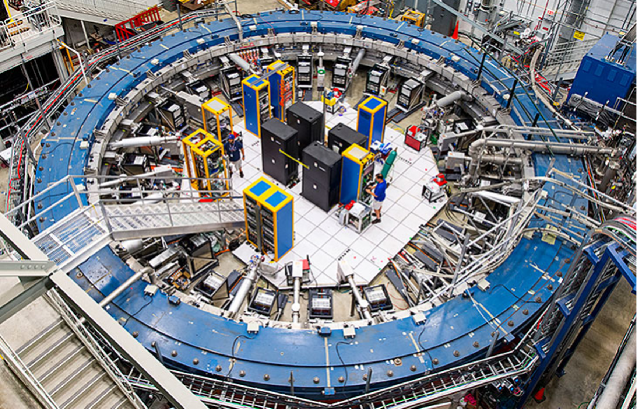
Muon g-2 experiment
Muon g-2 results announcement at Fermilab, April 2021 reached >3B people.
Muon g-2 success. The collaboration developed several new tools for systematic error probing.
High-precision numerical integrators for beam/spin dynamics simulations.

Slide 13
Hadronic Electric Dipole Moments

Slide 14
Input to hadronic EDM
Theta-QCD (part of the SM)
CP-violation sources beyond the SM
Several alternative simple systems could provide invaluable complementary information (e.g. proton, neutron and ³He, deuteron,…).

Slide 15



EDMs of different systems (Marciano)
Theta_QCD:
Super-Symmetry (SUSY) model predictions:

Slide 16
Storage ring Electric Dipole Moments
Frozen spin method:
Spin aligned with the momentum vector
Radial E-field precesses EDM/spin vertically
Monitoring the spin using a polarimeter

Slide 17
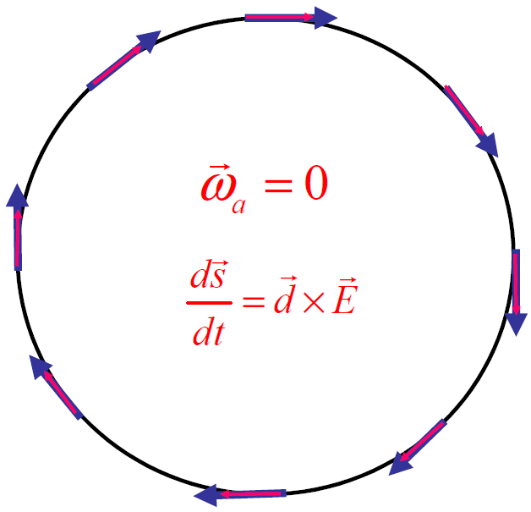
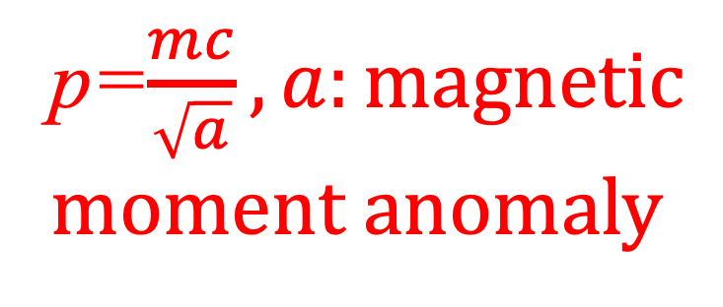
Storage Ring EDM experiments, frozen spin method
Pure electric bending, w/ “magic” momentum
F.J.M. Farley et al., “A new method of measuring electric dipole moments in storage rings,” Phys. Rev. Lett. 93, 052001 (2004)
p=$\frac{mc}{\sqrt{a}}, a:magnetic$
moment anomaly
Notes:
17

Slide 18
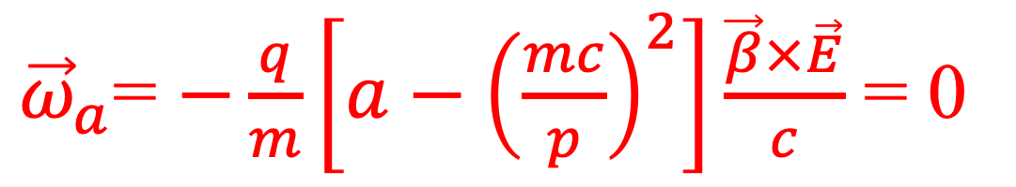
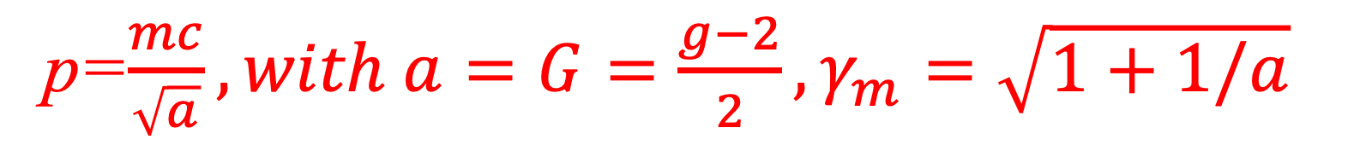
Electric fields: Freezing the g-2 spin precession
${\vec{ω}}_{a}$= $−\frac{q}{m}\left[a−{\left(\frac{mc}{p}\right)}^{2}\right]\frac{\vec{β}×\vec{E}}{c}$ = 0
The g-2 spin precession is zero at “magic” momentum (3.1GeV/c for muons,…), so the focusing system can be electric
p=$\frac{mc}{\sqrt{a}}, with a=G=\frac{g−2}{2}, γ_{m}=\sqrt{1+1/a}$
The “magic” momentum concept with electric focusing was first used in the last muon g-2 experiment at CERN, at BNL & FNAL.

Slide 19
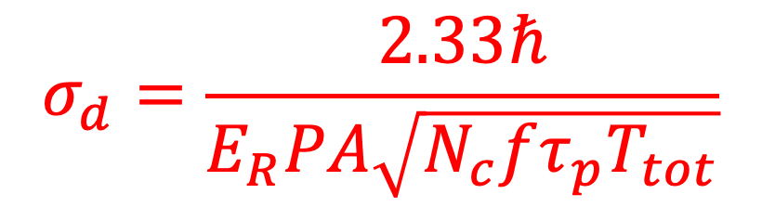
Proton Statistical Error (232MeV): 10⁻²⁹ e-cm
Phys. Rev. D 104, 096006 (2021)
$$σ_{d}=\frac{2.33ℏ}{E_{R}PA\sqrt{N_{c}fτ_{p}T_{tot}}}$$
τ_{p} : 2×10³s Polarization Lifetime (Spin Coherence Time)
A : 0.6 Left/right asymmetry observed by the polarimeter
P : 0.8 Beam polarization
N_{c} : 4×10¹⁰p/cycle Total number of stored particles per cycle (10³s)
T_{Tot}: 2×10⁷s Total running time per year
f : 1% Useful event rate fraction (efficiency for EDM)
E_{R} : 4.5 MV/m Radial electric field strength
Notes:
Yannis Semertzidis, BNL
19

Slide 20
Systematic errors

Slide 21
³He Co-magnetometer in nEDM experiment
If nEDM = 10⁻²⁶ e⋅cm,
10 kV/cm → 0.1 μHz shift
≅ B field of 2 × 10 ⁻¹⁵ T.
Co-magnetometer :
Uniformly samples the B Field
faster than the relaxation time.
Data: ILL nEDM experiment with ¹⁹⁹Hg co-magnetometer
EDM of ¹⁹⁹Hg < 10⁻²⁸ e-cm (measured); atomic EDM ~ Z² → ³He EDM << 10⁻³⁰ e-cm
Under gravity, the center of mass of He-3 is higher than UCN by Δh ≈ 0.13 cm,
sets ΔB = 30 pGauss (1 nA of leakage current). ΔB/B=10⁻³.

Slide 22
Storage Ring Electric Dipole Moments exp. options
Fields | Example | EDM signal term | Comments
Dipole magnetic field (B) (Parasitic) | Muon g-2 | Tilt of the spin precession plane. (Limited statistical sensitivity due to spin precession) | Eventually limited by geometrical alignment. Requires consecutive CW and CCW injection to eliminate systematic errors
Combination of electric & and magnetic fields (E, B) (Combined lattice) | Deuteron, ³He, proton, muon, etc. | Mainly: | High statistical sensitivity. Requires consecutive CW and CCW injection with main fields flipping sign to eliminate systematic errors
Radial Electric field (E) & Electric focusing (E) (All electric lattice) | Proton, etc. |  | Large ring, CW & CCW storage. Requires demonstration of adequate sensitivity to radial B-field syst. error
Radial Electric field (E) & Magnetic focusing (B) (Hybrid, symmetric lattice) | Proton, etc. |  | Large ring, CW & CCW storage. Only lattice to achieve direct cancellation of main systematic error sources (its own “co-magnetometer”). GOLD STANDARD!

Slide 23
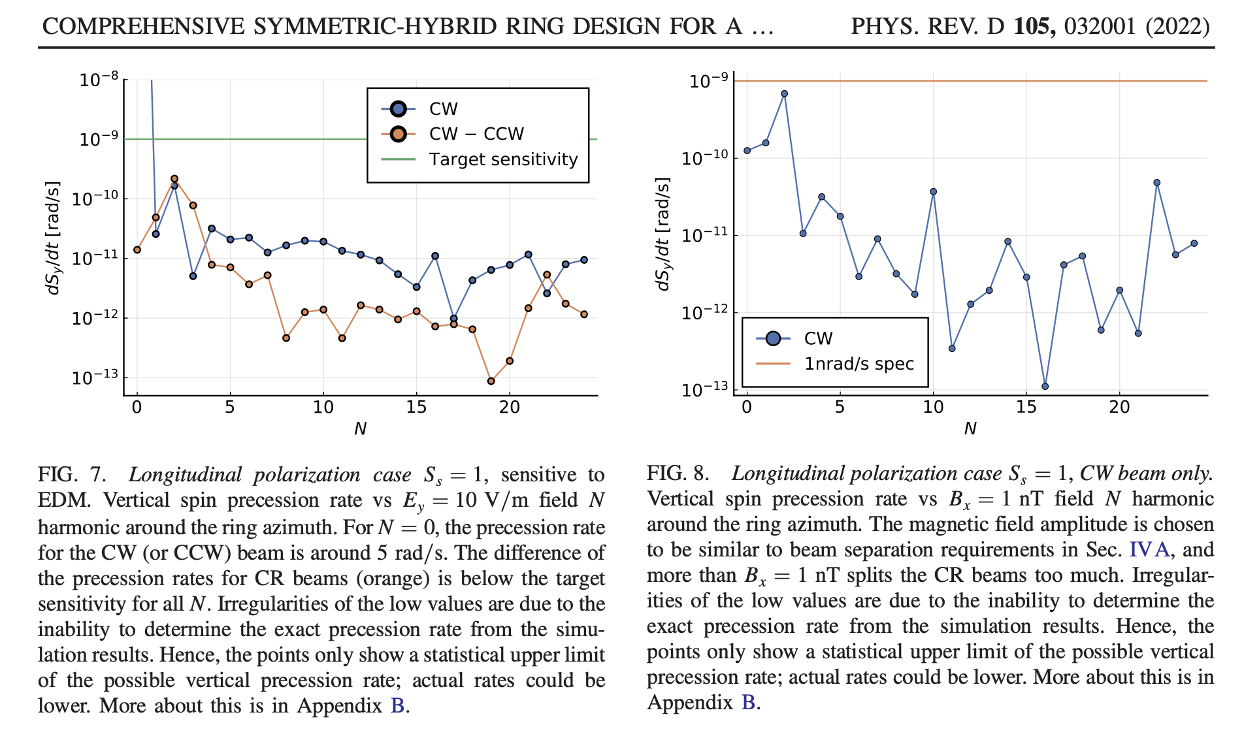
Effect as a function of azimuthal harmonic N
B-field
E-field

Slide 24
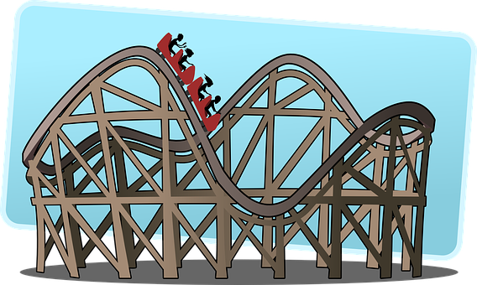
Ring planarity:
The average vertical speed in deflectors needs to be zero!
0.1 mm
Quads: 0.1T/m, 0.4m

Slide 25
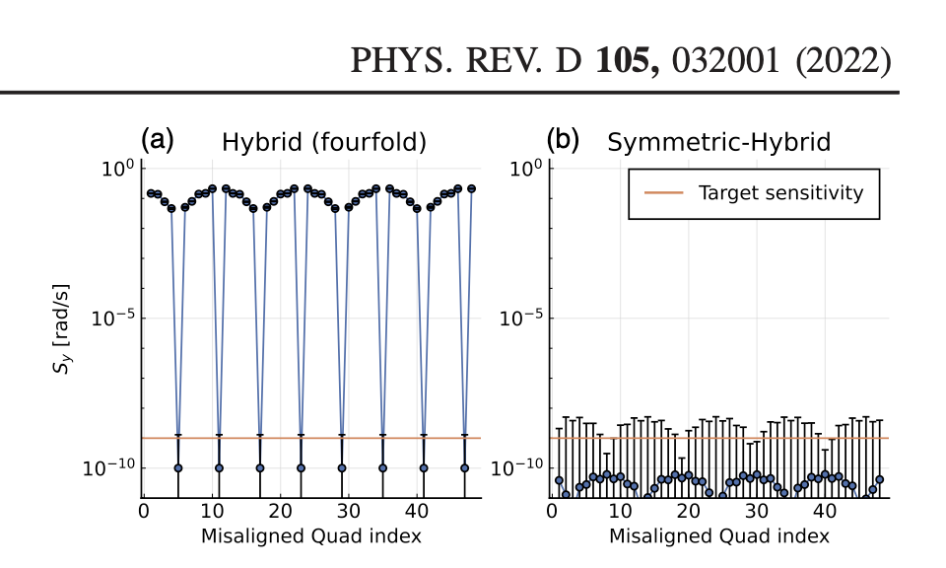
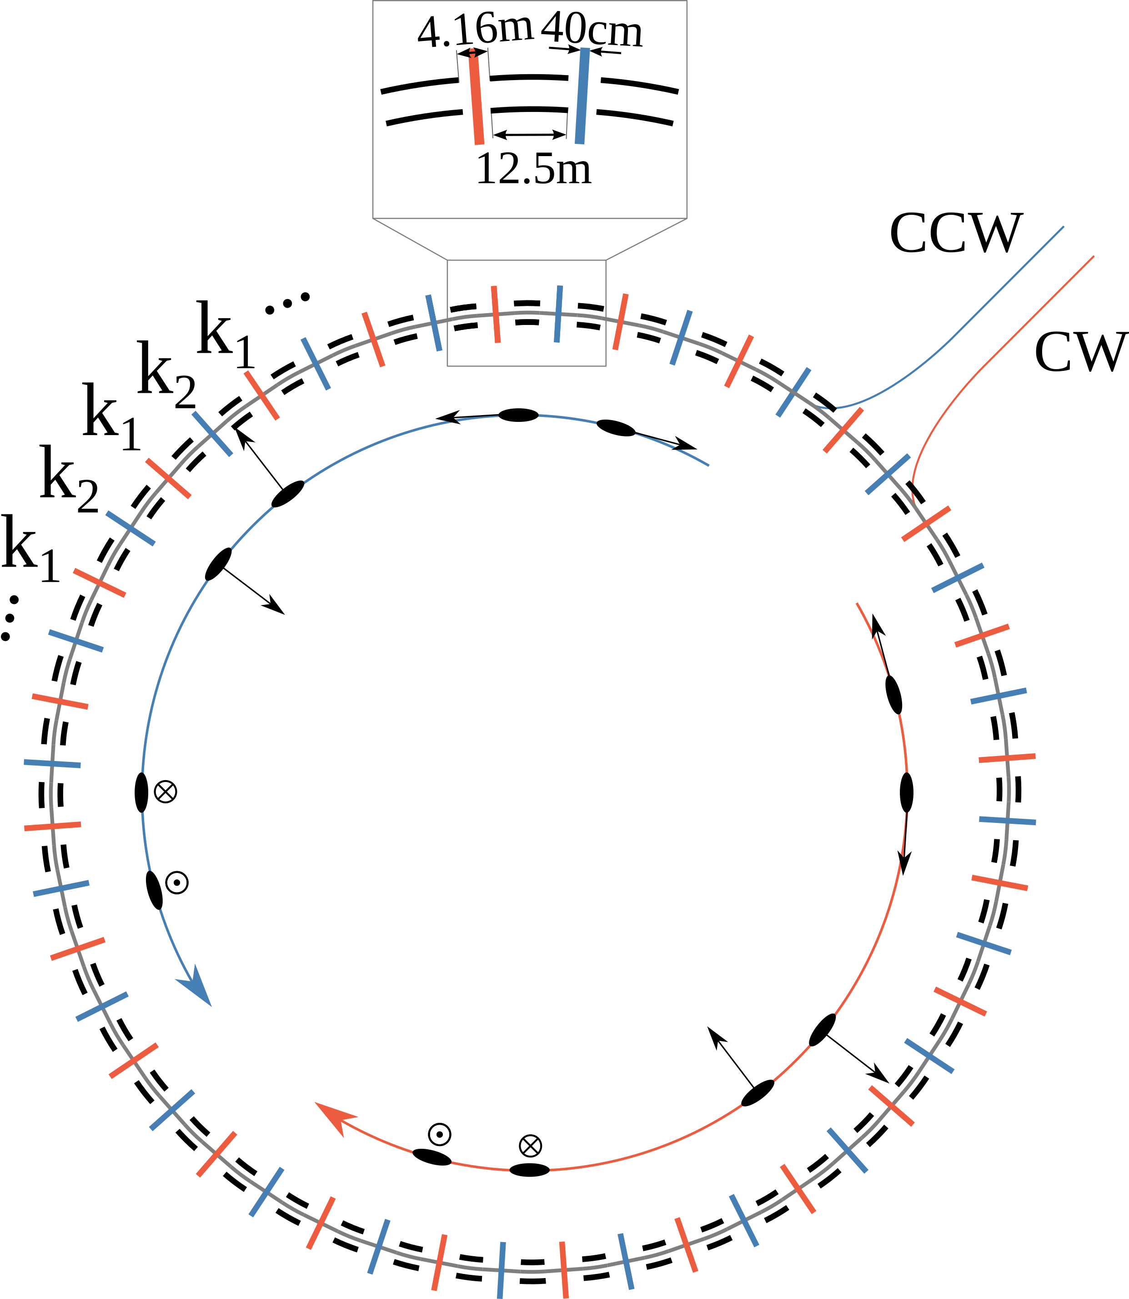
Hybrid, symmetric lattice storage ring. Great for systematic error reduction.
Z. Omarov et al.,
Sensitivity of radially polarized beam (sensitive to V. Dark Matter/Dark Energy, P. Graham et al., PRD, 055 010, 2021), most sensitive to vertical velocity problem

Slide 26
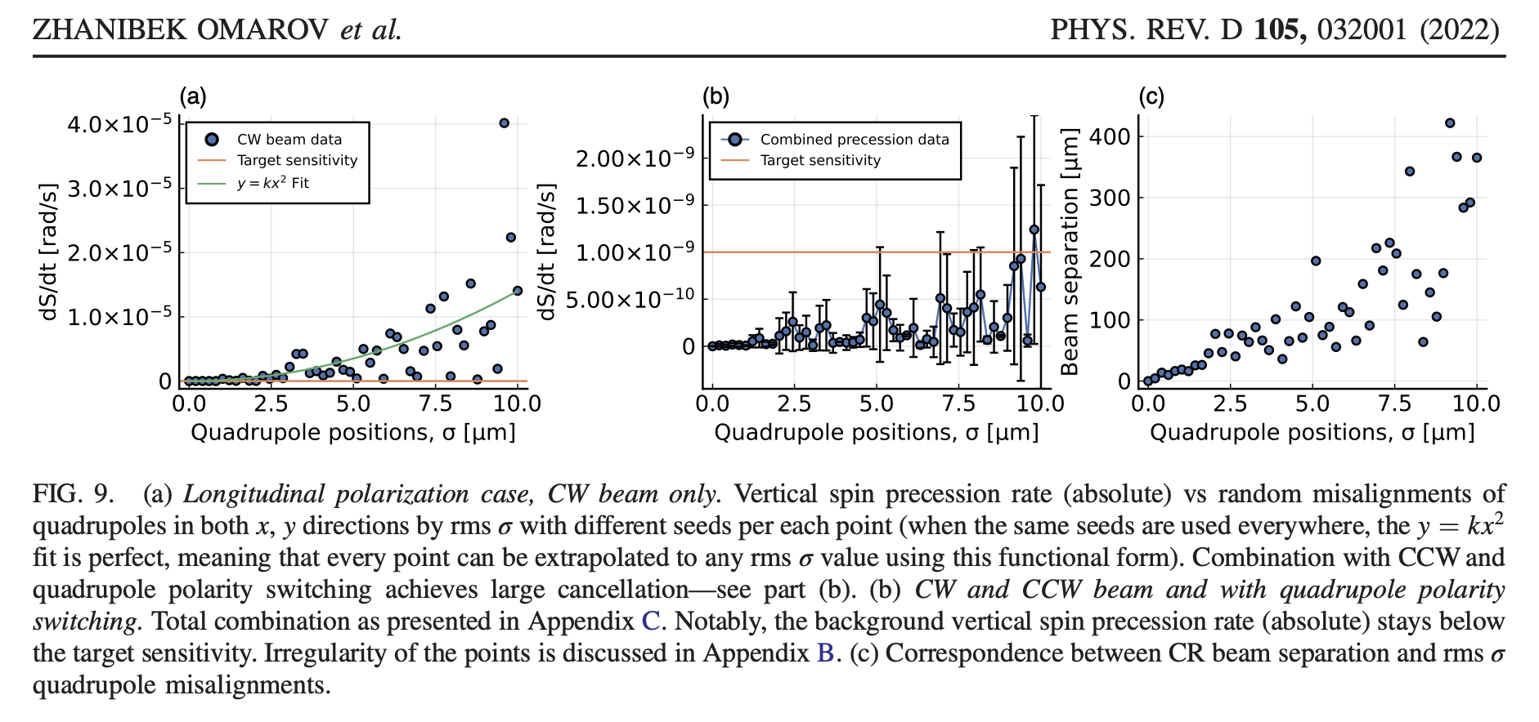
Vertical velocity effect cancels

Slide 27
Classification of systematic errors at 10⁻²⁹ e-cm for hybrid-symmetric lattice
Alternate magnetic focusing allows simultaneous CW & CCW storage and shields against external B-fields. Vertical dipole E-fields eliminated (its own “co-magnetometer”), unique feature of this lattice.
Symmetric lattice significantly reduces systematic errors associated with vertical velocity (major source). Using longitudinal, radial and vertical polarization directions, sensitive to different physics/systematic errors.
Required ring planarity <0.1mm; CW & CCW beam separation <0.01mm, resolves issues with geometrical phases

Slide 28
Symmetries against systematic errors
Clock-wise (CW) vs. Counter-Clock-Wise (CCW)
  Eliminates vertical Electric field background
Hybrid lattice (electric bending, magnetic focusing)
  Shields against background magnetic fields
Highly symmetric lattice (24 FODO systems)
  Eliminates vertical velocity background
Positive and negative helicity
  Reduce polarimeter systematic errors
Flat ring to 0.1 mm, beams overlap within 0.01 mm, spin-based alignment
  Geometrical phases; High-order vertical E-field

Slide 29
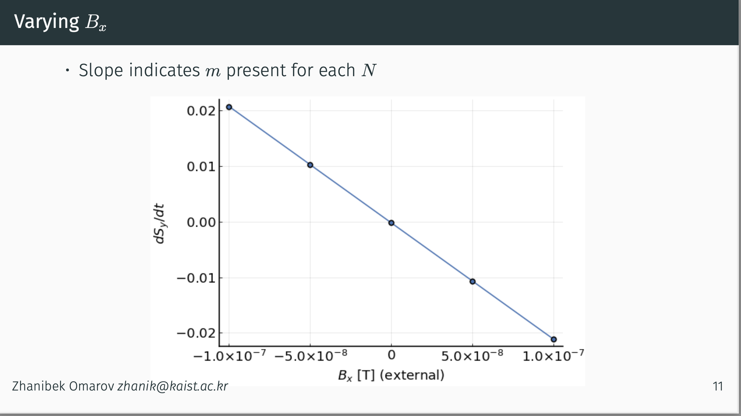
Spin-based alignment/background reduction
Omarov’s method: a combination of background fields can create false EDM signals. Artificially inflate one component to reduce the other.
From Zhanibek Omarov’s presentation
Vary the radial B-field (B_{x}) and observe the ds_{y}/dt slope vs. B_{x}.
The EDM signal does not depend on the value of B_{x}.
Tune out the background field (here electric field focusing) until we get zero slope in ds_{y}/dt vs. B_{x}.

Slide 30
Protons in a hybrid-symmetric ring: no new technology
No need to develop/test new technology
  Simultaneous CW/CCW beam storage is possible
  Electric field ~4.5 MV/m with present technology
  Magnetic fields from misplaced quads are self-shielded by the magnetic focusing
  Hybrid/symmetric ring options are simple. Large tune in both planes, beam position monitor (BPM) tasks are achievable with present technology.
  Estimated SCT are large, injection into ring works, while all primary systematic error sources are kept small.
After protons, add dipole magnetic field in bending sections:
  Can do proton, deuteron, ³He, (and muons)

Slide 31
System | Risk factor, comments
Ring construction, beam storage, stability, IBS | Low. Strong (alternate) focusing, a ring prototype has been built (AGS analog at BNL) in 60’s. Lattice elements placement specs are ordinary. Intra-beam-scattering (IBS) OK below transition.
E-field strength | Low. Plate-units are similar to those ran at Tevatron with higher specs.
E-field plates shape | Medium. Make as flat as conveniently possible. Probe and shim out high order fields by intentionally splitting the CR-beams
Spin coherence time | Low. Ordinary sextupoles will provide >10³s.
Beam position monitors (BPM), SQUID-based BPMs. | Medium. Ordinary BPMs and hydrostatic level system (HLS) to level the ring to better than 0.1mm; SQUID-based or more conventional BPMs to check CR-beams split to 0.01mm.
High-precision, efficient software | Low. Cross-checking our results routinely
Polarimeter | Low. Mature technology available

Slide 32
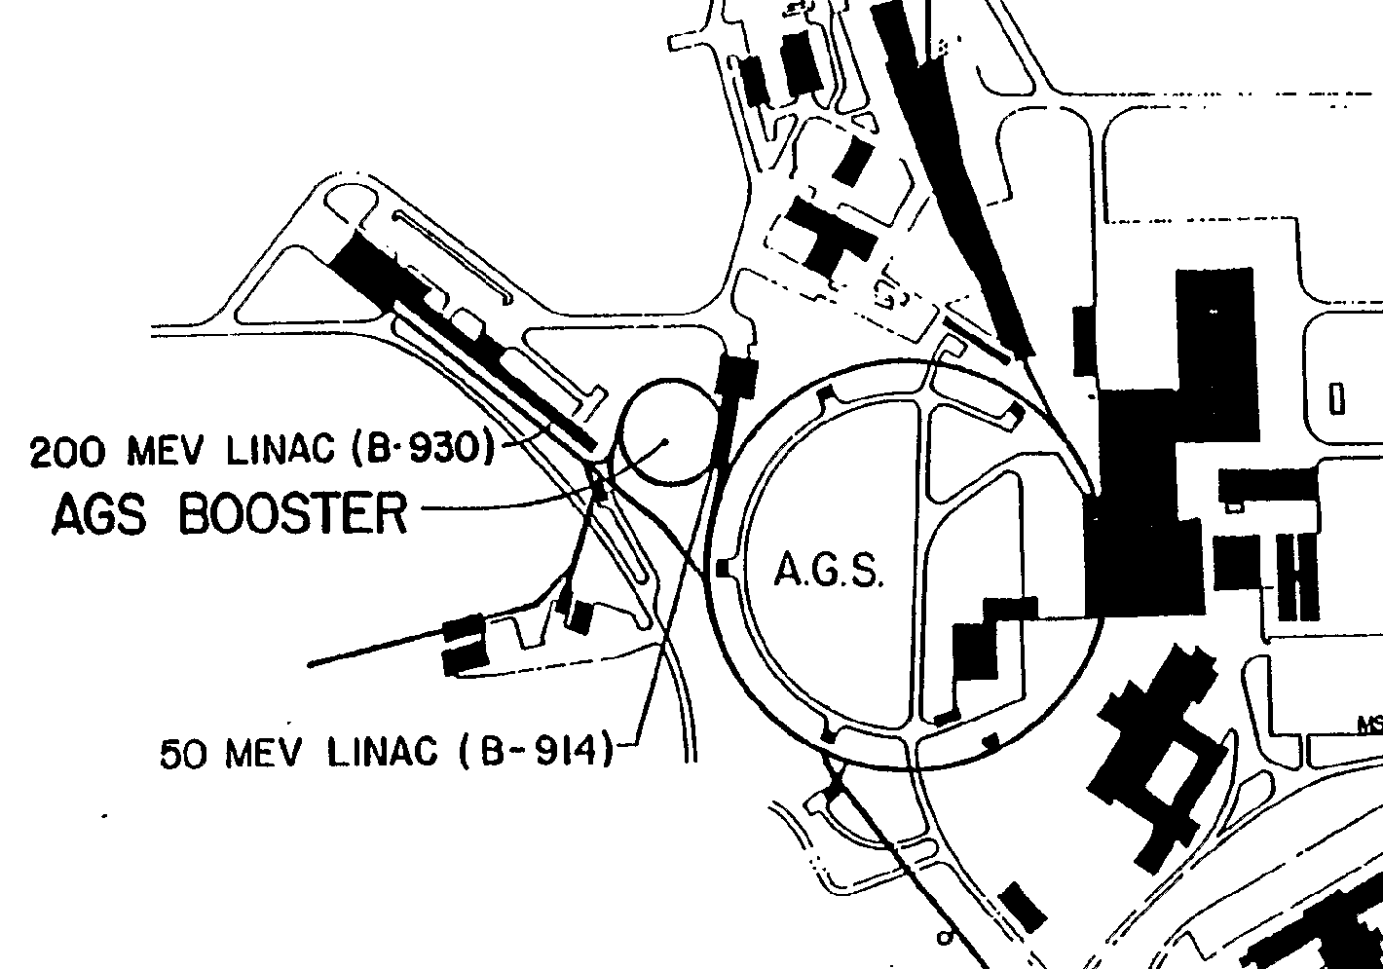
The proton EDM in the AGS tunnel at BNL
Circumference: 800m
Max E-field: 4.5MV/m

Slide 33
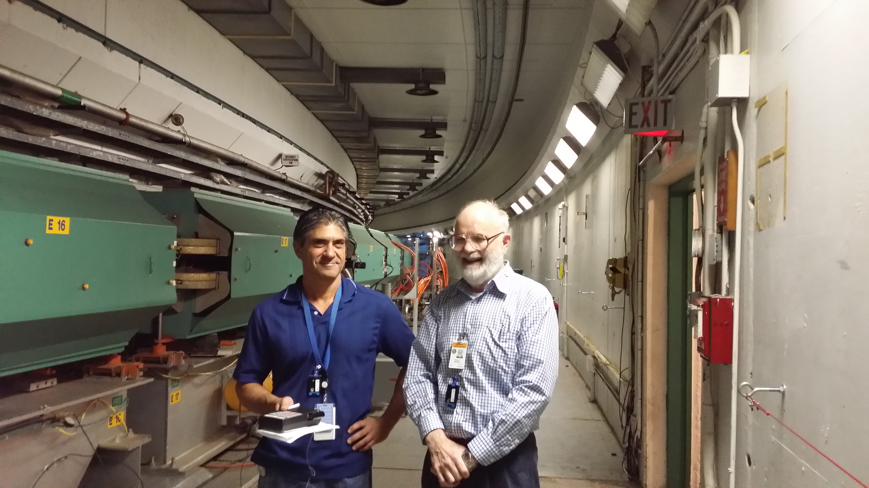
John Benante, Bill Morse in AGS tunnel, plenty of room for the EDM ring.

Slide 34
Hybrid, symmetric lattice storage ring, designed by Val. Lebedev (FNAL)
Z. Omarov et al., PHYS. REV. D 105, 032001 (2022)
Low risk
Strong focusing
Sensitivity goal
10⁻²⁹e-cm

Slide 35
Timeline
Snowmass/white paper, CDR, proposal/TDR, prototype/string-test, ring construction (3-5 years), storage (2-3 years) to first publication
Effort similar to muon g-2 experiments (under evaluation at BNL)
Possible interesting results within a decade.

Slide 36
Summary
EDM physics is must do, exciting and timely, CP-violation, ~10³ TeV New-Physics reach, axion physics, DM/DE.
Hybrid, symmetric ring lattice and spin-based alignment. Minimized systematic error sources. Statistics and systematics of pEDM to better than 10⁻²⁹e-cm.
Snowmass encouraged BNL to come up with a technically strong proposal for a storage ring proton EDM. BNL is currently funding the cost estimate of the storage ring EDM experiment.
Great progress in statistics and systematics promises two to three orders improvement in sensitivity of eEDM, nEDM, μEDM, and pEDM within the current and next decade.

Slide 37
References
Z. Omarov et al., Comprehensive Symmetric-Hybrid ring design for pEDM experiment at below 10⁻²⁹e-cm, Phys. Rev. D 105, 032001 (2022)
On Kim et al., New method of probing an oscillating EDM induced by axionlike dark matter…, Phys. Rev. D 104 (9), 096006 (2021)
P.W. Graham et al., Storage ring Probes for Dark Matter and Dark Energy, Phys. Rev. D 103 (5), 055010 (2021)
S. Haciomeroglu and Y.K. Semertzidis, Hybrid ring design in the storage-ring proton EDM experiment, Phys. Rev. Accel. Beams 22 (3), 034001 (2019)
S.P. Chang et al., Axionlike dark matter search using the storage ring EDM method, Phys. Rev. D 99 (8), 083002 (2019)
S. Haciomeroglu et al., SQUID-based Beam Position Monitor, PoS ICHEP2018 (2019) 279
N. Hempelmann et al., Phase locking the spin precession in a storage ring, Phys. Rev. Lett. 119 (1), 014801 (2017)
G. Guidoboni et al., How to reach a Thousand-second in-plane Polarization Lifetime with 0.97 GeV/c Deuterons in a storage ring, Phys. Rev. Lett. 117 (5), 054801 (2016)
V. Anastassopoulos et al., A storage ring experiment to detect a proton electric dipole moment, Rev. Sci. Instrum. 87 (11), 115116 (2016)
E.M. Metodiev et al., Analytical benchmarks for precision particle tracking in electric and magnetic rings, NIM A797, 311 (2015)
E.M. Metodiev et al., Fringe electric fields of flat and cylindrical deflectors in electrostatic charged particle storage rings, Phys. Rev. Accel. Beams 17 (7), 074002 (2014)
W.M. Morse et al., rf Wien filter in an electric dipole moment storage ring: The “partially frozen spin” effect, Phys. Rev. Accel. Beams 16 (11), 114001 (2013)
N.P.M. Brantjes et al., Correction systematic errors in high-sensitivity deuteron polarization measurements, Nucl. Instrum. Meth. A664, 49 (2012)
G.W. Bennett et al., An improved limit on the muon electric dipole moment, Phys. Rev. D 80, 052008 (2009)
F.J.M. Farley et al., A new method of measuring electric dipole moments in storage rings, Phys. Rev. Lett. 93, 052001 (2004)
…

Slide 38
Extra slides

Slide 39
Ring planarity critical to control geometrical phase errors
Numerous studies on slow ground motion in accelerators, Hydrostatic Level System for slow ground motion studies at Fermilab. (Part of the linear collider studies!)
Thorough review by Vladimir Shiltsev (FNAL):
https://arxiv.org/pdf/0905.4194.pdf

Slide 41
HLS measurements at Fermilab

Slide 42
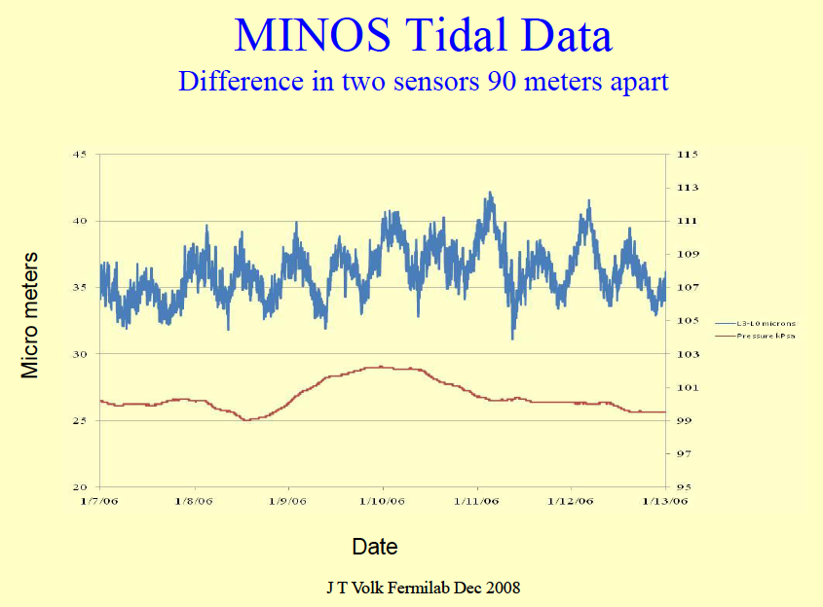

Slide 43
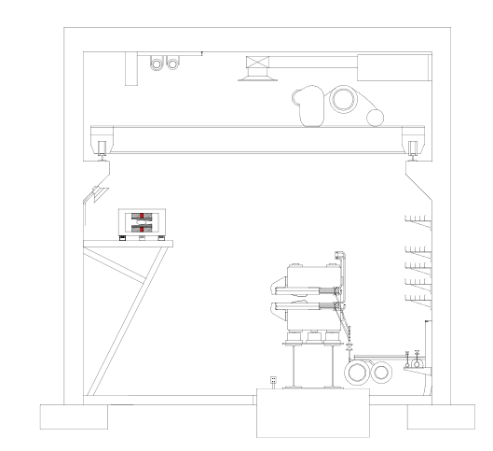
Sketch of the AGS Accumulator Ring
It was sketched for 1.5GeV ring. Space needed: 1mX1m.

Slide 44
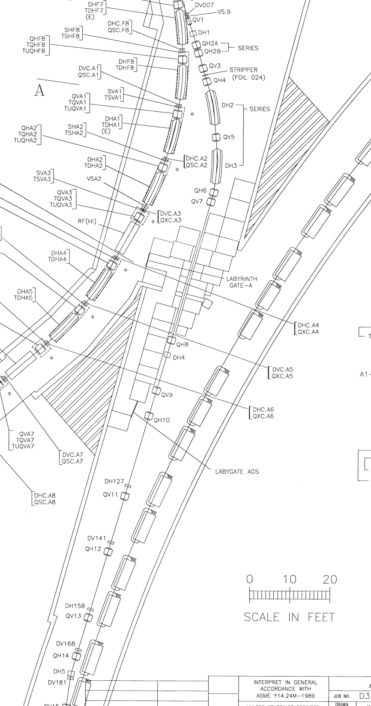
Booster-to-AGS BtA
Proposed EDM Ring
Booster
2nd Inj. Line
AGS
Beam Injection points
Q12 of BtA
1st Inj. Line

Slide 45
Emittance out of Booster
These intensity scan was done in 2009 with Booster input 3*10¹¹. Not much horizontal scan was done since then. The vertical scale is normalized 95% emittance.
The corresponding normalized rms emittance at 10¹¹ is 0.7π horizontal, 1.0π vertical for horizontal scraping.
vertical scraping
45
Intensity: 15~2e11 protons
@10¹¹
Horizontal scraping
V:6.1π
H:4.4π

Slide 46
Lattice with 800 m circumference for a sensitive experiment on EDM, Dark Matter (DM) and Dark Energy (DE)
Electric bending with cylindrically shaped E-field plates
  Radial E-field: 4.4 MV/m, 4-cm plate separation
Alternate-magnetic-focusing (k₁=-k₂)
  Simultaneous counter-rotating beams
  Strong focusing in both horizontal and vertical planes
Store Longitudinal, Radial and Vertical polarizations
  Sensitive to EDM (L), DM/DE (R), and both (V)

Slide 47
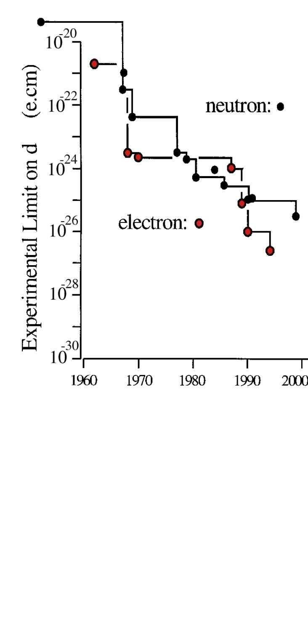
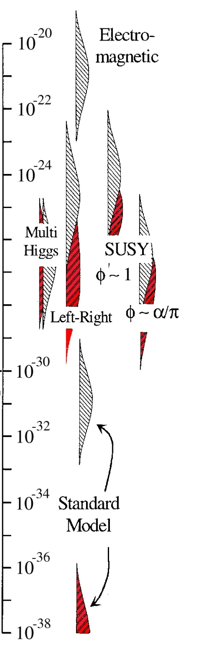
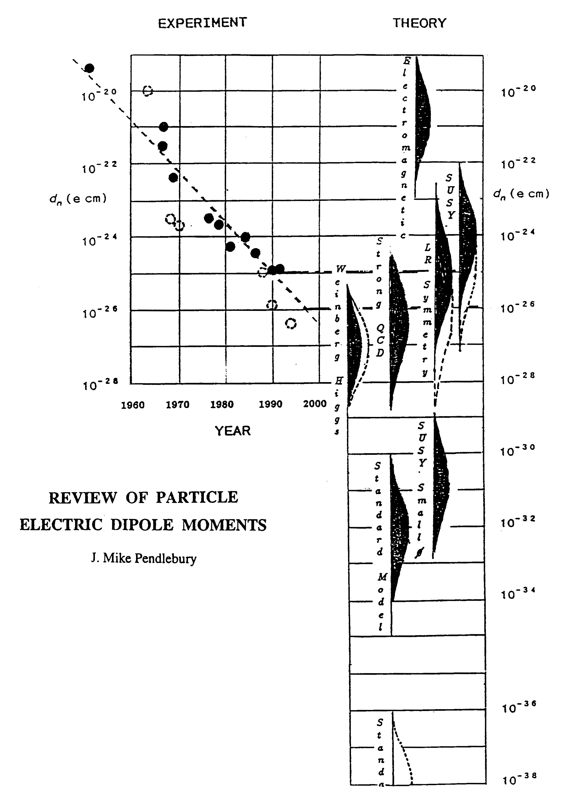
Sensitivity to Rule on Several New Models
Gray: Neutron
Red: Electron
If found it could explain
Baryogenesis (p, d, n (or ³He))
n current
e current
GUT SUSY
Electroweak
Baryogenises
n target
p, d target
e target
Upgrade
Statistics limited
pEDM probes EW-Baryogenesis
and axion physics
e-cm
J.M.Pendlebury and E.A. Hinds, NIMA 440 (2000) 471

Slide 48
SQUID-based BPMs

Slide 49
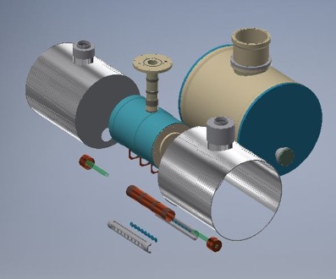
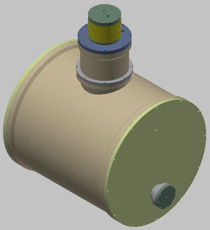
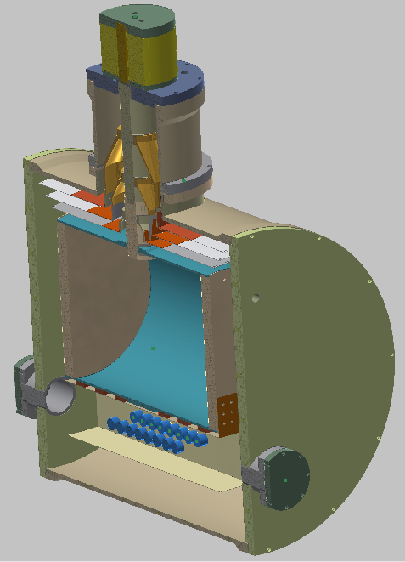
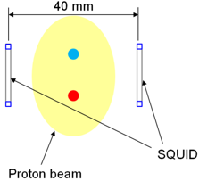
Beam position monitor: SQUID array
Goal: sense counter-rotating beam separation to 10μm
Liquid He
Vacuum
SQUID magnetometer
To p-beam line

Slide 50
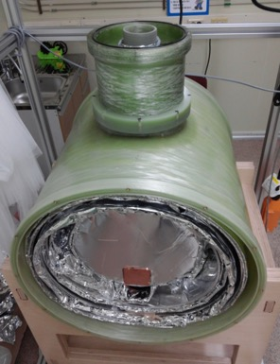
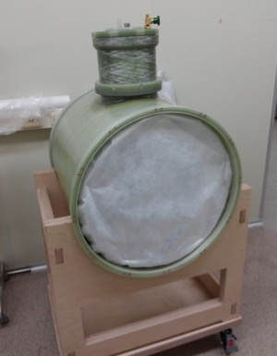
Cylindrical Dewar: original design (KRISS)

Slide 51
SQUID-based BPMs, Korea
Next: Testing the concept at an accelerator.

Slide 52
Large Surface Area Electrodes
Parameter | Tevatron pbar-p Separators | BNL K-pi Separators | pEDM (low risk)
Length/unit | 2.6m | 4.5m | 5×2.5m
Gap, E-field | 5cm, 7.2 MV/m | 10cm, 4 MV/m | 4cm, 4.5 MV/m
Height | 0.2m | 0.4m | 0.2m
Number | 24 | 2 | 48
Max. HV | ±(150-180)KV | ±200KV | ±90KV

Slide 53
E-field plate modules: The (24) FNAL Tevatron ES-separators ran for years with harder specs
Beam position
0.4 m
3 m

Slide 54
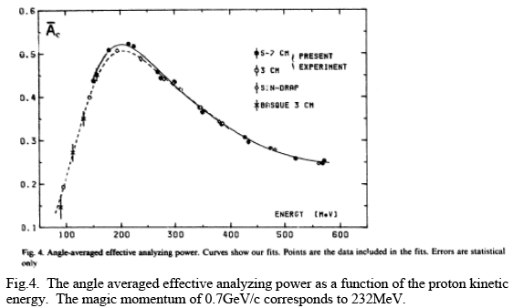
Polarimeter analyzing power at P_{magic} is great
Analyzing power can be further optimized

Slide 55
Spin Coherence Time
Not all particles have same deviation from magic momentum, or same horizontal and vertical divergence (second order effects)
They Cause a spread in the g-2 frequencies:
Correct by tuning plate shape/straight section length plus fine tuning with sextupoles (current plan) or cooling (mixing) during storage (under evaluation).

Slide 56
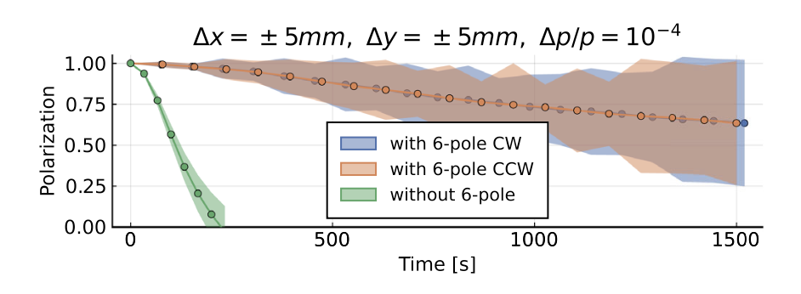
Hybrid, symmetric lattice storage ring. Spin Coherence Time with sextupoles
Z. Omarov et al., PHYS. REV. D 105, 032001 (2022)
Hybrid (magnetic and elecric) sextupoles were used to achieve long SCT.

Slide 57
Physics strength comparison (Marciano)
System | Current limit [e⋅cm] | Future goal | Neutron equivalent
Neutron | <1.6×10⁻²⁶ | ~10⁻²⁸ | 10⁻²⁸
¹⁹⁹Hg atom | <7×10⁻³⁰ | <10⁻³⁰ | 10⁻²⁶
¹²⁹Xe atom | <6×10⁻²⁷ | ~10⁻²⁹-10⁻³¹ | 10⁻²⁵-10⁻²⁷
Deuteron nucleus |  | ~10⁻²⁹ | 3×10⁻²⁹- 5×10⁻³¹
Proton nucleus | <2×10⁻²⁵ | ~10⁻²⁹ | 10⁻²⁹
From theta-QCD
From SUSY-like CPV
Notes:
57

Slide 58
How the srEDM exp. at 10⁻²⁹ e-cm works
Required radial E-field <5 MV/m, for 40mm plate separation
Beam and spin dynamics stable for required beam intensity
Spin coherence time estimated >10³s using sextupoles (no stochastic cooling)
Alternate magnetic focusing greatly shielding external B-fields
Symmetric lattice significantly reducing systematic error sources
Required ring planarity <0.1mm; CW & CCW beam separation <0.01mm

Slide 59
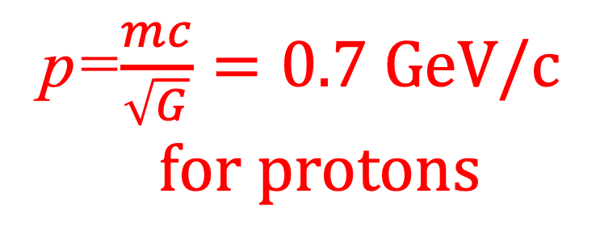
The spin precession relative to momentum in the plane is kept near zero. A vert. spin precession vs. time is an indication of an EDM (d) signal.
p=$\frac{mc}{\sqrt{G}}=0.7 GeV/c$
$$for protons$$
E
E
E
E
Yannis Semertzidis, IBS-CAPP & KAIST
Notes:
Yannis Semertzidis, BNL
59

Slide 60
The spin precession relative to momentum in the plane is kept near zero. A vert. spin precession vs. time is an indication of an EDM (d) signal.
E
E
E
E
Yannis Semertzidis, IBS-CAPP & KAIST
Notes:
Yannis Semertzidis, BNL
60

Slide 61
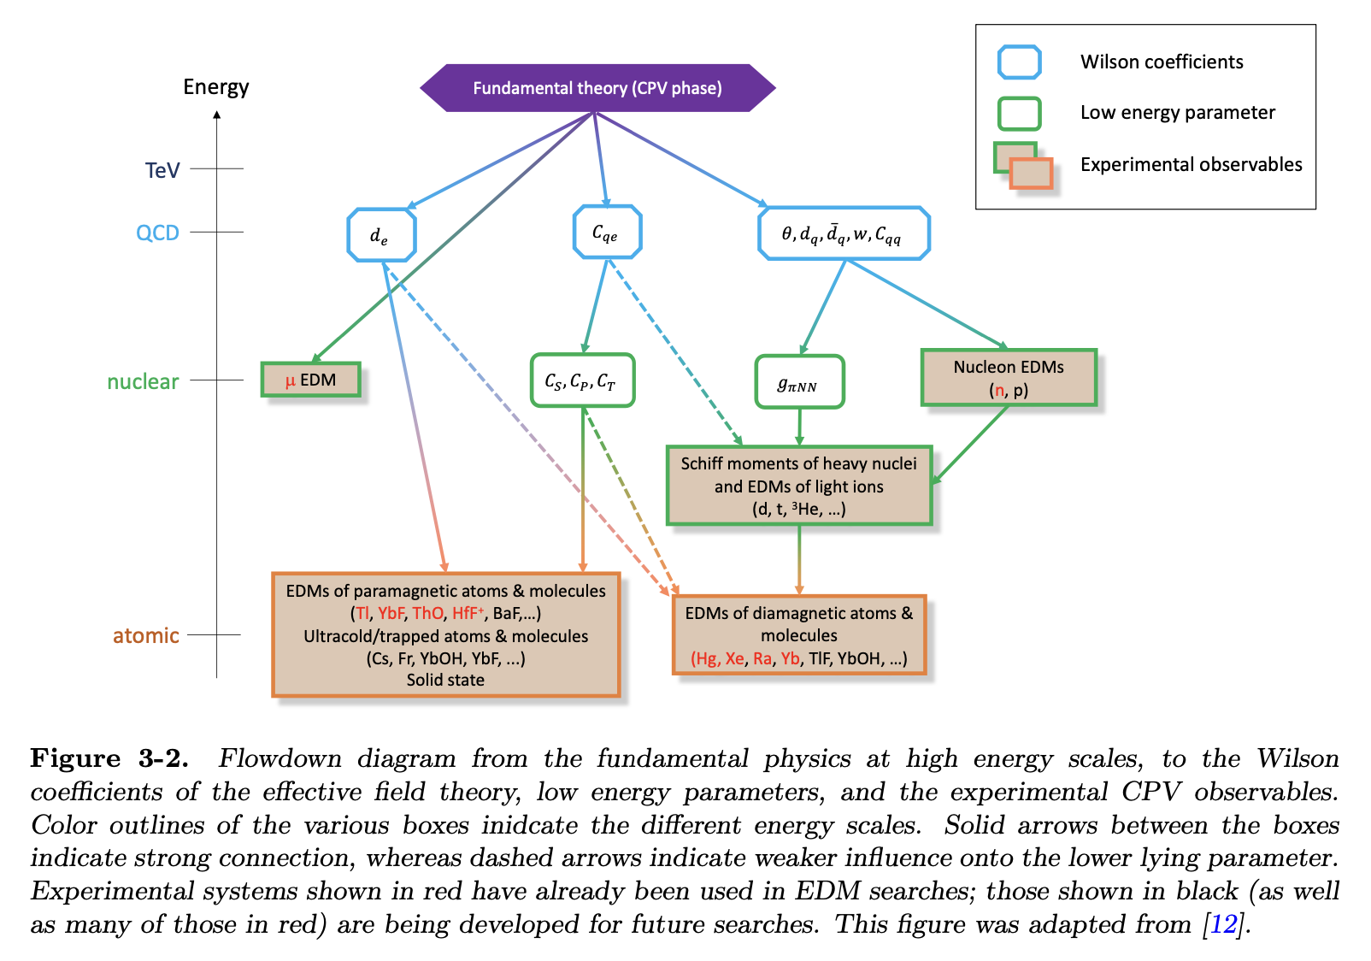
EDM theory, from Snowmass process.
Blum, Winter et al.

