Slide 1
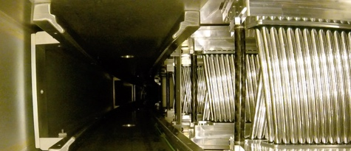




EDMs @ Liverpool, and the UK
Joe Price – University of Liverpool

Slide 2
EDM Research Overview

Slide 3
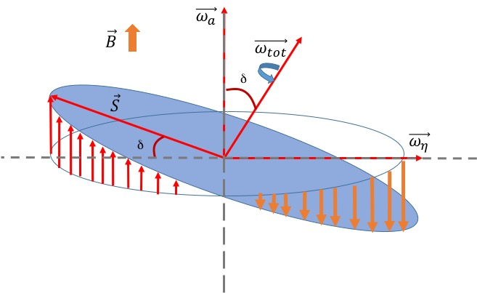
Muon EDM at FNAL
p_{μ}
A permanent muon EDM tilts the precession plane
Causes an oscillation in the vertical angle of positrons out of phase with g-2
The precession frequency also increases

Slide 4
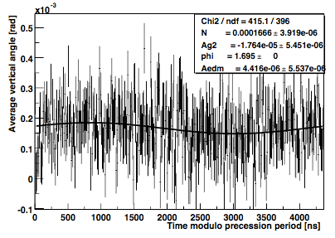
Vertical Angle - Tracker
Can also look directly at vertical position and angle measurement
Angular measurement less dependent on detector misalignment
Get phase and period from ω_{a} fit
Fold data over at precession period
Directly look for sinusoidal* oscillation out of phase with ω_{a}
*actually not sinusoidal!

Slide 5
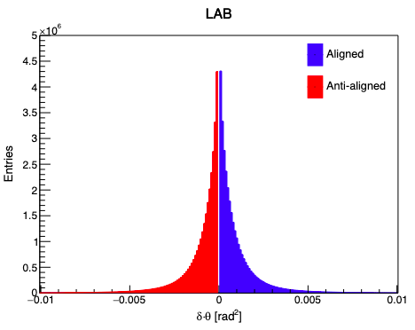
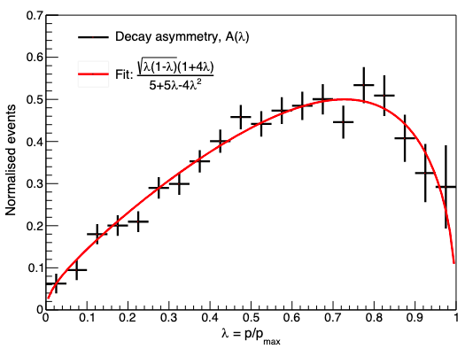
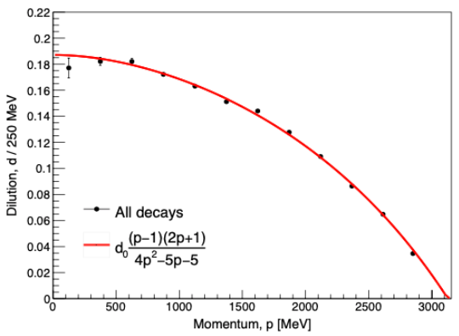
What Do We Gain From the Trackers?
The momentum measurement means we can focus on the most important positrons
The vertical angle measurement is less sensitive to mis-alignment
Can it also be used to re-weight?

Slide 6
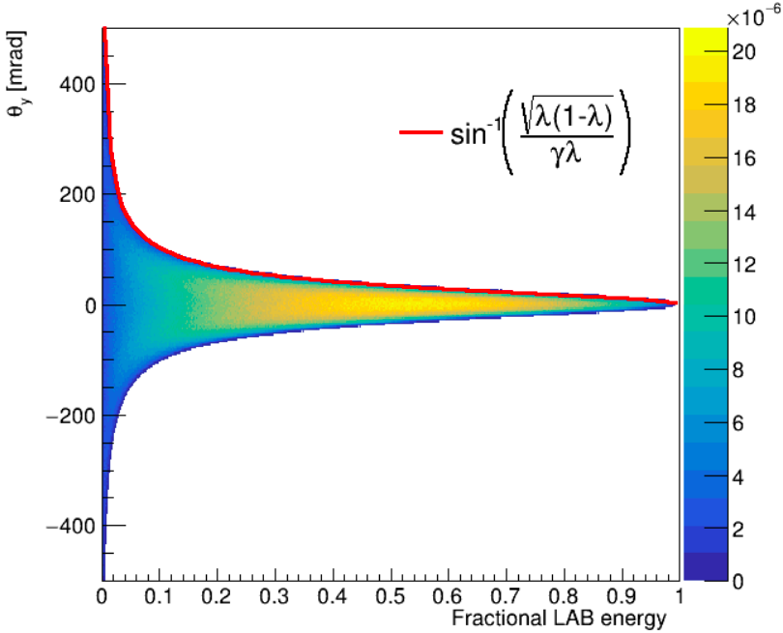
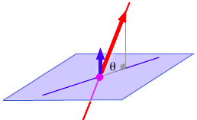

Vertical Angle in LAB Frame
e⁺ momentum
θ_{y}
Polarisation plane (d_{μ}=0)
Where y is fraction energy in rest frame
(λ)

Slide 7
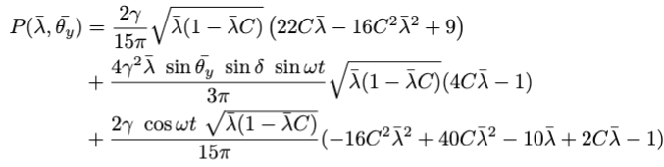

Vertical Angle Expression
Derived an expression, assuming β=1, m_{e}=0 and no betatron oscillations, for the time dependent probability of decay in terms of λ, θ_{y}
Good assumptions for the g-2 experiment!
1st term is time independent, and gives the average
2nd term depends on the tilt (EDM), and oscillates out of phase with g-2
3rd term is the g-2 oscillation, independent of EDM

Slide 8
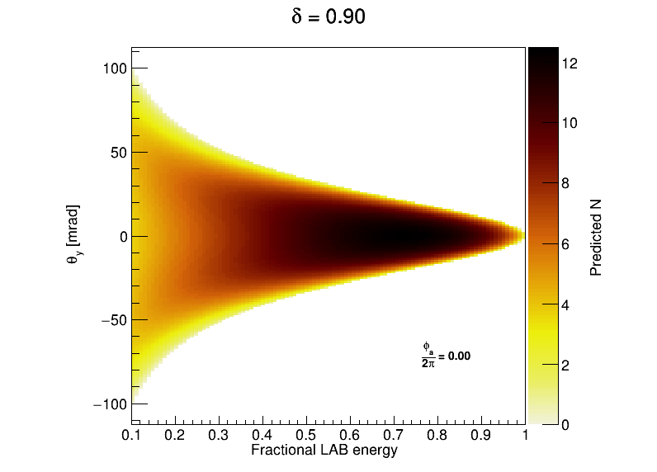
Total N(λ, θ_{y}, t)

Slide 9
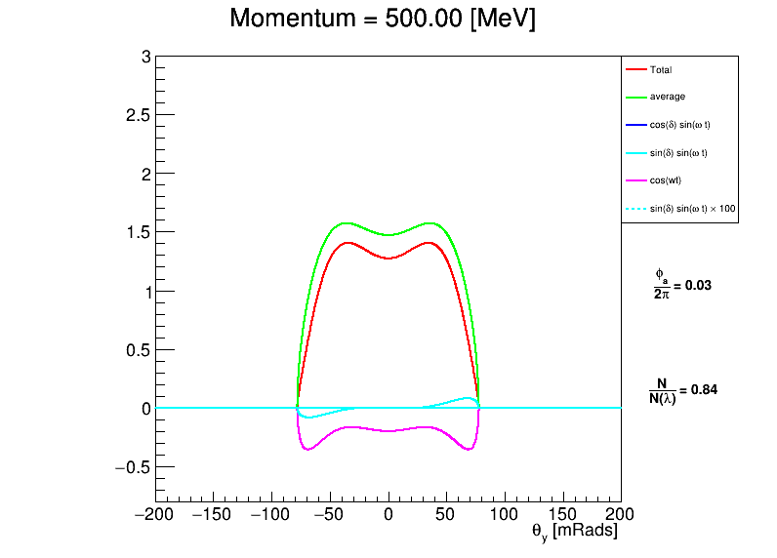
Visualising the oscillation

Slide 10
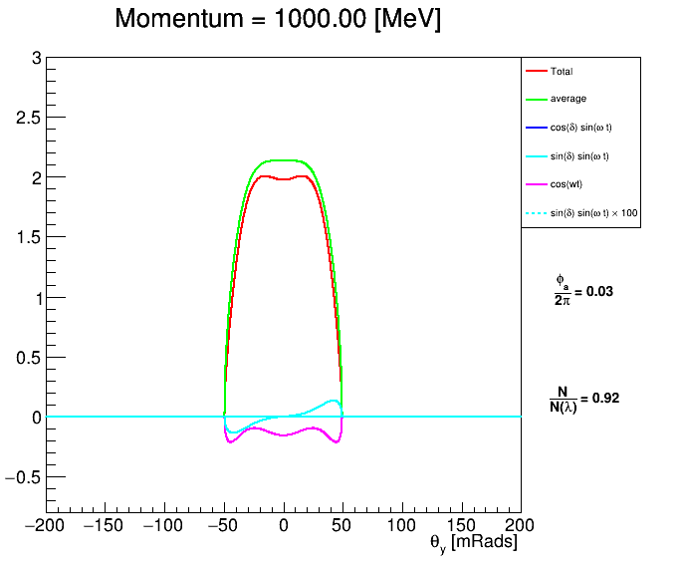
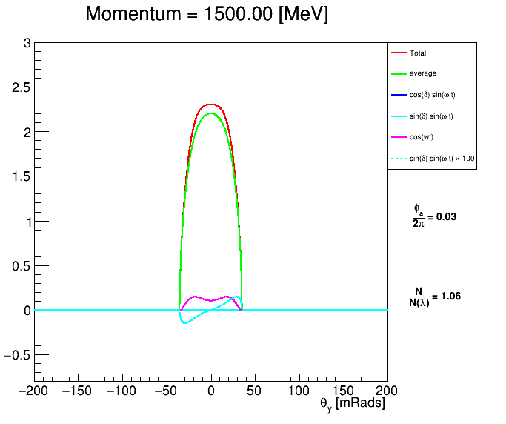
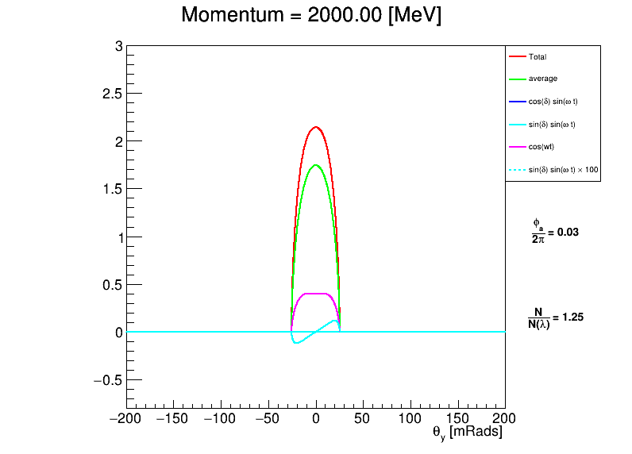
Visualising the oscillation

Slide 11
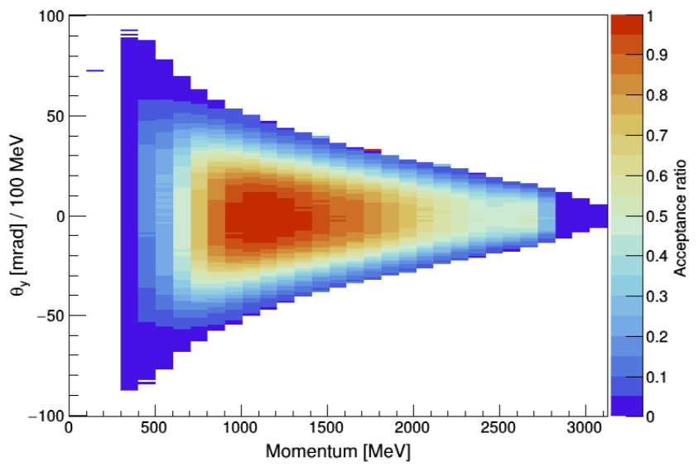
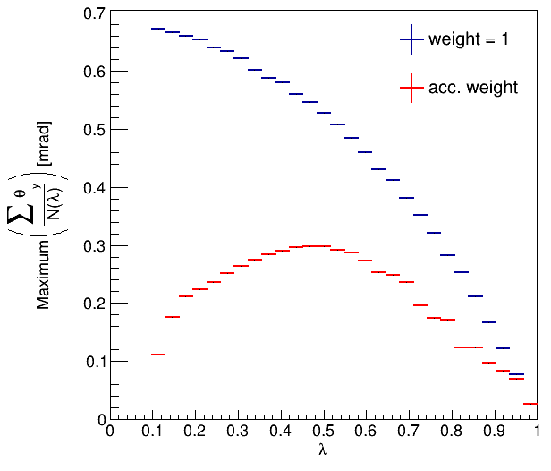
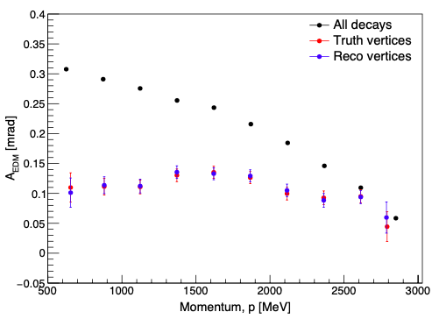
Detector Acceptance

Slide 12
Fermilab muon EDM – Projected Sensitivity
          Run 1 tracker analysis limit (for no signal):
          |d_{μ}| < 2.0 × 10⁻¹⁹ e.cm (95%)
          We expect a fully systematically limited calorimeter measurement: |d_{μ}| < 2.0 × 10⁻¹⁹ e.cm (95%)
          Using all data up to and including run 5 and 6, with current tracking, limit will approximately be
            |d_{μ}| < 0.3 ×10⁻¹⁹ e.cm (95%)
          Potential optimising of tracking + reprocessing and vertical angle reweighting to squeeze these limits further

Slide 13
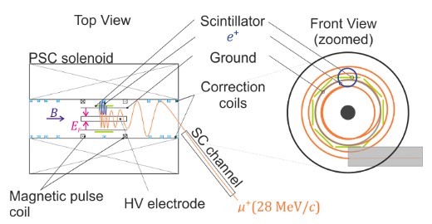
Straw tracker @ PSI
Have about 100mm of longitudinal space for tracker
The closeness of the layers to the storage region determines minimum momentum acceptance
Possibility of both inner and outer layers

Slide 14
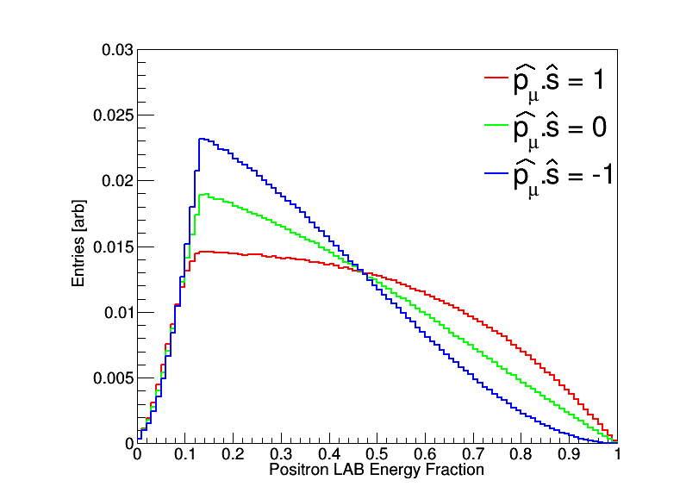
g-2 oscillation – Phase II
For Phase II (p = 125MeV) maximum energy is ~144.34 MeV
LAB frame e⁺ Momentum distribution depends on polarisation orientation
For frozen spin method and no EDM this will have no time dependence
Acceptance will typically cut off low momentum, so will see oscillation in detected number of e⁺
|p_{μ}| = 125MeV

Slide 15
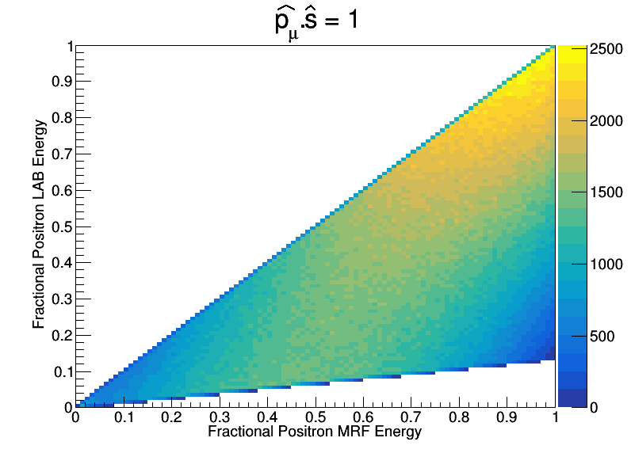
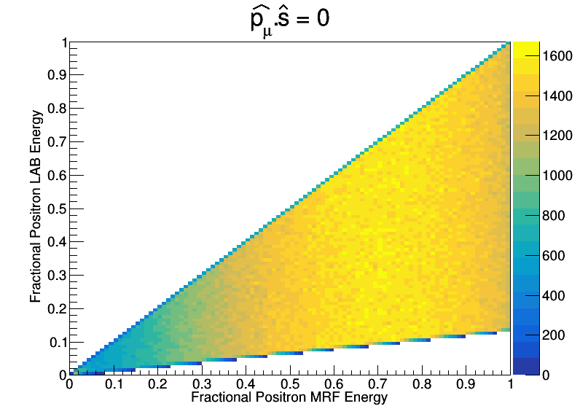
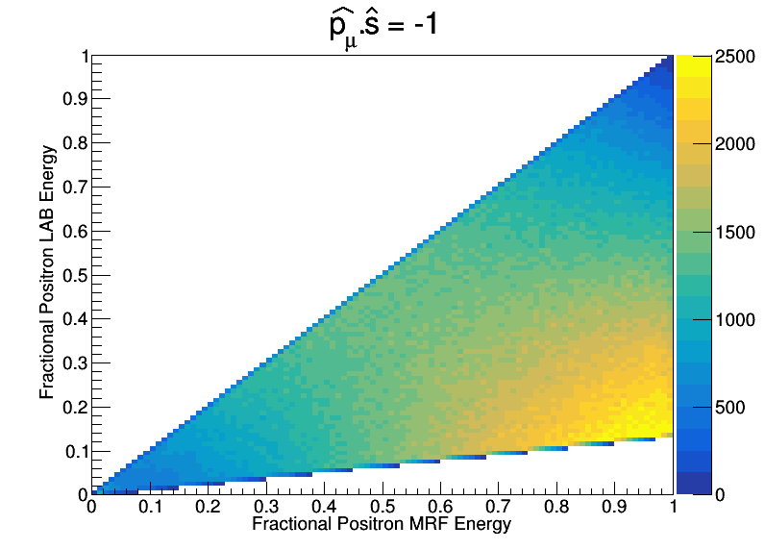
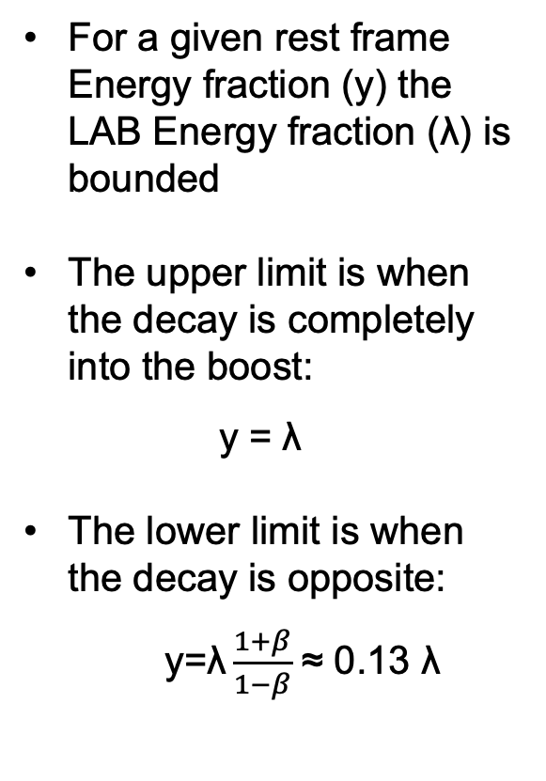
Kinematics – Phase II
β =-0.77
For a given rest frame Energy fraction (y) the LAB Energy fraction (λ) is bounded
The upper limit is when the decay is completely into the boost:
y = λ
The lower limit is when the decay is opposite:
y=$\text{λ}\frac{1+β}{1−β}$ ≈ 0.13 $\text{λ}$
|p_{μ}| = 125MeV

Slide 16
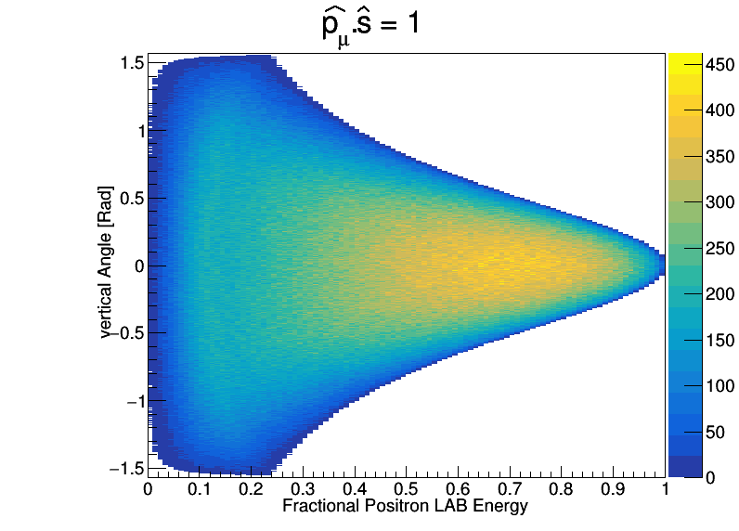
Vertical Angle – Phase II
λ=1 → |p|≈144MeV
|p_{μ}| = 125MeV
Rotating the polarization vector (s) w.r.t the momentum vector changes
For g-2 precession in XZ plane average decay angle is unaffected

Slide 17
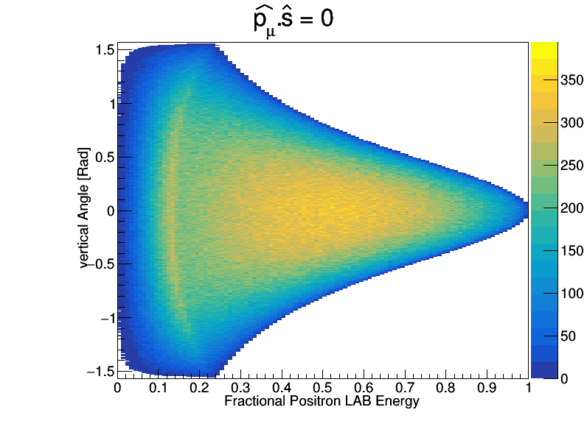
Vertical Angle – Phase II
λ=1 → |p|≈144MeV
|p_{μ}| = 125MeV
Rotating the polarization vector (s) w.r.t the momentum vector changes
For g-2 precession in XZ plane average decay angle is unaffected

Slide 18
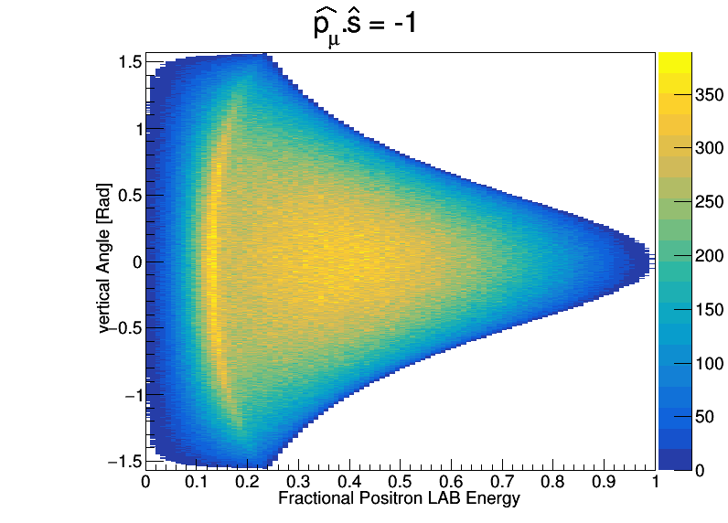
Vertical Angle – Phase II
λ=1 → |p|≈144MeV
|p_{μ}| = 125MeV
Rotating the polarization vector (s) w.r.t the momentum vector changes
For g-2 precession in XZ plane average decay angle is unaffected

Slide 19
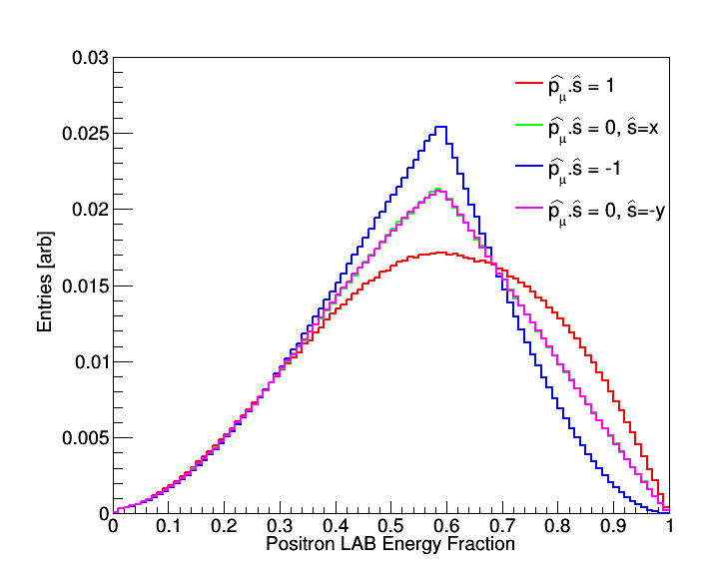
g-2 oscillation – Phase I
For Phase I (p = 28MeV) maximum energy is ~68.65 MeV
LAB frame e⁺ Momentum distribution depends on polarisation orientation
For frozen spin method and no EDM this will have no time dependence
Acceptance will typically cut off low momentum, so will see oscillation in detected number of e⁺
|p_{μ}| = 28MeV

Slide 20
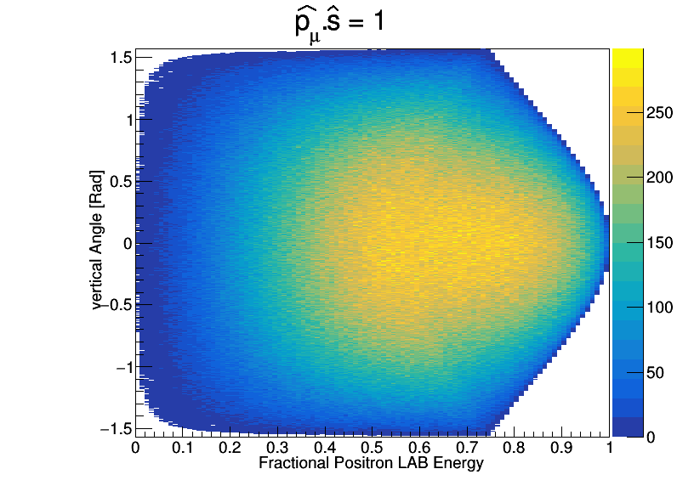
Vertical Angle – Phase I
λ=1 → |p|≈68MeV
|p_{μ}| = 28MeV
Rotating the polarization vector (s) w.r.t the momentum vector changes
For g-2 precession in XZ plane average decay angle is unaffected

Slide 21
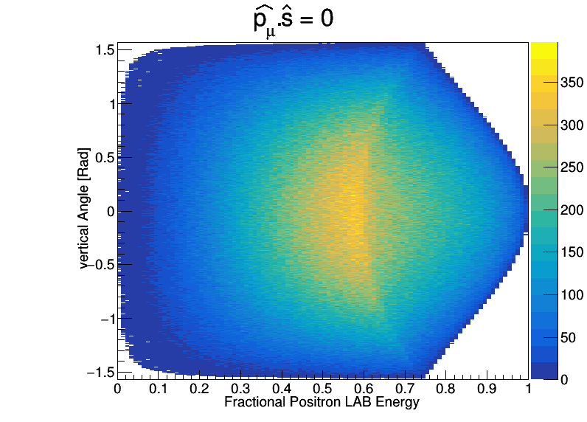
Vertical Angle – Phase I
λ=1 → |p|≈68MeV
|p_{μ}| = 28MeV
Rotating the polarization vector (s) w.r.t the momentum vector changes
For g-2 precession in XZ plane average decay angle is unaffected

Slide 22
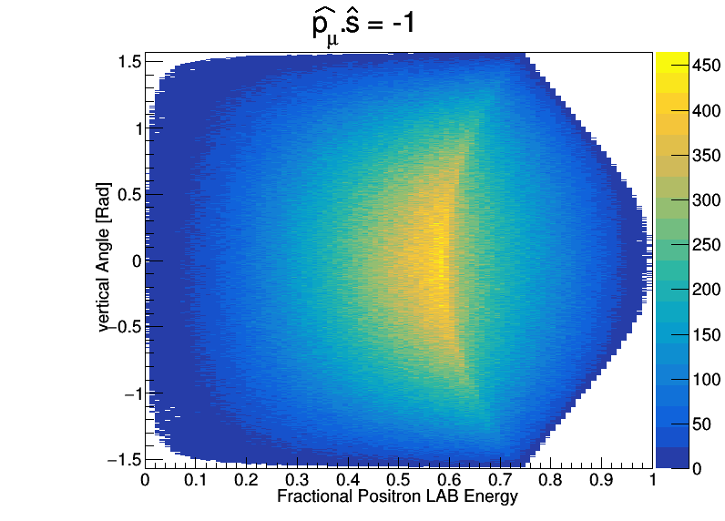
Vertical Angle – Phase I
λ=1 → |p|≈68MeV
|p_{μ}| = 28MeV
Rotating the polarization vector (s) w.r.t the momentum vector changes
For g-2 precession in XZ plane average decay angle is unaffected

Slide 23
Acceptance
λ=1 → |p|≈68MeV
|p_{μ}| = 28MeV
Acceptance selects a region of this space
Shown here is a min. momentum of 41MeV, |θ_{y}|=0.5

Slide 24
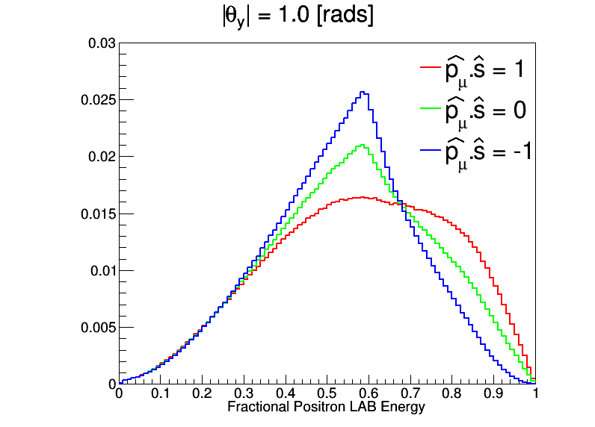
Effect of Acceptance – Phase I
λ=1 → |p|≈68MeV
Apply a simple absolute cut on the vertical angle as proxy for acceptance…
|p_{μ}| = 28MeV
Amplitude of oscillation at this λ

Slide 25
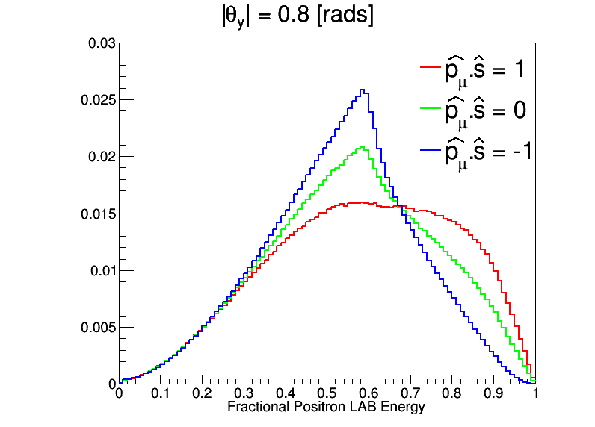
Effect of Acceptance – Phase I
λ=1 → |p|≈68MeV
Apply a simple absolute cut on the vertical angle as proxy for acceptance…
|p_{μ}| = 28MeV

Slide 26
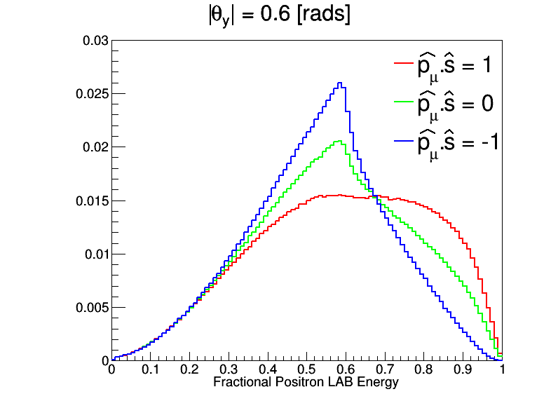
Effect of Acceptance – Phase I
λ=1 → |p|≈68MeV
Apply a simple absolute cut on the vertical angle as proxy for acceptance…
|p_{μ}| = 28MeV

Slide 27

Effect of Acceptance – Phase I
λ=1 → |p|≈68MeV
Apply a simple absolute cut on the vertical angle as proxy for acceptance…
|p_{μ}| = 28MeV

Slide 28
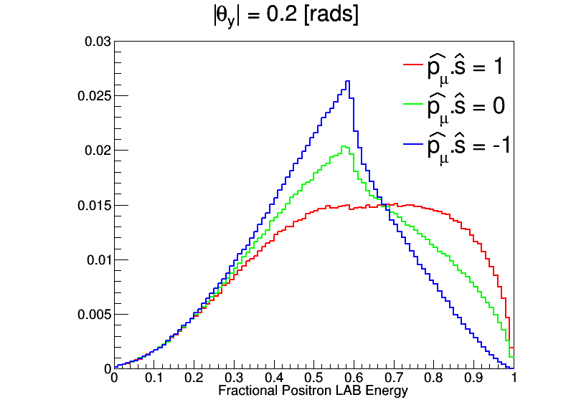
Effect of Acceptance – Phase I
λ=1 → |p|≈68MeV
Apply a simple absolute cut on the vertical angle as proxy for acceptance…
|p_{μ}| = 28MeV

Slide 29
Conclusions
Straw detector design, build, test and DAQ expertise at Liverpool/Manchester/UCL
Demonstrated measurement of straw only g-2 oscillation at FNAL
See King et. al: https://iopscience.iop.org/article/10.1088/1748-0221/17/02/P02035/meta
Phase I
Straws used to confirm g-2 oscillation is frozen out
Optimal position/orientation being studied
Need for inner and outer layer?
Acceptance cuts on momentum and vertical longitudinal angle
Phase II
Momentum and longitudinal angle potentially used to improve muon EDM sensitivity
Possible change of technology – additional layers…
… and replace the word vertical with longitudinal in plots!

Slide 30
Backups…

Slide 31
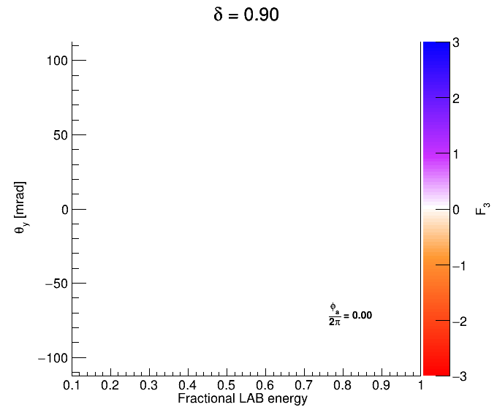
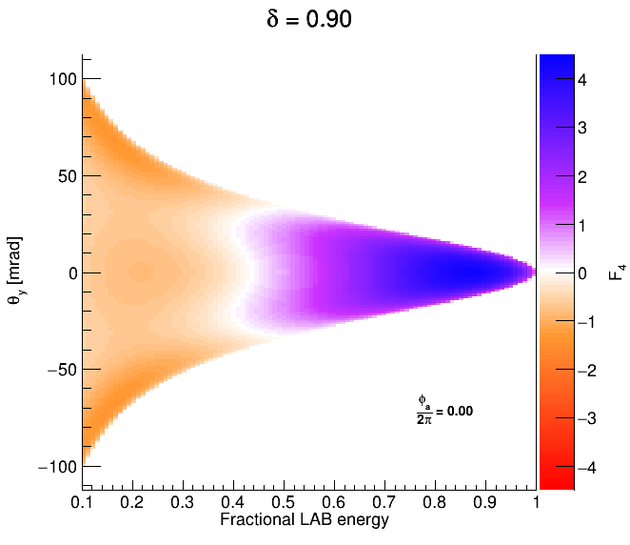
F₃(λ, θ_{y}, t) and F₄(λ, θ_{y}, t)

Slide 32
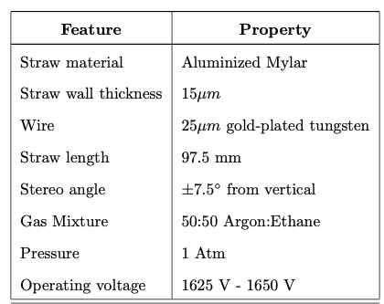

Slide 33
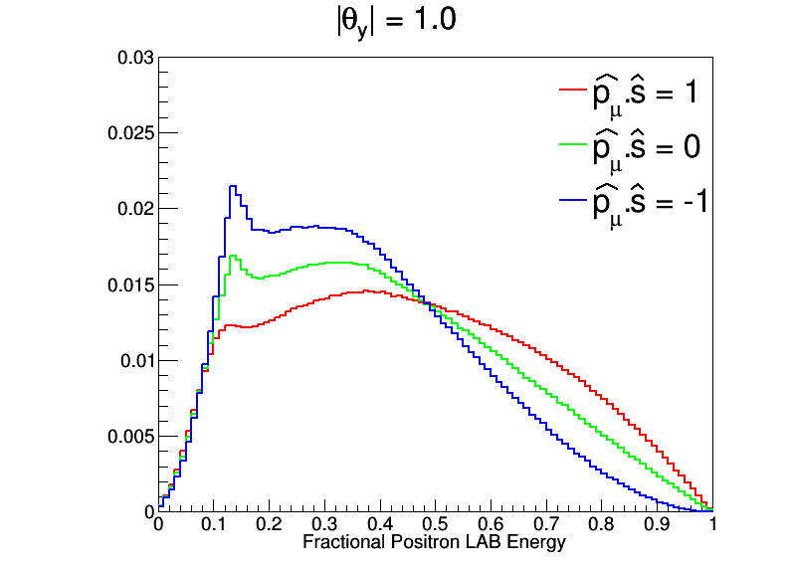
Effect of Acceptance – Phase II
λ=1 → |p|≈144MeV
Apply a simple absolute cut on the vertical angle as proxy for acceptance…

Slide 34
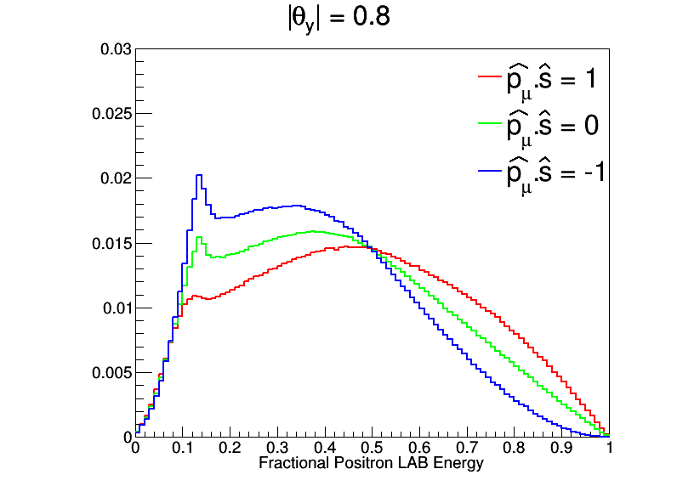
Effect of Acceptance – Phase II
λ=1 → |p|≈144MeV
Apply a simple absolute cut on the vertical angle as proxy for acceptance…

Slide 35
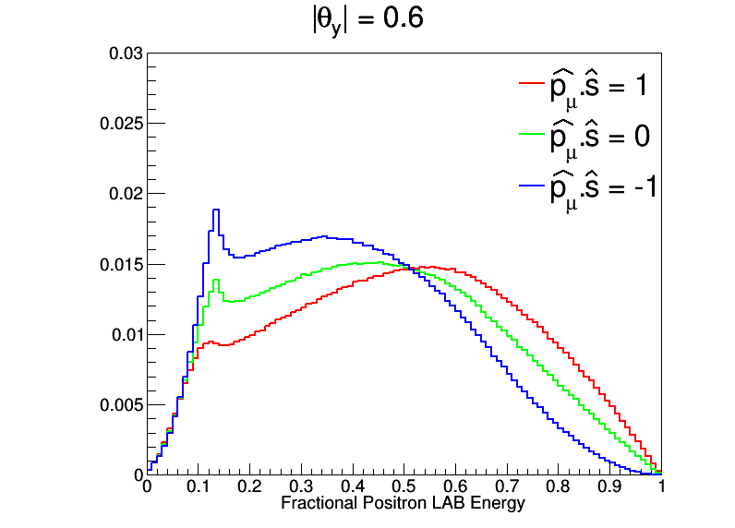
Effect of Acceptance – Phase II
λ=1 → |p|≈144MeV
Apply a simple absolute cut on the vertical angle as proxy for acceptance…

Slide 36
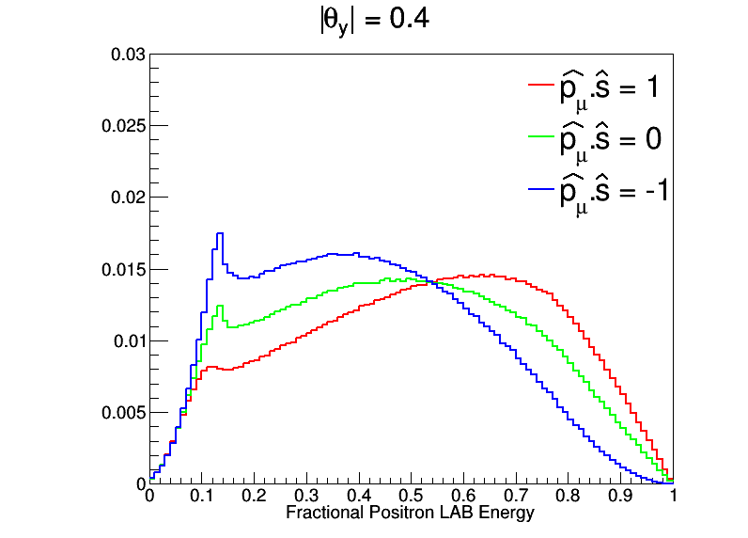
Effect of Acceptance – Phase II
λ=1 → |p|≈144MeV
Apply a simple absolute cut on the vertical angle as proxy for acceptance…

Slide 37
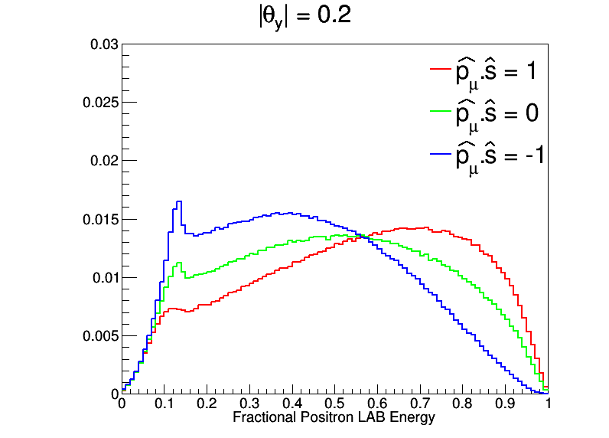
Effect of Acceptance – Phase II
λ=1 → |p|≈144MeV
Apply a simple absolute cut on the vertical angle as proxy for acceptance…

Slide 38
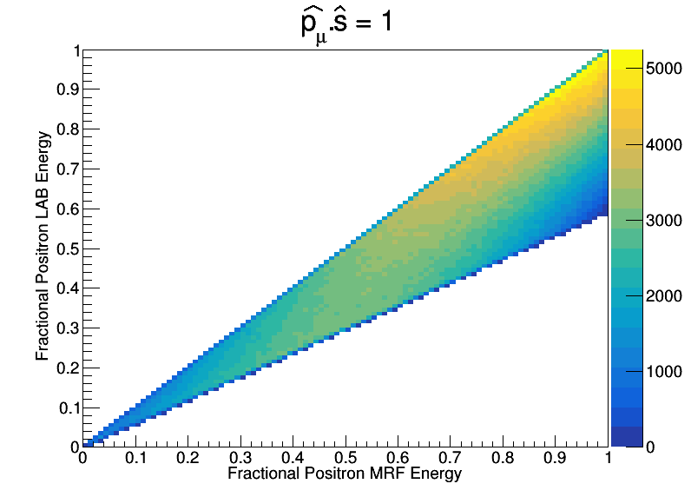
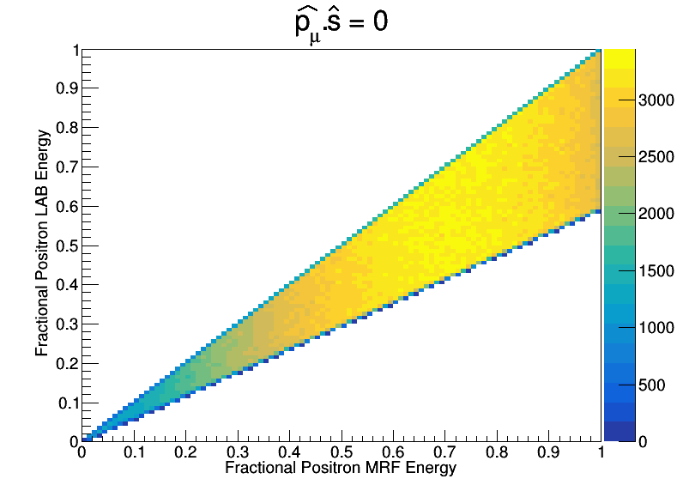
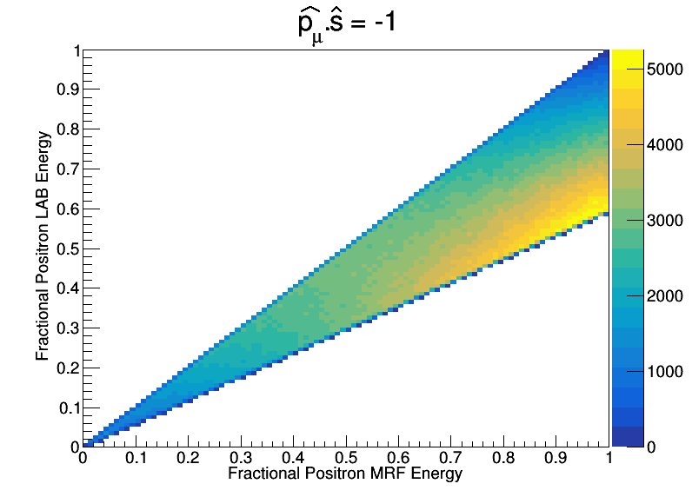
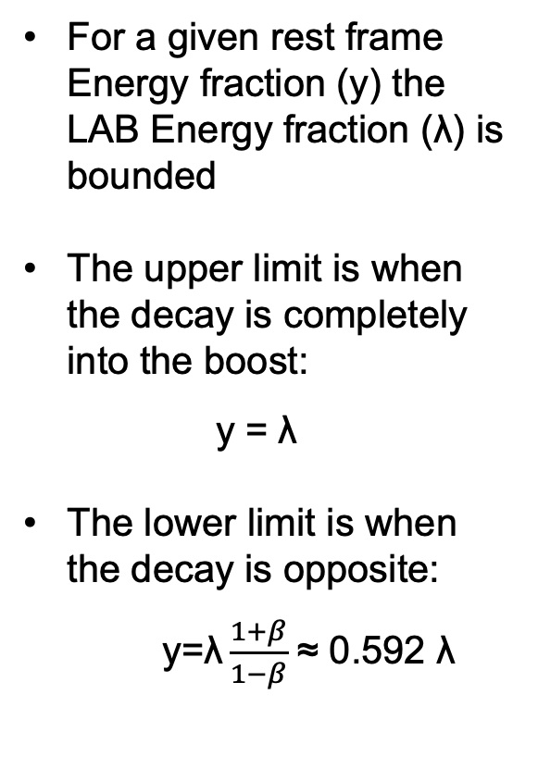
Kinematics – Phase I
β =-0.256
For a given rest frame Energy fraction (y) the LAB Energy fraction (λ) is bounded
The upper limit is when the decay is completely into the boost:
y = λ
The lower limit is when the decay is opposite:
y=$\text{λ}\frac{1+β}{1−β}$ ≈ 0.592 $\text{λ}$
|p_{μ}| = 28MeV

Slide 40
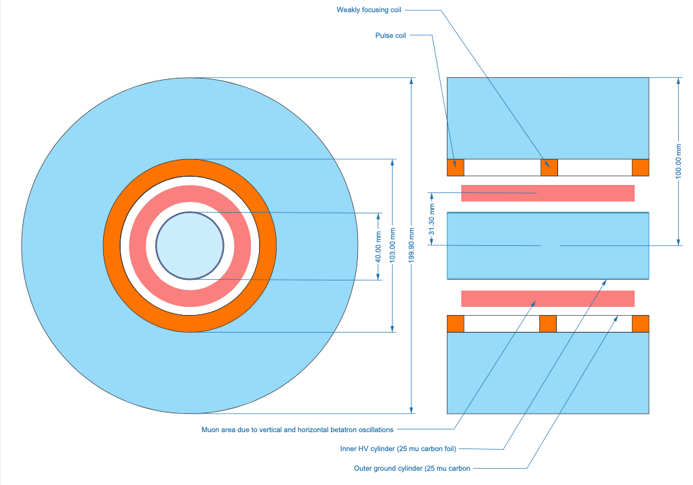
Overview
Ⓧy
y

Slide 41
Overview
Open question about whether we need both inner and outer layer – maybe just inner?
100mm height available
Inner radius 20mm
For straws of g-2 radius (2.5mm) can get ~32 (39?) straws:
Layers of ~20, 12, (7?)
Outer layer ~ 40 straws
10
25
15
30
39
33
5
20
1
2.5cm
4cm

Slide 42
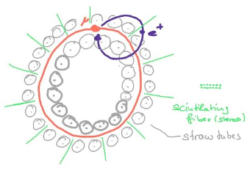

Slide 43
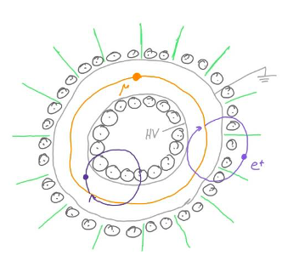

Slide 44
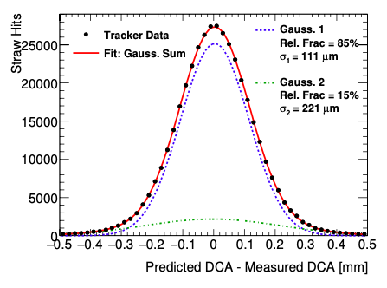



Additional pictures
Paper: https://iopscience.iop.org/article/10.1088/1748-0221/17/02/P02035/meta

Slide 45


Straw Trackers @ FNAL
Demonstrated to run in vacuum, in high B-field gradients
15μm mylar walls, filled with either Argon-Ethane or Argon-CO₂
Demonstrated observation of g-2 oscillation using reconstructed tracks
Design, construction, testing and readout expertise at Liverpool, Manchester and UCL

Slide 46


Straw Trackers – Single hit
Highly efficient across straw radius (2.52mm)
Straw hit resolution ~110μm
Single straw ready to read out again after ~100ns, capable of 10MHz rate

Slide 47

Gas Leaking
Straws will permeate gas through thin walls
Straws were tested up to relative pressure of 2ATM
The numbers quoted here are for a gas mixture 50:50 Ar:CO₂
Different gases permeate at different rates
Have option of thicker mylar if leak rate is too high
~5 minor straw ruptures in 5 years. Due to multiple pump down/let up cycles
Useful to have ‘hot spares’ to swap in

Slide 48


Readout
Individual readout of each straw
Passed through ASDQ for signal shaping
Minimal noise hits throughout data taking
HV supplied to groups of 16 straws – 1625V
On board cooling required

Slide 49
Calorimeter Phase Analysis (1)

Slide 50
Calorimeter Phase Analysis (2)

