Slide 1
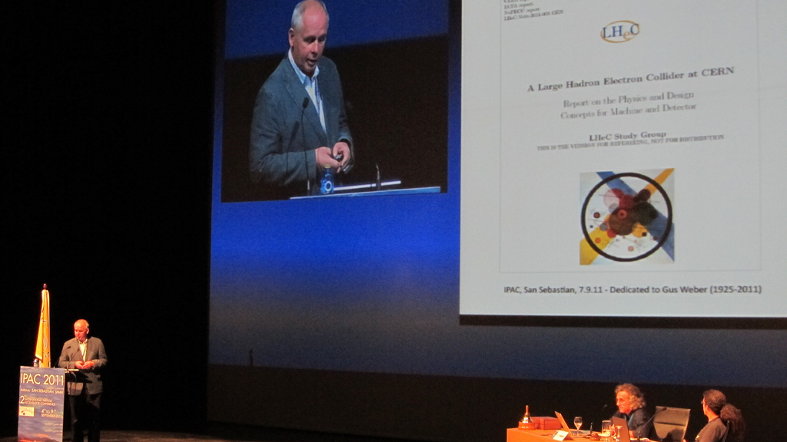
Max Klein
50 years in Particle Physics

Slide 3
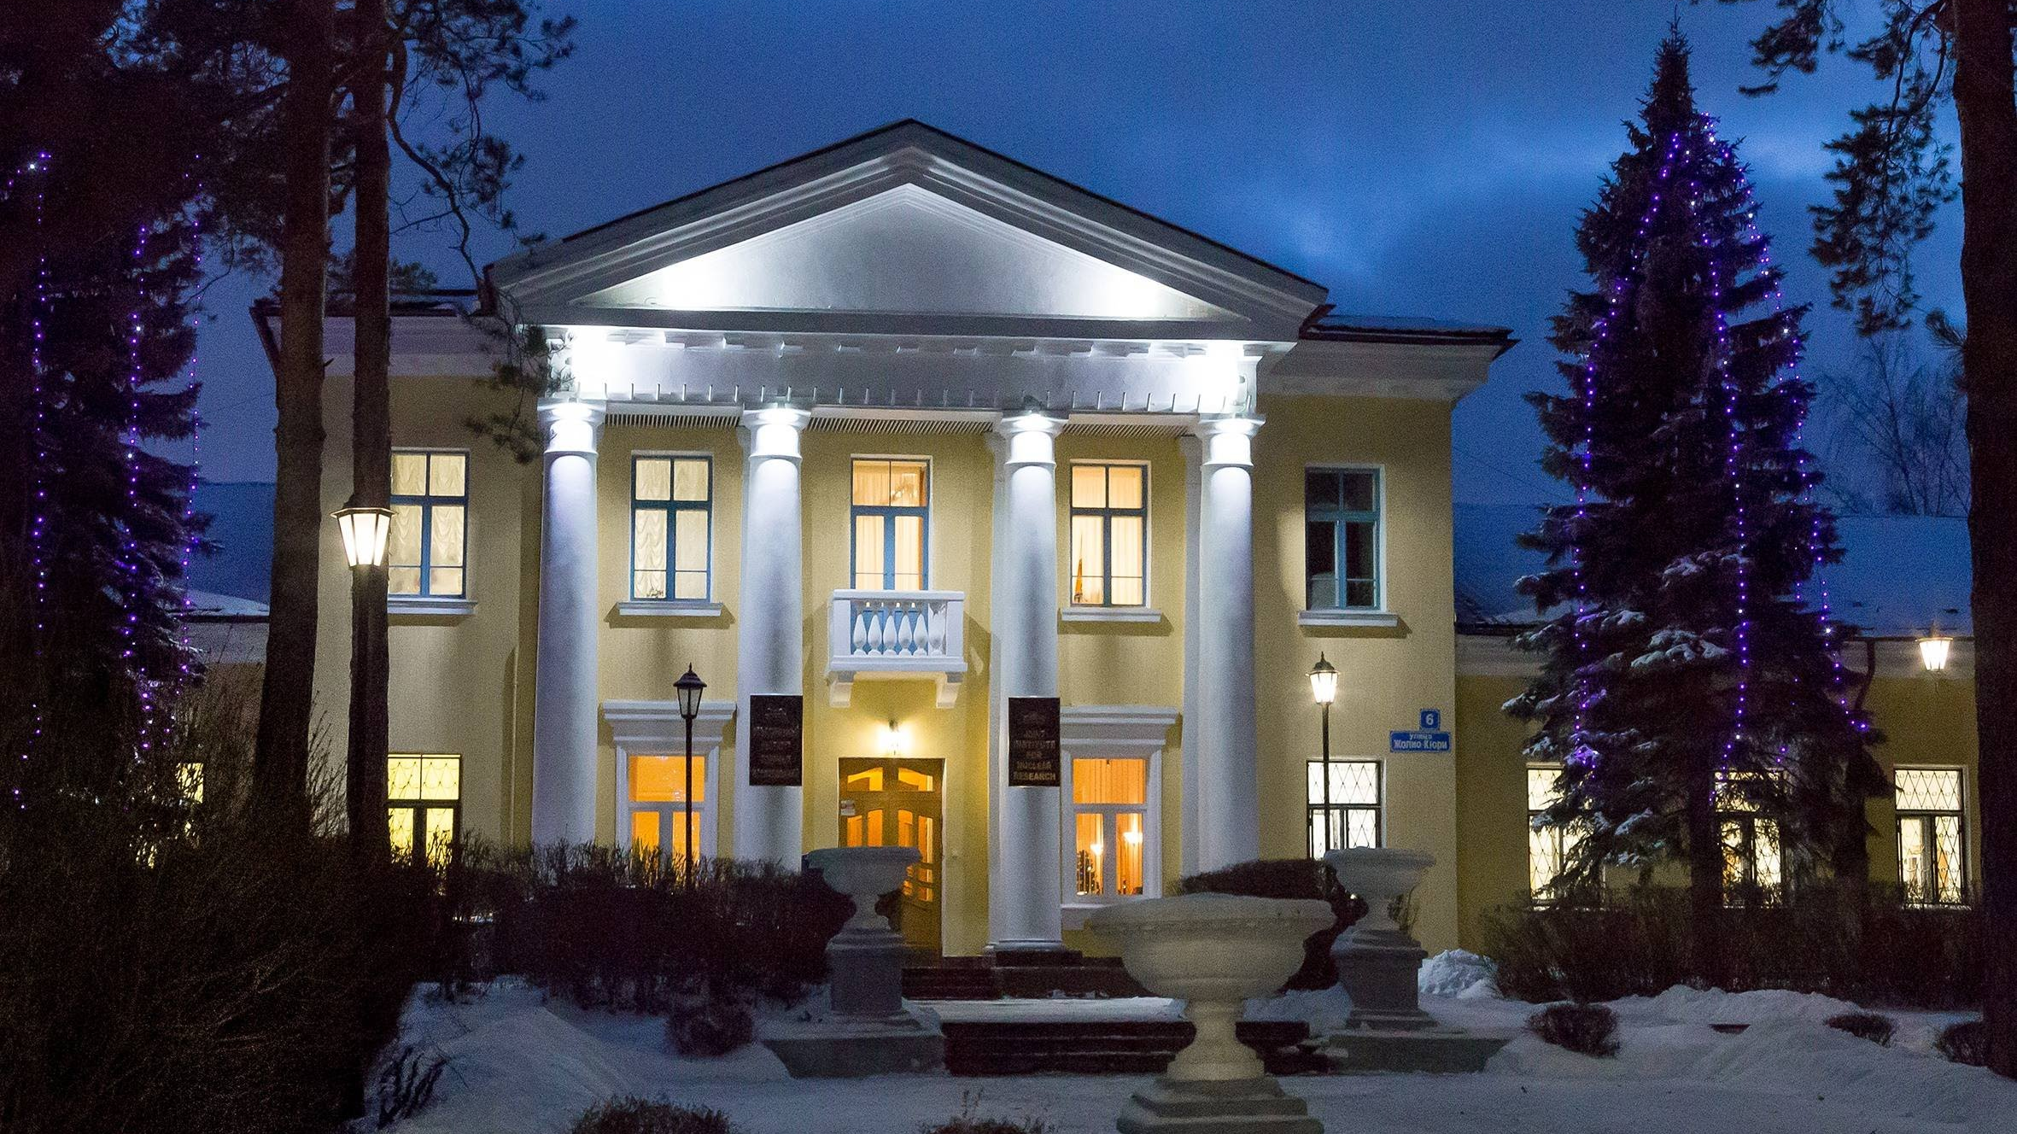
Dubna
Leading experiments around the world

Slide 4
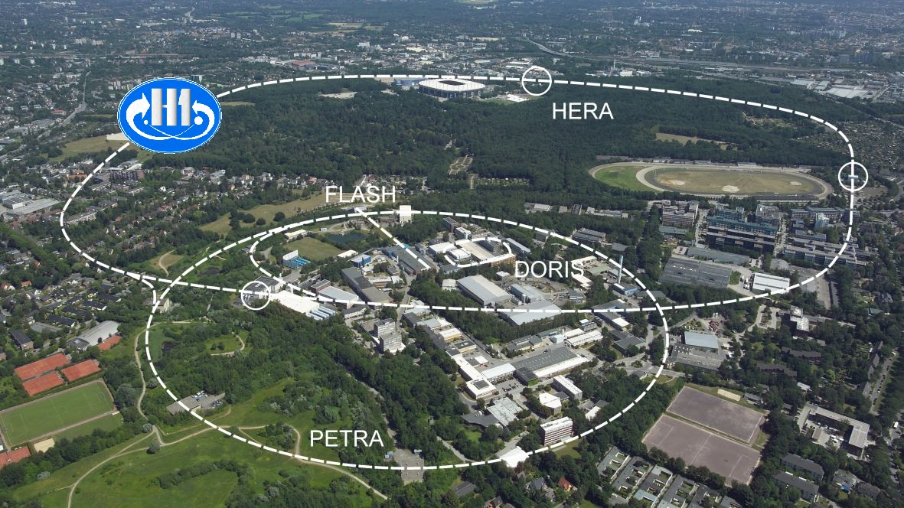
DESY
Head of H1 Experiment

Slide 5
ATLAS
Physics leadership and CB chair

Slide 6
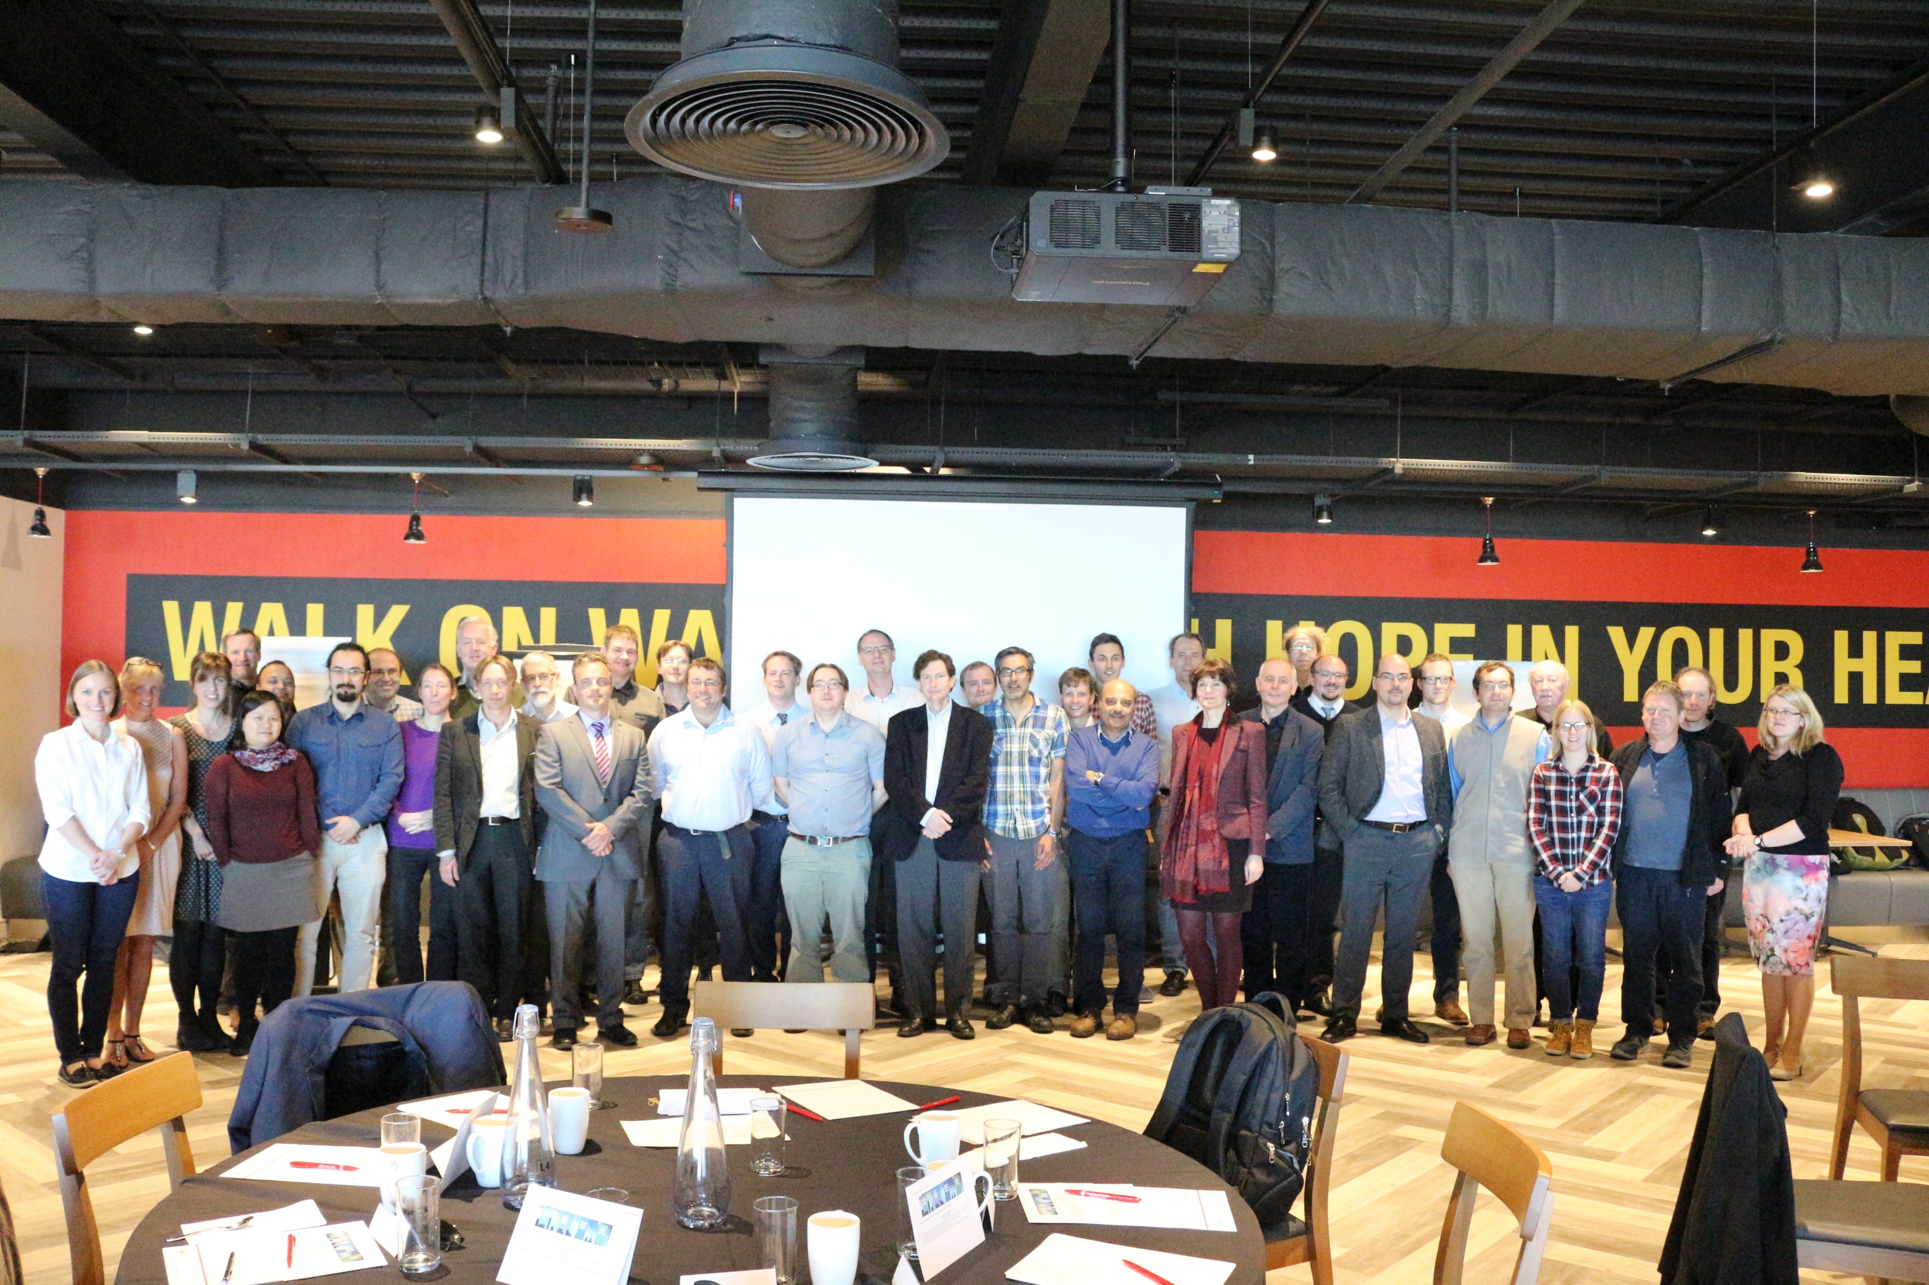
Department of Physics
Research, teaching, mentoring…and more

Slide 7
