Slide 1
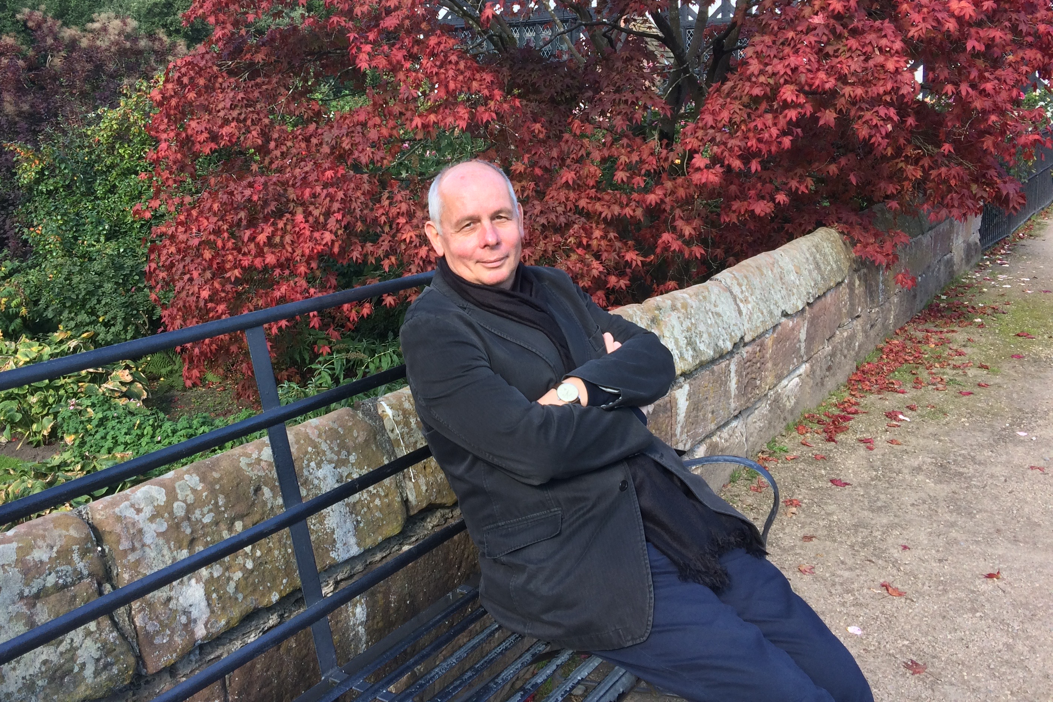
Max Klein
in ATLAS and ECFA
Karl Jakobs
University of Freiburg / Germany

Slide 2
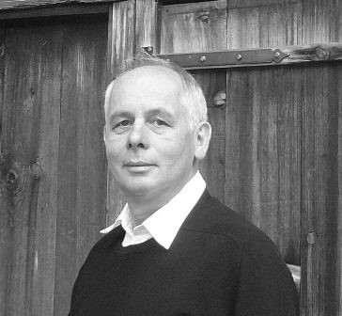
The pre-ATLAS days …
First contacts to Max during his time as H1 Spokesperson (2002 – 2006)
Mainly related to German pre-selection of CERN fellow candidates
Care about the young people
Calm approach
General wisdom
Broadly interested

Slide 3
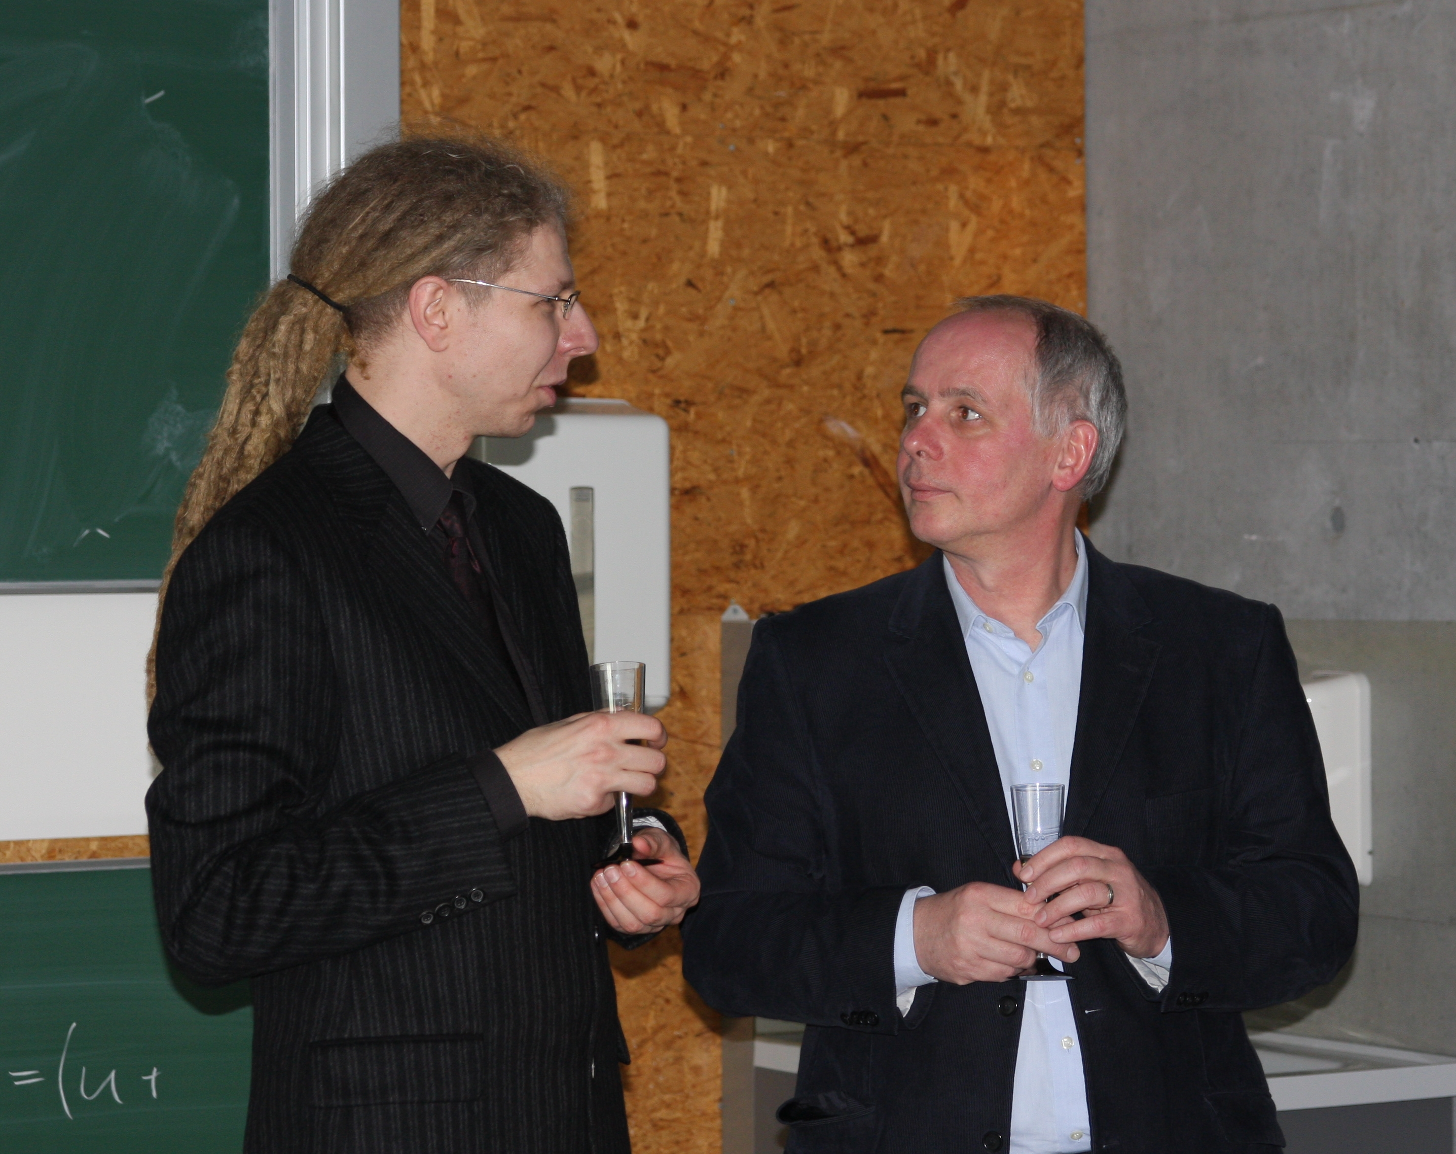
Max Klein’s early days in ATLAS
Joined the ATLAS Collaboration on 1 January 2007
Strongly interested in Standard Model Physics
and precise measurements
W and Z physics, QCD measurements, pdf
(with focus on the exploitation of ep and pp synergies)
Max’ first “titles” in ATLAS:
“Contact person for the Standard Model group on luminosity”
“CSC Standard Model reviewer”
AT the beginning, Max felt that ATLAS had too heavy, cumbersome structures,… too formal,…
A “very steep” ATLAS career:
On 1. March 2008 Max Klein was appointed as ATLAS Publication Committee Chair

Slide 4
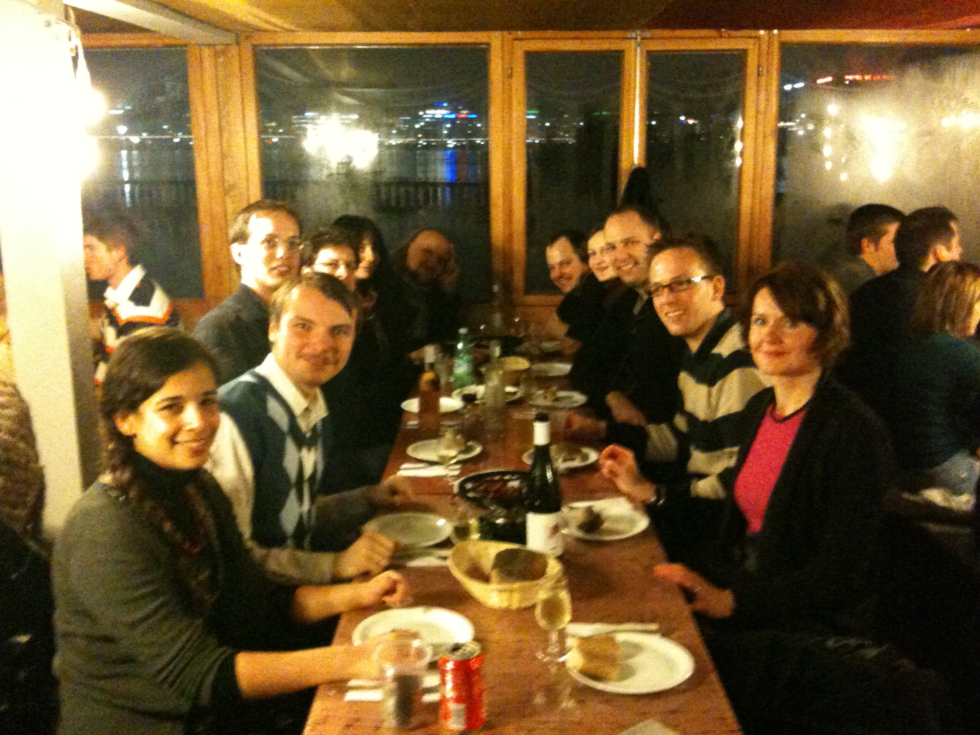
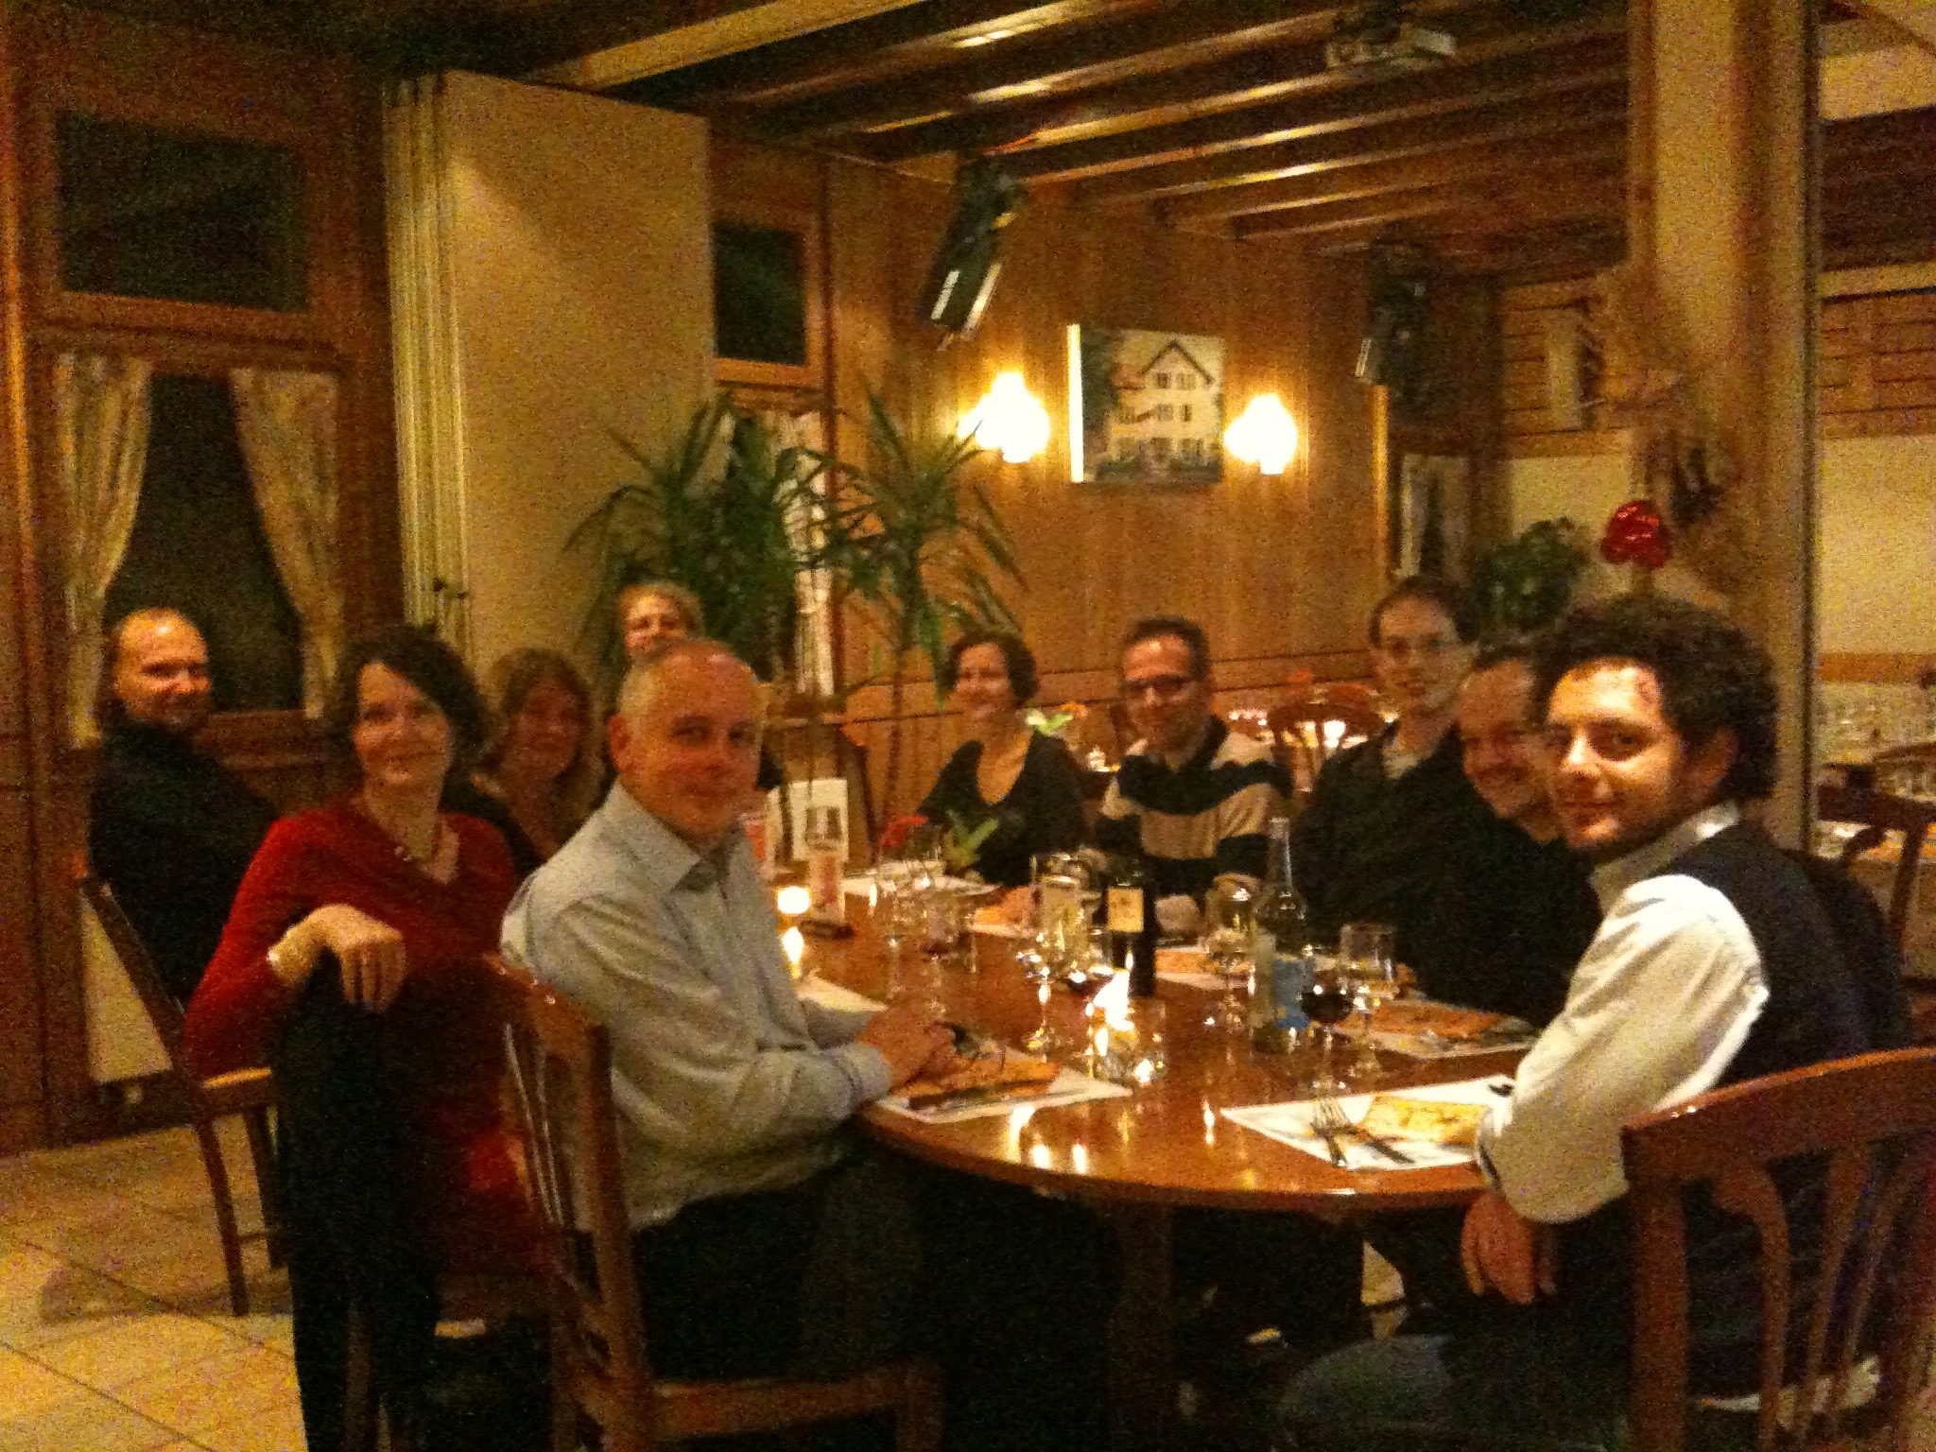

Max Klein’s early days in ATLAS
Max felt that ATLAS had too heavy, cumbersome
structures,…
Maybe this was a reason why Max decided to set up an
informal group called ELAN (engl: impetus, drive, pep, ...)
to carry out the W and Z boson analysis with first data
.. and even worse… the group was know to have dinner
meetings, enjoying red wine that was labelled
“La Rebelle”

Slide 5
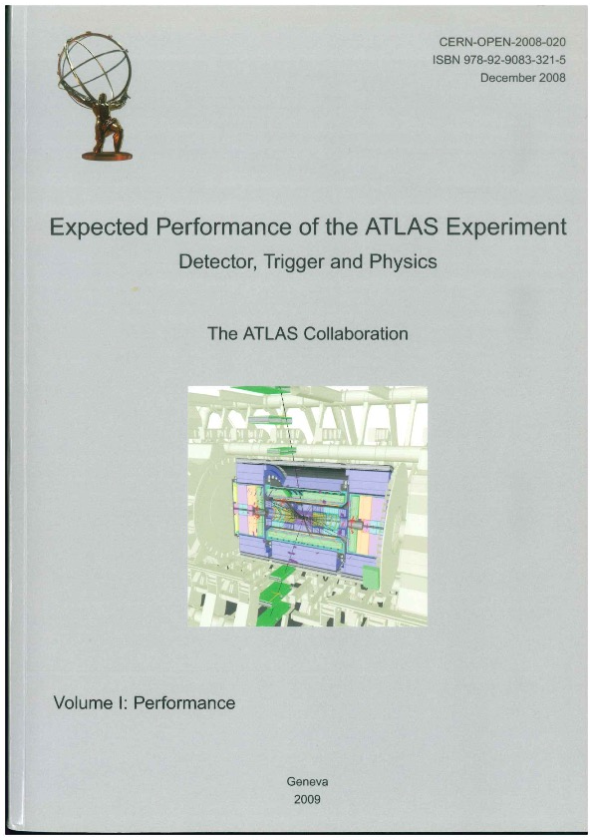
Max an the CSC Book
Critical judgement
general wisdom
calm approach

Slide 6
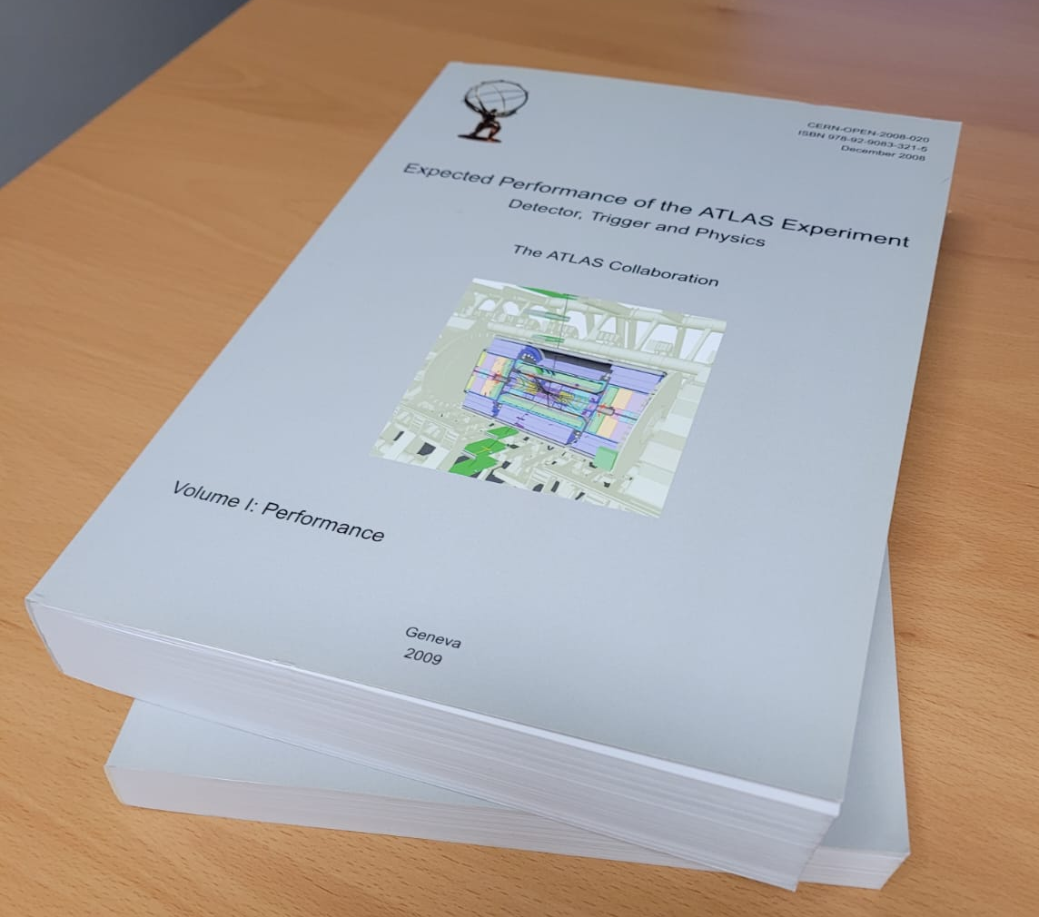
Max an the CSC Book
Dear Colleagues
as was announced in my mail from last
Thursday on the CSC book release:
There are updates ongoing on the authorlist.
In doubt or when interested, please look here,
http://atlas-authdb.web.cern.ch/atlas-authdb/
make sure you get the CSC book
version (a bit further down) and check if
changes are necessary. Since the book release
is imminent, a reply by the time of the
reading, Wednesday 11am, CERN, is much appreciated.
Comments please to
Marina Cobal <Marina.Cobal@cern.ch>
best regards Max
Critical judgement
general wisdom
calm approach

Slide 7
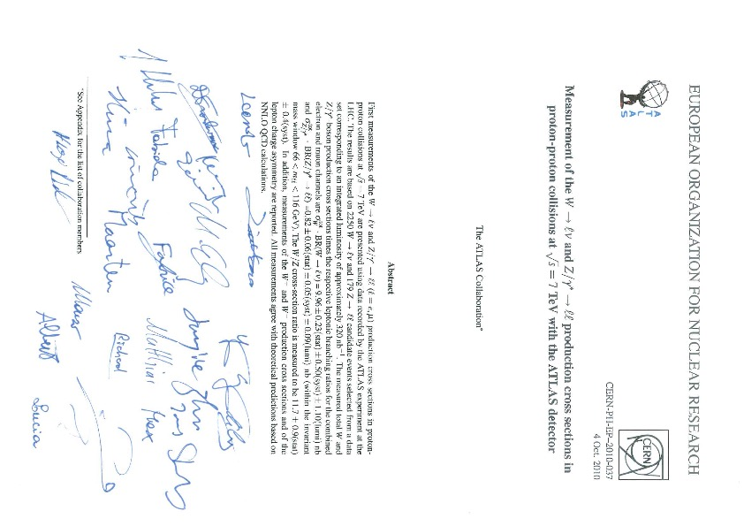
First Data in ATLAS

Slide 8
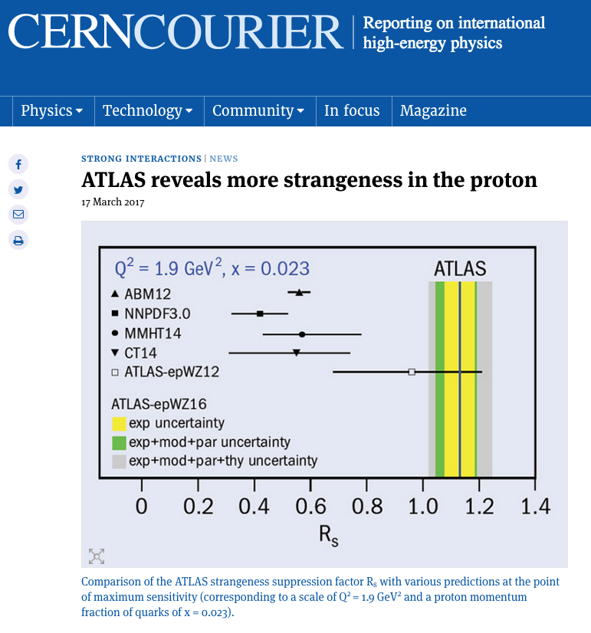
The Run-1 legacy results on W and Z bosons
The excellent theoretical understanding of the production of electroweak W and Z gauge bosons in proton–proton collisions at the LHC makes these “standard-candle” processes ideal for studying the detailed performance of the ATLAS detector, and thus improves the precision on measurements. Specifically, differences in the couplings of the W⁺, W–, Z and γ* bosons to quarks and antiquarks appear as differences in rapidity distributions that reveal additional information about the structure of the proton.
Protons are often considered to be composed of two up quarks and one down quark, but when probed at small distances they reveal additional content. This includes a “sea” of up and down quarks, strange quarks from the heavier second generation of particles, and the gluons that bind the quarks together into the proton.
Extreme rigour and care in physics analysis

Slide 9
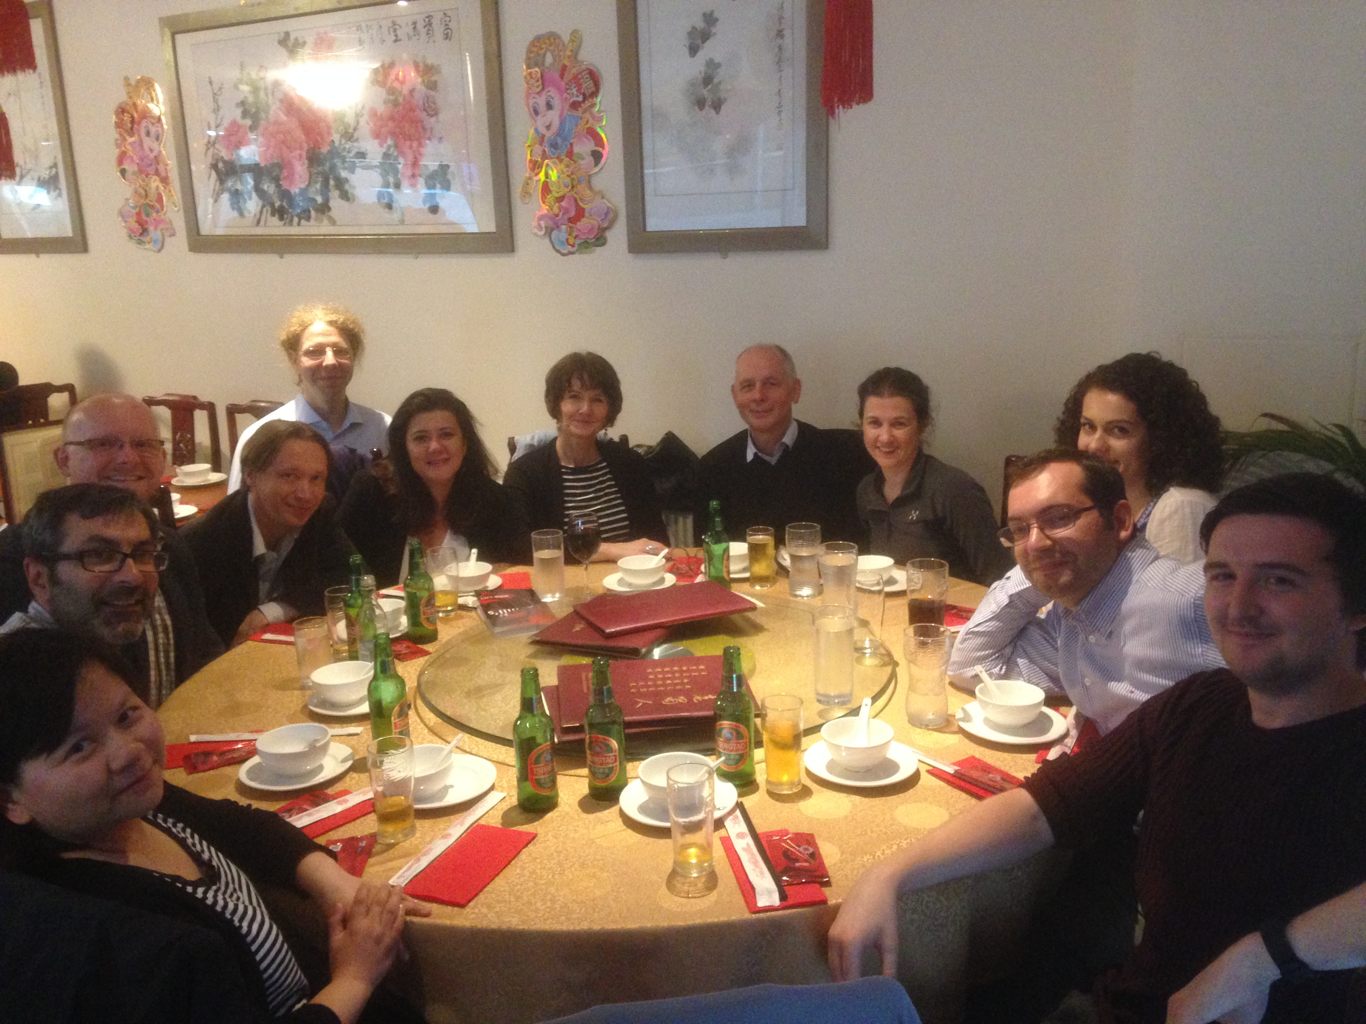
Max Klein as ATLAS group leader
“.. share his infinite knowledge on physics and pdfs with young enthusiast members of the group - teaching them for real what they only read in books so far…”
“ … talk to each of us and try to ensure people were happy and fulfilling their potential.”

Slide 10
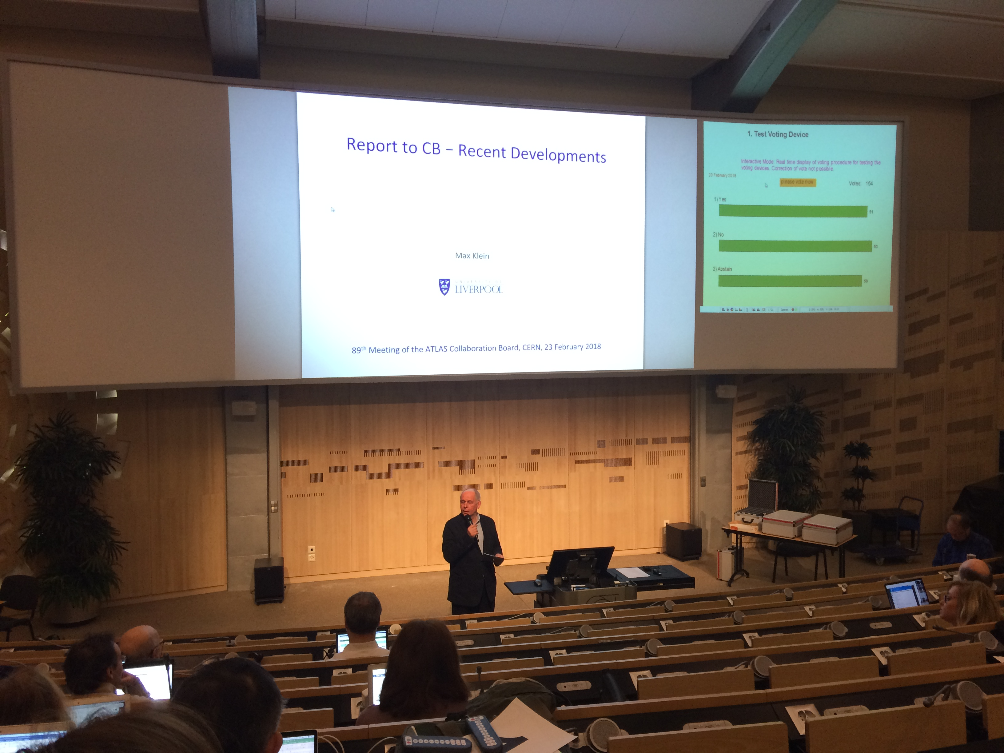
Max Klein as CB Chair
New Small Wheel
3 .or. 4 years
Phase-II TDRs
FTK
EB meetings
Early Career Researchers
General wisdom and calm approach in addressing even the
most controversial issues
… and in the end: Covid 19
and CB election procedure

Slide 11
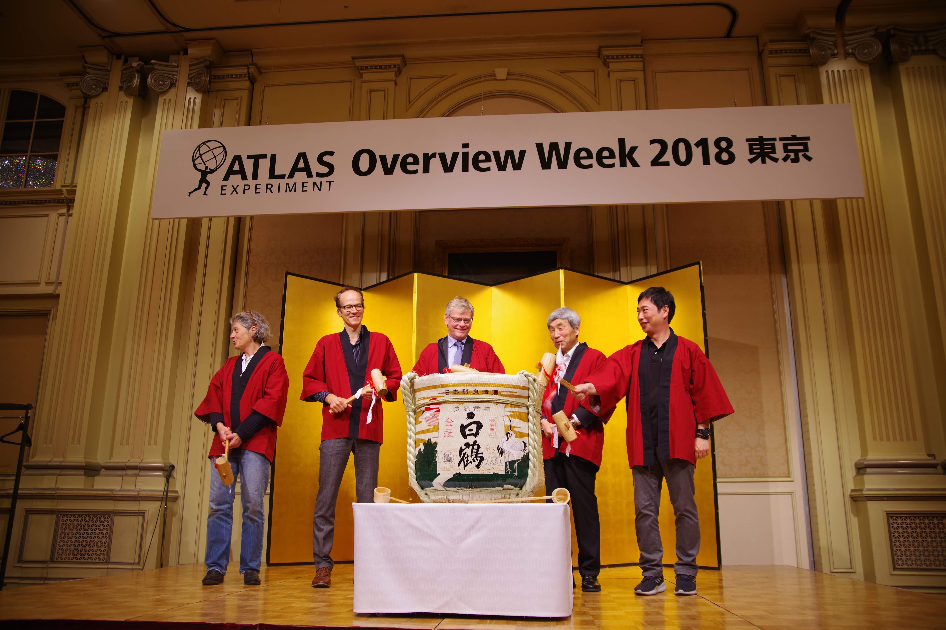
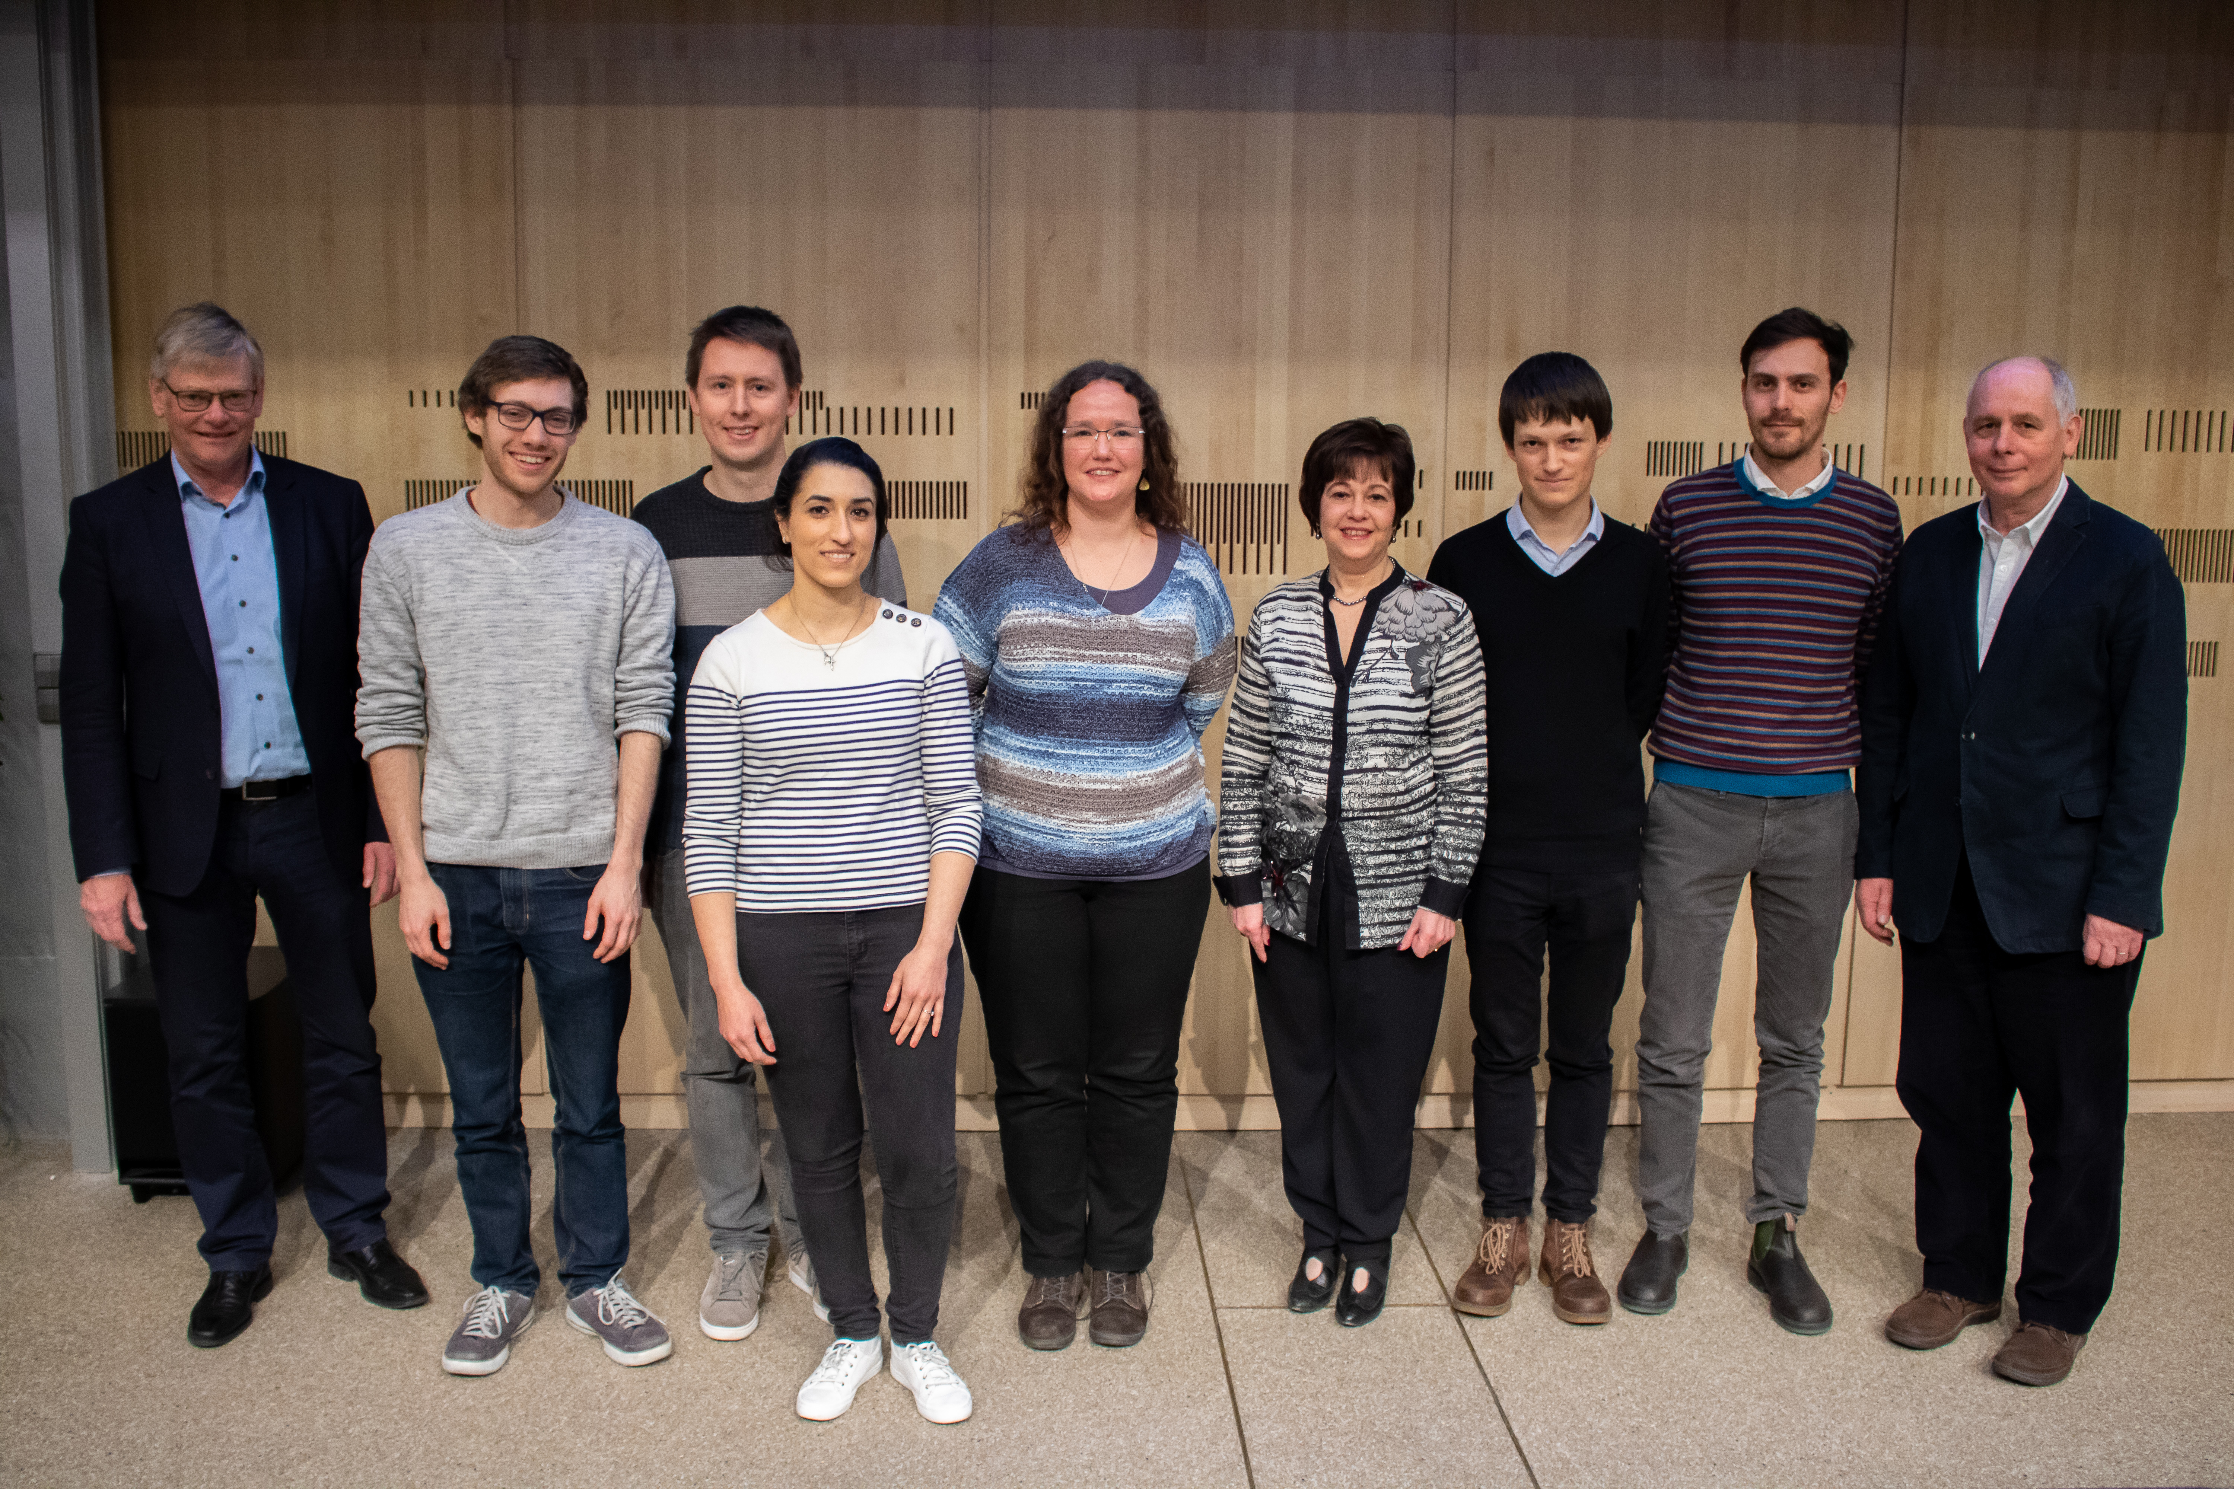
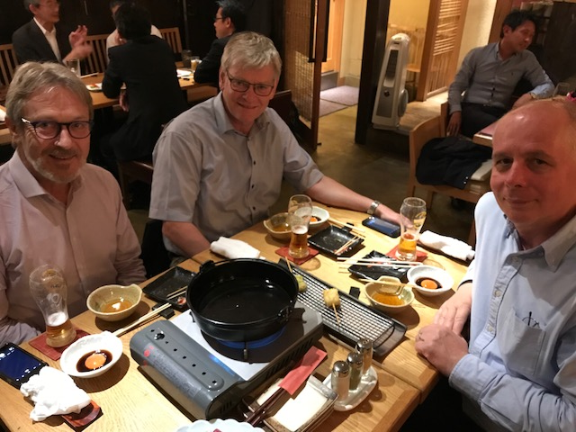
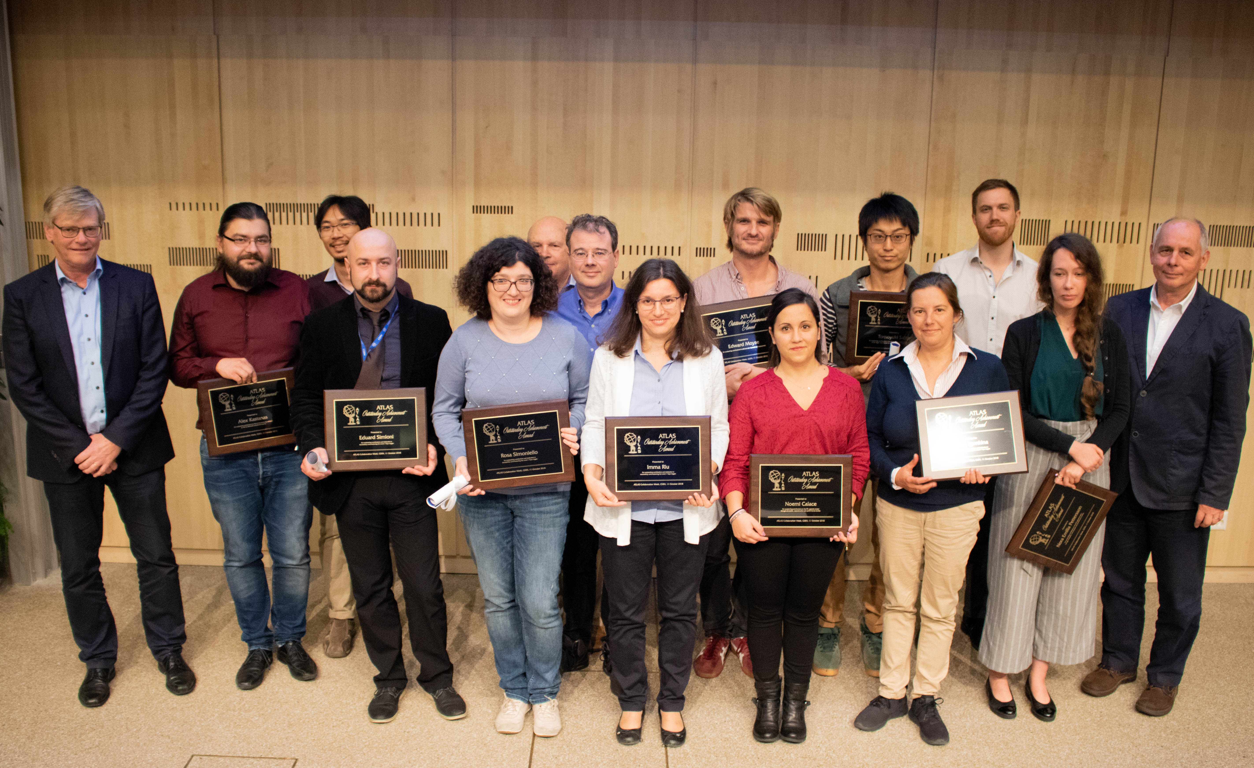
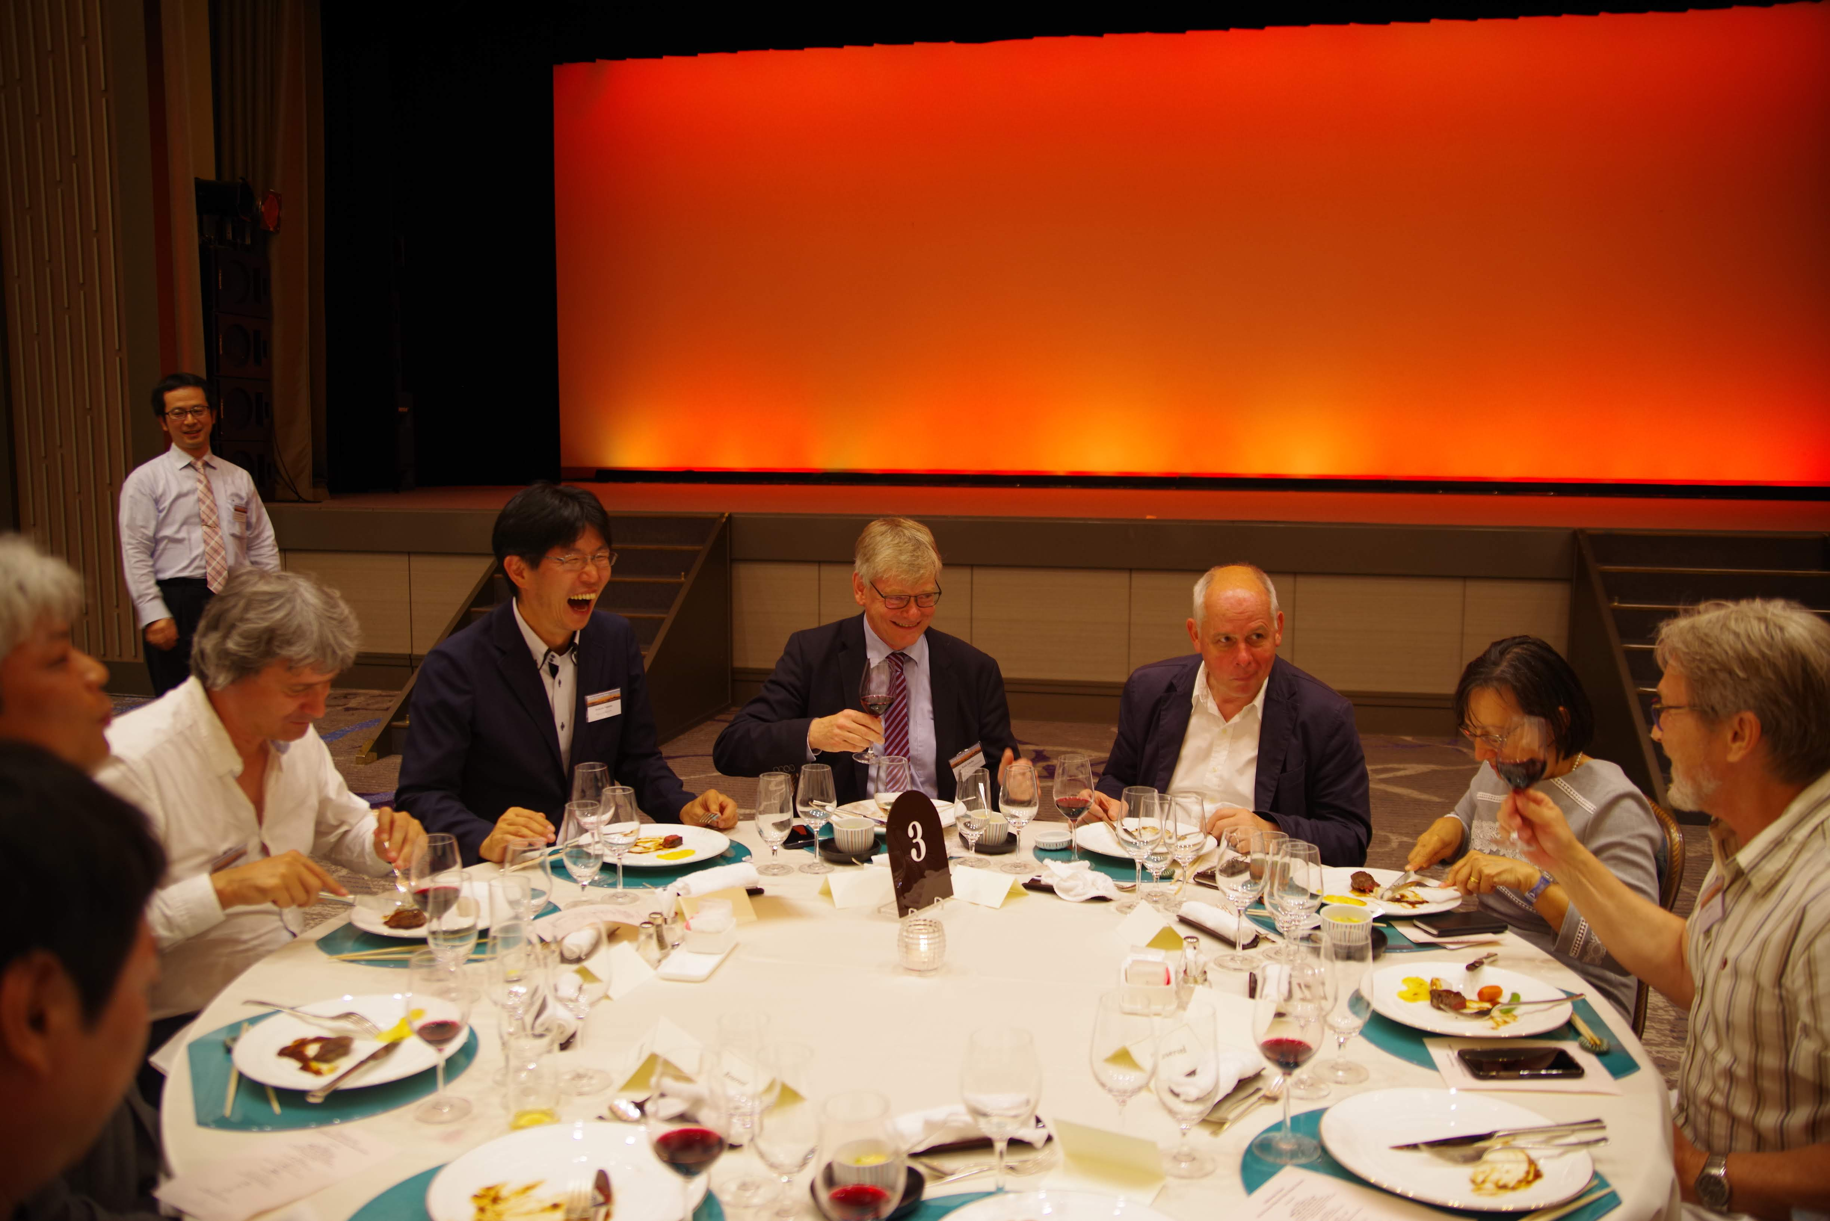
Max Klein as CB Chair

Slide 12
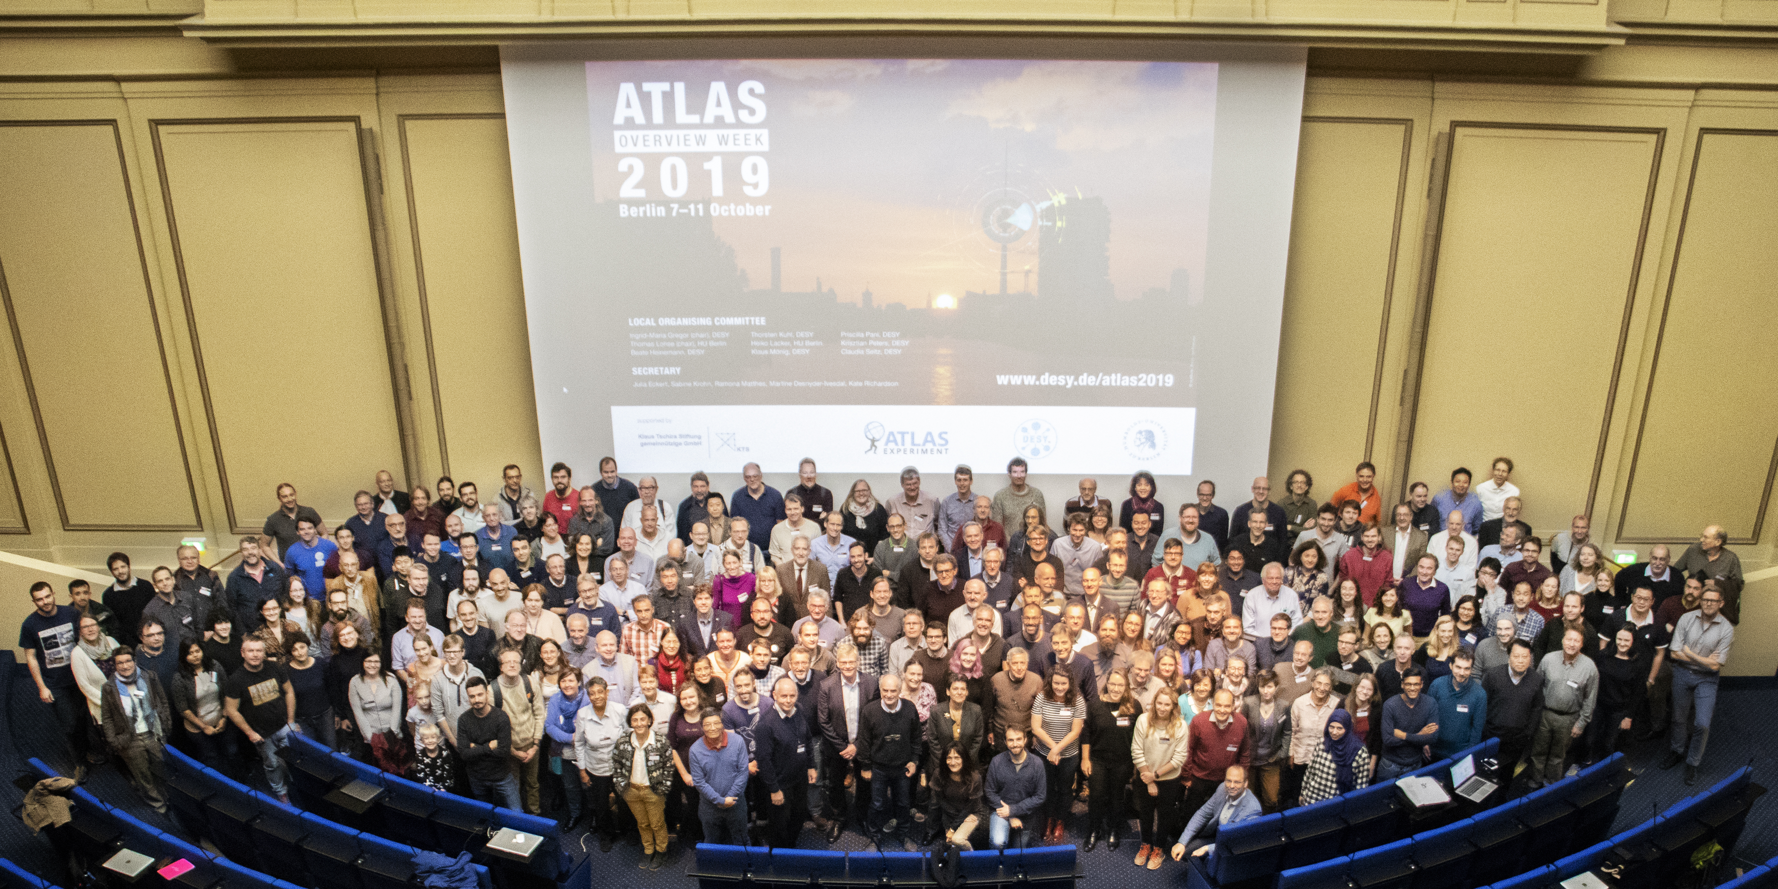

Slide 13
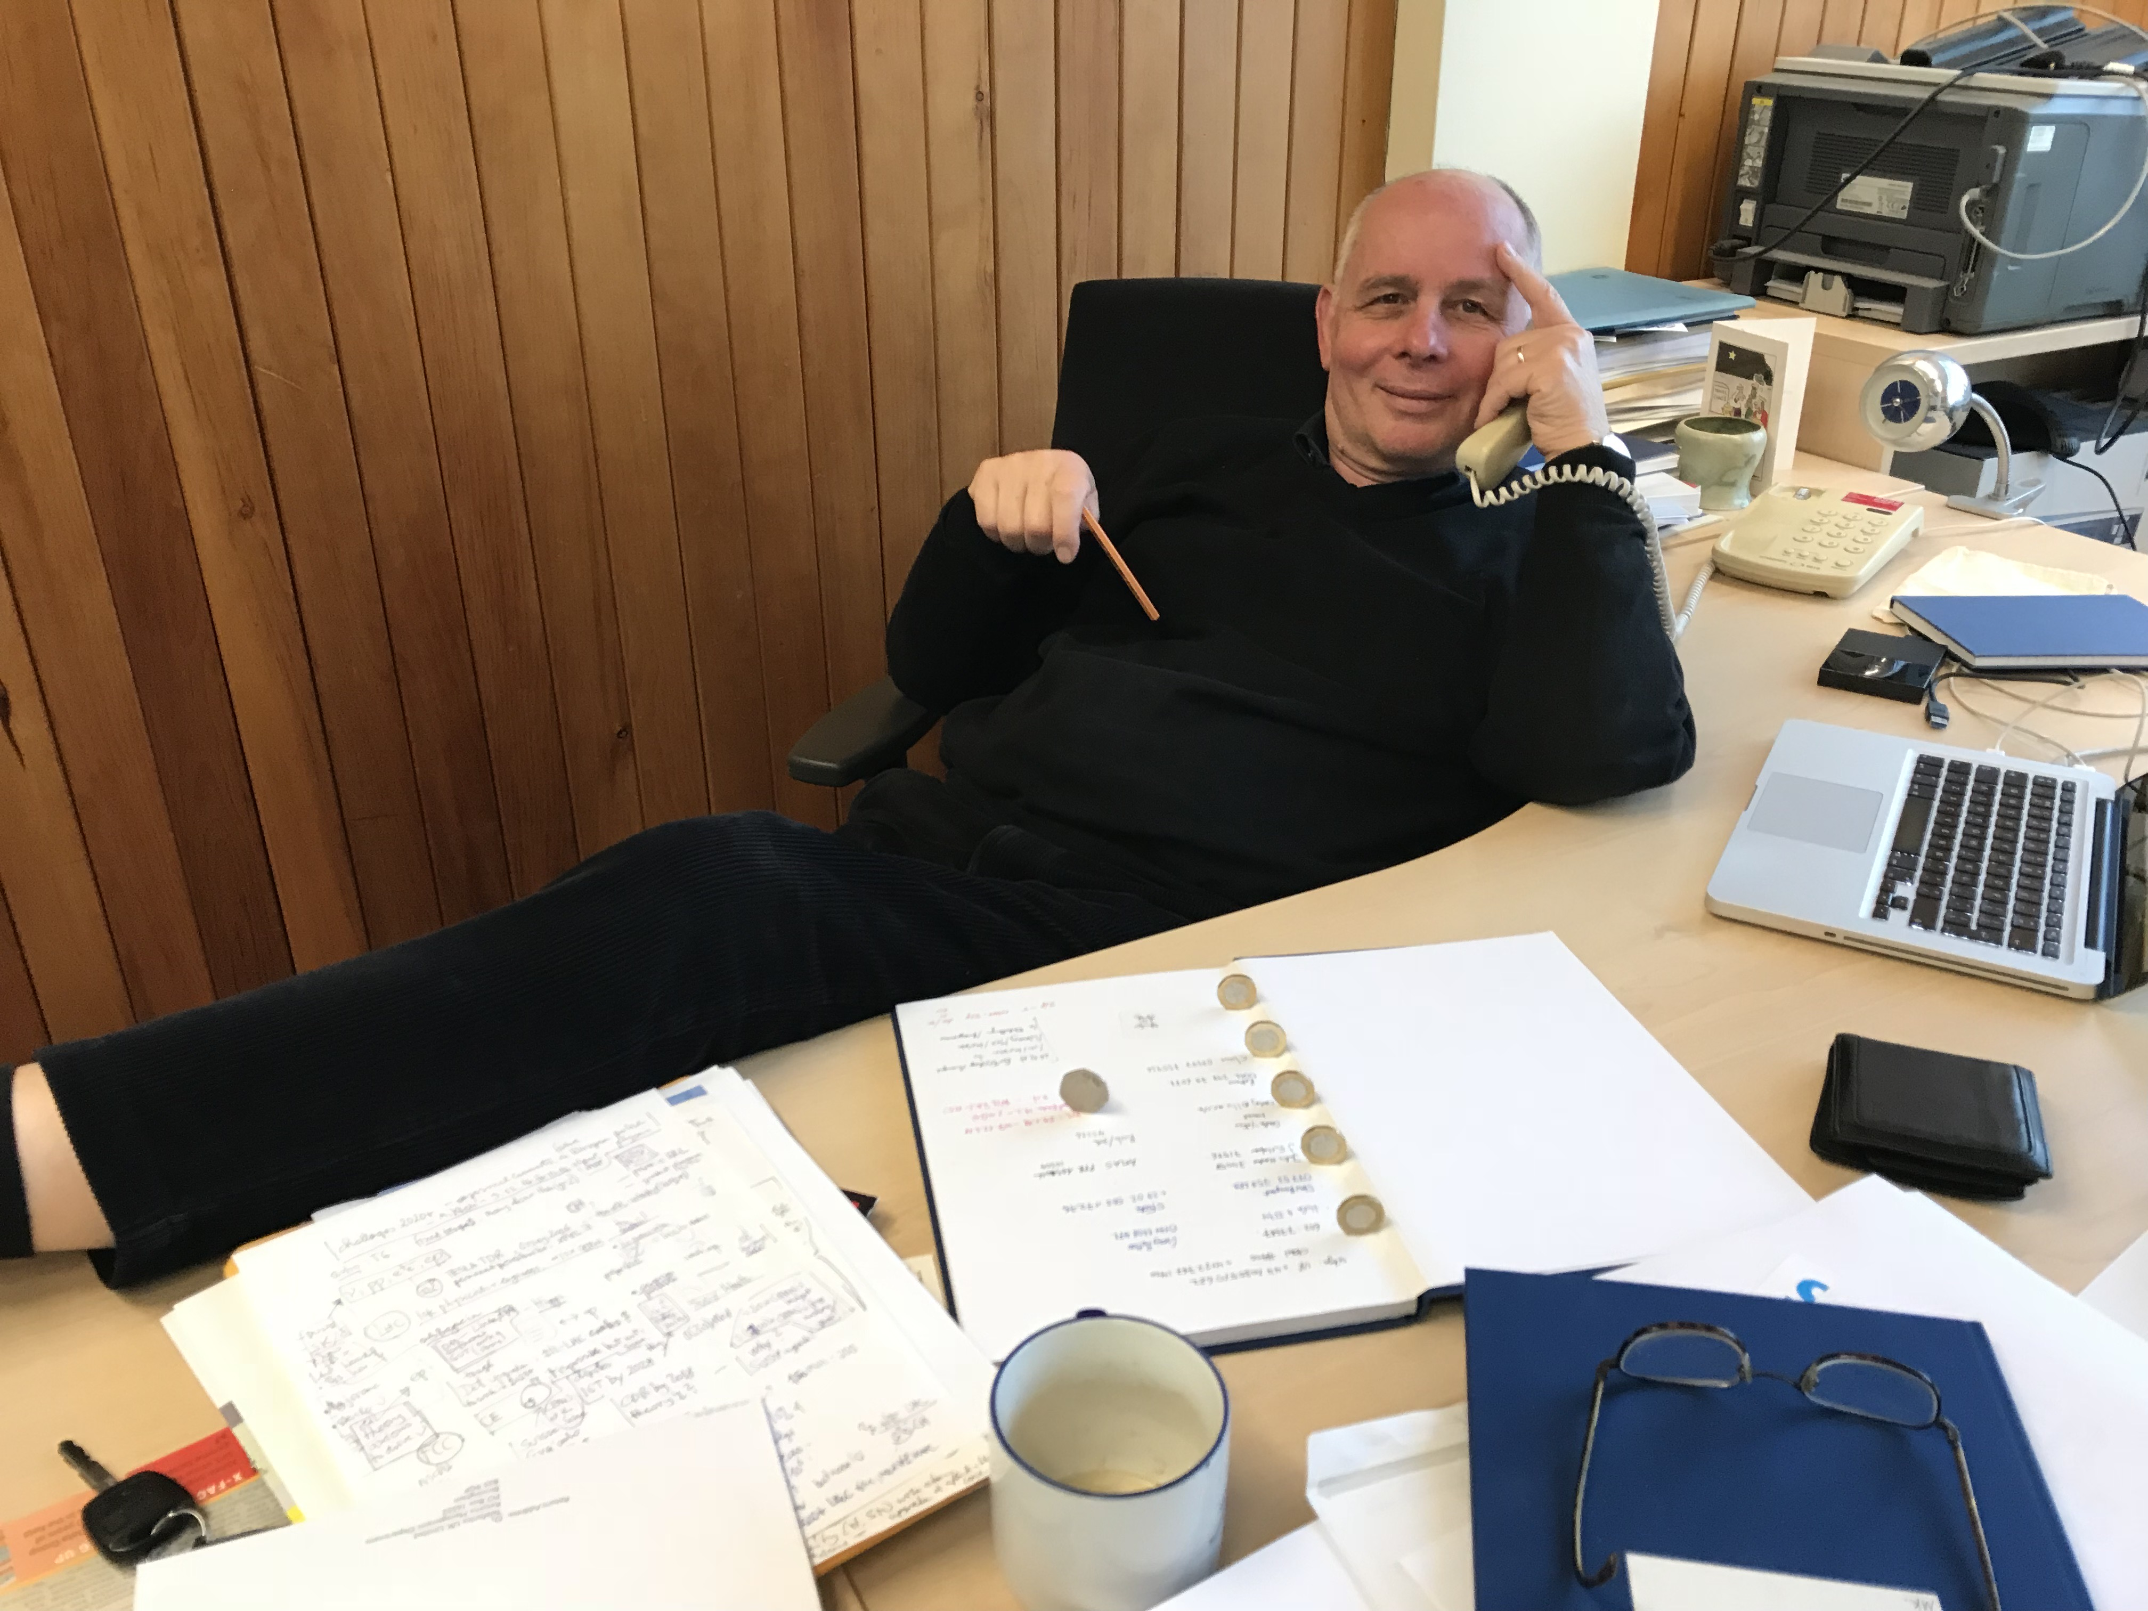
Max Klein as a person “Beyond Physics”
Engagement in “Vereinigung Deutscher Wissenschaftler”
(to reflect on the new responsibility physicists carried in the nuclear age
nuclear age)
Dedication and preseverance in following ideas
– in particular those of your favoured collider –
Deeply concerned, driven by what is possible, rather than dreams
Wealth of stories and wisdom about physics, life and humanity
Science without boarders

Slide 14
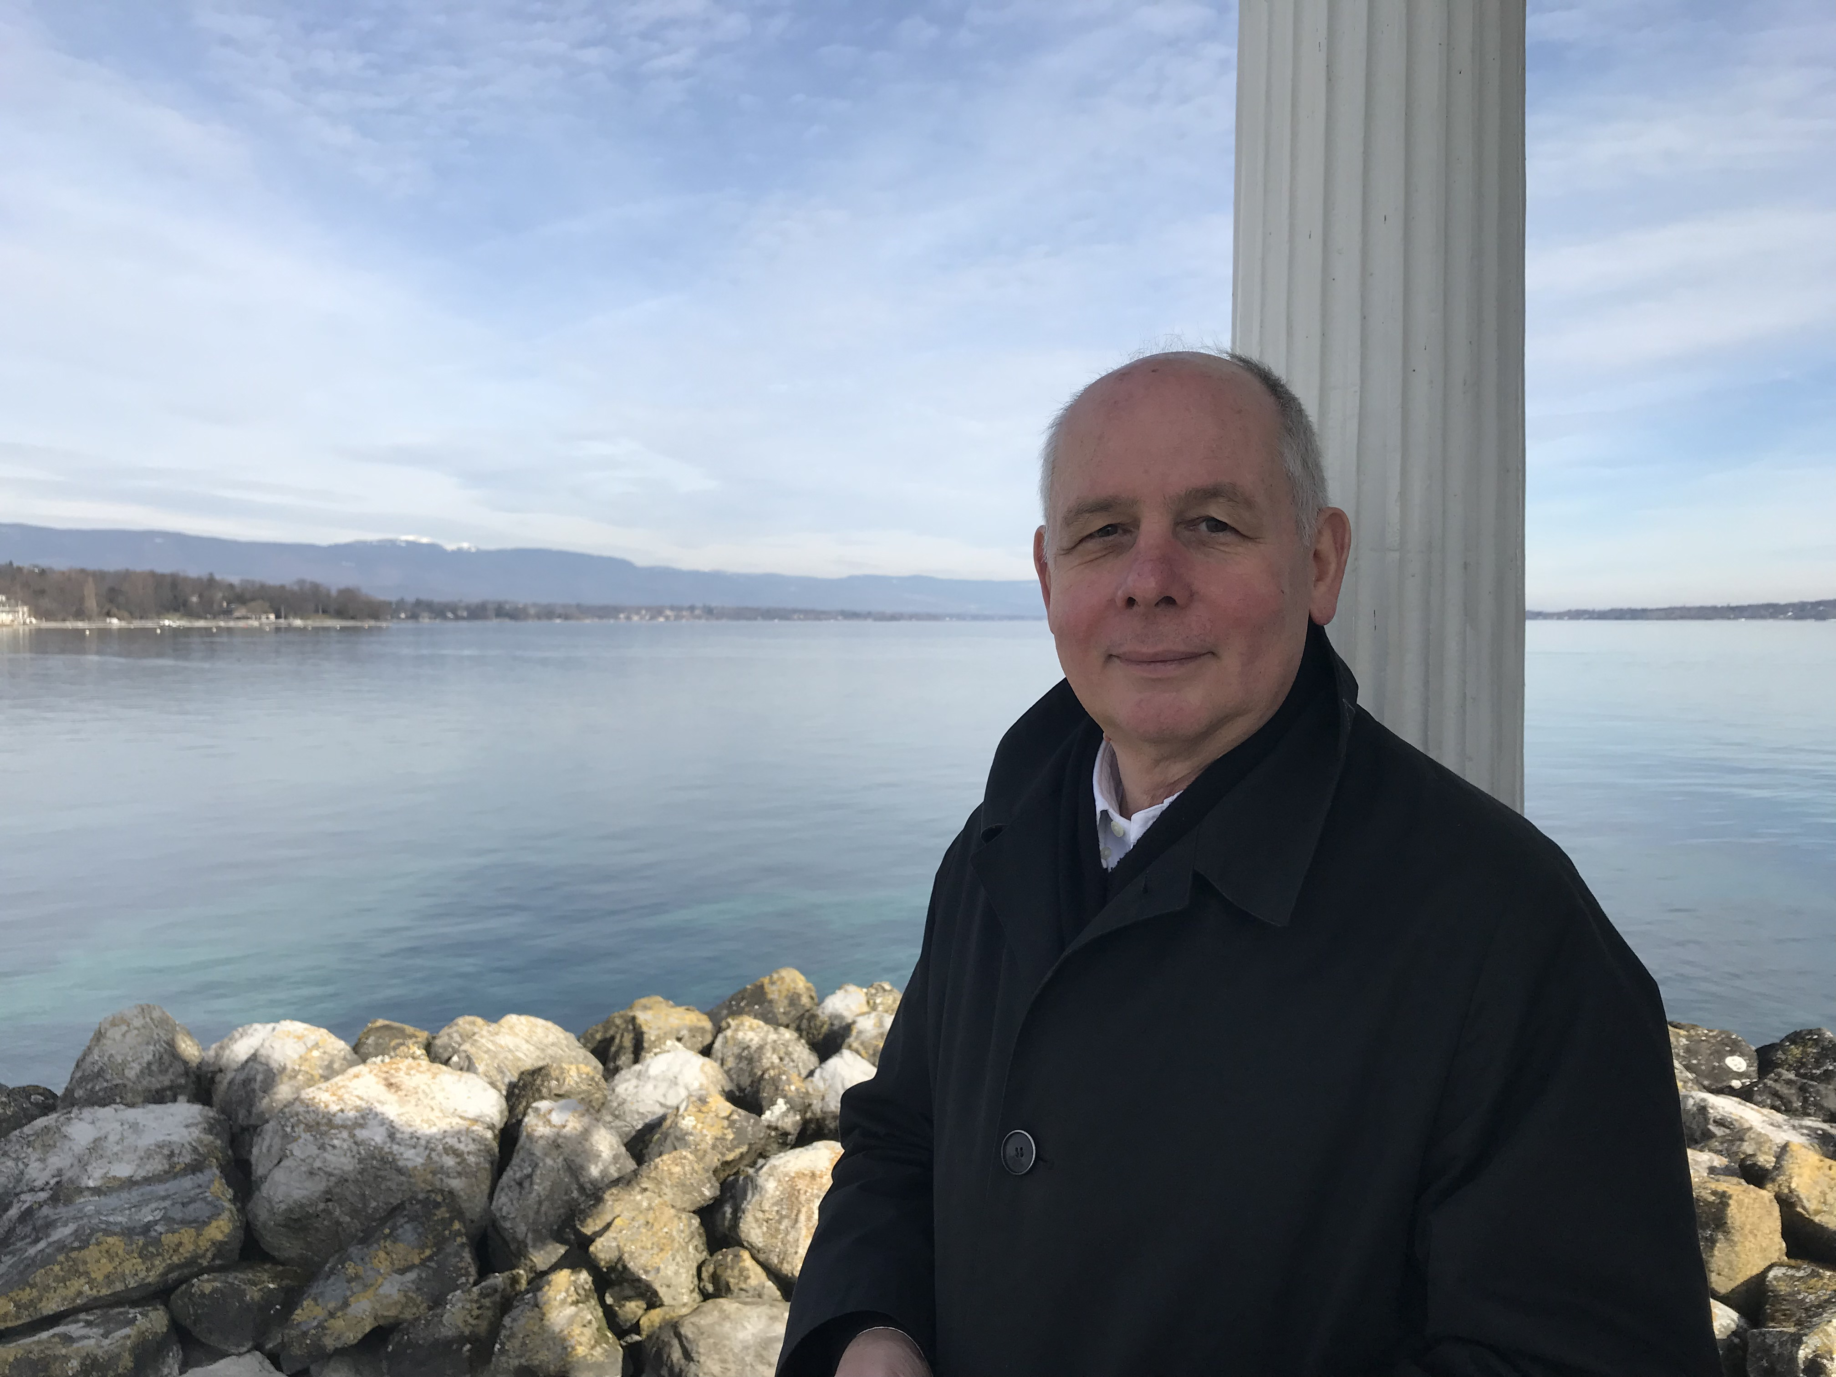
Max and ECFA
One of the oldest members (primitive rock) of ECFA
(since 2011)
UK representative in Restricted ECFA (since 2021)
Contributions to various panels and advisory
committees with his wisdom and his view of the
future of our field

Slide 15
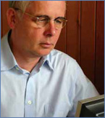
Max Born Prize for Max Klein
2012/11/15
DPG awards Max Born Prize to Max Klein
The German Physical Society (DPG) awards the Max Born Prize to Professor
Max Klein for his fundamental experimental contributions to reveal the structure of the
proton through deep inelastic scattering.
In the past 40 years, Max Klein particularly concentrated on the investigation of the inner structure of the
proton. In the 1990s, he played a decisive role in the discovery of a surprisingly large gluon component, an
element of the proton. The gluons are important in the generation of Higgs bosons; a promising candidate
of these particles was recently detected at CERN.
After first experiments in Dubna, already in the 1980s Klein joined experiments at DESY in Hamburg and
CERN. Since 1985, he is a member of the H1 collaboration at DESY’s storage ring HERA. From 2002 to
2006, Klein was head of the H1 collaboration and he guided the project into a new era of precision
measurements of the proton structure and tests of the elementary particle physics standard model. Since
2006, Klein works in England and is Chair for Particle Physics of the University of Liverpool.
During his whole career, Klein was a tireless forerunner in the field of lepton-nucleon scattering. Still
today, he plays a leading international role in the planning of a next generation scattering experiment.

Slide 16
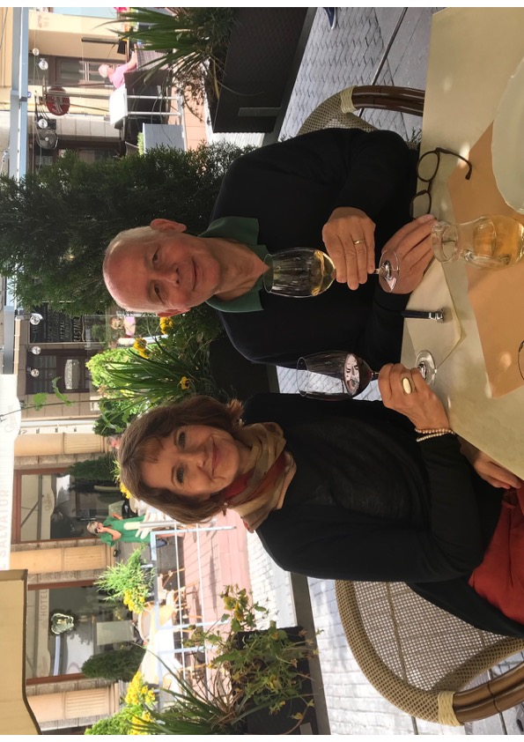
Thank you, Max!
For all your contributions
to our research field
… to ATLAS, ECFA and beyond,
and for your friendship!
And enjoy the post-ATLAS days!

Slide 17
Dear Max,
I am very sorry that it was not possible for me to attend your 50-years-of-particle-physics Fest in person. Talks and speeches will recall the wealth of your contributions to our field, ATLAS will be covered by Karl, so I would here only want to address a few personal words to you.
Yesterday, I was looking again at pictures I took in 2019 during the ATLAS Week of a place so deeply filled with history, history with a capital H as well as personal, anecdotal history: Rosa-Luxemburg Platz, Volksbühne, Karl-Liebknecht-Haus, the Babylon cinema — in Berlin — your city. Every grateful hour I spent with you during the last years were a relish for me, I consumed your inexhaustible wealth of stories about physics, life and humanity.
With your experience, as a border crosser between East and West, you had to learn early to advocate and stand firm to make your ideas heard. You always cared. You engaged in the Federation of German Scientists (Vereinigung Deutscher Wissenschaftler) founded end of the 1950s by Carl Friedrich von Weizsäcker, Otto Hahn and Max Born to reflect on the new responsibility physicists carried in the nuclear age.
With indefatigable dedication and perseverance you champion your ideas, in particular those on your favorite colliders, never loosing the big picture of things out of sight. You are deeply concerned about what is possible, realism prevails over dreams. Progress in physics is made in small well-controlled steps, deepening our understanding with every one of these towards and beyond the beauty of the artwork we have constructed altogether and through generations: the Standard Model. A triumph of depth and patience over cursoriness and fashion, the precedence of dialogue over confrontation, up to the recent past. I wish you a wonderful fest, joy and health.
With my admiration and friendship, yours Andreas.

