Slide 1
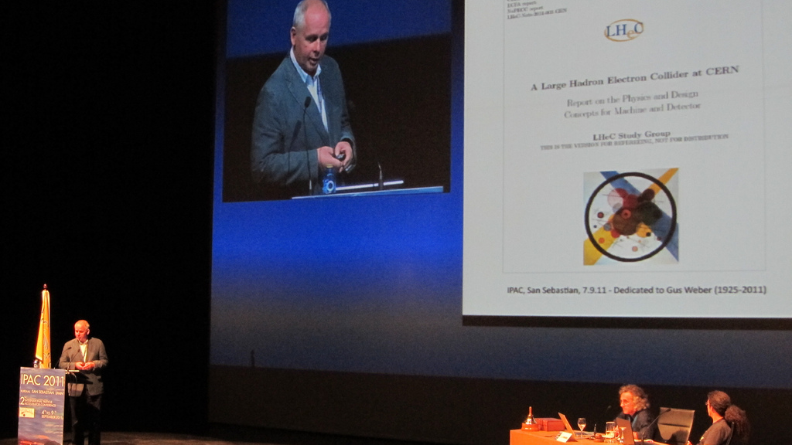

Slide 2
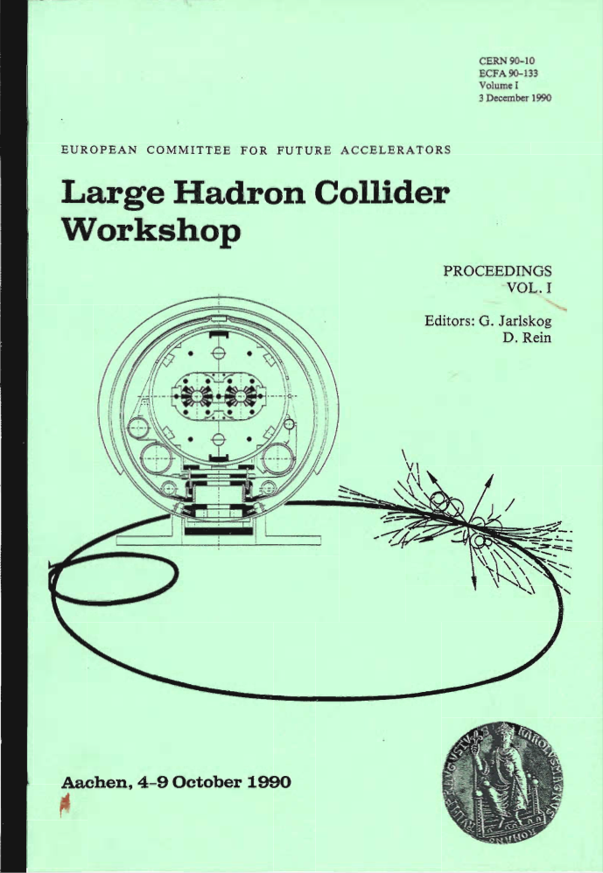
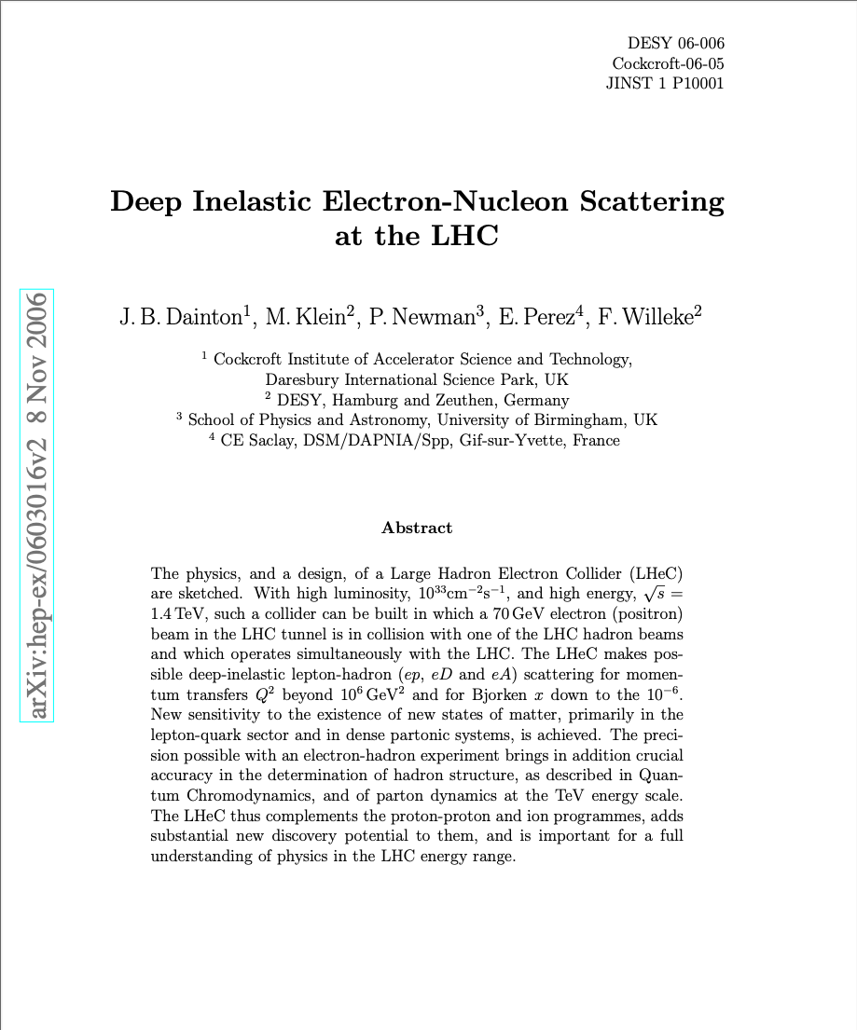
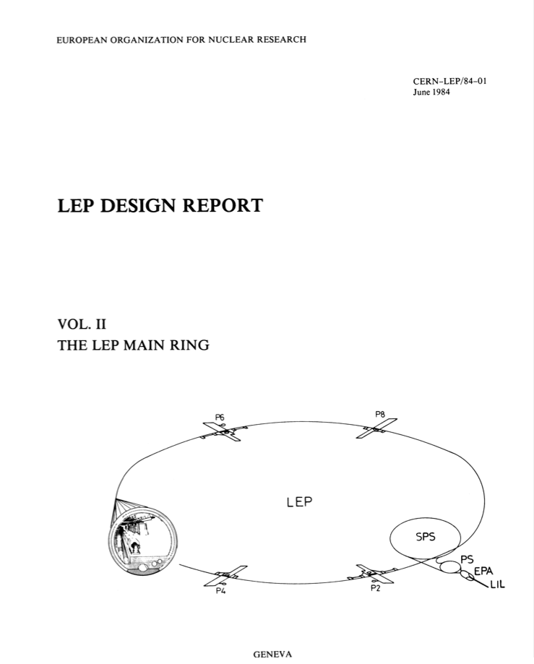
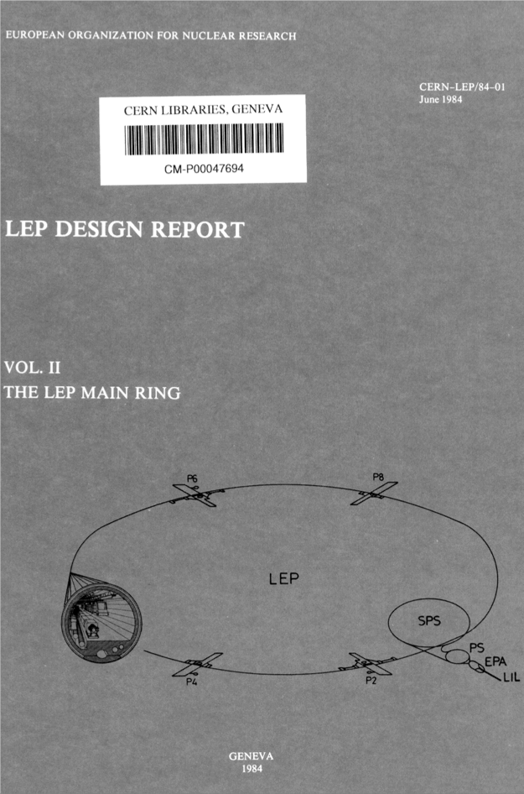
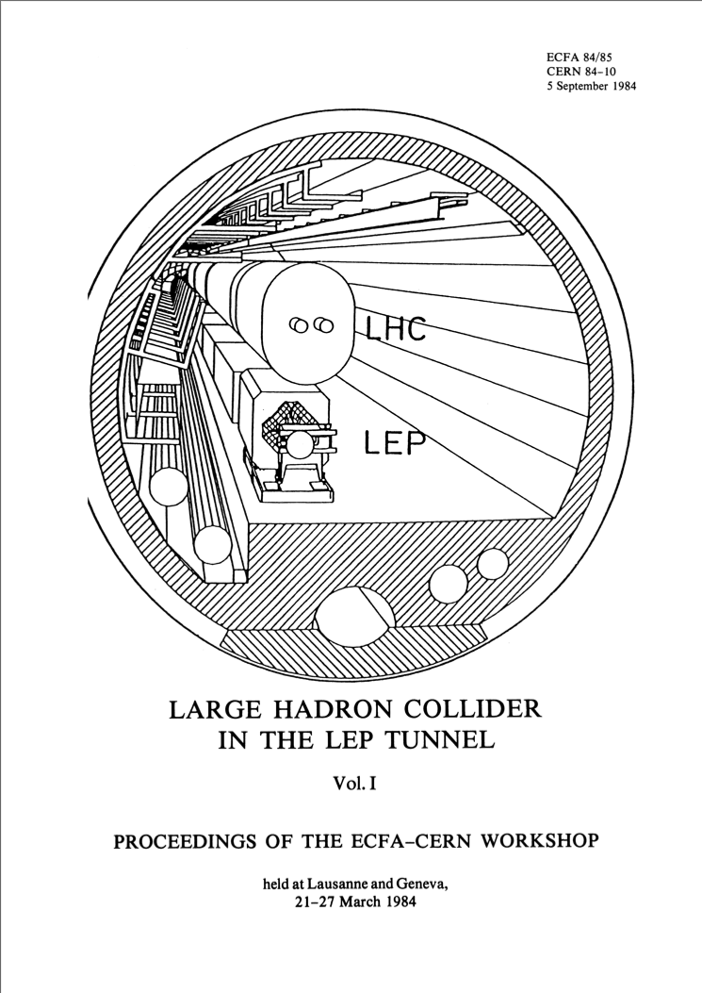
LHeC: e-p Option was already Considered from the Start of LEP
LEP
Design
Report
1984
Lausanne
ECFA-CERN
Workshop
1984
This is where Steve Myers introduced me to Max and John Dainton over a very nice lunch at the Auberge Communale in Meyrin in Summer 2007
Steve’s boundary Condition:
The proposed collider must fit into the existing power infrastructure of CERN ➔ 100MW power limit
➔ L = 10³²cm⁻²s⁻¹
➔ L = 10³³cm⁻²s⁻¹
Notes:
With the mandate to help preparing an update on the ep option for the LHC

Slide 3

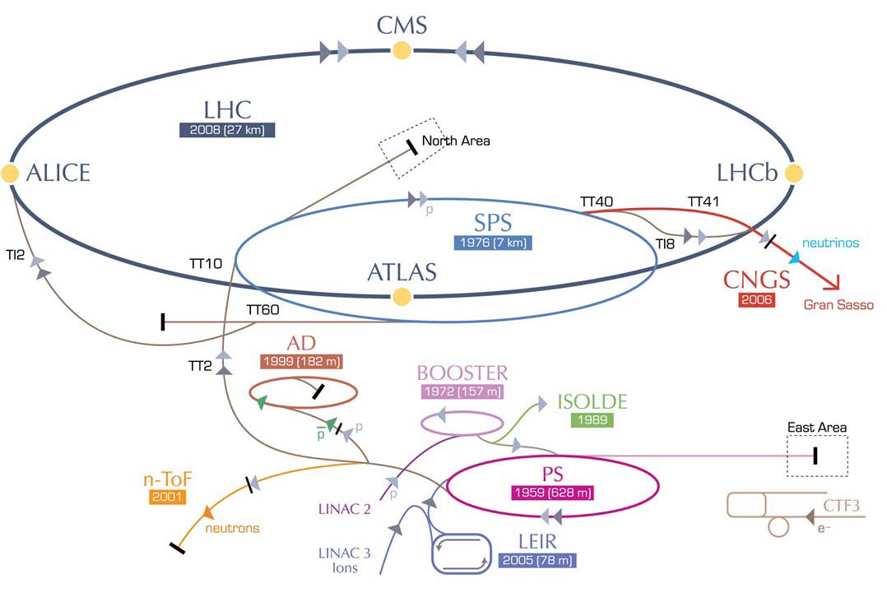
LHeC options: RR and LR
RR LHeC:
new ring in
LHC tunnel,
with bypasses
around
existing
experiments
RR LHeC
e-/e+ injector
10 GeV,
10 min. filling time
LR LHeC:
recirculating
linac with
energy
recovery,
or straight
linac

Slide 4
LHeC Proposal endorsed by ECFA (30.11.2007)
As an add-on to the LHC, the LHeC delivers in excess of 1 TeV to the electron-quark cms system. It accesses high parton densities ‘beyond’ what is expected to be the unitarity limit. Its physics is thus fundamental and deserves to be further worked out, also with respect to the findings at the LHC and the final results of the Tevatron and of HERA.
First considerations of a ring-ring and a linac-ring accelerator layout lead to an unprecedented combination of energy and luminosity in lepton-hadron physics, exploiting the latest developments in accelerator and detector technology.
It is thus proposed to hold two workshops (2008 and 2009), under the auspices of ECFA and CERN, with the goal of having a Conceptual Design Report on the accelerator, the experiment and the physics. A Technical Design report will then follow if appropriate.
Unanimously supported by rECFA and ECFA plenary in November 2007

Slide 5
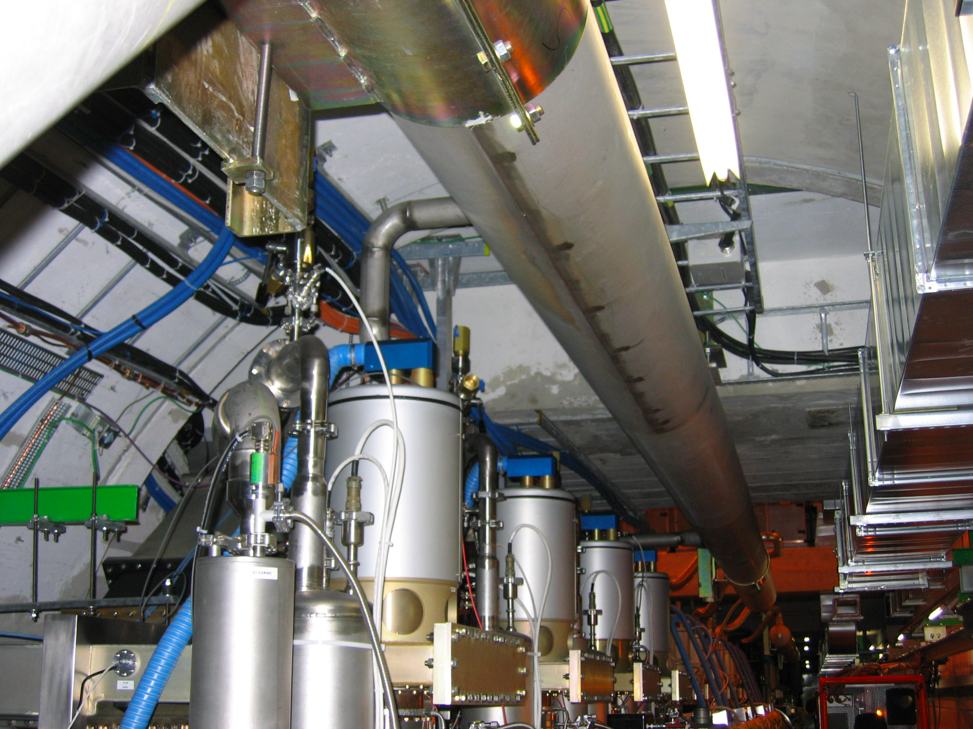
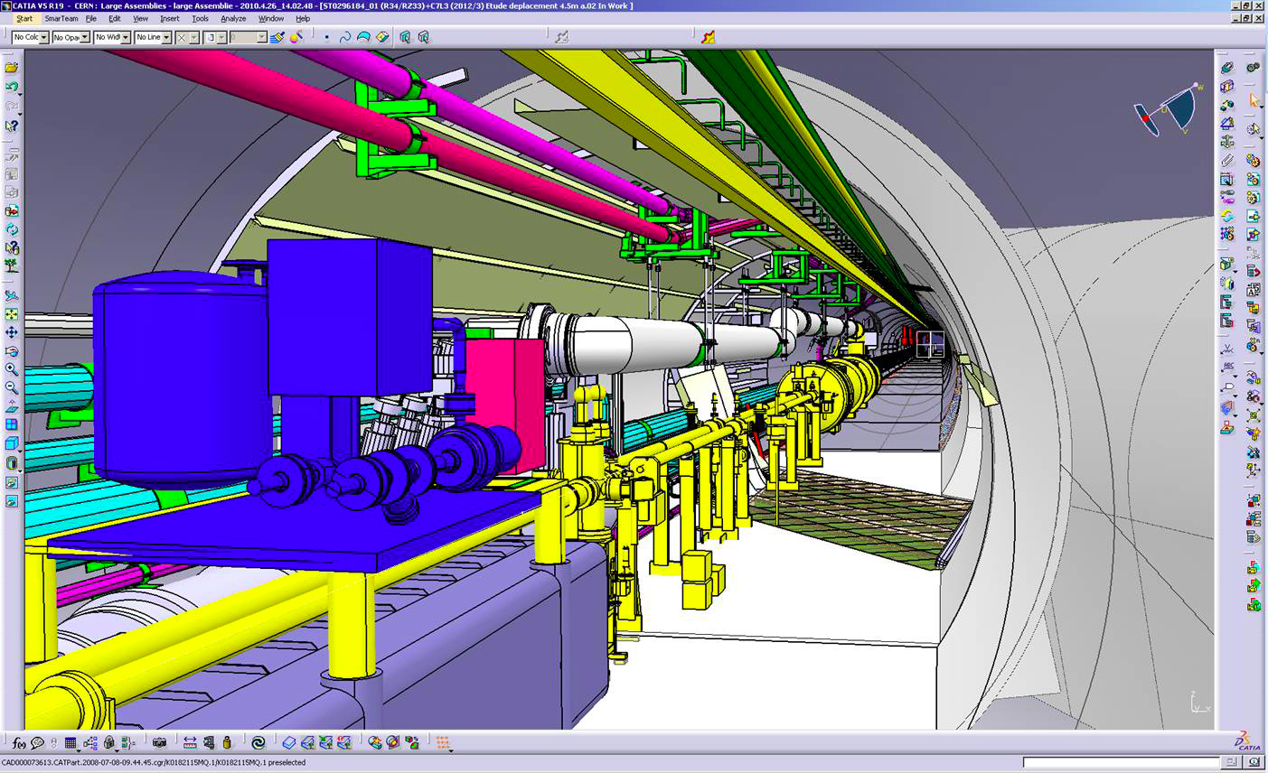
1st Workshop @ Divonne: Ring-Ring Option
Challenge: Integration in the LHC tunnel
RF Installation in IR4
We judged in the end the constraints and limitations implied by a Ring-Ring implementations as to too restrictive
➔ Linac-Ring Option chosen as the baseline configuration
Many Obstacles and interferences with existing LHC machine!
Cryo link in IR3

Slide 6
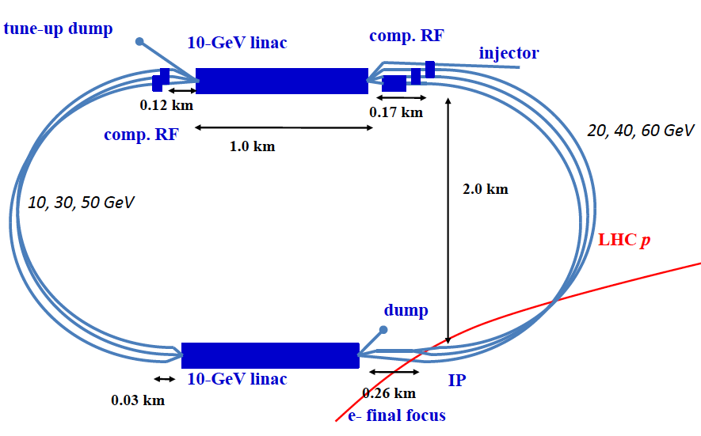
LHeC Linac-Ring Option: Power & Cost considerations
2 Super Conducting Linacs with Energy Recover & high current (> 6mA)
Two 1 km long SC
linacs in CW operation (Q₀ > 10¹⁰)
requires Cryogenic system
comparable to LHC system!
ca. 9km underground tunnel
infrastructure [SPS size]
Installation fully decoupled from LHC operation!
Efficient Concept
re-circulation implies cost effective use of the SRF investment
ERL implies efficient operation and higher performance reach

Slide 7
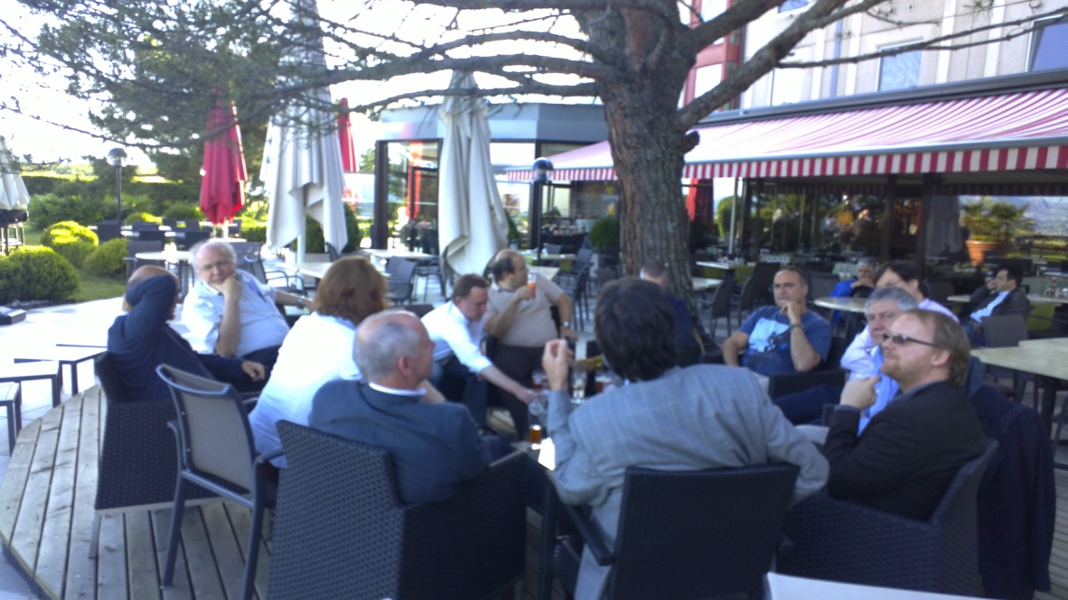
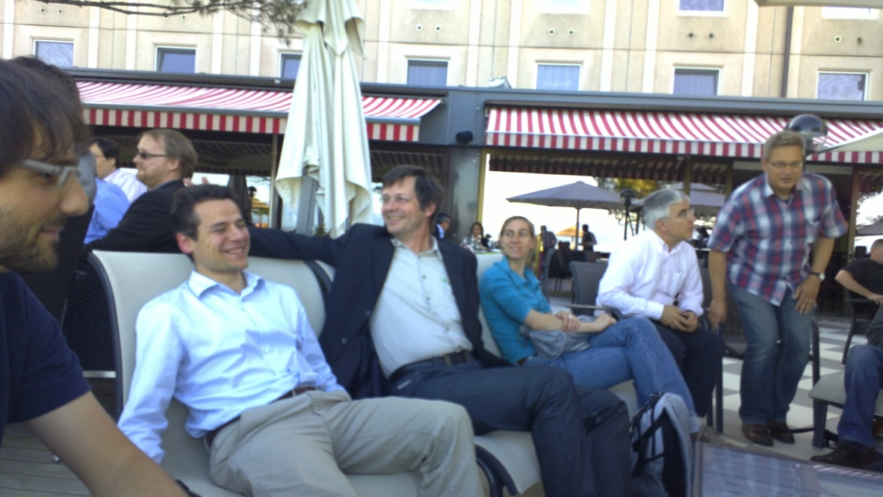
Developing and the ERL solution:
Chavannes de Bogies Workshop in 2010
Shaping of a highly motivated
and enthusiastic team around the LHeC!
Notes:
First workshop in Chavannes de Bogies in 2010

Slide 8
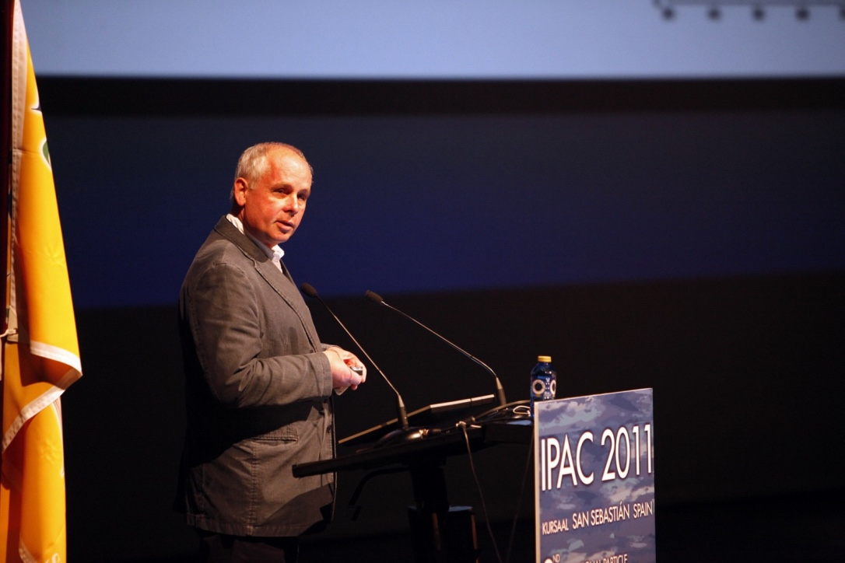
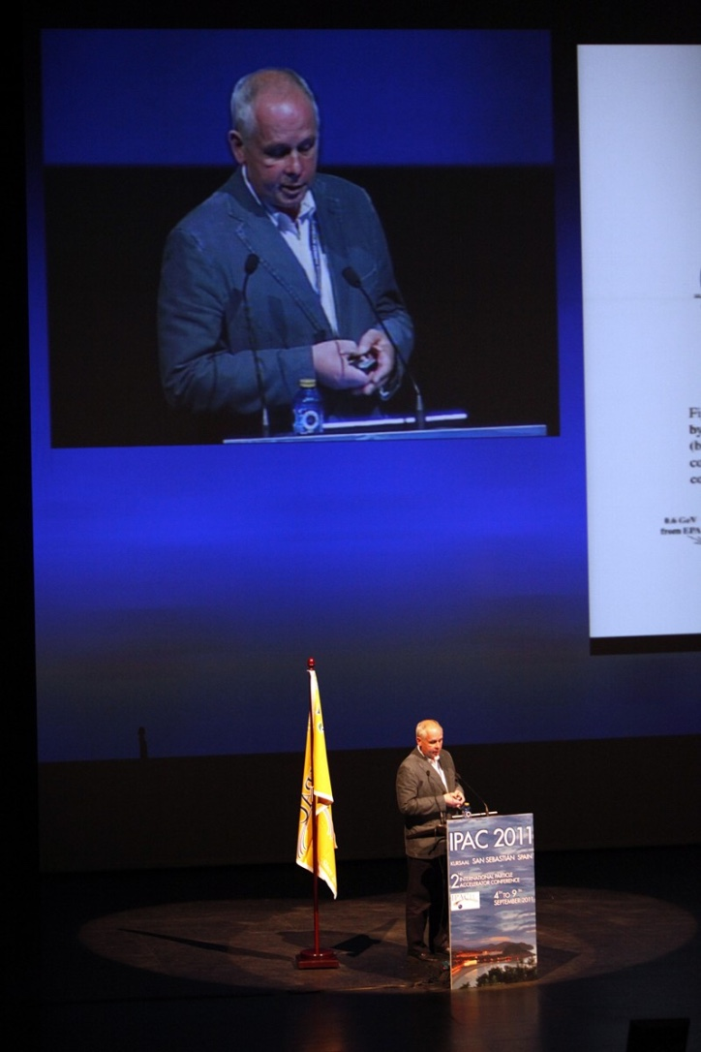
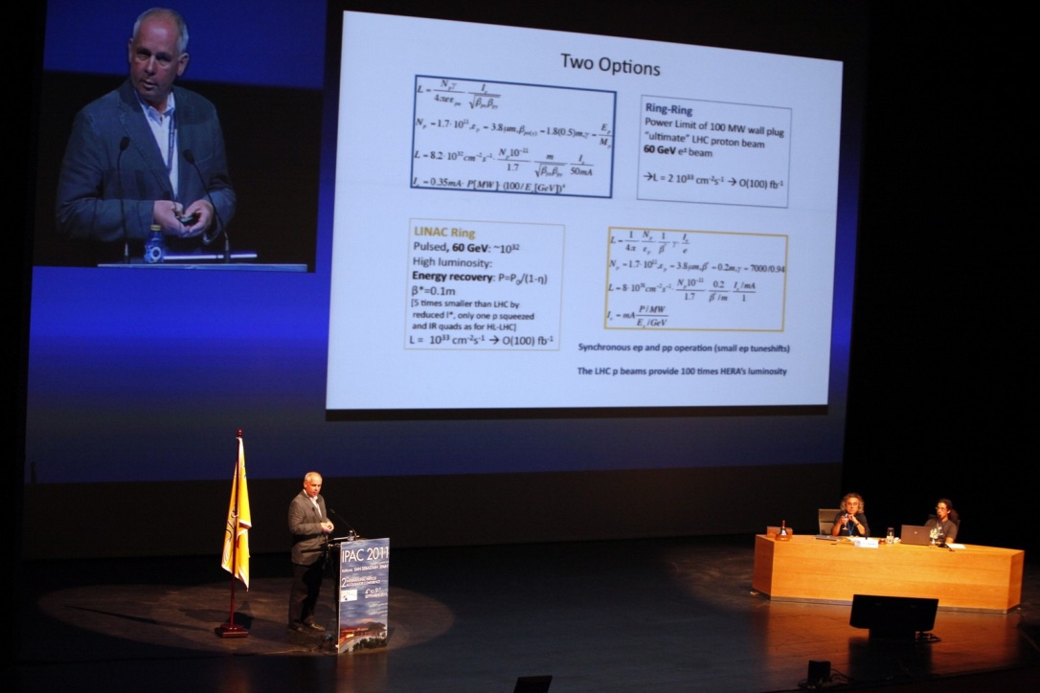
Presenting the LHeC Linac-Ring Option to the
International Community
Given Max’s past engagement for THERA, the LR Options was probably anyway an obvious choice

Slide 9
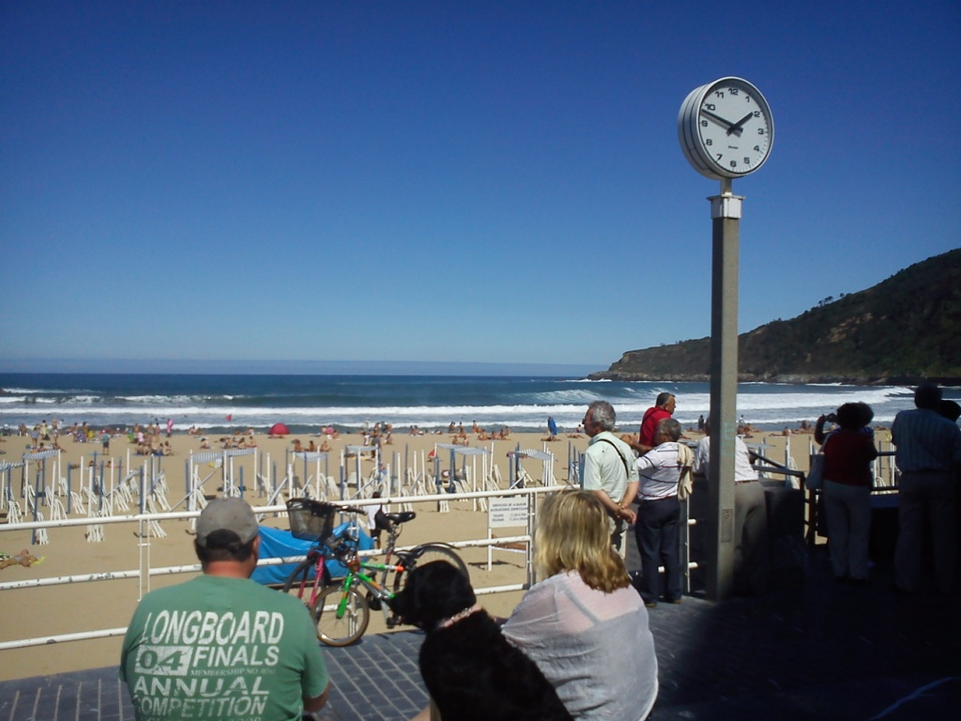
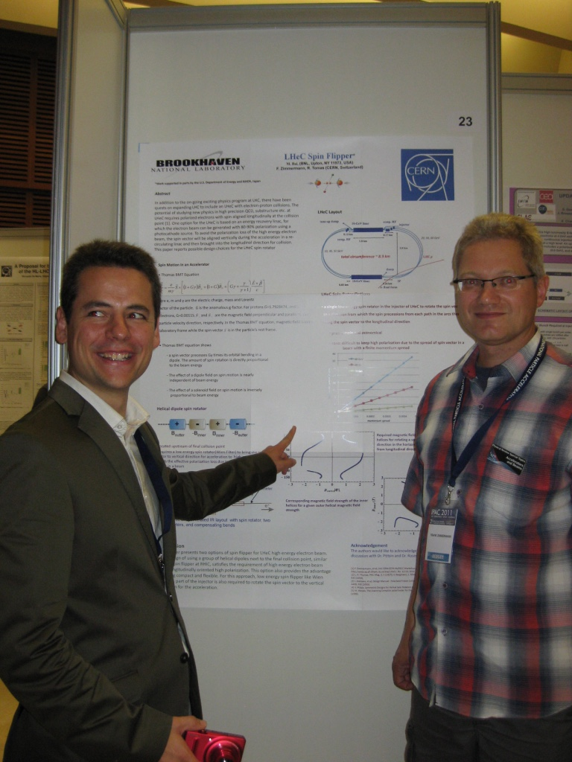
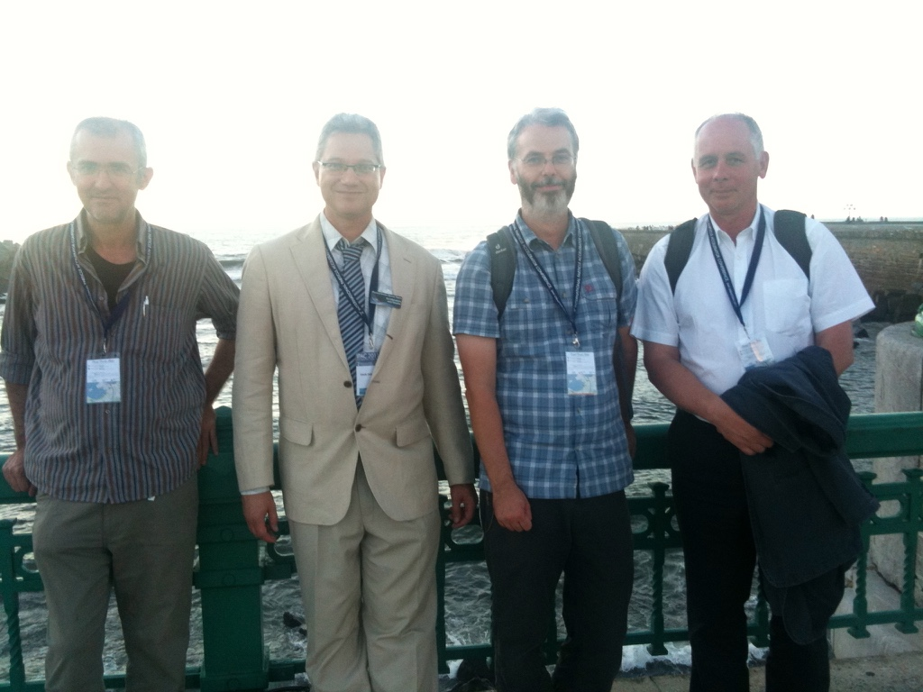
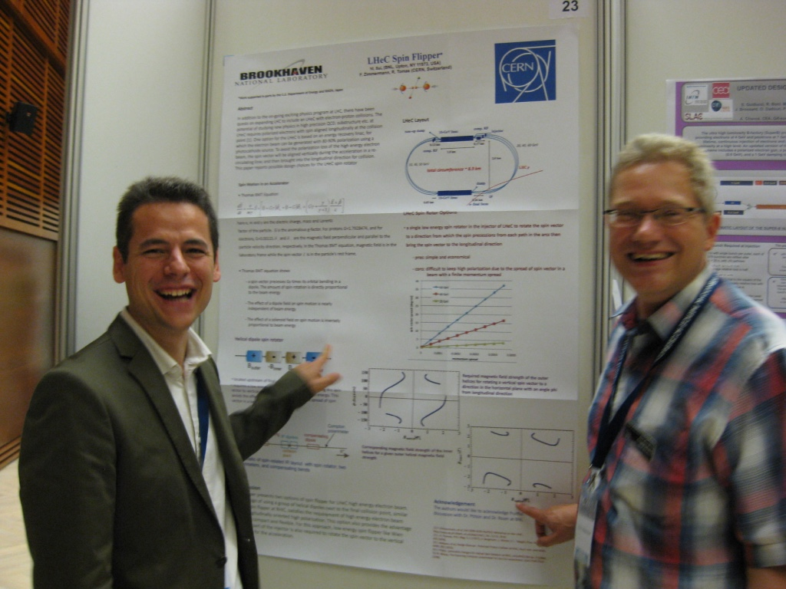
Max’s was not alone at IPAC but got the support from a highly enthusiastic team
Notes:
Max was not alone in IPAC but got the support from a broader team

Slide 10





















LHeC - Participating Institutes: A very rich collaboration
TOBB ETU
KEK

Slide 11
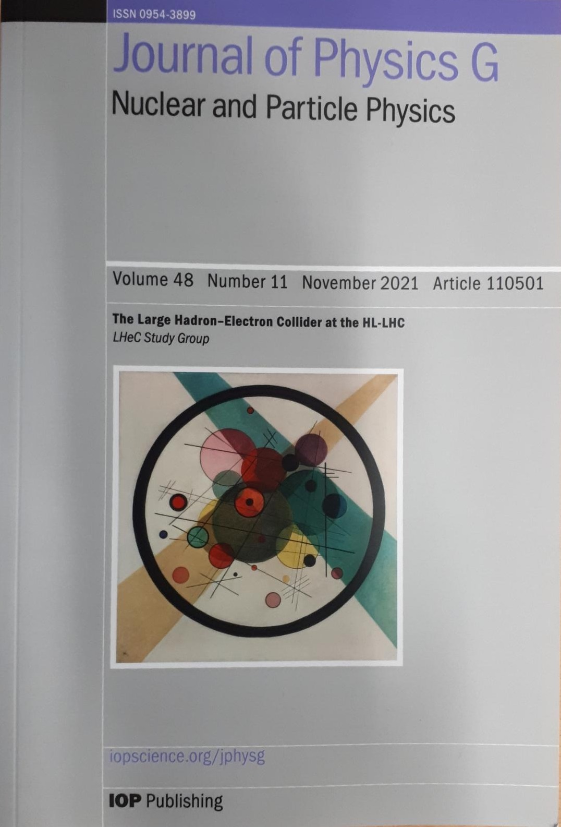
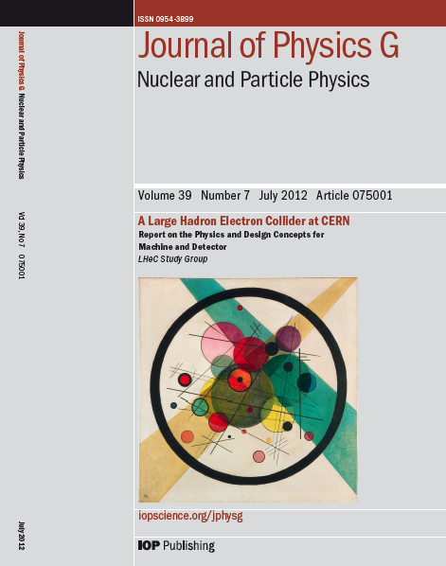
Documenting the LHeC Concept: CDRs
CDR Study assumptions:
-Assume parallel operation to HL-LHC / FCC-hh
-TeV Scale collision energy
➔ 50-150 GeV Beam Energy
-Limit power consumption to 100 MW
➔ (beam & SR power < 70 MW)
➔ 60 GeV beam energy
-Peak Luminosity > 10³³ cm⁻²s⁻¹
Higgs @ 125GeV
➔ 150MW
➔ 50GeV
➔ 1000 * HERA
➔ L > 10³⁴ cm⁻²s⁻¹
& Cost Study

Slide 12
CERN Mandate: 5 main points
The mandate for the technology development includes studies and prototyping of the following key technical components:
Superconducting RF system for CW operation in an Energy Recovery Linac (high Q₀ for efficient energy recovery)
Superconducting magnet development of the insertion regions of the LHeC with three beams. The studies require the design and construction of short magnet models
Studies related to the experimental beam pipes with large beam acceptance in a high synchrotron radiation environment
The design and specification of an ERL test facility for the LHeC.
The finalization of the ERL design for the LHeC including a finalization of the optics design, beam dynamics studies and identificationof potential performance limitations
The above technological developments require close collaboration between the relevant technical groups at CERN and external collaborators.
Given the rather tight personnel resource conditions at CERN the above studies should exploit where possible synergies with existing CERN studies.
S.Bertolucci at Chavannes workshop 6/12 based on
CERN directorate’s decision to include LHeC in the MTP

Slide 13
Superconducting RF Studies
Choice of the SC RF frequency:
-HL-LHC bunch spacing requires bunch spacing with multiples of
25ns (40.079 MHz)
Decided to redesign from scratch:
Chose a frequency of 802MHz as optimum from power considerations and beam stability considerations
➔ Later: Synergy with FCC-ee SRF developments!
Frequency choice: h * n* 40.079 MHz
Symmetry in ERL: n=3 ➔ h * 120.237 MHz
h=6: 721 MHz or h=11: 1.323GHz
SPL & ESS: 704.42 MHz; ILC & XFEL: 1.3 GHz
Frequencies are slightly different (20MHz) from existing technologies!
➔ Can not directly profit from ILC / TESLA and ESS developments

Slide 14
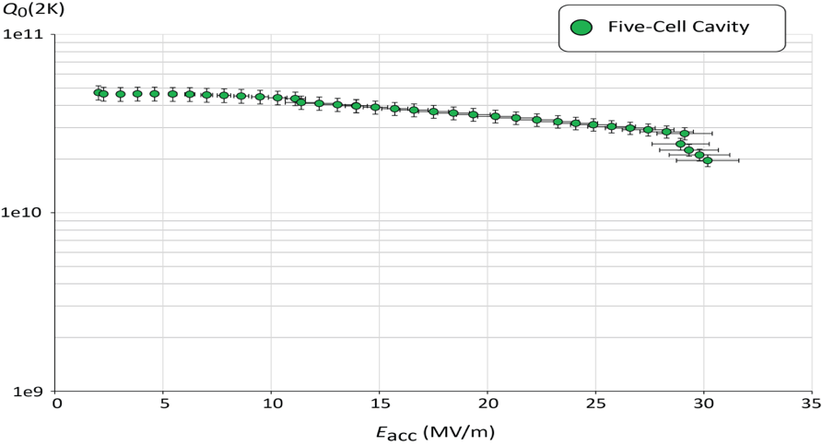
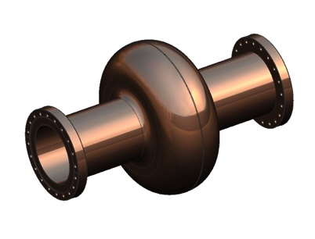
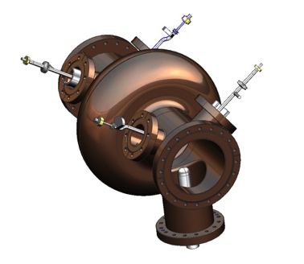
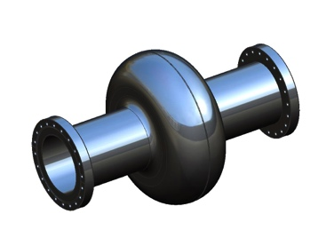
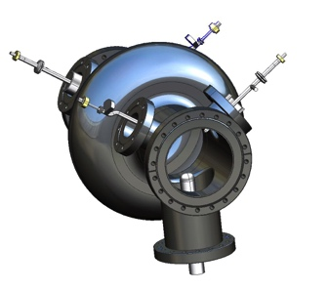
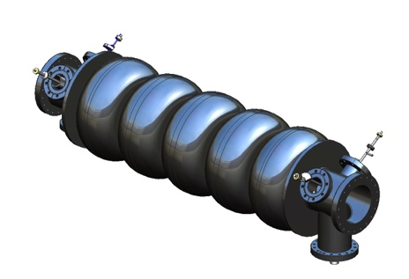
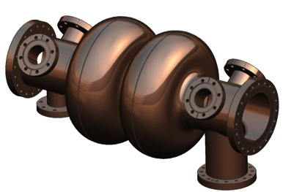
Superconducting RF Studies: 802 MHz 5-Cell Cavity
JLAB / CERN
collaboration
1st Cavity Prototype for PERLE/LHeC and FCC-ee/eh
F. Marhauser Feb 2018
Q₀ (2k) = 3 e10 @ ~27 MV/m
Very encouraging SRF results that still offer headroom for improved performance!!!
LHeC can be done with state-of-the-art SRF!
✔
?
Quench @ E_{acc} ~ 30 MV/m
✔
?
LHeC minimum requirements
✔
?
✔ = done, ? = option

Slide 15
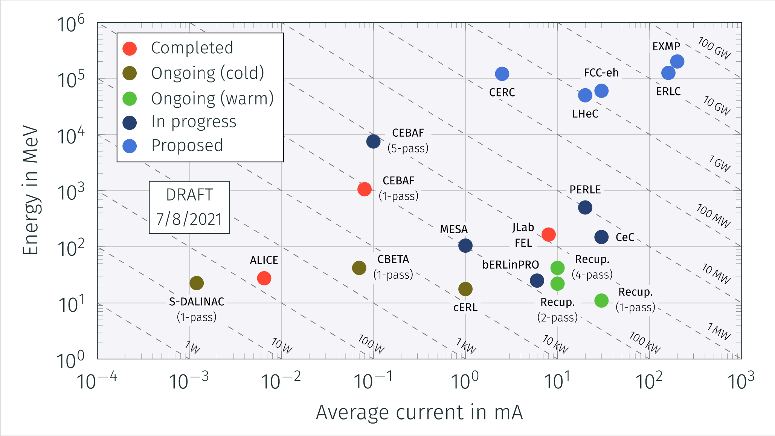
Advancing the ERL Concept
Need to demonstrate scalability!

Slide 16
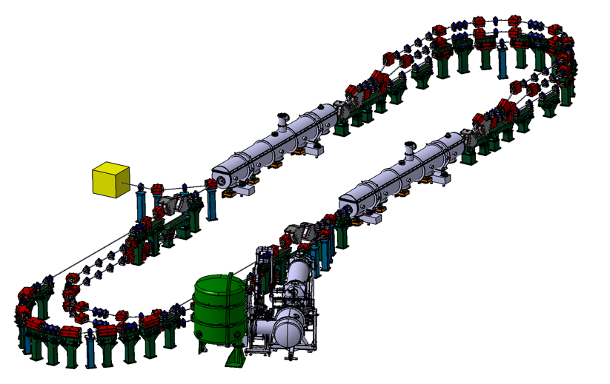
ERL Demonstrator / Test Facility
PERLE: A testbed to explore and validate a broad range of accelerator phenomena & technical choices on the pathway to the LHeC and other new frontier machines realisation.
Main challenges: Multi-turn, high bunch charge, high power energy recovery, …
2 Linacs (Four 5-Cell 801.58 MHz SC cavities)
3 turns (164 MeV/turn)
Max. beam energy 500 MeV
I = 20mA
Target Parameter | Unit | Value
Injection energy | MeV | 7
Electron beam energy | MeV | 500
Normalised Emittance γε_{x,y} | mm mrad | 6
Average beam current | mA | 20
Bunch charge | pC | 500
Bunch length | mm | 3
Bunch spacing | ns | 25
RF frequency | MHz | 801.58
Duty factor |  | CW
Walid Kaabi @ Electrons for the LHC workshop in Orsay in 2022

Slide 17
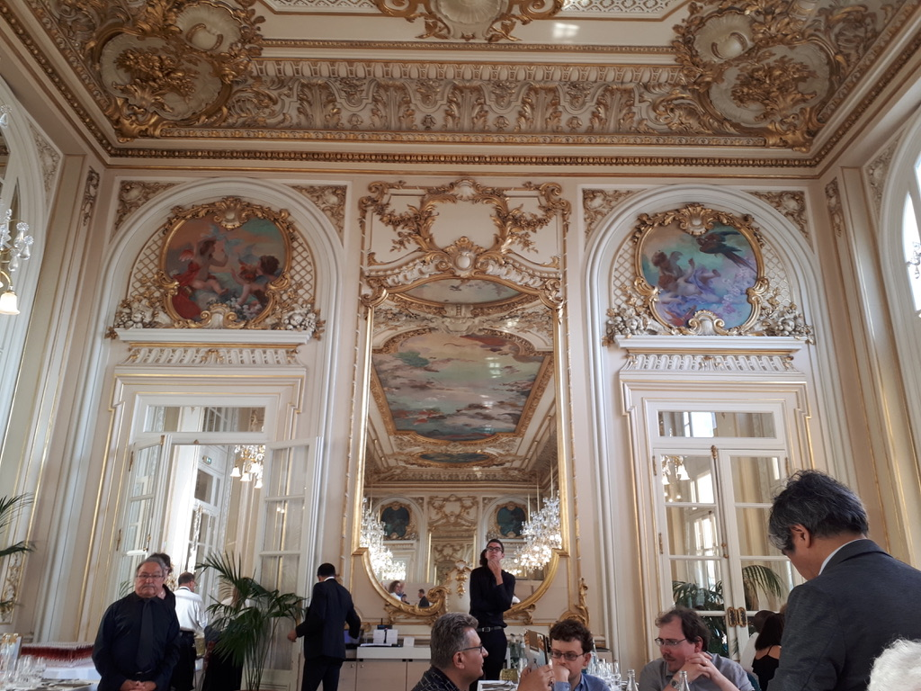
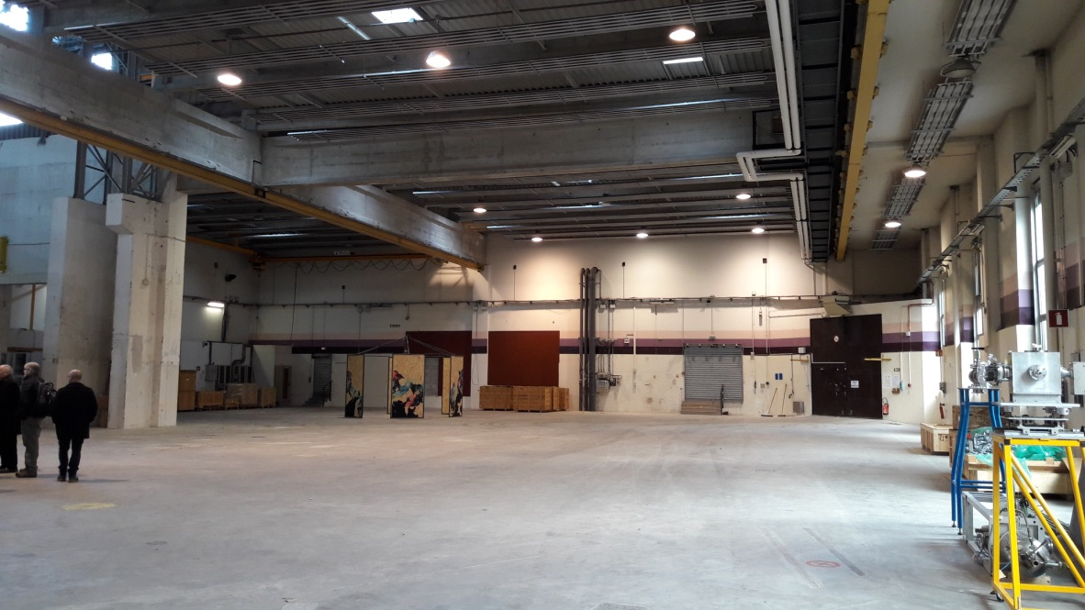
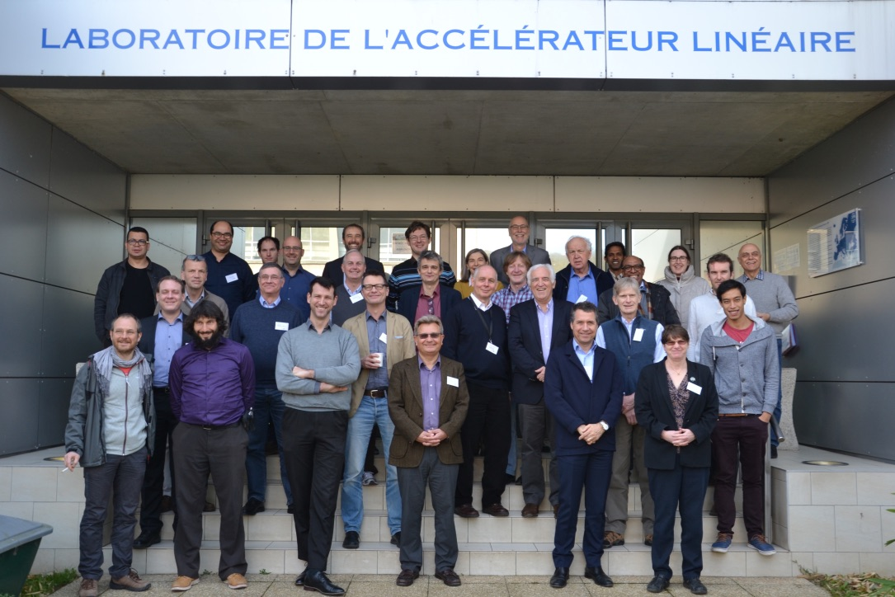
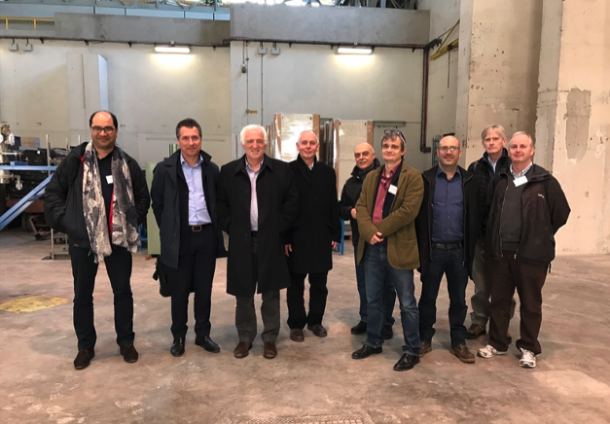
LHeC / PERLE Workshop @ Orsay in 2018
Notes:
LHeC / PERLE Workshop @ Orsay in 2018

Slide 18
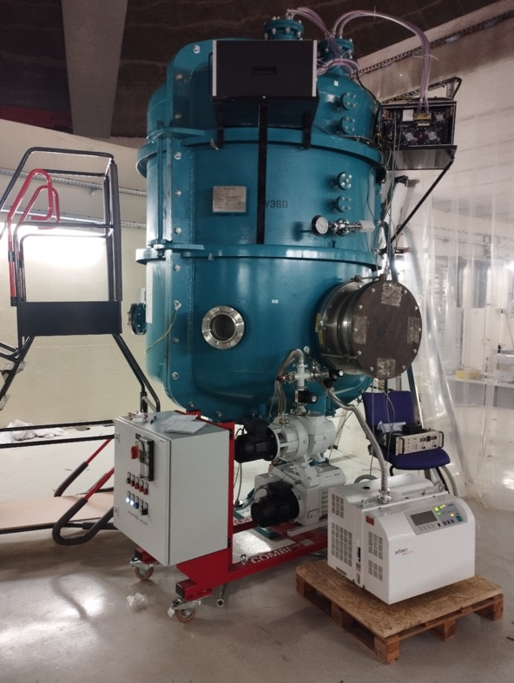
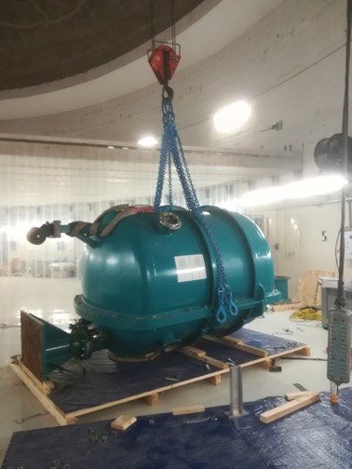
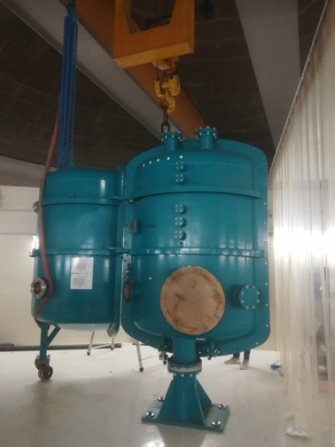
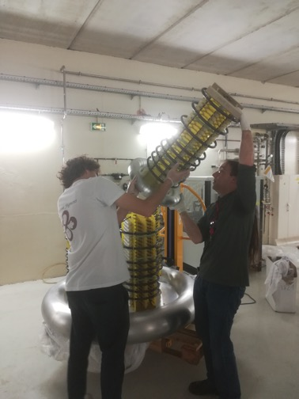
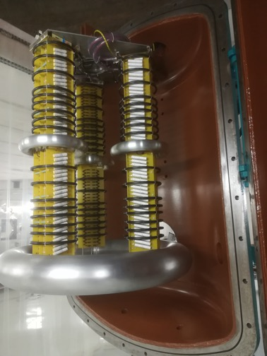
PERLE e- Source
HV vessel installation
(June 22)
HV power supply assembly
(July 22)
Checking the HV vessel tightness
(September 22)
Walid Kaabi at ERL 2022 Workshop in Cornel University

Slide 19
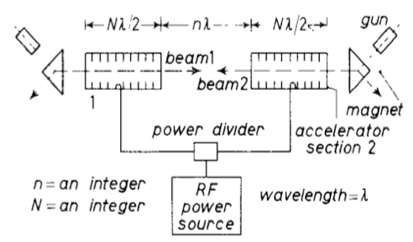
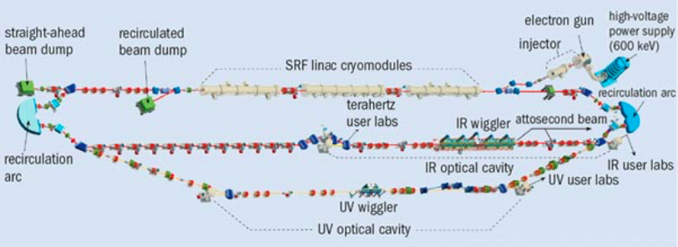
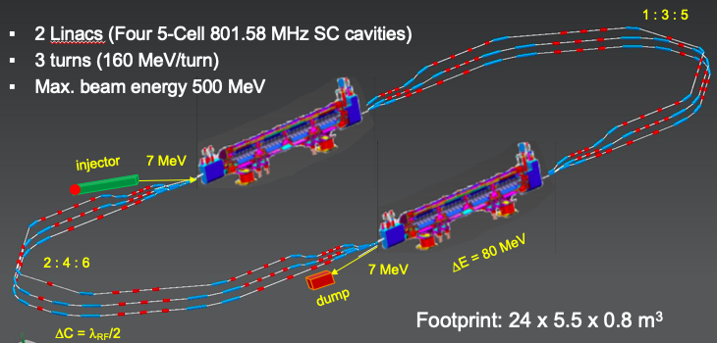
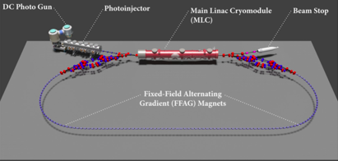
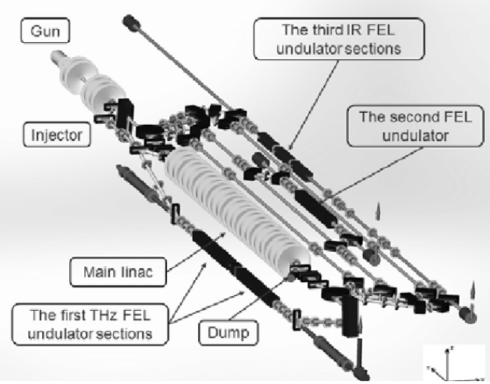
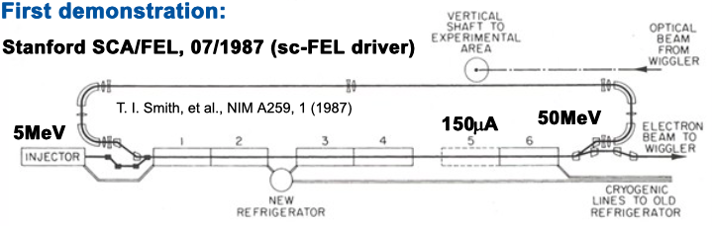
ERL Evolution:
First Idea:
M. Tigner 1965
JLab First MW beam power operation
FEL Demo [1999] & Upgrade [2000]
Multi-turn SRF
C-Beta 2019-2020
Multi-turn SRF, multi-MW
PERLE@Orsay 2025
PERLE is now part of the ERL Roadmap for Accelerator R&D!
ALICE
JEARI ERL
1960
1970
1980
1990
2000
2010
2020
2030
2040
First Demonstration
SLAC SCA / FEL 1987
Multi-turn Operation
BINP FEL 2004 [NC]
Multi-MW Operation
bERLin-Pro 2020
HEP / NP ERL application
LHeC; FCC-hh; ep and eI;

Slide 20
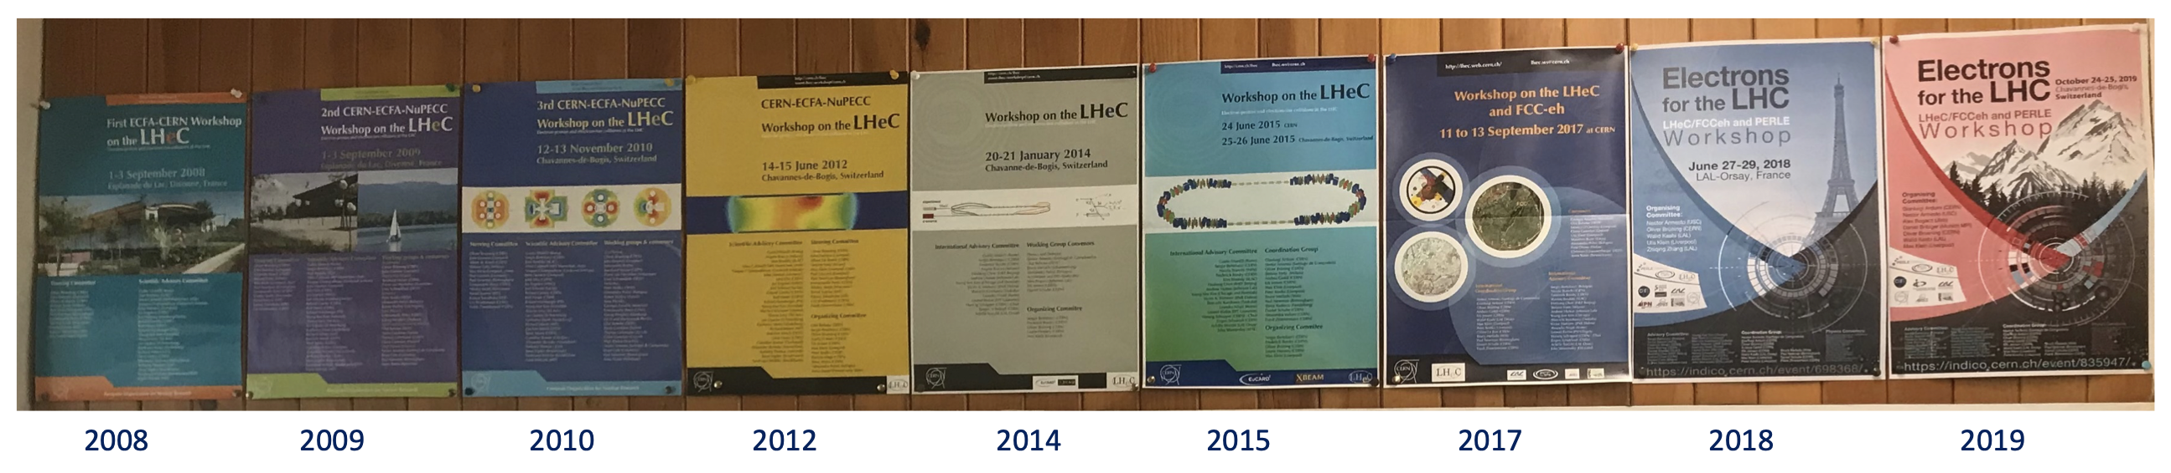
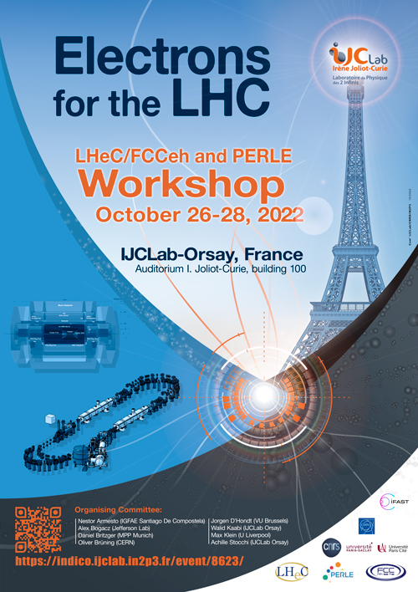
Out of 2 initially requested workshops grew over 10!
Plus many participations to
FCC and EIC Workshops!

Slide 21
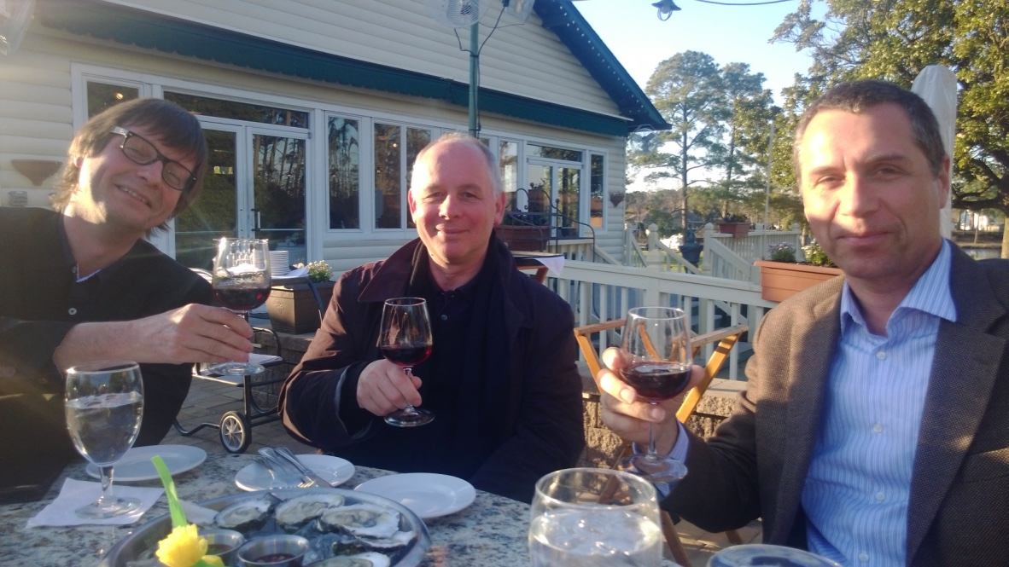
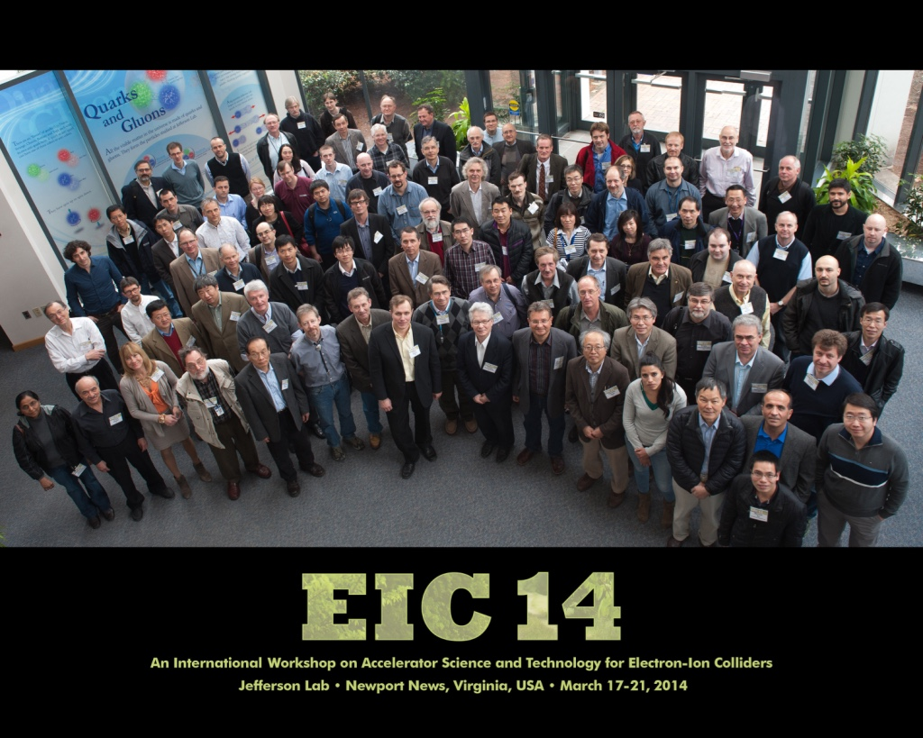
Developing Collaborations with the EIC Community
With Max it was never ‘only’ work
There was always room for celebrating and
enjoying the moment
Notes:
With Max it was never only work. There was always room for enjoying the moment

Slide 22
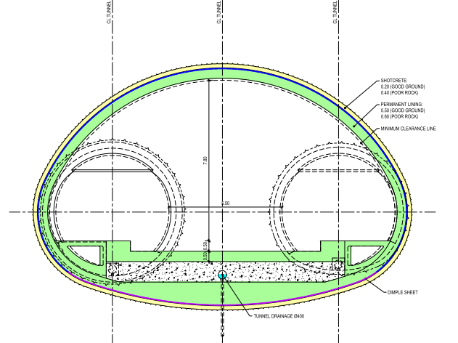







FCC-eh Studies
Initially Point L
Junction Caverns
16.8 m x 15 m x 100 m
25 m x 15 m x 50 m
16.8 m x 15 m x 90 m
Small Experimental Caverns
30 m x 35 m x 66m
Tunnels:
9.091 km of 5.5m dia. machine tunnel.
2 x 1.04 km of 5.5m dia RF tunnel.
Shafts:
2 x Service shafts:
9 m dia. x 175 m depth
Service Caverns
25 m x 15 m x 50 m

Slide 23




Integration into the FCC Community
Notes:
FCC Week in Amsterdam 2018

Slide 24




HEP Community: Keeping the eh Option on the Map
Max’s vision can not easily be deterred
➔ ability to overcome any obstacle
2014 ICFA Seminar in Beijing
Notes:
ICFA Meeting in Beijing in 2014: no obstacle too big; Does not get deterred by obstacles

Slide 25



HEP Comunity: Keeping LHeC on the HEP Roadmap
Revision of the HEP Strategy in Grenada in 2019
Not just with factual arguments, but with
Creativity and Inspiration!
Notes:
Grenada 2019 with Kandinski as choice for CDR: Circle in a Circle from 1923

Slide 26
Summary
Unique machine for exploring the TeV Center of Mass region of HEP with ep
Maximum Infrastructure exploitation of the LHC!
Moderate cost – [compared to ILC, CLIC or FCC]
Unique oportunity – no other machine can provide ep @ TeV CME
Technology driver with many spin off benefits – ERL & SRF
Unique physics program
Modular design with several phases!
➔ LHeC, FCC-ee injector, FCC-eh
Not only here because it is a good idea!!!
But largely thanks to Max’s commitment and leadership!!!

Slide 27

Time flies when you have fun! Max @ Orsay PERLE workshop 2022
Notes:
From Max @ PERLE Workshop in Orsay 2022

Slide 28

Personal Note:
Thank you for a fantastic experience and rewarding collaboration over the last 15 years!

