Slide 1
Max Klein - The Educator
Teaching at Liverpool
David Joss

Slide 2
Liverpool University and Physics
For the advancement of learning and the ennoblement of life.
Physics was one of the founding departments at the University of Liverpool.
Sir Oliver Lodge was the first professor of Physics and Maths.
Sir James Chadwick established Liverpool as a major centre for nuclear and particle physics.
All academics in the Physics Department have taught alongside their research.

Slide 3
Max’s Teaching Philosophy in quotes …
There is no learning without teaching.
There is no teaching without learning.
John Wheeler (Line 1), Max Klein (Line 2).

Slide 4
Max’s Teaching Philosophy in quotes …
There is no royal road to science, and only those who do not dread the fatiguing climb of its steep paths have a chance of gaining its luminous summits.
Karl Marx, Philosopher Capital Vol I, 1867 Preface - Remark to his french editor La Chatre.

Slide 5
Max’s Teaching Philosophy in quotes …
I see it as a crucial task to open the University not only to the intellectually (often socially) privileged but to all students who express a sincere interest in learning from us and later perhaps working with us.
Max Klein, Fellow of the Higher Education Academy on the importance of culture and environment for learning and social justice.

Slide 6
Welcome to Liverpool
Contributor to Open Days for prospective students.
Max led the Welcome Week for several years.
A dedicated academic advisor.
I came back to find visitors and parents thoroughly captivated and the current students talking about how wonderful Max was. He had provided one of the most engaging displays of the whole day and is, I am sure, the reason that we have recruited many of the applicants to the department.

Slide 7
Teaching
Max has contributed to several modules during his tenure at Liverpool.
Mathematics
Particle Physics
Practical Laboratory
Thermodynamics
Statistical Physics
Projects
Doctoral Supervision

Slide 8
Mathematics
“There is no physics knowledge nor professional work possible in physics without mastering mathematics”.
Max led the Year 2 maths module for many years.
Three strands of activity:
Careful derivations in real time.
Collaborative problem-solving classes.
Examination.

Slide 9
What the students said …
Max and David [E] are two lovely lecturers. Their lectures are really well made and portray the information well. I have thoroughly enjoyed this module so far.
The module is pretty well run, the problem classes are definitely challenging and they truly test your understanding. The midterm assessment was tough but fair.
The lecturers are very kind and helpful, you can tell they've taken time to prepare the module and want to help. The module has ran very smoothly and I like the hand written derivations Max does.

Slide 10
Teaching during the Covid Pandemic
The UK moves into lockdown on 26th March 2020.
The University switches to online teaching.
Department changes teaching & assessment in response.
Challenging time for students and staff.
Social distancing requires teaching in small groups.
All staff have to take on extra teaching!

Slide 11
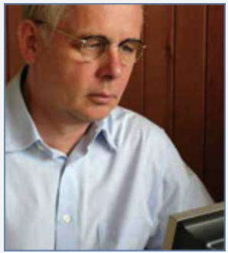
Tutorials for Online Teaching
Max was asked to teach on the core modules
Year 1 Thermodynamics.
Year 3 Statistical Physics.
What did the students say ? …..

Slide 12
What the students said …
Max Klein again is awesome his workshop lectures always start with a helpful sheet of notes from the week and he tackles each problem from the sheet (especially the harder problems).
He really explains the physics behind them and helps you to think about the problem in a different way to the way you may have thought before.
I think the module is delivered perfectly considered the COVID situation, hats off to Max Klein.

Slide 13
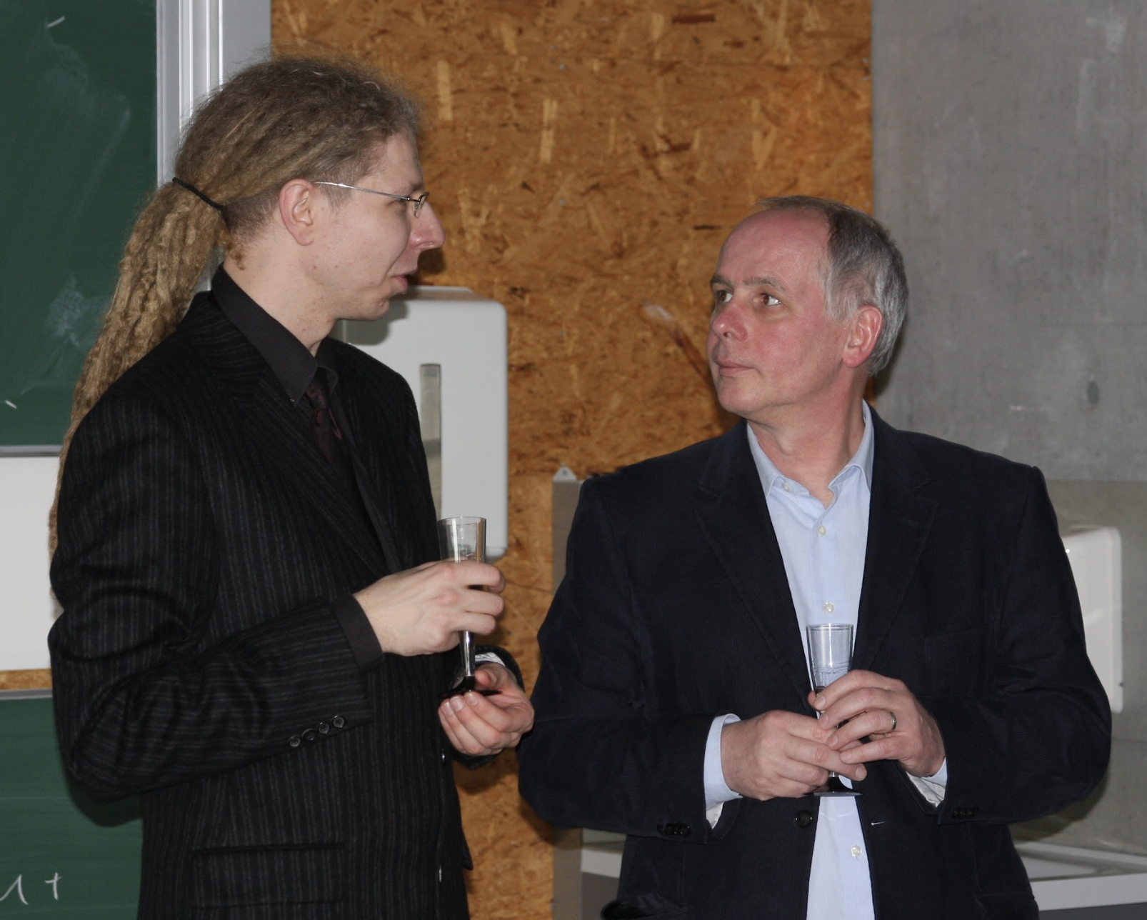
Postgraduates
Prof Max Klein and Dr Jan Kretzschmar, Berlin 2008.
Prof Max Klein and Dr Kevin Andre, Liverpool 2022.

Slide 14
A final word from one of Max’s advisees.
Max acted as my academic advisor from first year through to third and was an incredible source of support the whole time, whilst also just being a great person to talk to.
During this time he helped support me through difficulties I faced both in and outside of physics, and also helped me gain a better understanding on several areas in particle physics and maths.
A huge congratulations to you on 50 years in particle physics, and thank you for everything you’ve done for me, the department and physics as a whole.

