Slide 1
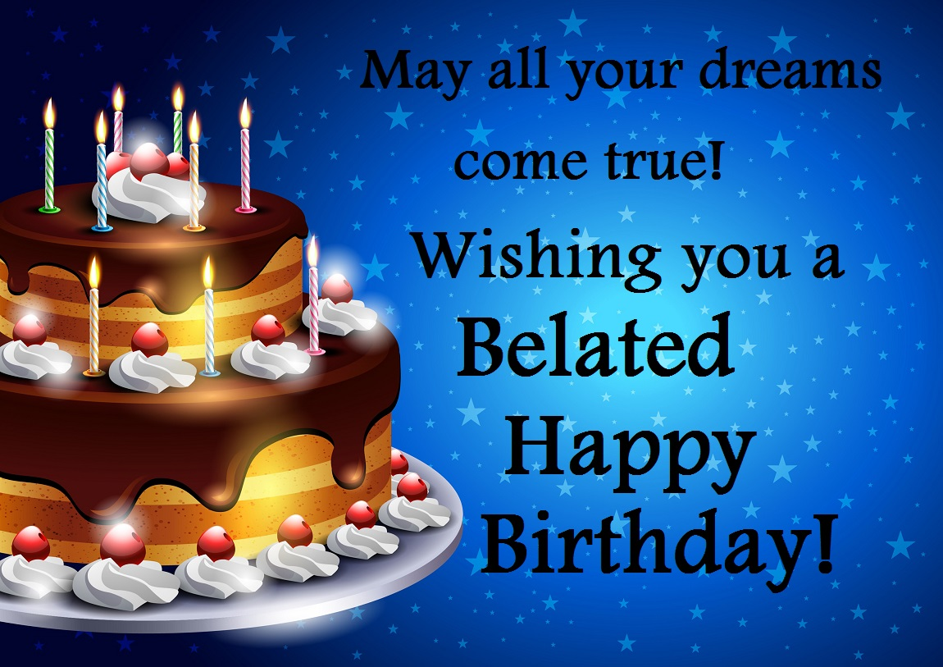
Max
70 years
2021

Slide 2
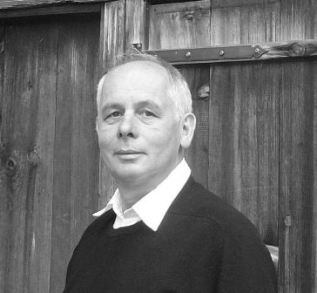
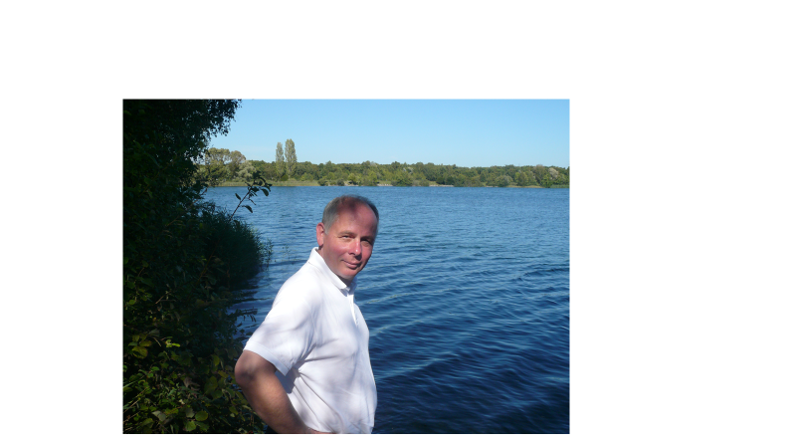
70th birthday is an appropriate date;
First date to Look back at achievements
and to reorganize your activities,
- advance somewhat slower, put more responsibilities y on younger generation
-

Slide 3
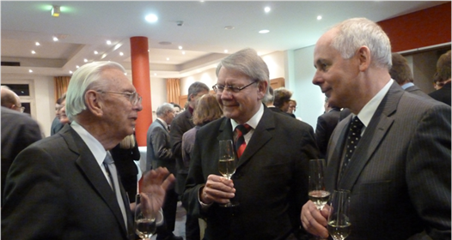
Decorations
We listened to Max’s achievements presented by speakers
Reminds me cardinal's birthday, little story
I Can testify that everything reported is true!
1984 Max-von-Laue-Medaille of Academy of Sciencces DDR for. meaduring the assymemetrs of positive and negative myons in the BCDMS-c ollaboration at CERN
Born Medal DPG
2013 Max-BornPprize isof the German Physical Society for fundasmental experimentel contributions for the investigation of the structure of the protons with deep inelastic electron scattering at HERA at DESY

Slide 4
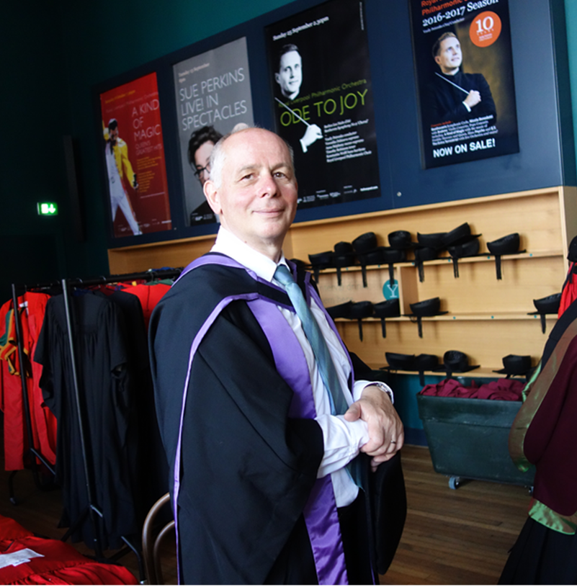
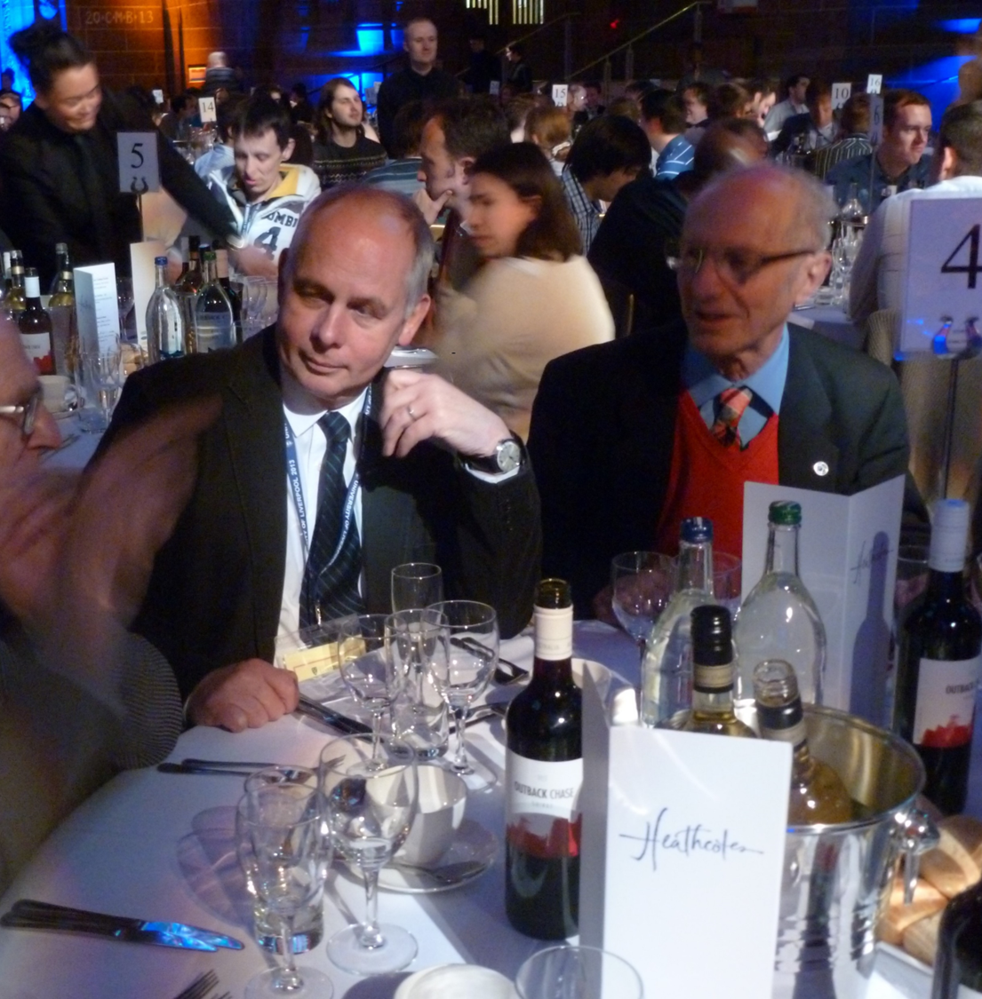
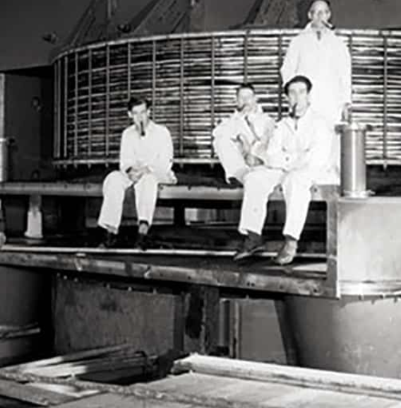
Appointment as Professor at Liverpool
Famous Physics Department
With long tradition
Janes Chadeick
Synchrocycloton. Nuclear physics, neuzton
Important contribotion to development of CERN SC
Chadwick’s SC

Slide 5
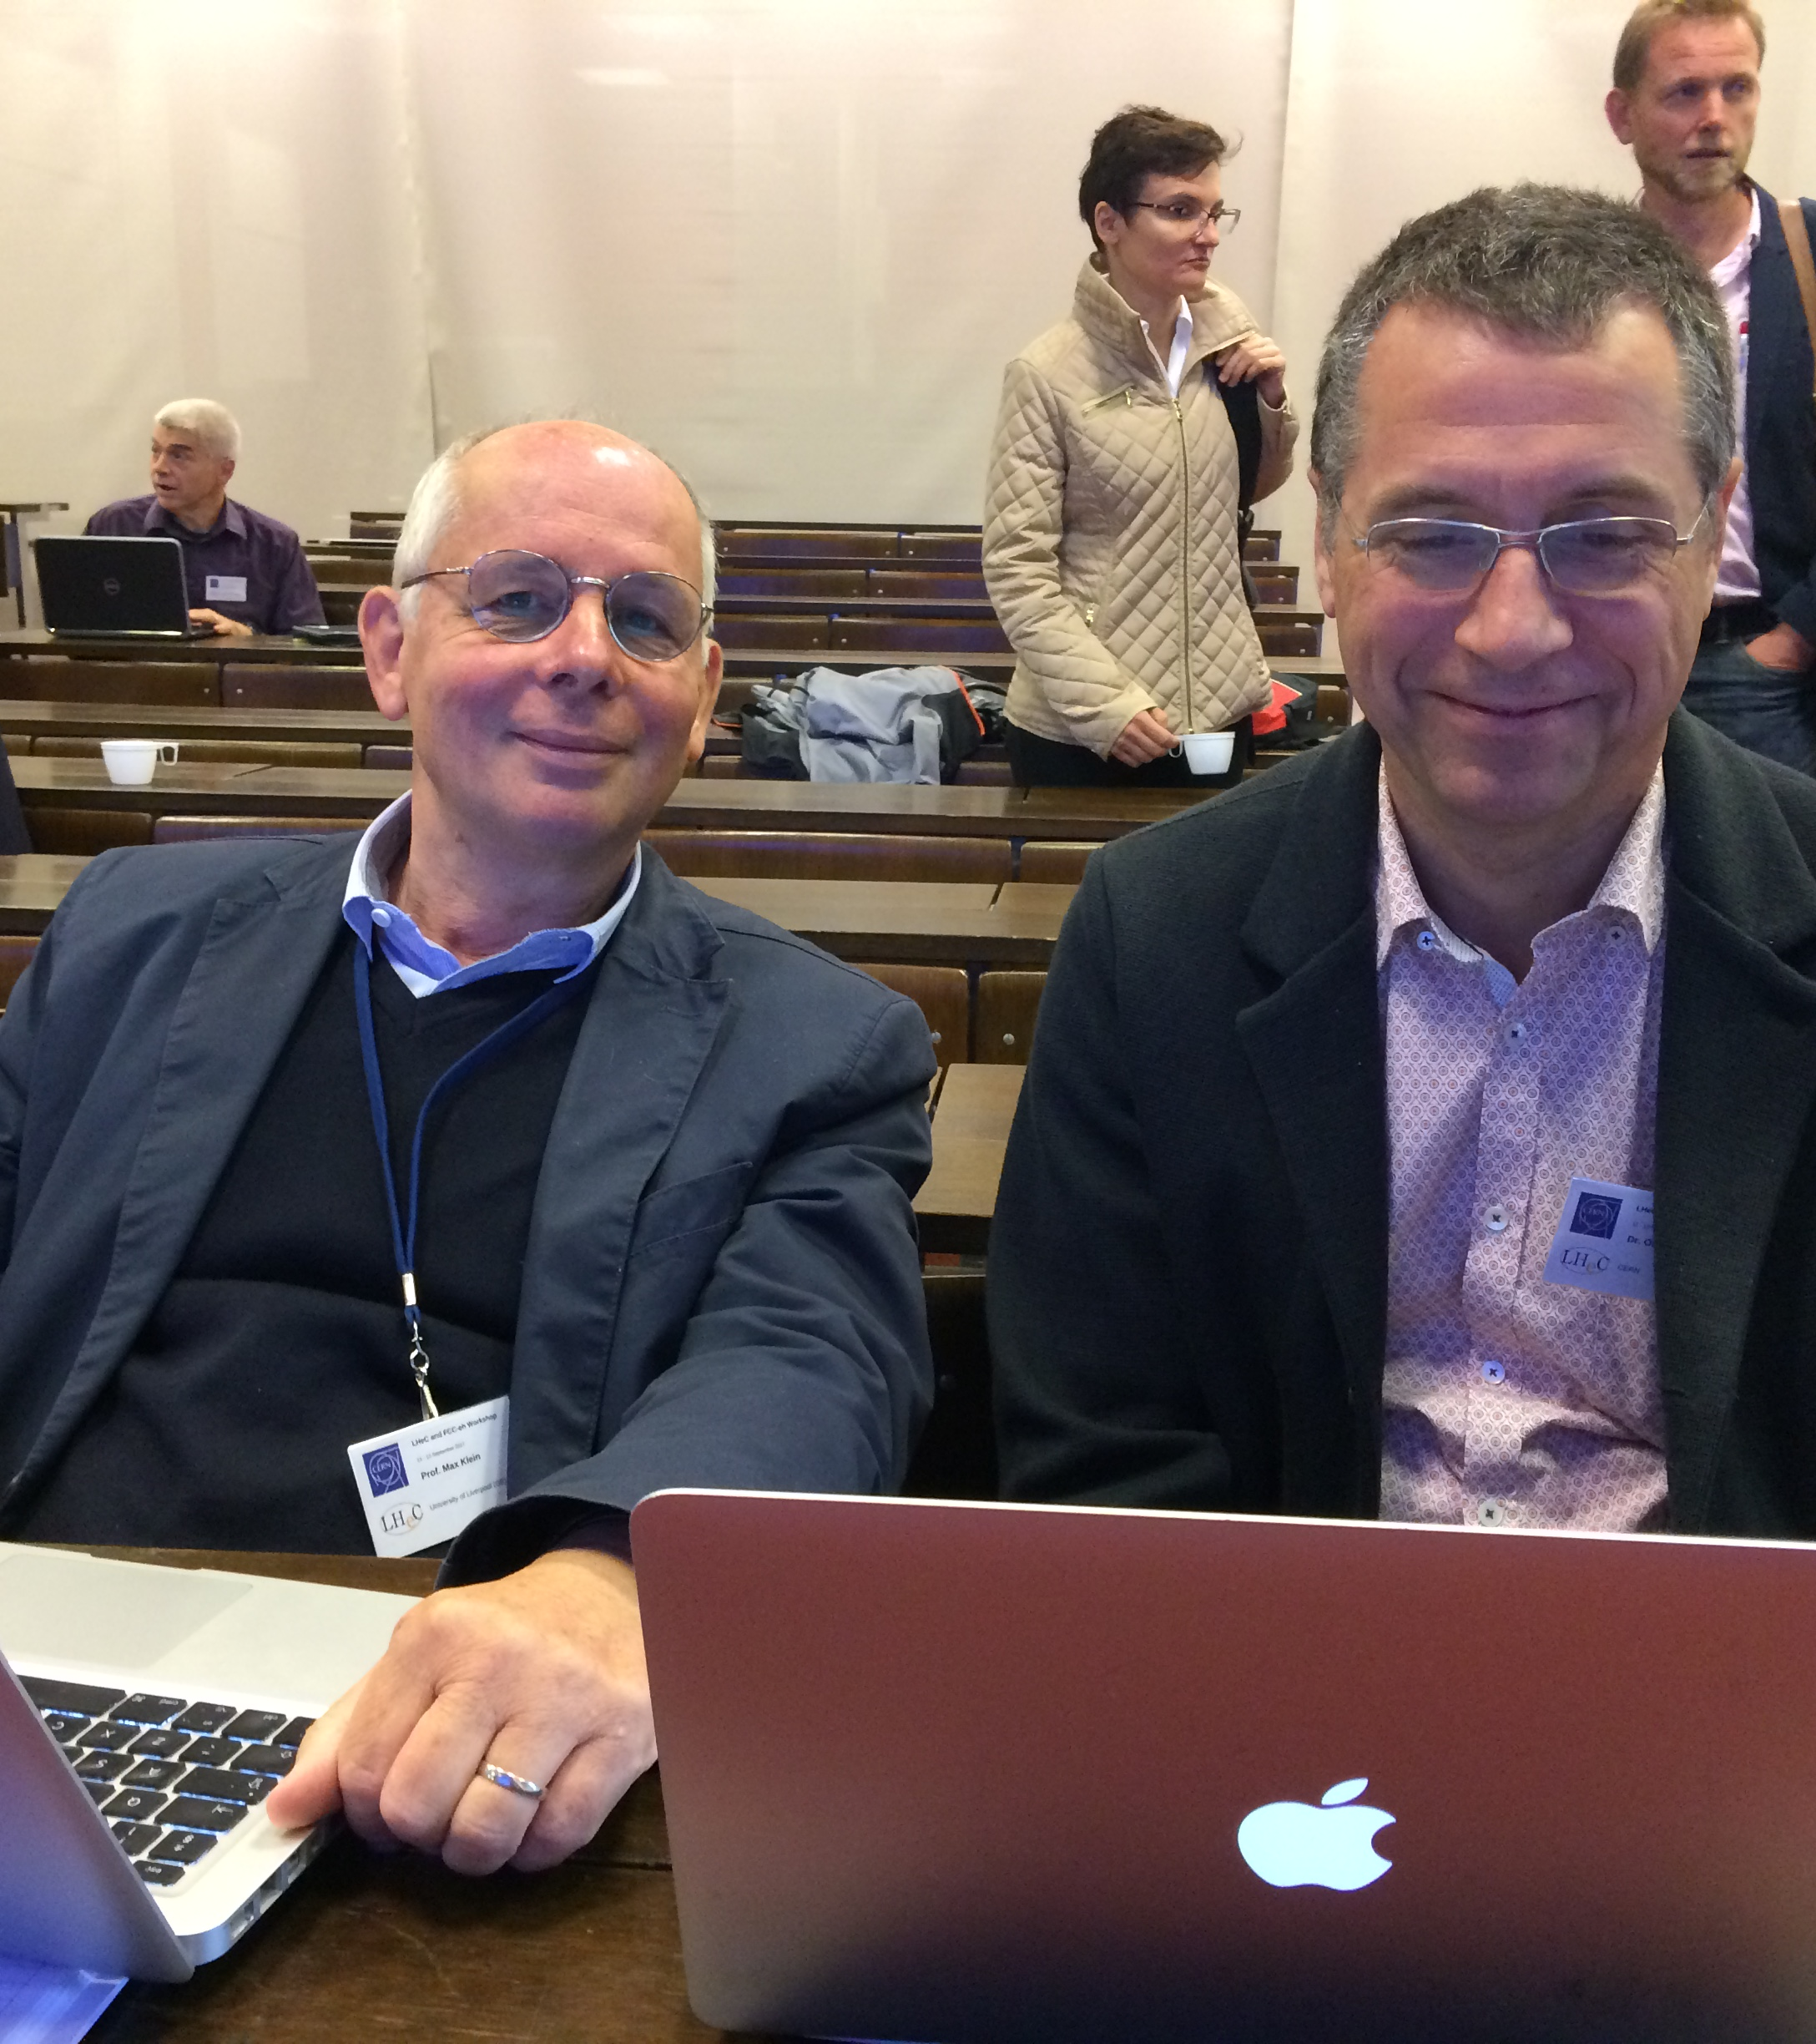
I must mention again what I consider as
Max’s most important achievement: creating, promoting and holding together the LHeC study group longer than a decade with determination and insistency together with Oliveer Brüning
Max and Oliver at work
International Advisory Committee IAC in set up 2013 by DG Rolf Heuer I was asked to chair it

Slide 6
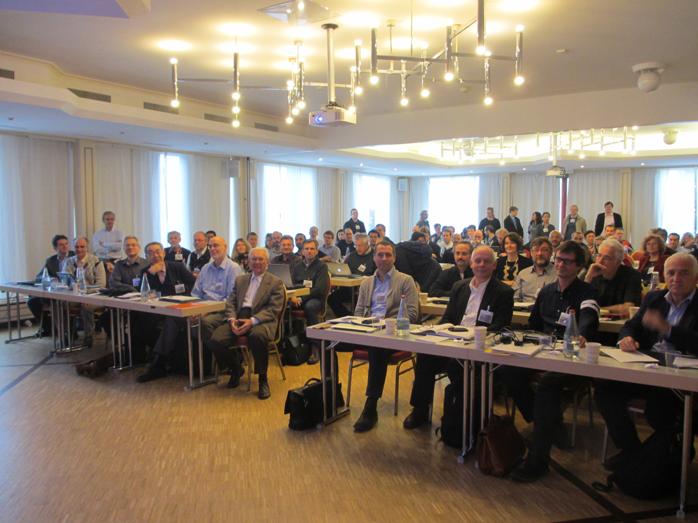
Many meetings. Workshops and recommendations
Most recent LeHC workshop at Chavanne 2018
Enormous work has beem done by hundreds of colleagues Results documented in many reports. As reported by previous speakers

Slide 7
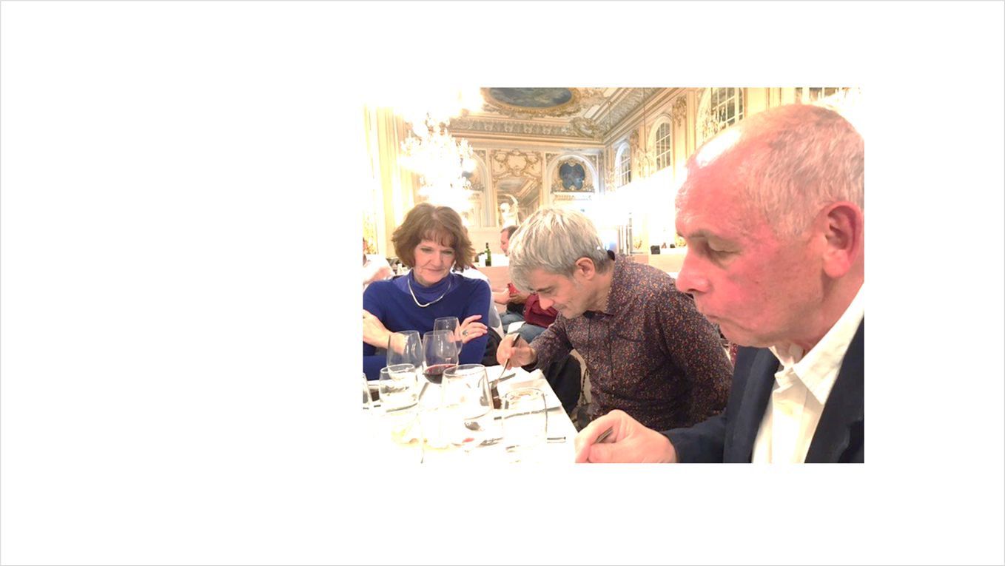
Immediate succes of LeHC Activitas and IAC recomandation
Creation of PERLE project develloping the ERL technology
Responsibility
Achille Stocki and Joliot Curie Laboratory
at PRRLE workshop Orsay October 2022

Slide 8
The main resultsof LheC will become important only when decisions for the large projects for particle physics will be taken
All large projects (e.g. FEEC, FCC, ILC) have in common some some fundamental problems:
- Enormous energy consumption - high Cost amd very long time scales - difficulty to explain added value to society and politicians
- Final decision will be influenced by. political considerations- prestige,
All possible options will be valuable to guarantee the future of CERN, soprecious for EUROPE and particle physics

Slide 9
Allow some Personal remarks concerning the relations between Max and me
Until recently we never had a chance to ork together This is Natural because of our age difference in age
By chance your father, Fritz Klein junior , a well known historien and literate, was born in same year as me
Only thanks to LHeC activitie and IAC we could establish aclose ccooperation and excellent understanding within in a short time.
We found out that oour lives were indirectly interwoven in many respects

Slide 10
Looking at your CV I found that you studied at Berlin at the Humboldt university.
The Phd you made at Institute for particle physics at Zeuthen (Berlin) after Geermn unification now part of DESY
later you worked at Dubna DESY, and CERN
In all these places I also had been been active before you So common experiences and shared adventures .

Slide 11
Also in private life we had similar similar fates We both suffered from dramatic political changes
I as refugee from Czechoslovakia, You were directly affected by the problems following unification of Germany.
All this provided an excellent background for mutual understanding and and sharing similar general views
We became friends in an increfibly short time

Slide 12
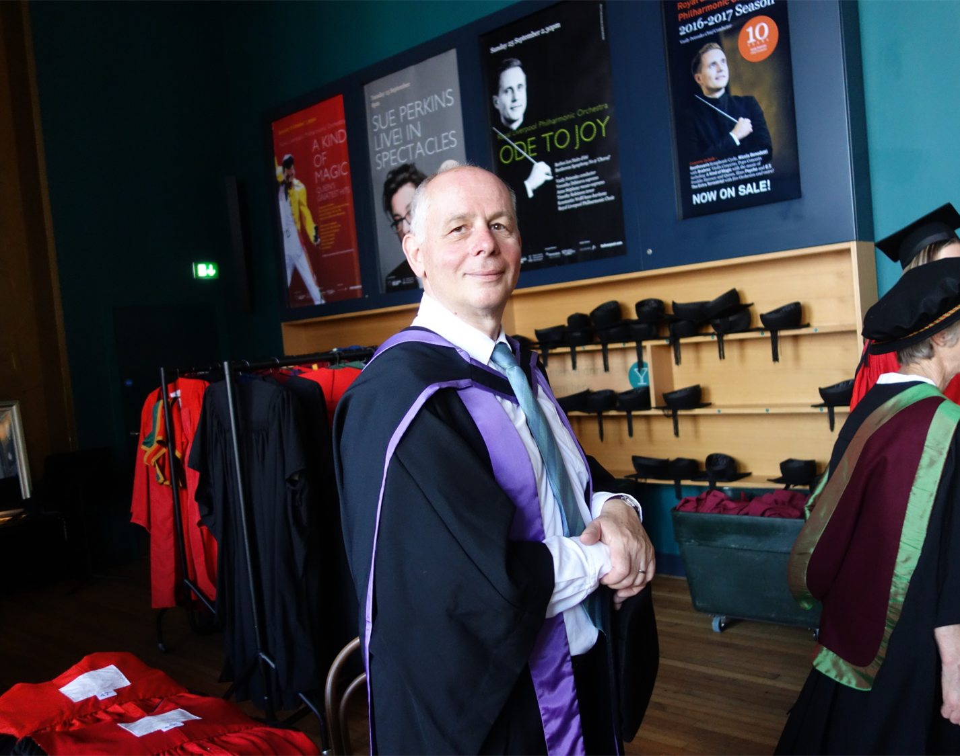
I learned to appreciate your personality
Not only as physicist
but your general education and interest in culture and literature, Bildung as we say in German
I admire your dry humor,
you can aptly characterise a situation or stigmatise it by a short remark very often by a quotation from literature

Slide 13
An example: when discussing the behaviourof some colleagues putting forward too much their ego Max obsered by quoting
Goethe has said everybody wants to play the 1, violin but the 2, violin or flute are also beautiful instruments. And Leonard Bernstein said the best orchestra are the ones with the best scond violin since without them there is no m no harmony.
The second violin
This is the secrete why Max was so successful in collaborations: Max remained overmodest and reserved in the back seat often guiding from there

Slide 14
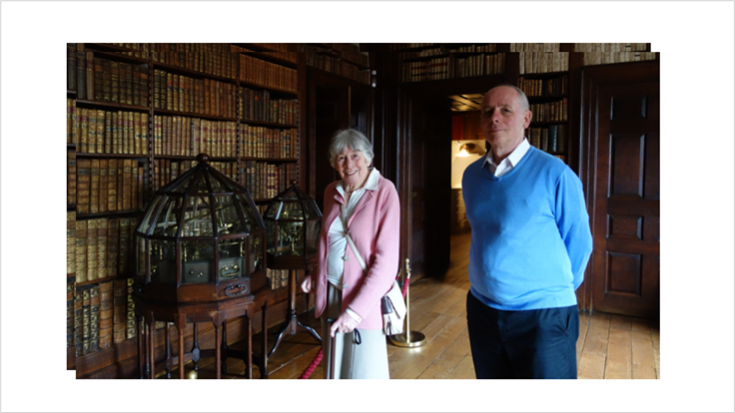
The formation of such a personality would not have been possible without being imbedded in an mpressive family. living in harmony
Max with mother brother Wolfgang (literature), sister Katharia (art)
Max and mother (expert in Slviatic) in a British library

Slide 15
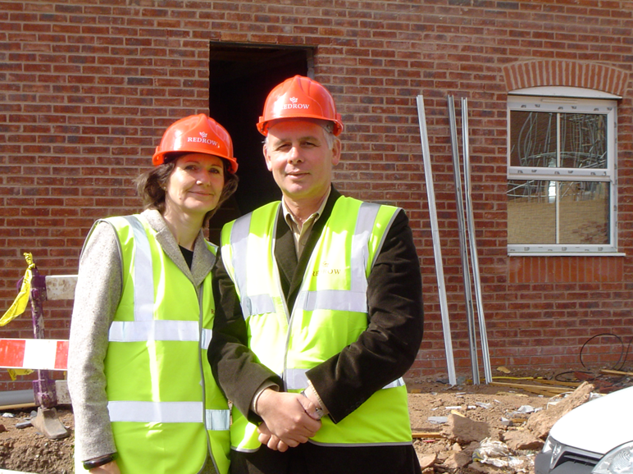
And of course, a charming wife Uta who with all her competence could not only help you in all LHeC activities but she is so full of joy of life and charm which she can transmit to others and contributes to your general happiness

Slide 16
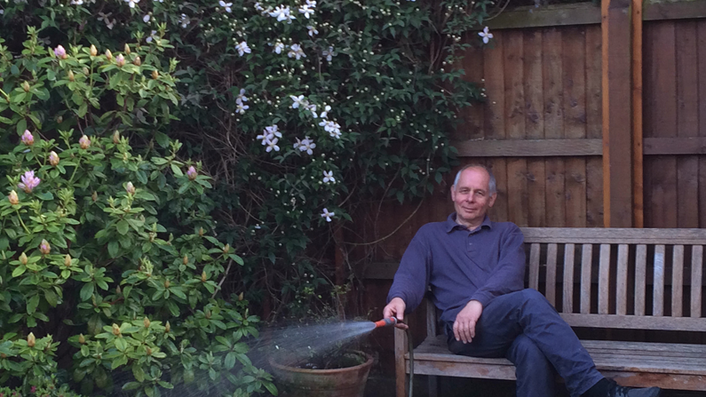
advice oby an old friend : in future relax, spemd more time with your family

Slide 17
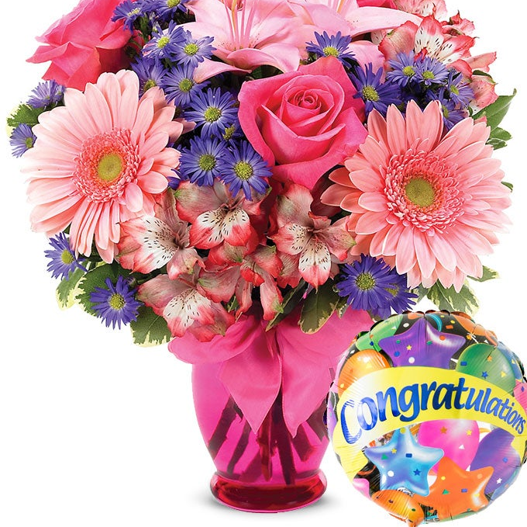
Best wishes for many years . And we still need you
Ad multos annos!

Slide 18
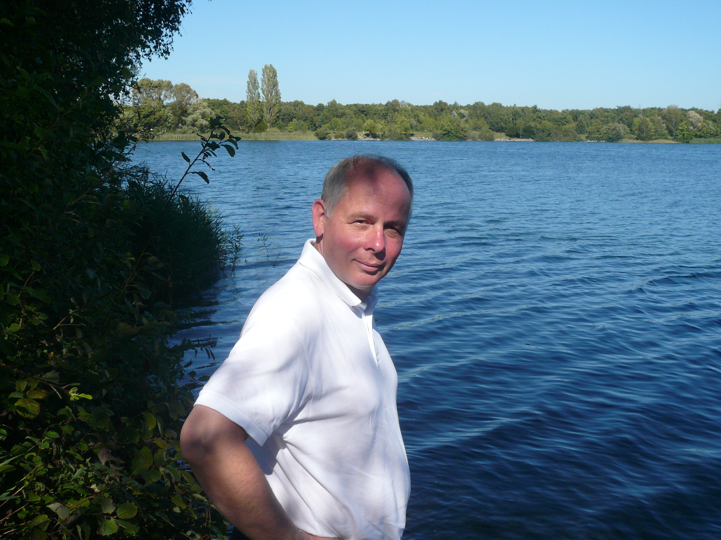

Slide 20
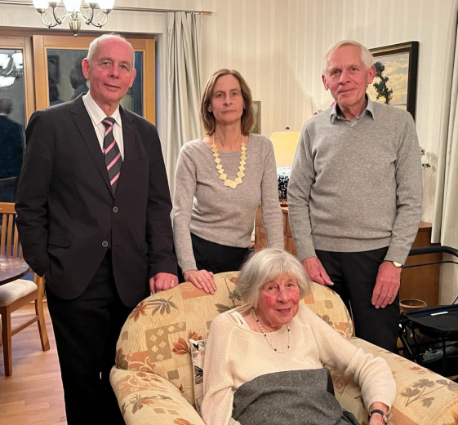

Slide 21
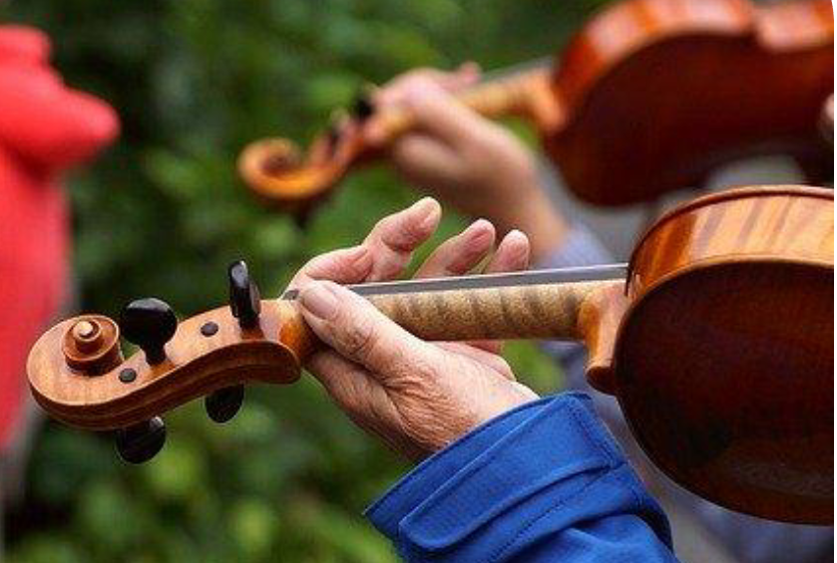

Slide 22
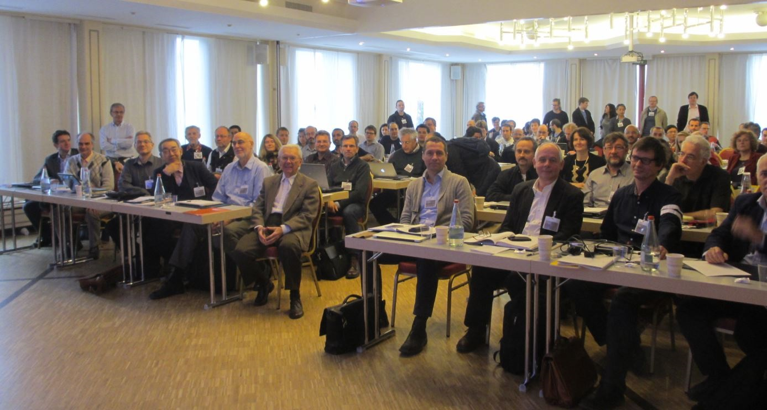

Slide 23
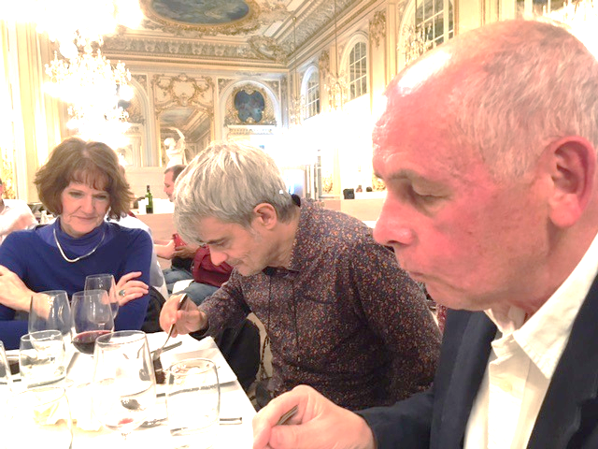

Slide 24
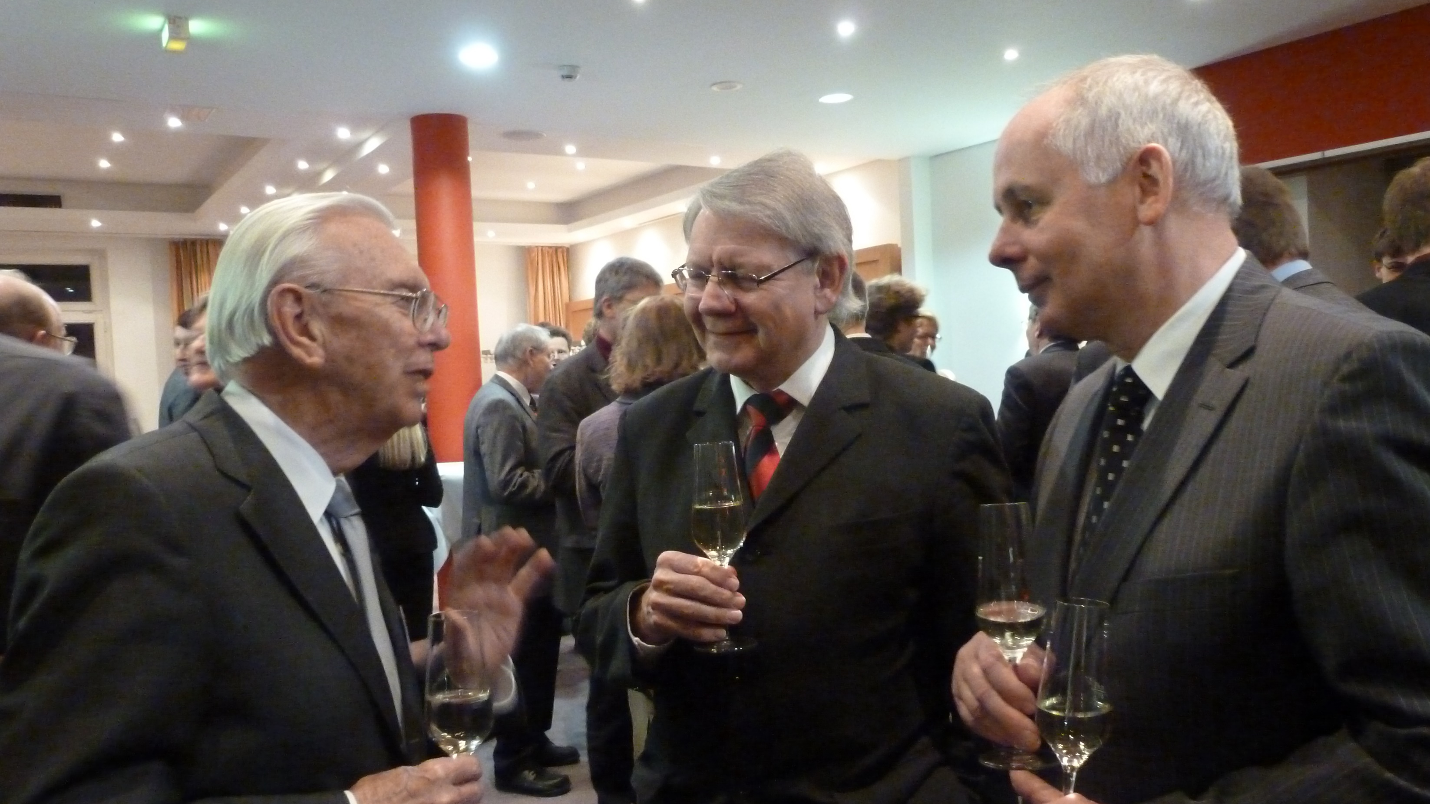

Slide 25
At workshop at Orsay 2022 HS, Uta Oliver Fischer , Max

